Slide 1
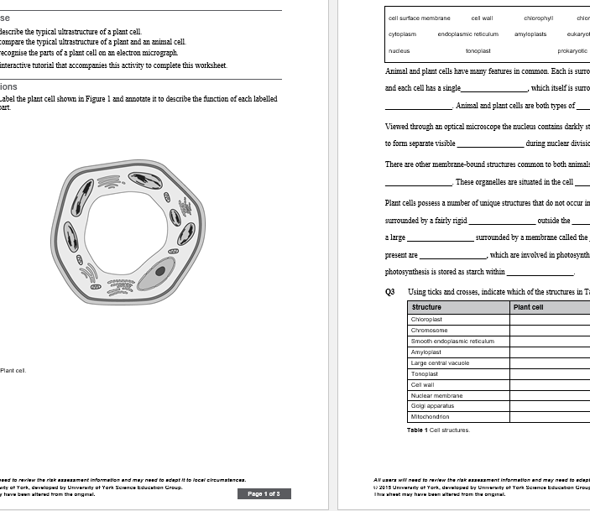
Reviewing your flipped learning
Mark scheme is in the folder

Slide 2
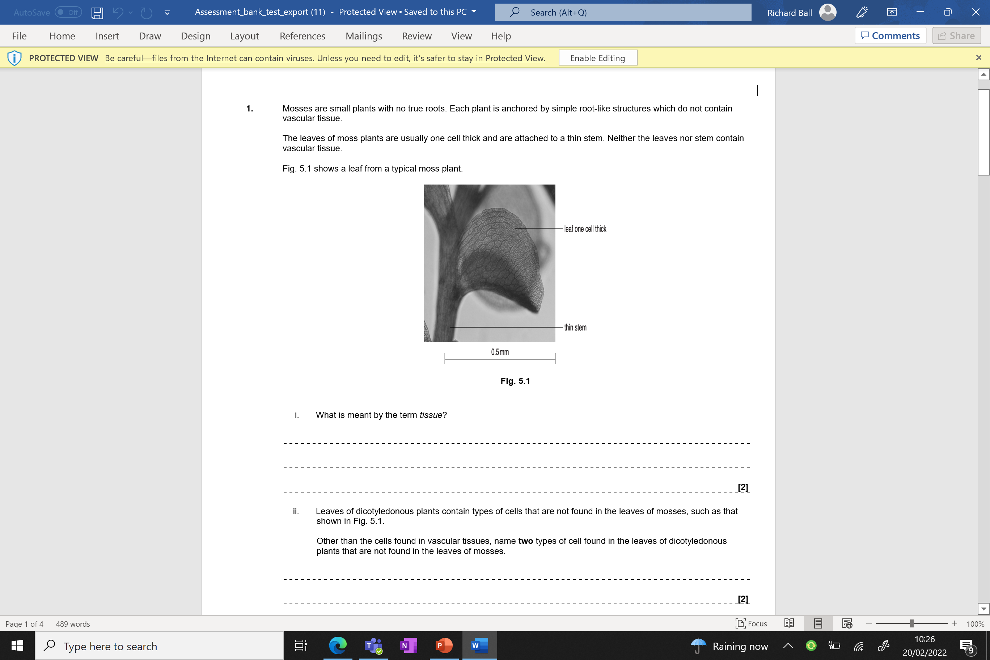
Knowledge retrieval questions
Mosses are small plants with no true roots. Each plant is anchored by simple root-like structures which do not contain vascular tissue.
The leaves of moss plants are usually one cell thick and are attached to a thin stem. Neither the leaves nor stem contain vascular tissue.
Q1. a) What is meant by the term tissue?
A group of cells
Working together to perform a function
b) Leaves of dicotyledonous plants contain types of cells that are not found in the leaves of mosses, such as that shown in Fig. 5.1.
Other than the cells found in vascular tissues, name two types of cell found in the leaves of dicotyledonous plants that are not found in the leaves of mosses.
palisade (mesophyll);
spongy mesophyll;
guard cells;
(upper / lower) epidermal cells
The need for transport in plants
Q2. Water lost from the leaf must be replaced with water from the xylem.
Complete the following passage about movement of water from the xylem to the cells of the leaf using the most appropriate terms.
When water is lost from the cells of the leaf it reduces the ...........................................................
in those cells. As a result, water enters the cells by ........................................................... .
This process occurs across the plasma membrane which is ........................................................... .
If all the water lost from the leaf cells is not replaced, they lose ........................................................... and the leaf may wilt.
water potential
osmosis
partially permeable
turgidity

Slide 3
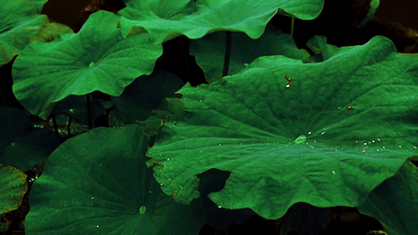
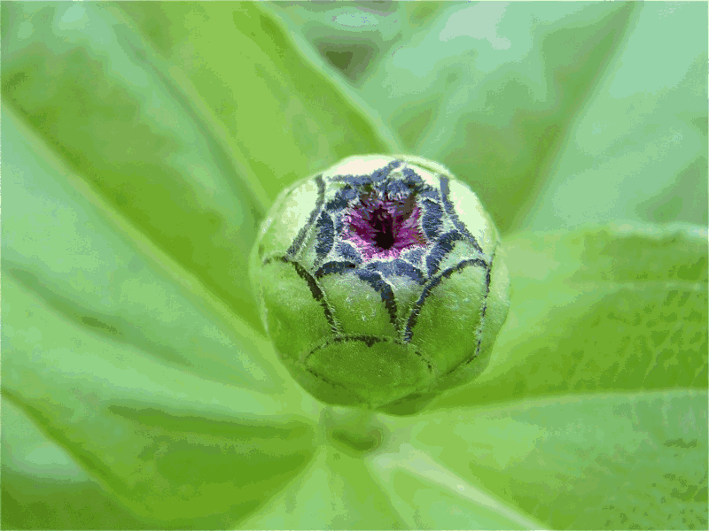
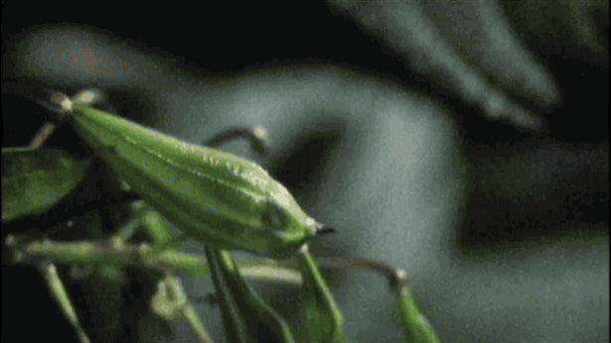
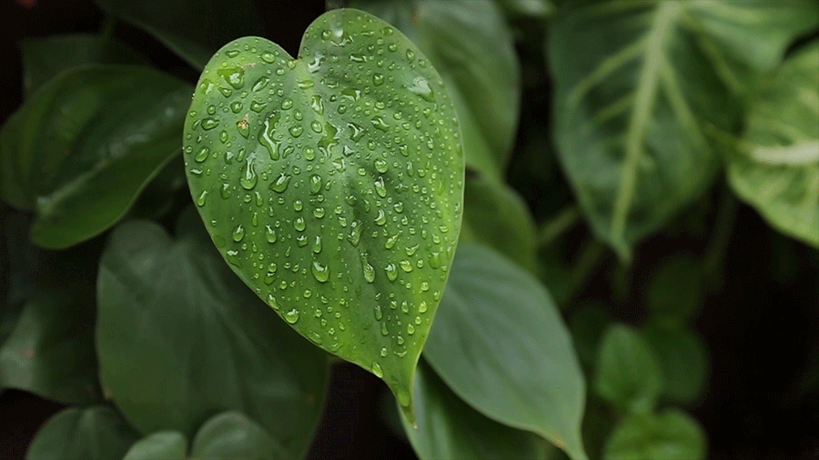
The Need for Transport Systems in Multicellular Plants

Slide 4

Make bullet points for the following:
Why do plants need a transport system?
What makes up a plants transport system?
Which substances need to be transported?
Which direction do these substances move?
Why do O_{2(g)} and CO_{2(g)} not make use of the transport system?

Slide 5

Add anything you don’t already have….

Slide 6
Why do plants need a transport system?
There are 2 main reasons:
Small surface area: Volume ratio: although leaves have a relatively large surface area to volume ratio, multicellular organisms have a small SA:V ratio. This means that they cannot rely on diffusion alone to supply their cells with what they need.
Metabolic demand: many internal and underground parts do not photosynthesise so do not make their own glucose.

Slide 7
What makes up a plants transport system?
Which substances need to be transported?
There are two main transport systems:
Transpiration System
The movement of water molecules and dissolved minerals ions
Xylem vessels
Passive process
Translocation System
The movement of sugars (Sucrose), amino acid assimilates and hormones
Phloem vessel – sieve & companion cells
Active process
Notes:
amino acid assimilates that are created as a result of photosynthesis

Slide 8
Which direction do these substances move?
Xylem - Water and mineral/ions up xylem in stem towards leaves
Phloem – Sugars/assimilates in both directions, from source (leaf) to sink (roots)
Why does O_{2(g)} and CO_{2(g)} not make use of the transport system?
Diffusion into and out of leaf, through stomata, is sufficient.
Notes:
Assimilates – products of photosynthesis

Slide 9
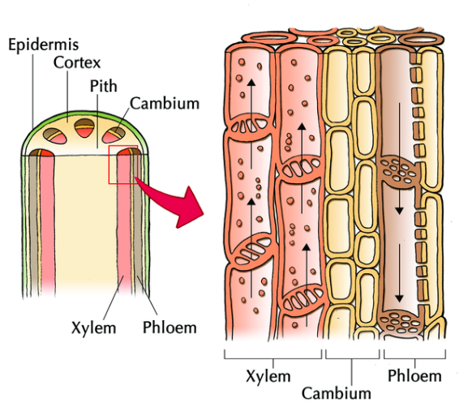
Fluids are transported by mass flow (all together) in specialised cells. These cells make up the vascular tissue.
You will need to know the name, function and adaptation of these cells.
Xylem cells
Sieve tube elements – in the phloem
Companion cells – in the phloem

Slide 10
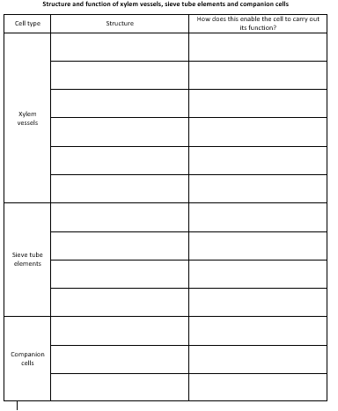
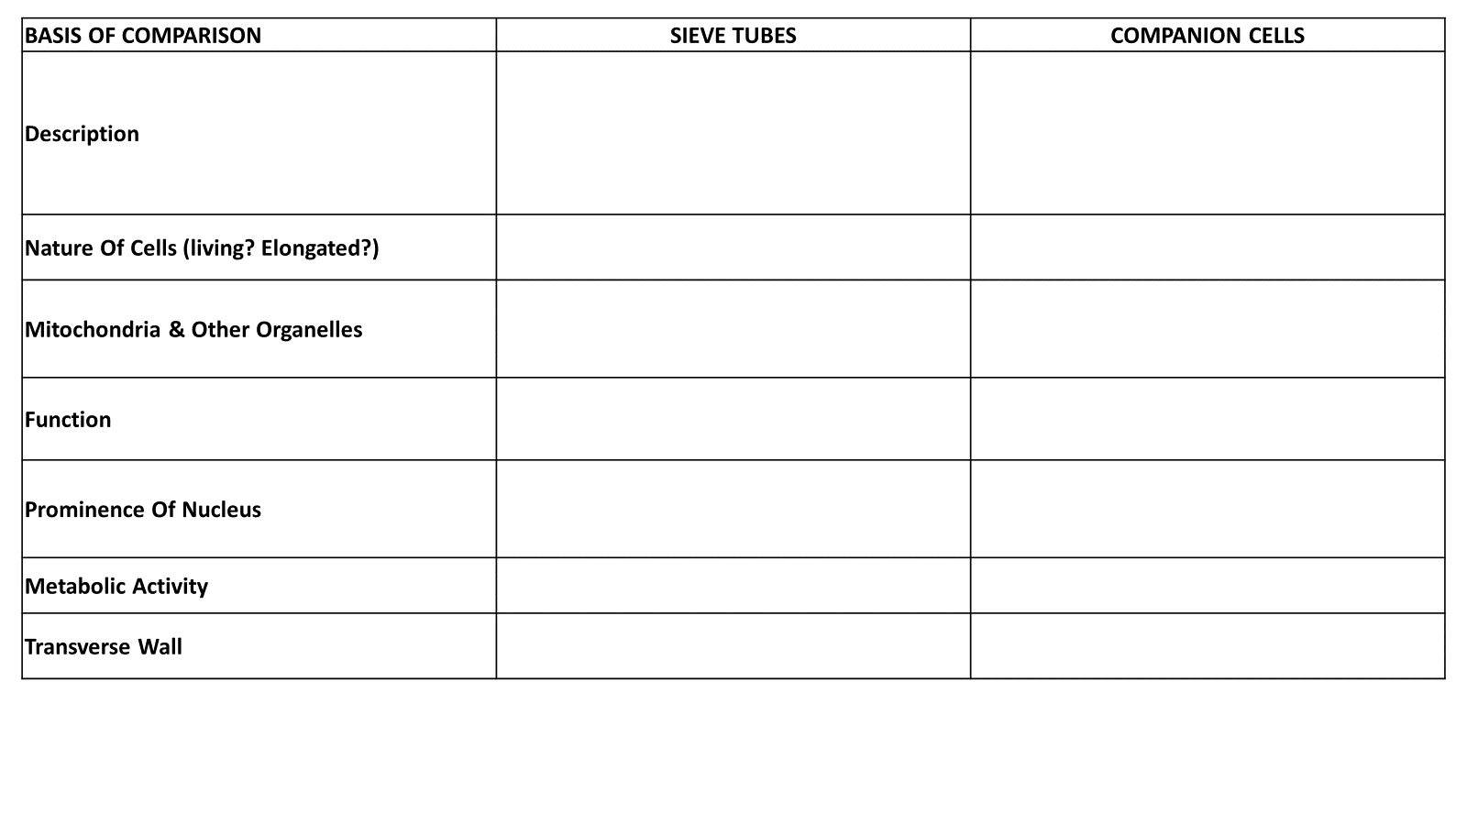
Vascular tissue
Use the information sources around the room to complete a table - suggest how the structural features enable the cell to carry out its function
Complete the companion cell vs sieve tube element comparison table
Try the “1a Additional questions” if you finish. These are on a separate page on class notebook

Slide 11
BASIS OF COMPARISON | SIEVE TUBES | COMPANION CELLS
Description
Nature Of Cells (living? Elongated?)
Mitochondria & Other Organelles
Function
Prominence Of Nucleus
Metabolic Activity
Transverse Wall

Slide 12
BASIS OF COMPARISON | SIEVE TUBES | COMPANION CELLS
Description | Sieve Tubes are a series of cells placed end to end to form a continuous tube. | Companion cells are specialized parenchyma cell, located in the phloem of flowering plants and closely associated in development and function with sieve tube elements.
Nature Of Cells | They are usually living cells with an elongated structure. | They are living and elongated in structure with thin walls.
Mitochondria & Other Organelles | They contain fewer mitochondria. | They contain a large number of mitochondria and ribosomes as they are very metabolically active.
Function | They are responsible for the transport of sucrose throughout the plant body. | They are responsible for regulating the activity of the sieve element.
Prominence Of Nucleus | No nucleus | Companion cells have a prominent elongated nucleus, which is retained throughout the life of the cell.
Metabolic Activity | They show low rate of metabolic activity. | They show high rate of metabolic activity.
Transverse Wall | The transverse wall of sieve tubes contains pores. | The transverse wall of companion cells does not contain pores.
Try the “1a Additional questions” if you finish. These are on a separate page on class notebook

Slide 13
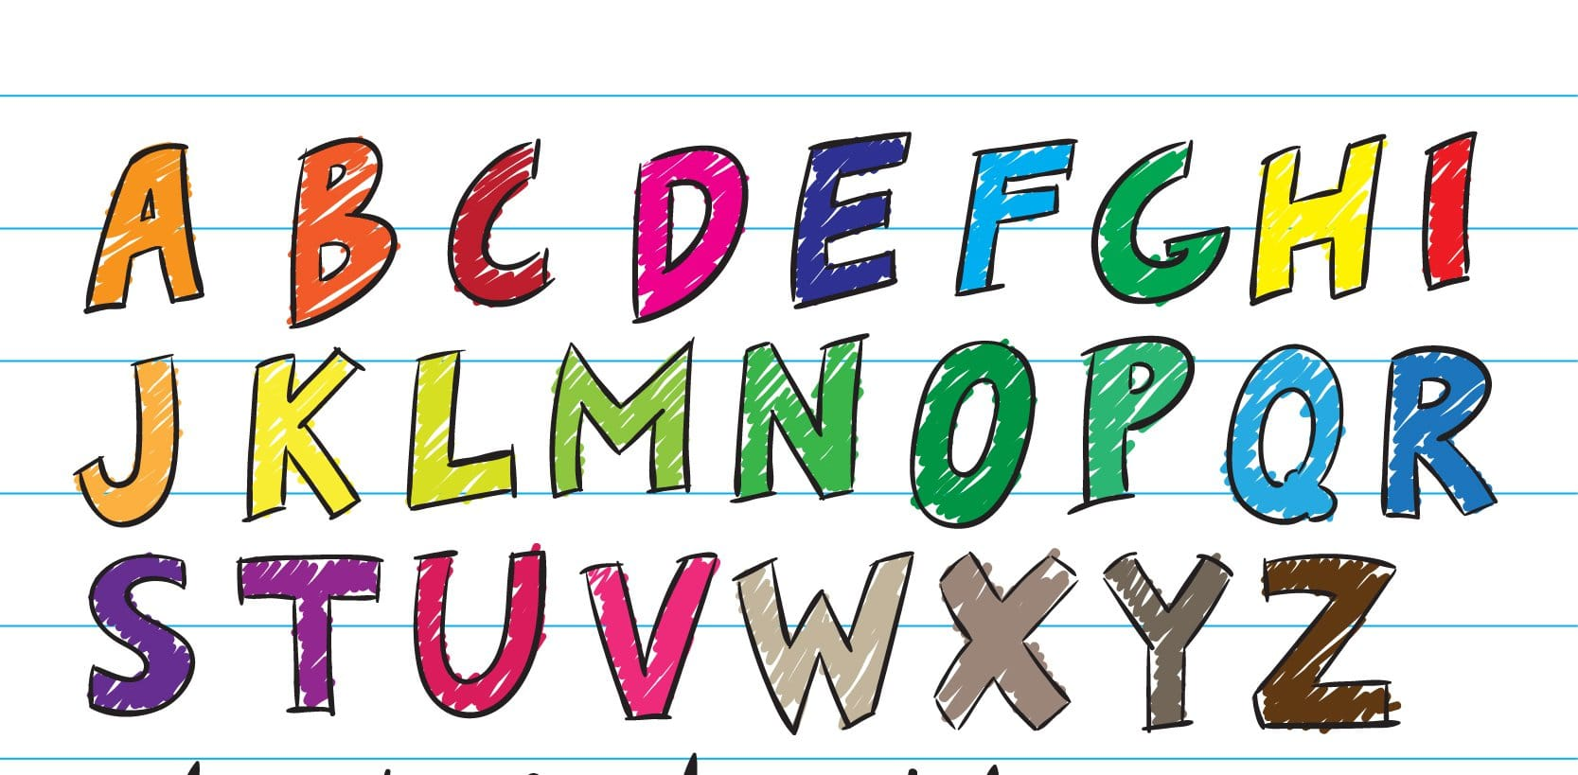
LAST LETTER GAME (3 seconds each)
X3 small groups
JUSTIFY BUZZER
PlasmodesmatA
AmyloplasT
Thylakoid

Slide 14
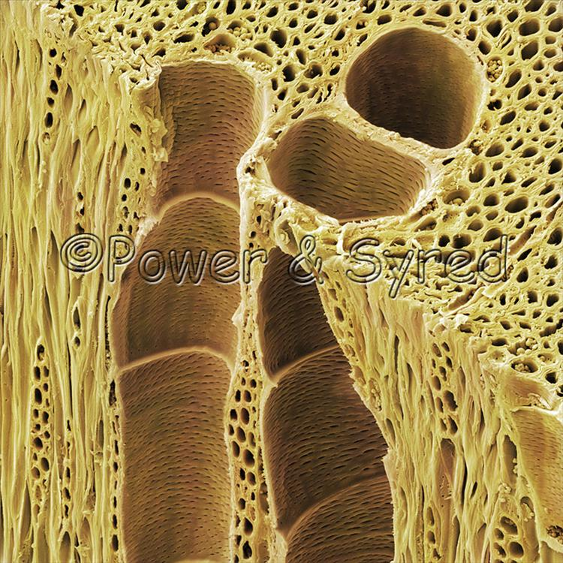
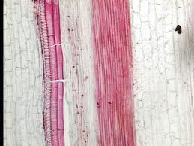
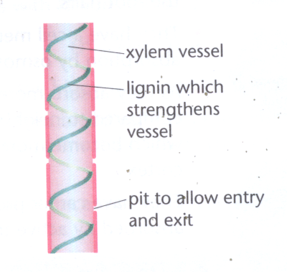
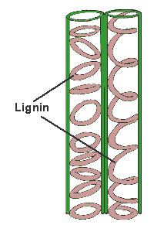
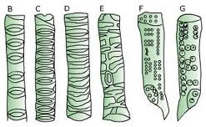
Complete the practical activity to observe the lignin in xylem vessels of rhubarb
The lignin often forms rings or spirals around the vessel.

Slide 15
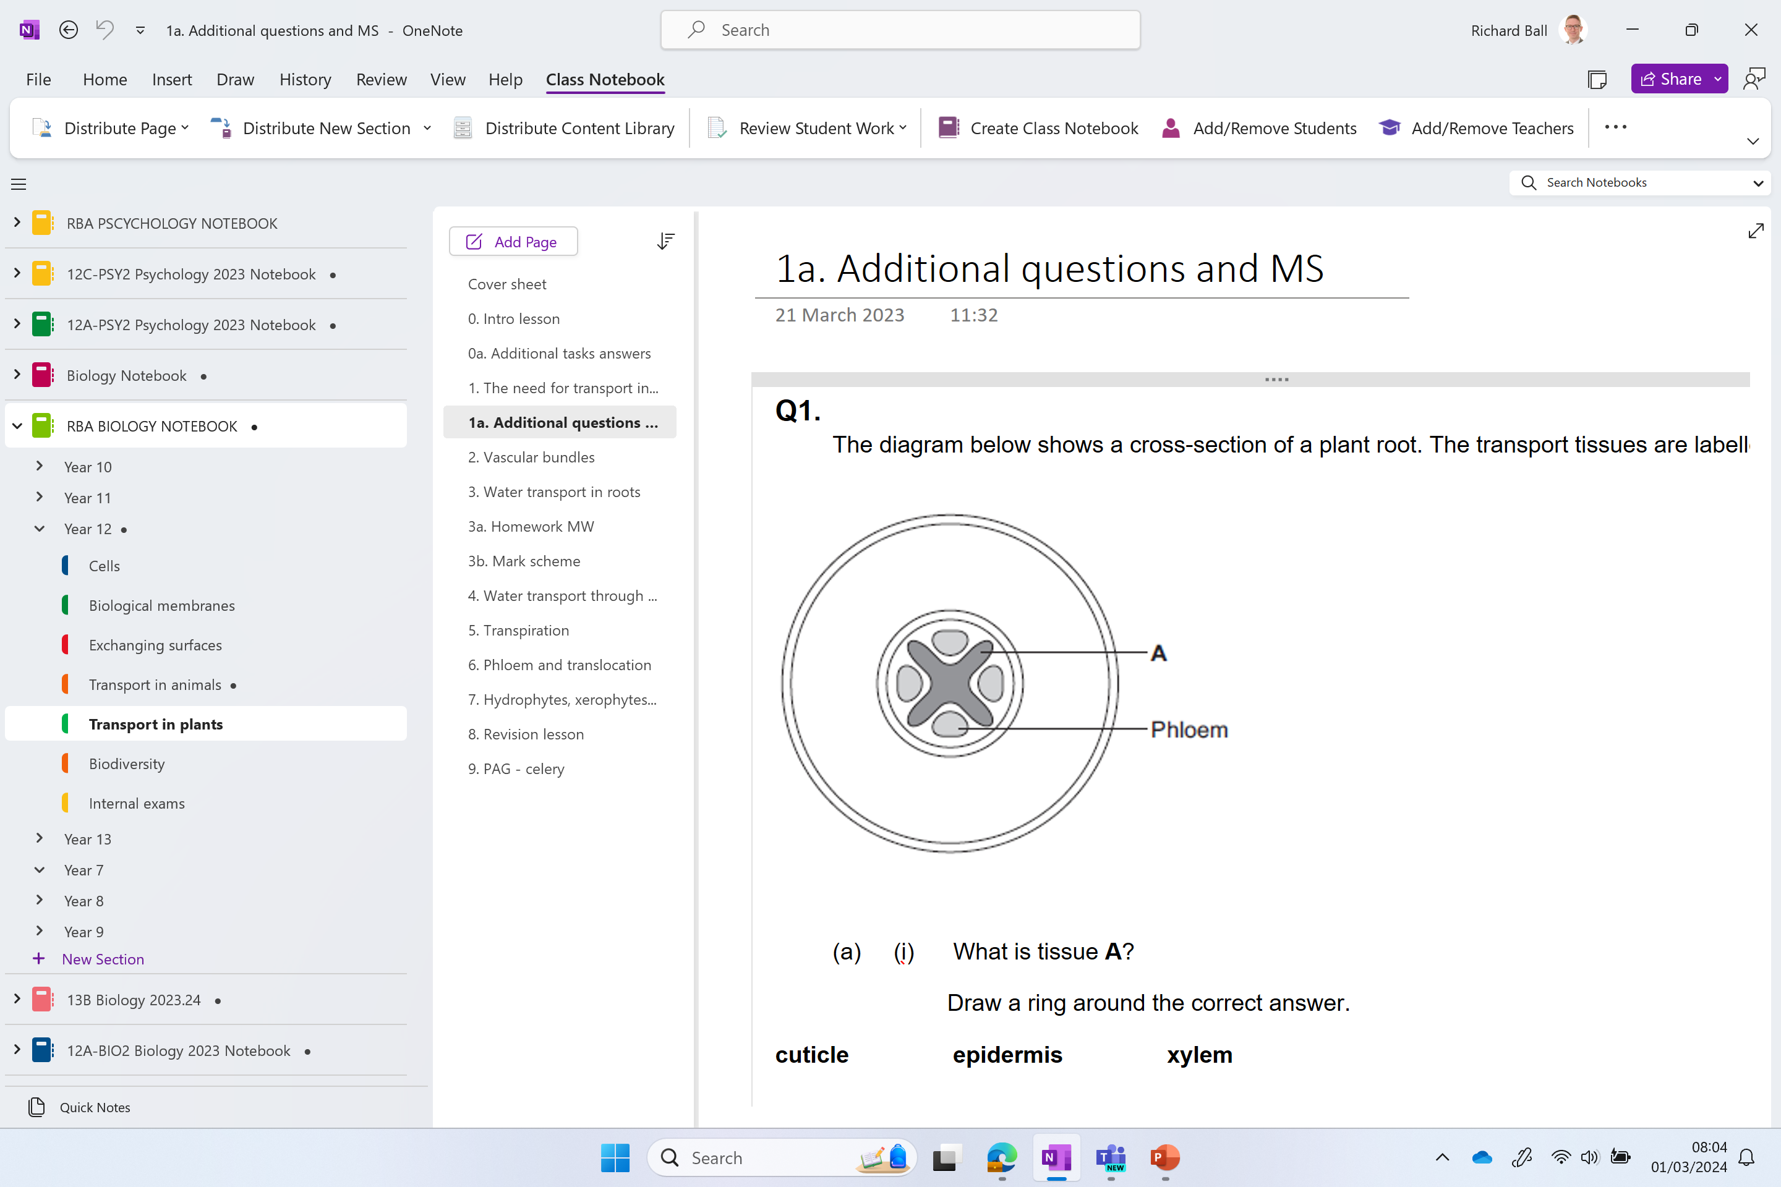
Additional questions

Slide 16

Quiz to start next lesson on the xylem/phloem

Slide 17
Note below on platids
Notes:
Plastids are organelles that function primarily in nutrient synthesis and storage of biological molecules. While there are different types of plastids specialized to fill specific roles, plastids share some common characteristics. They are located in the cell cytoplasm and are surrounded by a double lipid membrane. Plastids also have their own DNA and can replicate independently from the rest of the cell. Some plastids contain pigments and are colorful, while others lack pigments and are colorless. Plastids develop from immature, undifferentiated cells called proplastids. Proplastids mature into four types of specialized plastids: chloroplasts, chromoplasts, gerontoplasts, and leucoplasts.
Chloroplasts: These green plastids are responsible for photosynthesis and energy production through glucose synthesis. They contain chlorophyll, a green pigment that absorbs light energy. Chloroplasts are commonly found in specialized cells called guard cells located in plant leaves and stems. Guard cells open and close tiny pores called stomata to allow for gas exchange required for photosynthesis.
Chromoplasts: These colorful plastids are responsible for cartenoid pigment production and storage. Carotenoids produce red, yellow, and orange pigments. Chromoplasts are primarily located in ripened fruit, flowers, roots, and leaves of angiosperms. They are responsible for tissue coloration in plants, which serves to attract pollinators. Some chloroplasts found in unripened fruit convert to chromoplasts as the fruit matures. This change of color from green to a carotenoid color indicates that the fruit is ripe. Leaf color change in fall is due to loss of the green pigment chlorophyll, which reveals the underlying carotenoid coloration of the leaves. Amyloplasts can also be converted to chromoplasts by first transitioning to amylochromoplasts (plastids containing starch and carotenoids) and then to chromoplasts.
Gerontoplasts: These plastids develop from the degradation of chloroplasts, which occurs when plant cells die. In the process, chlorophyll is broken down in chloroplasts leaving only cartotenoid pigments in the resulting gerontoplast cells.
Leucoplasts: These plastids lack color and function to store nutrients.
Leucoplast Plastids
This false-color transmission electron micrograph shows an amyloplast (large central body), a starch- containing plastid, found in a cell from the root cap of an onion. Amyloplasts contain large quantities of starch (blue globules). Dr. Jeremy Burgess/Science Photo Library/Getty ImagesLeucoplasts are typically found in tissues that don't undergo photosynthesis, such as roots and seeds. Types of leucoplasts include:
Amyloplasts: These leucoplasts convert glucose to starch for storage. The starch is stored as granules in amyloplasts of tubers, seeds, stems, and fruit. The dense starch grains cause amyloplasts to sediment in plant tissue in response to gravity. This induces growth in a downward direction. Amyloplasts also synthesize transitory starch. This type of starch is stored temporarily in chloroplasts to be broken down and used for energy at night when photosynthesis does not occur. Transitory starch is found primarily in tissues where photosynthesis occurs, such as leaves.
Elaioplasts: These leucoplasts synthesize fatty acids and store oils in lipid-filled microcompartments called plastoglobuli. They are important to the proper development of pollen grains.
Etioplasts: These light-deprived chloroplasts do not contain chlorophyll but have the precursor pigment for chlorophyll production. Once exposed to light, chlorophyll production occurs and etioplasts are converted to chloroplasts.
Proteinoplasts: Also called aleuroplasts, these leucoplasts store protein and are often found in seeds.

