Slide 1
Feedback
Quick lesson – teach slower discuss more

Slide 2
Organisation of the Nervous System

Slide 3
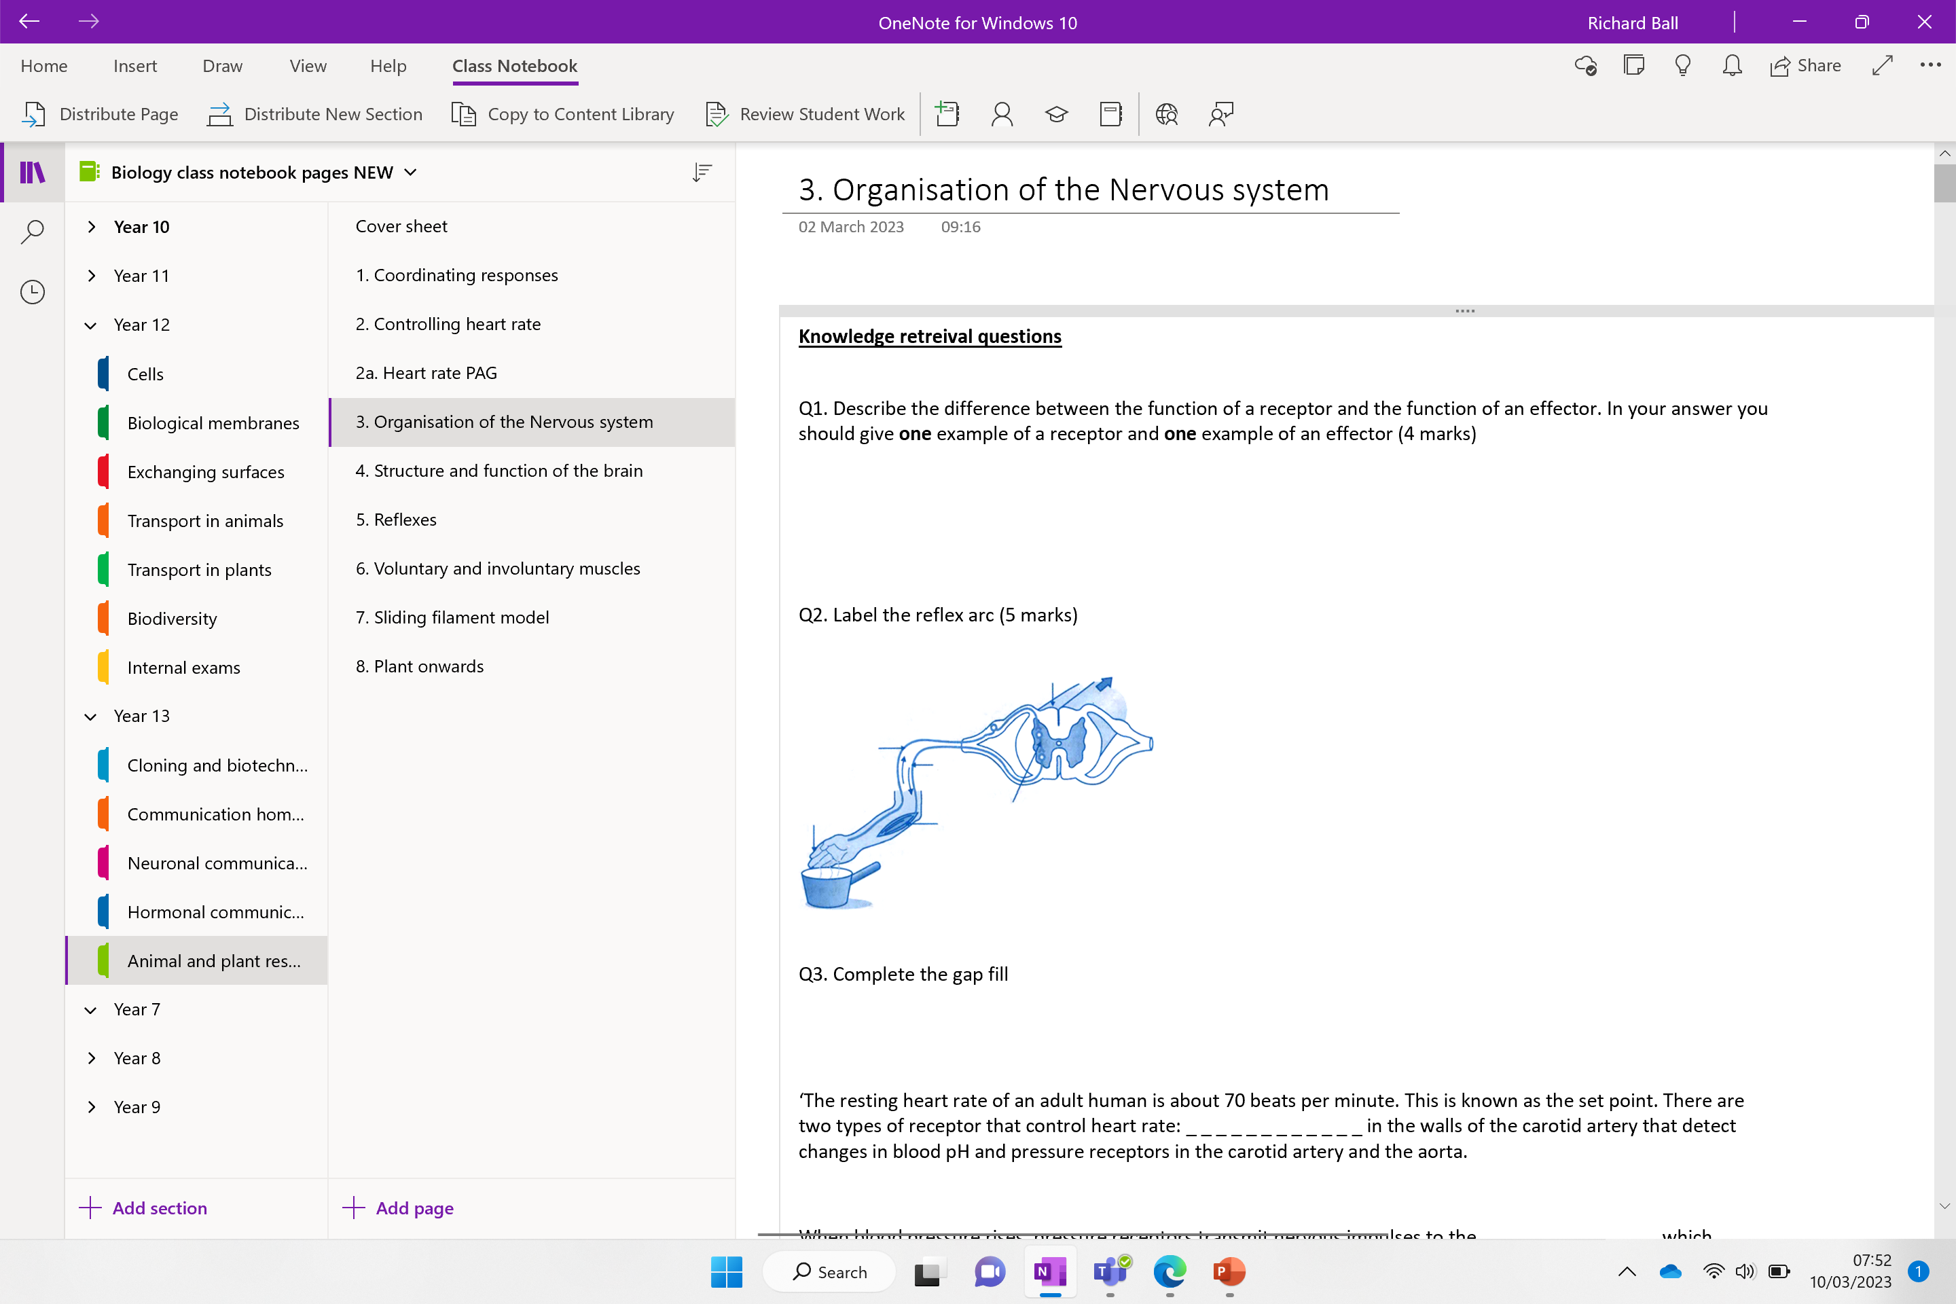

Slide 4
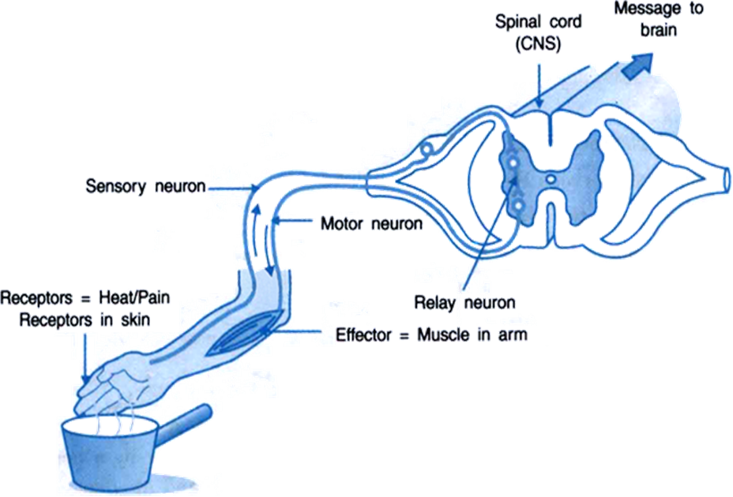
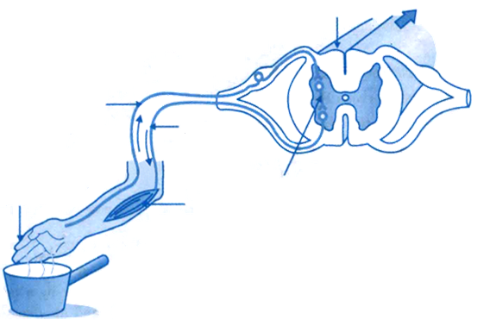
Knowledge retrieval question
Q1. Describe the difference between the function of a receptor and the function of an effector. In your answer you should give one example of a receptor and one example of an effector (4 marks)
receptors detect / sense stimuli / change in surroundings or convert stimulus into an electrical impulse
example of a receptor – Pacinian corpuscle – pressure receptor
effectors allow / make response or convert an impulse to an action
(effector) muscle / gland
Q2. Label the reflex arc (5 marks)
Q3. Complete the gap (5 marks)
‘The resting heart rate of an adult human is about 70 beats per minute. This is known as the set point. There are two types of receptor that control heart rate: _ _ _ _ _ _ _ _ _ _ _ _ in the walls of the carotid artery that detect changes in blood pH and pressure receptors in the carotid artery and the aorta.
When blood pressure rises, pressure receptors transmit nervous impulses to the _ _ _ _ _ _ _ _ _ _ _ _ which decreases heart rate via the _ _ _ _ _ _ _ _ _ _ _ _ nervous system. This is an example of _ _ _ _ _ _ _ _ _ _ _ _.’

Slide 5
Q3.
‘The resting heart rate of an adult human is about 70 beats per minute. This is known as the set point. There are two types of receptor that control heart rate: _ _ _ _ _ _ and _ _ _ _ _ _ in the walls of the carotid artery that detect changes in blood pH and pressure receptors in the carotid artery and the aorta.
When blood pressure rises, pressure receptors transmit nervous impulses to the _ _ _ _ _ _ _ _ _ _ _ _ which decreases heart rate via the _ _ _ _ _ _ _ _ _ _ _ _ nervous system. This is an example of _ _ _ _ _ _ _ _ _ _ _ _ _ _ _ _ _.’
chemoreceptor baroreceptor
medulla oblongata
Parasympathetic
negative feedback

Slide 6
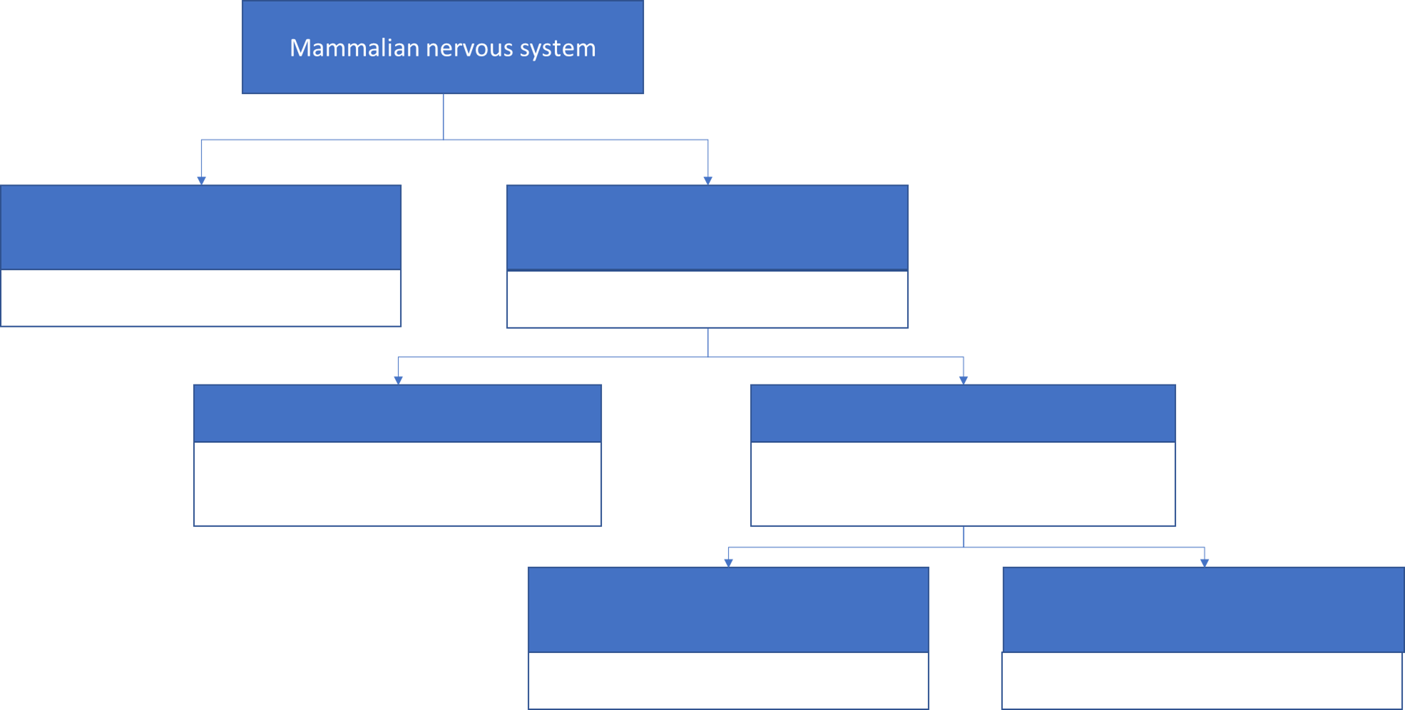

Complete the flow chart – from prior knowledge first
Name
Description
Use the laminated cards for this task!

Slide 7
Now cover your notes with the correct answers
Name
Description
Somatic nervous system
Central nervous system (CNS)
Relaxing responses neurotransmitter - acetylcholine
Sensory and motor neurones
Conscious control input from sense organs output to skeletal muscles
Autonomic nervous system
Sympathetic motor system
Sensory and motor neurones
Brian, spinal cord and relay neurones
Parasympathetic motor system
Peripheral nervous system (PNS)
Subconscious control input from internal receptors output to smooth muscles and glands
‘fight or flight’ responses. Neurotransmitters – noradrenaline

Slide 8
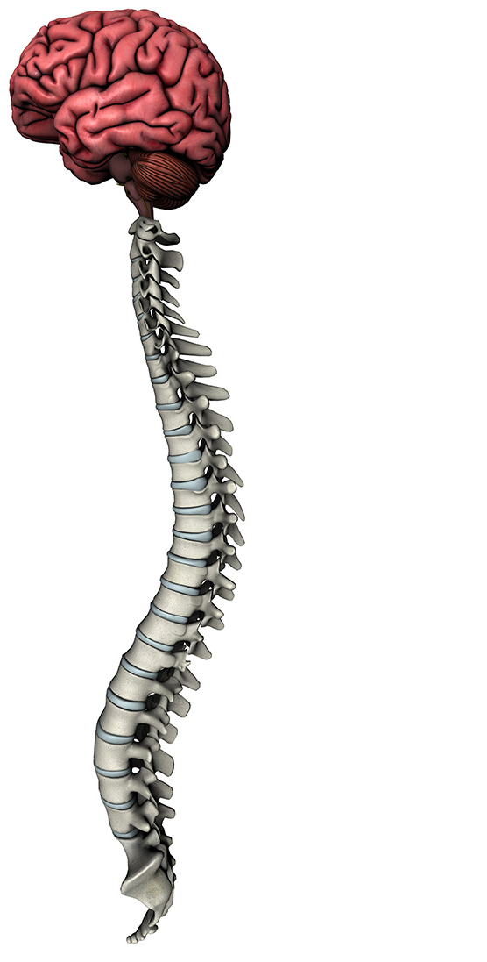
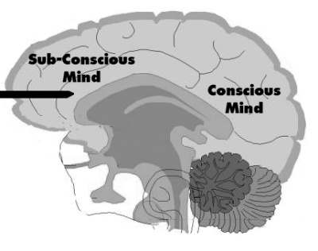
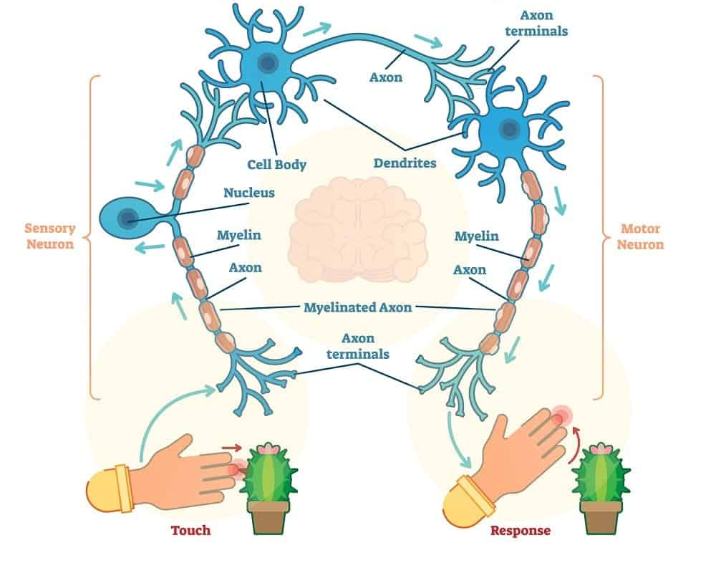
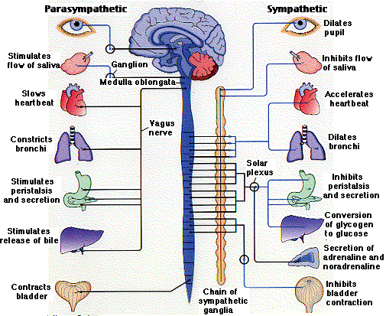
Organisation of the nervous system
Internal receptors
Autonomic
External receptors
Somatic
Motor systems
Notes:
Ganglia can be thought of as synaptic junctions / stations between neurons – important they exists so that a response can be amplified or inhibited – present on autonomic motor pathways
The basal ganglia are located in the brain stem, thalamus, and cerebral cortex areas of the brain. Being in the brain, they are part of the central nervous system, not the peripheral nervous system, as other ganglia are.
Somatic – Greek for the body

Slide 9
Posted on Teams
Name
Mammalian nervous system
Description
Central nervous system (CNS)
Peripheral nervous system (PNS)
Brain, spinal cord and relay neurones
Sensory and motor neurones
Somatic nervous system
Autonomic nervous system
Conscious control input from sense organs output to skeletal muscles
Subconscious control input from internal receptors output to smooth muscles and glands
Somatosensation!
Sympathetic motor system
Parasympathetic motor system
‘fight or flight’ responses. Neurotransmitters – noradrenaline
Relaxing responses neurotransmitter - acetylcholine
Notes:
Somatosensation – you have different receptors for pressure, pain or vibration, which when triggered send an impulse to the brain

Slide 10
Both autonomic
Activate! (fight or flight)
Relax

Slide 11
Effects of sympathetic and parasympathetic stimulation
(fight or flight)
Structure | Sympathetic stimulation | Parasympathetic stimulation
Salivary ………. | Saliva production ………. | Saliva production ……….
………. | Bronchial ………. relaxed | Bronchial muscle ……….
………. | ………. urine secretion | ………. urine secreted
Stomach | p………. reduced | g………. juice secreted
Small intestine | p………. reduced | Digestion ……….
Same word

Slide 12
Effects of sympathetic and parasympathetic stimulation
Structure | Sympathetic stimulation | Parasympathetic stimulation
Salivary glands | Saliva production reduced | Saliva production increases
Lung | Bronchial muscle relaxed | Bronchial muscle contracted
Kidney | Decreased urine secretion | Increased urine secreted
Stomach | Peristalsis reduced | Gastric juice secreted
Small intestine | Peristalsis reduced | Digestion increased

Slide 13
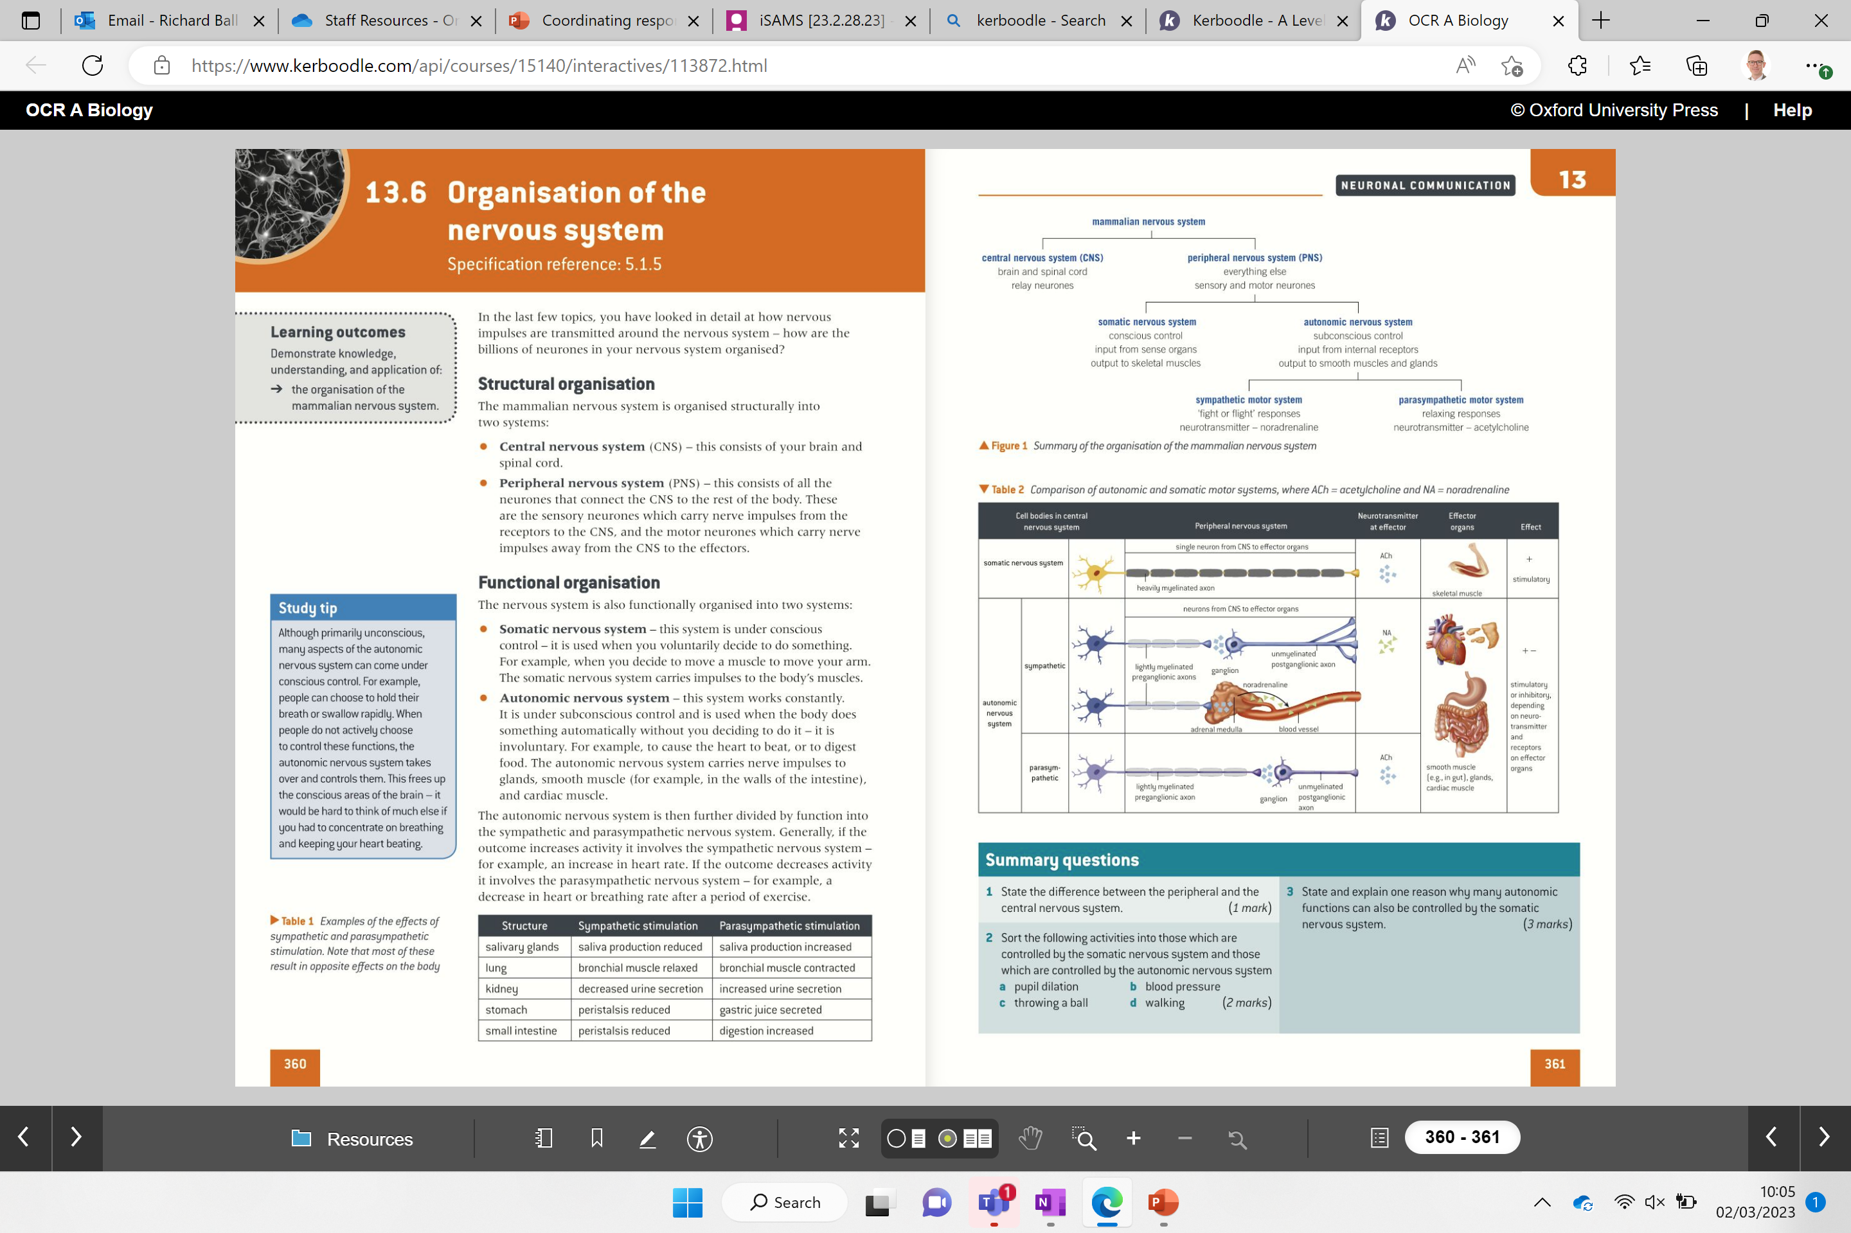
Comparing somatic and autonomic motor systems
Notes:
ANSWER TO THE BELOW: ACh can have an excitor or inhibitory effect on an effector depending on the receptor it binds to. If (like in the somatic system it binds to a Na voltage gated ion channel – this would increase the likelihood of the AP. In the cardiac muscle to reduce heart rate ACh binds to negative ion channels like Cl- and therefore makes the post-synaptic neurone more negatively charged and less likely to trigger and AP
Sympathetic shorter as they are closer to spine than parasympathetic
the preganglionic neuron must first cross a synapse onto a postganglionic neuron before innervating the target organ. The preganglionic, or first neuron will begin at the outflow and will cross a synapse at the postganglionic, or second neuron’s cell body. The postganglionic neuron will then cross a synapse at the target organ.
Sympathetic preganglionic fibers tend to be shorter than parasympathetic preganglionic fibers because sympathetic ganglia are often closer to the spinal cord while parasympathetic preganglionic fibers tend to project to and synapse with the postganglionic fibre close to the target organ.

Slide 14
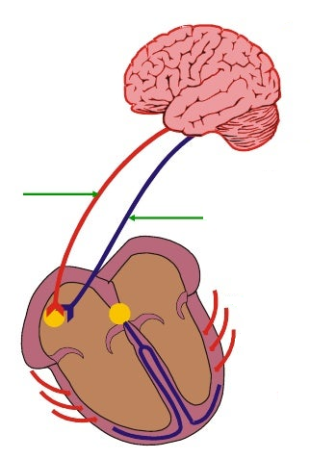
Link to learning from last lesson
Which is a sympathetic and which is a parasympathetic response?
Accelerator
nerve
Vagus
nerve

Slide 15
Key points
Accelerator nerve
Send sympathetic output to the SAN to increase heart rate
Vegus nerve
Send parasympathetic output to the SAN to slow heart rate

Slide 16
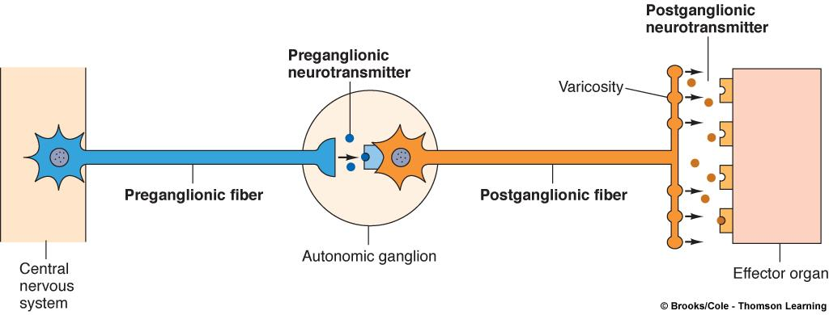
Ganglion
Notes:
Ganglia can be thought of as synaptic junctions / stations between neurons – important they exists so that a response can be amplified or inhibited – present on autonomic motor pathways

Slide 17
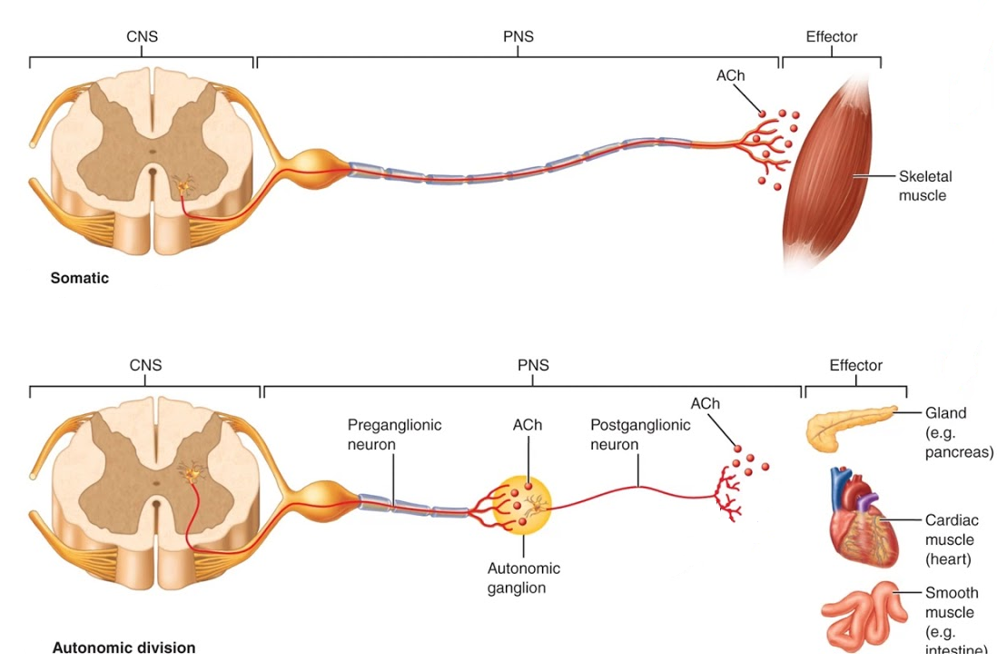
Motor pathway somatic vs autonomic
Notes:
The information from the CNS can be amplified, inhibited – reason for presence of ganglion
Ganglia can be thought of as synaptic junctions / stations between neurons – important they exists so that a response can be amplified or inhibited – present on autonomic motor pathways

Slide 18
Types of motor neurones
Somatic motor neurone | Autonomic motor neurone
Under v…………… control | Under i………………. control
Example: Sending an impulse to the s…………. m…………… | Example sending an impulse to the ………………………………………………
Heavily m……………. neurones | Presence of a……………. g…………… to amplify or inhibit response
Both transmit impulses to the e…………… (…………. or …………..)

Slide 19
Types of motor neurones
Somatic motor neurone | Autonomic motor neurone
Under voluntary control | Under involuntary control
Example: Sending an impulse to the skeletal muscles | Example sending an impulse to the cardiac muscles or smooth muscle in the walls of the gut
Heavily myelinated neurones | Presence of autonomic ganglion to amplify or inhibit response
Both transmit impulses to the effectors (muscles or glands)

Slide 20

Now complete the paper card sort

Slide 21
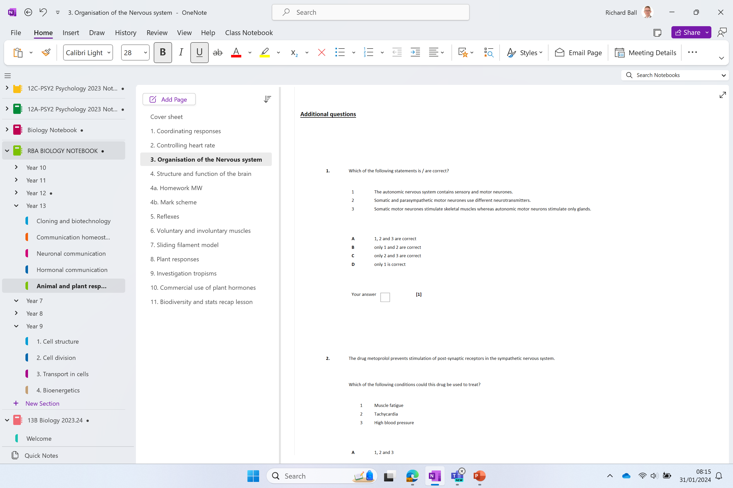
Additional questions

