Slide 1
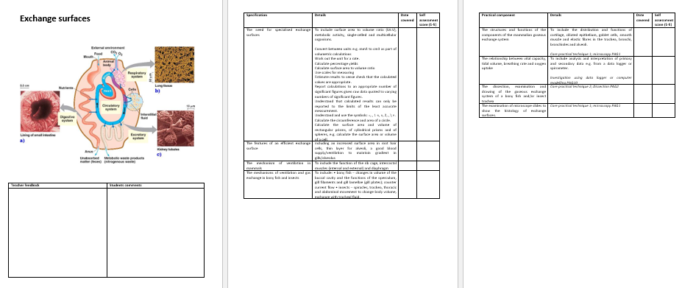

Slide 2
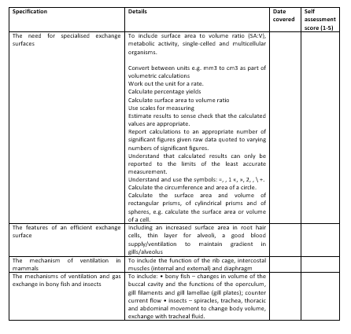
Learning Outcomes
Explain the need for specialised exchange surfaces and describe some substances which may be exchanged.
Calculate and compare surface area to volume ratio

Slide 3
New Topic: Exchange Surfaces

Slide 4
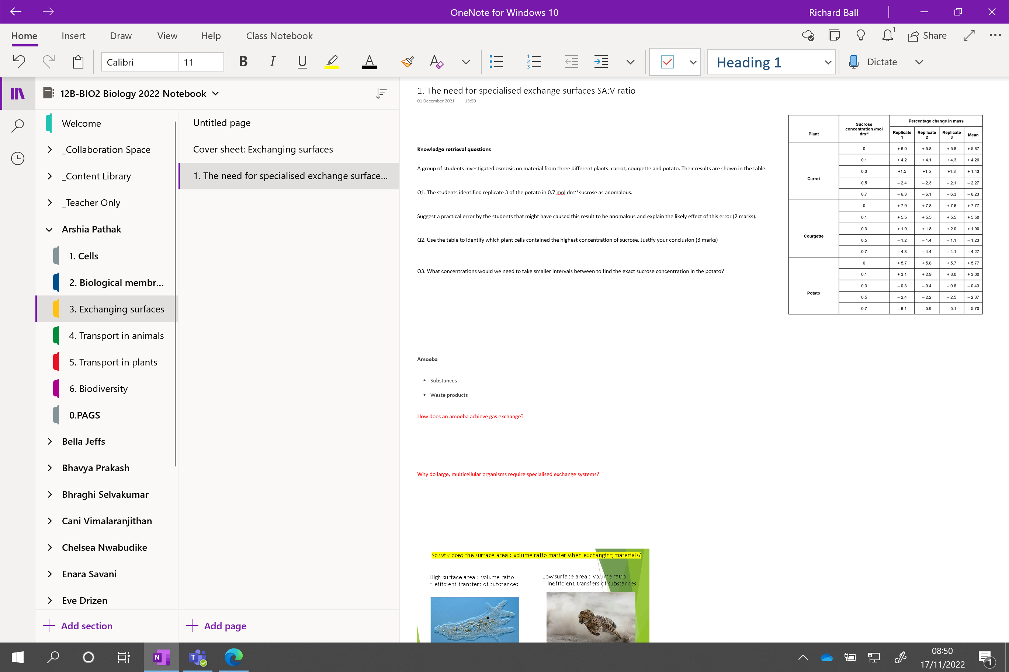

Slide 5
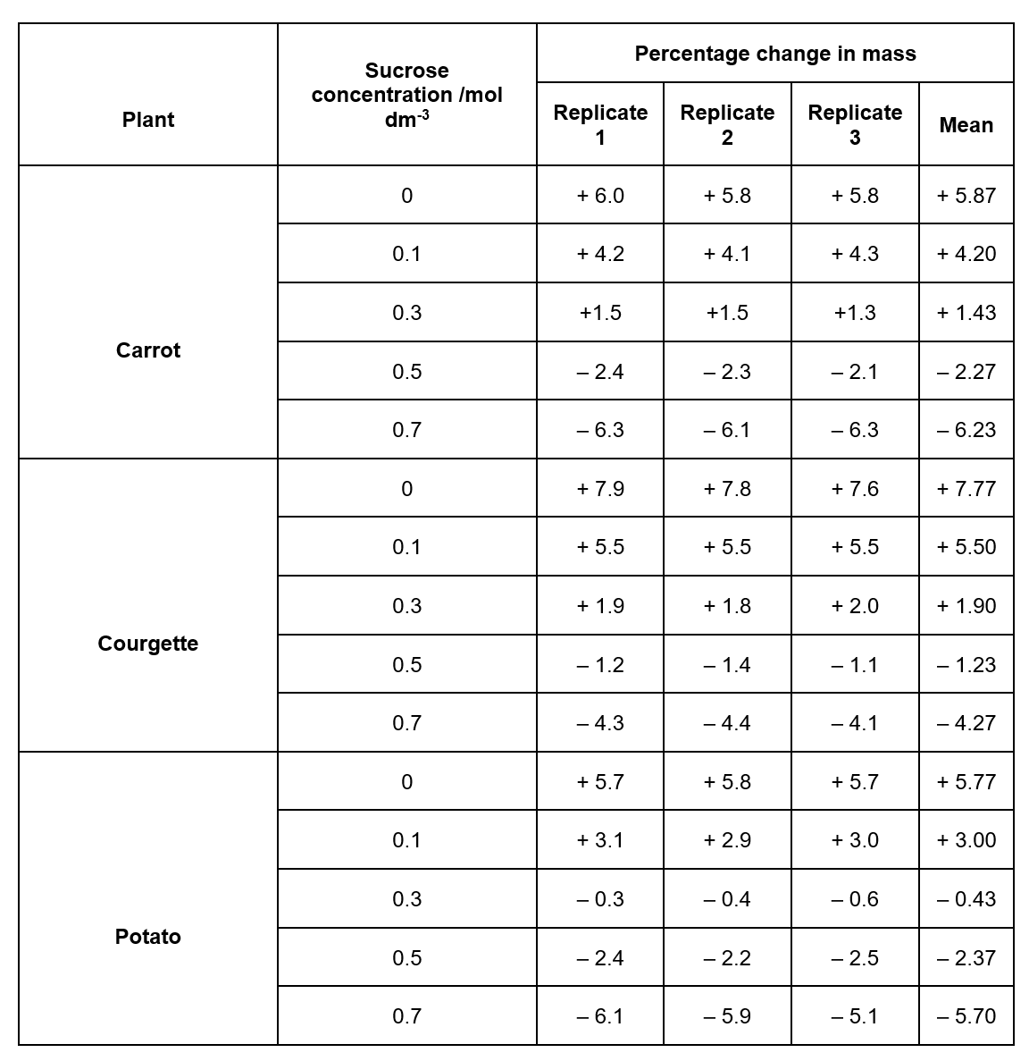
Knowledge retrieval questions Exchanges surfaces lesson1
A group of students investigated osmosis on material from three different plants: carrot, courgette and potato. Their results are shown in the table.
Q1. The students identified replicate 3 of the potato in 0.7 mol dm⁻³ sucrose as anomalous.
Suggest a practical error by the students that might have caused this result to be anomalous and explain the likely effect of this error (2 marks).
Q2. Use the table to identify which plant cells contained the highest concentration of sucrose. Justify your conclusion (3 marks)
Q3. What concentrations would we need to take smaller intervals between to find the exact sucrose concentration in the potato? (1 mark)
inadequate drying - (so) more mass / heavier (than other pieces) ✓
piece cut from different (part of) potato - (so) cells might have different water potential (at start) ✓
Courgette
Highest mass gain at 0mol dm⁻³ / least mass lost at 0.7mol dm⁻³
0.1 – 0.3mol dm⁻³

Slide 6
The Need for Exchange Surfaces

Slide 7
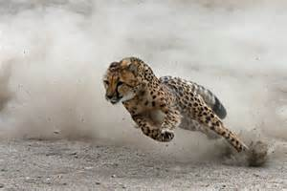
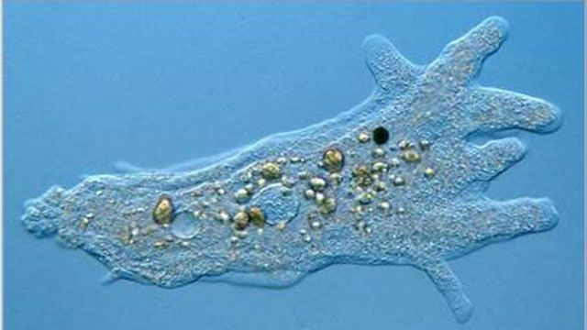
Which has a higher metabolic rate?
How do the demands of oxygen differ between organisms?

Slide 8
Amoeba
  - Substances are needed to survive e.g. oxygen, glucose, ions, amino acids etc
  - Waste products need removing e.g. carbon dioxide, urea
How does an amoeba achieve gas exchange?
Single celled organisms or small, simple multicellular organisms can rely upon diffusion across their outer membrane alone for this exchange.
Very short diffusion pathway

Slide 9
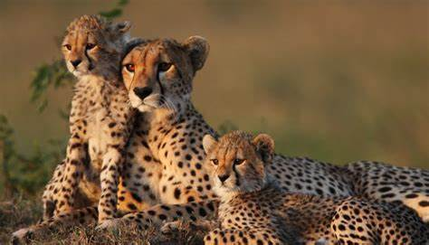
Could the cheater use the same method to supply their cells with oxygen?
Why not?

Slide 10
Why do large, multicellular organisms require specialised exchange systems?
Multicellular organisms have many layers of cells so there is a large diffusion distance.
Large multicellular organisms have a small surface area to volume ratio
So, cells in the centre of the organism would not receive any materials or receive them too slowly to meet demand
Some organisms have a high metabolic rate, (e.g. high rate of respiration which requires oxygen and glucose and produces carbon dioxide).
Warm blooded animals that need to maintain a constant body temperature or animals that are highly active.

Slide 11
So why does the surface area : volume ratio matter when exchanging materials?
High surface area : volume ratio
= efficient transfers of substances
Low surface area : volume ratio
= inefficient transfers of substances
How are mammals different from amoeba, when it comes to transferring substances around the organism?
Notes:
Mammals use specialised systems to transfer substances into their body
E.G Respiratory system, circulatory system
Amoeba only rely on diffusion for substances to reach all the cells in the body

Slide 12
How are mammals different from amoeba, when it comes to transferring substances?
Mammals use specialised systems to transfer substances into their body
E.G Respiratory system, circulatory system
Amoeba only rely on diffusion for substances to reach all the cells in the body

Slide 13
Calculating SA:V ratios

Slide 14
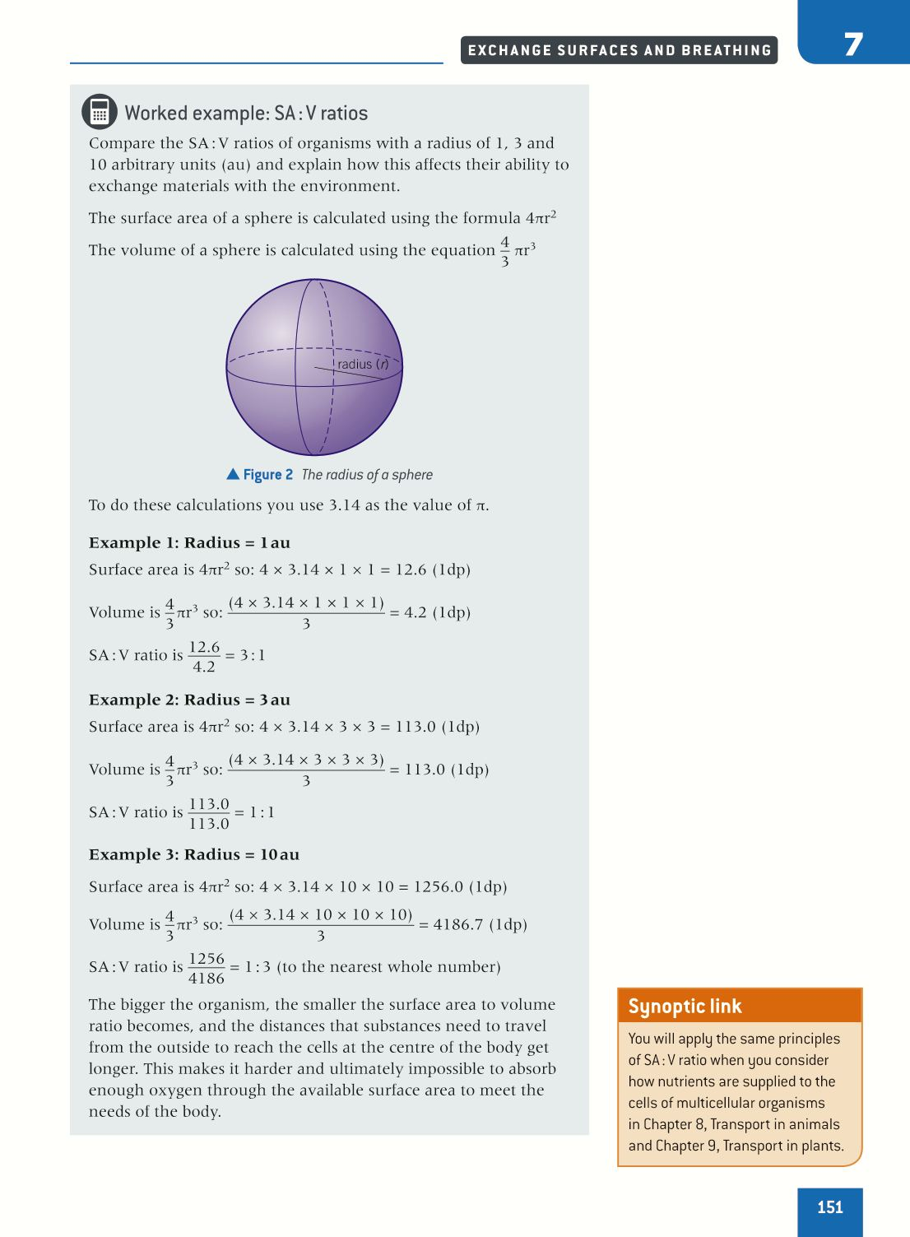
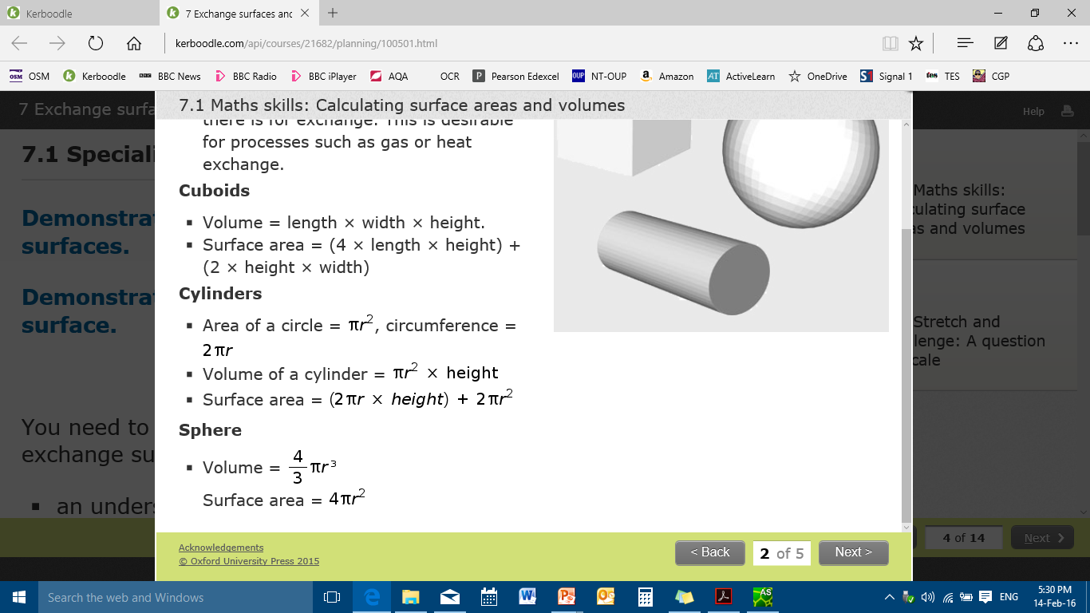
Lets look at a sphere to explain
Have
How do you calculate the surface area of a sphere?
How do you calculate the volume of a sphere?
Convert into a decimal by dividing SA/V = 3/1 = 3.0

Slide 15
Calculate the surface area : volume ratio of spheres with a 3au and 10au radius. Write a conclusion about how surface area:volume ratio changes as the size of a sphere increases
Example 1
What happens to the SA:V ratio as the sphere increases in size?
3:1 (3.0)
As the size of a sphere increases its surface area to volume ratio decreases
1:1 (1.0)
1:3 (0.3)

Slide 16
Calculate the surface area : volume ratio of spheres with a 3au and 10au radius. Write a conclusion about how surface area:volume ratio changes as the size of a sphere increases
Example 1
3:1 (3.0)
As the size of a sphere increases its surface area to volume ratio decreases
1:1 (1.0)
1:3 (0.3)

Slide 17
Largest surface area : volume ratio
Smallest surface area : volume ratio
Very efficient exchange surface
Less efficient exchange surface

Slide 18
The bigger the organisms the smaller its SA:V ratio!

Slide 19
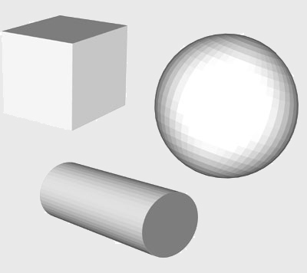
Surface Area : Volume Ratio
Calculations you need to know!

Slide 20
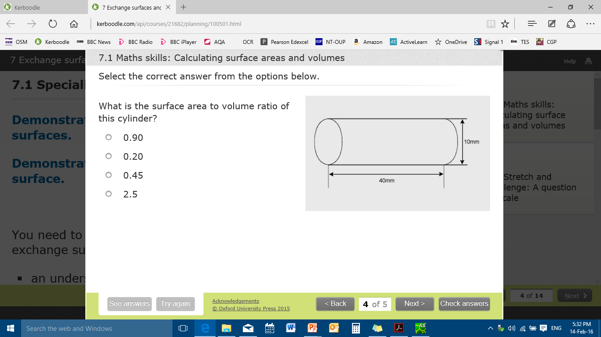
Surface Area : Volume Ratio calculations
Q1.
Q2. Why do multicellular organisms need specialist exchange systems? (3 marks)

Slide 21
Surface Area : Volume Ratio calculations
Surface area:
(2 x TT x r x h) + (2 x TT x r²)
(2 x TT x 5 x 40) + (2xTTx5²)= 450TT = 1413.7
Volume:
TT x r² x h
TT x 5² x 40 = 1000TT = 3141.6
1413.7 : 3141.6
1414.7 / 3145.6
0.45

Slide 22
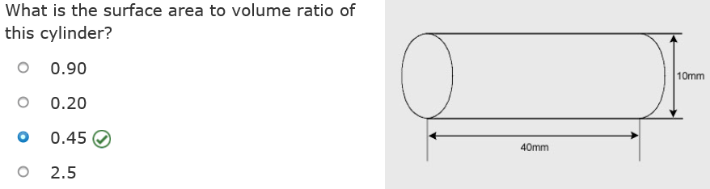
Why do multicellular organisms need specialist exchange systems? (3 marks)
Small surface area to volume ratio
Many layers of cells – long diffusion pathway
High metabolic rate / unable to meet metabolic demand

Slide 23
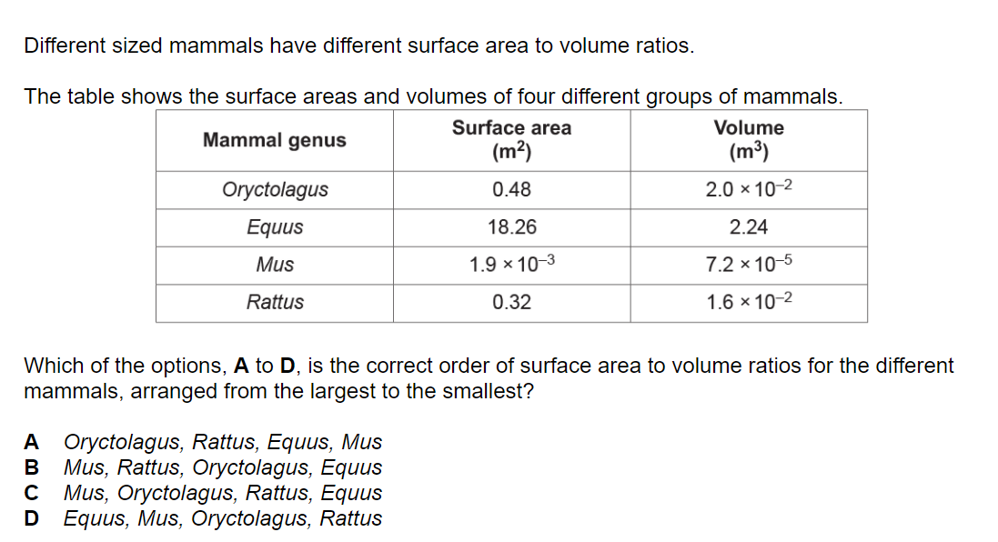

Slide 24
A = 24
B = 8.15
C = 26.38
D = 20
C

Slide 25
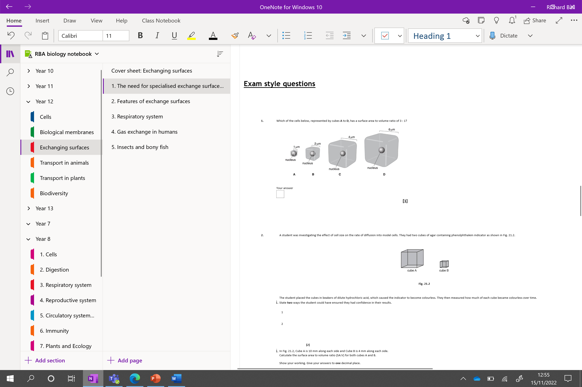
Exam style questions below

Slide 26
Learning Outcomes
Explain the need for specialised exchange surfaces and describe some substances which may be exchanged.
Calculate and compare surface area to volume ratio

