Slide 1
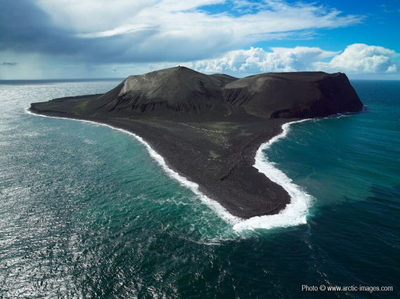
Surtsey island
1963 this new landmass appeared as a result of volcanic action on the sea bed (off the coast of Iceland).
130m below sea level
Island formed by 2nd day
Sporadic eruption continued for 3.5 years
Can organisms survive here?
List abiotic factors that are suitable to sustain life.
List abiotic factors that make this island less inhabitable.

Slide 2
SUCCESSION
Understand the stages of succession from colonisation to a climax community, including deflected succession
http://www.youtube.com/watch?v=V49IovRSJDs

Slide 3
Succession
Top tip:
Students often describe changes in organisms here rather than the composition of the community changing with time.
The progressive change in the community of a given area over time.
It occurs because all organisms in an area interact with each other and their environments.
The community is said to be dynamic in that it is constantly changing.

Slide 4
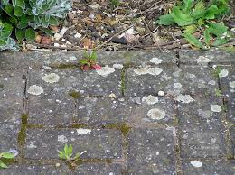

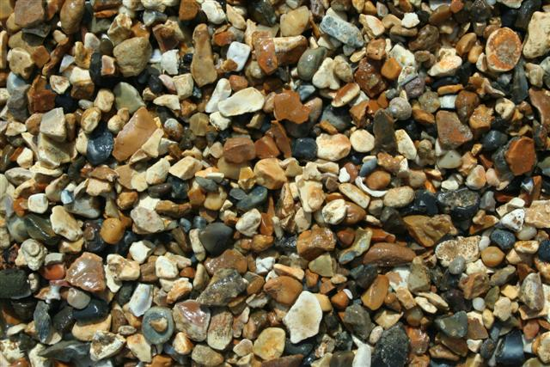
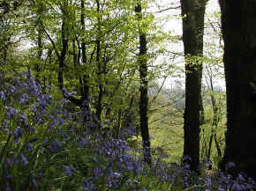
Primary succession
A primary succession starts in newly formed habitats. This may occur on bare rock, on sand or shingle on the sea shore and in open water.
How?

Slide 5
PRIMARY SUCCESSION is what occurs when land has not previously been colonised
  e.g. bare rock or open water, is first colonised with species and then succession ensues.
SECONDARY SUCCESSION occurs on land or water that had previously supported life and then become barren
  e.g. waste land, land fills, drained lakes, forest fires.

Slide 6
What Causes Succession?
Colonisation of barren land/water may occur as a result of:
  Deposition of lava
  Subsidence of land to create ponds or lakes
  Retreating glaciers
  Deposition of silt/mud in river estuaries
  Deposition of sand into dunes by wind/sea

Slide 7
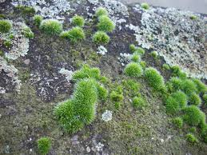
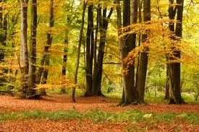
The first colonisers in succession are called the PIONEER SPECIES.
May have:
  Ability to photosynthesise
  Produce large quantities of seeds/spores which are easily dispersed over a wide area
  Rapid germination of seeds/spores (no dormancy)
  Ability to withstand extreme conditions
  Ability to fix atmospheric nitrogen
In time and without interference the area will reach a CLIMAX COMMUNITY.
Often are woodland areas with different species occupying their own niche within the habitat.
Usually contain a dominant plant species and a
dominant animal species.

Slide 8
Sand dune succession
In pairs/ groups of three:
Arrange the cards to show succession in the sand dune ecosystem.
Use the information and your text book (p280) to draw an A4 annotated diagram.
Include the key words:
Pioneer species, herbaceous plants, climax community
Above write the plant species present at each stage. Include any adaptations
Below list the abiotic conditions at each stage

Slide 9
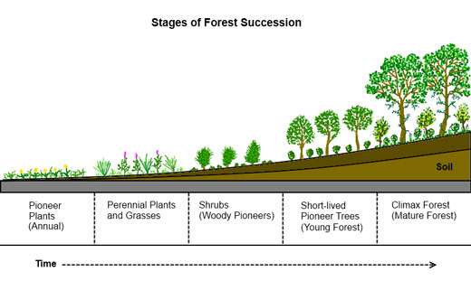
Annotate this diagram with as many key terms and explanations of succession as you can.

Slide 11
Put these terms in order to represent succession:
Trees
Lichen
Shrubs
Grass
Ferns
Small plants e.g. moss
Deciduous oak trees (UK)

Slide 12
Bare rock
Lichen grow
Basic soil containing sufficient nutrients for….
Small plants e.g. mosses
Thicker layer of more nutritious soil develops
Ferns
Grasses
Shrubs
Trees
Deciduous oak woodland (in UK)
PIONEER SPECIES
Rock weathering and decomposition of lichen
Increasing nutrient content of soil allows support of larger, more highly developed plant species.
Continued rock erosion and increase in organic matter from decaying plants
CLIMAX COMMUNITY

Slide 13
During the Course of Succession
The environment becomes LESS HOSTILE (more soil, nutrients, shelter etc.)
The number and variety of habitats increases
There is an increase in BIODIVERSITY to the middle of the succession (followed by a decrease as a dominant species out-competes others in the climax community)
Food webs become more complex
There is an increase in BIOMASS

Slide 14
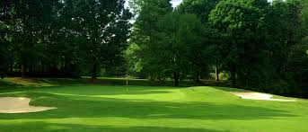
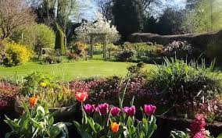
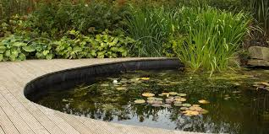
Deflected succession
Human interference often prevents a community reaching its natural climax.
The intermediate state that it remains in is called a plagioclimax
Can you give me 3 examples of this?

Slide 15
(a) Explain the meaning of the term primary succession.
.........................................................................................................................
.........................................................................................................................
.........................................................................................................................
.........................................................................................................................
[2]
starts with previously uncolonised area / bare ground / bare rock;
ref to pioneer species / named pioneer;
series of recognisable, seres / stages;
progresses to, climax / final equilibrium stage;

Slide 16
(b) Explain the role of pioneer plants in succession on a bare rock or sand dune.
.........................................................................................................................
.........................................................................................................................
.........................................................................................................................
.........................................................................................................................
.........................................................................................................................
.........................................................................................................................
[3]
stabilise environment;
soil development / increase humus / organic material;
change soil pH;
hold more water;
release more minerals or nutrients / increase N content or fix N / hold ions;
form microhabitat / reduce exposure / provide shelter / reduce erosion;

Slide 17
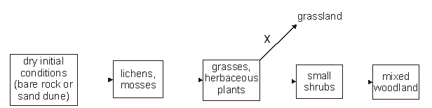
The figure below shows a primary succession in a temperate climate.
X represents an example of deflected succession.
Suggest two ways in which deflected succession at X could be caused.
[2]

Slide 18
any two from following:
grazing;
burning;
mowing / application of fertilizer / application of selective herbicide;
exposure to wind;
grass able to continue to grow (linked to a statement above);

Slide 19
(d) Explain how biomass changes during a primary succession.
.........................................................................................................................
.........................................................................................................................
.........................................................................................................................
.........................................................................................................................
[2]
increases;
plants at later stages are large / plants in early stages are small;
trees / shrubs. are woody, appear later in succession;

