Slide 1
(g) the role of isolating mechanisms in the evolution of new species
Keywords: geographic, allopatric, sympatric
Lesson objectives:
Describe the process of allopatric speciation
Compare allopatric and sympatric speciation
Notes:
Including:
Geographic mechanisms (allopatric speciation)
Reproductive mechanisms (sympatric speciation)

Slide 2
Remember these?
(Classification & Evolution topic)
Dumb Kids Playing Chicken On Freeways Get Squashed!
Did King Philip Come Over For Good Spaghetti?
Do Kids Prefer Candy Over Fried Green Spinach?
Do Kangaroos Play Chess On Fridays? Get Serious!

Slide 3
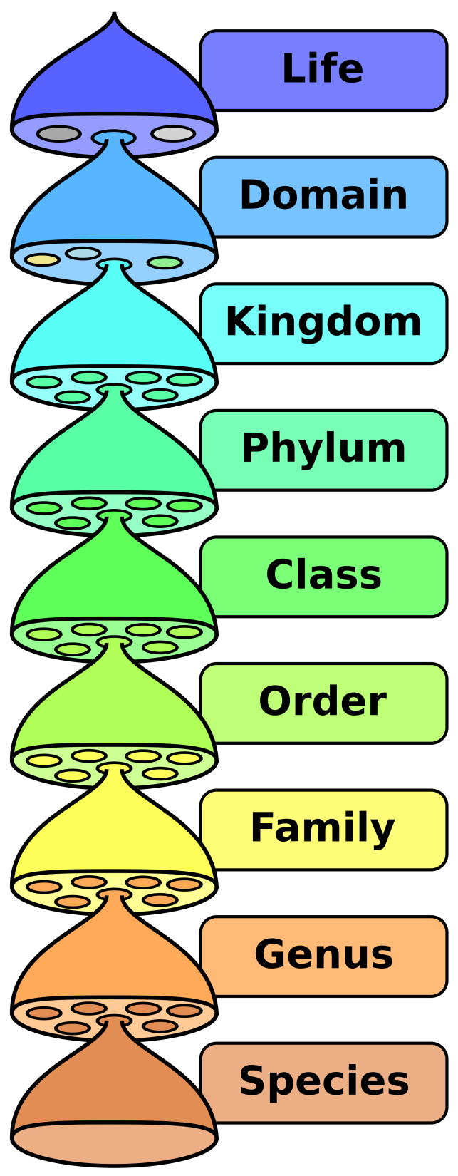
The most widely used definition of a species comes from the biological species concept:
A group of organisms that can interbreed to produce fertile offspring
What issues are there with using this definition?
It is impossible to study gene flow and reproductive behaviour of species known only from fossil remains
Genetic evidence suggests that there is gene flow between organisms that are considered different species (evidence of hybrids)
It can’t be applied to organisms that reproduce asexually
The phylogenetic species concept:
The concept of a species as an irreducible group whose members are descended from a common ancestor and who all possess a combination of certain traits.
(a group that have a shared and unique evolutionary history).
Notes:
https://academic.oup.com/nsr/article/7/8/1387/5691349
https://www.discovermagazine.com/the-sciences/how-do-we-define-a-species

Slide 4
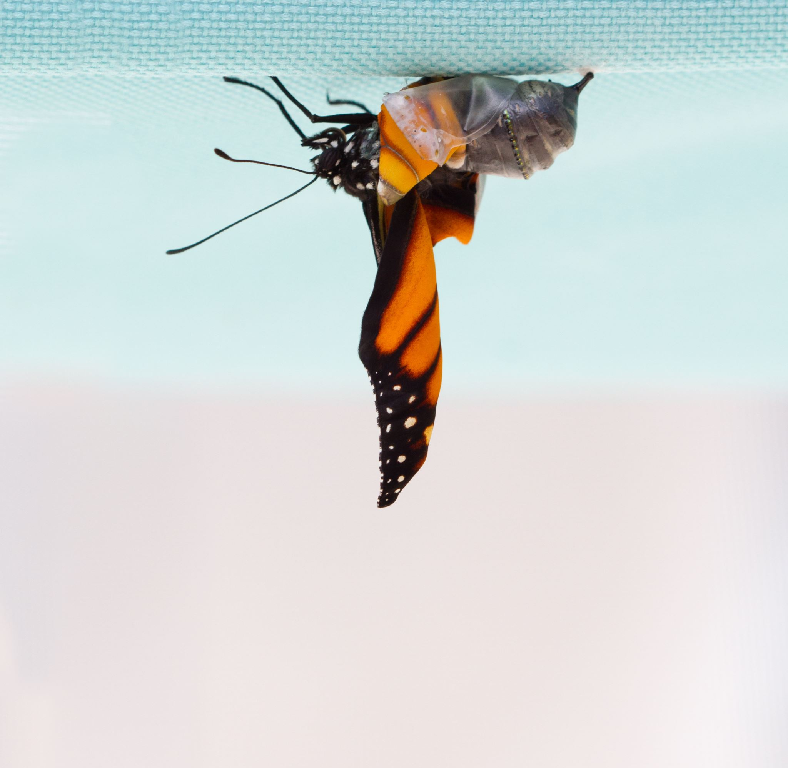
The process of speciation based on the biological species concept:

Slide 5
Reproductive isolation
Members of different species are reproductively isolated from one another (they cannot breed together to produce fertile offspring). The mechanisms of reproductive isolation can be grouped into two categories:
Prezygotic
Members of different species can’t mate to produce a zygote
Postzygotic
Zygotes cannot form into healthy, fertile adults

Slide 6
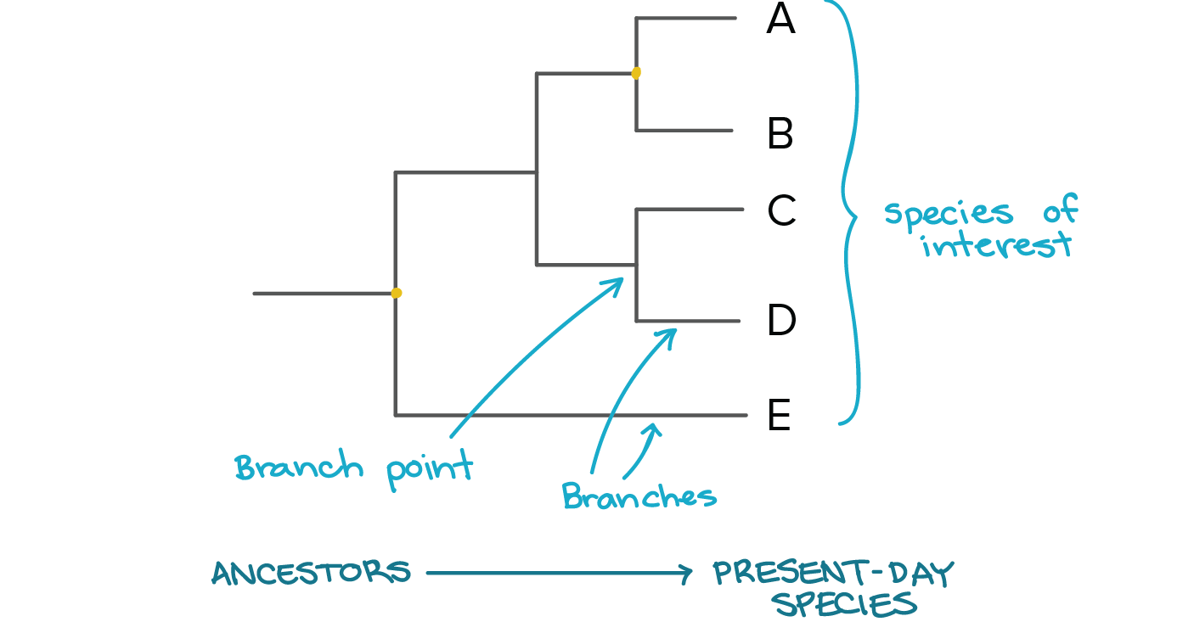
Speciation:
The evolution of two different species from one existing species
New species arise through the process of speciation
Two populations form from one original population
Natural selection and genetic shift result in a shift in allele frequency
This leads to changes in phenotype frequency
Reproductive isolation results

Slide 7
The way that speciation occurs can be divided into two categories
Allopatric
Involves geographic separation of populations from a parent species and subsequent evolution
Sympatric
Involves speciation occurring within a parent species remaining in one location.

Slide 8

Allopatric Speciation:
Meet the Wibbleys

Slide 9
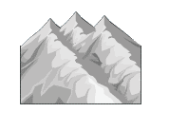





Oh no a mountain!
Geographic
Isolation
Mutation
Mutation
Separate gene pools, no interbreeding between the 2 new populations

Slide 10
Years pass…
Natural selection
Hair is better for staying warm
Blue is better for camouflage in this environment
Variation due to mutation
Different biotic/abiotic factors/ selection factors
Differential reproductive success / (selected) organisms survive and reproduce
Leads to change in allele frequency

Slide 11
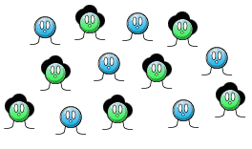
More years pass…
Mountain barrier is removed
New species have been created and cannot breed together – called speciation

Slide 12
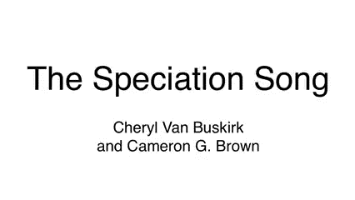
The Wibbley song!
Notes:
http://www.youtube.com/watch?v=WDPsZPKSEFg

Slide 13
Geographical isolation and speciation
These separated populations will then experience slightly different conditions/environments/selection pressures.
Eventually, individuals from different populations will have changed so much that they will no longer be able to reproduce and produce fertile offspring. This is speciation.
A physical barrier divides a population of a species, causing some individuals to become separated from the main population. This is geographical isolation.
Certain alleles which give an advantage will thus be selected for, leading to evolution.

Slide 14
Geographical isolation and speciation
1. A physical barrier divides a population of a species, causing some individuals to become separated from the main population. This is geographical isolation.
2. These separated populations will then experience slightly different conditions/environments/selection pressures.
3. Certain alleles which give an advantage will thus be selected for, leading to evolution.
4. Eventually, individuals from different populations will have changed so much that they will no longer be able to reproduce and produce fertile offspring. This is speciation.

Slide 15
Sympatric Speciation
Organisms from the same ancestral species become reproductively isolated and diverge without any physical separation
How?
Changes in the alleles and phenotype of the two populations prevent them from successfully breeding together. Examples include:
Temporal isolation – different flowering/mating seasons
Mechanical isolation – changes in genitalia prevent successful mating
Behavioural isolation – different courtship rituals developed.
Ecological isolation – species occupy different parts of the same habitat

Slide 16
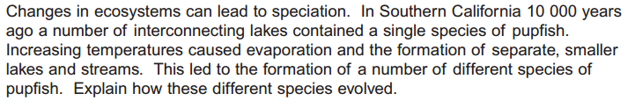
AQA Jan 2011 8c
[5 marks]

Slide 17
Mark scheme
1. Geographical isolation/allopatric
2. Separate gene pools / no interbreeding (between populations);
3. Variation due to mutation;
4. Different environmental/abiotic/biotic conditions / selection pressures;
5. Selection for different/advantageous, features/characteristics/mutation/ /allele;
6. Differential reproductive success / (selected) organisms survive and reproduce;
7. Leads to change in allele frequency;
8. Occurs over a long period of time;

Slide 18
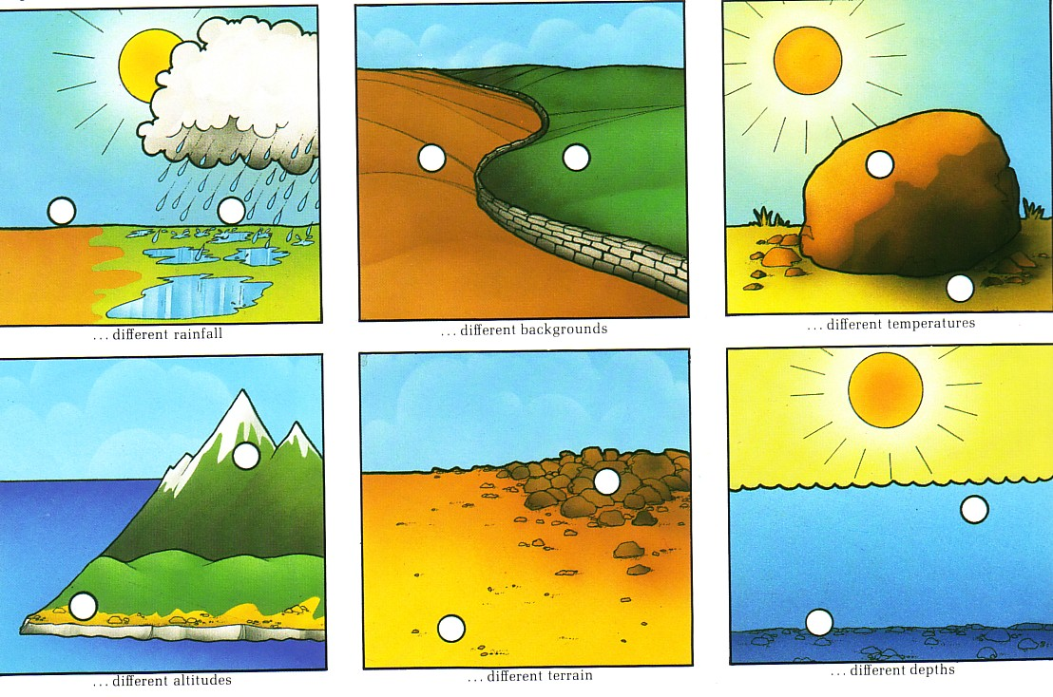
Which type of isolation is this?
Sympatric isolation

Slide 19
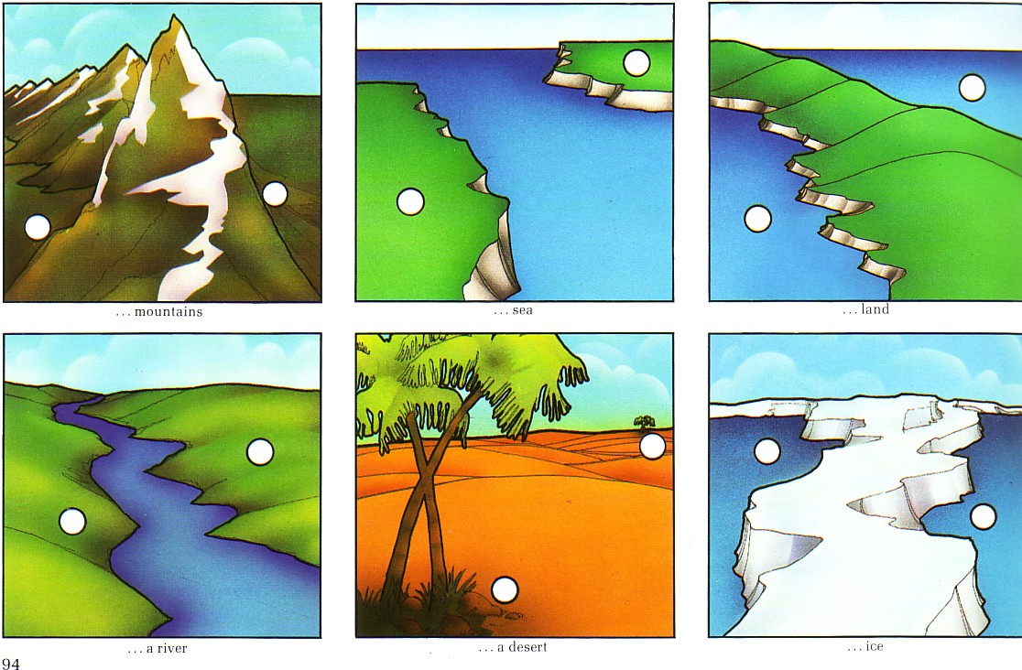
Which type of isolation is this?
Allopatric isolation

Slide 20
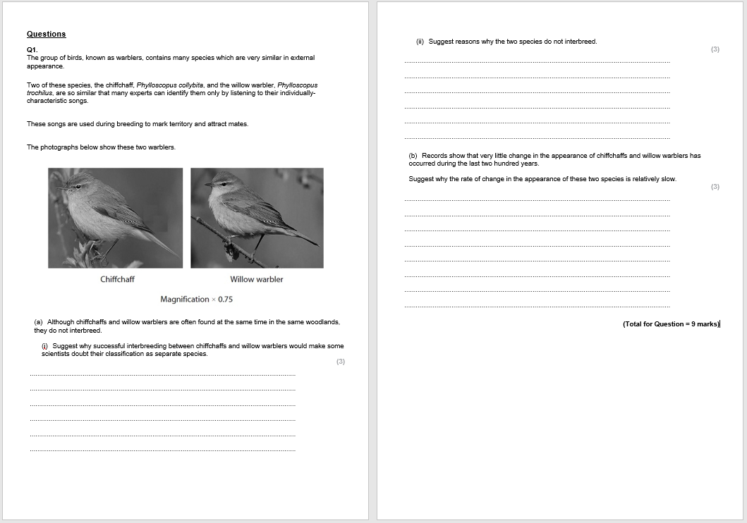
Now try this question

Slide 21

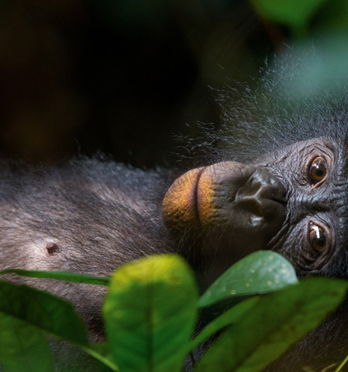
Want to read more?
Bonobo versus Chimp
Use the article to answer the following questions:
How does reproductive isolation occur?
What does species mean?
In the case of the bonobos and chimp, what factors have led to their changes in behaviour?

