Slide 1
Print
Assessment starter question

Slide 2
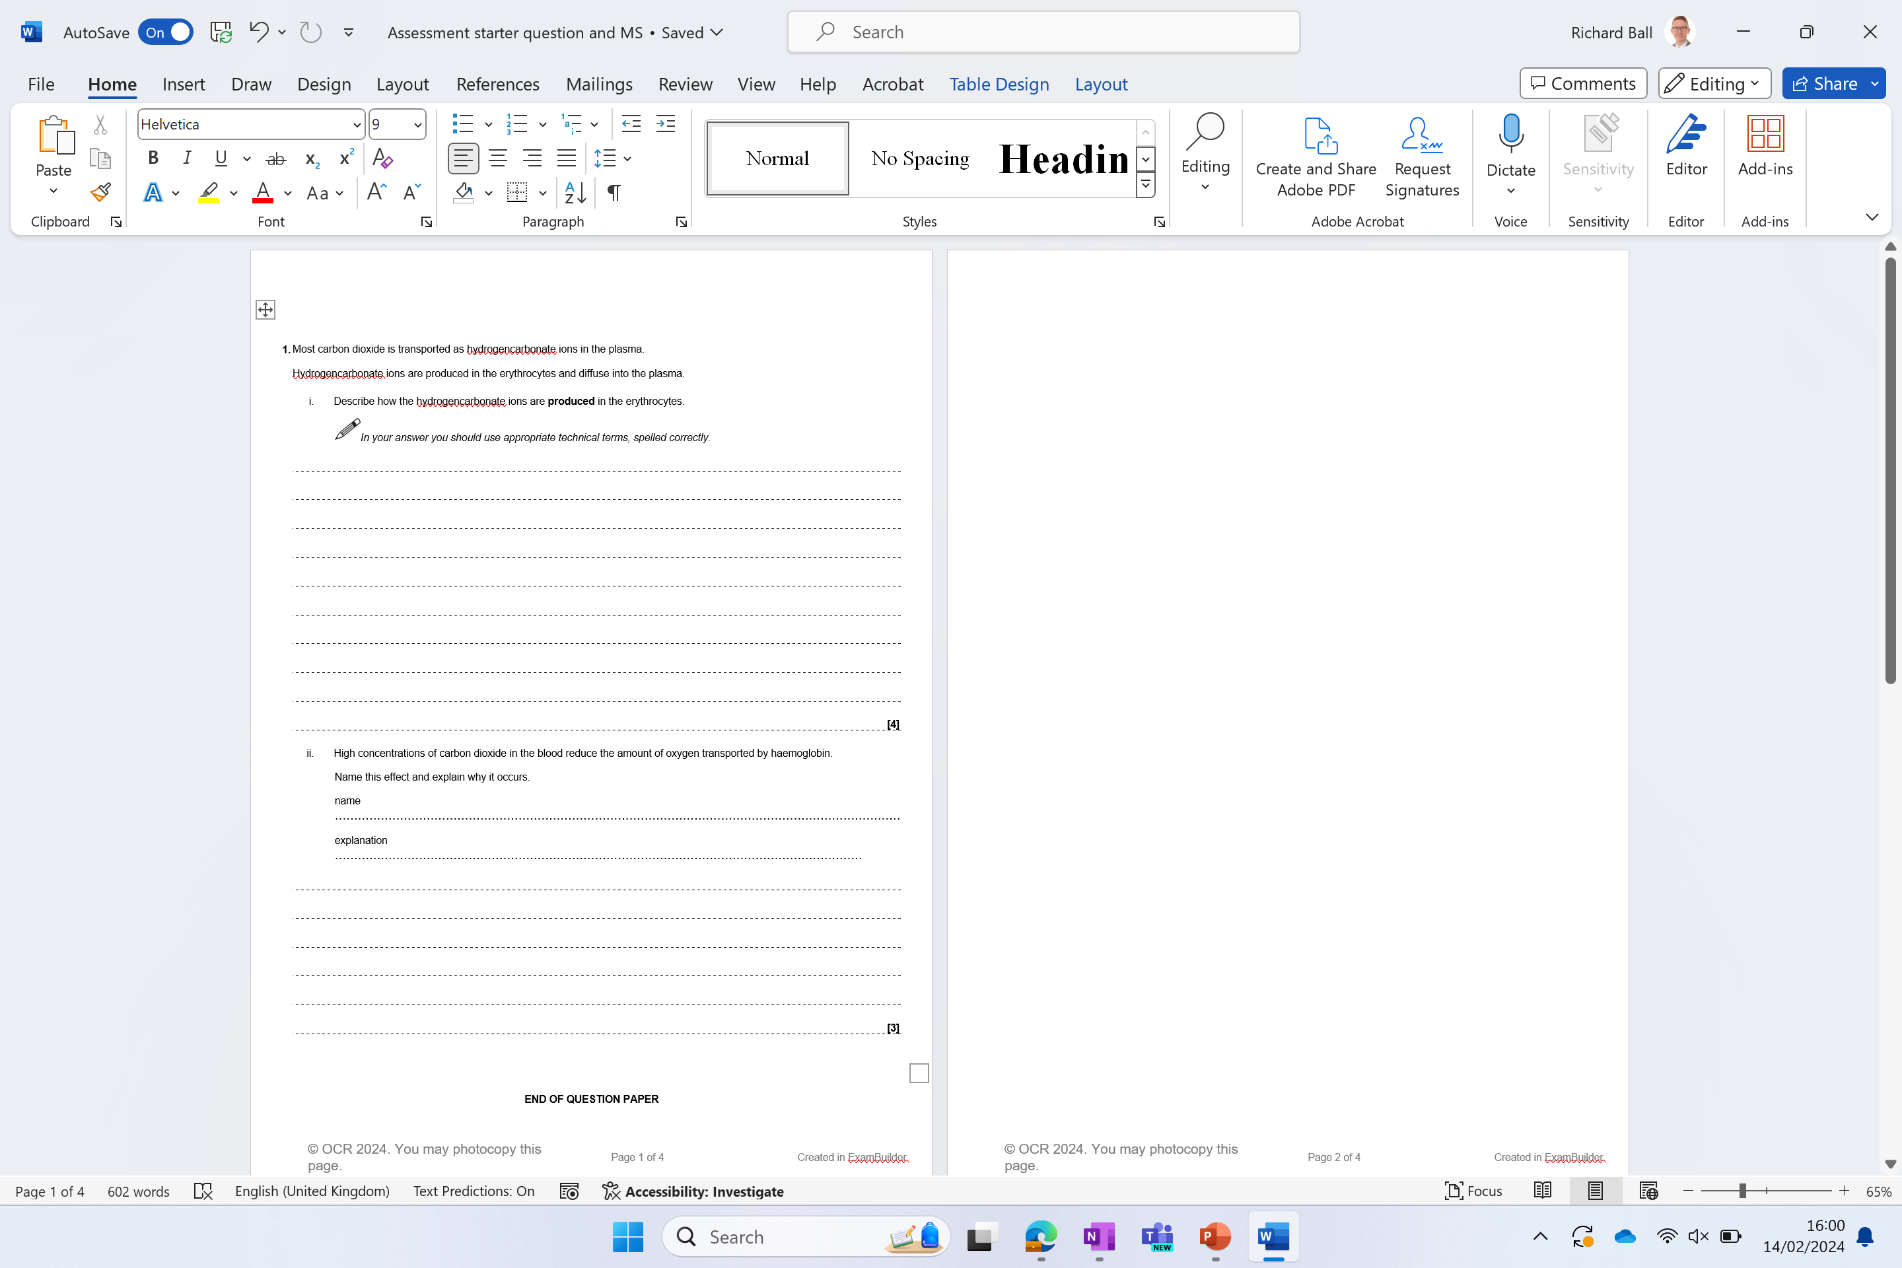
Independent exam question
You have 6 minutes
Start straight away
(7 marks)

Slide 3
Q1. i)
1 carbon dioxide, enters / diffuses into, erythrocytes ;
2 (carbon dioxide) combines / reacts, with water ;
3 Using enzyme carbonic anhydrase to catalyse the reaction
4 forms carbonic acid ;
5 (carbonic acid) dissociates to form hydrogencarbonate ions and, hydrogen ions / protons ;
ii)
Name
1 Bohr (effect / shift) ;
Explanation (any 2 of the following marks)
2 reduces affinity (of Hb) for oxygen ;
3 formation of haemoglobinic acid / hydrogen ions interact with haemoglobin ;
4 prevents, fall in pH / build-up of H+, in cells
5 alter, structure / shape, of haemoglobin ;
6 more oxygen released where, needed / more respiration / carbon dioxide concentration high

Slide 4
Sliding filament model

Slide 5
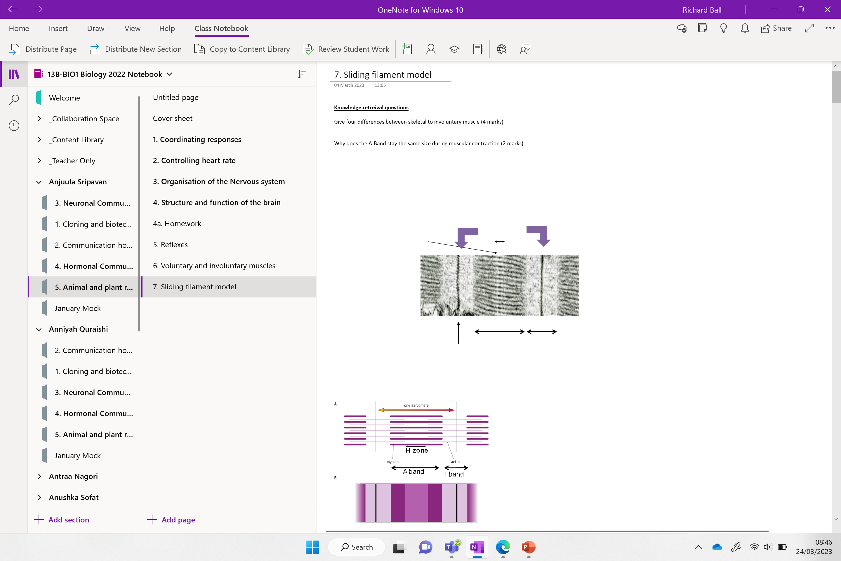

Slide 6
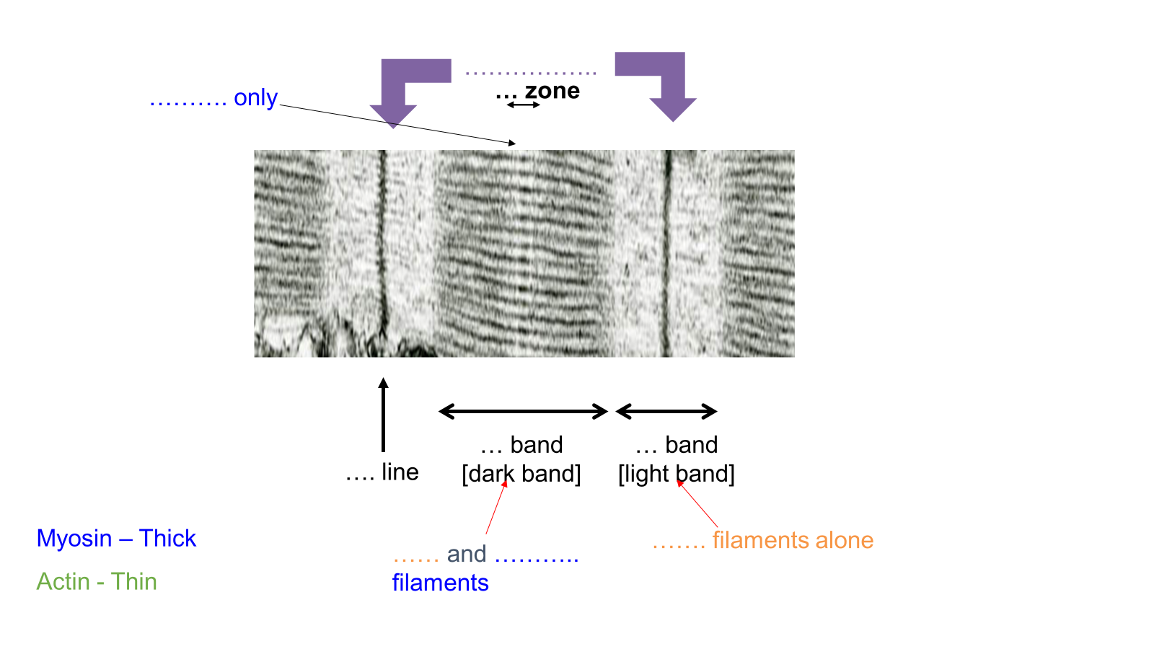
Knowledge retrieval question
Give four differences between skeletal and involuntary muscle (4 marks)
S: Striated In: non-striated
S: Conscious In: Involuntary
S: Contact in one direction In: Contract in different directions
S: Rapid contraction In: Slow contractions
S: Short duration of contraction In: Can remain contracted for long periods
Why does the A-Band stay the same size during muscular contraction (2 marks)
The A-Band contains thick myosin filaments
The length is unaffected by actin sliding across them

Slide 7
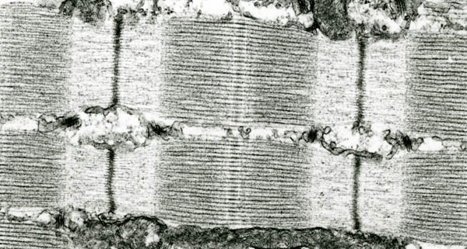
……………..
………. only
… zone
… band
[dark band]
… band
[light band]
…. line
Myosin – Thick
Actin - Thin
……. filaments alone
…… and ……….. filaments

Slide 8
Sarcomere
Myosin only
H zone
A band
[dark band]
I band
[light band]
Z line
Myosin – Thick
Actin - Thin
Actin and myosin filaments
Actin filaments alone

Slide 9
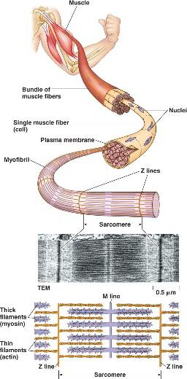
RECAP
The plasma membrane
The extensions of the plasma membrane that help transmit the impulse
The cytoplasm
The reticulum that is found in myofibrils
Sarcolemma
T tubules
Sarcoplasm
Sarcoplasmic reticulum

Slide 10
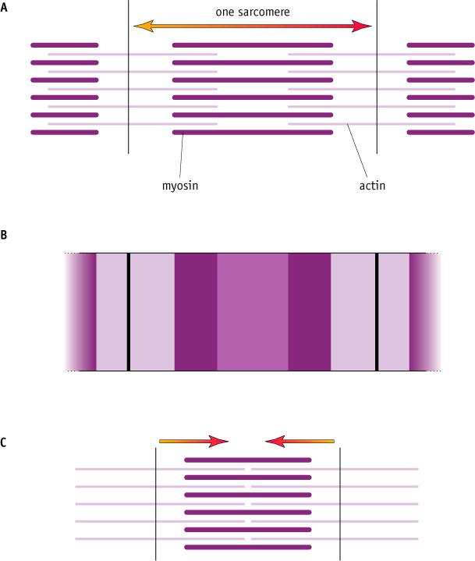
A relaxed (extended) sarcomere
Describe the change to the following:
Sarcomere
Z
A band
I band smaller
H zone disappears
H zone
A band
I band
Describe what has changed
A contracted sarcomere

Slide 11
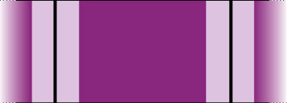
Z line, H zone, I band and A band during Contraction
I band
A band
Z line
H zone
Sarcomere smaller
Z lines closer
A band unchanged - no change in length of thick filaments
I band smaller - thin filaments pulled along myosin filaments to centre of sarcomere
H zone disappears - thin filaments pulled by thick filament into centre of sarcomere

Slide 12
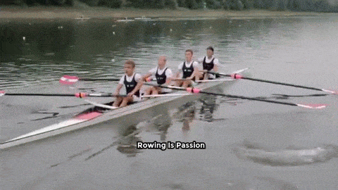

How do the actin side along the myosin?

Slide 13
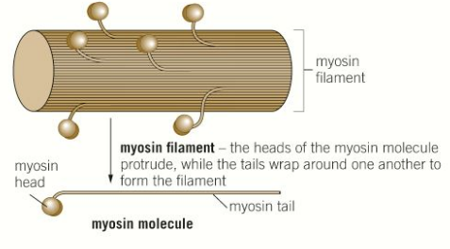

Slide 14
Structure of myosin
Contain globular heads that are hinged to allow them to move backwards and forwards.
The head of each myosin molecule protrudes, while the tails wrap around one another to form the filament.
On each head is a binding site for the actin and ATP.

Slide 15
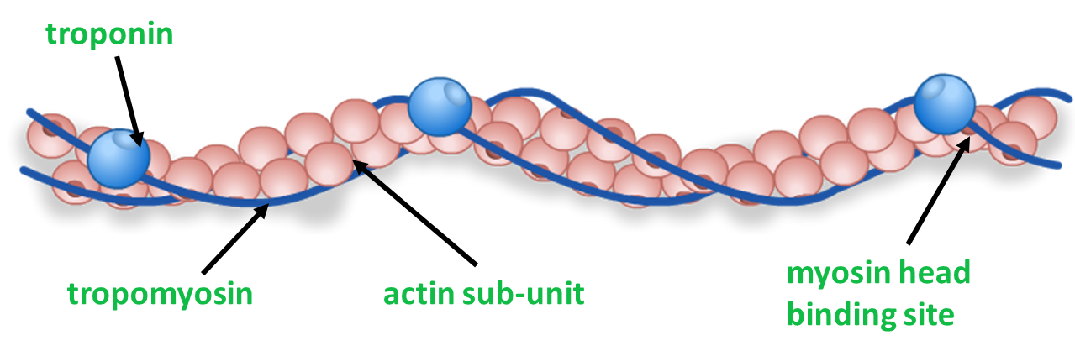
Structure of actin
At rest
Actin filaments have binding sites for myosin heads (actin-myosin binding sites).
At rest these binding sites are blocked by a protein called tropomyosin.
Tropomyosin is held in place by another protein called troponin.
This prevents the filaments from sliding past each other

Slide 16
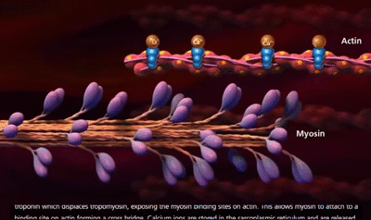
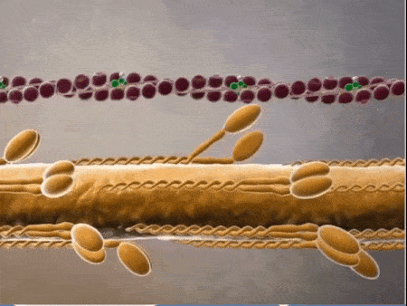
During contraction
The myosin heads form bonds with the actin filaments (known as the actin-myosin cross-bridge).
Once connected the myosin heads flex (change angle) in unison, pulling the actin filament along the myosin filament.
Using ATP the myosin then detach and return to their original angle.
Myosin then reattach further along the actin filament and the process occurs again. This repeats up to 100 times per second!

Slide 17
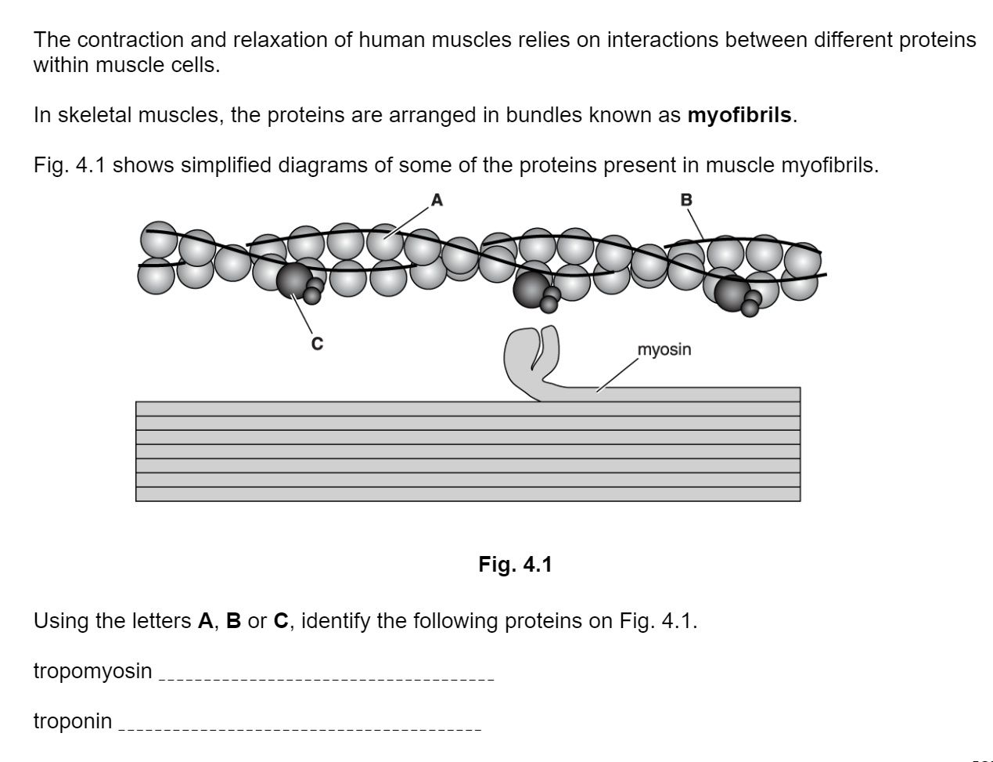
Try this!
Extension: What must A be?
A: Actin with myosin head binding site
B
C

Slide 18
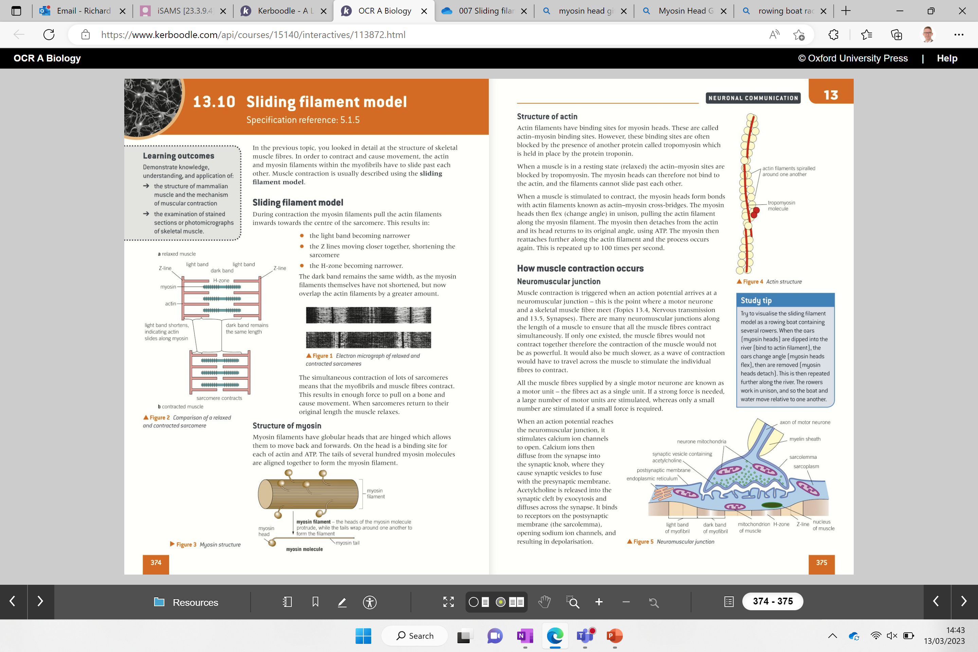
Stimulating muscle contraction

Slide 19
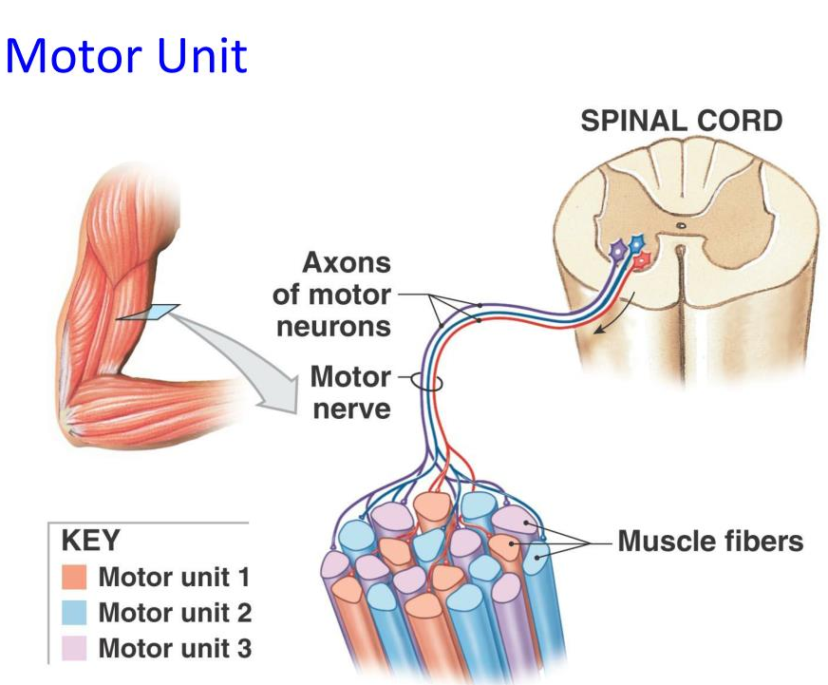
Stimulating muscle contraction
Numerous muscle fibres can be stimulated by one motor neurone.
This is known as a motor unit.
If a strong force is needed, a large number of motor units are stimulated.

Slide 20
Stop at T-tubules in clip
Watch the video and try to fill in the gaps

Slide 21
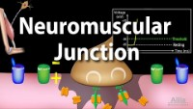

Slide 22
Stimulating muscle contraction
Muscle contraction is triggered when the ………… …………… arrives at the neuromuscular junction. (motor neurone meets the ………… muscle fibre).
There are numerous neuromuscular junctions along the length of a muscle to ensure that all the muscle fibres contract ……………………….
The AP reaches the neuromuscular junction and causes ………… ions channels to open.
Calcium ions then …………. into the …………. knob, where they cause synaptic ………… to fuse with the presynaptic membrane.
Acetylcholine is released into the synaptic ……… by ……………. and diffuse across the synapse.
ACh binds to the …………… (nicotinic) on the postsynaptic membrane (the sarcolemma), opening ………….. ion channels, resulting in ………………….
ACh is then broken down by ……………………… into ………….. and ethanoic acid. This prevents the muscle from being overstimulated.
……………. and ethanoic acid diffuse back into the neurone and are recombined into ACh using …….. .

Slide 23
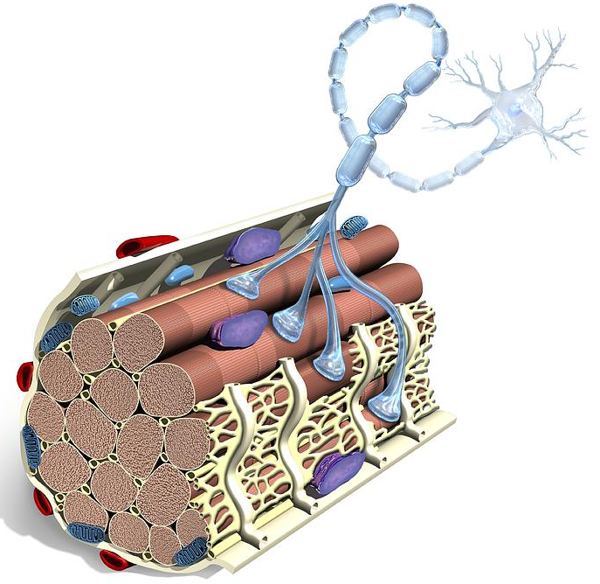
Stimulating muscle contraction
Muscle contraction is triggered when the action potential arrives at the neuromuscular junction. (motor neurone meets the skeletal muscle fibre).
There are numerous neuromuscular junctions along the length of a muscle to ensure that all the muscle fibres contract simultaneously.
The AP reaches the neuromuscular junction and causes calcium ions channels to open.
Calcium ions then diffuse into the pre-synaptic knob, where they cause synaptic vesicles to fuse with the presynaptic membrane.
Acetylcholine is released into the synaptic cleft by exocytosis and diffuse across the synapse.
ACh binds to the receptors (nicotinic) on the postsynaptic membrane (the sarcolemma), opening sodium ion channels, resulting in depolarisation of the muscle fibre.
ACh is then broken down by acetylcholinesterase into choline and ethanoic acid. This prevents the muscle from being overstimulated.
Choline and ethanoic acid diffuse back into the neurone and are recombined into ACh using ATP.
Notes:
Ligand ion channels – open when a chemical binds to them
Voltage gated ion channels open when the membrane depolarises

Slide 24
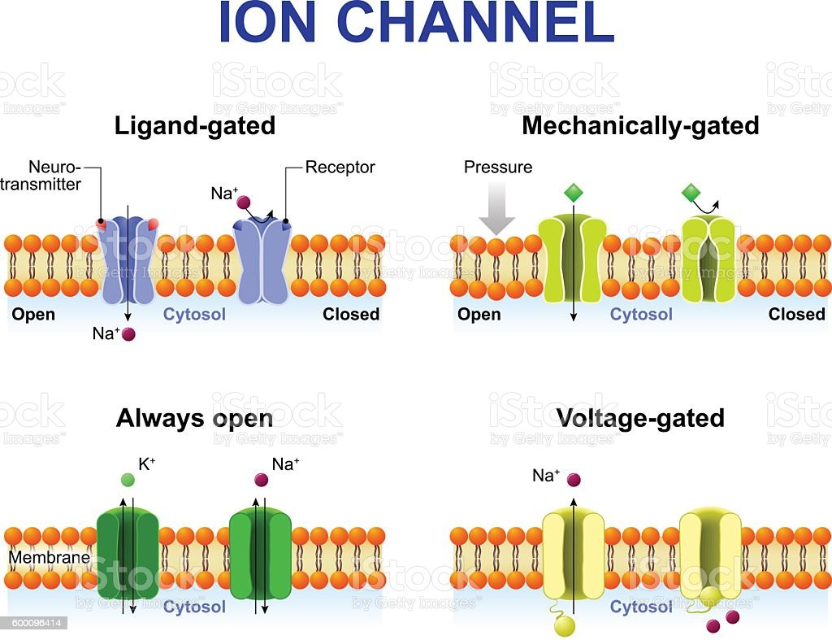
Ion channels
Ligand-gated : open when a ……………………. attaches (Ach receptors)
Voltage-gated : Open when the ………………….. (during an action potential)
Stretch-mediated (mechanically-gated) ion channels : Open …………………. (in the Pacinian corpuscle)

Slide 25
Ion channels
Ligand-gated : open when a chemical messenger attaches (Ach receptors)
Voltage-gated : Open when the membrane depolarises (during an action potential)
Stretch-mediated (mechanically-gated) ion channels : Open when stretched (in the Pacinian corpuscle)

Slide 26
NL below
Exam questions print to start

Slide 27
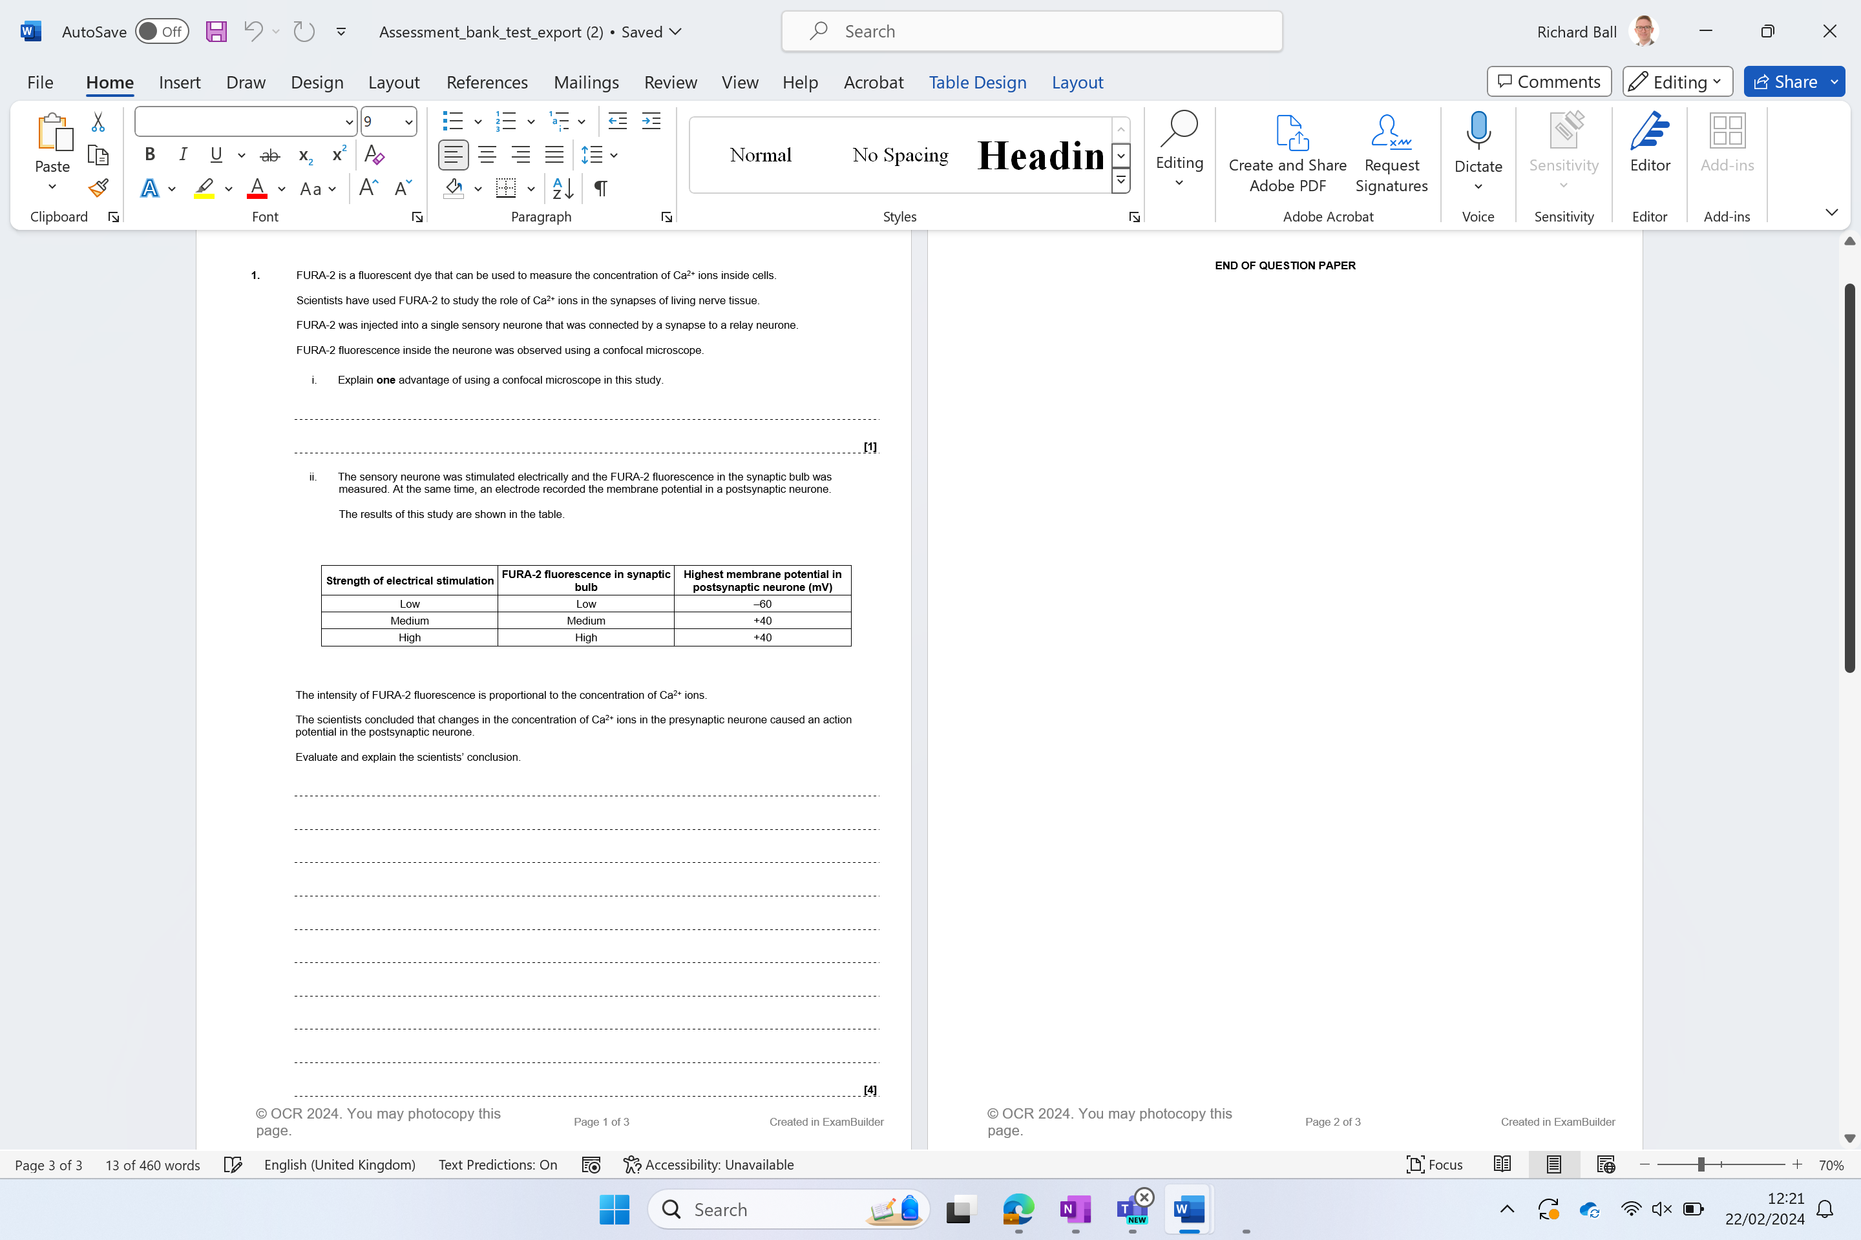
Independent exam question
You have 6 minutes
Start straight away
(5 marks total)
EVALUATE – VALID AND NOT VALID

Slide 28
1) i. can be used with , living cells / high resolution
ii. EVALUATE – VALID AND NOT VALID
conclusion may be valid because:
1 concentration of Ca²⁺ is proportional to strength of stimulus ✓
2 Ca²⁺ change from low to , medium / high , causes increase in (membrane) potential ✓
3 Action potential in , presynaptic neurone, leads to , opening of Ca²⁺ channels / entry of Ca²⁺ ✓
4 Ca²⁺ , causes release of (named) neurotransmitter ✓
5 (named) neurotransmitter causes , Na⁺ sodium ion channels to open in (post-synaptic) neurone ✓
6 If threshold is exceeded this causes , action potential in (postsynaptic) neurone / depolarises (postsynaptic) membrane ✓
conclusion may not be valid because:
7 changes in Ca²⁺ concentration may not be the cause of (postsynaptic) action potential ✓
8 Ca²⁺ change from medium to high but no change in (membrane) potential ✓

Slide 29
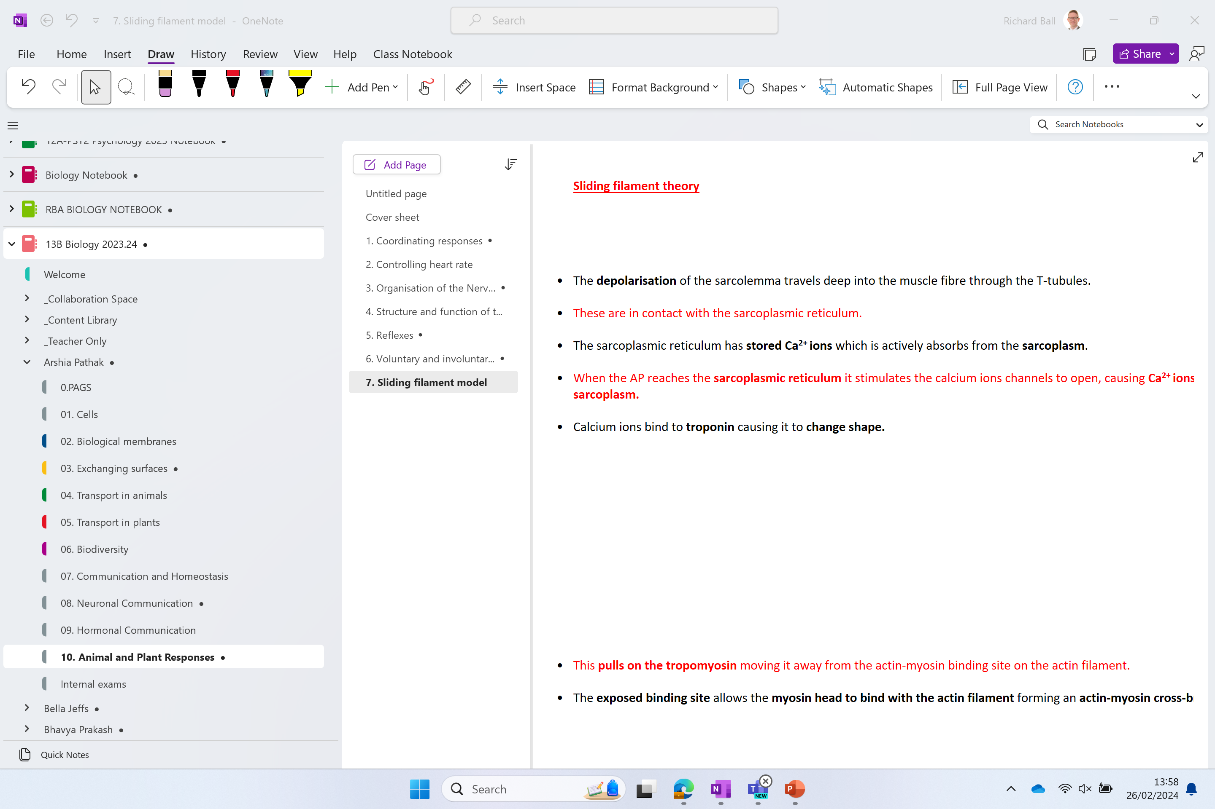

Slide 30
RECAP!!
Muscle contraction is triggered when the action potential arrives at the neuromuscular junction. (motor neurone meets the skeletal muscle fibre).
There are numerous neuromuscular junctions along the length of a muscle to ensure that all the muscle fibres contract simultaneously.
The AP reaches the neuromuscular junction and causes calcium ions channels to open.
Calcium ions then diffuse into the pre-synaptic knob, where they cause synaptic vesicles to fuse with the presynaptic membrane.
Acetylcholine is released into the synaptic cleft by exocytosis and diffuse across the synapse.
ACh binds to the receptors (nicotinic) on the postsynaptic membrane (the sarcolemma), opening sodium ion channels, resulting in depolarisation of the muscle fibre.
Notes:
Ligand ion channels – open when a chemical binds to them
Voltage gated ion channels open when the membrane depolarises

Slide 31
RECAP

Slide 32
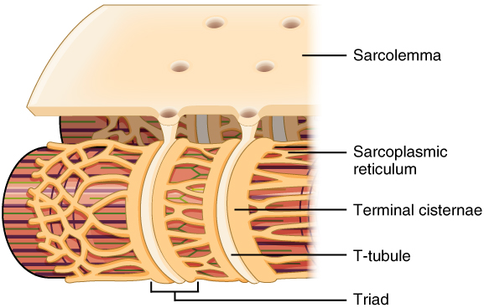
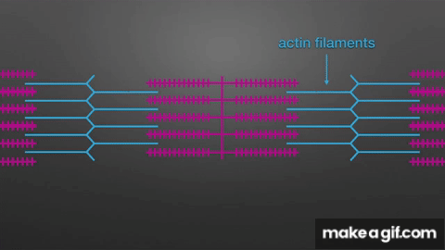
The depolarisation of the sarcolemma travels deep into the muscle fibre through the T-tubules.
These are in contact with the sarcoplasmic reticulum.
The sarcoplasmic reticulum has stored Ca²⁺ ions which are actively absorbs from the sarcoplasm.
When the AP reaches the sarcoplasmic reticulum it stimulates the calcium ions channels to open, causing Ca²⁺ ions to diffuse out into the sarcoplasm.
Calcium ions bind to troponin causing it to change shape.

Slide 34
2:40 start
Neuromuscular Junction, Animation - YouTube

Slide 35
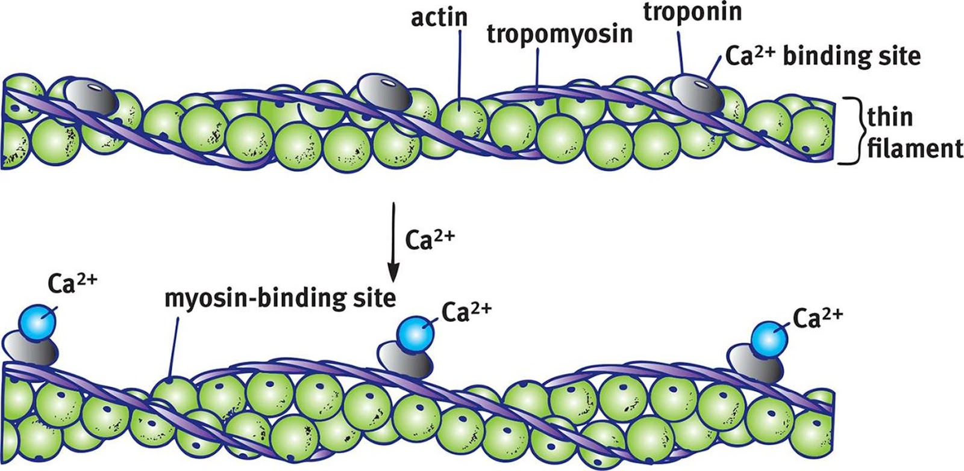
This pulls on the tropomyosin moving it away from the actin-myosin binding site on the actin filament.
The exposed binding site allows the myosin head to bind with the actin filament forming an actin-myosin cross-bridge.

Slide 36
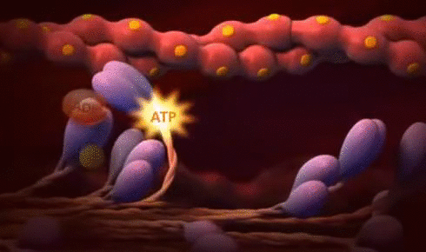
The myosin heads (once attached) now flex, pulling the actin filament along.
Next, a molecule of ADP already bound to the myosin head is released.
It is replaced by an ATP molecule, which causes the myosin head to detach from the actin filament.

Slide 37
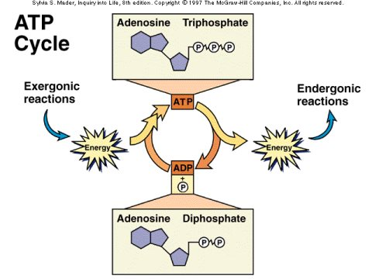
The calcium ions present in the sarcoplasm also activate ATPase. This hydrolyses ATP into ADP and phosphate.
Muscles require large amounts of energy to contract. The energy released during this allows the myosin head to returns to its original position.
The energy is also used by the sarcoplasmic reticulum to actively reabsorb calcium ions from the sarcoplasm (storage).

Slide 38
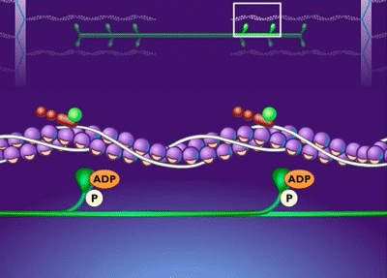
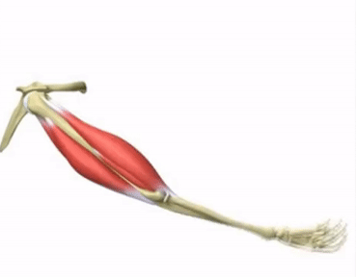
The myosin head can now attach itself to another actin-myosin binding site further along the actin filament and the cycle is repeated.
The cycle continues as long as the muscle is stimulated, shortening the sarcomere and contracting the muscle.

Slide 39
Muscle Contraction - Cross Bridge Cycle, Animation. - YouTube

Slide 40
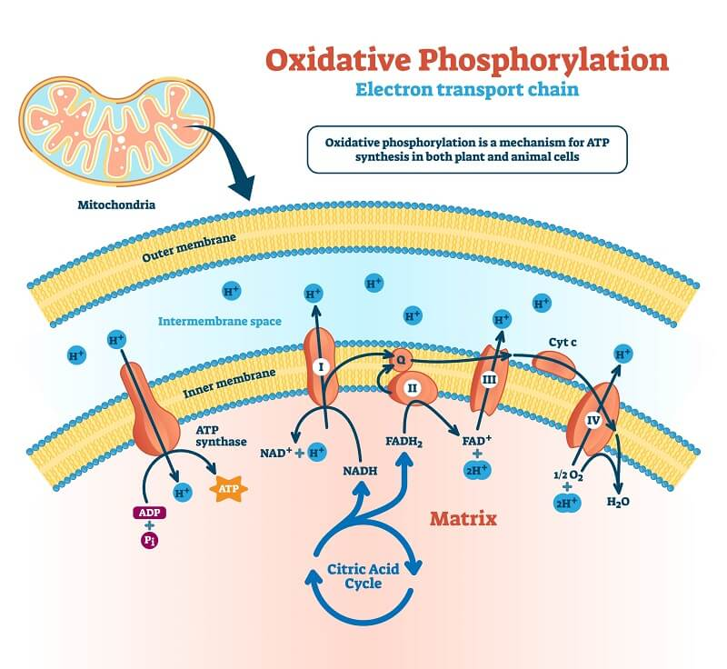
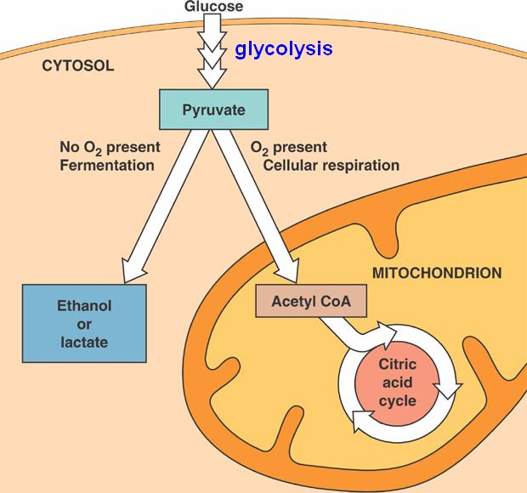
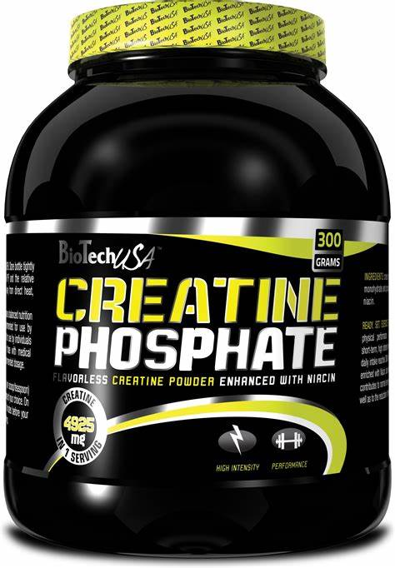
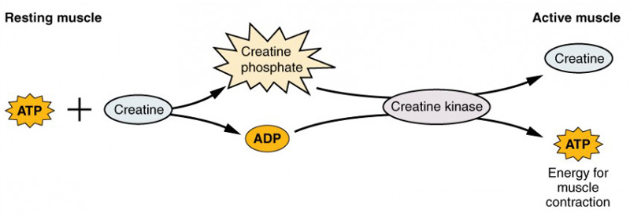
ATP generation

Slide 41
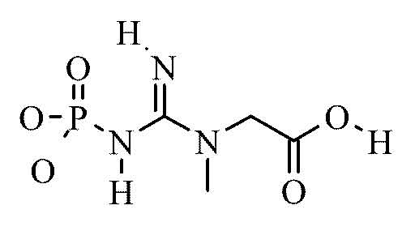
ATP generation
Aerobic respiration
ATP is generated by ADP during o…………………. p…………………. in the mitochondria.
Used for l…….. periods of l……..- i……………. exercise .
Anaerobic respiration
ATP is generated by g……………. in the sarcoplasm. But, as no oxygen is present the p……………. which is also produced is converted in to l……….. a………...
Used for s………… periods of h………. intensity exercise
Creatine phosphate
Creatine phosphate is a chemical stored in m………….. .
To generate ATP, ADP is p……………………. (phosphate group is added). The creatine phosphate provides a reserve of p……………… for this.
This rapidly converts A……… into ATP.
The reserves are quickly used up (10 seconds), so this is used for s………. burst of h………. intensity exercise.
When the muscle is r……………. the reserves of creatine phosphate are replenished.

Slide 42
ATP generation
Aerobic respiration
ATP is generated by ADP during oxidative phosphorylation in the mitochondria.
Used for long periods of low-intensity exercise .
Anaerobic respiration
ATP is generated by glycolysis in the sarcoplasm. But, as no oxygen is present the pyruvate which is also produced is converted into lactic acid.
Used for short periods of high intensity exercise
Creatine phosphate
Creatine phosphate is a chemical stored in muscle.
To generate ATP, ADP is phosphorylated (phosphate group is added). The creatine phosphate provides a reserve of phosphate for this.
This rapidly converts ADP into ATP.
The reserves are quickly used up (10 seconds), so this is used for short burst of high intensity exercise.
When the muscle is relaxed the reserves of creatine phosphate are replenished.

Slide 43
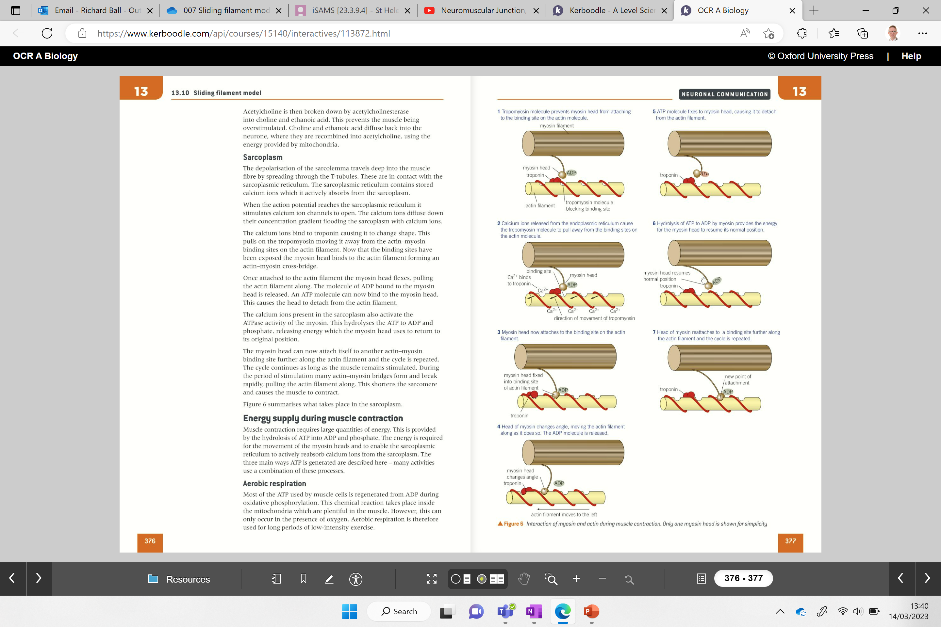
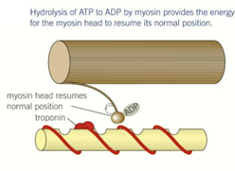
Arrange images into the correct order

Slide 44
Arrange images into the correct order

Slide 45
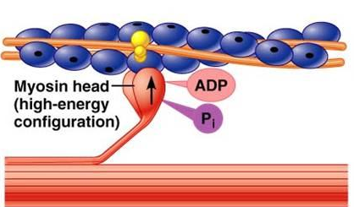
Rigor Mortis
After death the body becomes stiff in a condition called rigor mortis. What causes rigor mortis? (think of the actin myosin cross bridge)
Why does it occur?
ATP is required to break the cross bridge between actin and myosin.
The bridges remain firm and the body stiff.
Notes:
Latin – rigor = stiff
Mortis = death

Slide 46
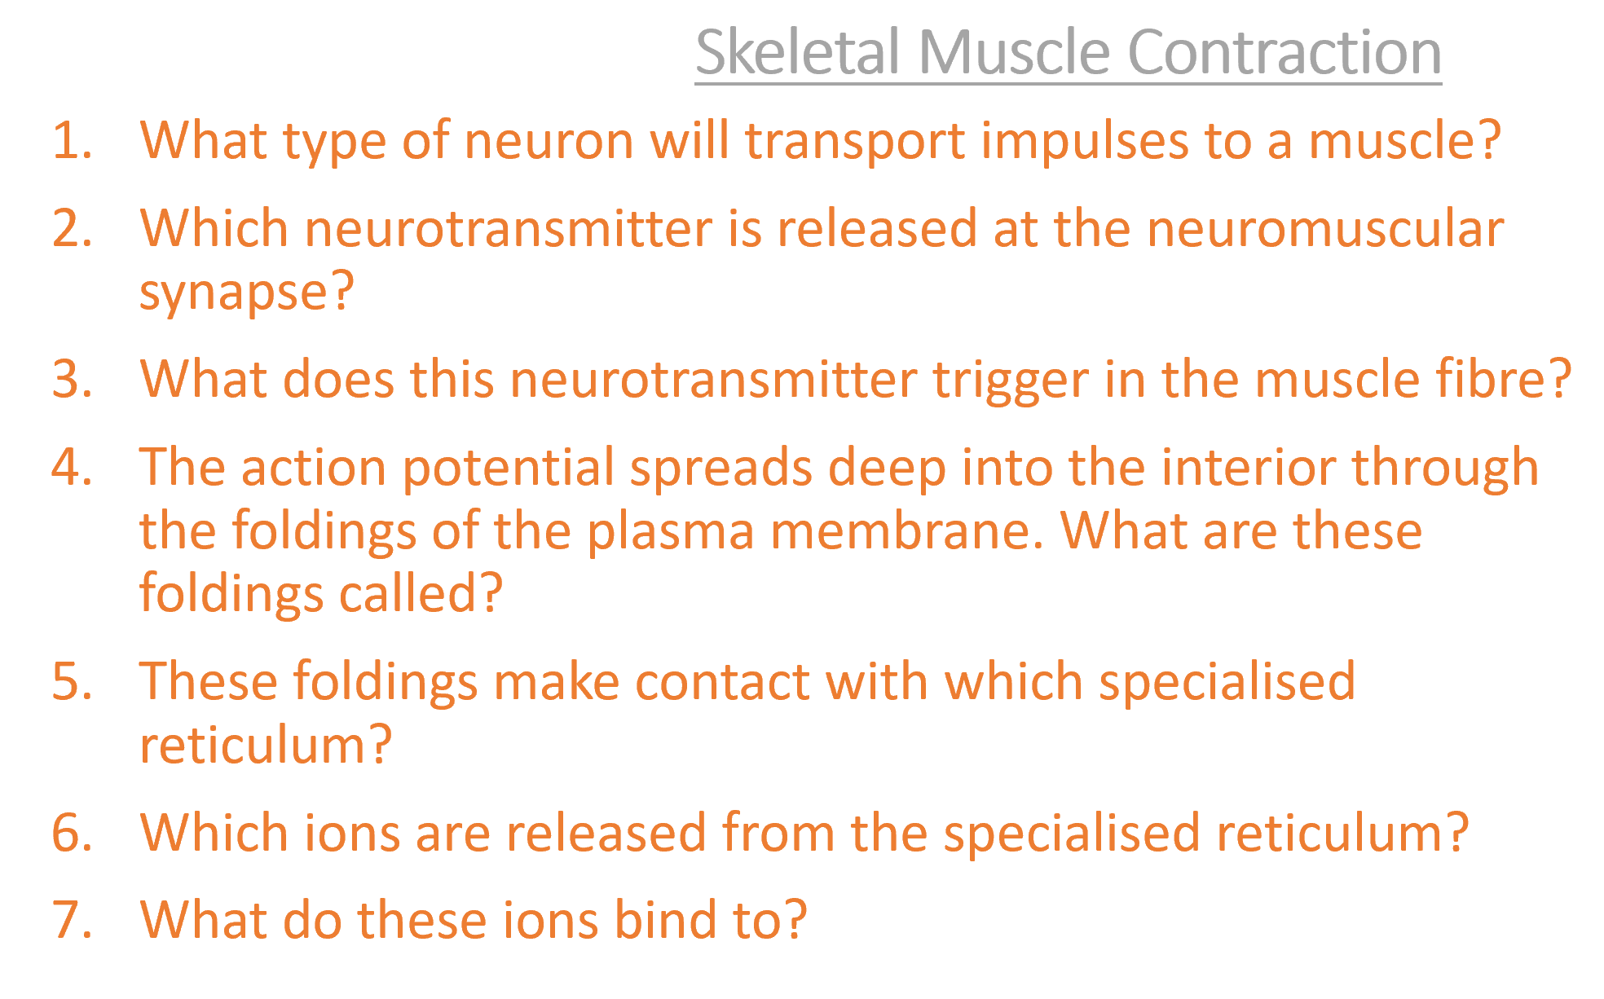
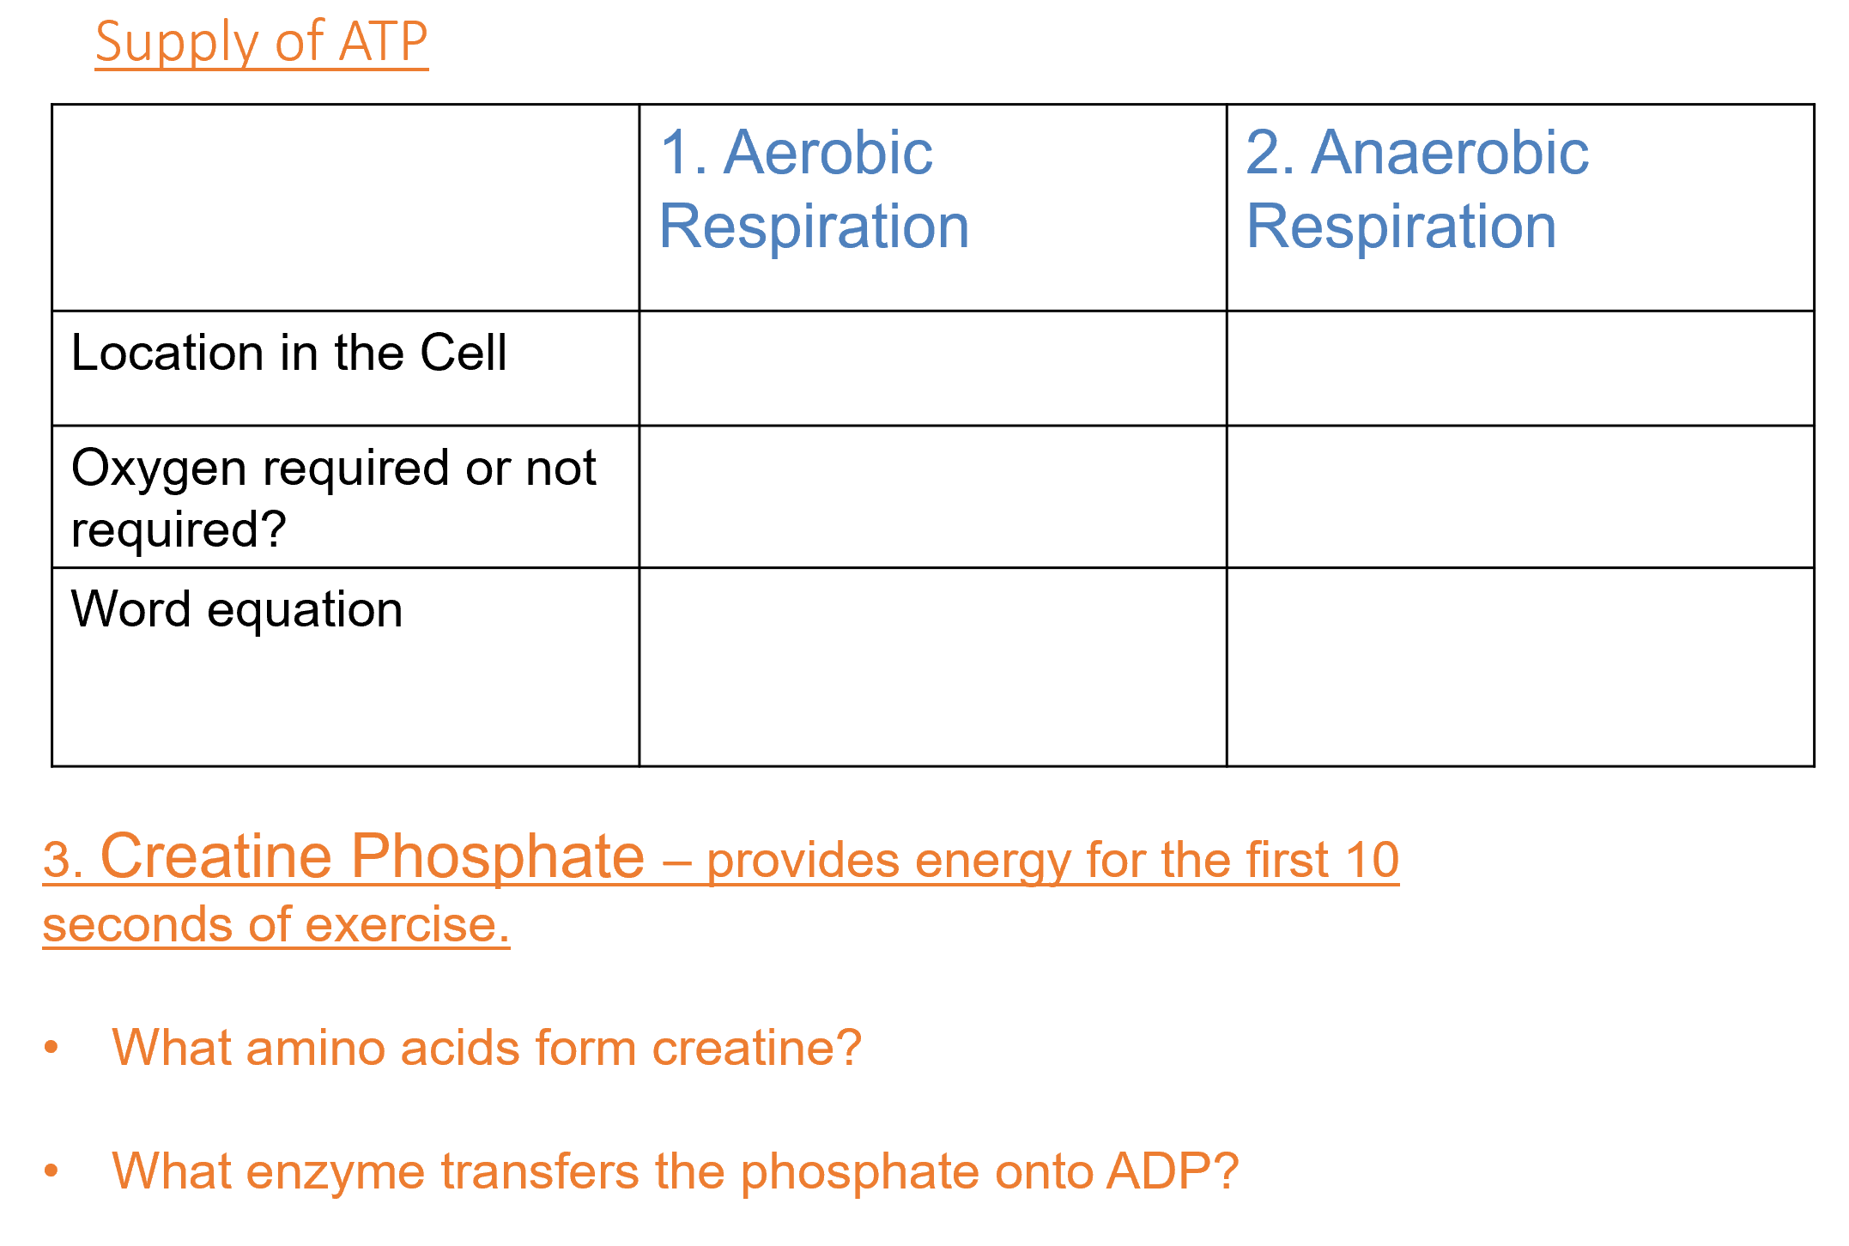
Extension: Complete the additional questions

Slide 47
Skeletal Muscle Contraction
What type of neuron will transport impulses to a muscle?
Which neurotransmitter is released at the neuromuscular synapse?
What does this neurotransmitter trigger in the muscle fibre?
The action potential spreads deep into the interior through the foldings of the plasma membrane. What are these foldings called?
These foldings make contact with which specialised reticulum?
Which ions are released from the specialised reticulum?
What do these ions bind to?
Motor neuron
Acetylcholine
Action potential
Transverse tubules
Sarcoplasmic reticulum
Ca²⁺
Toponin complex
http://www.youtube.com/watch?v=CepeYFvqmk4

Slide 48
Supply of ATP
 | 1. Aerobic Respiration | 2. Anaerobic Respiration
Location in the Cell
Oxygen required or not required?
Word equation
mitochondria
sarcoplasm
required
not required
glucose + oxygen → carbon dioxide + water + ATP
glucose →lactic acid + ATP
3. Creatine Phosphate – provides energy for the first 10 seconds of exercise.
What amino acids form creatine?
What enzyme transfers the phosphate onto ADP?
arginine, glycine and methionine.
creatine phosphotransferase.

Slide 49
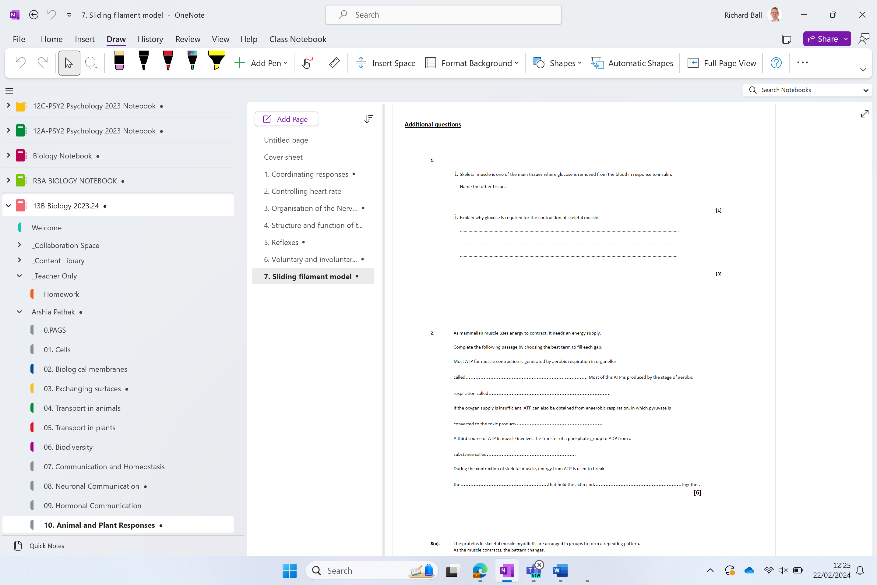
Additional questions

