Slide 1
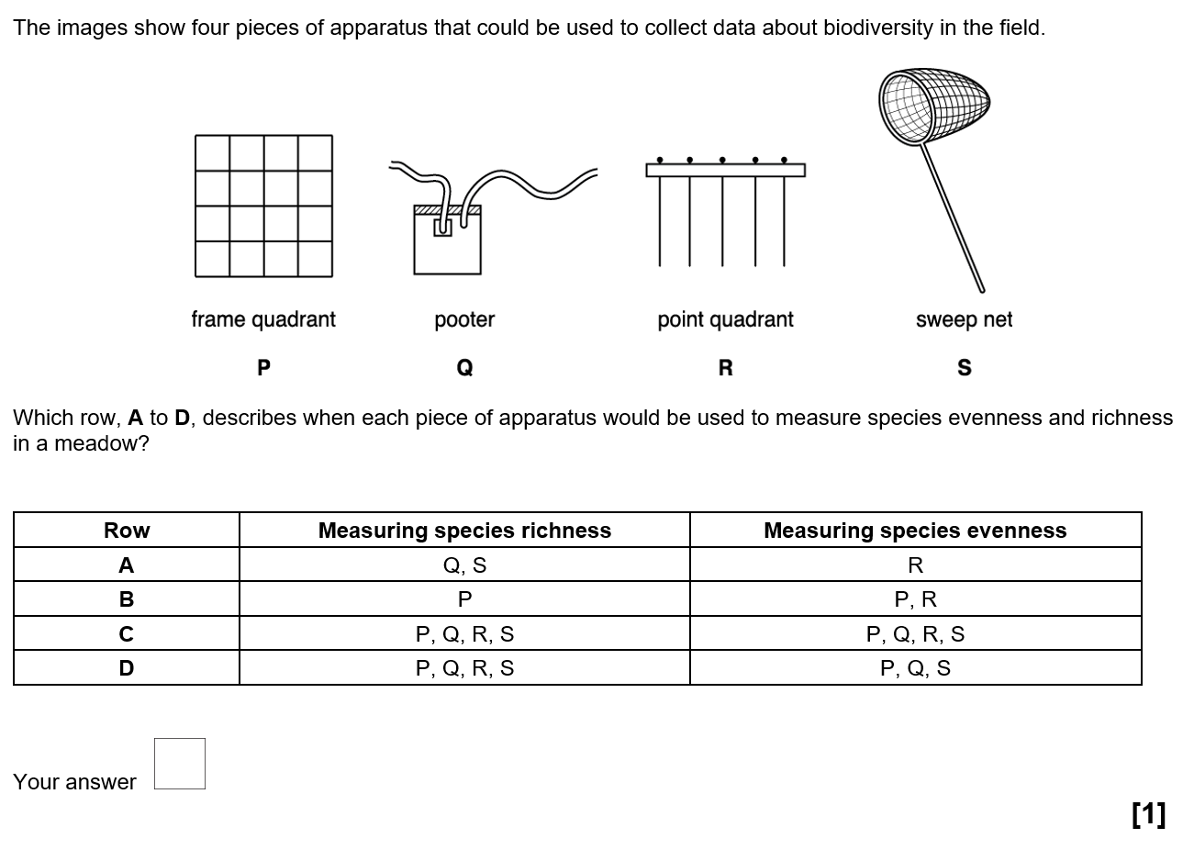
Knowledge retrieval questions
C

Slide 2
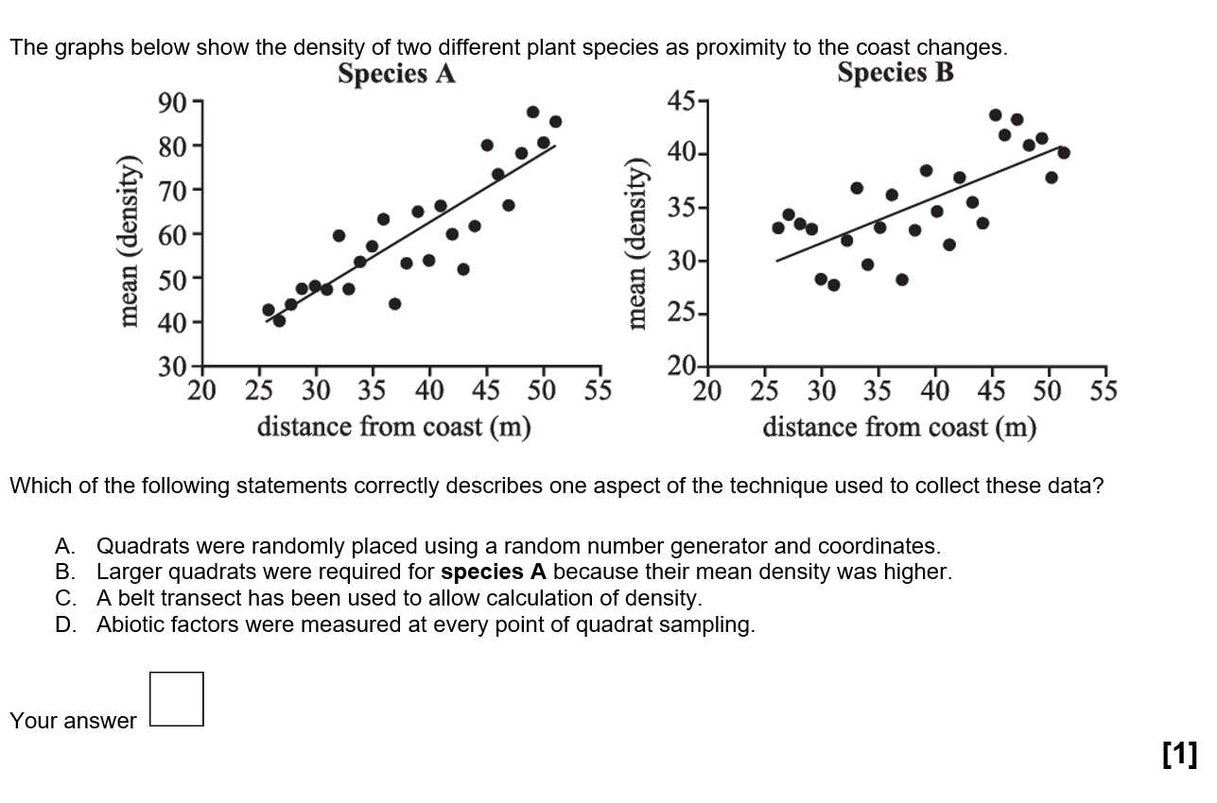
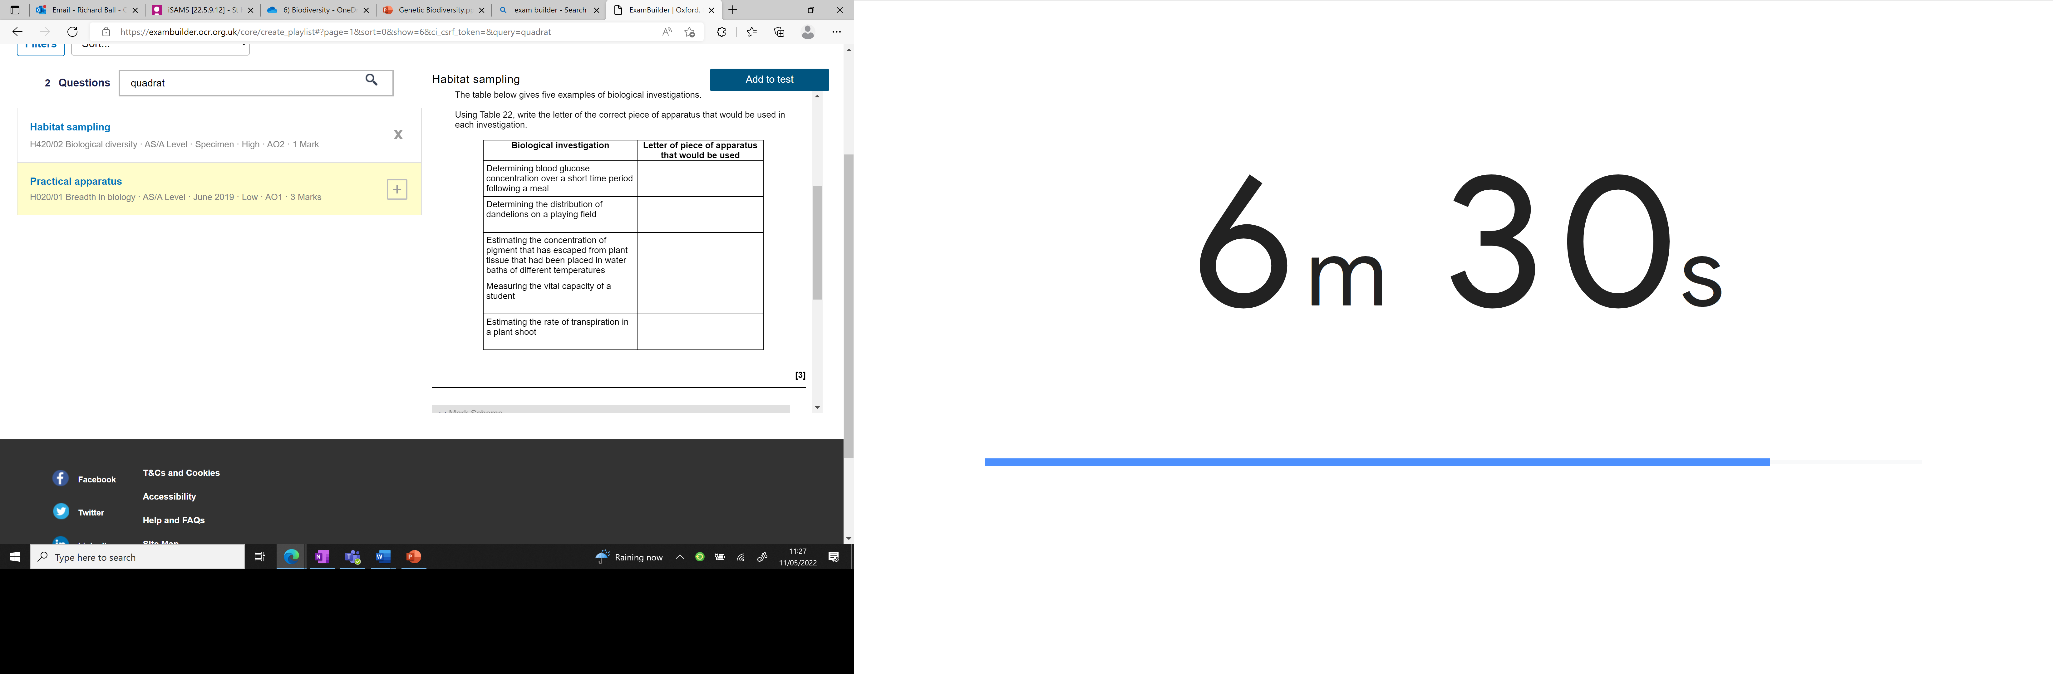

Knowledge retrieval questions
Complete the table with the equipment used in the investigation:
Biosensor
Quadrat
Colorimeter
Spirometer
C
Potometer

Slide 3
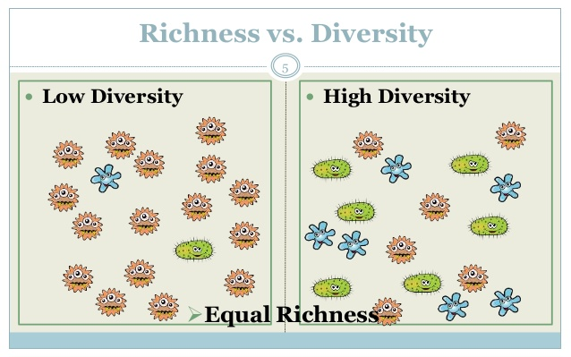
Species richness and Species evenness
Area 1
Area 2
Compare the species richness and species evenness in both areas (3 marks)
Equal species richness
Area 2 greater species evenness
Area 1 dominated by one species

Slide 4
Calculating diversity
Biodiversity accounts for species evenness as well as species richness.
Simpson’s index of diversity gives us a way to quantitatively compare the biodiversity of different habitats
This takes richness and evenness into account

Slide 5
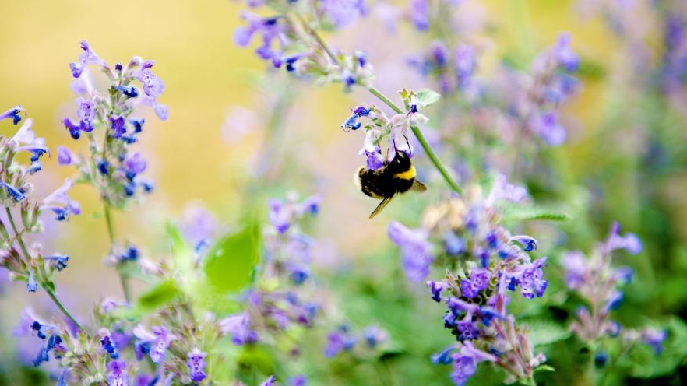
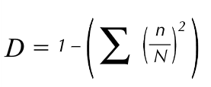
Simpson’s Index of Diversity

Slide 6

Simpsons Index of Diversity
Total number of organisms in one species
Total number of all organisms
(sigma) Sum of (add together)

Slide 7
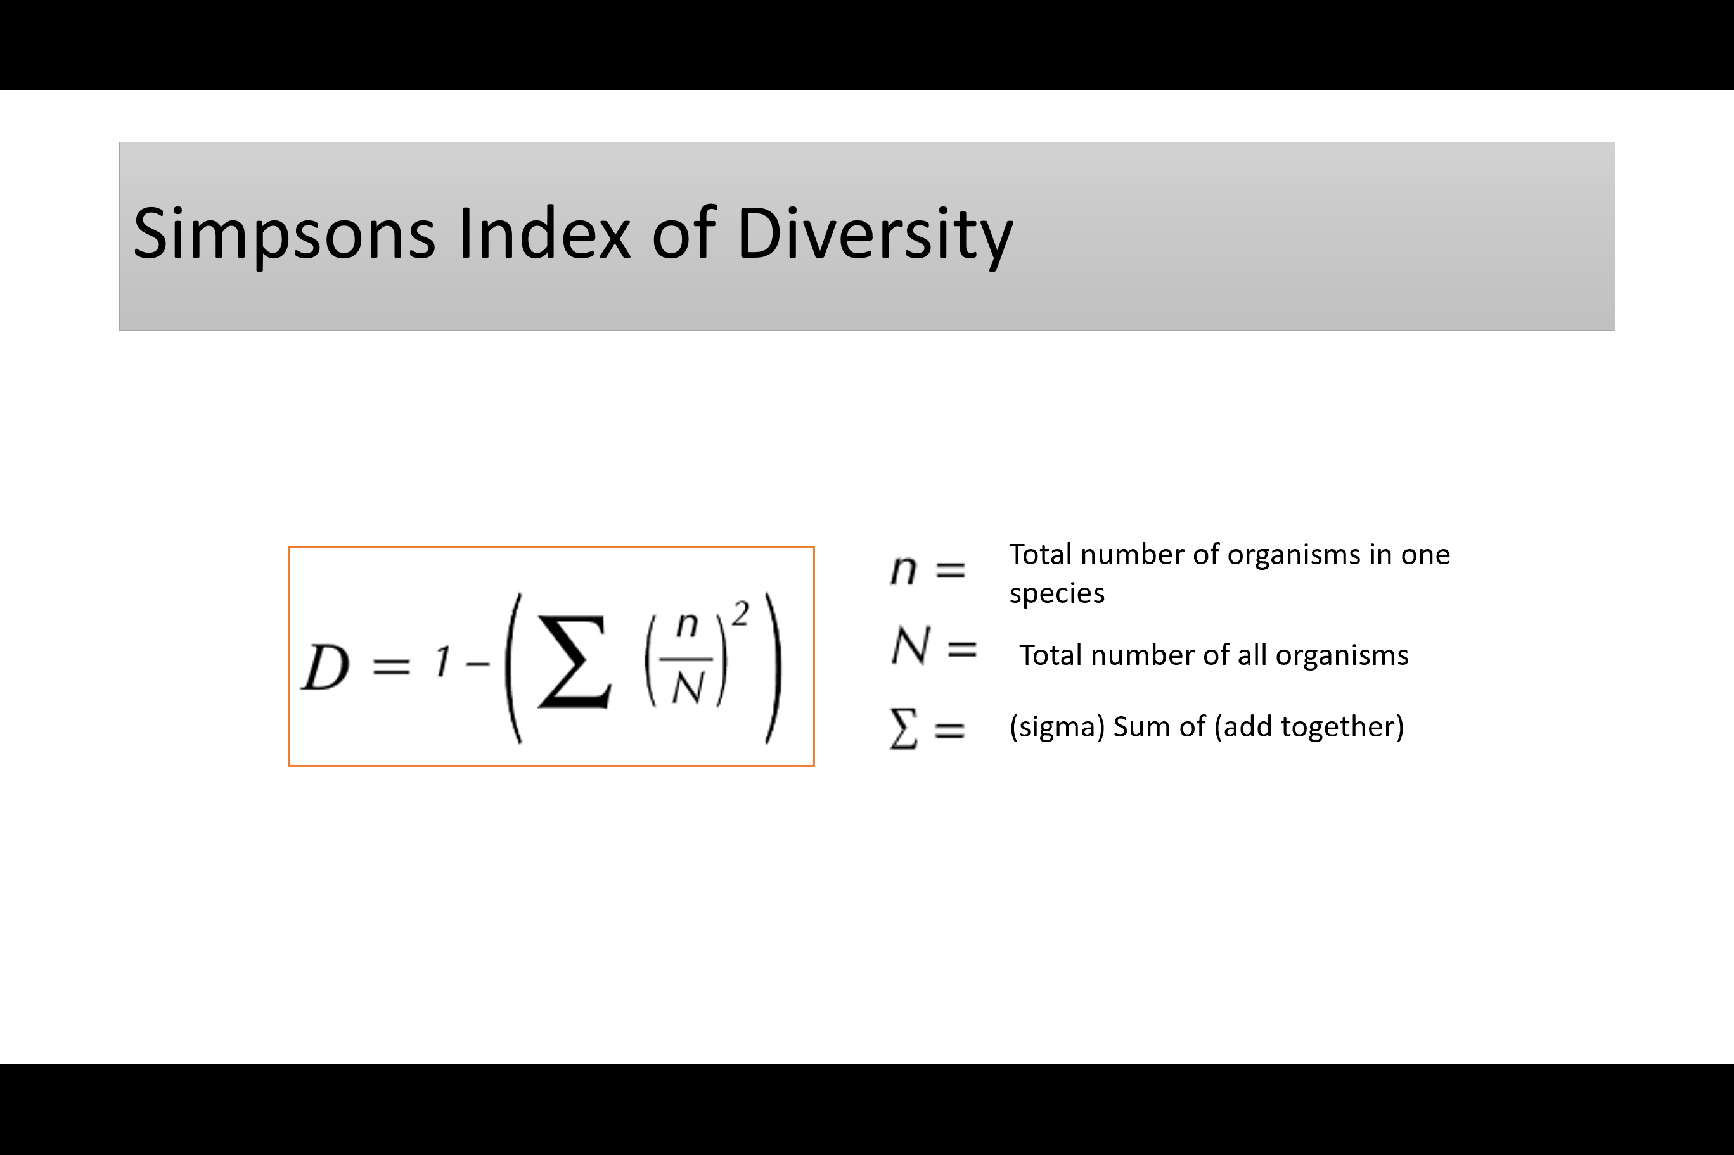
Calculate the biodiversity of both habitats using Simpsons index (4 marks)
Exam tips
If your answer is not between 0 and 1 then you have done something wrong!
First picture
n = 1, 1, 15
N = 17
Σ(n/N)² = 0.0035 + 0.0035 + 0.78
= 0.79 2sf
1 – 0.79 = 0.21 on the Simpsons index
Second picture (you try)
n = 6, 6, 6
N = 18
Σ(n/N)² = 0.11 + 0.11 + 0.11
= 0.33
1 – 0.33 = 0.67 on the SI

Slide 8
Simpsons Index of Diversity
Interpreting results
Always get a value between 0 and 1
High value (Closer to 1) = more diverse, can usually cope with change
Low value ( close to 0 ) = less stable and easily damaged by change

Slide 9
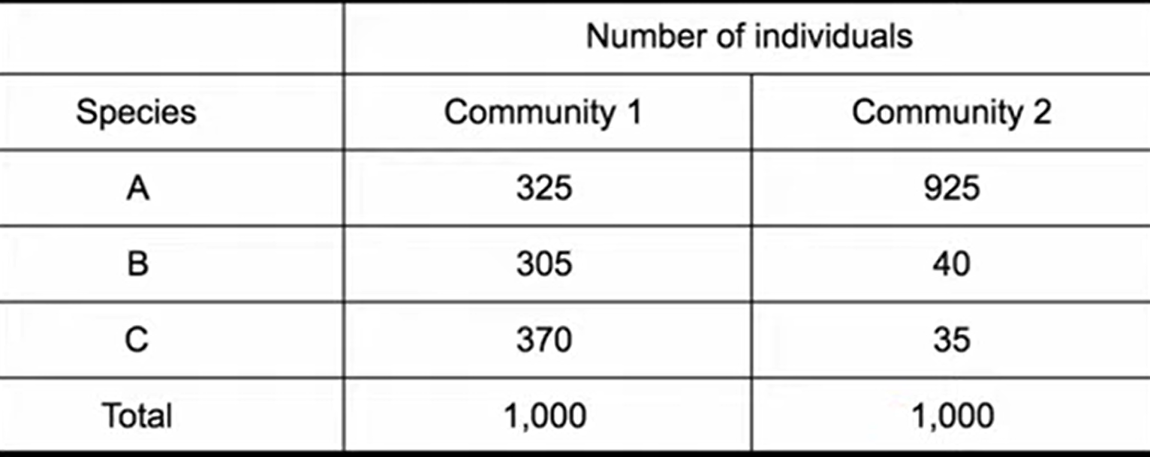
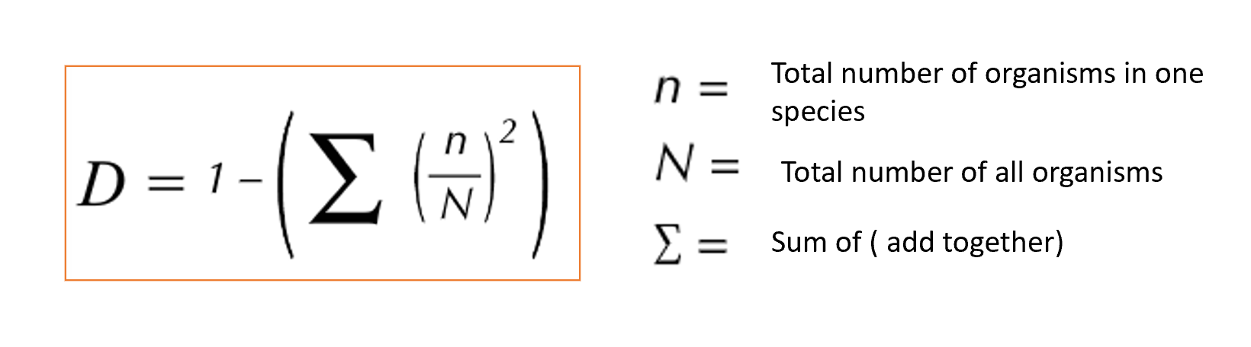
Before you start make a prediction which is likely to give a higher value and why
Calculate the Simpsons Index for both communities.
Community 1 D = 1 – (($\frac{325}{1000})2+\text{(}\frac{305}{1000})2$ + ($\frac{370}{1000})2$) = 0.664
Community 2 D = 1 – (($\frac{925}{1000})2+\text{(}\frac{40}{1000})2$ + ($\frac{35}{1000})2$) = 0.142
Community 1 has a higher biodiversity

Slide 11
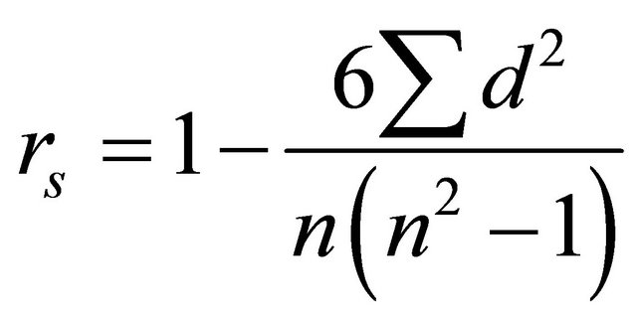
Spearman's rank
Spearman’s rank correlation measures the strength and direction of association between two ranked variables.
Sum of the differences squared
Spearman's rank correlation coefficient
n is the number of sets of results

Slide 12
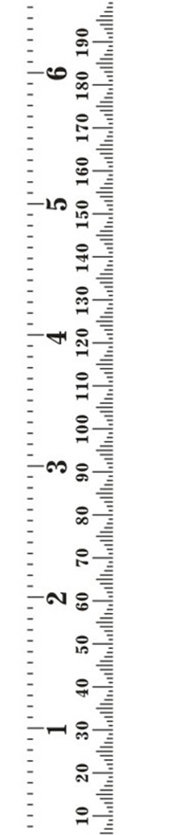
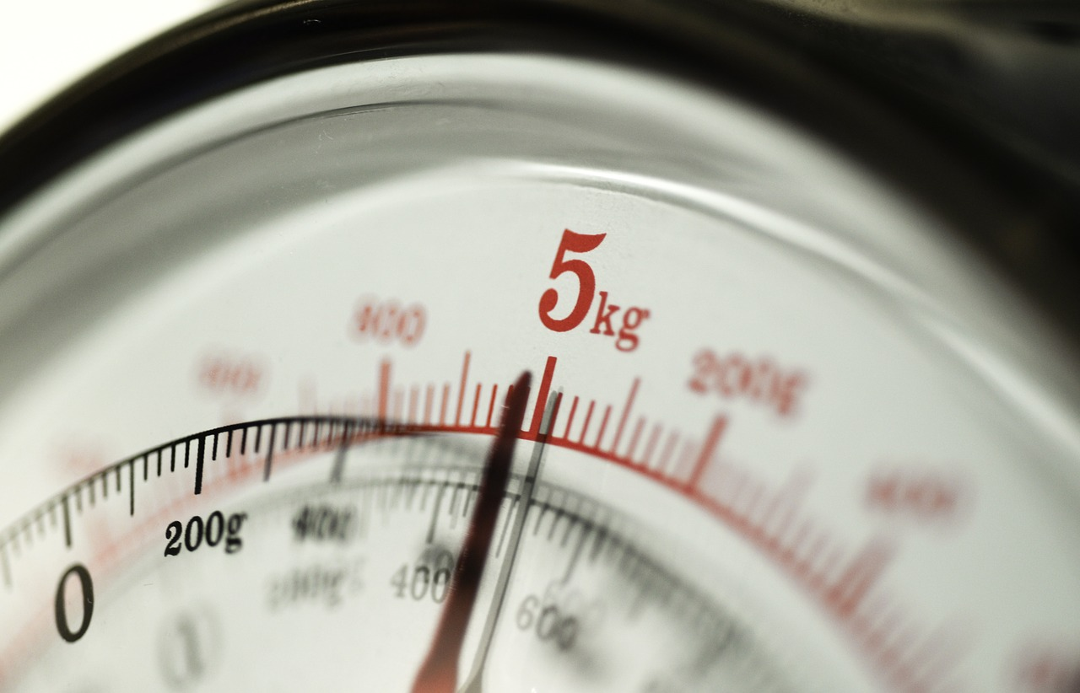
Null hypothesis:
There is no correlation between the height of year 12 students and their masses
Height (cm) | Mass (kg)
170 | 72
172 | 72
174 | 73
193 | 85
169 | 71
180 | 77
192 | 84
177 | 74
183 | 79
171 | 70
Notes:
A null hypothesis acts as a starting point because the statement is accepted as true in the absence of additional information.

Slide 13
Rank the heights and masses (any equal values get the same rank half way between the two ranks)
Calculate the difference in ranks
Square the difference in ranks
Find the sum of d²
Height (cm) | Rank of height | Mass (Kg) | Rank of mass | Difference in ranks (D) | d²
170 |  | 72
172 |  | 72
174 |  | 73
193 |  | 85
169 |  | 71
180 |  | 77
192 |  | 84
177 |  | 74
183 |  | 79
171 |  | 70
9
7
6
7.5
7.5
6
1.5
-0.5
0.0
2.25
0.25
0.00
1
10
4
1
9
4
0.0
1.0
0.0
0.00
1.00
0.00
2
5
2
5
0.0
0.0
0.00
0.00
3
8
3
10
0.0
-2.0
0.00
4.00
: 7.5
is the sum of d²

Slide 14
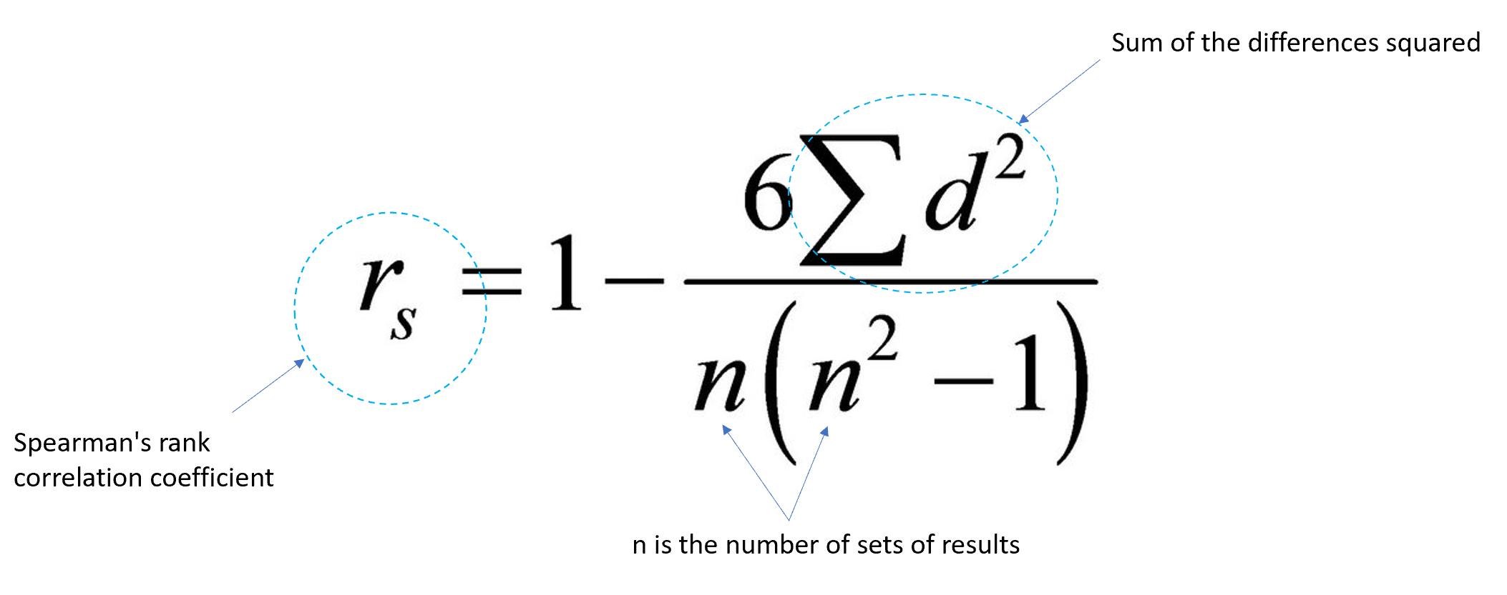











: 7.5
is the sum of d²
Calculating Spearman’s rank
We had 10 sets of results
Try to calculate Spearman's rank using the data and formula:

Slide 15
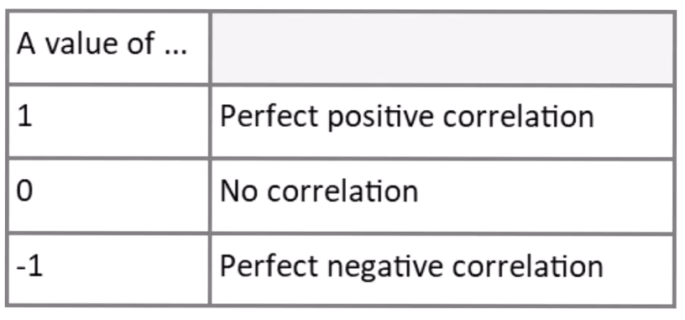
What does 0.955 tell us?
A Spearman's rank value will always be between -1 and 1
As one variable increases so does the other variable
As one variable increases the other decreases
A value of 0.955 indicates and almost perfect positive correlation.
BUT……..
Not all values are as close to perfect as this one.
So when they are not close to either perfect correlation we need to find out if they are significant or not.

Slide 16
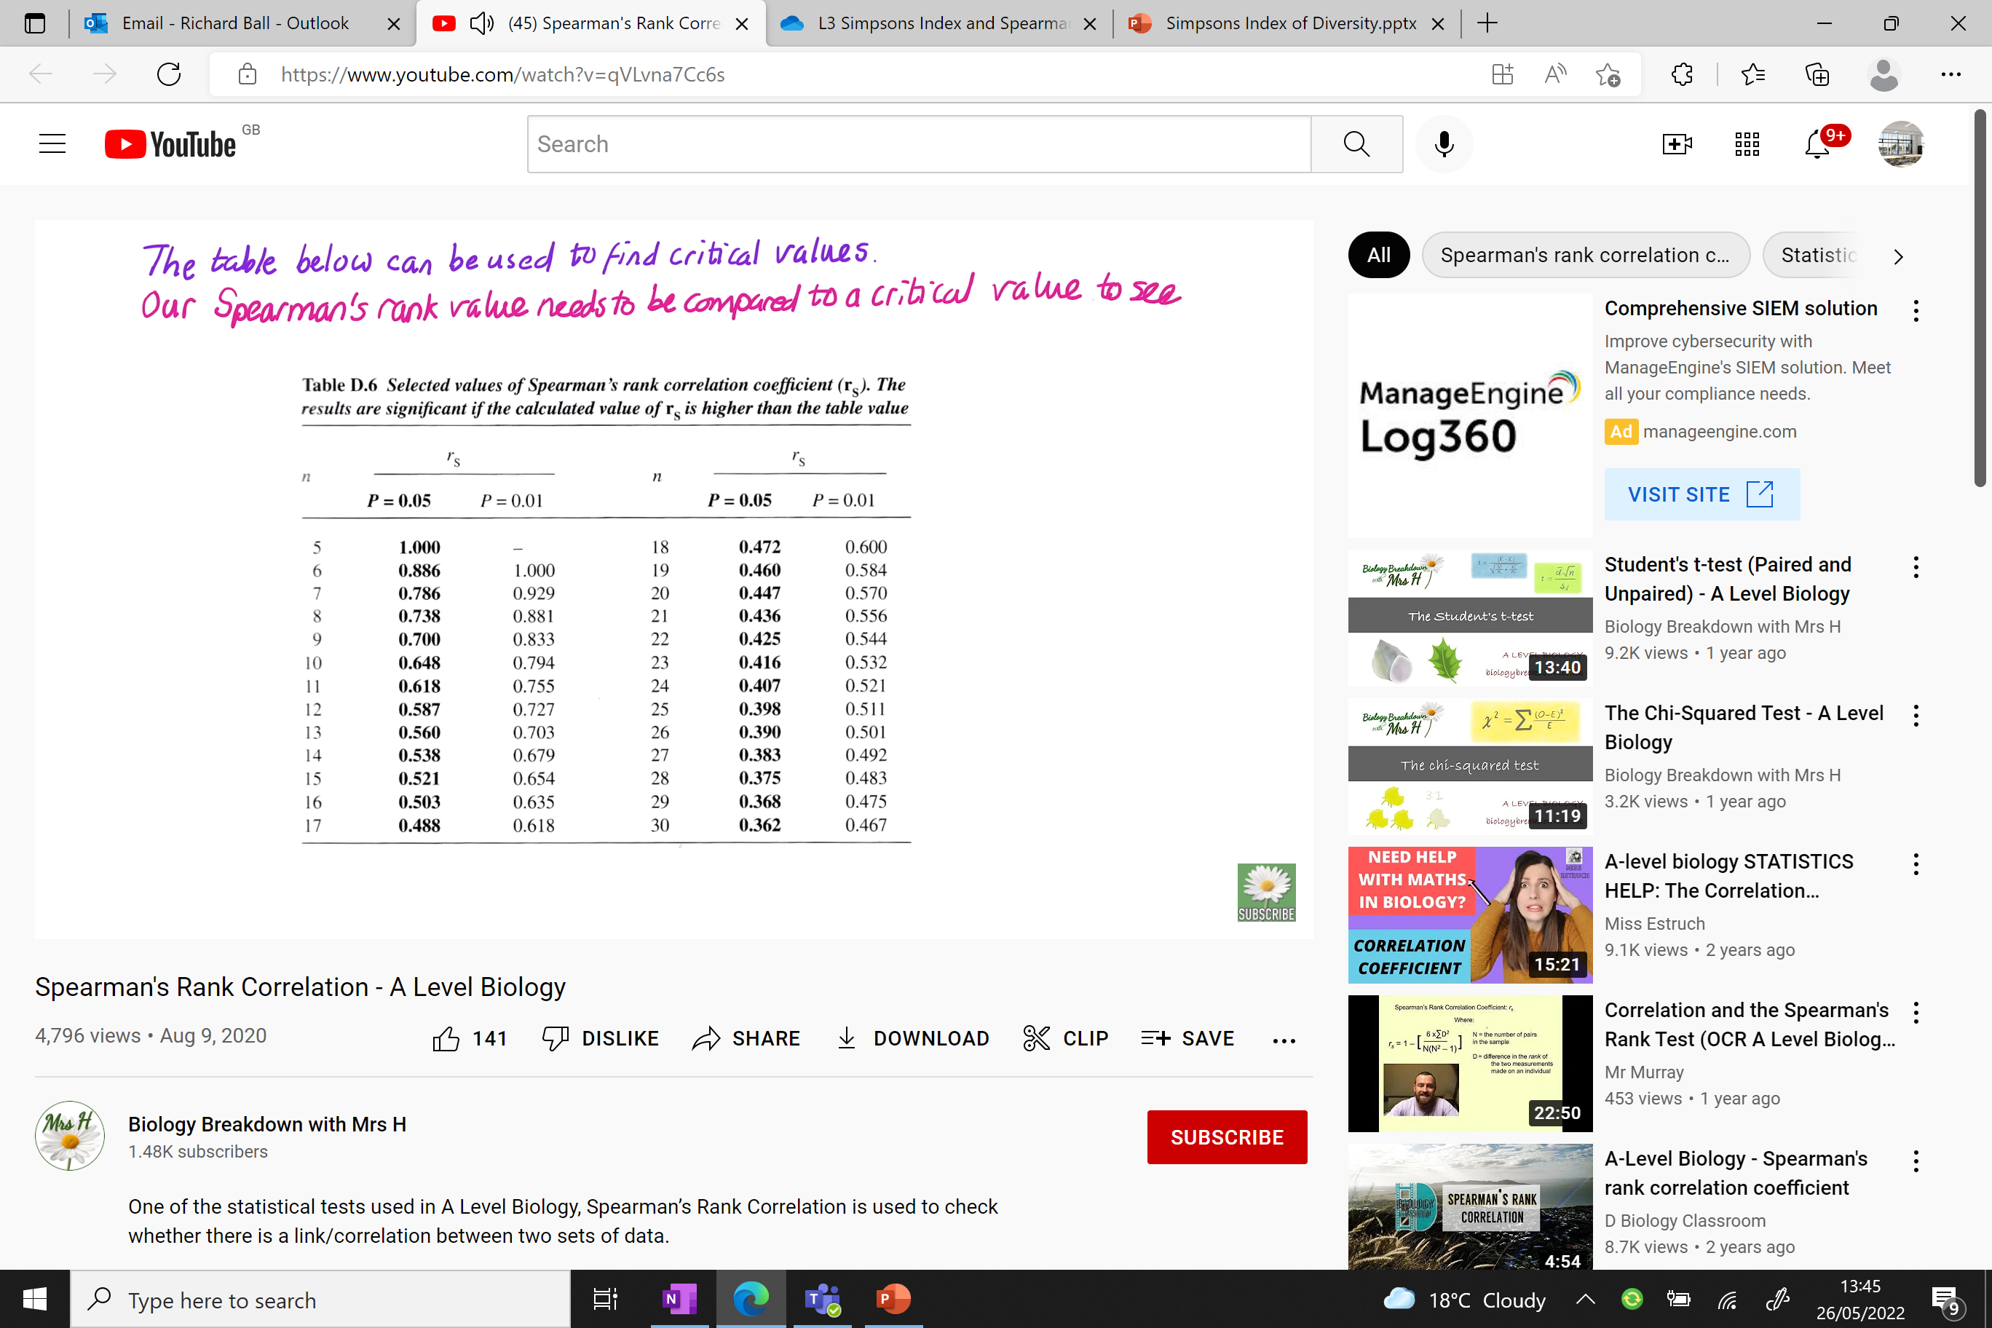
Critical value tables can be used to see if your Spearman’s rank is statistically significant (is there a significant correlation?)
Using the table
We had 10 sets of results, so n is 10
Giving us a critical value of 0.648
If our statistical value is greater than the value in this column, the probability of our results being due to chance is less than 5%.
LETS COMPARE!
Notes:
P : the lowest value accepted before it we deem it to have no statistical value

Slide 17
Reminder:
Null hypothesis:
There is no correlation between the height of year 12 students and their masses

Slide 18
Accept the null hypothesis
Critical
value
Reject the null hypothesis
0.648
0.955
Null hypothesis:
There is no correlation between the height of year 12 students and their masses
Conclusion:
The Spearman’s rank value of 0.955 is greater than the critical value of 0.648 and the null hypothesis is rejected.
There is a significant positive correlation between the heights of year 12 students and their masses.
There is less than a 5% probability you would get these results due to chance

Slide 19
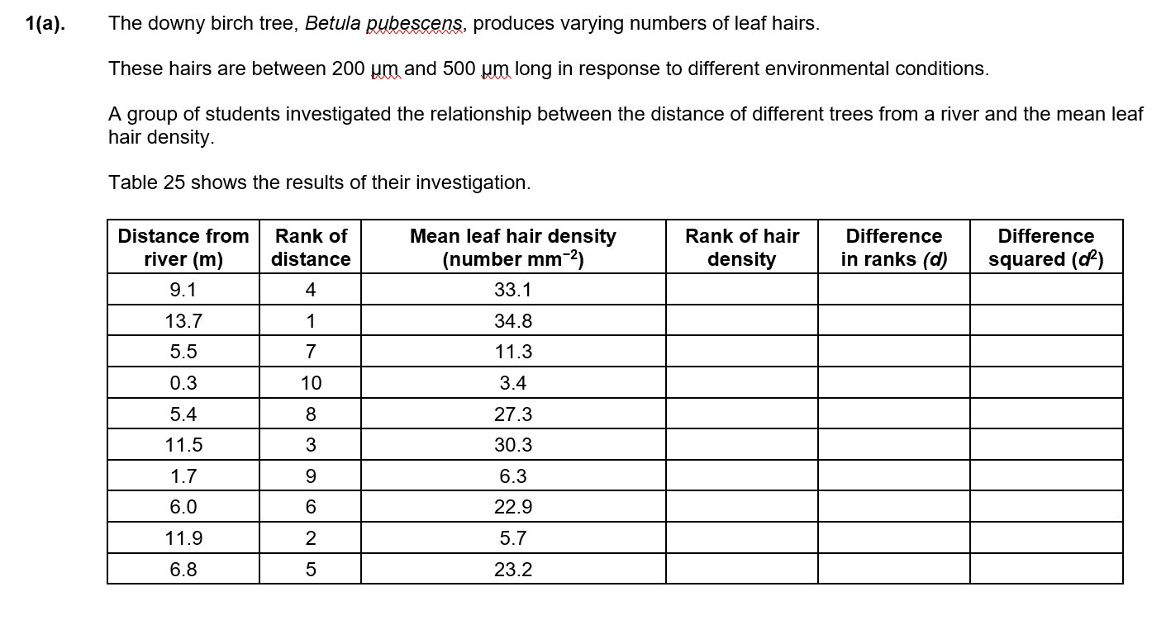

Q1.
A) Complete Table 25 by calculating the difference between the ranks and then squaring the difference (3 marks)
B) Use the formula below to calculate Spearman’s rank correlation coefficient for this data (2 marks)
C) The students concluded that there is a positive correlation between distance of the tree from the river and mean leaf hair density. Suggest reasons for this positive correlation (2 marks)

Slide 20
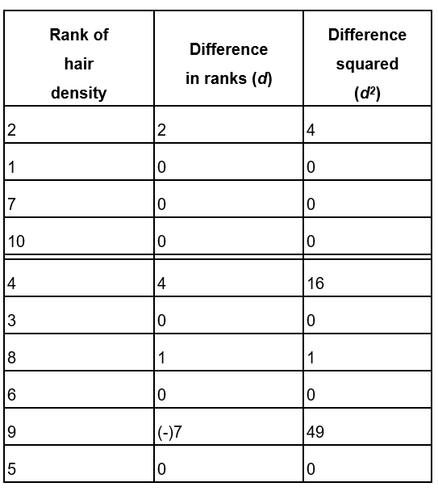
A)
B)
r_{s} = 1 – 6 x 70
10(10² – 1)
r_{s} = 1 – 420 _
990
r_{s} = 1 – 0.42
r_{s} = 0.58
C)
Higher leaf hair density further from the river because:
further away from the river less water (available) / ORA ✓
transpiration causes water loss ✓
hairs, trap water vapour / reduce transpiration / reduce loss of water (vapour)✓
reduced water (vapour) potential gradient from inside to outside leaf ✓

Slide 21
Investigate the following null hypothesis
Null hypothesis:
There is no correlation between the hand and their foot length

Slide 22
Upload work and complete the additional question below
Additional questions in folder if time

Slide 23
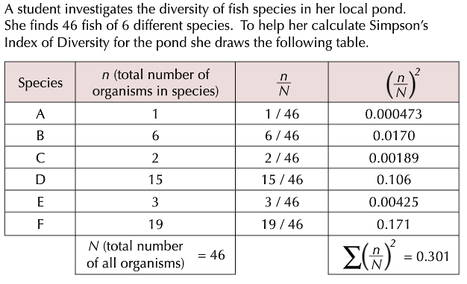


Slide 24
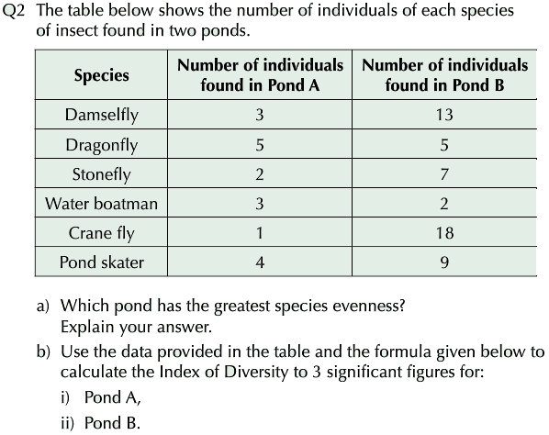
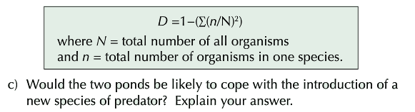

Slide 25
