Slide 1
Delete duplicate relay on starter question

Slide 2
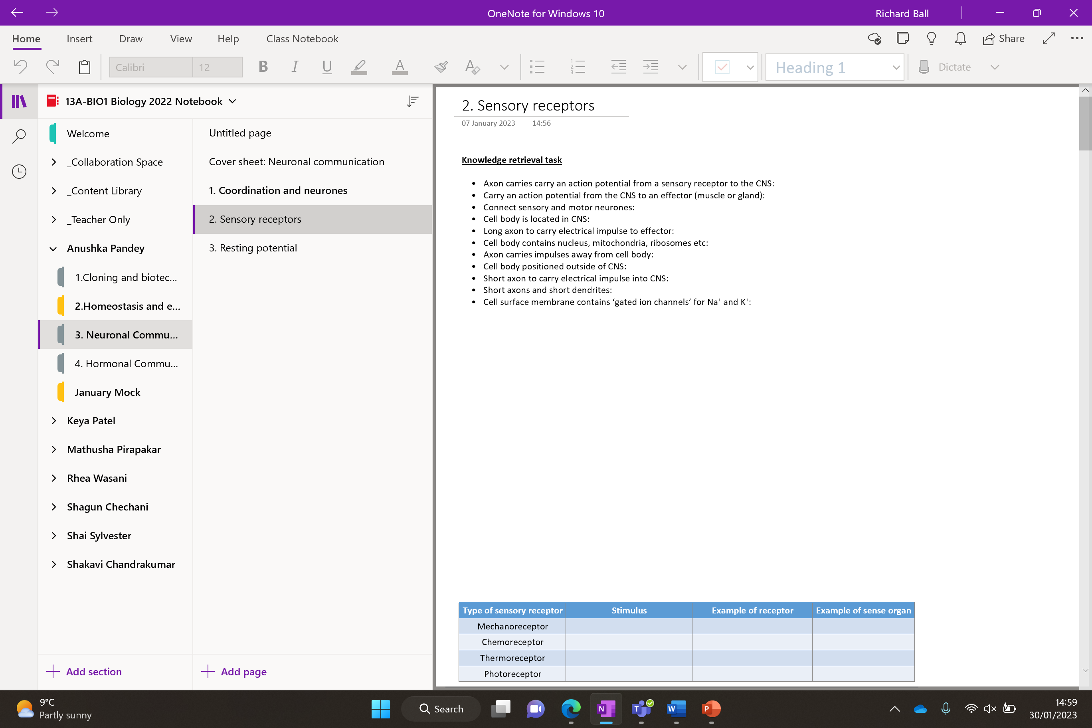

Slide 3
Sensory receptors

Slide 4
Knowledge retrieval task
Action potential = Nerve impulse
Axon carries carry an action potential from a sensory receptor to the CNS: sensory neurone
Carry an action potential from the CNS to an effector (muscle or gland): motor neurone
Connect sensory and motor neurones: relay neurone
Cell body is located in CNS: relay neurone
Long axon to carry electrical impulse to effector: motor neurone
Cell body contains nucleus, mitochondria, ribosomes etc: all neurones
Axon carries impulses away from cell body: all neurone
Cell body positioned alongside the axon sensory neurone
Short axon to carry electrical impulse into CNS: sensory neurone
Short axons and short dendrites: relay neurone
Cell surface membrane contains ‘gated ion channels’ for Na⁺ and K⁺: all neurones
Which neurone is it?

Slide 5
Axon carries carry an action potential from a sensory receptor to the CNS sensory neurone
Carry an action potential from the CNS to an effector (muscle or gland) motor neurone
Connect sensory and motor neurones relay neurone
Cell body is located in CNS relay neurone
Long axon to carry electrical impulse to effector motor neurone
Cell body contains nucleus, mitochondria, ribosomes etc. all neurones
Axon carries impulses away from cell body All neurones
Cell body positioned alongside the axon sensory neurone
Short axon to carry electrical impulse into CNS sensory neurone
Short axons and short dendrites relay neurone
Cell surface membrane contains ‘gated ion channels’ for Na⁺ and K⁺ all neurones

Slide 6
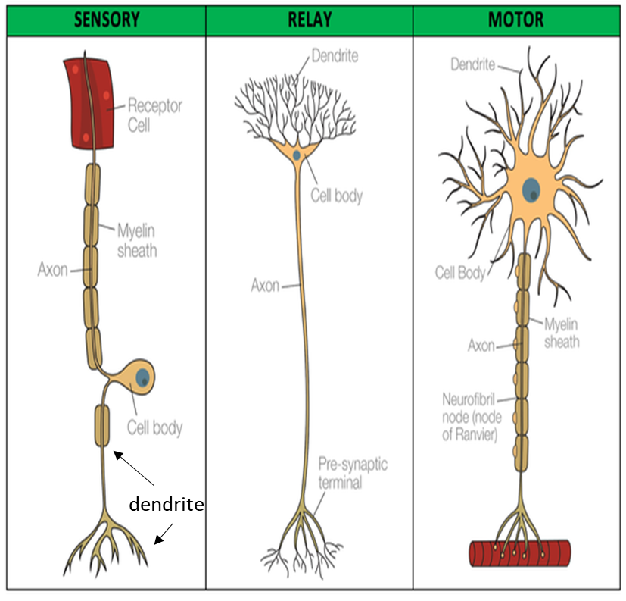
Structure of a neurone
They have three distinct parts:
Cell body – contains nucleus and cytoplasm. Also contains many mitochondria, ribosome and RER to produce neurotransmitters.
Dendron / Dendrites – Extend from the cell body. The electrical impulse travels towards the cell body along these.
Axon – Elongated nerve fibres that transmit impulses away from the cell body to pre-synaptic terminals.
Three types of neurone:
Sensory neurone – Carry the impulse from receptor cells to the relay neurone. Cell body found along the axon.
Relay neurone – Transit impulses between neurones. Have short axons and many dendron. Cell body at the end of axon.
Motor neurone – Carry the impulse from relay neurone to an effector (muscle/gland). Long axon and short dendrites. Cell body found at the end of the axon. Often myelinated.

Slide 7
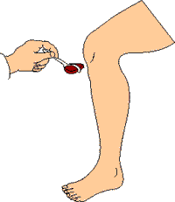
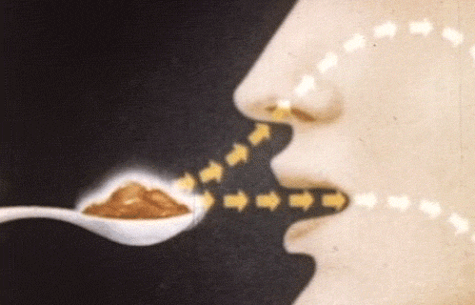
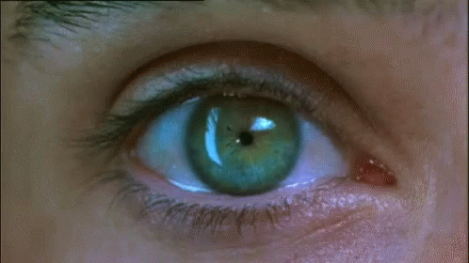
Sensory receptors
What are the four main types of sensory receptors?
Complete the table for the four main types of sensory receptors

Slide 8
Sensory receptors
This column may need some research!
Type of sensory receptor | Stimulus | Example of receptor | Example of sense organ
Mechanoreceptor
Chemoreceptor
Thermoreceptor
Photoreceptor

Slide 9
Sensory receptors
Type of sensory receptor | Stimulus | Example of receptor | Example of sense organ
Mechanoreceptor | Pressure and movement (in joints) | Pacinian corpuscle (detects pressure) | Skin
Chemoreceptor | Chemicals | Olfactory receptors (detects smells) | Nose
Thermoreceptor | Heat | End-bulbs Krause | Tongue
Photoreceptor | Light | Cone cells (detect wavelengths) | Eye
P……….. C…………..
O…………………
E…..-b…… K…………..
R……. & c………

Slide 10
Sensory receptors
Type of sensory receptor | Stimulus | Example of receptor | Example of sense organ
Mechanoreceptor | Pressure and movement (in joints) | Pacinian corpuscle (detects pressure) | Skin
Chemoreceptor | Chemicals | Olfactory receptors (detects smells) | Nose
Thermoreceptor | Heat | End-bulbs Krause | Tongue
Photoreceptor | Light | Rod / cone cells (detect wavelengths) | Eye

Slide 11
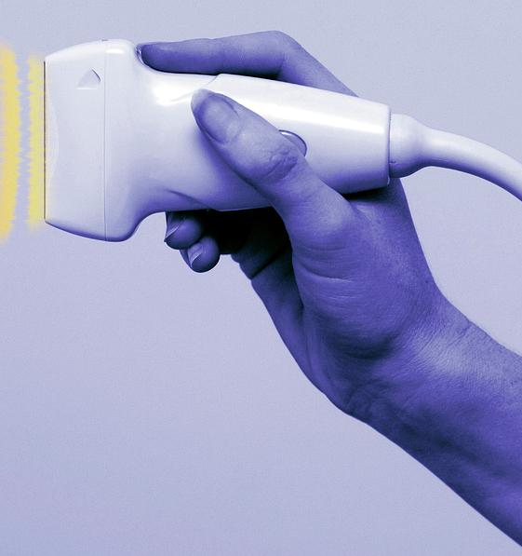
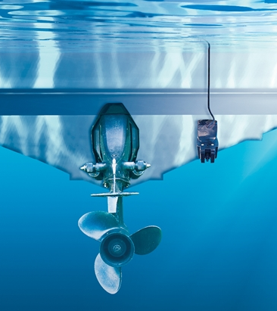

Notes:
Transducer used for ultrasounds convert soundwaves into an electrical current

Slide 12
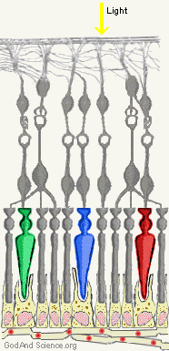
Transducer
Convert a stimulus (form of energy) into a nerve impulse (electrical energy)
The sensory receptors do this.
Example: The rods and cones found in your eye respond to light to produce a nerve impulse, which travels to the brain.

Slide 13
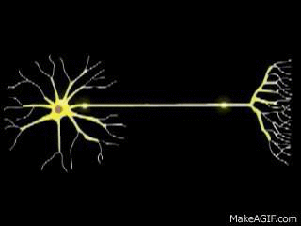
How does a sensory receptor change a physical or chemical stimulus into an electrical nerve impulse?

Slide 14
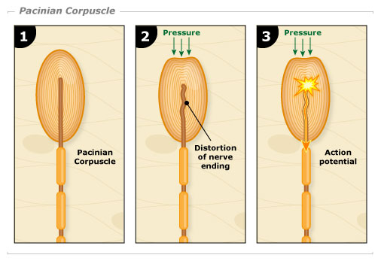
Pacinian corpuscle (type of mechanoreceptor)
Connective tissue – contains gel to transmit any vibrations better
Capsule
End of the sensory neuron
Notes:
A2 Biology - Pacinian corpuscle (OCR A Chapter 13.3) - YouTube

Slide 15
Key terminology
Generator potential: the potential threshold you must reach in the cell membrane for an action potential to occur
Action potential: a rapid sequence of changes in the voltage across a membrane.
When enough generator potential has built up it triggers an action potential.

Slide 16
Show how does this part occur?

Slide 17
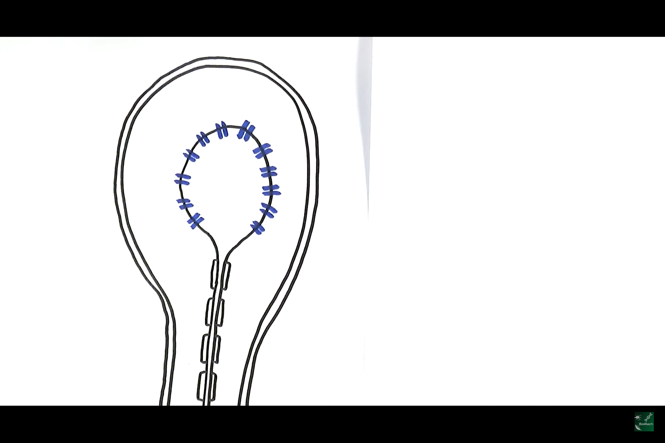
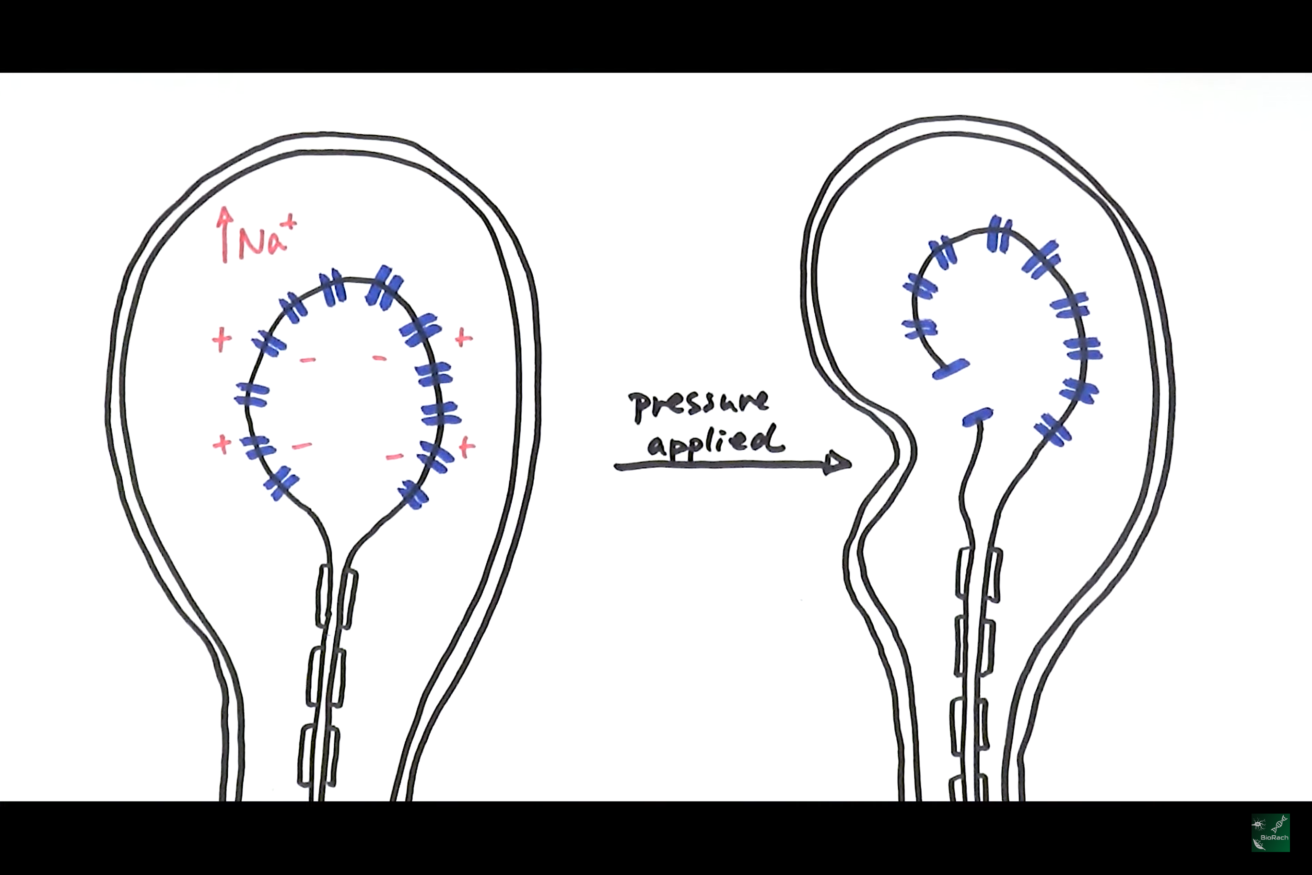
Pacinian corpuscle – mechanical pressure → nerve impulse
*Connective tissue not drawn
Stretched-mediated sodium ion channels. Remain closed at rest (resting potential).
The Pacinian corpuscle changes shape, which causes the membrane of the sensory neuron to change shape
This opens the Na⁺ ion channel and Na⁺ diffuse I, down the electrochemical gradient (depolarising the membrane)
At rest we say the membrane surrounding the neurons is polarised due to the high centration of Na⁺ ions
Na⁺
Na⁺
Na⁺
-
-
Na⁺
-
-
Na⁺
Na⁺
This creates a generator potential. When enough ions have diffused in it triggers an action potential.
Sending an electrical impulse along the sensory neurone.
Notes:
Generator potentials are the potentials you need to get a cell membrane to for an action potential to occur. For Pacinian corpuscles, if the mechanical stimulus is of a magnitude sufficient to open enough Na+ ion channels that the potential difference is increased to the generator potential, then this will cause the opening of voltage gated Na+ channels and cause an action potential.

Slide 18
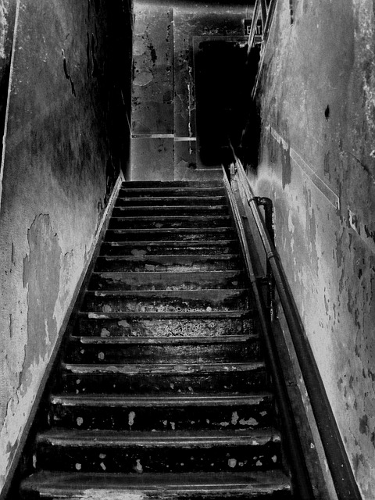
STEPS OF DOOM!!!

Slide 19
At rest the stretched-mediated sodium ion channels are closed
Pressure causes the corpuscle to change shape, stretching the neurone membrane
Sodium ion channels widen and sodium ions diffuse into the neurone
The corpuscle membrane depolarises creating a generator potential
Eventually the generator potential triggers an action potential which is sent along the sensory neurone

Slide 20
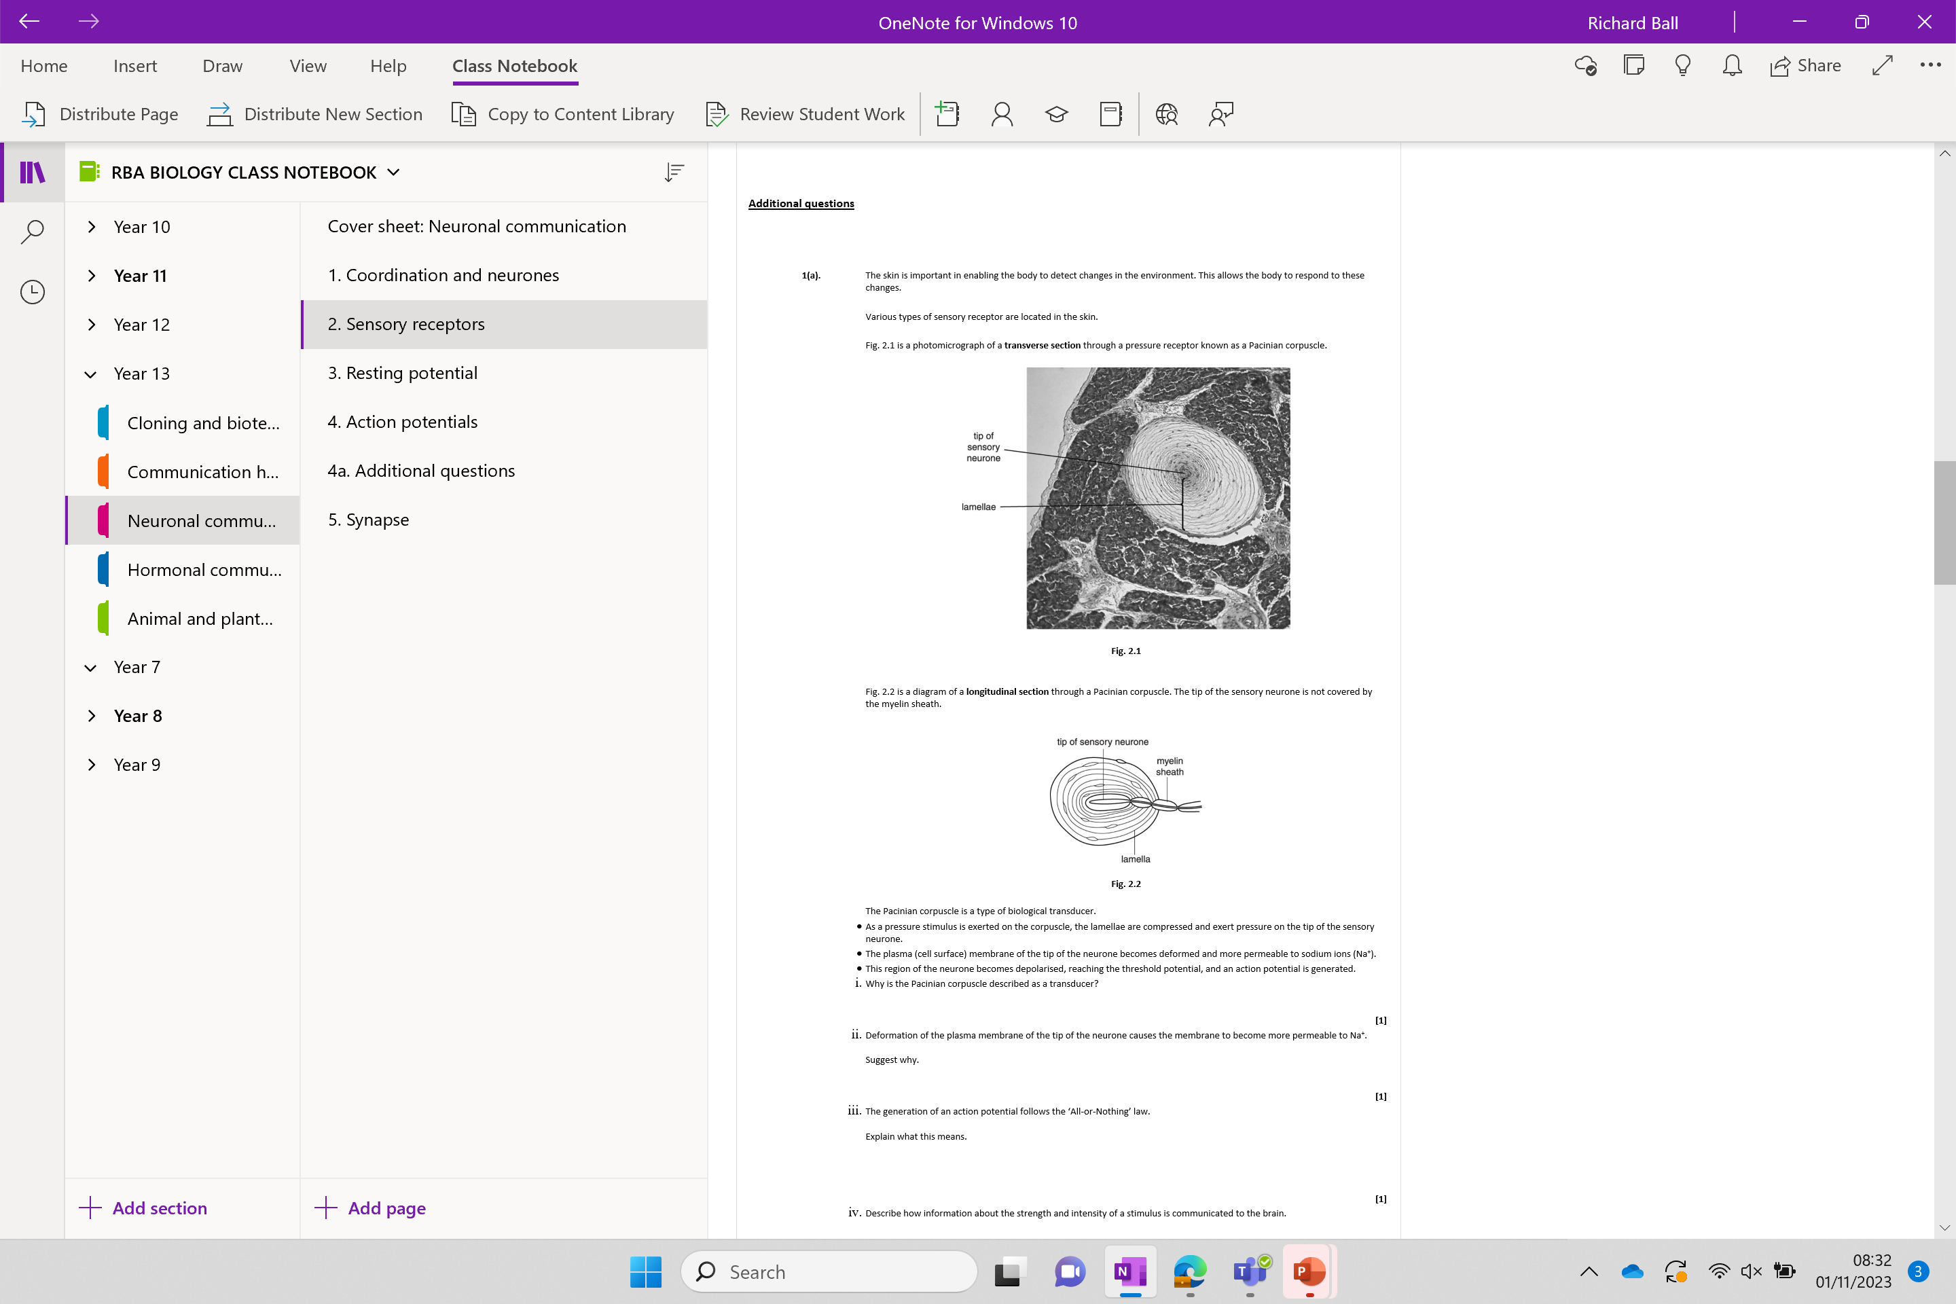
Additional questions

Slide 21

Work down the list – no words – no numbers – pictures only!

Slide 22
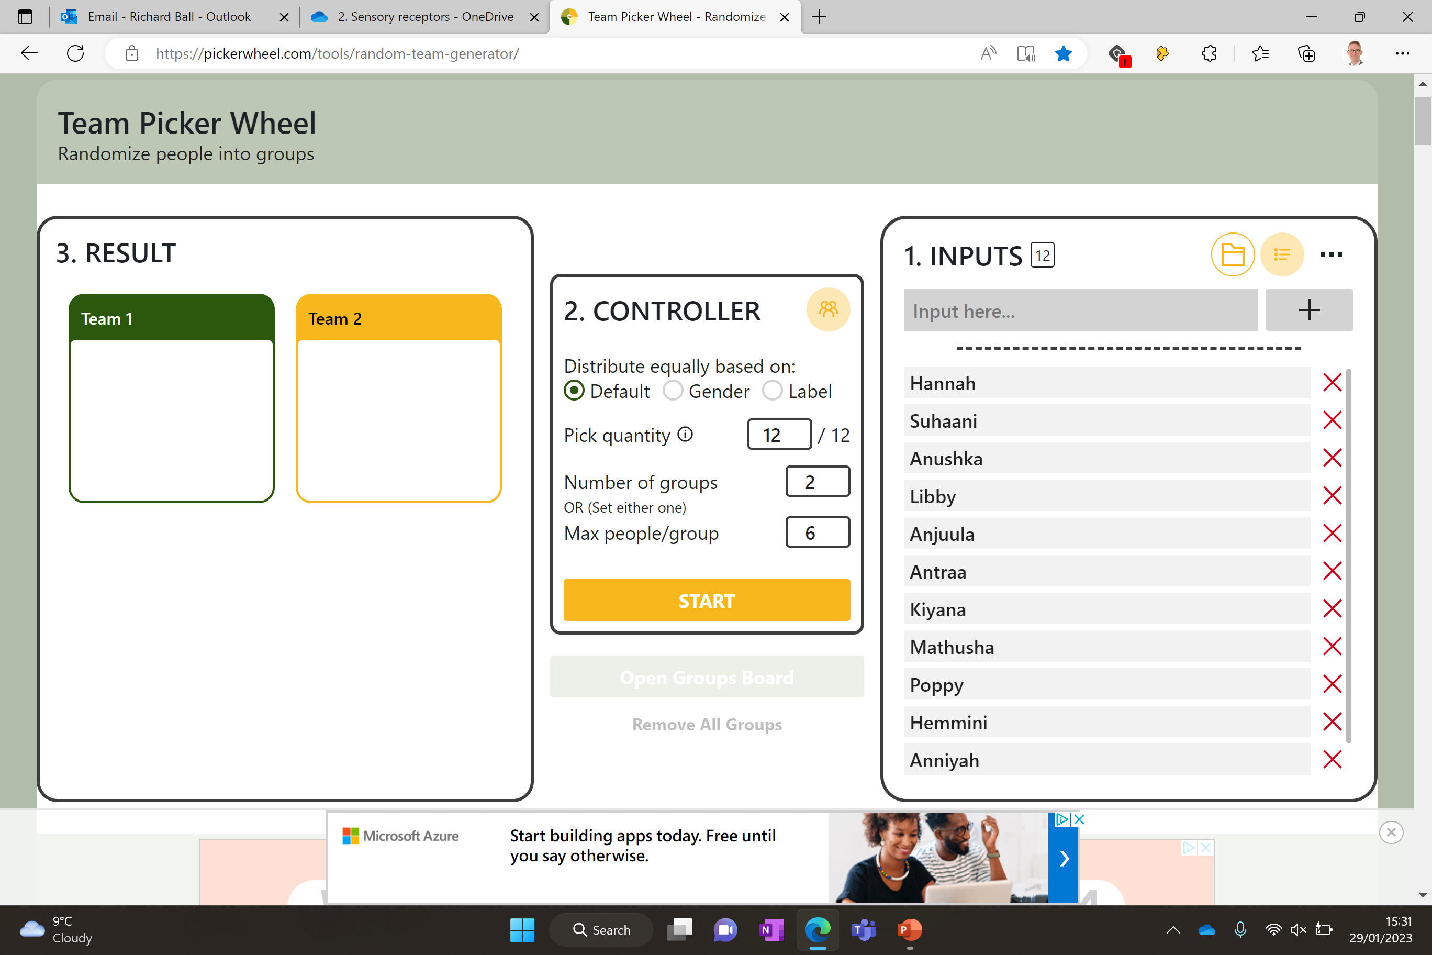

Slide 23
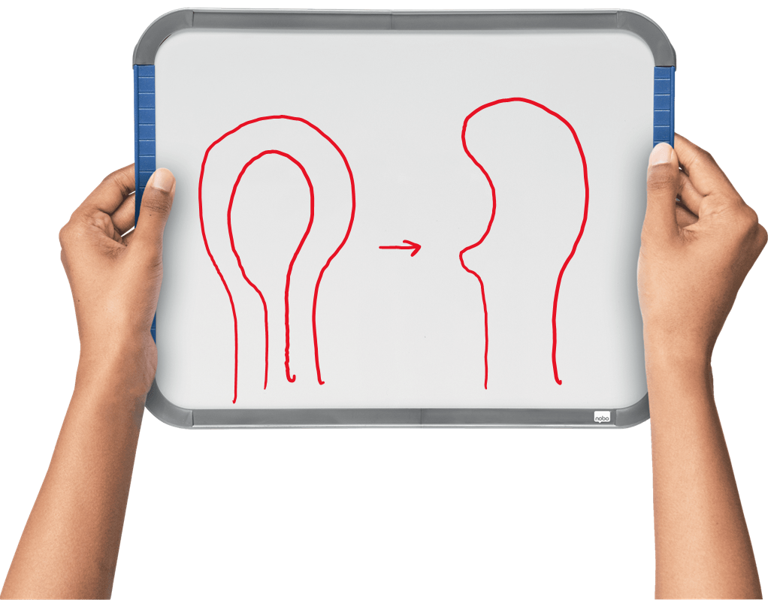
Use your whiteboard to explain how the Pacinian corpuscle responds to pressure being applied to it
Include:
Stretch-mediated ion channels
Na+
Pressure
Electrochemical gradient
Generator potential
Action potential

Slide 24
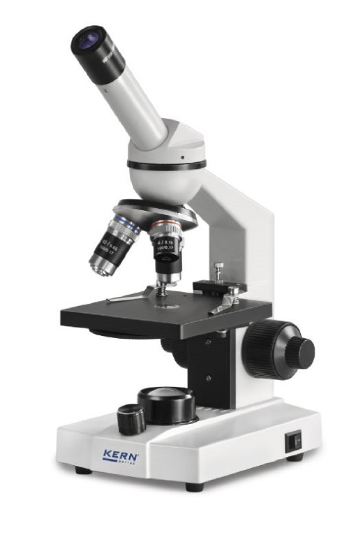
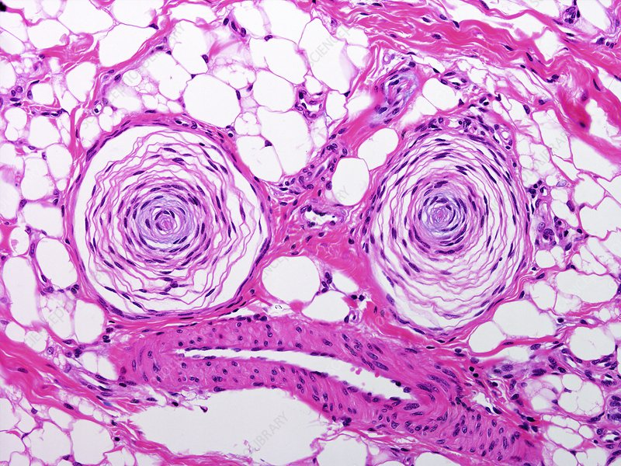
Skin histology
Identify the Pacinian corpuscle under the microscope

Slide 25
Additional questions

Slide 26
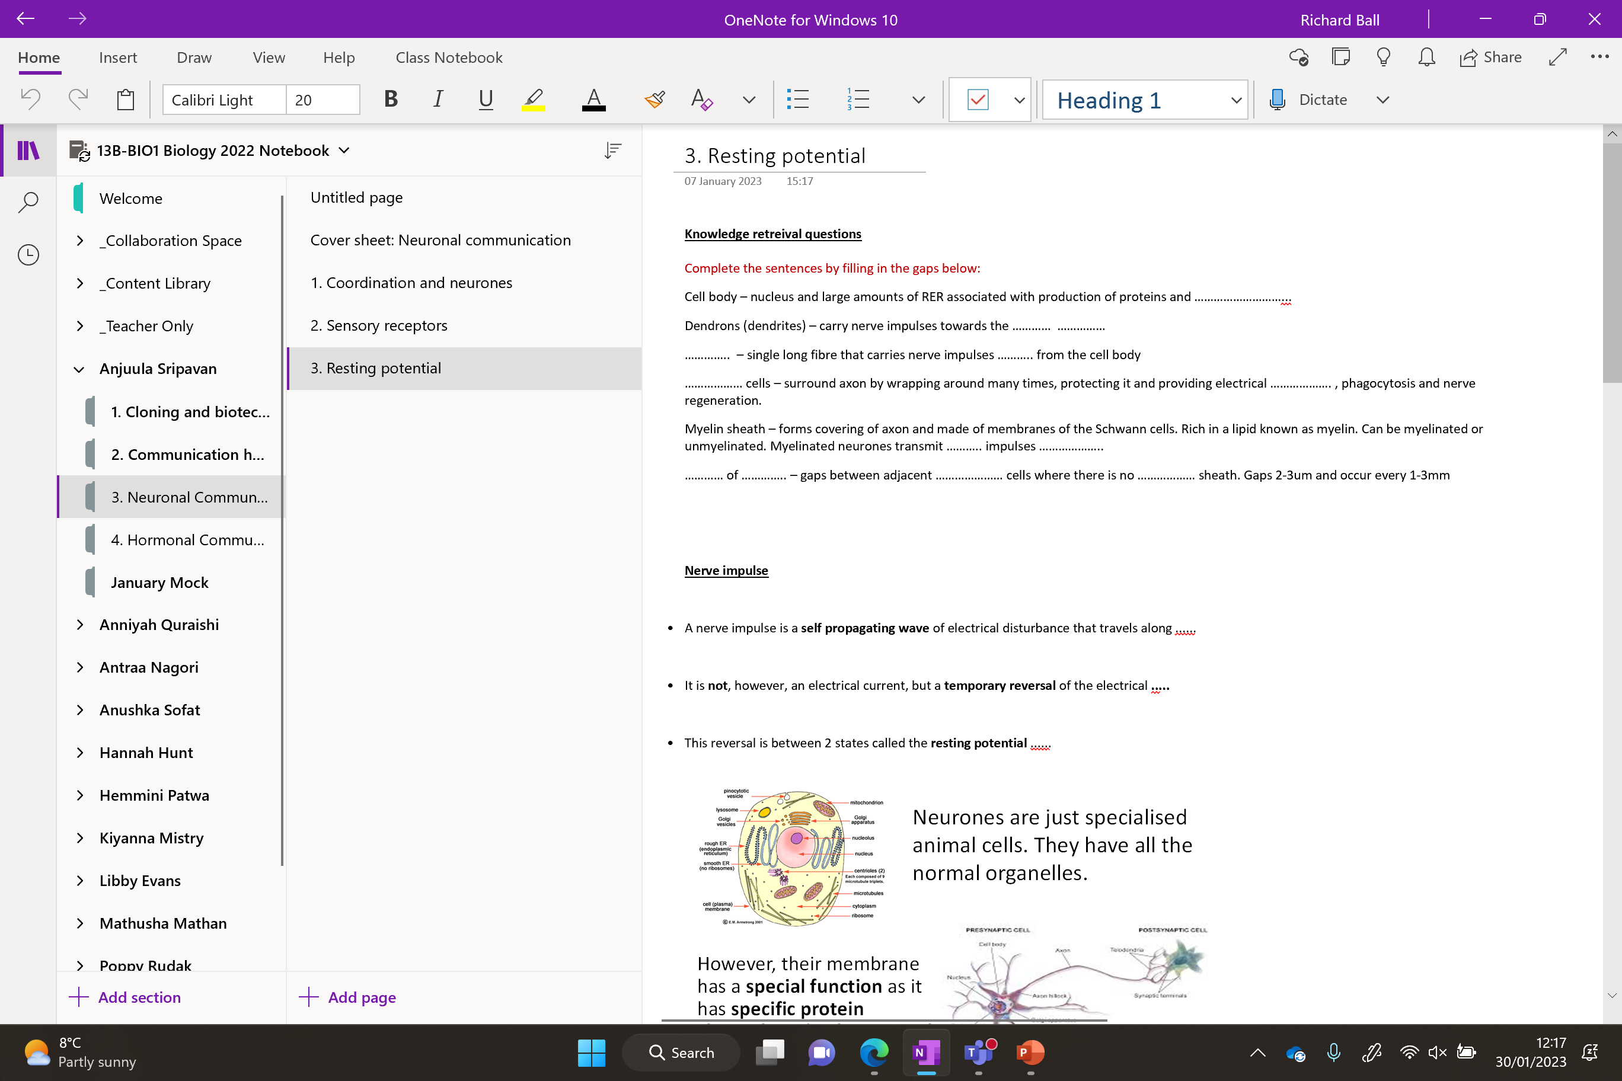
Additional questions
Next lesson

