Slide 1
Topic 3: Provisional Government and the Bolshevik Revolution
To Cover:
Weaknesses and mistakes of the Provisional Government.
The impact of the Petrograd Soviet.
The activities of Lenin and the Bolsheviks, including the April Theses and July Days.
Nature and impact of the Kornilov Revolt.
Key events of the Bolshevik takeover.
Reasons for success of Bolsheviks, especially the roles of Lenin and Trotsky.

Slide 2
Weaknesses of the PG
‘Dual Control’ with Petrograd Soviet meant that the PG lacked control over some areas of government.
Petrograd Soviet had ‘Order Number 1’- they had the final say on military matters. This damaged the authority of the PG.
Petrograd Soviet was elected but PG was not- this weakened their authority further.

Slide 3
Mistakes of the PG
Continuing WW1: to keep the Allies on side to invest in Russia’s recovery. Ordinary people wanted Russia out of the war.
Delaying elections: PG found organising a general election challenging and preferred to focus on other issues. Delaying elections led to unpopularity.
Delaying reforms: Peasants wanted more land, the PG had little authority and were waiting for the constituent assembly.
Allowing more freedom: The PG allowed freedom of speech meaning people could openly criticise the PG.

Slide 4
The Petrograd Soviet
Set up after the Mensheviks encouraged workers to form a soviet like the one in 1905.
Started representing factory workers, eventually soldiers.
Decisions make by the executive committee.
Did not challenge PG because:
Didn’t want to weaken PG and allow tsarist forces back in.
Russia needed a bourgeois phase (with a PG) in Russia before a socialist revolution.
Didn’t want to be blamed for problems in Russia.

Slide 5
Impact of the Petrograd Soviet
Tried to use its power to influence government policies to make sure they were in the interests of ordinary people and soldiers.
Lenin was convinced it was time for the Bolsheviks to seize power and create a worker’s state.
By September 1917, Lenin had achieved his goal of gaining control of the Petrograd Soviet Executive: a majority of the delegates were Bolshevik supporters.

Slide 6
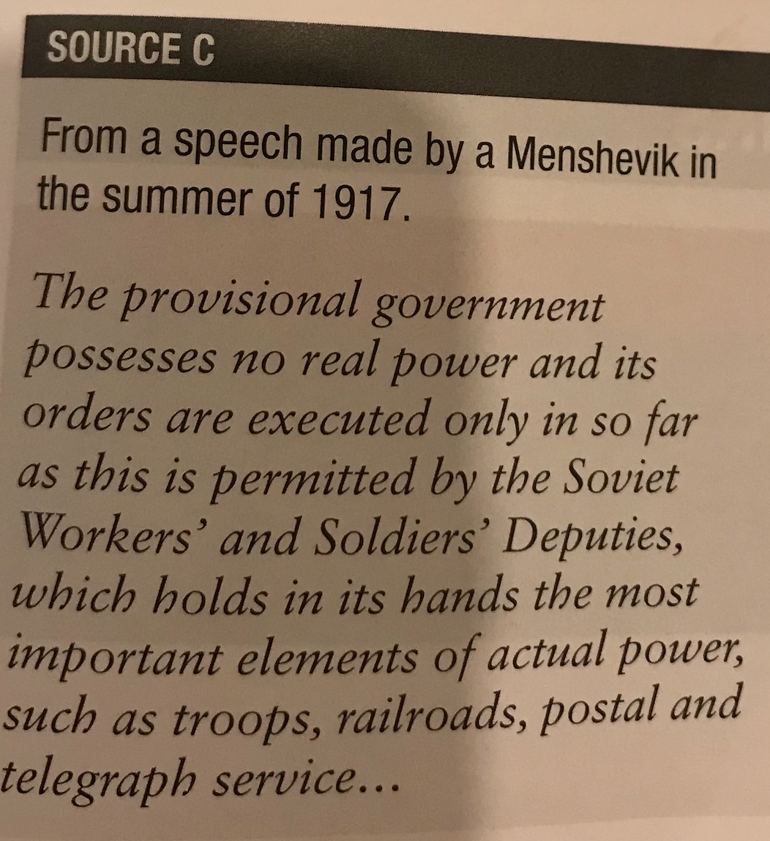
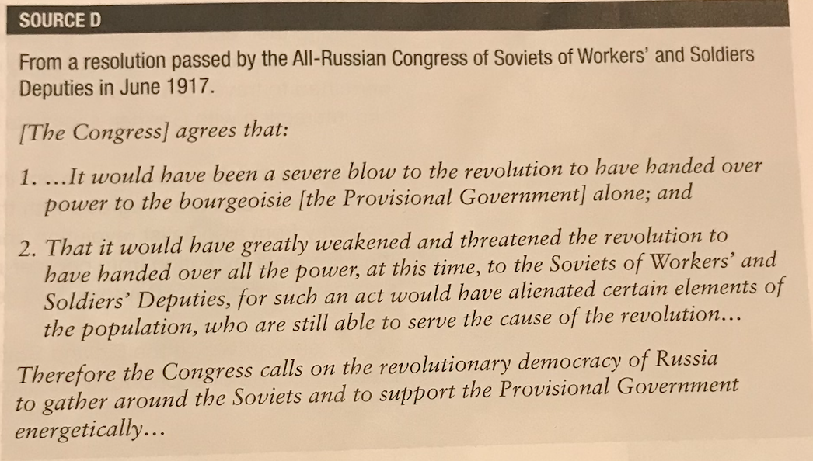
B Question:
How far does Source C support the evidence of Source D about the relationship between the Provisional Government and the Petrograd Soviet.
Explain your answer.
(8 marks)
Lets write it together.

Slide 7
Lenin’s Return
In 1917 the Germans finally allowed Lenin to cross their territory back from Switzerland in a sealed train. Why?
The Bolsheviks were not in a strong position, Kamenev and Stalin agreed with the Mensheviks that Russia was a long way from a February Revolution. What was their aim?
Lenin arrived in Petrograd on 3rd April 1917, and made a speech: PG deceiving people, socialist revolution needed.

Slide 8
The April Theses
Lenin wrote the Theses on the way back to Russia, as he believed the Marxist revolution did not need to wait until Russia was fully capitalist.
‘Peace, Land and Bread’ and ‘All Power to the Soviets’.
End all cooperation with the PG.
End the war.
Nationalisation of all land.
Educate peasants and workers so they could see all power should go to the Soviets, and police/army/bureaucracy should be abolished.
Industry should be controlled by the soviets, all banks into one state bank.

Slide 9
Support for the Bolsheviks
Support for the Bolsheviks grew through summer of 1917 because of: Lenin’s strong leadership, Trotsky’s excellent organisation and the PG’s continuing weaknesses.
They recruited armed workers’ militias (Red Guards) to the party.
What was the impact of the April Theses?
What impact did Germany have?

Slide 10
The July Days
March 1917 PG introduced bread rationing, war was using up lots of resources.
June Offensive against the Germans was a disaster. Many soldiers deserted.
3rd – 7th July 1917: July Days. Why? Food shortages, failure of June Offensive, effective Bolshevik propaganda against PG.
Uprising started by anarchist revolutionaries, Bolsheviks tried to prevent and then realised could lead to overthrow of PG.
Petrograd Soviet did not support: worked with PG and arrested hundreds of Bolsheviks including Trotsky. Lenin fled to Finland.

Slide 11
A Question
Give two features of the July Days.
Lets add detail:
One feature was that it was an improvised attempt by some Bolsheviks to take power…
Another feature was that it was easily crushed….

Slide 12
Kornilov Revolt
Kerensky took credit for putting down July Days: became leader of PG (Prime Minister).
Kerensky wanted to restore discipline in the army to prevent defeat in the war: great if it succeeded! How?
18th July 1917 he appointed new commander-in-chief: General Kornilov. Agreed to bring troops to Petrograd in case of unrest.
Kornilov wanted martial law to break power of soviets (supported by middle-class: why?).
Kerensky saw this as challenge to leadership, dismissed Kornilov.
Kornilov ignored: sent troops to Petrograd planning to shut down the Petrograd Soviet.
Huge alarm in Petrograd: Kerensky allowed Bolsheviks to arm their supporters to defend city. They did so using armed Red Guard units, and convinced Kornilov’s troops to stop. Kornilov arrested 1st September. Impact?

Slide 13
A question
Describe two features of the Kornilov Revolt (August 1917).

Slide 14
Impact of Kornilov Revolt
Boosted support for Bolsheviks while weakening Kerensky and PG. (how did it do this?)
Bolsheviks could say they saved Petrograd: more elected to soviets and soon had control of Petrograd Soviet.
25th September Trotsky elected president of soviet.
Red Guards added military power to Bolsheviks: many kept weapons after Kornilov revolt.
Army discipline collapsed- officers accused of being part of the counter-revolution. Many murdered, many soldiers deserted.

Slide 15
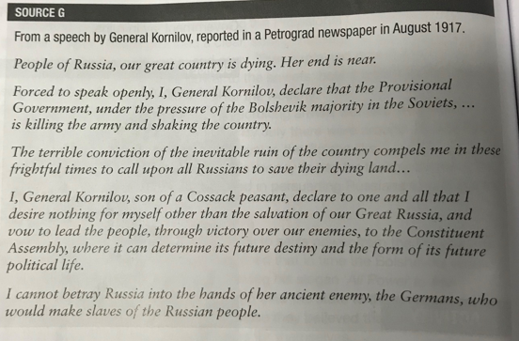
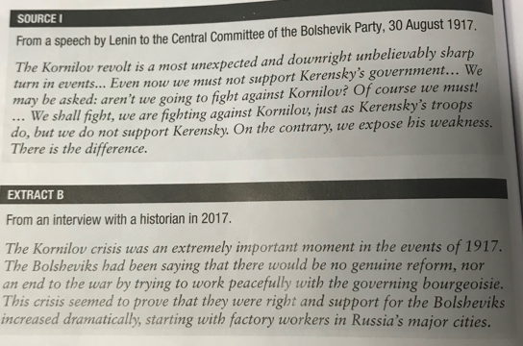
C Question Extract B suggests that the Kornilov Revolt was the most important reason for the rapid increase in support for the Bolsheviks. How far do you agree with this interpretation? Use Extract B, Sources G and I and your own knowledge.

