Slide 1
Topic 2: Opposition to Tsarist rule 1914–17: the impact of war and the February Revolution
To Cover:
Economic, social and political effects of WW1 on Russia.
Influence of Rasputin.
Immediate causes of Feb. Revolution.
Army Mutiny.
Abdication of the Tsar.
Setting up of PG.

Slide 2
Russia and WW1
Russia was brought into the war as an ally of Serbia.
The war initially gave Tsarism a boost- people were patriotic- the duma voted to raise taxes.
Rapid mobilisation meant early successes which quickly turned to terrible defeats, eg: Tannenberg Aug. 1914. Russia was in retreat by end of 1915.
People began to blame Tsarist government: army did not have enough weapons or supplies.
August 1915, Nicholas decided to take command of Russian army and navy, as a commander-in-chief, despite being advised against this as he had no experience.

Slide 3
Economic Effects of WW1
Huge costs incurred, 15 times as much as in Russo-Japanese War.
Govt. had introduced prohibition in 1914, but was suffering from lack of vodka sales tax, so had to raise other taxes and get loans- increase of national debt.
Germans captured coal-mining areas, blocked access to trade with Europe.
Military banned grain exports so they could feed soldiers.
Men sent to war meant not enough labour for factories or fields.
Govt. printed money- led to inflation.

Slide 4
Social Effects of WW1
Russia militarised economy, by requisitioning food, switching industrial production, repurposing railways.
Not enough food was left for people, and what was left could not be transported.
Inflation meant prices increased faster than wages.
So many men killed, especially in countryside.
Jobs were lost in cities due to impact on factories.

Slide 5
Political Effects of WW1
Fourth Duma was suspended so govt. could focus on war.
Duma members lost faith in tsar and wanted to replace his govt.
He refused, so they created the Progressive Bloc which was a centre of opposition to the govt.
Duma restarted in 1916- very critical of tsarist govt. and Rasputin.

Slide 6
A Question
Describe two features of the social impacts of the First World War in Russia (6 marks).
Support each feature with accurate detail.

Slide 7
Leaving Alexandra in Charge
Tsar went to war and left Tsarina in charge. Problems:
The Tsarina was dedicated to autocracy, and ignored duma, replacing ministers who disagreed with her.
She was German- seen as the enemy, and as betraying military secrets to Germans and sending supplies needed by Russians.
She became obsessed with Rasputin who weakened authority of royal family.

Slide 8
Opposition to Rasputin
Rasputin:
Brought in to help haemophiliac Prince Alexis.
Connected with God by sinning (alcohol, stealing, sex) and then repenting.
Alexandra relied on him for political advice.
Hated by court and govt. due to influence on Royal Family, as well as making them look bad.
Rumours that he was having an affair with Alexandra.
Damaging rumours led to December 1916, group of aristocrats murdered Rasputin.

Slide 9
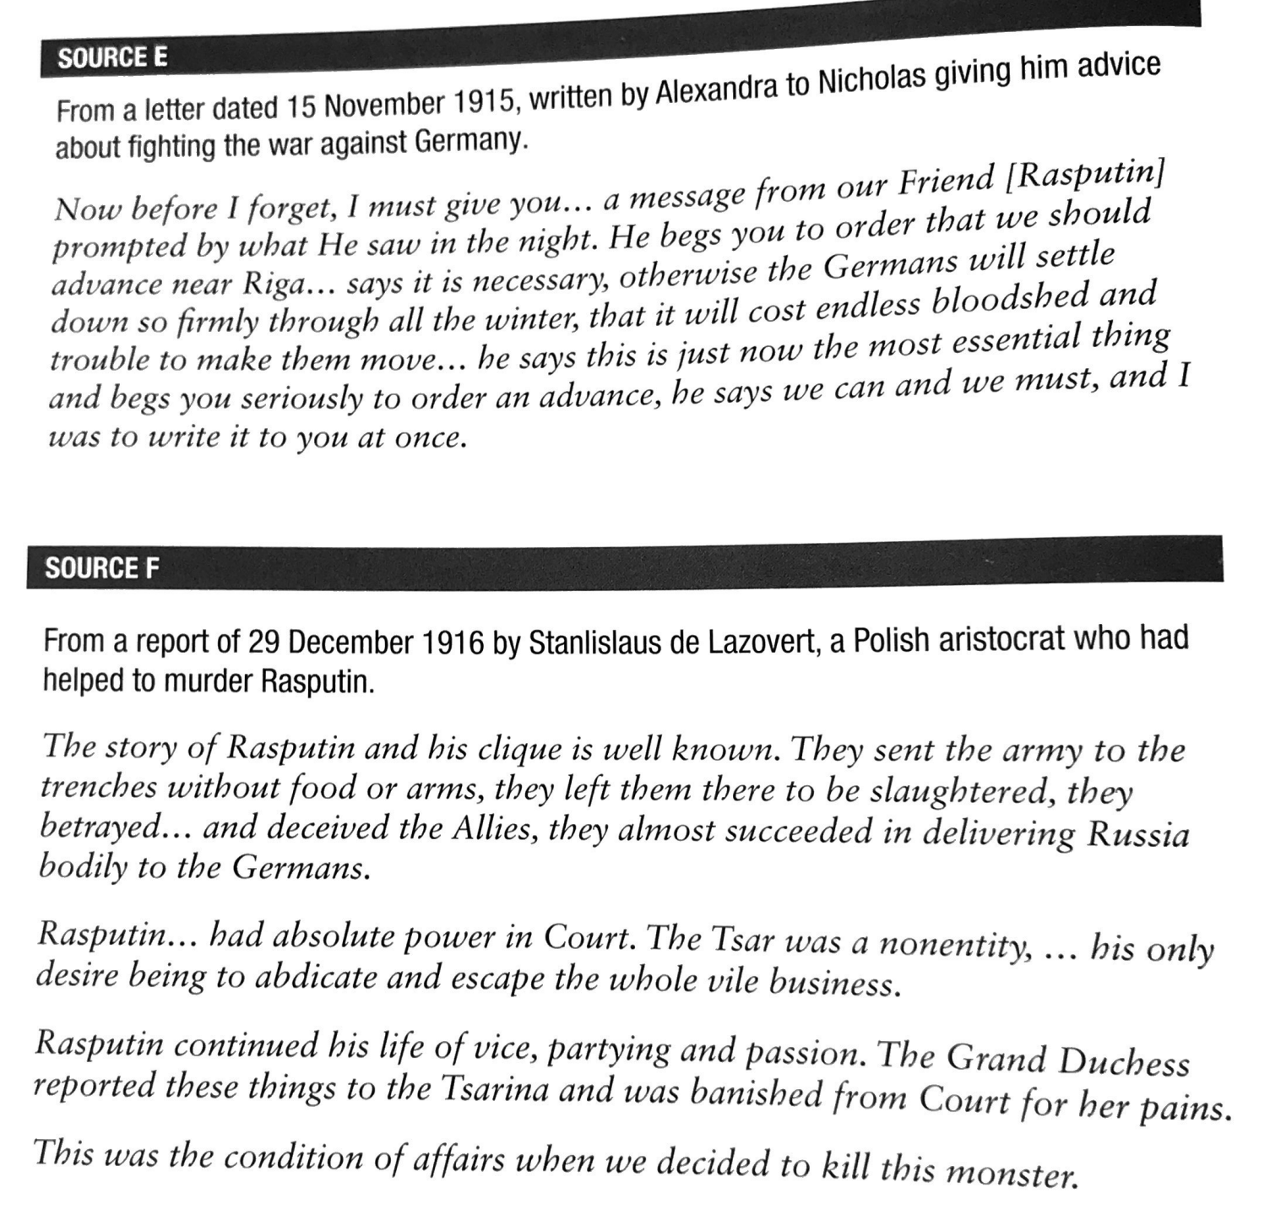
B Question
How far does Source E support the claims made in Source F about Rasputin’s influence on the tsar and tsarina? (8 marks)
(p. 32 in textbook)

Slide 10
Immediate Causes of Feb. Revolution
The tsar being away from Petrograd | Contempt for the Tsarina
The army’s mutiny against the tsar’s rule | Unusually mild winter weather
Demonstrations in support of the duma | International Women’s Day march
Industrial unrest; strikes | Announcement of bread rationing
Food shortages in Petrograd | (Long-term causes same as 1905)
For each trigger, explain why it led to the Feb. Revolution. See textbook p33-36 and your knowledge for details.
Can you group the triggers into ‘paragraphs’?

Slide 11
The Army Mutiny
26th Feb, Pavlovsky Regiment heard that trainee soldiers from another regiment shot more than 50 people.
They refused to obey orders to fire on demonstrators.
Over 27th-28th February: soldiers and workers captured Petrograd’s main weapons store and broke into prisons.
Not all soldiers mutinied, but many different regiments did and showed the revolution to have properly begun.

Slide 12
Abdication of the Tsar
Tsar decided to travel to Petrograd when he heard of the mutiny, ordering his troops to take back the capital.
1st March- he was at Pskov, on the 2nd officers and members of the duma came to urge him to abdicate to save Russia. He agreed to abdicate in favour of his brother Michael.
The leaders of the revolution warned Michael that if he accepted, it would be a civil war.
He turned it down.

Slide 13
The Provisional Government
Revolution caused a power vacuum, with the Petrograd Soviet and duma representatives.
29th March 1917 Provisional Govt. set up- Prince Lvov to lead until elections could take place for a Constituent Assembly.
PG Manifesto- 8 principles:
Political prisoners and exiles to be freed/allowed to return.
Freedom of speech, press and to hold meetings.
No class, religious or nationality discrimination.
Preparations to be started for CA constitution.
Police organisations replaced by elected people’s militia.
Local govts. Elected.
Military units that joined revolution to not be disbanded or sent to front.
Off-duty soldiers to have same rights as civilians.

Slide 14
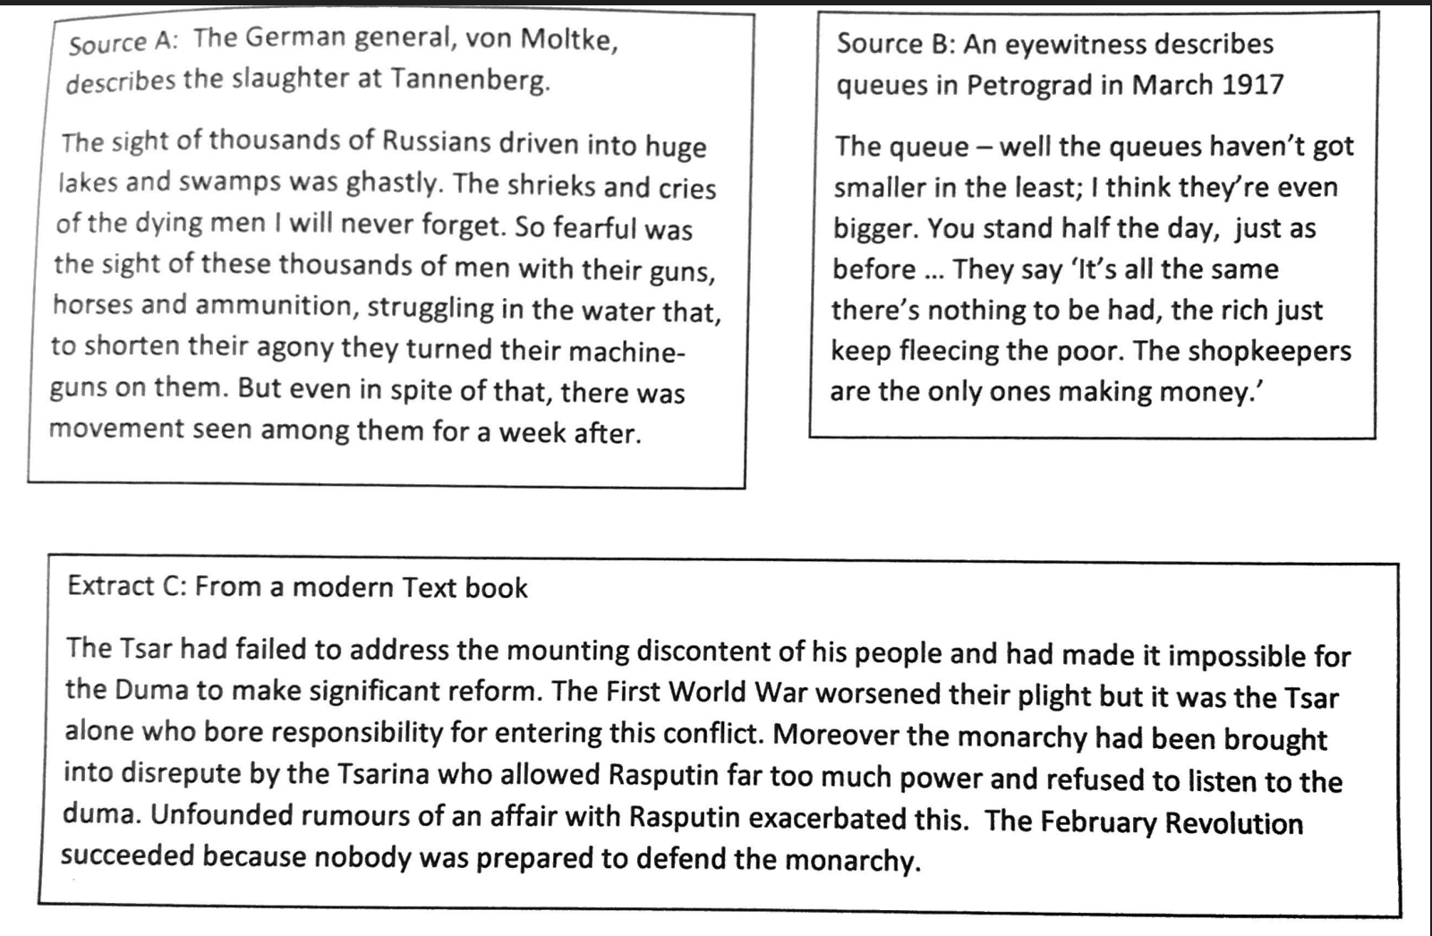
C Question
Extract C suggests that ‘The February Revolution succeeded because nobody was prepared to defend the monarchy’.
Use the sources, extract and your own knowledge to explain how far you agree with this statement. (16 marks).

