Slide 1
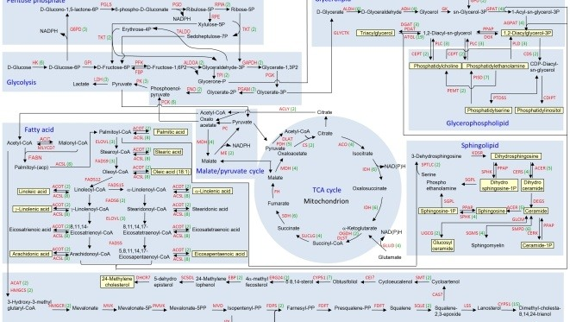
Respiratory substrates

Slide 2

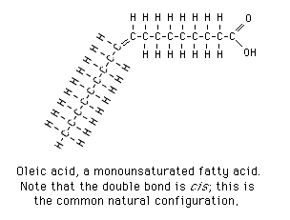
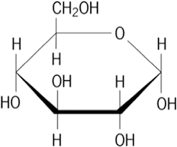
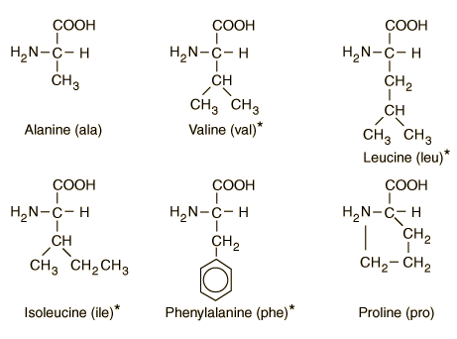
What is a respiratory substrate and how many can you think of?
Any molecule that can be broken down in respiration to release energy. (Carbohydrates, lipids & proteins)
Different respiratory substrates enter respiration at different points

Slide 3
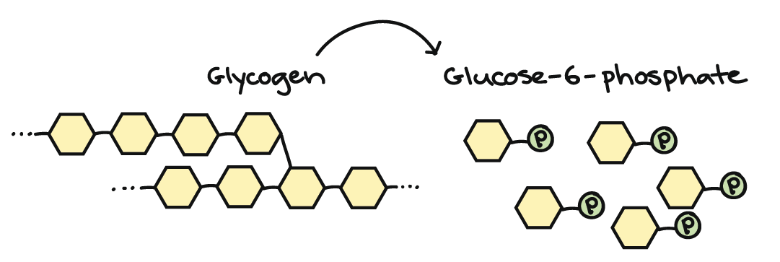
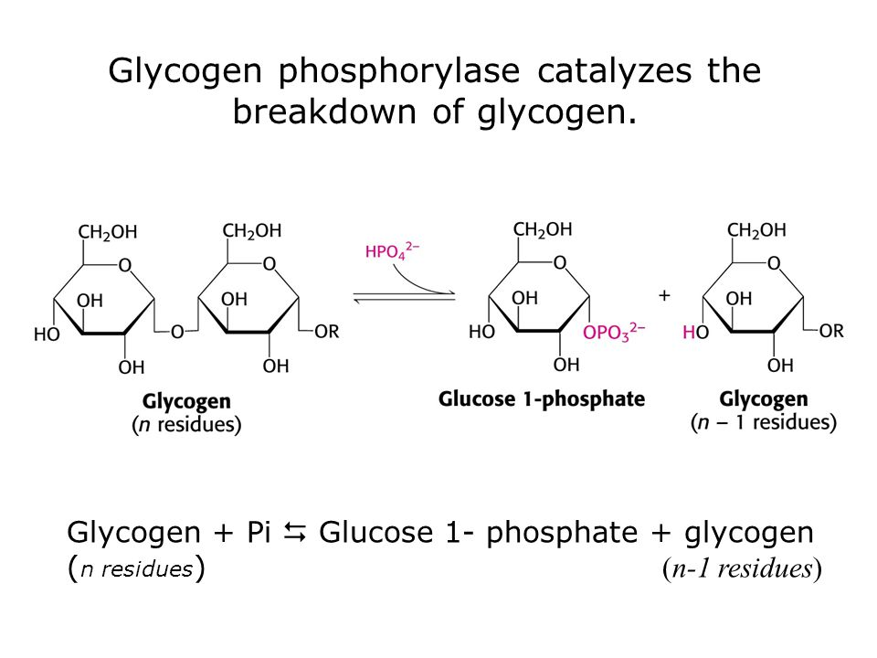
How carbohydrates enter the respiratory pathway
Most carbohydrates enter cellular respiration during glycolysis
Polymers such as glycogen can be hydrolysed to glucose phosphate and enter at the start of glycolysis
Other sugars such as fructose can enter near the top of the glycolysis pathway

Slide 4
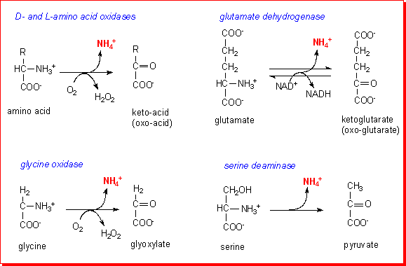
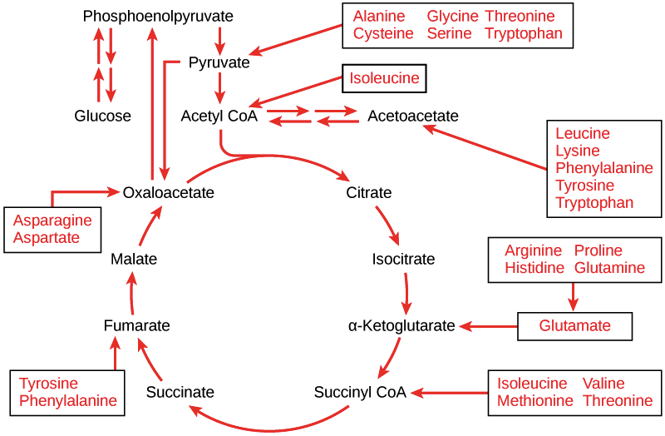
How proteins enter the respiratory pathway
Excess amino acids are deaminated in the liver (the amino group is removed)
This results in a keto acid forming.
The keto acids can be converted to various respiratory substrates (including pyruvate, acetyl coA or one of the Krebs cycle intermediates). This depends upon the R group.

Slide 5
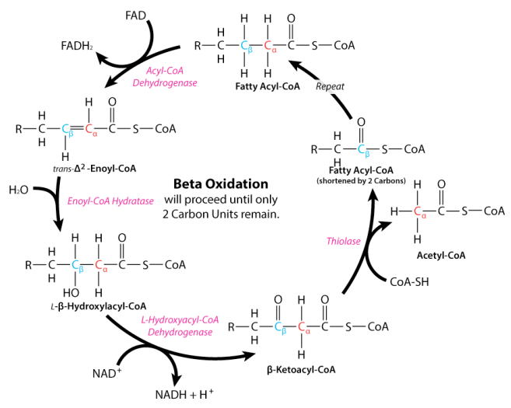
How lipids enter the respiratory pathway
Triglycerides are hydrolysed to glycerol and fatty acids
Glycerol can be converted into triose phosphate (glyceraldehyde-3-phosphate) and can enter glycolysis
Fatty acids undergo a process called beta oxidation in the mitochondrial matrix
During beta oxidation the fatty acid tails are broken down into a series of two-carbon units that combine with coenzyme A, forming acetyl CoA, which enters the Krebs cycle
The process of beta oxidation produces reduced NAD and reduced FAD molecules

Slide 6
Complete the diagram below to show how proteins and fats can be respired:
glucose (6C)
glycogen
glycolysis
triose phosphate (3C)
glycerol
proteins
pyruvate (3C)
fats (triglycerides)
link reaction
amino acids
acetyl CoA (2C)
fatty acids
OAA (4C)
citrate (6C)
Kreb’s cycle
5C compound

Slide 7
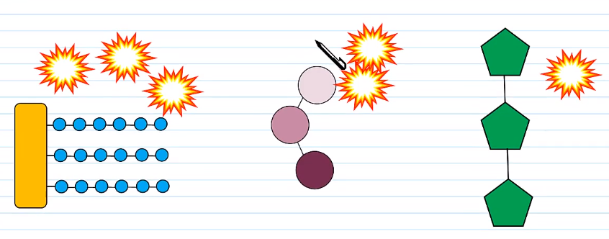
Energy released by different respiratory substrates
Different respiratory substrates generate different amounts of ATP
The respiratory substrates with the most Hydrogen atoms generate the most ATP per molecule of substrate
  Suggest why

Slide 8
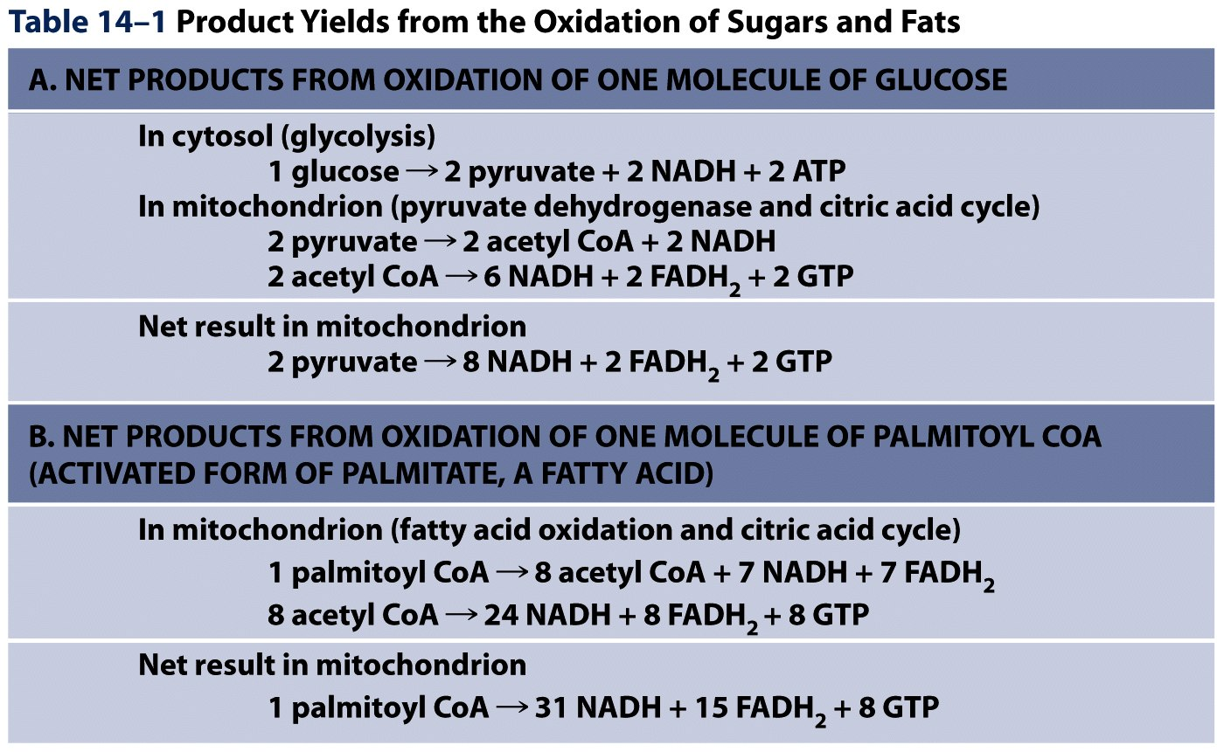
Glucose
C₆H₁₂O₆
Why is carb respiration more efficient?
Palmitoyl CoA
C₃₇H₆₆N₇O₁₇P₃S
More oxygen is needed as the final electron acceptor!
Are you thinking that respiring fats is more efficient at this point?

Slide 9
Explain how the demand for O₂ changes if there are more NADH and reduced FAD
Increases O₂ demand
O₂ is the final electron acceptor in ETC
More O₂ is required to undergo oxidative phosphorylation

Slide 10
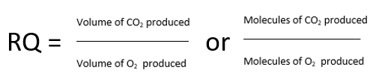

Respiratory Quotients
The respiratory quotient is a ratio of the volume of CO₂ produced to the volume of O₂ used, in a given unit of time.
Remember: The more H atoms in the substrate, the more O₂ is required. This results in a smaller RQ value.
Taken up
Taken up
RQ Values:
You need to learn these off by heart

Slide 11
Calculate the RQ when glucose is respired by yeast under:
(i) aerobic & (ii) anaerobic conditions:
aerobic
C₆H₁₂O₆ + 6 O₂ 6 CO₂ + 6 H₂O + energy
RQ CO₂ 6 1.0
O₂ 6
=
=
=
anaerobic
C₆H₁₂O₆ 2 C₂H₅OH + 2 CO₂ + energy
RQ CO₂ 2
O₂ 0
=
=
=
8
Explain why an RQ value greater than 1 indicates a mixture of aerobic and anaerobic respiration
Why can't respiratory quotient be calculated for anaerobic respiration in mammals?

Slide 12
Suggest why an RQ value greater than 1 indicates a mixture of aerobic and anaerobic respiration
Calculate the RQ when glucose is respired by muscle cells under:
(i) aerobic & (ii) anaerobic conditions:

Slide 13
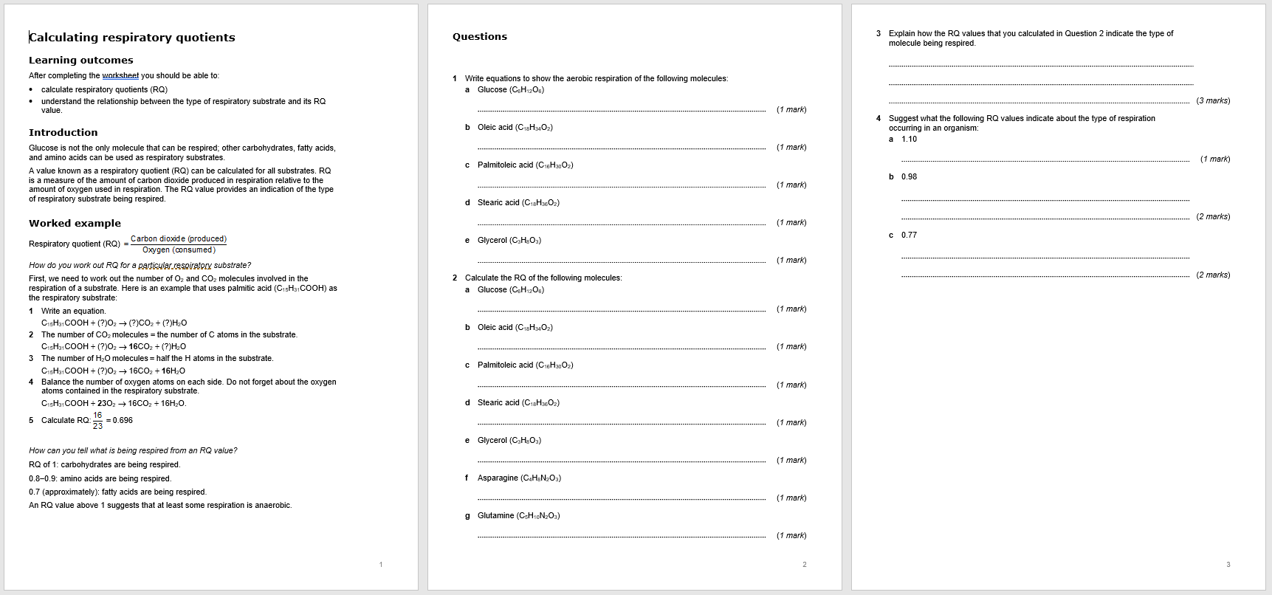
Practice calculating RQ Values

Slide 14
RQ = ……… released
……… consumed
Do!
Respiratory Quotients
Cells can respire glucose, other carbohydrates, lipids and proteins.
A respiratory ………….. is a biological molecule that can be broken down in respiration to release energy
Different respiratory substances release different amounts of …………. when respired.
Respiratory Substrate | RQ
Lipids
Proteins/ amino acids
Carbohydrates
Calculating the Respiratory Quotient
Work out a ………… symbol equation for the respiration of the respiratory substrate.
Divide the number of molecules of carbon dioxide released by the number of molecules of ……….. consumed
Example
C₆H₁₂O₆ + 6O₂ 6CO₂ + 6H₂O
RQ = …………….
Use the big numbers to plug into the formula
The Respiratory Quotient Tells You What Substrate is Being Respired
Usually the RQ for humans is between 0.7 and 1.0. An RQ in that range suggests some …………. are being used for respiration as well as ……………….
Proteins are usually only respired when there is …………. else.
High RQs (greater than 1) mean an organism is short on oxygen and is respiring ……………… and aerobically.
Plants sometimes have a low RQ, as the carbon dioxide released in respiration is used in …………….. (so can’t be measured).

Slide 15
Review!
Respiratory Quotients
RQ = CO₂ released
O₂ consumed
Cells can respire glucose, other carbohydrates, lipids and proteins.
A respiratory substrate is a biological molecule that can be broken down in respiration to release energy
Different respiratory substances release different amounts of energy when respired.
Respiratory Substrate | RQ
Lipids | 0.7
Proteins/ amino acids | 0.9
Carbohydrates | 1.0
Calculating the Respiratory Quotient
Work out a balanced symbol equation for the respiration of the respiratory substrate.
Divide the number of molecules of carbon dioxide released by the number of molecules of oxygen consumed
Example
C₆H₁₂O₆ + 6O₂ 6CO₂ + 6H₂O
RQ = 6/6 = 1
Use the big numbers to plug into the formula
The Respiratory Quotient Tells You What Substrate is Being Respired
Usually the RQ for humans is between 0.7 and 1.0. An RQ in that range suggests some lipids are being used for respiration as well as carbohydrates.
Proteins are usually only respired when there is nothing else.
High RQs (greater than 1) mean an organism is short on oxygen and is respiring anaerobically and aerobically.
Plants sometimes have a low RQ, as the carbon dioxide released in respiration is used in photosynthesis (so can’t be measured).

