Slide 1
Primary defences against disease
Lesson 3a – non-specific defences

Slide 2
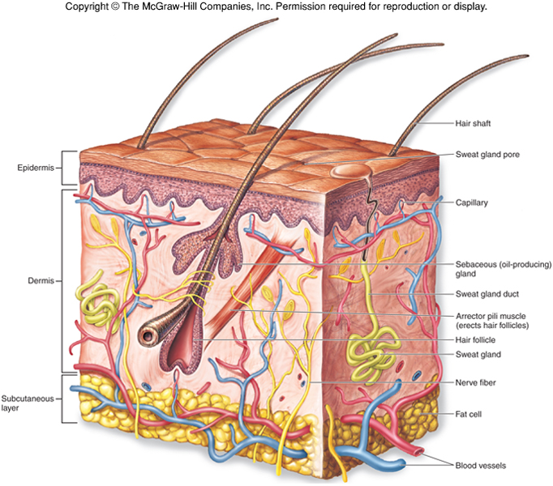
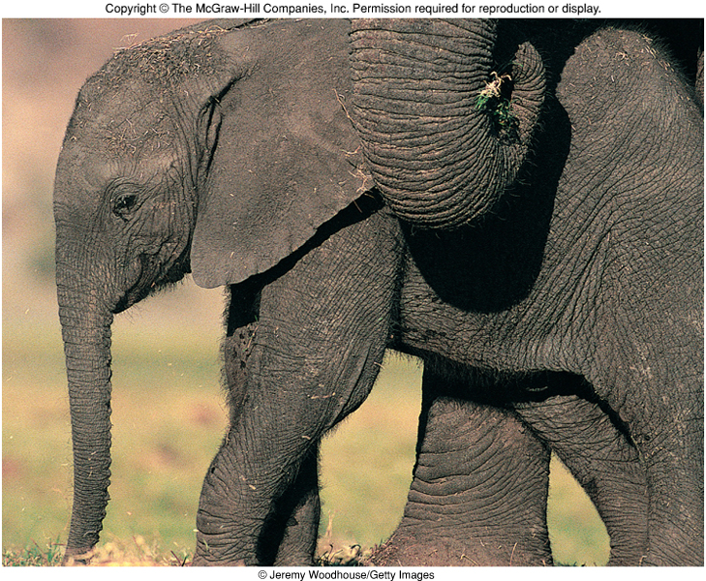
Brain storm the first line of defence of our body
Barriers

Slide 3
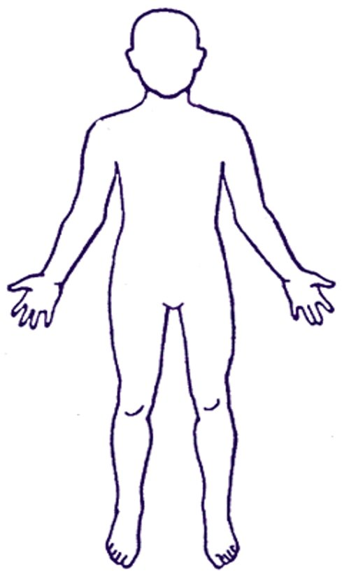
Primary defences
With your partner list the places where pathogens can enter the body.
Next add methods of defence in these places
Use a highlighter to show the essential key words that will give you exam marks when answering these questions.

Slide 4
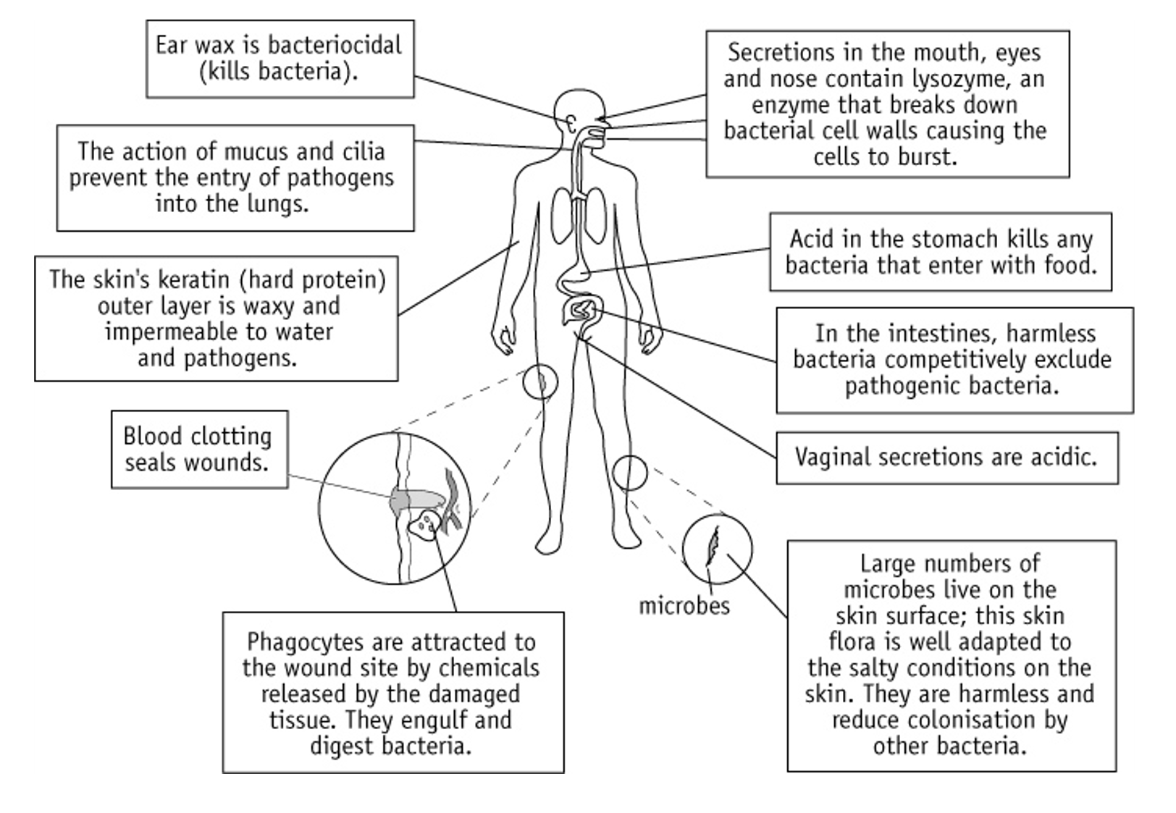
Don't forget the cough, sneeze and vomit expulsive reflexes.

Slide 5
Second line of defence – what happens to prevent further damage?
1 - Blood clotting
2- Inflammation – mast cells secrete histamines
3 - Wound repair – stem cells divide, and platelets secrete growth factors
4 – Phagocytosis (next lesson)

Slide 6
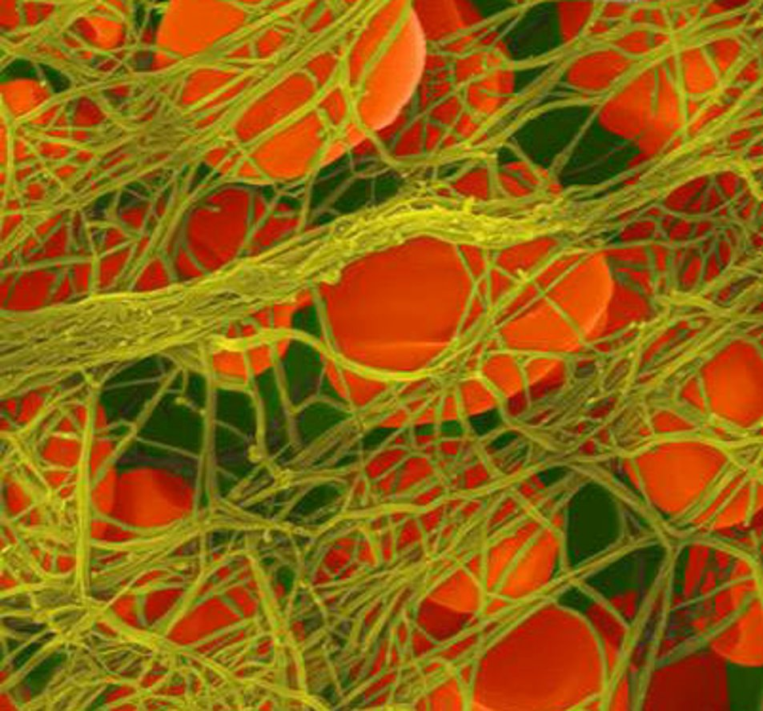
1.Blood clotting
Purpose:
Stops loss of blood
Prevents entry of pathogens
Provides a protective surface for wound healing underneath
If damage to the blood vessel wall is deep enough (platelets come into contact with collagen) a cascade reaction is initiated........

Slide 7
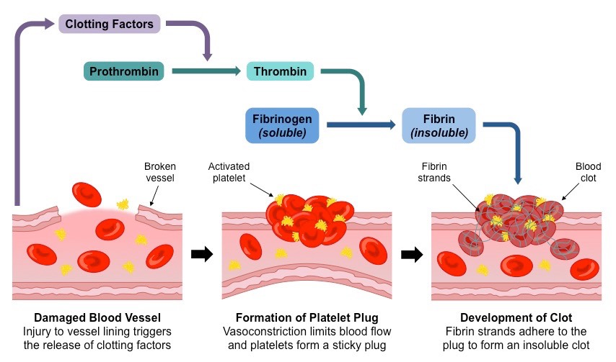
Blood clotting cascade reaction
Use this information to create a simplified flow diagram

Slide 8
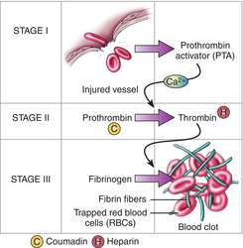
Damage to blood vessel wall → collagen and clotting factors released
Sticky platelets bind to collagen and release clotting factors – forms temporary plug
Active thromboplastin enzyme is released
Thromboplastin and Ca²⁺ convert prothrombin → thrombin
Thrombin converts fibrinogen → fibrin
Fibrin fibres attach to platelets in plug
RBC and platelets trapped in fibrin net → clot formed
Seratonin is also released which causes vasoconstriction

Slide 9
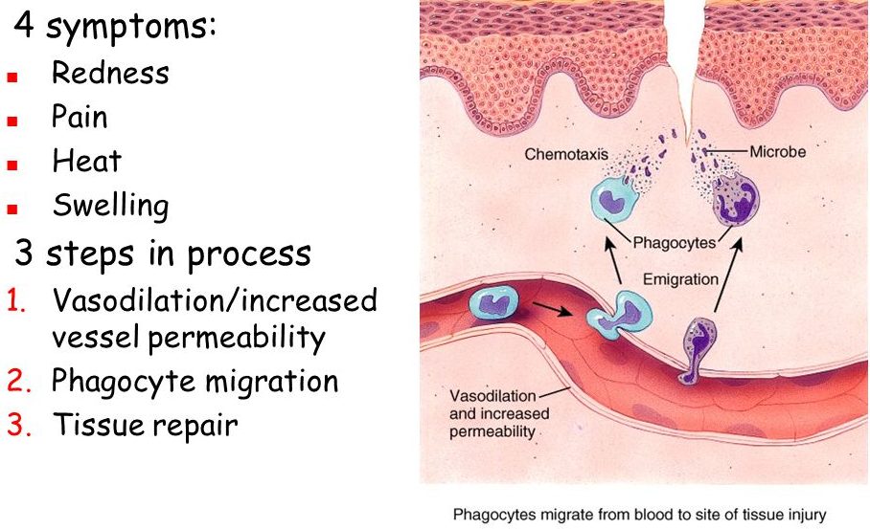
Local response to tissue damage / infection
Release of chemical signalling molecules
Increased blood flow
Movement of phagocytes (chemotaxis) into the affected area/ infected tissues
2. Inflammation

Slide 10
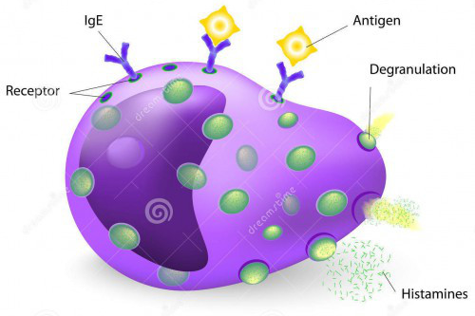
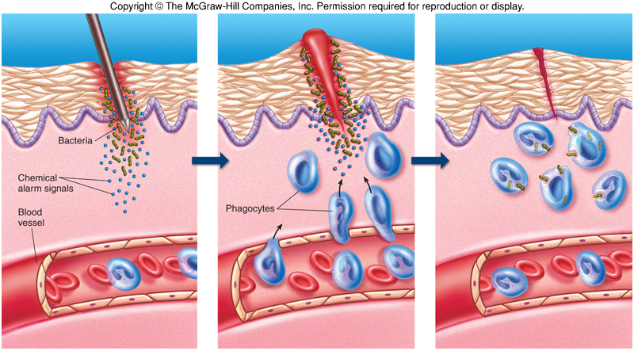
Presence of microorganisms is detected by mast cells. Mast cells produce histamine (cell signalling substance) – various effects of surrounding tissue.
Label your diagram

Slide 11
Histamine causes....
Vasodilation – blood flow through capillaries increases
capillary walls become more permeable to WBC and some proteins
these cells and proteins enter the tissue fluid, which leads to increased tissue fluid - swelling
excess tissue fluid drains into the lymphatic system which can initiate the specific immune response (third line of defence).
Histamine also stimulates cells to secrete cytokines to stimulate defences in the area of infection and some that have an affect on the whole body.

Slide 12
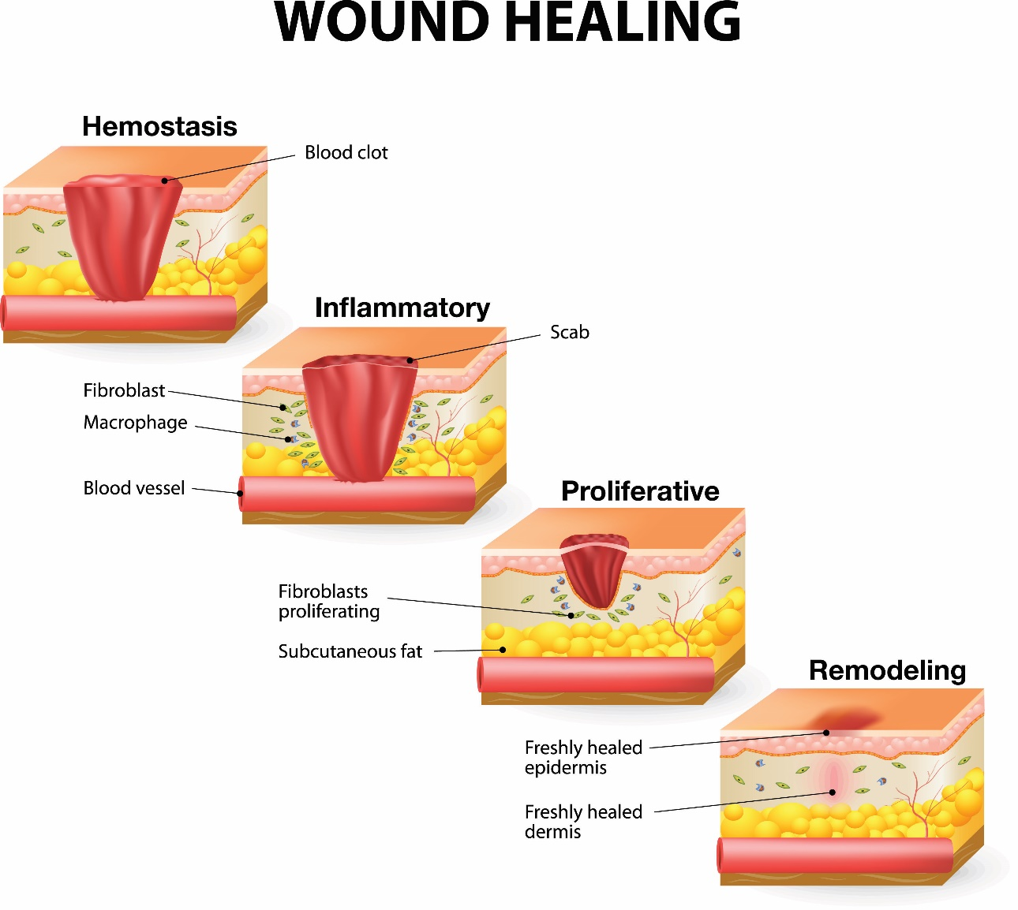
3. Wound repair
The skin heals from the bottom up and eventually pushes off the old scab
Stem cells under a scab begin to divide to repair the wound (mitosis) (details of stages not needed)
Platelets secrete growth factors that attract cells to divide and grow.

Slide 13
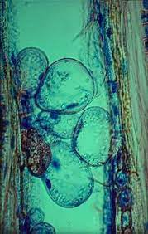
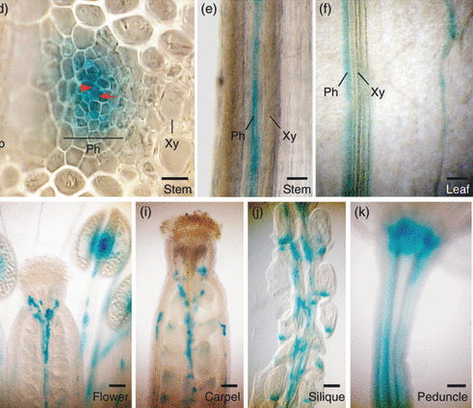
Plant defence against pathogens
Passive defence |  | Active defence
Physical |  | Chemical
Structure | Function | Structure | Function
Cellulose cell wall |  | Terpenoids
 | Waterproof and indigestible thickening | Phenols
 | Guard cells swell | Alkaloids
Bark |  | Defensins
 | Blocks the flow in the sieve tube | Hydrolytic enzymes
Tylose |  | Necrosis
 |  | Canker

Slide 14
Passive defence |  | Active defence
Physical |  | Chemical
Structure | Function | Structure | Function
Cellulose cell wall | Provides a barrier | terpenoids | Airborne signals that induce defence responses
Lignin | Waterproof and indigestible thickening | phenols | Protect against biotic and abiotic stress
Stomata control | Guard cells swell | alkaloids | Bitter tasting deter herbivores
Bark | Physical barrier, impenetrable layer | defensins | Have antimicrobial actions
Callose | Blocks the flow in the sieve tube | Hydrolytic enzymes | Degrades fungal cell walls and destroys fungal pathogens
Tylose | Blocks plasmodesmata to prevent movement of pathogens between cells | necrosis | Rapid forced cell death of parts of the plant under attack to protect the rest of the plant
 |  | canker | A large growth around a twig or a branch, killing the foliage behind it to protect the rest of the plant.

Slide 15

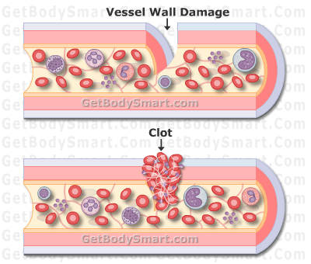
Perfect revision moment…
You cut yourself, what happens next?
Using your whiteboard:
What happens to start a reaction?
Which part of the blood is attracted to the damage site?
Write out the cascade reaction that causes blood to clot.
What is trapped in the mesh?
Collagen exposed
Sticky platelets attach
Thromboplastin released
Prothrombin converted into the enzyme thrombin. This catalyses soluble fibrinogen into insoluble fibrous fibrin.
Red blood cells caught in mesh.

Slide 16
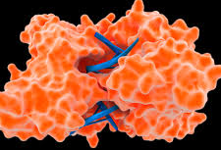
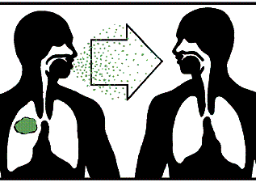
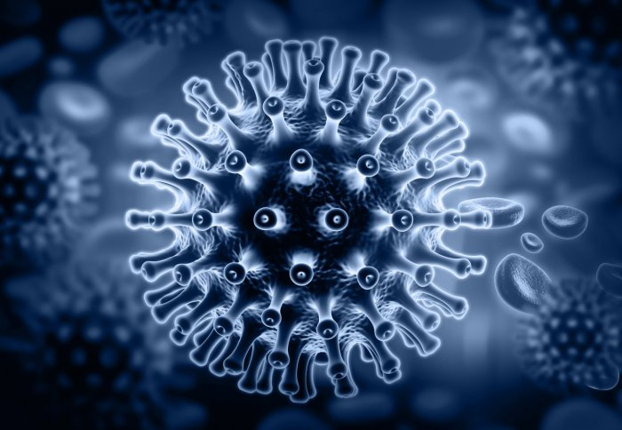
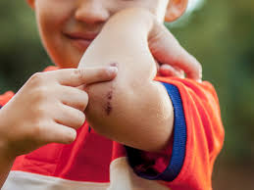
Choose a picture for your partner and get them to tell you as much as they can about it. Correct them and add information wherever you can.

