Slide 1
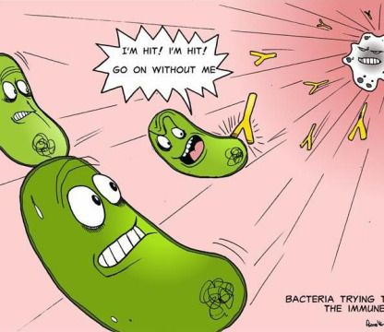
Non-specific defences against disease
Wednesday, 23 July 2025
You are under attack, what happens next?

Slide 2
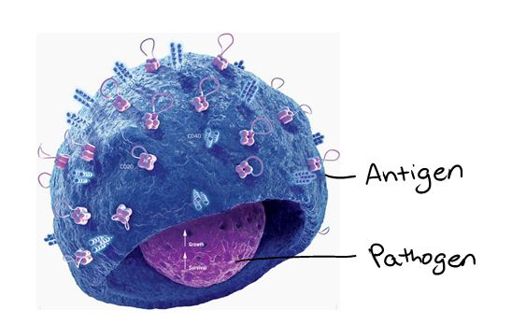
The immune response: the response of the immune system if a pathogen or parasite gets past the primary defences.
Antigens; molecules, such as proteins and polysaccharides, on the surface of cells.
These antigens are recognised by the immune system as either normal or foreign.
If foreign, the immune system acts to deal with the pathogen.
Stages of the immune system:
Phagocytosis (second line of defence)
T lymphocyte activation ( third line of defence )
B lymphocyte activation ( third line of defence )
Antibody production (third line of defence)
What do you know about each stage?

Slide 3
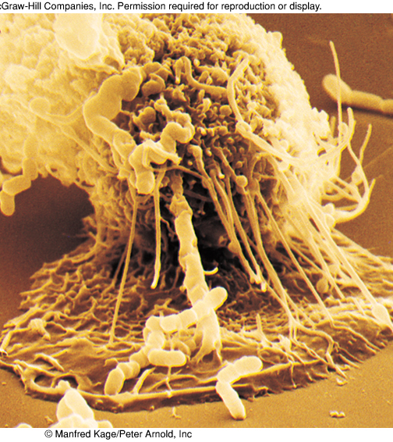
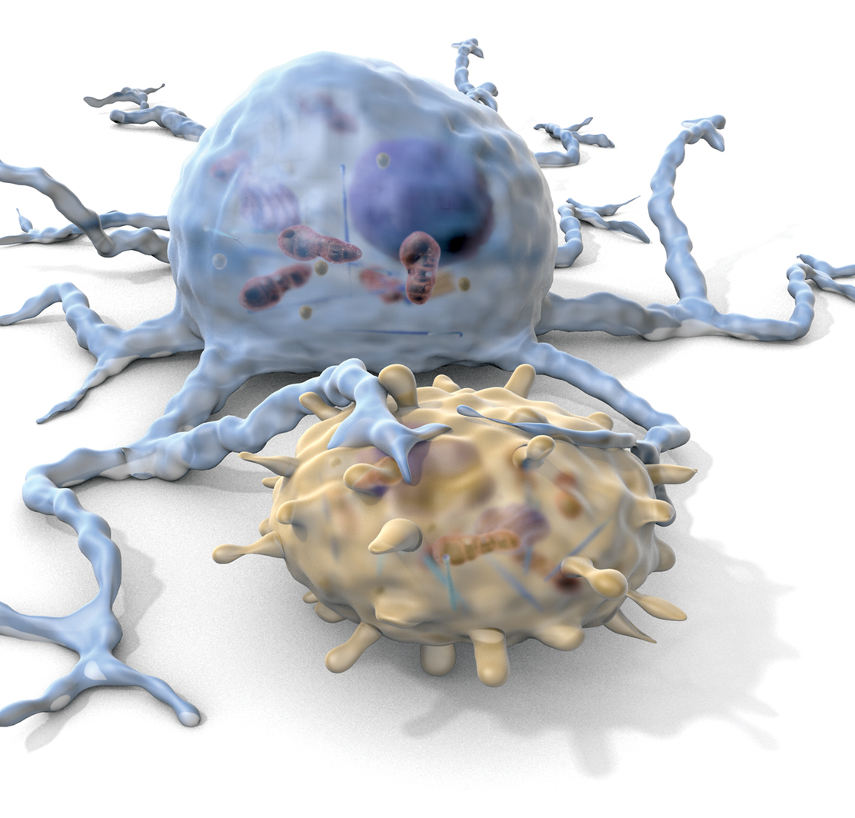
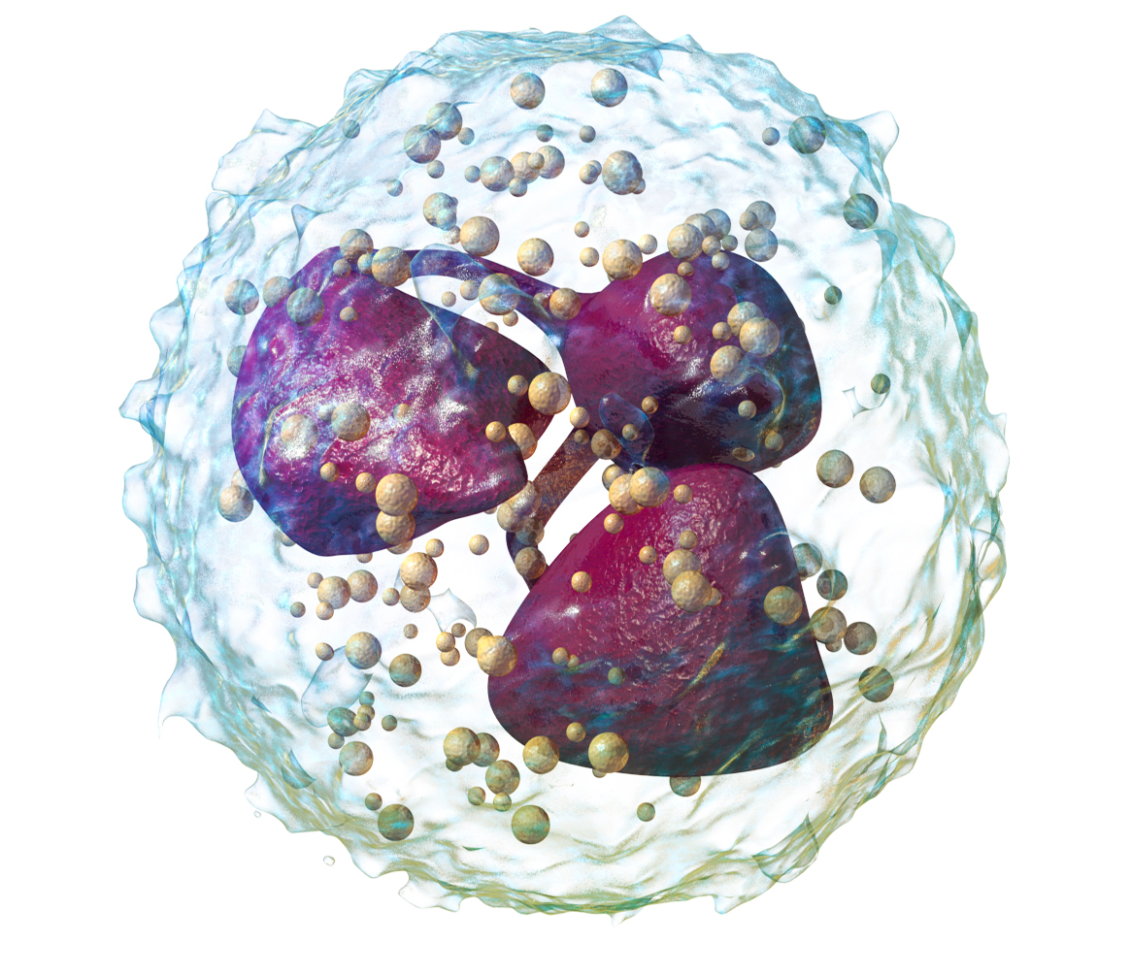
Cells that carry out phagocytosis
Three main types:
  Neutrophils
  Monocytes (macrophages)
  Dendritic cells

Slide 4
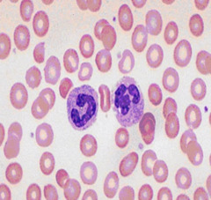
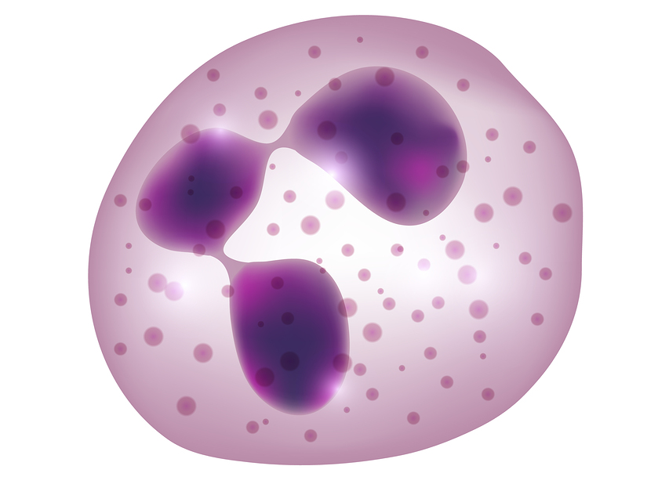
Neutrophils (multi-lobed nucleus)
Circulate in the blood, spread to tissues during an infection
‘rapid responders’
Not long lasting – take approximately 10 minutes to destroy pathogen and then die
After ingesting and digesting a few bacteria, neutrophils often die and accumulate to form pus

Slide 5
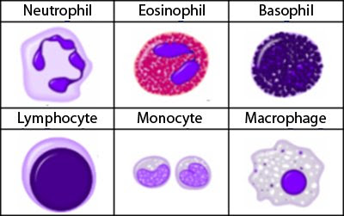
Monocytes in the blood which become macrophages in the tissue
Pass out of the bloodstream, enter tissues and lymph where they become macrophages.
Long lasting – become antigen presenting cells when they have destroyed a pathogen.
Play a role in the specific immune response (processing and presenting antigens to lymphocytes)
Some migrate, other remain stationary in certain tissues (kidneys, brain, lungs, liver, spleen, lymph nodes) where much antigen presentation occurs.
Types of granulocyte
Types of lymphocyte

Slide 6
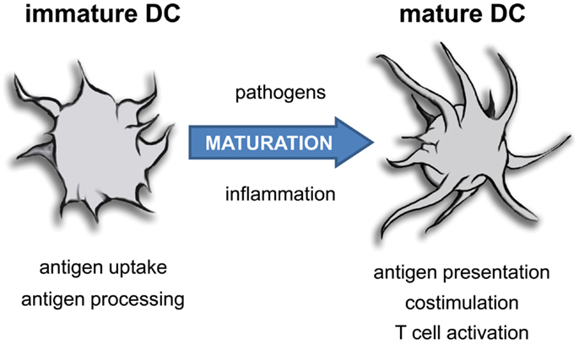
Dendritic cells (type of macrophage, antigen presenting cell)
Long processes – large surface area
Found throughout the body
When foreign material is ingested, they migrate to the lymph nodes
Play a role in the specific immune response (processing and presenting antigens to lymphocytes)
Why does the Dr check your neck when you are unwell?

Slide 7
Phagocytosis
To do (using the next slides) either:
1. Bullet point the process of phagocytosis.
0r
2. Draw a series of labelled diagrams to illustrate the steps.
Use all key terms and stick to the point.
Amazing video : Bacterial Phagocytosis by Macrophages and Neutrophils - YouTube
Play dough out, lets have fun!

Slide 8
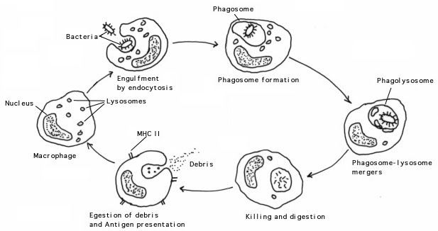
Phagocytosis
Add numbered steps to your diagram with description of each stage
INGEST
DIGEST
http://www.zo.utexas.edu/faculty/sjasper/bio301L/immune.html

Slide 9
Mark your work:
The description may include the following points:
Phagocyte attracted to microbe by chemical products (chemotaxis)
Bacterial antigen binds to receptor on phagocyte plasma membrane
Membrane processes surround the bacterium.
Bacterium engulfed by the macrophage or neutrophil.
Bacterium is inside the cell contained within a vacuole.
Lysosome containing digestive enzymes attaches to the phagosome forming a phagolysosome.
Bacterium digested within the vacuole.
The vacuoles fuse with the cell surface membrane.
The digested contents are released from the cell by exocytosis.
Dead cells form pus which may break through the skin but usually gets broken down and absorbed into the tissue.

Slide 10
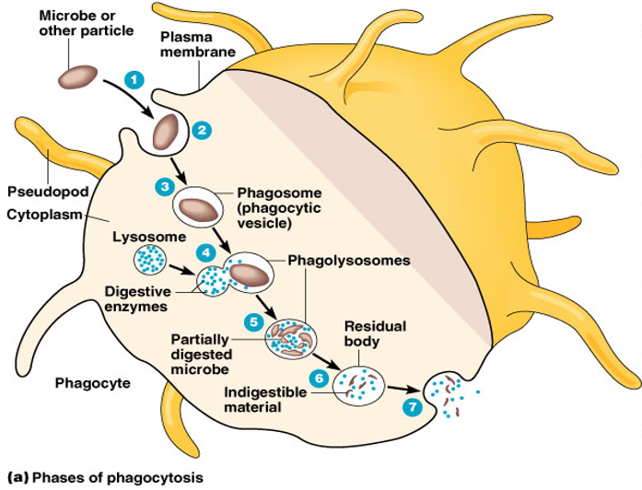







Check your learning:
Now order these stages:
1
2
3
4
5
6
7
6, 4, 7, 2, 1, 5,3

Slide 11
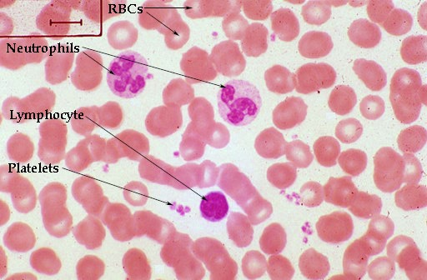
Cells of the immune system

Slide 12
Detecting an infection through a blood test
Number of neutrophils in the blood increases rapidly during an infection
Produced in the bone marrow, travel in the blood, pass though capillary walls into damaged tissues.

Slide 13
What are the key features of the primary non-specific defences against pathogens in animals
Present from birth
Don’t distinguish between different pathogens
Same response each time a pathogen enters the body
Usually act quickly but not always very effective

Slide 14
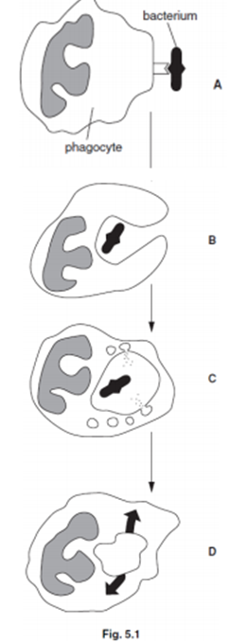
Practice Questions
1. The body has adaptations that provide it with a primary defence against the entry of pathogens and parasites. State two features of the body that form part of the primary defence. For each feature, explain how it helps to prevent the entry of pathogens and parasites into the body. 4 marks
2. In an individual with bronchitis, the mucus contains a large number of pathogenic bacteria. Phagocytic white blood cells destroy the bacteria. Fig. 5.1 shows the sequence of events that results in the destruction of a bacterium. 6 marks
Describe the events taking place at stages A, B, C and D, in sequence

Slide 15
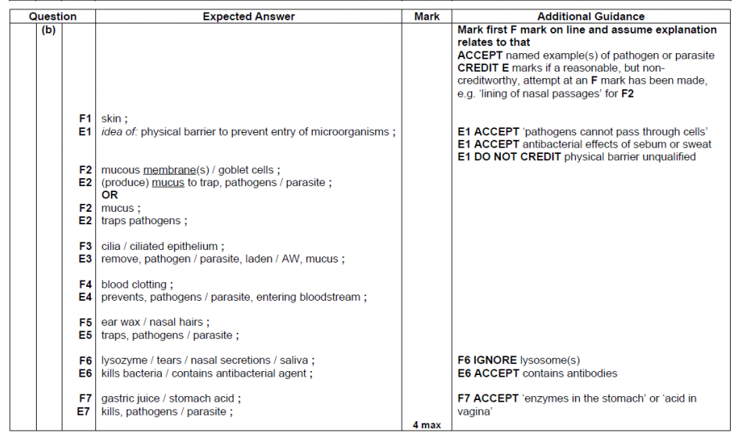

Slide 16
