Slide 1

Starter task
As the slides rotate, discuss each stage of the sliding filament model with your groups.
Try to stay ahead of the information!!
Include any key terms as you go.

Slide 2
Starter task
As the slides rotate, discuss each stage of the sliding filament model with your groups.
Try to stay ahead of the information!!
Include any key terms as you go.

Slide 3
Starter task
As the slides rotate, discuss each stage of the sliding filament model with your groups.
Try to stay ahead of the information!!
Include any key terms as you go.

Slide 4
Name the structures!

Slide 5
actin

Slide 6
troponin
actin

Slide 7
tropomyosin
troponin
actin

Slide 8
tropomyosin
troponin
actin

Slide 9
myosin binding site
tropomyosin
troponin
actin

Slide 10
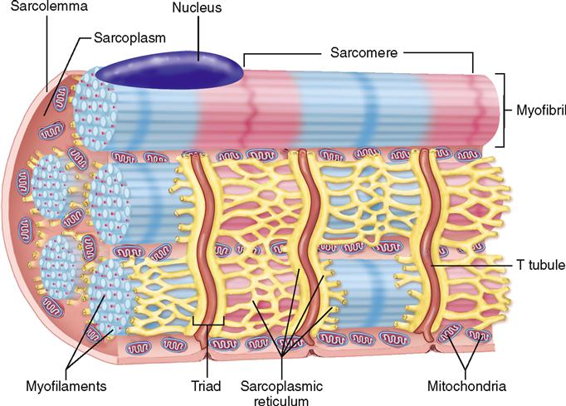
What happens next?
Ca²⁺
Ca²⁺
Ca²⁺
Ca²⁺
WHATS THIS?

Slide 11
Ca²⁺
Ca²⁺
Ca²⁺
Ca²⁺

Slide 12
What happens next?
Ca²⁺
Ca²⁺
Ca²⁺
Ca²⁺

Slide 13
The calcium ions bind to the troponin and changes its shape
Ca²⁺
Ca²⁺
Ca²⁺
Ca²⁺

Slide 14
What happens next?
Ca²⁺
Ca²⁺
Ca²⁺
Ca²⁺

Slide 15
Ca²⁺
Ca²⁺
Ca²⁺
Ca²⁺

Slide 16
What happens next?
Ca²⁺
Ca²⁺
Ca²⁺
Ca²⁺
The troponin displaces the tropomyosin and exposes the myosin binding sites

Slide 17
Ca²⁺
Ca²⁺
Ca²⁺
Ca²⁺

Slide 18
What happens next?
Ca²⁺
Ca²⁺
Ca²⁺
Ca²⁺

Slide 19
What happens next?
Ca²⁺
Ca²⁺
Ca²⁺
Ca²⁺
The bulbous heads of the myosin attach to the binding sites on the actin filaments

Slide 20
What happens next?
Ca²⁺
Ca²⁺
Ca²⁺
Ca²⁺

Slide 21
What happens next?
Ca²⁺
Ca²⁺
Ca²⁺
Ca²⁺

Slide 22
What happens next?
Ca²⁺
Ca²⁺
Ca²⁺
Ca²⁺
The myosin heads (flex) change position and slide the actin filaments past the stationary myosin

Slide 23

What happens next?
Ca²⁺
Ca²⁺
Ca²⁺
Ca²⁺
P_{i}
P_{i}
P_{i}
A
P_{i}
P_{i}
P_{i}
A
P_{i}
P_{i}
P_{i}
A

Slide 24
What happens next?
P_{i}
P_{i}
P_{i}
A
Ca²⁺
P_{i}
P_{i}
P_{i}
Ca²⁺
Ca²⁺
P_{i}
P_{i}
P_{i}
A
A
Ca²⁺

Slide 25
What happens next?
P_{i}
P_{i}
P_{i}
A
P_{i}
P_{i}
P_{i}
Ca²⁺
Ca²⁺
P_{i}
P_{i}
P_{i}
A
Ca²⁺
A
Ca²⁺

Slide 26

Ca²⁺
P_{i}
P_{i}
P_{i}
A
Ca²⁺
P_{i}
P_{i}
P_{i}
A
P_{i}
P_{i}
P_{i}
A
ATP binds to the bulbous heads and causes it to become detached

Slide 27
P_{i}
P_{i}
P_{i}
A
What happens next?
P_{i}
P_{i}
P_{i}
P_{i}
A
P_{i}
P_{i}
A
Ca²⁺
Ca²⁺
Ca²⁺
Ca²⁺
Hydrolysis of ATP provides the energy to “re-cock” the heads

Slide 28
What happens next?
P_{i}
P_{i}
P_{i}
A
P_{i}
P_{i}
P_{i}
P_{i}
A
P_{i}
P_{i}
A
Ca²⁺
Ca²⁺
Ca²⁺
Ca²⁺

Slide 29
What happens next?
P_{i}
P_{i}
P_{i}
A
P_{i}
P_{i}
P_{i}
P_{i}
A
P_{i}
P_{i}
A
Ca²⁺
Ca²⁺
Ca²⁺
Ca²⁺
Head of the myosin attach to the binding sites further up the actin filament

Slide 30

P_{i}
P_{i}
P_{i}
A
P_{i}
P_{i}
P_{i}
P_{i}
A
P_{i}
P_{i}
A
Ca²⁺
Ca²⁺
Ca²⁺
Ca²⁺
Calcium ions are re-absorbed and process repeats as long as the stimuli is present

Slide 31
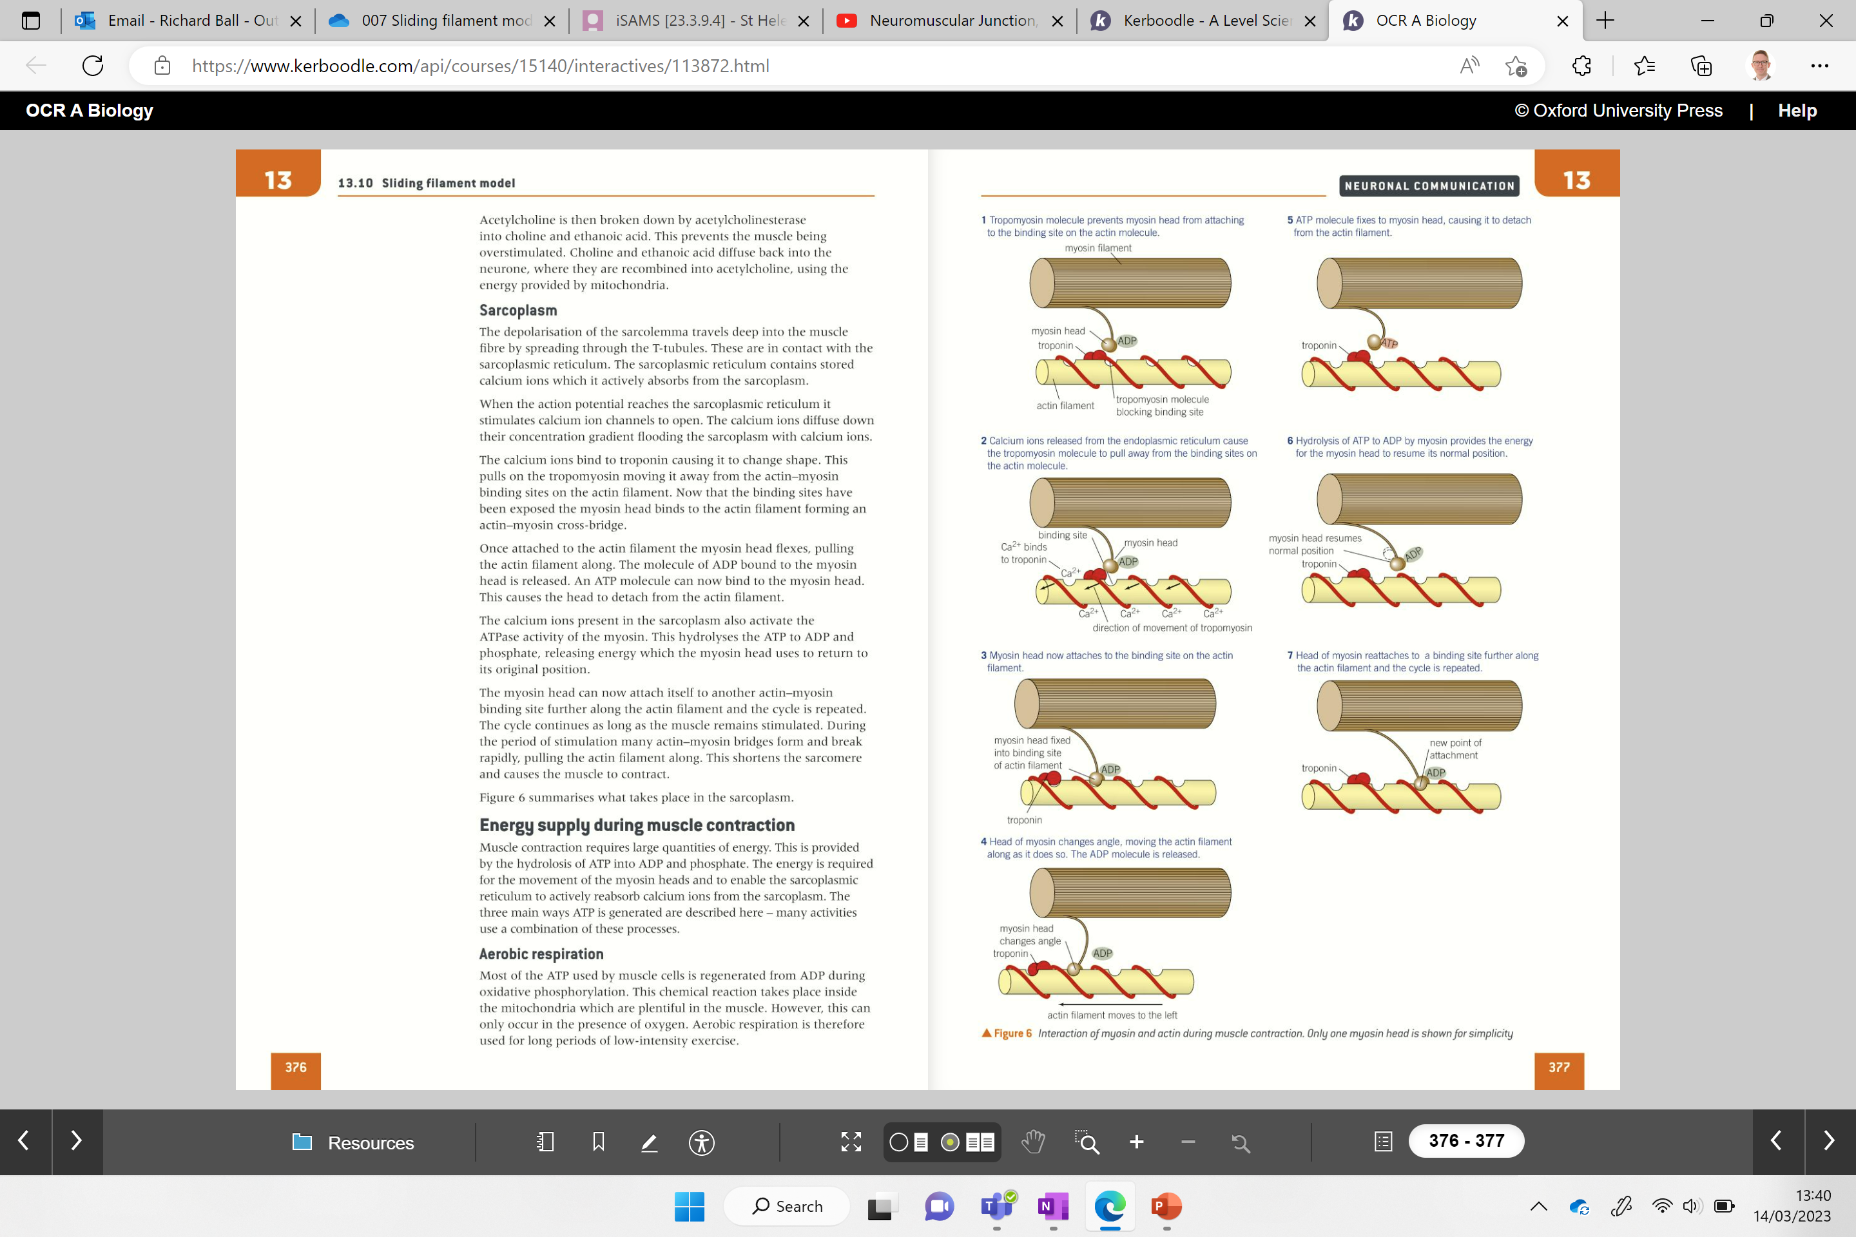
Arrange images into the correct order

Slide 32
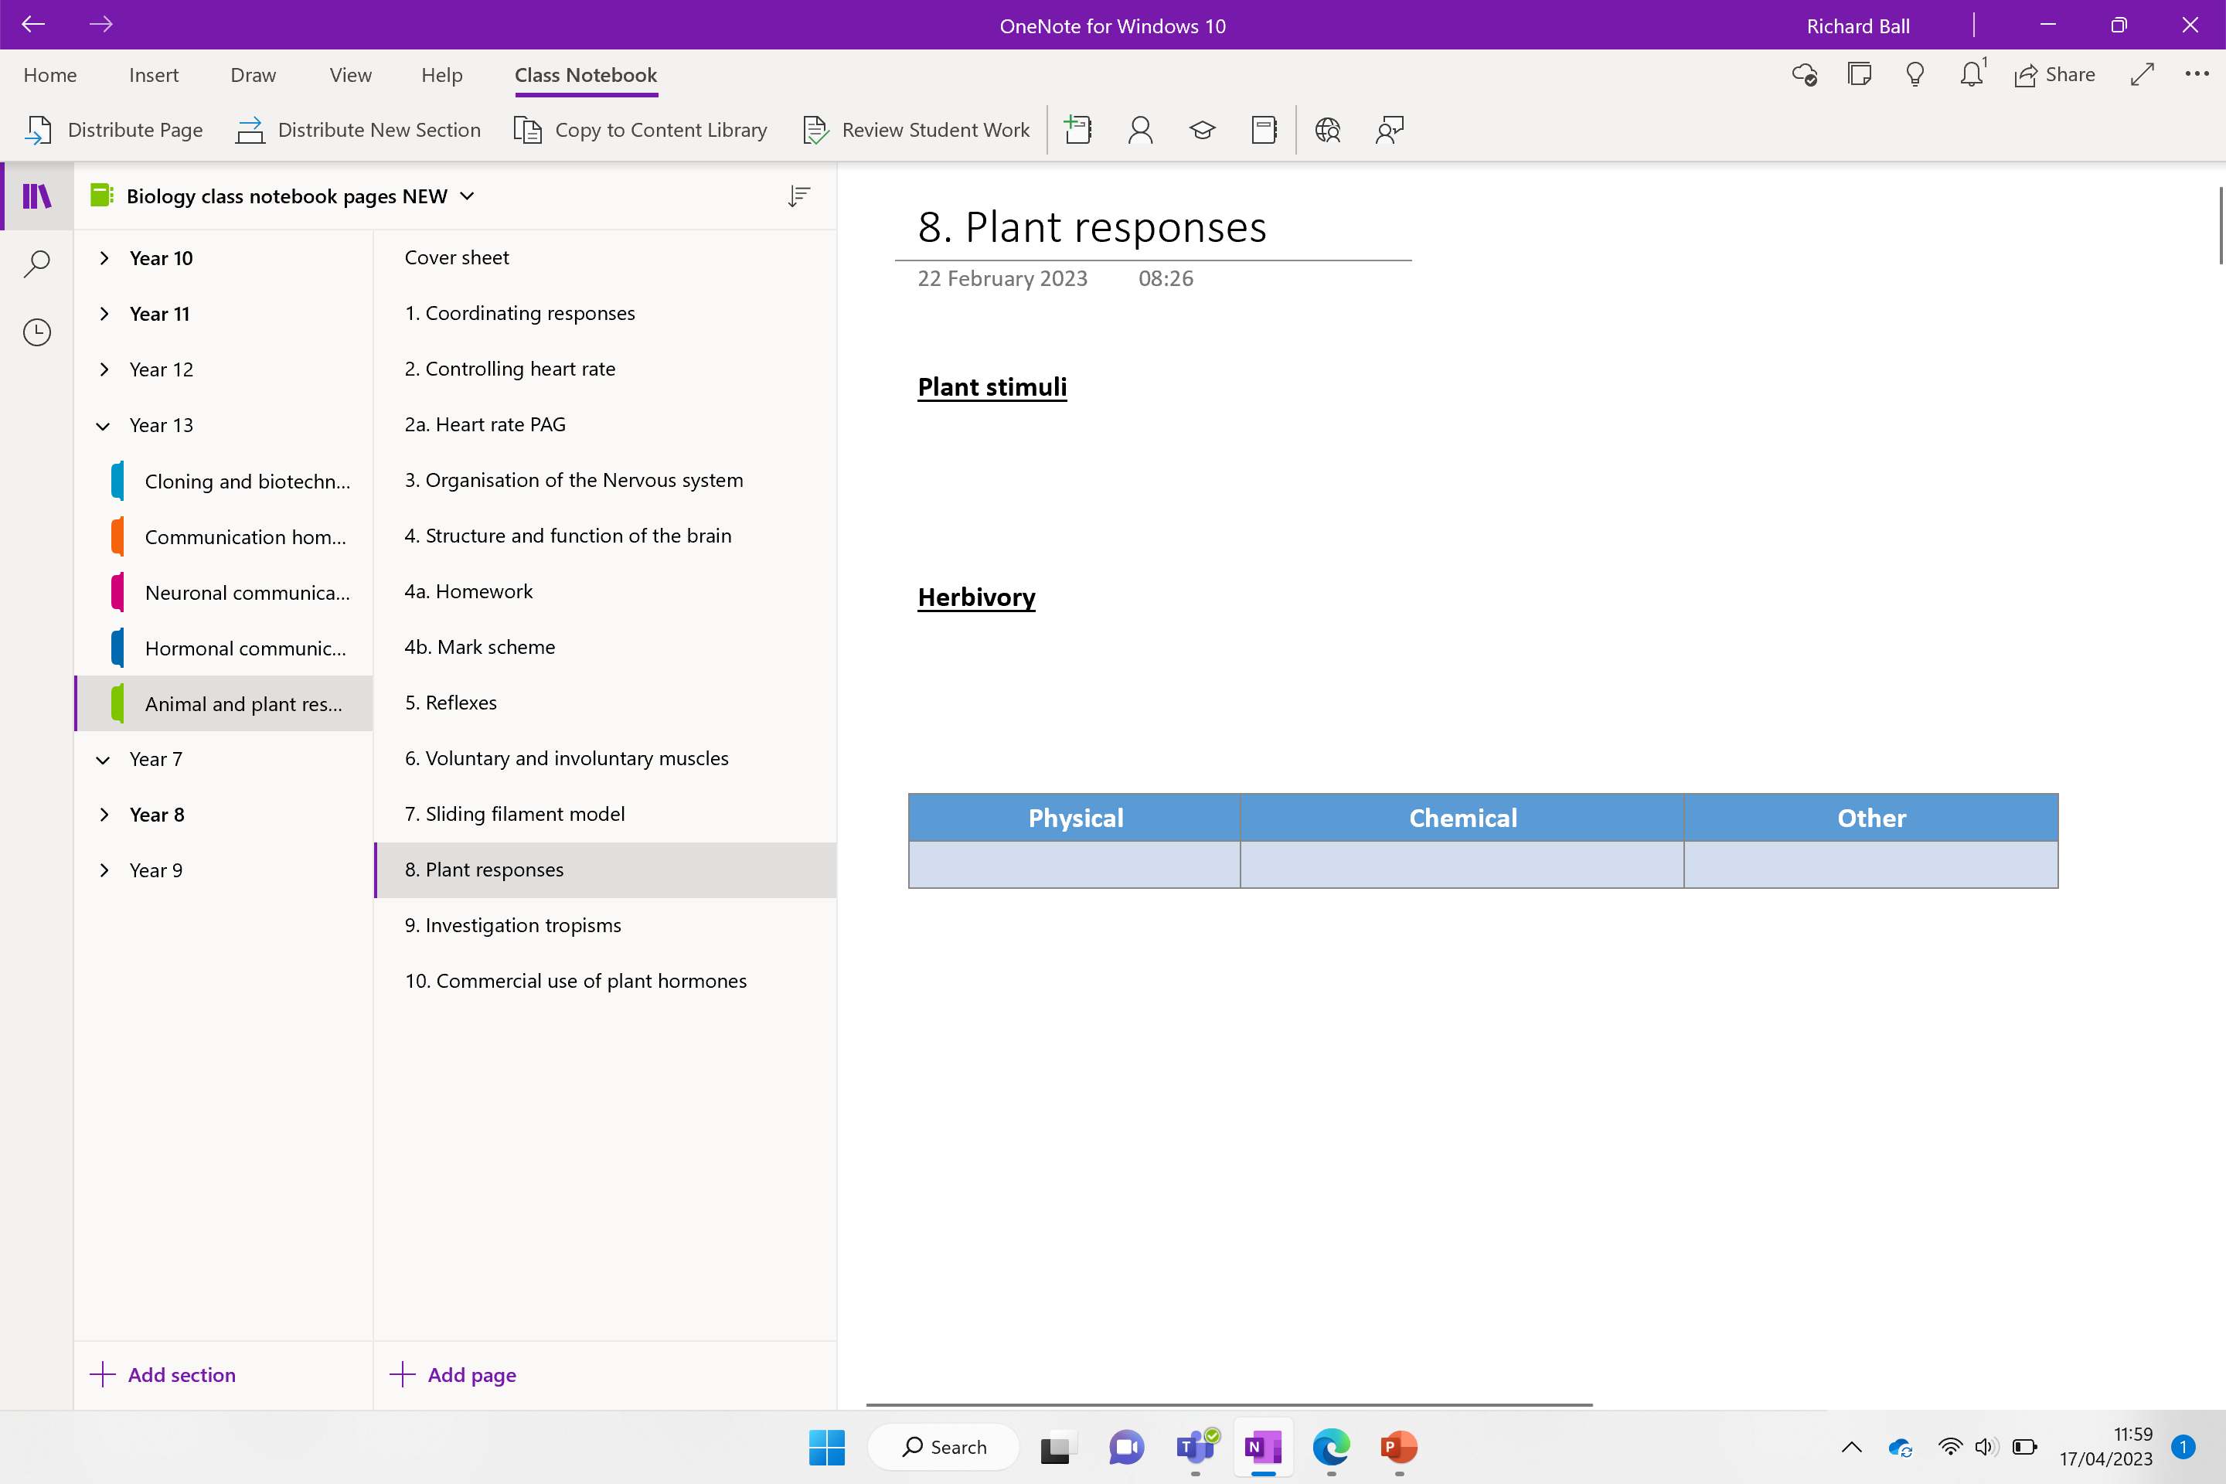

Slide 33
Plant responses

Slide 34
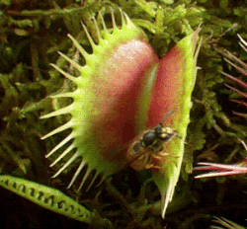
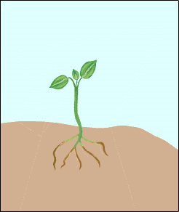
Plant Stimuli
Plants detect changes in the environment and produce the relevant responses.
Two types of stimuli from the environment:
  ABIOTIC – Non-living stimuli
  BIOTIC – Living parts of the environment
Plants do not have a nervous system
Instead they respond using hormones
Hormones are not released by endocrine glands but by cells in specific tissues
Notes:
Copy down

Slide 35
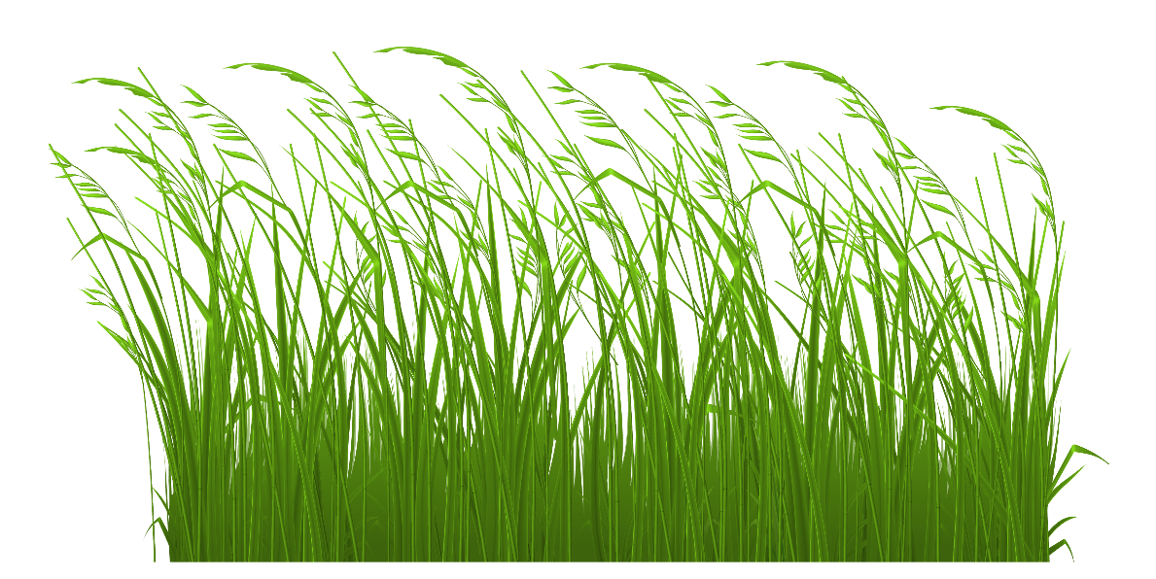
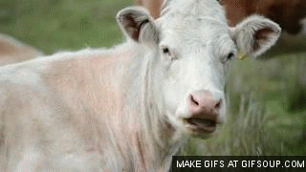
Response to biotic factors

Slide 36
Herbivory
When herbivores eat plants
Plants produce chemicals that act as a repellent to animal (sometimes even poisonous)
Sometimes the plant always has these chemicals
Other times the plants produce the chemical in response to stress or damage.

Slide 37
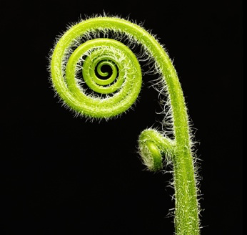
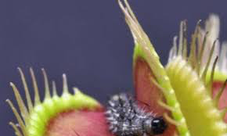
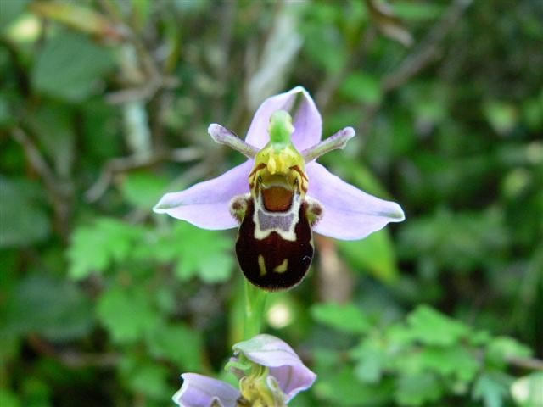
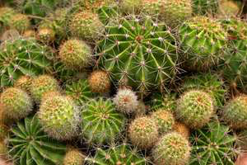
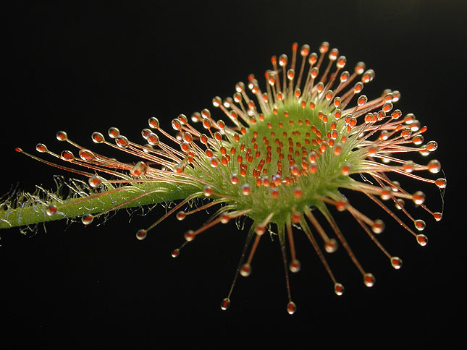
Explain how plants have adapted to prevent being eaten.
Physical | Chemical | Other
https://www.youtube.com/watch?v=Hja0SLs2kus

Slide 38
Exam style question
Explain how plants have adapted to prevent being eaten.
Physical barriers
Chemical barriers
Any other relevant adaptations
Physical | Chemical | Other

Slide 39
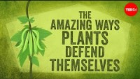

Slide 40
Plant defence
Physical barriers
Cellulose builds cell walls to strengthen the plant cell
Tough waxy cuticle acts as a pathogen barrier
Bark made from lignin on trees is a dead layer of cells that act as a barrier
Leaf fall – diseased leaves fall from tree to prevent spread
Spines/thorns prevent larger herbivores
Curling up when touch will dislodge the herbivore
Callose – large polysaccharide that is deposited in sieve tubes at the end of the growing season. Blocks the flow so that pathogens can’t spread
Guard cells - open and close stomata
other methods
Mimicry – some plants mimic unhealthy plants to avoid being eaten or mimic insects
Chemical barriers
Alkaloids are bitter tasting and can also be toxic
Oil released to prevent aphids attaching
Mint and hazel produced from plants act as antiseptics (terpenoids)
Stored in vacuoles, fatal to insects (toxic when broken down)
Pheromones are chemicals released by a species to affect another organism in the same species

Slide 41
More on chemical plant defence
Tannins
Water soluble flavonoids
Stored in vacuoles, fatal to insects (toxic when broken down)
Also has a bitter taste to put off herbivores
Alkaloids
Nitrogenous compounds from amino acids
Bitter tasting and can be toxic
Caffeine and nicotine (insect neurotoxin) are alkaloids
Capsaicin in chillies
Pheromones
Chemicals released by a species to affect another organism in the same species
Ethene released by plants causes ripening of fruit in nearby plants and/or leaf loss
Oxides of ethene are toxic to insects
Controls other chemical defences in plants
Switches on genes that produce chemicals to deter insects.
Terpenoids
Antibacterial and antifungal properties (some create a scent this is why mint plants smell minty!)
Notes:
Flavanoids are antioxidents (prevent free radicals oxidising atoms in our cells, they are compounds which react with FR neutralising them) that help remove free radicals in the body – FR are atom with an unpaired electron – produced naturally through metabolic pathways – used to fight infection (so some needed). Too many can be a problem, which is why a number of antioxidants are important (flavonoids being one) . FR can also be produced by environmental factors UV light, pollution etc – can cause mutations in DNA
What are flavonoids? Flavonoids are various compounds found naturally in many fruits and vegetables. They’re also in plant products like wine, tea, and chocolate.
Anti-inflammatory , bone strength ….. In simpler terms, they help your body function more efficiently while protecting it against everyday toxins and stressors. Flavonoids are also powerful antioxidant agents.
Flavonoids are secondary metabolites synthesized mainly by plants.
Flavonoids and isoflavonoids are polyphenolic secondary metabolites usually produced by plants adapting to changing ecological environments over a long period of time. Therefore, their biosynthesis pathways are considered as the most distinctive natural product pathway in plants.

Slide 42
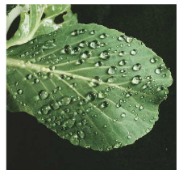
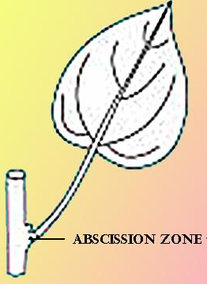
Response to abiotic stress:
State how a plant responds to each of the following abiotic stresses
High temperatures:
  Thicker layers of wax form on leaves to prevent water loss.
Freezing
  Some plants produce a hormones called ABA (abscisic acid) which prevents ice crystals from forming inside (like antifreeze!)
Drought
  Closing stomata or losing leaves altogether (ABA hormone is released to close stomata)
Decreasing light levels
  Leaf fall. Ethene is produce in the abcission zone at the base of the leaf which triggers an enzyme to digest the weakened cells in this zone.
  Vascular bundles are sealed off. Low temperatures and strong winds help the leaf break away.
  A neat waterproof scar remains.
Other abiotic stresses include:
  Increased salinity of soil water (membrane used to filter salt)
Notes:
Sea plants break salt down into Na and Cl ions and remove them during respiration – not sure how – something to look up!
Ab sis ic

Slide 43
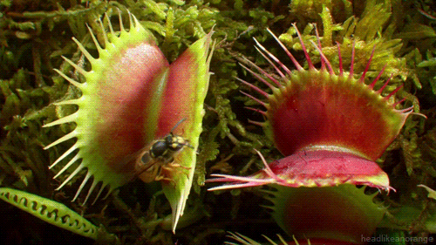
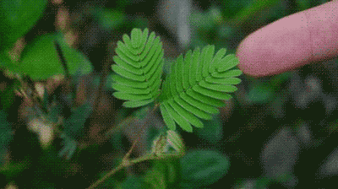
Electrical signals in plants

Slide 44
Nastic Movement
(Mimosa pudica)
Similar to thigmotropism caused by touch sensitive leaves / hairs
Leaflets fold in rapidly / trap closes
Caused by rapid uptake of water at the base of each leaflet
Adjacent cells lose water and collapse
As this response is not related to the direction of the touch stimulus it is not considered a tropism
Caused by an electrochemical change in cells.
Rapid movement of potassium ions allows water to move in an out of cells in different parts of the leaf causing is to curl.

Slide 45
What types of tropism do you know?

Slide 46
Biology Lesson Idea: Plants, Tropisms and Hormones | Twig (youtube.com)

Slide 47

Complete the description for the following tropisms using your prior knowledge and online research
Tropism | Description
Phototropism
Geotropism
Hydrotropism
Thigmotropism
Chemotropism

Slide 48
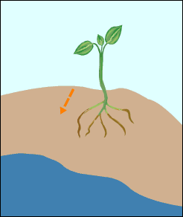
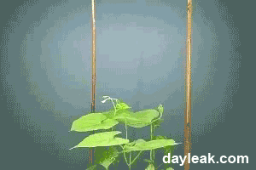
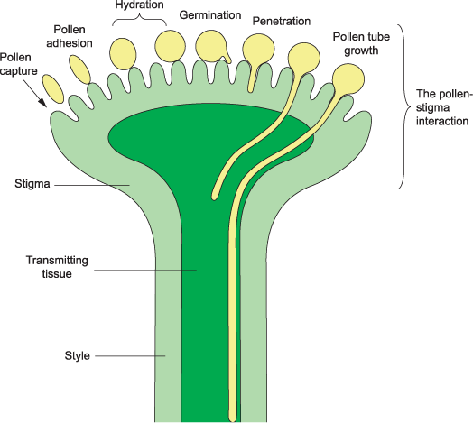
Tropisms (Growth response to a stimulus)
Phototropism – Light
  Ensures plant receives as much light as possible
Geotropism – Gravity
  Shoots have negative geotropism (grows upward).
  Roots have positive geotropism
Hydrotropism – Moisture
  Root tips grow toward damper soil.
Thigmotropism – Touch
  Climbing plants detect a support and curl around it
Chemotropism – Chemicals
  Pollen tubes grow down flower’s stigma toward ovules due to chemicals

Slide 49

CLICK LINK – TRANSPORT RECAP QUIZ TO START
Love Biology A Level Quiz | Transport in animals
Click advance and continue

Slide 50
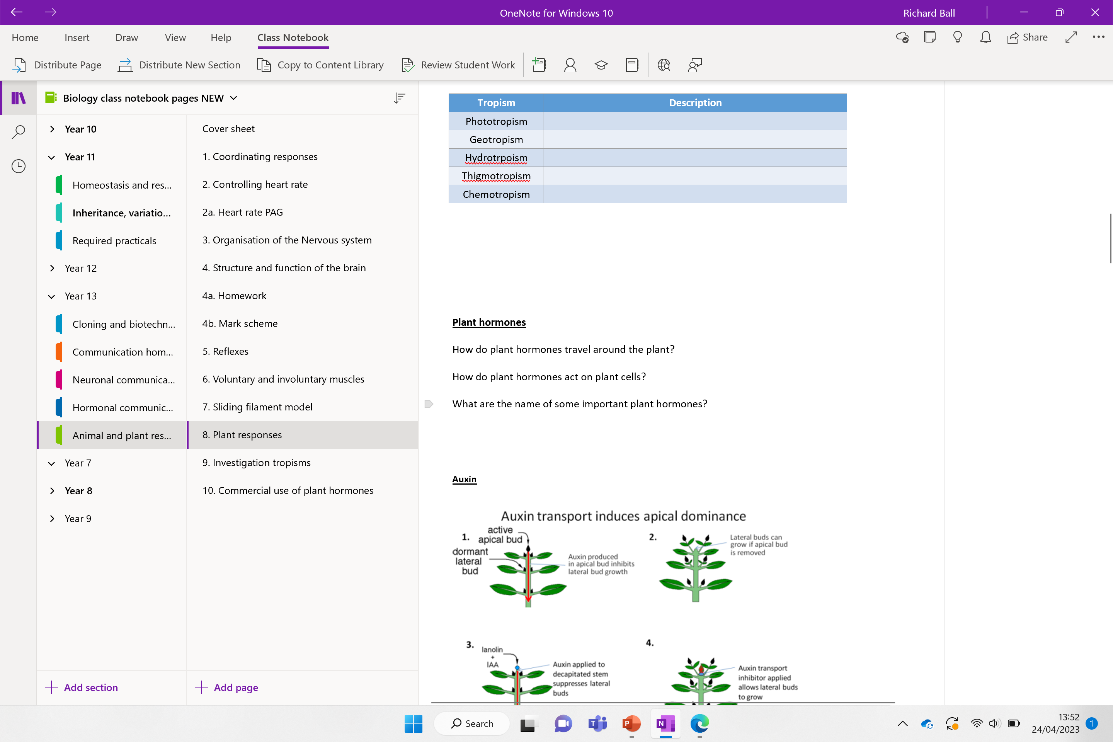
Next lesson below

Slide 51
Plant hormones
How do plant hormones travel around the plant?
Plant hormones can move through the intercellular spaces between cells
How do plant hormones act on plant cells?
The can bind to receptors / switch on genes to instruct the synthesis of proteins
What are the name of some important plant hormones?
Auxin, gibberellins, cytokinin’s, abscisic acid and ethene
Notes:
Ethene is produce in the abcission zone at the base of the leaf which triggers an enzyme to digest the weakened cells in this zone.
Cytokinin – cell growth

Slide 52
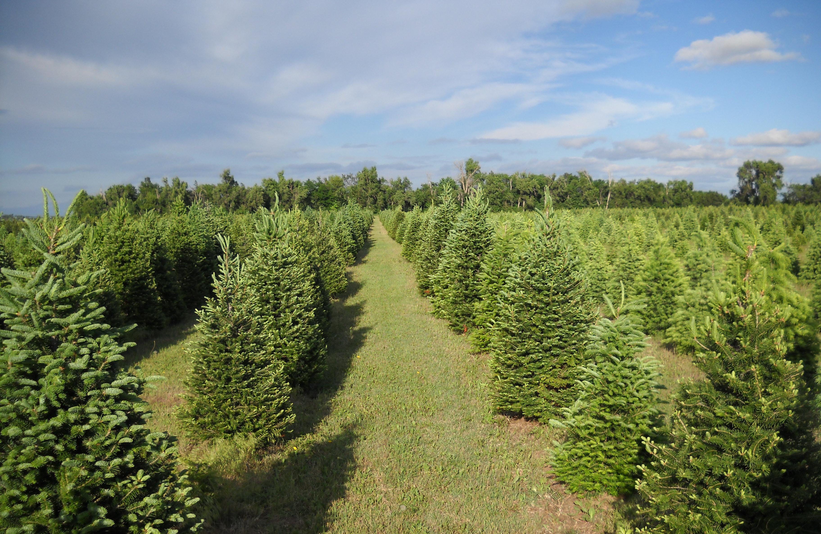
Why are most trees this shape?

Slide 53
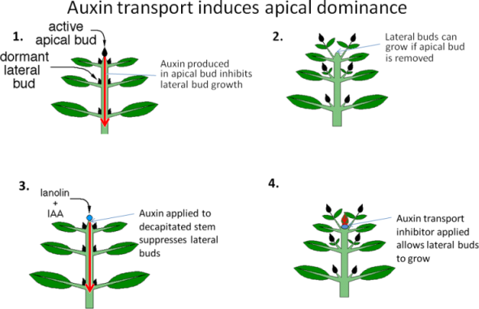
Further down the plant, auxin concentrations are lower so lateral growth is greater.

Slide 54
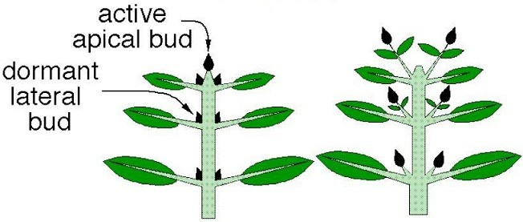
Auxin
High concentration of auxin supress growth of lateral shoots.
This results in apical dominance – growth of the main central stem of the plant form the tip.
Further down the plant, auxin concentrations are lower so lateral growth is greater.
Experimental data supports the role auxin has in plants.
How does the image below show this?
When the apical shoot is removed (containing auxin producing cells) lateral growth is more prevalent higher up the plant.
The lateral shoots are freed from the dominance of the apical shoot and grow faster

Slide 55
Note
If auxin is applied artificially to the cut apical shoot, apical dominance is reasserted, and lateral shoot growth is supressed
*While the experimental data supports this theory its thought that abscisic acid and cytokinin's play an important role in lateral growth.

Slide 56
Other hormones involved in plant growth
Scientist now think that 2 other hormones are involved in growth:
Abscisic acid (ABA): Involved in keeping the bud dormant. When abscisic levels drop this causes bud/seed to grow/germinate.
Cytokinins: high levels of auxin cause cytokinins to move to the shoot apex. When apex is removed, cytokinin spreads evenly around the plant and causes bud growth.
Notes:
Auxin + cytokinins – synergism – work in synergy

Slide 57
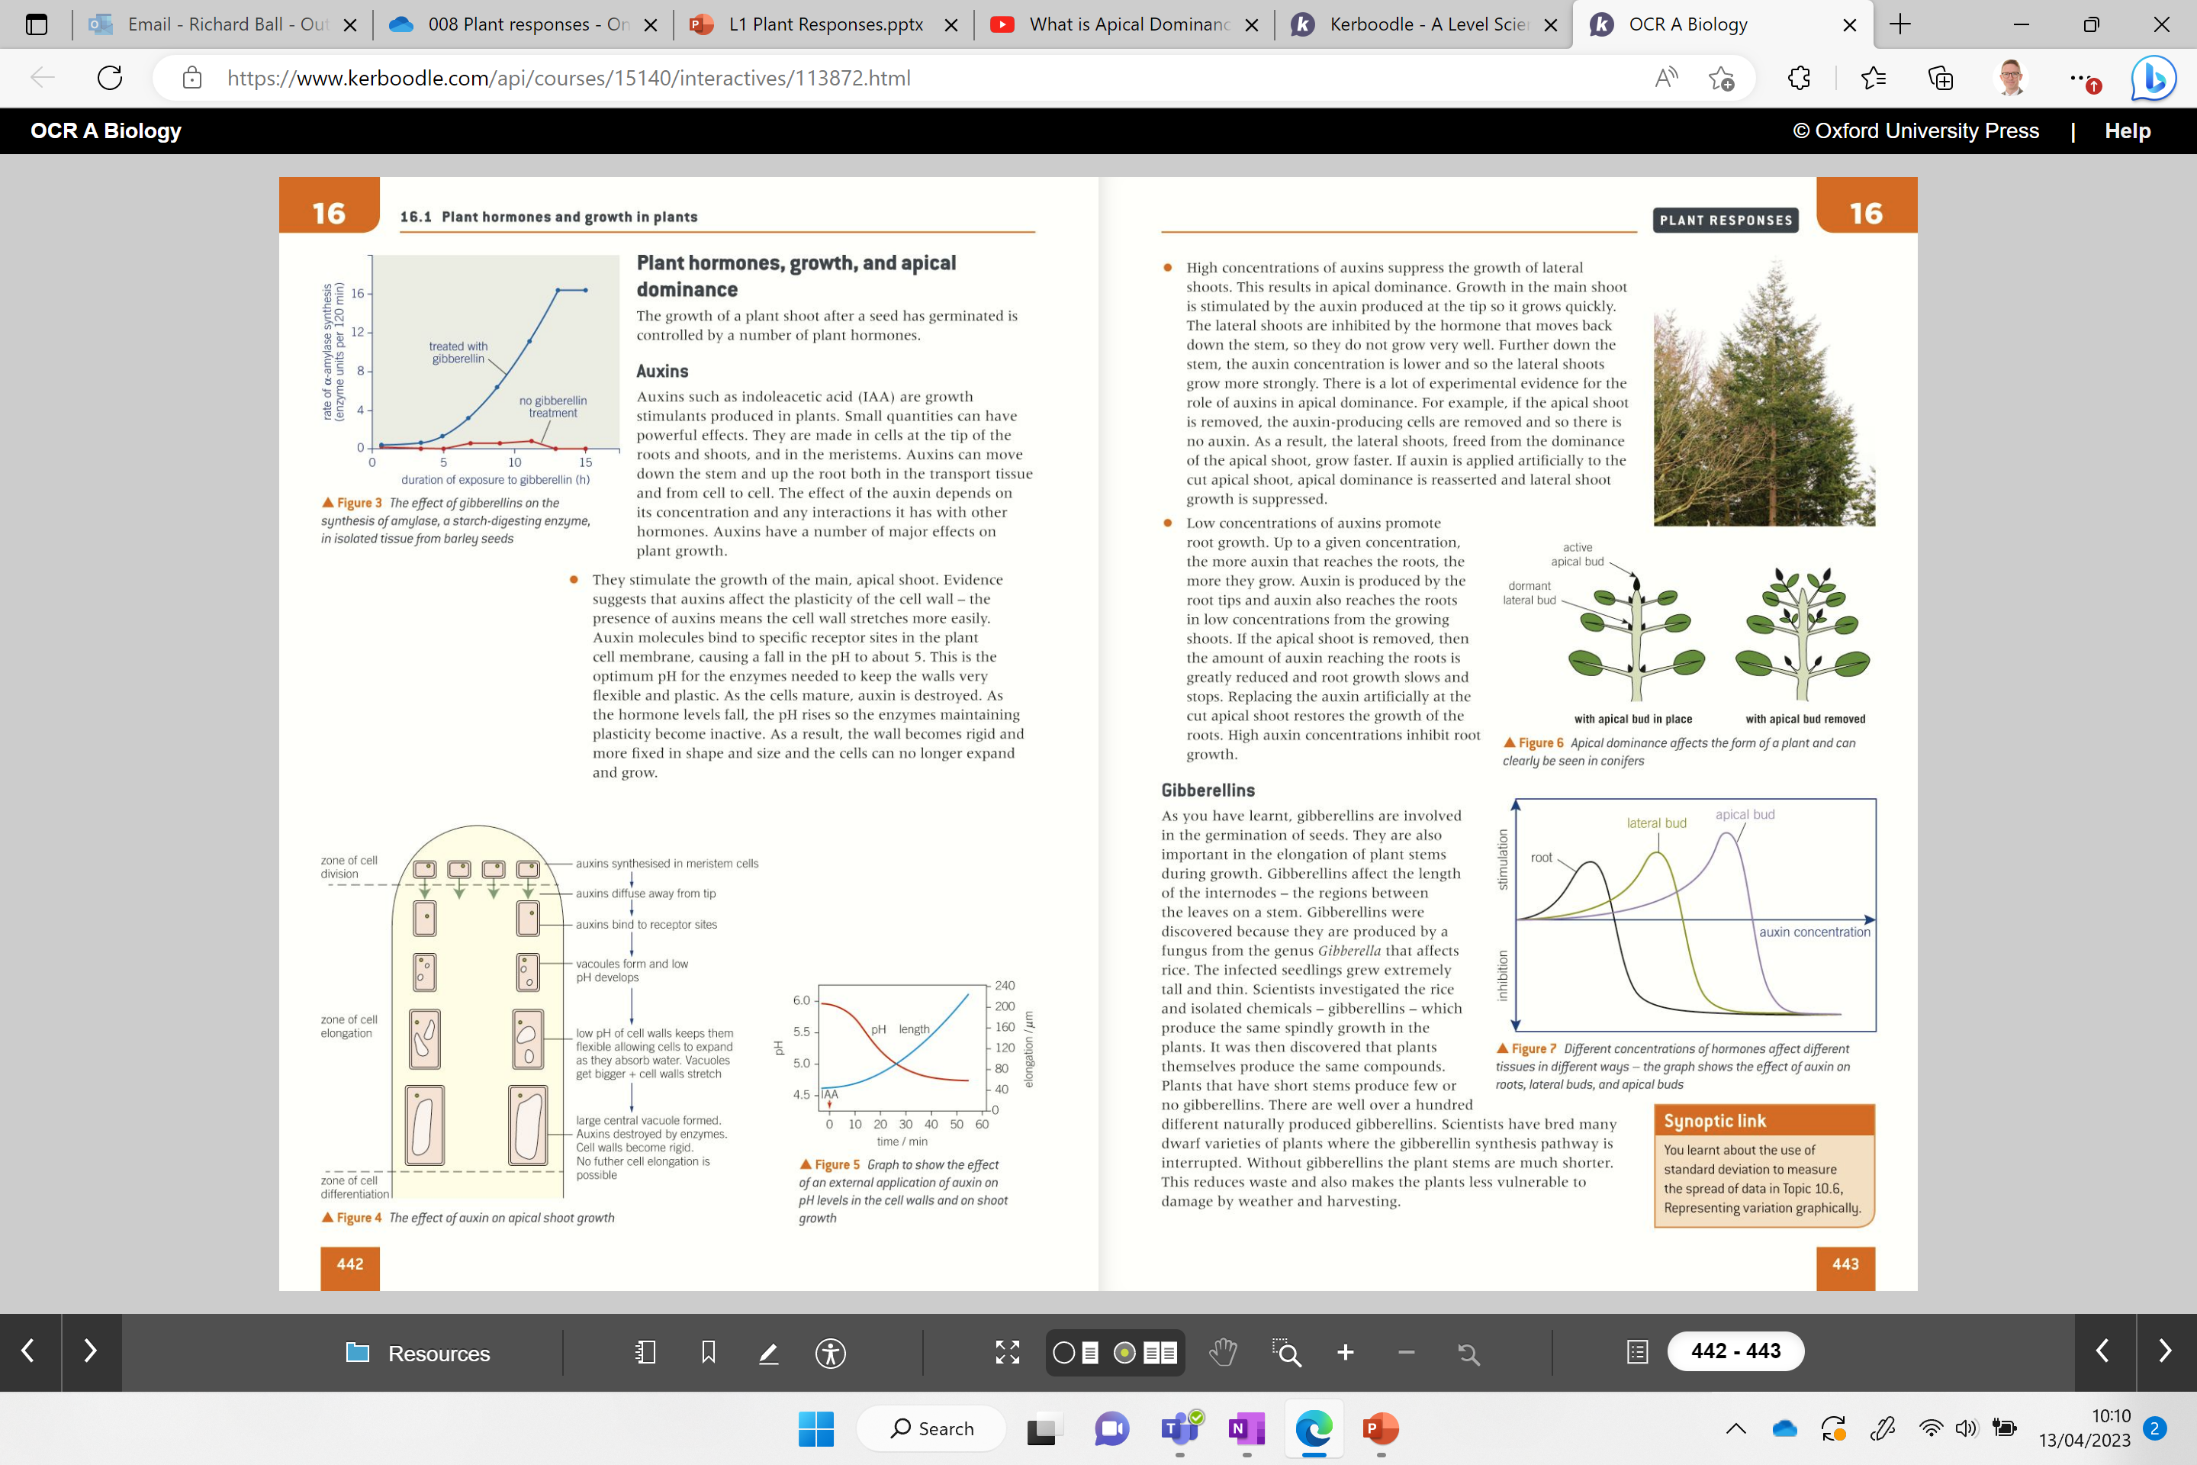
Lateral bud growth inhibited at these levels of auxin!!
Important!

Slide 58
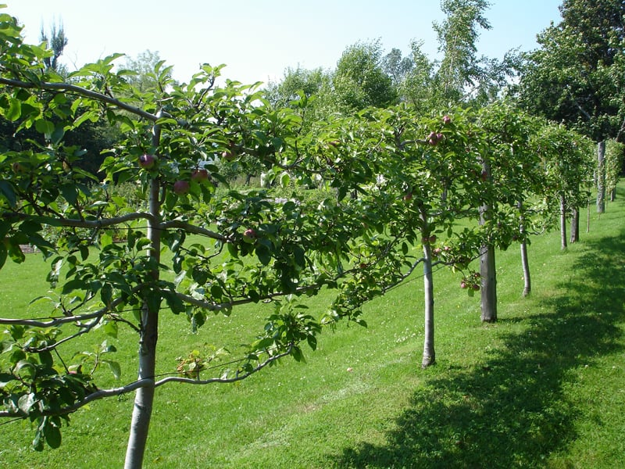
Can knowledge of apical dominance be useful for farmers / growers?

Slide 59
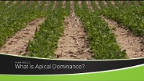

Slide 60
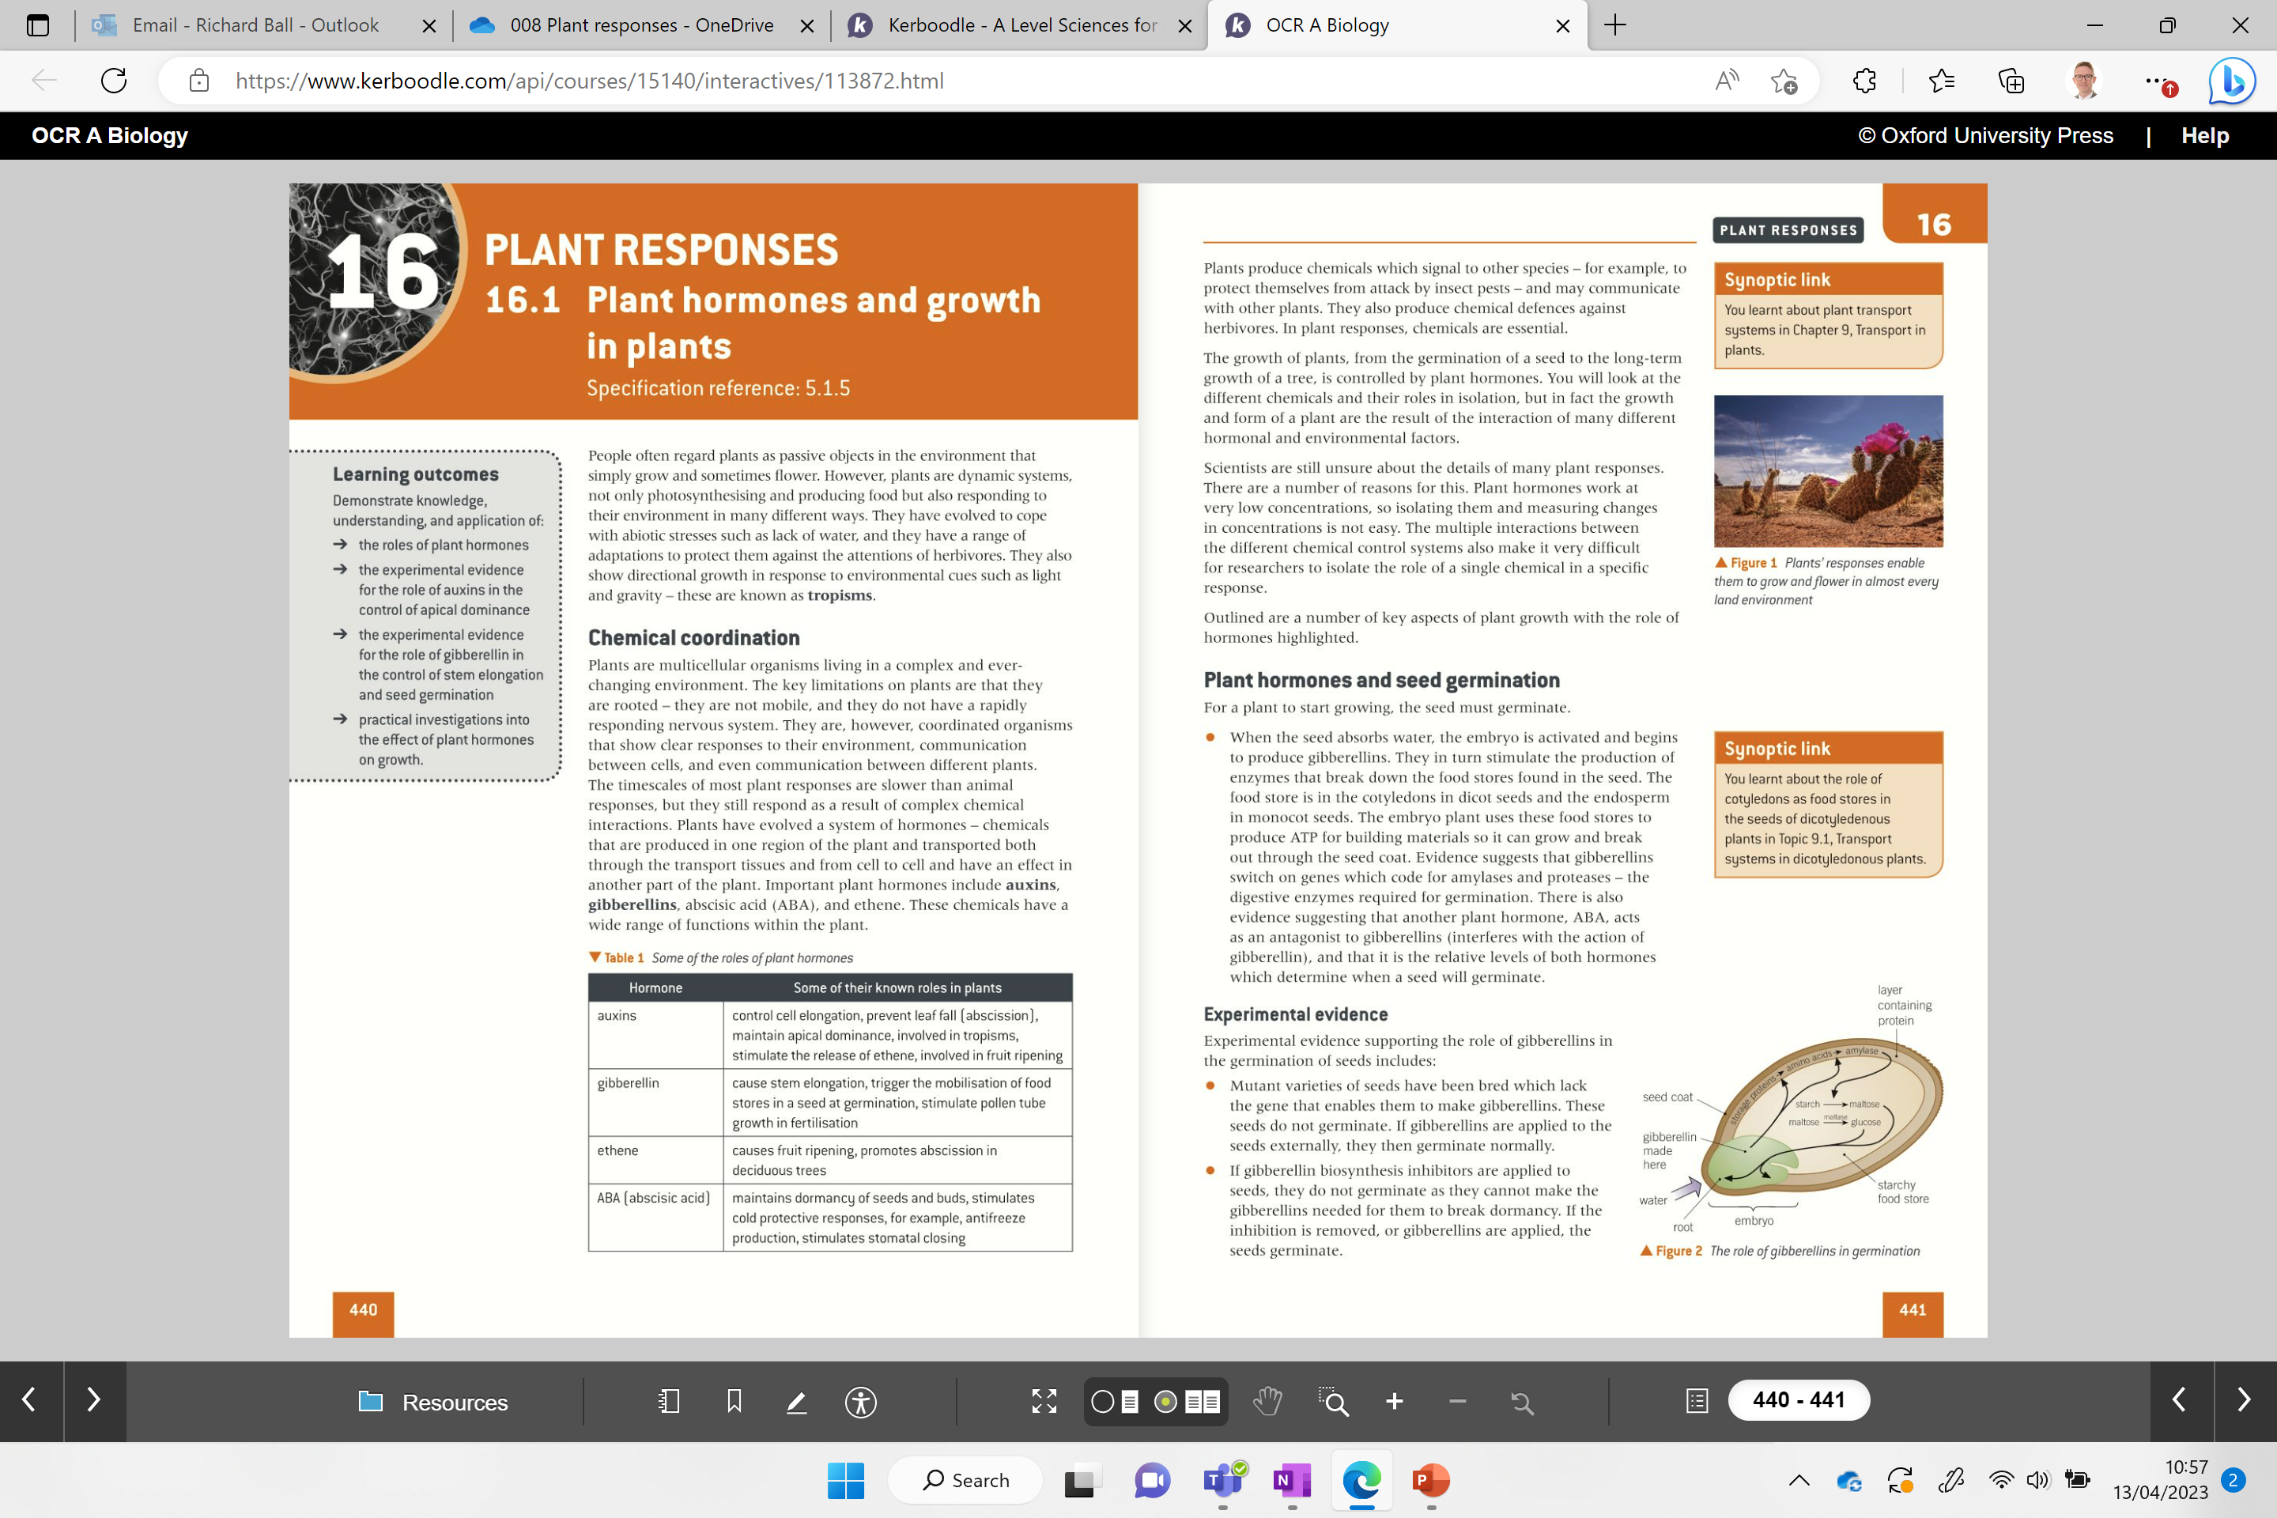
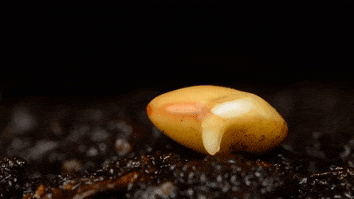
Seed germination
Discuss how seeds germinate using the diagram

Slide 61
Seed germination
Seeds absorb water which activates the embryo to produce gibberellins.
In turn food stores found in the seed are broken down to produce ATP to grow and break through the seed coat.
Evidence suggests that gibberellins switch on genes to produce amylase and protease in plants – digestive enzymes required for germination.
ABA has also been found to interfere with gibberellin hormone and it is the relative levels of each hormone that determine when the seed will germinate (antagonism)
*When two substances work together but have the opposite effect this is known as antagonism.
*When two substances work together and promote the same effect this is known as synergism.
Notes:
Auxin and cytokinin

Slide 62
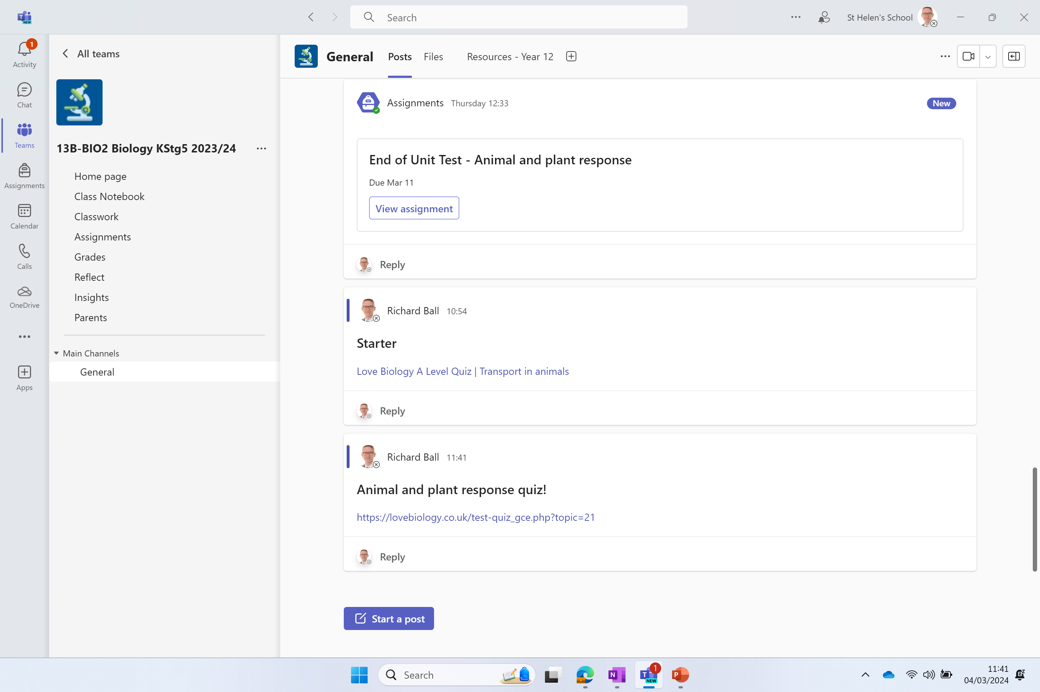
Complete the table then try additional questions below if you finish
Plant responses to biotic factors |  | Plant responses to abiotic factors
Pathogens | Release toxic chemicals called Tannins, increased production of lignin, cellulose and callose (physical barriers), closure of stomata | Light intensity | Positive phototropism (grow towards light, for photosynthesis)
Prey | Release pheromones to attract insects | Gravitational field | Positive geotropism (grow in the direction gravity, anchoring plant in soil, better able to find water)
Predators (herbivores) | Release of Tannins and bitter tasting chemicals called Alkaloids, release of chemicals which cause stings | Chemical concentration | Positive chemotropism (pollen tubes grow in direction of concentration of certain chemicals, e.g. towards ovary)
 |  | Solid structures / touch | thigmotropism (shoots of climbing plants growing upwards or respond to touch by folding leaves, Mimosa pudica)
← Now try this quiz

Slide 63
Click the link – needs posting
Love Biology A Level Quiz | Plant and animal responses

Slide 64
