Slide 1
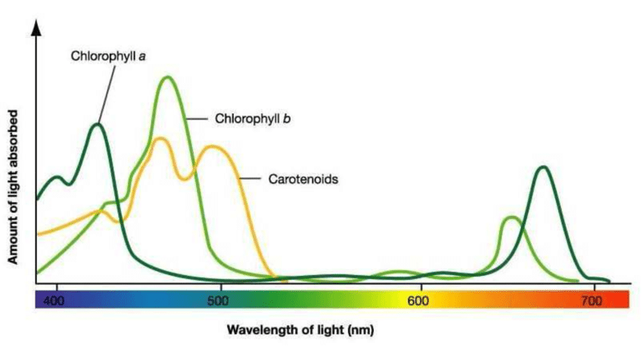
Photosynthesis
Outline why plants, animals and microorganisms need to respire, with reference to active transport and metabolic reactions.
Define the terms ‘autotroph’ and ‘heterotroph’.
Know that light energy is used during photosynthesis to produce complex organic molecules.
Explain how respiration in plants and animals depends upon the products of photosynthesis.
Describe, with the aid of diagrams, the structure of ATP.
Know that ATP provides the immediate source of energy for biological processes.

Slide 2
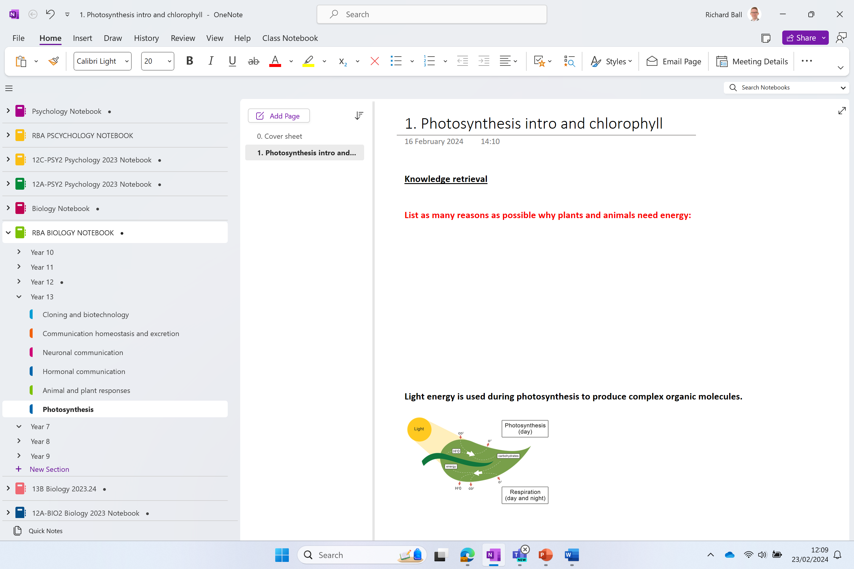

Slide 3
Knowledge retrieval question
List as many reasons as possible why plants and animals need energy:
TYPE AND FILL IN THE GAPS
Light energy for photosynthesis
Active transport (against concentration gradient)
Metabolism
DNA replication
Cell division
Muscle contraction
Maintenance of body temperature
Cells need energy for respiration
P……………..
A……………. T………….
M…………………
R………………..
d…………………
c……………………
t……………………….
r………………….
Notes:
Regeneration of ATP requires energy

Slide 4
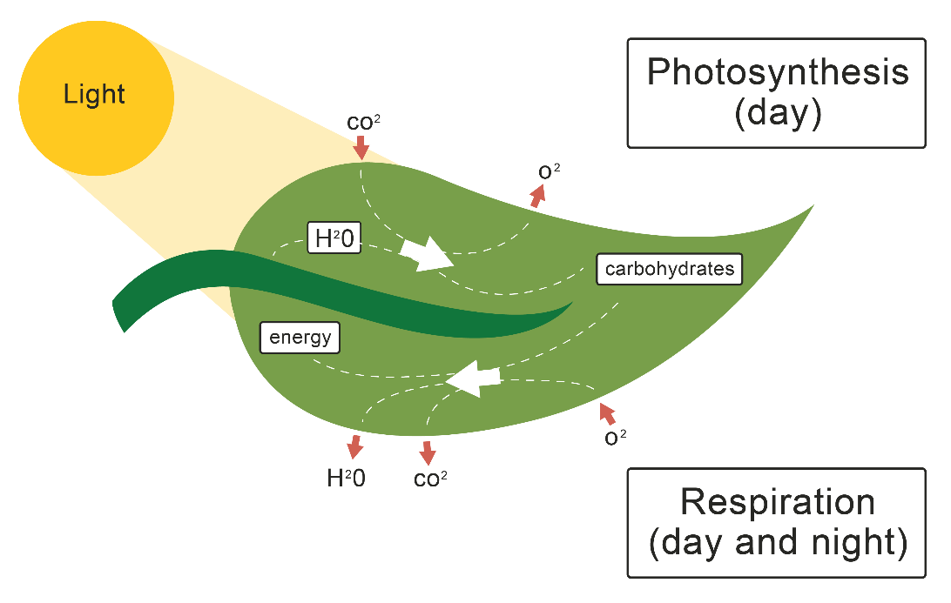
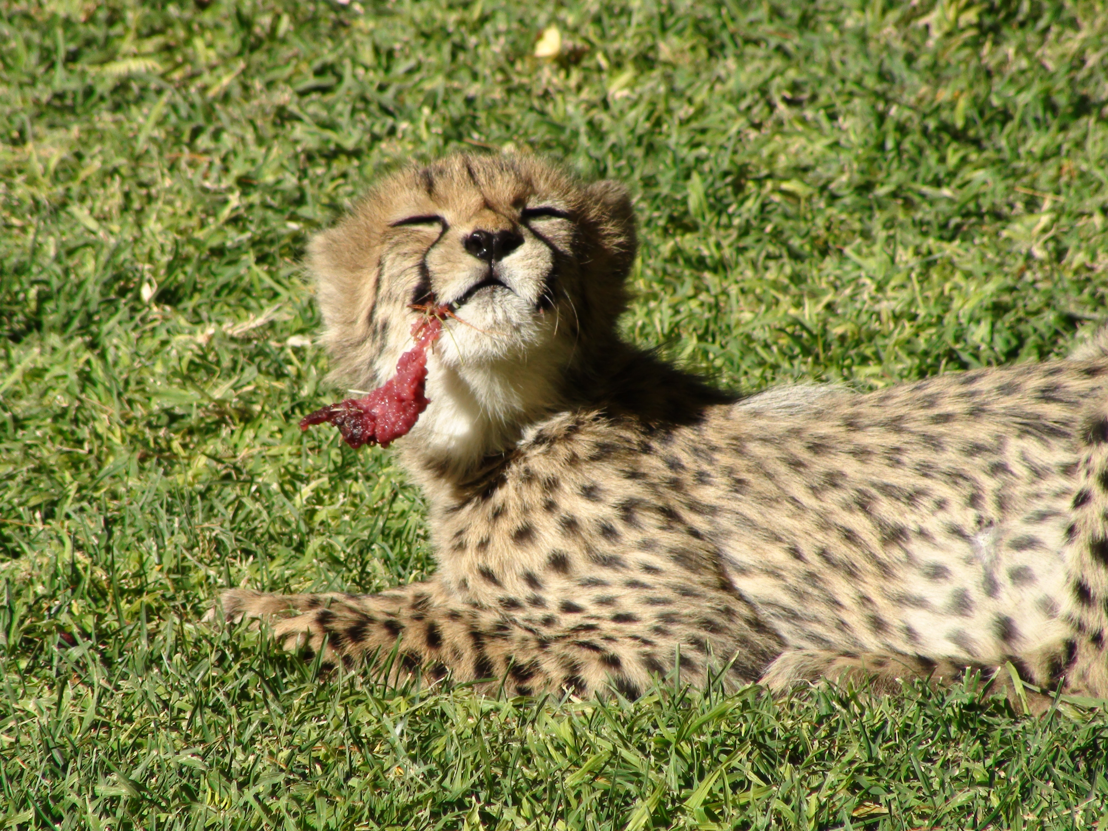
Light energy is used during photosynthesis to produce complex organic molecules.
Autotrophs (autotrophic) can make their own organic molecules (e.g. plants). They can do this using light from photosynthesis. These are then broken down to respire.
6CO_{2(g)} + 6H₂O_{(l)} → C₆H₁₂O_{6(s)} + 6O_{2(g)}
Heterotrophs (heterotrophic) cannot make their own organic molecules (e.g. animals). They obtain it by eating other organisms (plants and animals). These are then broken down to respire.
C₆H₁₂O_{6(s)} + 6O_{2(g)} → 6CO_{2(g)} + 6H₂O_{(l)}

Slide 5
Chloroplasts and Pigments
Explain, with the aid of diagrams and electron micrographs, how the structure of chloroplasts enables them to carry out their functions.
Define the term photosynthetic.
Explain the importance of photosynthetic pigments in photosynthesis.

Slide 6
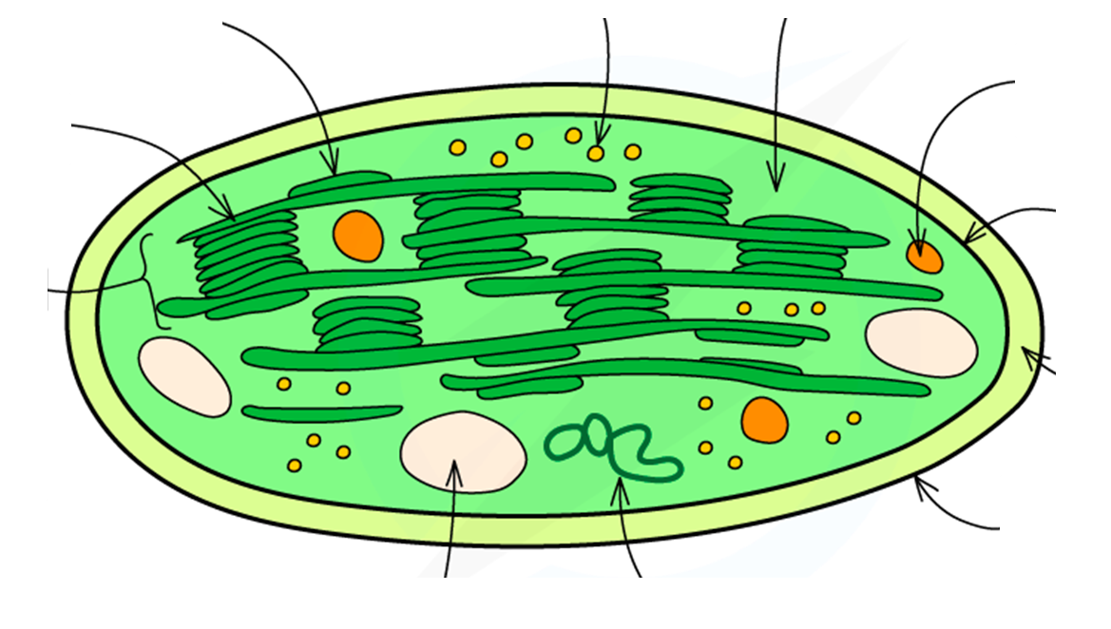
Label the chloroplast
Chloroplast DNA / Ribosome / Stroma / Inner membrane / Outer membrane / Intermembrane space / Drop of lipids / Starch granule / Thylakoid / Lamella / Granum

Slide 7
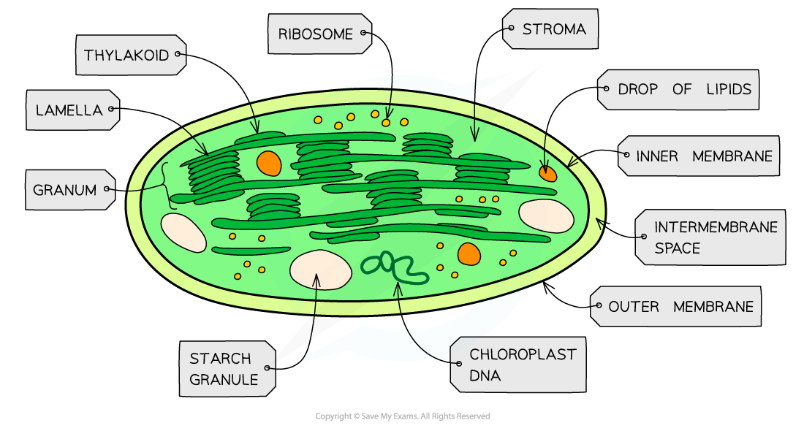
Chloroplast DNA / Ribosome / Stroma / Inner membrane / Outer membrane / Intermembrane space / Drop of lipids / Starch granule / Thylakoid / Lemella / Granum
Task: Write the function of the following parts:
Thylakoid
Lamella
Granum
Stroma

Slide 8
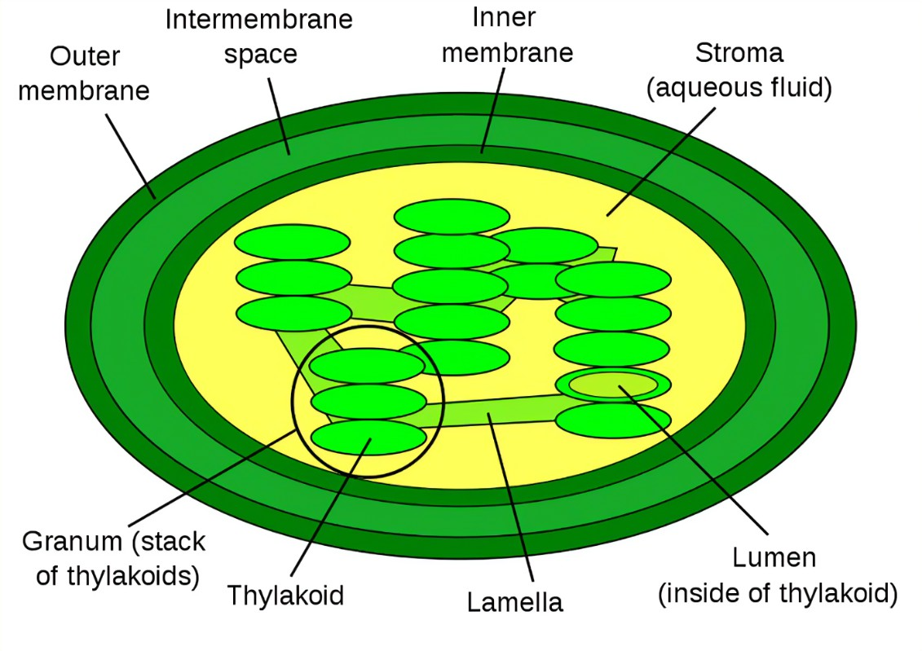
Thylakoids are fluid-filled sacs. Thylakoid membranes contain ATP synthases and electron transport chains. Light absorbing chlorophyll pigment is embedded in the thylakoid membrane
Granum thylakoids stacked on top of each other (grana is plural). Grana are linked together via bits of thylakoid membrane called lamella.
Stroma is the fluid containing enzymes and reactants for light the independent stage of photosynthesis
A double membrane called the chloroplast envelope (outer and inner membrane)
Notes:
Granum contains the carotenoids and chlorophylls, which produces the color of the plant, and are the sites of the light reactions of photosynthesis¹.

Slide 9
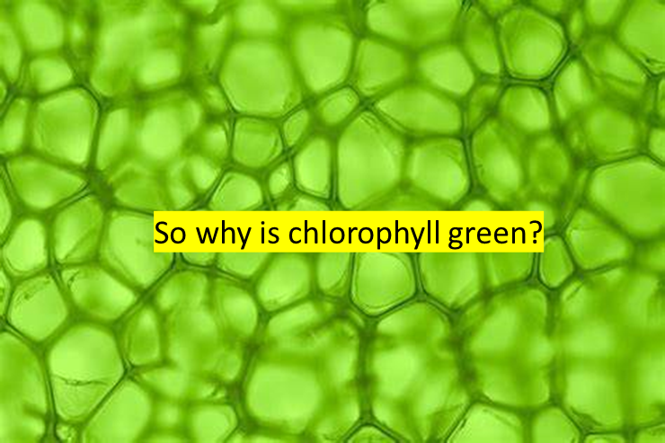
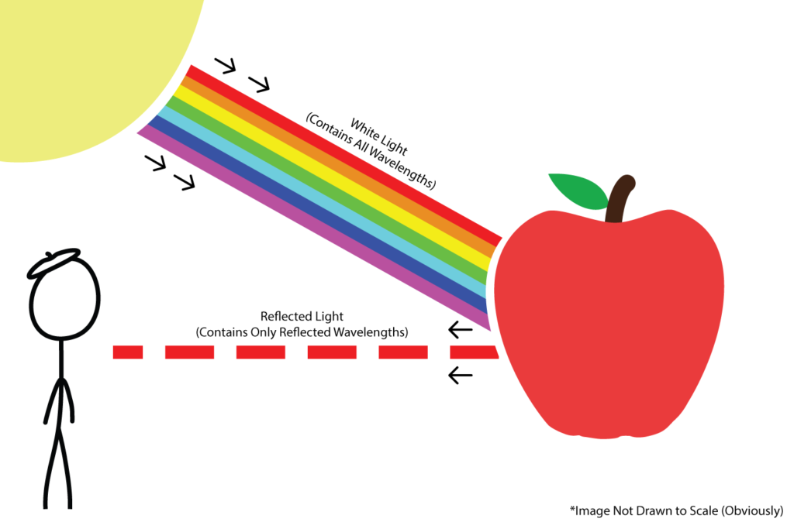
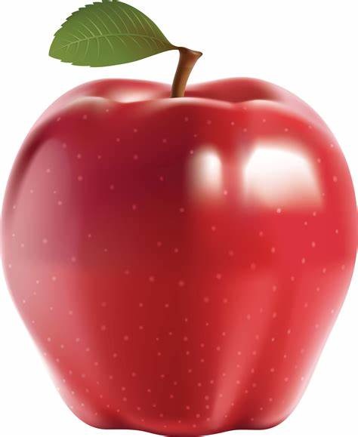
Why does this apple appear red?

Slide 10
Pigments
Absorb certain w……………… of
light and r…………….. others
Appear to us as the c………….. they reflect
Found in t……………… membranes,
arranged in photosystems

Slide 11
Pigments
Why is chlorophyll green?
Absorb certain wavelengths of
light and reflect others
Appear to us as the colour they reflect
Found in thylakoid membranes,
arranged in photosystems
Notes:
Different pigments absorb and reflect different wavelengths

Slide 12
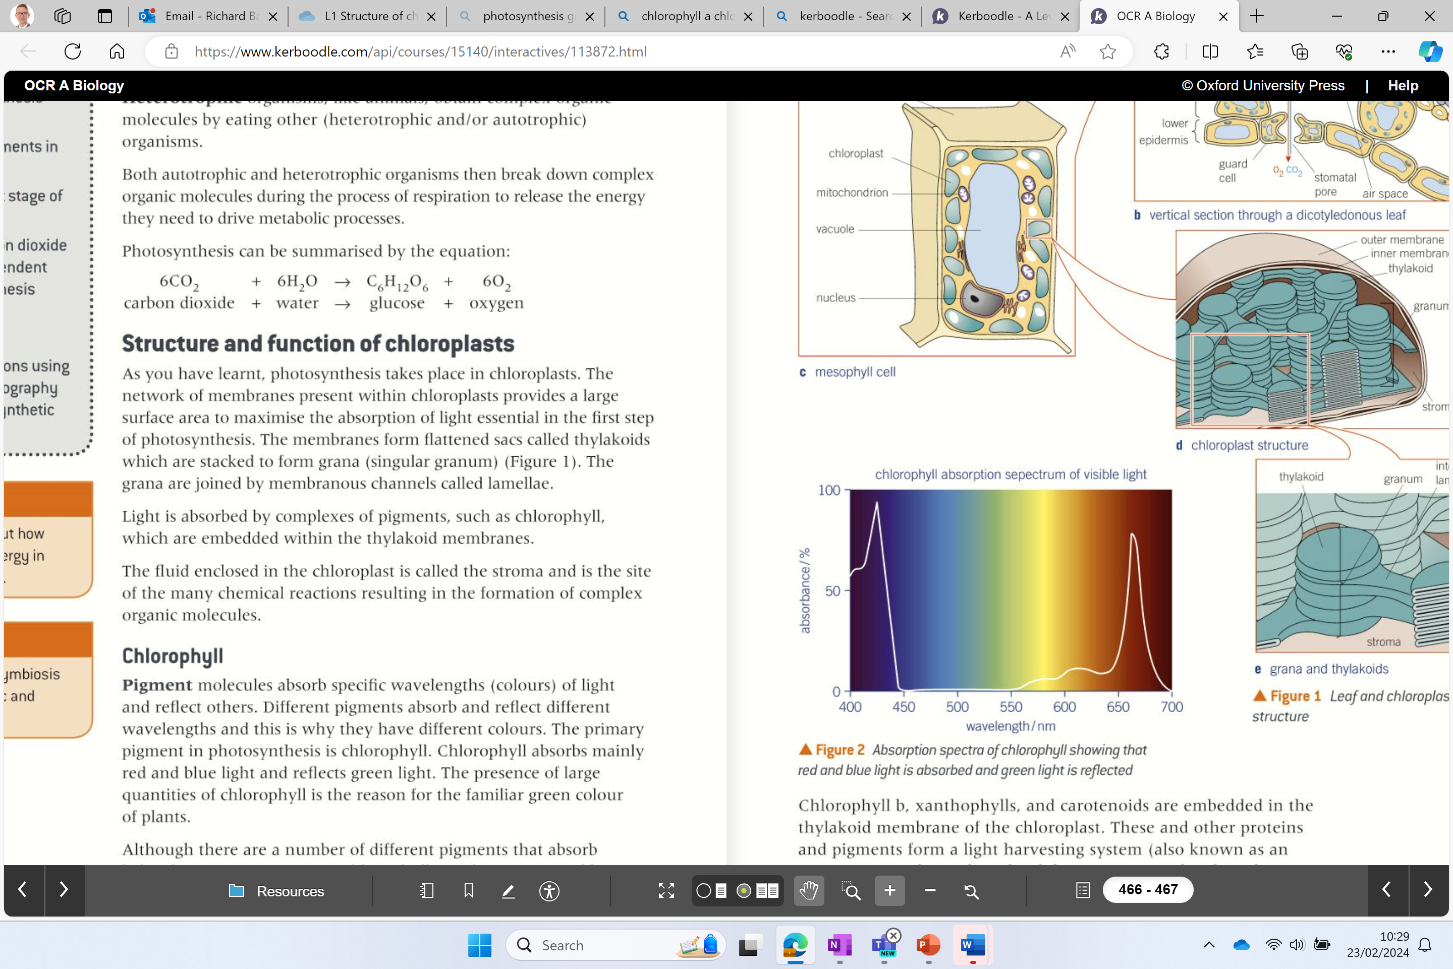
Chlorophyll
The primary pigment for photosynthesis is chlorophyll a.
Chlorophyll a, absorbs mainly red and blue light and reflects green. (See figure 2)
Large quantities of chlorophyll a in plants give them a green colour.
Chlorophyll b, xanthophylls and carotenoids are also pigments found in the thylakoid membrane (accessory pigments)
These absorb different wavelengths of light which explains the different shades of colour of leaves.
Low absorption of green
*accessory pigments are not involved directly in the light dependent reaction of photosynthesis.

Slide 13
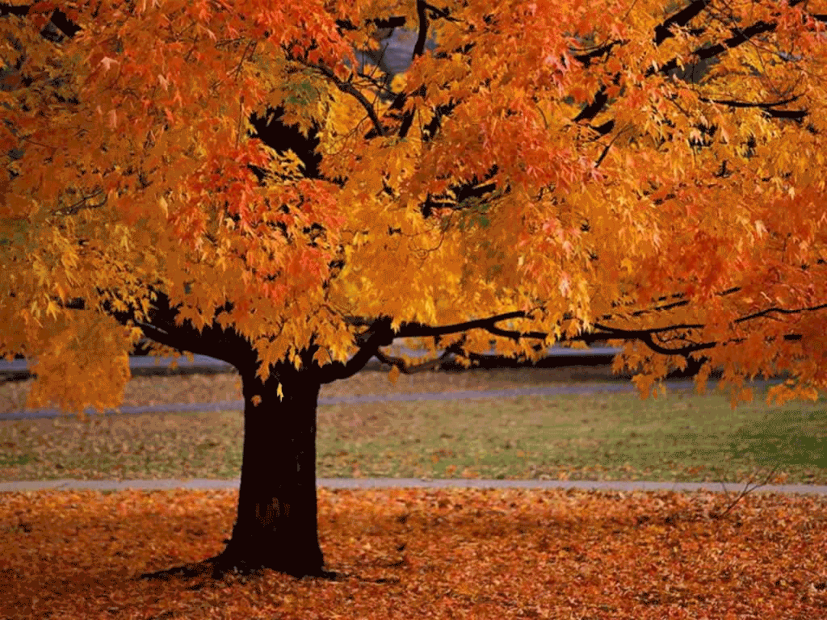
Why do leaves change colour in autumn?
Notes:
As weather conditions change (colder, less sunny) less chlorophyll a is produce and the other pigments become more visible !!
Carotenoids – orange / yellow autumn colours

Slide 14
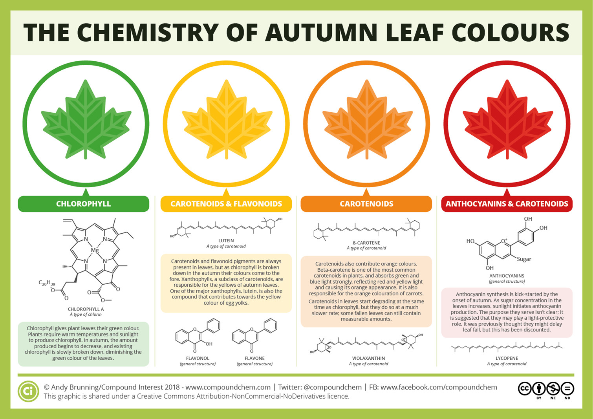
Notes:
As weather conditions change (colder, less sunny) less chlorophyll a is produce and the other pigments become more visible !!
Carotenoids – orange / yellow autumn colours

Slide 15
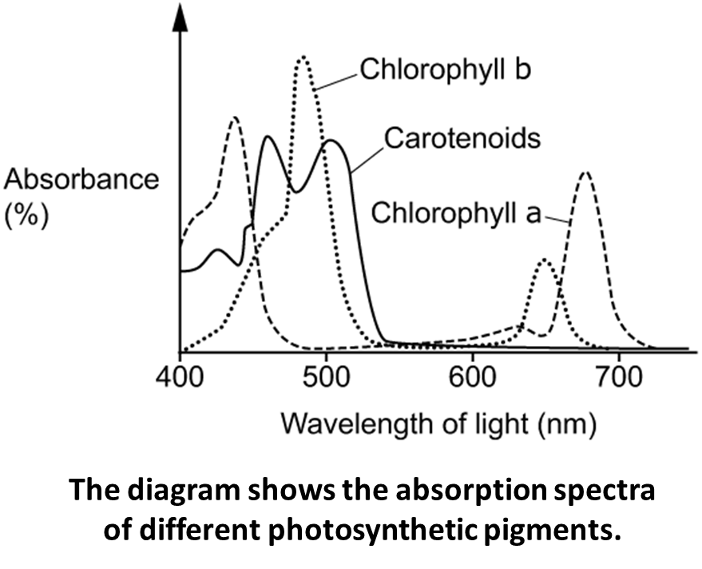
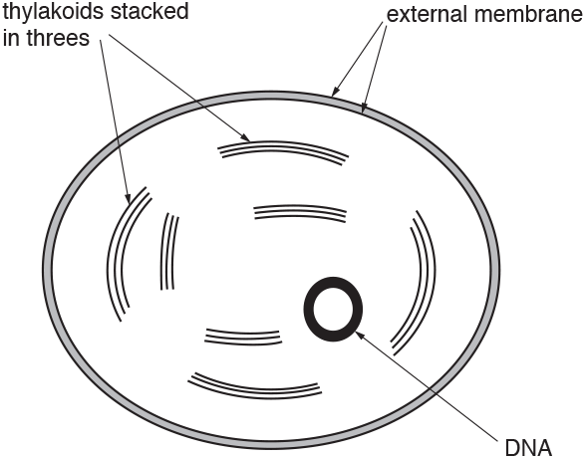
Q1. Which of the statements about the absorption spectra shown in the diagram is not correct?
A. Absorption of light energy by accessory pigments such as chlorophyll b and carotenoids increases the efficiency of light harvesting.
B. Chlorophyll a absorbs red light but not blue light and chlorophyll b absorbs blue light but not red light.
C. Chlorophyll b and carotenoids are described as accessory pigments because they are not involved directly in the light dependent reaction of photosynthesis.
D. The absorption spectra explain why plants appear green because they absorb red and blue wavelengths of light.
Q2. Chromista are photosynthetic protoctists that live in water.
Chromista are different from other photosynthetic organisms because they contain the pigment chlorophyll c.
Chlorophyll c is not found in plants.
Fig. 17.1 is a diagram of the chloroplast found in a Chromista cell.
Outline the structural differences between the Chromista chloroplast in Fig. 17.1 and the chloroplasts found in flowering plants (3 marks)
Chromista (chloroplast) has no lamellae between thylakoids
plants (chloroplasts) have thylakoids in groups of more than three
plants (chloroplasts) have starch grains
Chromista (chloroplast) has fewer thylakoids
Notes:
Granum contains the carotenoids and chlorophylls, which produces the color of the plant, and are the sites of the light reactions of photosynthesis¹.

Slide 16
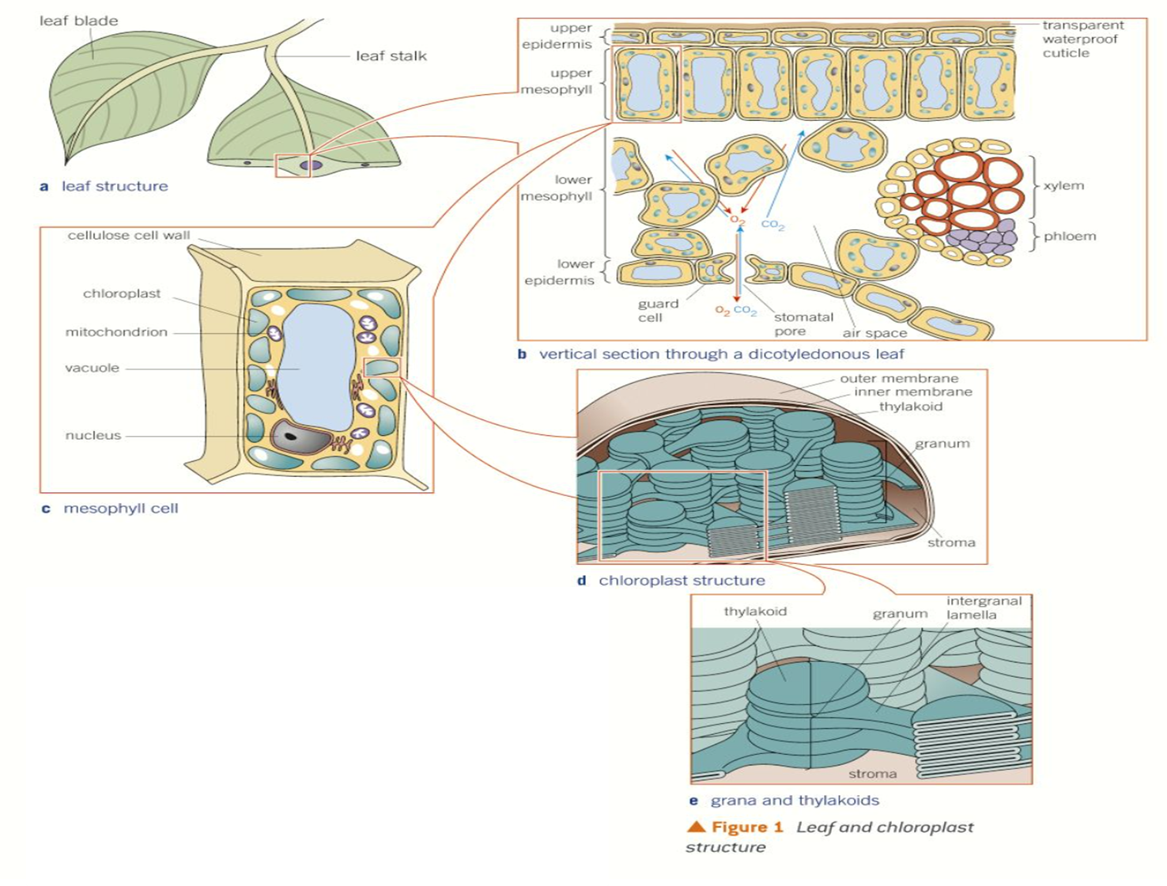
Chlorophyll b, xanthophylls and carotenoids in the thylakoid membrane are known as the light harvesting system (antennae complex)
Chlorophyll a is located in the reaction centre where photosynthesis takes place.
The light harvesting system + the reaction centre = photosystem
Antenna complex – funnel / transfers light energy to one chlorophyll a molecule at the reaction center of a photosystem
Notes:
An antenna complex is a collection of pigments and proteins that capture and funnel light energy for photosynthesis¹²³⁴. The pigments are organized into protein scaffolds that hold them in the right position and orientation¹. The antenna complex transfers light energy to one chlorophyll a molecule at the reaction center of a photosystem

Slide 17
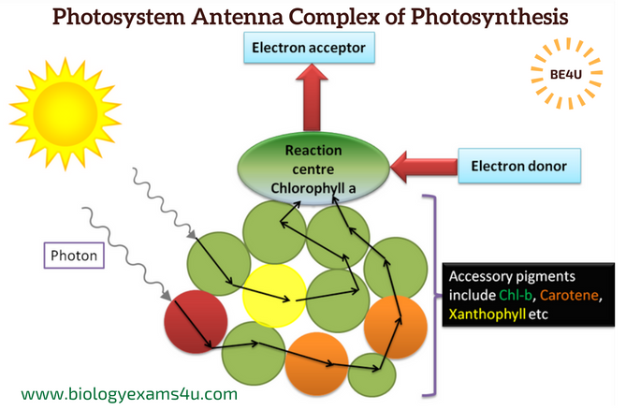

Slide 18
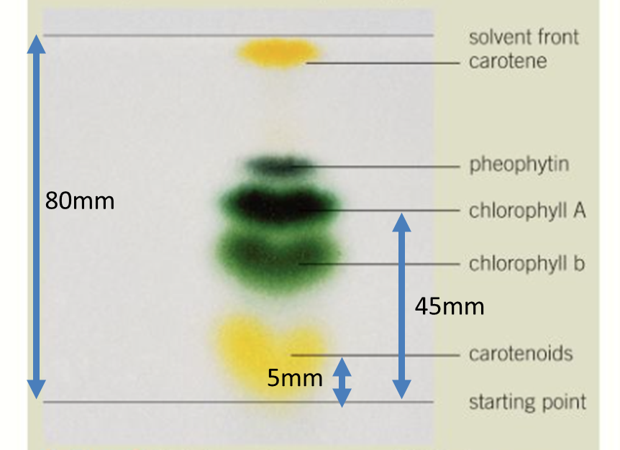
Investigating photosynthetic pigment
Q1. Explain how you would you produce the results on the chromatogram.
Extract thylakoid membrane from leaf
Add an extract to the bottom of chromatogram along starting point
Place bottom into solvent
Q2. What is the mobile phase and the stationary phase?
Mobile: Mixture dissolved in solvent (mobile substance)
Stationary: Chromatography paper (static material) TLC plate
Q3. Calculate the R_{f} value for:
chlorophyll A: 45/80 = 0.5625
Carotenoids 5/80 = 0.0625
Q4. Explain the difference in Rf values for each pigment.
Chlorophyll A has a greater solubility so is more attracted to the mobile phase so moves up at a greater rate.
Carotenoids are more attracted to the stationary phase and have a lower solubility.
Notes:
Pheophytin or phaeophytin is a chemical compound that serves as the first electron carrier intermediate in the electron transfer pathway of Photosystem II (PS II)

Slide 19
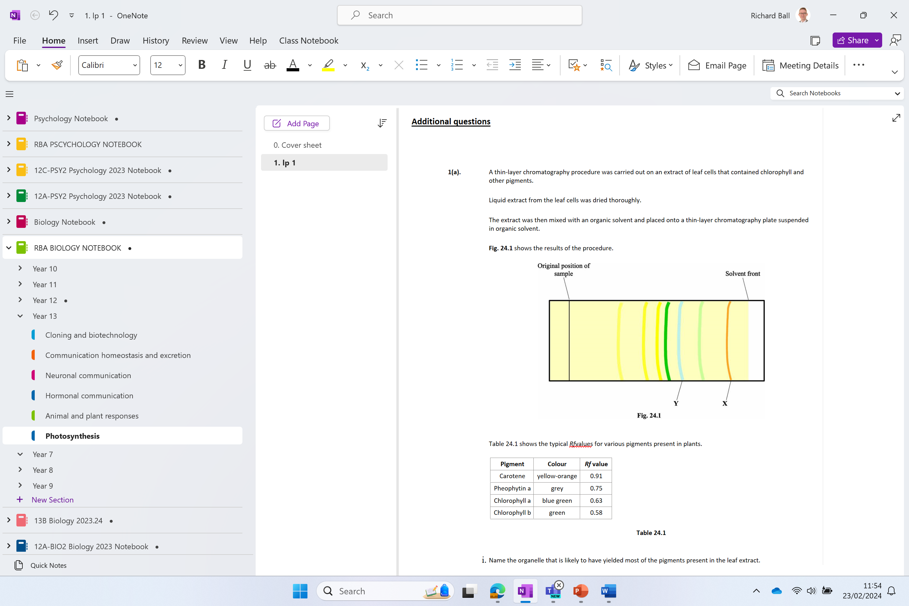
Additional questions

Slide 25
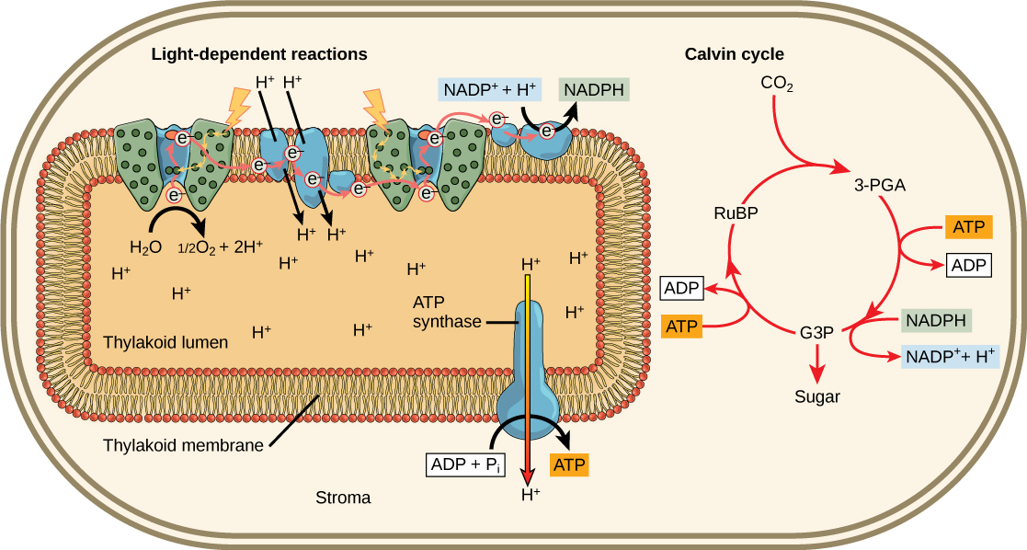
Summary of photosynthetic pathway inside chloroplast
The reactions that make ATP and reduced NADP can only occur in membranes - chloroplasts are adapted to maximise these reactions by containing a large surface area of thylakoid membranes
The reactions that fix CO₂ into organic molecules occur in the stroma (fluid-filled space surrounding the membranes)

Slide 26
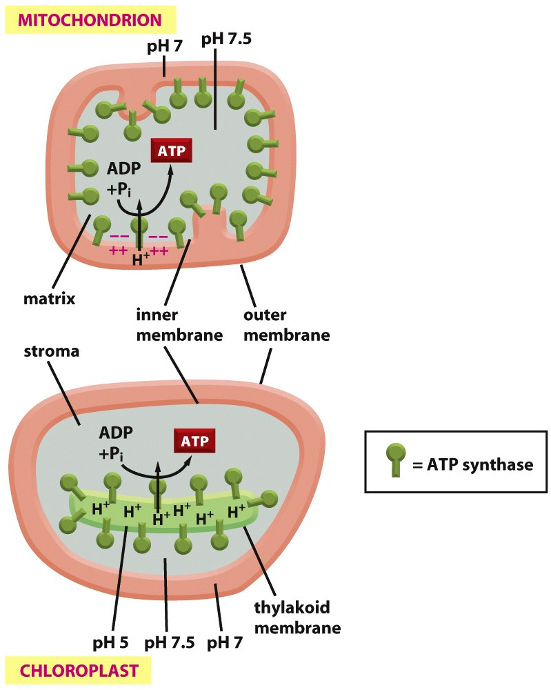
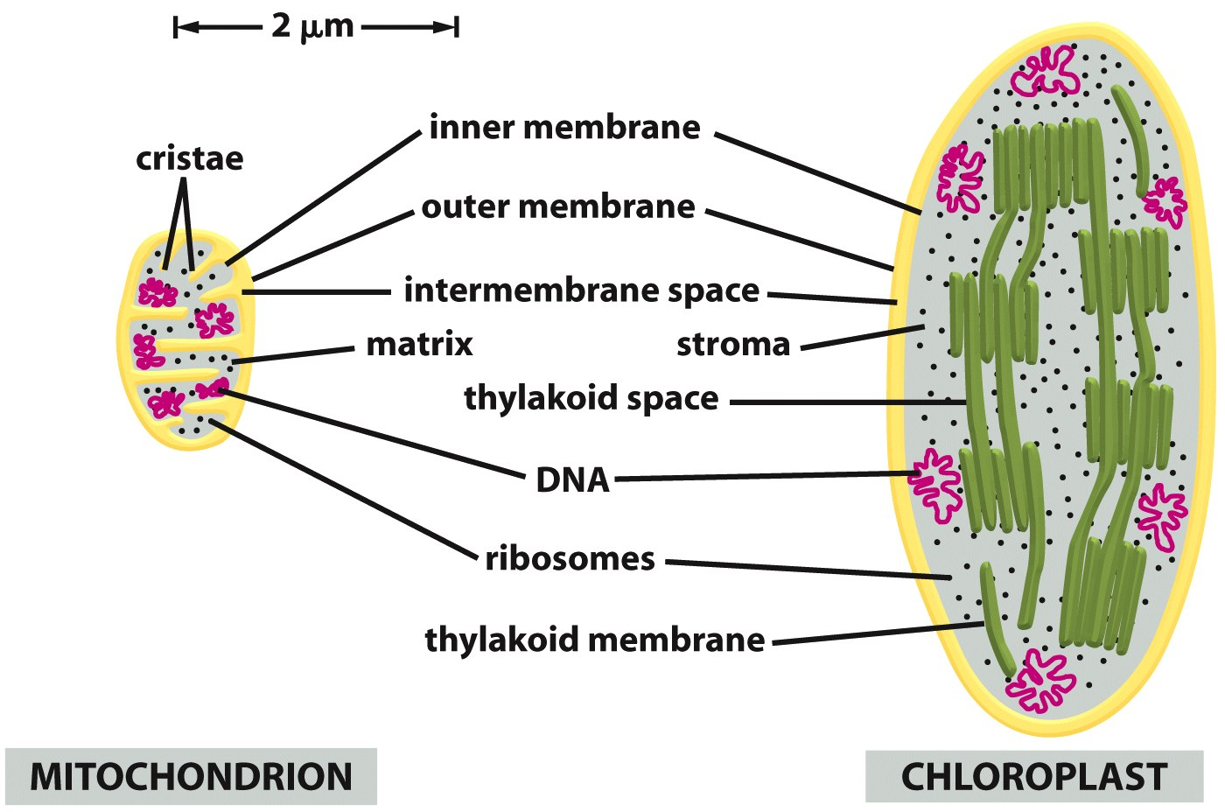
Use the diagrams to explain the size difference between the mitochondrion and the chloroplast.

Slide 27
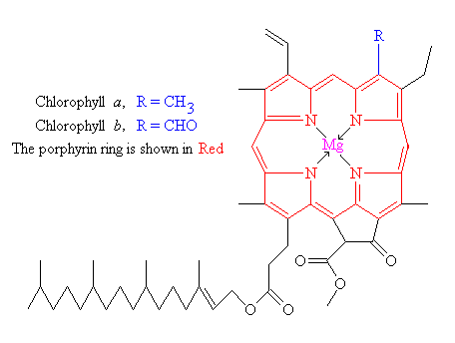
CHLOROPHYLL
Hydrophilic head –
membrane surface,
facing sunlight
The porphyrin ring is very similar to the haem group which forms the centre of the haemoglobin molecule - except that the central inorganic ion is Mg not Fe.
Hydrophobic tail –
anchored in
thylakoid membrane

Slide 28
Listen to four slides of information
Discuss the information

Slide 29
THE ELECTROMAGNETIC SPECTRUM
Visible light represents only a small fraction of the full spectrum of electromagnetic
radiation produced by the sun
Plant pigments absorb light energy with wavelengths that fall within this
visible spectrum
400
500
600
700
750
Wavelength (nm)

Slide 30
ABSORPTION SPECTRA
When a beam of light is passed through a glass prism, the visible spectrum of white
light is obtained
white light
When a beam of light is first passed through a solution of leaf extract, then an
absorption spectrum is obtained
white light
Black bands appear in the spectrum where particular wavelengths of light
have been absorbed
Predominantly, wavelengths at the blue and red ends of the spectrum have
been absorbed

Slide 31
ABSORPTION AND ACTION SPECTRA GRAPHS
action
spectrum
absorption
spectrum
Although all wavelengths between 400 and 700 nm are absorbed by the plant extract,
maximum absorption occurs in the violet/blue and red regions of the spectrum
There is a close correlation between the action spectrum and the absorption spectrum
The rate of photosynthesis is largely determined by the amount of light of different
wavelengths being absorbed

Slide 32
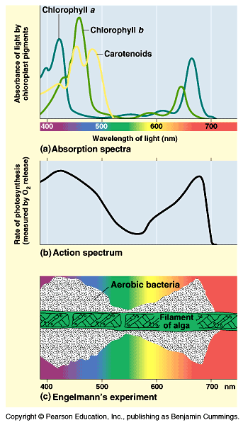
The Absorption Spectrum shows which frequencies (colours) of light are absorbed by the chlorophyll molecule. These are the colours whose energy is harvested by photosynthesis.
The Action Spectrum shows which frequencies (colours) of light work best to power photosynthesis. The similarity between these two graphs suggests that chlorophyll is the light harvesting molecule.
Aerobic bacteria (which require oxygen) gather close to photosynthesising algae. This experiment shows that they gather best around algae illuminated with Red or Blue but not Green.

Slide 33
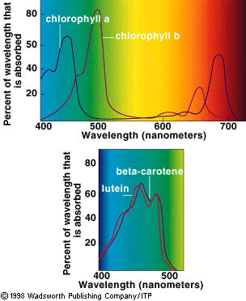
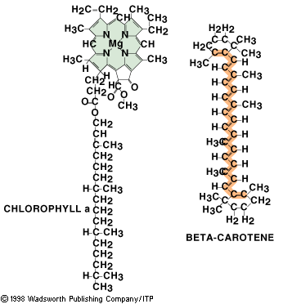

Slide 34
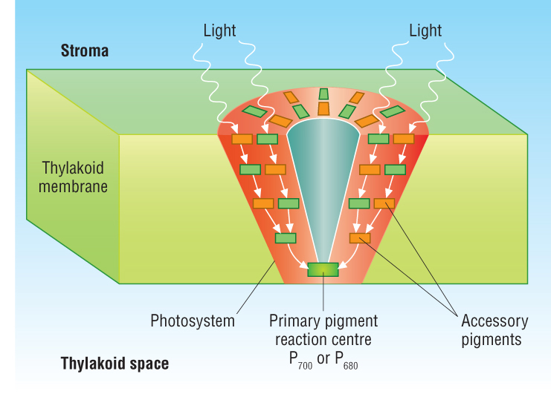
Chlorophyll a/b and carotene are photosynthetic pigments.
This means they absorb light energy.
They are found in the thylakoid membranes, attached to proteins.
Protein + pigment = photosystem.
Two photosystems used in photosynthesis.

Slide 35
A photosystem is made up of two photosynthetic pigments, primary and accessory.
1. Primary pigments
Reaction centres where electrons are excited during light dependent reaction.
In chloroplasts is chlorophyll a.
2. Accessory pigments
Surround the primary pigment and transfer light energy to them.
e.g. carotenoids.

Slide 36
1. The figure below shows the absorption spectra for three different photosynthetic pigments.
(i) Explain what is meant by the term photosynthetic pigment.
.........................................................................................................................
.........................................................................................................................
.........................................................................................................................
.........................................................................................................................
.........................................................................................................................
[3]
(ii) Using the figure above, describe the pattern shown by chlorophyll a.
.........................................................................................................................
.........................................................................................................................
.........................................................................................................................
.........................................................................................................................
[2]
[Total 5 marks]

Slide 37
1.
(i)
light absorbing/AW;
ref to excited electrons/AW;
used in light dependent stage;
ref. to location; e.g. chloroplasts, thylakoids,
photosystems, grana, lamellae
AVP; e.g. (long) hydrocarbon chains,
different pigments absorb different wavelengths. max 3
(ii)
high absorption of, wavelengths 450 – 480 nm/
blue region of spectrum;
high absorption of, wavelengths 660 – 710 nm/
red region of spectrum;
low absorption of, wavelengths 500 – 620 nm/
green region of spectrum;
for each marking point accept single figure in range.
If candidate gives range it
must fall within the range on the mark scheme.
only penalise lack of units once. max 2
[5]

Slide 38
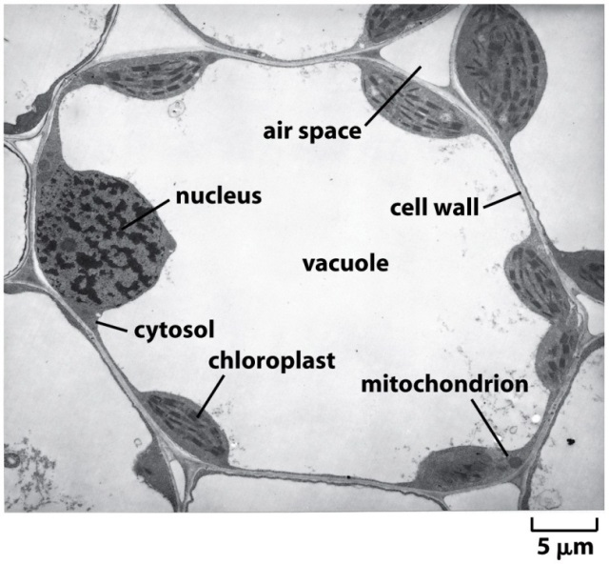
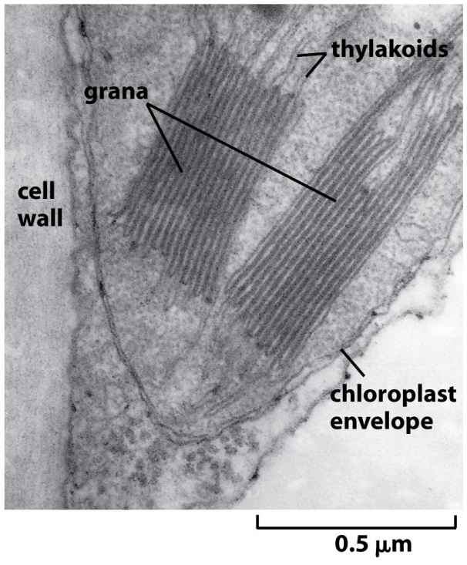
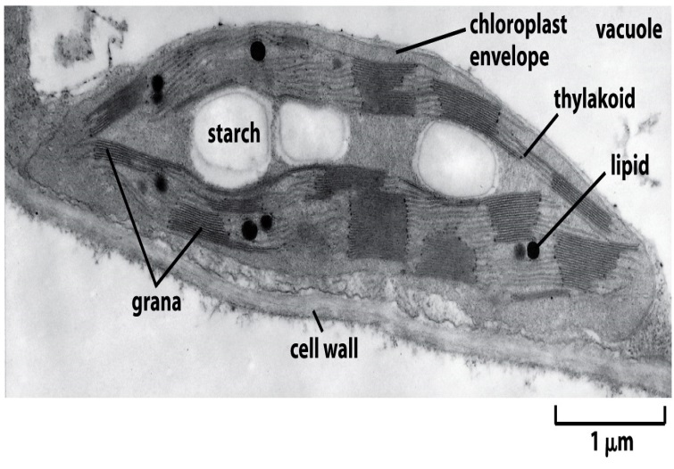
Adaptations of chloroplasts:
Chloroplast envelope keeps the reactants for photosynthesis close to their reaction sites.
Thylakoids have a large surface area to allow as much light to be absorbed as possible.
Lots of ATP synthase molecules present in thylakoid membrane to produce ATP for light dependent reaction.
Stroma contains all the enzymes, sugars and organic acids needed for light independent reaction.

Slide 39
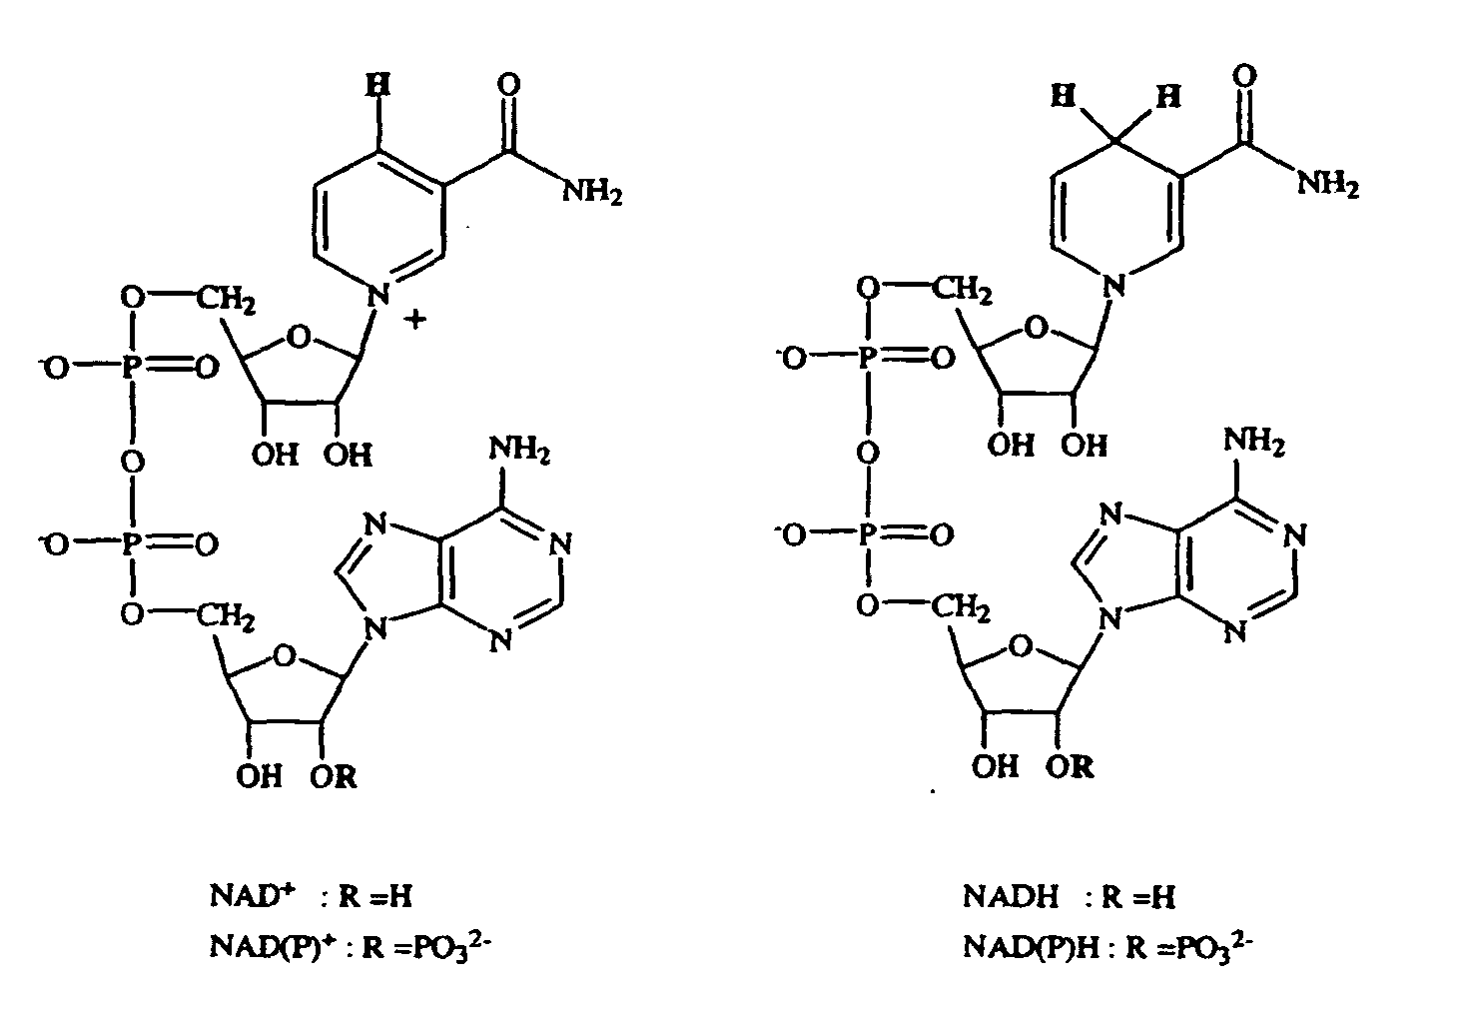
Stages of photosynthesis
Know that in plants, photosynthesis is a two-stage process taking place in chloroplasts.
Know that the light-dependent stage takes place in thylakoid membranes and that the light-independent stage takes place in the stroma.
Outline how light energy is converted to chemical energy (ATP and NADPH) in the light-dependent stage.
Explain the role of water in the light-dependent stage.
Explain what the molecules to the left do, using as many scientific words are possible.

Slide 40
NADP is the coenzyme involved in photosynthesis.
It transfers hydride from one molecule to another.
It can oxidise and reduce.

Slide 41
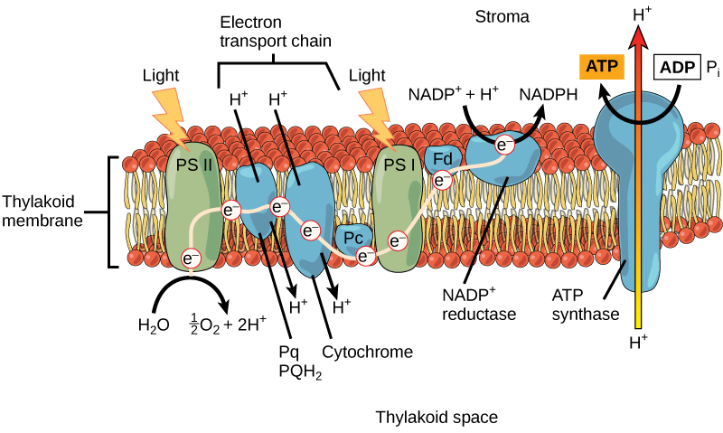
Summary of photosynthetic pathway

Slide 42
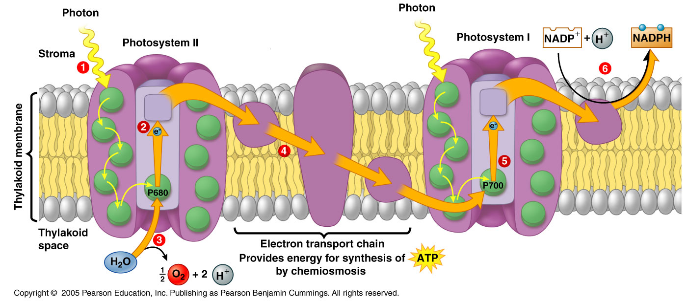
The light dependent reaction – use of photosystems
Named after their order of discovery, not the order in the reaction sequence.
During the Light Reactions Photosystem II comes before Photosystem I.
Light energy absorbed by photosystem is used for:
Photophosphorylation (converting ADP into ATP using light)
Reducing NADP to NADPH
Photolysis (splitting H₂O into H⁺, O_{2(g)} and e⁻, note not balanced).

Slide 43
4. High energy electrons move along the electron transport chain, losing energy as they do. This energy is used to pump H⁺ into thylakoid space, creating H⁺ electrochemical gradient across membrane. ATP then generated via chemiosmosis of H⁺ down gradient through ATP synthase
1. Light energy is absorbed by PSII
5. Light energy absorbed by PSI, electrons end up at NADP, along with H⁺ from stroma
2. This excites e⁻ in chlorophyll to a higher energy level. These high energy electrons are then passed to an electron carrier (protein which can transfer electrons)
3. The electrons leaving PSII must be replaced, photolysis (splitting of H₂O) provides these electrons, generating O_{2(g)}

Slide 44
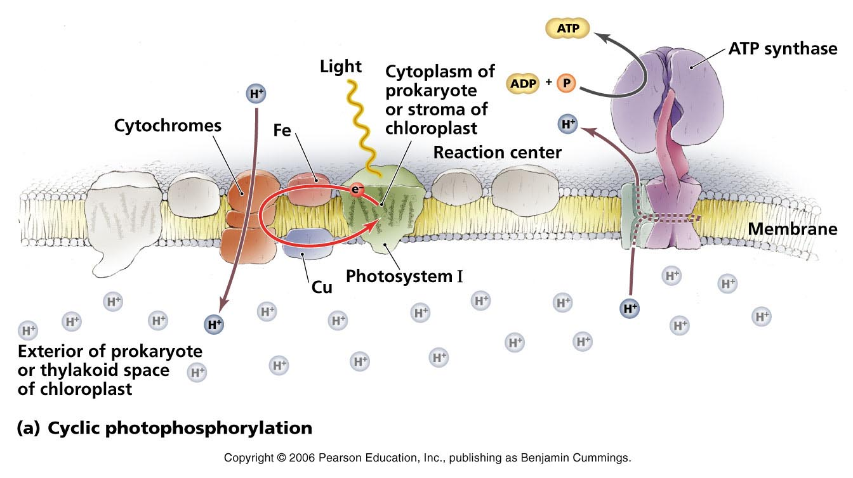
Non-cyclic photophosphorylation
Produces ATP, NADPH and O_{2(g).}
Electrons are passed on, via electron carriers through the chain.
Uses PSII and PSI.
Cyclic phosphorylation
Produces ATP.
Only uses PSI.
Is cyclic because electrons are not passed from chlorophyll on to NADP. Instead electrons are passed back to PSI by electron carriers.
This means electrons are recycled and can repeatedly flow through PSI. There is no need for photolysis.
No NADPH or O_{2(g)} produced.
Only small amount of energy is produced (ATP).
High energy electrons are used to pump H⁺ into thylakoid space.

Slide 45
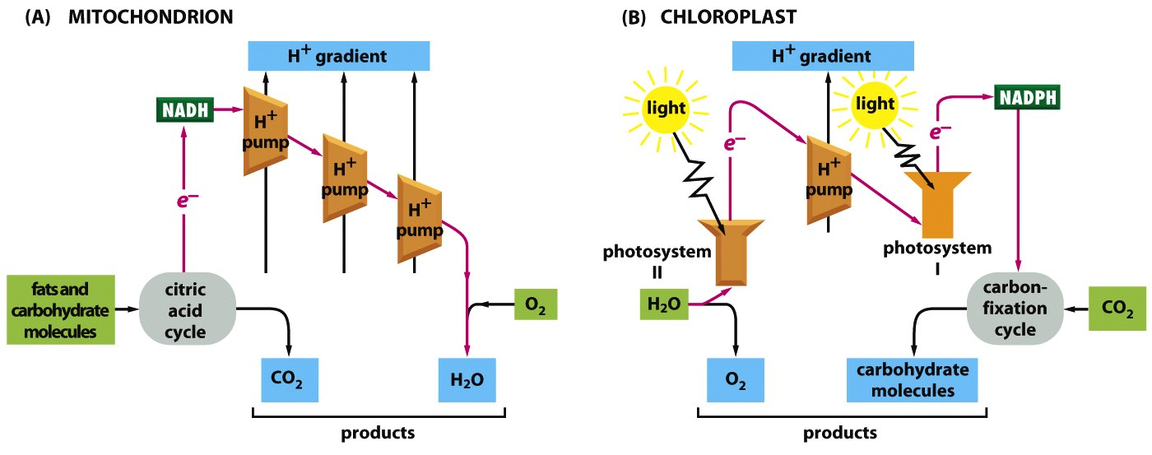

Slide 46
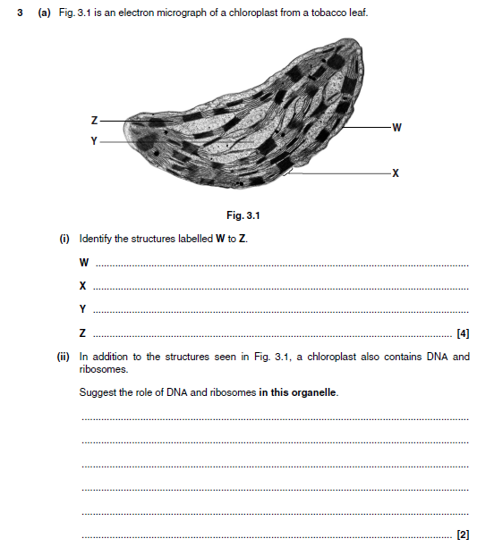
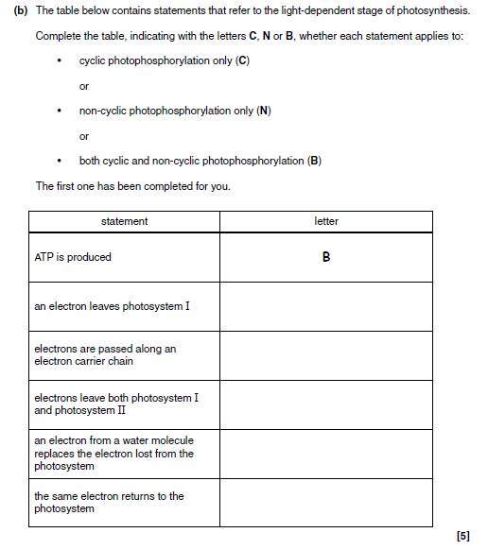
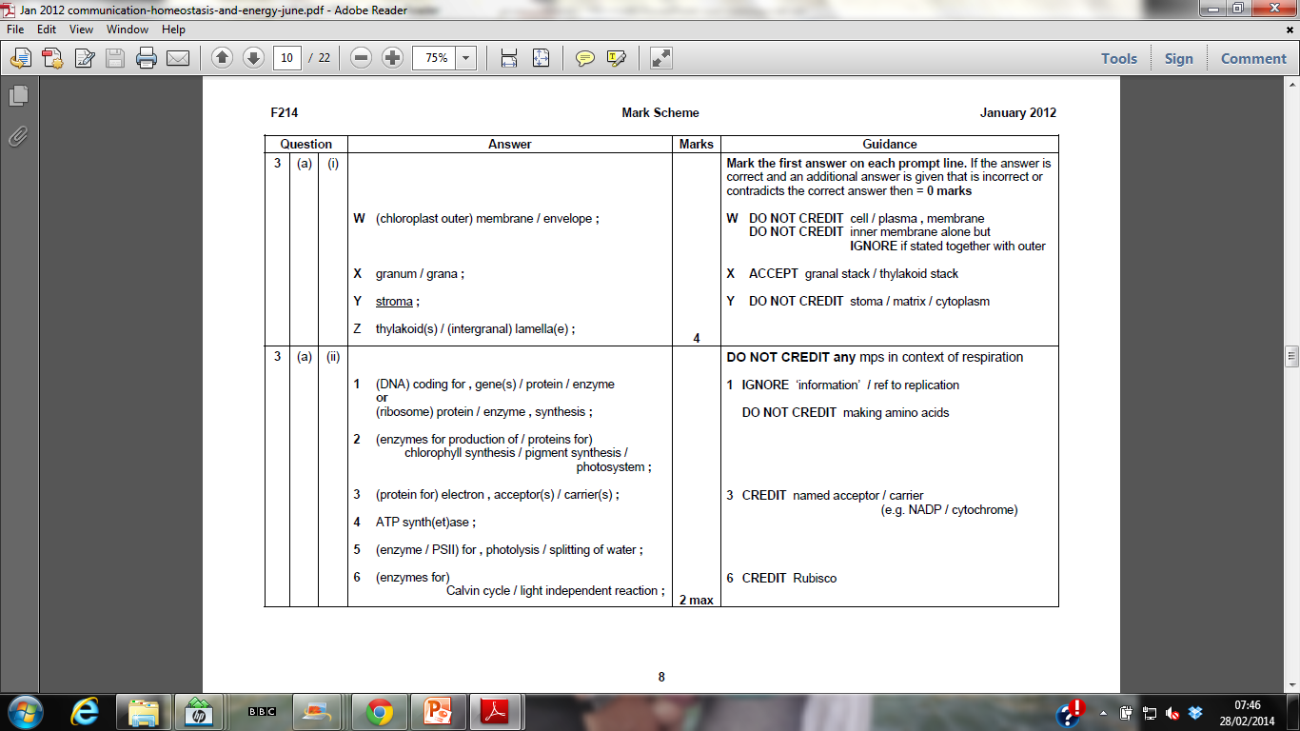
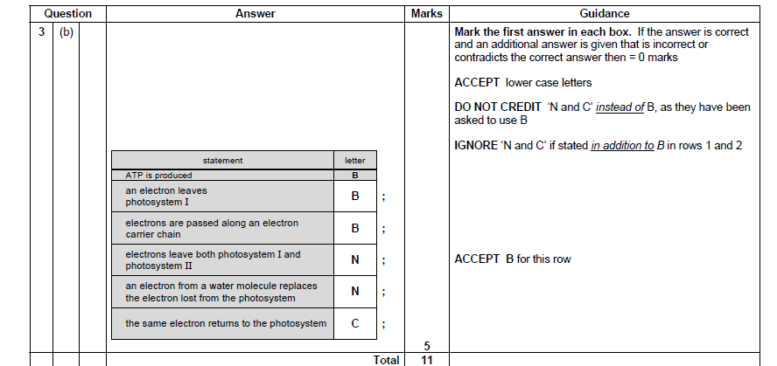

Slide 47
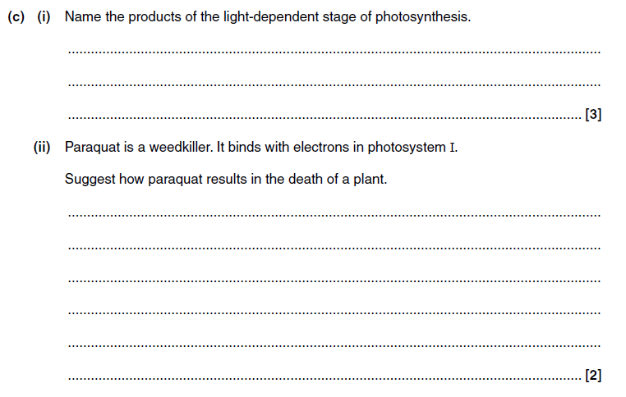
(i) reduced NADP / NADPH / NADPH² / NADPH⁺ ;
  ATP ;
oxygen ; 3 Mark the first 3 answers.
IGNORE numbers of molecules
ACCEPT O² (to be consistent with the other answers
(ii) 1 prevents photophosphorylation ;
2 cyclic and non-cyclic ;
3 no / less , ATP / reduced NADP , for , light-independent stage / Calvin cycle / GP to TP ;
4 no (named) substrate made for respiration ; 2 max 3 ‘no ATP for photosynthesis’ is not quite enough
DO NOT CREDIT (oxidised) NADP, 4 substrate eg glucose / starch / carbohydrate / sucrose / sugars
IGNORE triose phosphate / food / nutrients

Slide 48
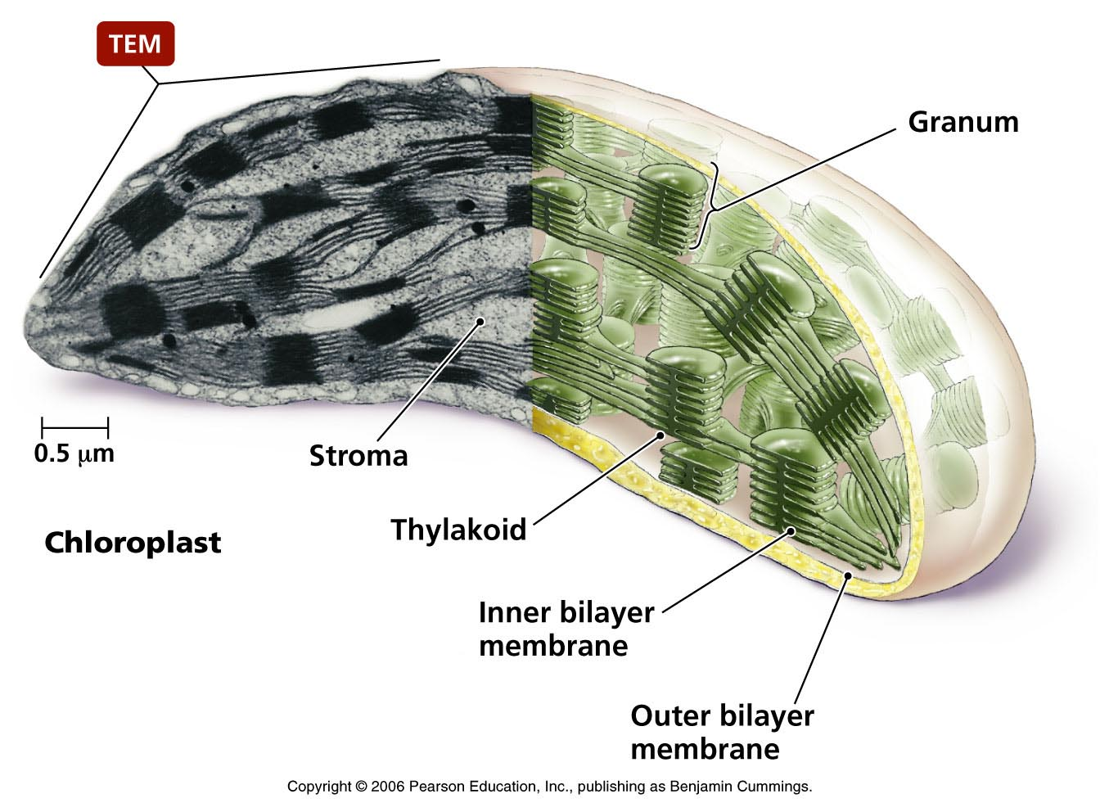
Stages of photosynthesis
Explain the role of carbon dioxide in the light-independent stage (Calvin cycle).
Outline how the products of the light-dependent stage are used in the light-independent stage (Calvin cycle) to produce triose phosphate (TP), including reference to ribulose bisphosphate (RuBP), ribulose bisphosphate carboxylase (rubisco) and glycerate-3-phosphate (GP).
Know that most TP is recycled to RuBP.
Know that TP can be used to make carbohydrates, lipids and amino acids.
Identify the missing labels for the chloroplast.

Slide 49
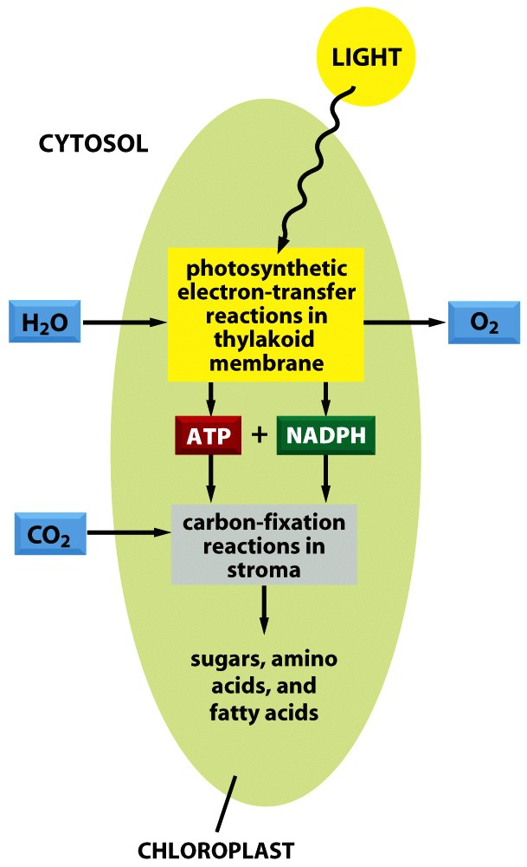
The light-dependent stage of photosynthesis took place in the thylakoid membrane.
PS II
Light absorption
Electron capture
Splitting of water and releasing oxygen
Electron Transport Chain (ATP made)
PS I
NADP⁺ to NADPH
The light-independent stage takes place in the stroma of the chloroplast.
Products from LD stage are used here.
CO_{2(g)} is converted into glucose.

Slide 50
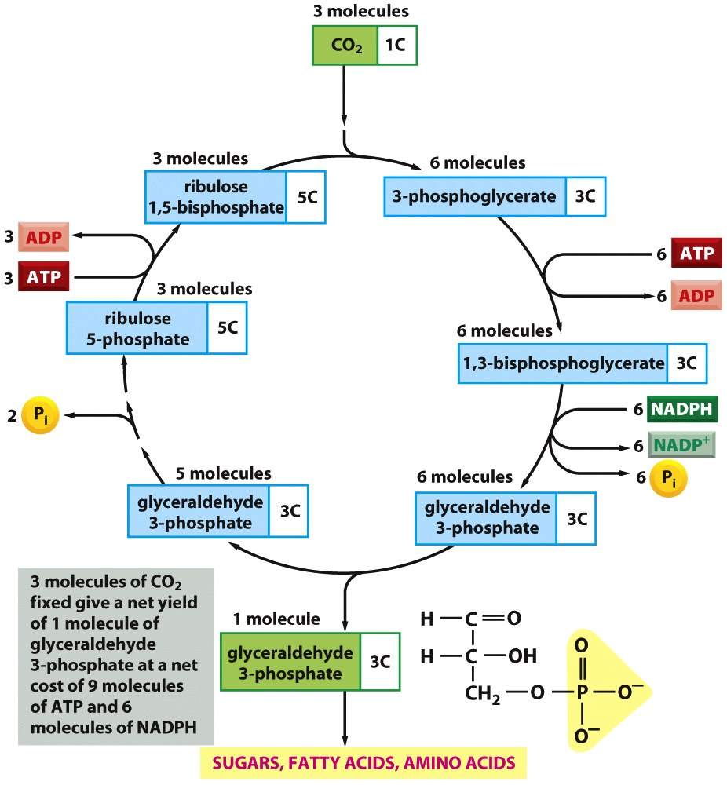
The Calvin cycle
carbon
dioxide
+
ribulose
bisphosphate
2 NADPH
2 ATP
triose
phosphate
carbohydrates, lipids,
amino acids

Slide 51
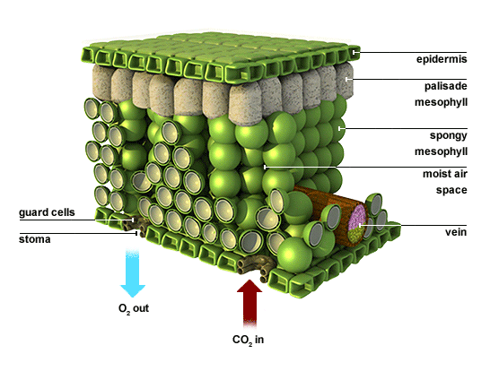
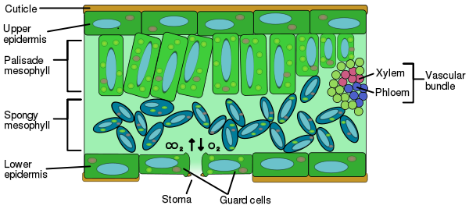
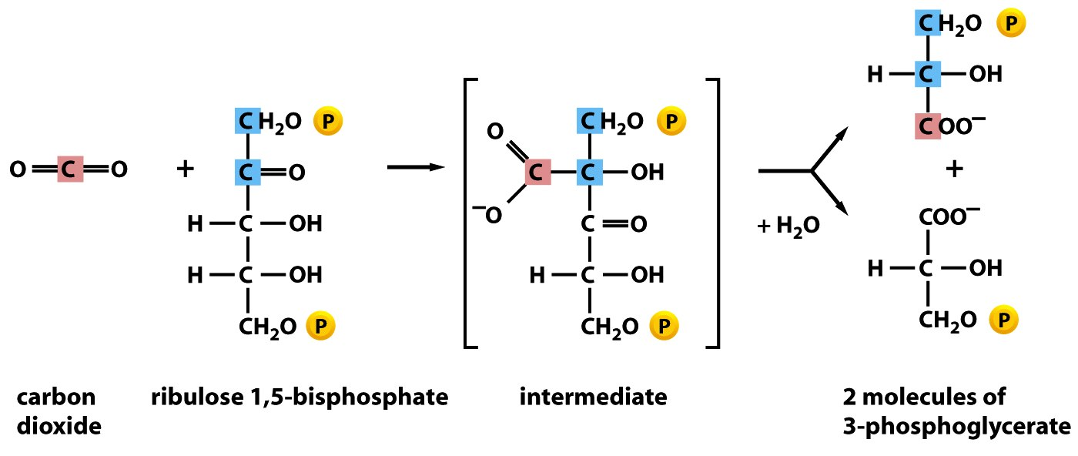
CO_{2(g)} enters the stomata and diffuses into the stroma of the chloroplast
Enzyme = Ribulose bisphosphate carboxylase (rubisco)

Slide 52
Carbon fixation
1. CO₂ reacts with ribulose bisphosphate to make glycerate 3-phosphate (GP)
rubisco
Regeneration
3. RuBP is regenerated.
Triose
phosphate
Triose
phosphate
2. GP reduced to triose phosphate, using NADPH, ATP also needed.
Triose
Phosphate
Reduction

Slide 53
SKIP

Slide 54
Most useful compounds have more than one carbon atom, this means the cycle has to turn more than once to make them……..
5 out of every 6 molecules of triose phosphate are used to regenerate RuBP, this requires the ATP made during the light-dependent reaction.
2x TP (3C) + ATP → RuBP (5C) + (1C to use in an organic compound)
How many CO₂ molecules (turns of the cycle) are needed to make a hexose sugar (6C)?
Answer = 6 CO₂ molecules (6 turns)
How much ATP and NADP is needed?
18 ATP
12 NADPH
1CO₂
2GP
2TP
5C towards re-generating RuBP + 1C to use in an organic compound
2 ATP
2 NADPH
1 ATP

Slide 55
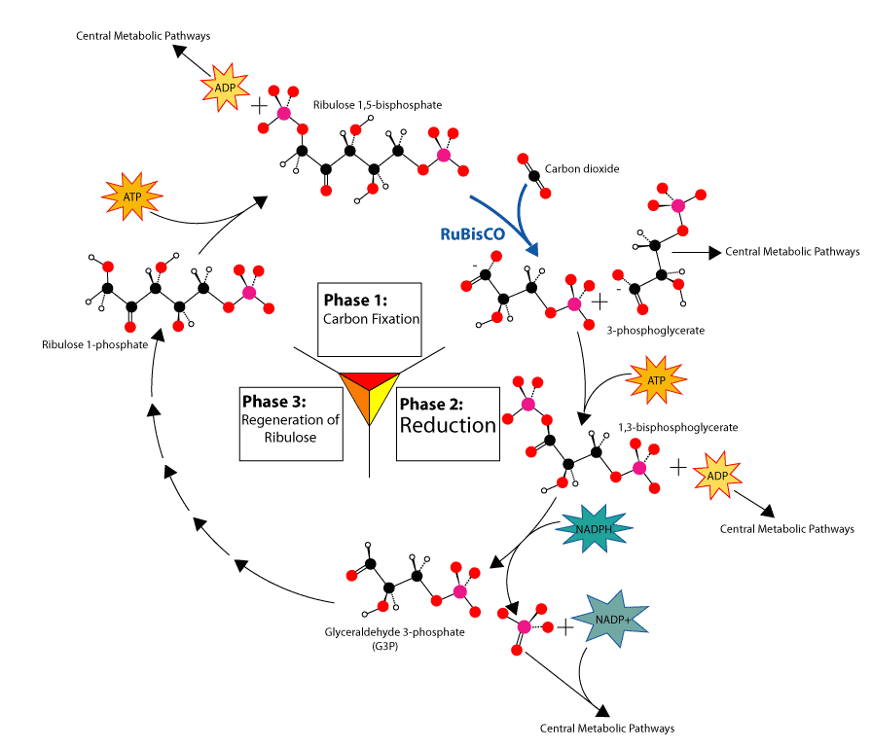
Summary of photosynthetic pathway

Slide 56
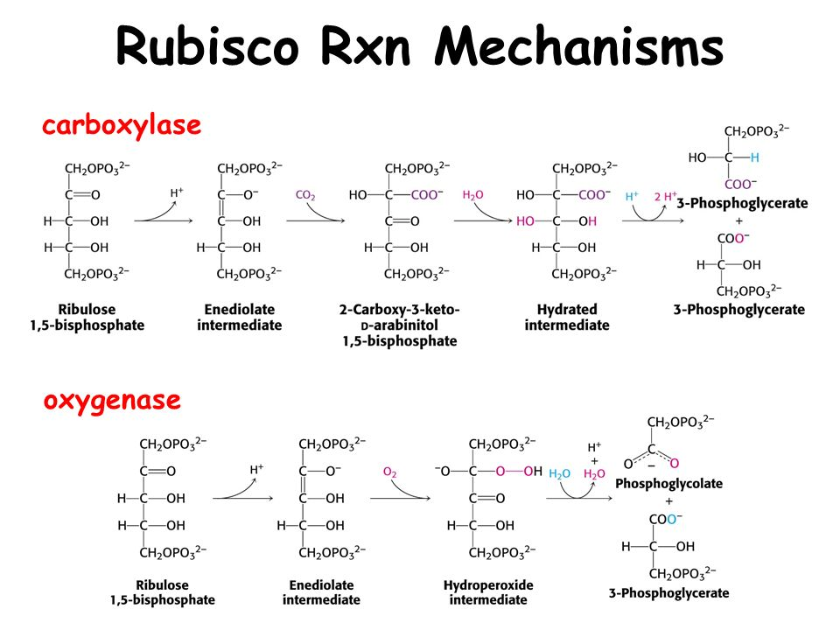

Slide 57
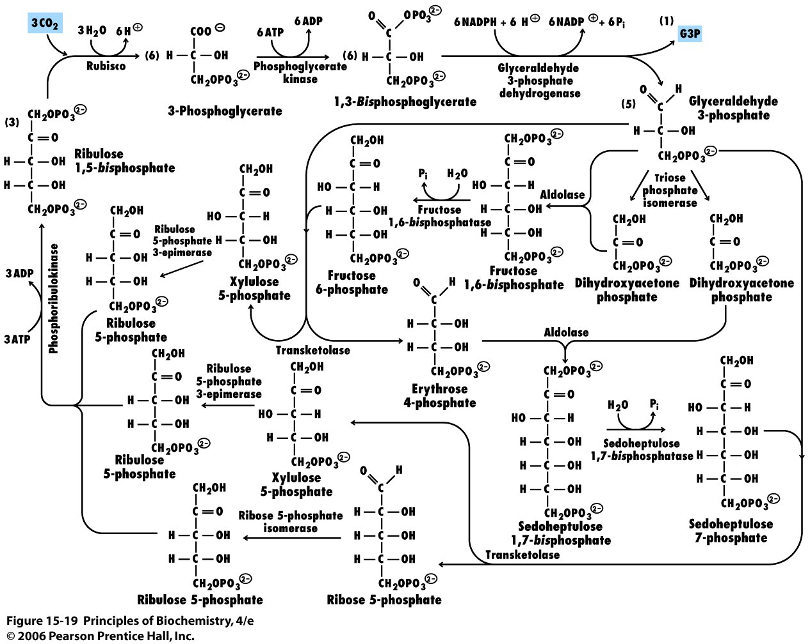
Calvin Cycle simplified (no mechanisms shown)

Slide 58
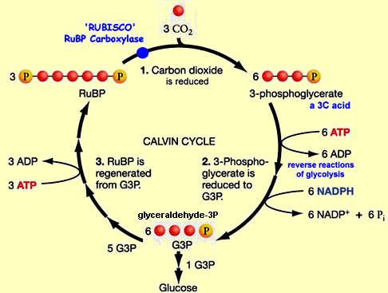
The light-independent reactions (Calvin cycle) occur in the stroma:
6 turns of the cycle needed
to form 1 molecule of hexose
1
4
2
3
The enzyme rubisco combines CO₂ with 5-carbon ribulose bisphosphate (RuBP) to form 2 molecules of 3-carbon glycerate 3-phosphate (GP)
GP reduced to glyceraldehyde 3-phosphate (G3P/ PGAL/triose phosphate) using ATP & NADPH from light-dependent reactions
TP can be used to build organic molecules, e.g. hexose sugars (glucose), amino acids & lipids
Some TP is used to reform RuBP to continue the cycle

Slide 59

This graph shows the levels of GP and RuBP with time.
Explain the changes shown:
In dark - light reaction stops so no ATP/ no NADPH/H⁺ produced
GP rises as it cannot be converted into TP.
RuBP falls as Rubisco converts remaining RuBP into GP & there is no TP to make new RuBP.
In light - light reactions start so ATP & NADPH/H⁺ produced
(1) GP falls as it is converted into TP
(3) RuBP rises as GP converted into TP to make new RuBP

Slide 60
Complete the following explanation of the light independent reactions:
RuBP
In the light-independent stage the molecules of carbon dioxide are accepted by _________.
The products ______ and ______________ from the light-dependent stage are needed to
form __________. This compound can then be converted into a _____________ sugar.
ATP
NADPH/H⁺
TP
hexose
State in which part of photosynthesis the following occur:
the splitting of water to release oxygen
the reduction of CO₂ to form carbohydrate
the reduction of NADP
non-cyclic photophosphorylation
Calvin cycle
non-cyclic photophosphorylation
How many turns of the Calvin cycle are needed to produce:
one molecule of RuBP |  | one molecule of glucose
1
6
Give the number of carbon atoms each of the following contains:
GP |  | RuBP |  | triose phosphate
3
5
3

Slide 61
Carbohydrates, lipids and amino acids
Carbohydrates…
Larger carbohydrates are made from joining together hexose sugars in different ways.
Lipids…
Made from glycerol
Glycerol made from triose phosphate and fatty acids
Amino acids…
- Some are made from glycerate-3-phosphate GP

Slide 62
Summary of photosynthetic pathway

Slide 63

Limiting factors in photosynthesis
Discuss limiting factors in photosynthesis with reference to light intensity, temperature and carbon dioxide concentration.
Describe how to investigate experimentally the factors that affect the rate of photosynthesis.
Describe the effect on the rate of photosynthesis, and on the levels of glycerate-3-phosphate, ribulose bisphosphate and triose phosphate, of changing light intensity, temperature and carbon dioxide concentration.
Using your knowledge of the Calvin cycle and light dependent reactions of photosynthesis, explain how an insufficient quantity of any one of three environmental factors limits the rate of photosynthesis a plant can achieve

Slide 64
limiting factor | explanation
light intensity
light provides the energy to synthesise ATP and NADPH/H⁺, both are required to reduce CO₂ to form sugars
CO₂ is the reactant from which sugars are formed,
lower CO₂ concentration means lower rate of reaction, as does not combine with RuBP
CO₂ concentration
the reactions of the Calvin cycle are catalysed by enzymes e.g. rubisco, enzyme activity is dependent on temperature,
the lower the temperature the lower the rate of reaction
temperature

Slide 65

CO₂ exchange
The graph shows the relationship between light intensity (x axis) and the net exchange of CO₂ with the environment (y axis)
Label the following points on the graph, explaining your reasons for each choice:
light intensity
 | point | explanation
X | max CO₂ release from plant
Y | max CO₂ uptake by plant
Z | compensation point (no net CO₂ exchange)
Light intensity = 0, so no photosynthesis, so no uptake of CO₂;
plant is respiring so producing CO₂;
= max CO₂ release since rate of respiration relatively constant
graph levels off so light intensity no longer limiting ,
max rate of photosynthesis achieved;
so uptake of CO₂ also at maximum;
rate of photosynthesis > rate of respiration
rate of photosynthesis = rate of respiration;
CO₂ taken up for photosynthesis is balanced by CO₂ released from respiration

Slide 66



Limiting factors?
High intensity of certain wavelengths of light:
Specific wavelengths required for pigments.
High intensity needed of specific wavelength, so much energy is provided.
Optimum temperature of ~25 ºC:
Below 10 ºC enzymes inactive.
Above 45 ºC enzymes denatured.
Enzymes are rubisco and ATP synthase.
At high temperature, stomata close to avoid loss of H₂O, this means less CO₂ can enter the leaf.
Concentration of CO₂:
0.04% in atmosphere.
Higher % increases rate of photosynthesis but causes stomata to close.
Water:
Needed for light dependent stage/PSII
Too much and soil becomes water logged, decreasing uptake of minerals (Mg²⁺).

Slide 67
Describe how to investigate experimentally the factors that affect the rate of photosynthesis.
Describe the effect on the rate of photosynthesis, and on the levels of glycerate-3-phosphate, ribulose bisphosphate and triose phosphate, of changing light intensity, temperature and carbon dioxide concentration.
Design an experiment that will allow you to measure the rate of photosynthesis during different limiting factors. Remember to include:
Hypothesis
Scientific theory to support hypothesis
Controls
Safety/hazard information
Method
Table
Graph
You must include how this will affect the levels of GP RuBP and TP.

Slide 68

A photosynthometer – apparatus used to measure the rate of photosynthesis under various conditions

Slide 69

Using leaf discs to measure the rate of photosynthesis

Slide 70

Using an indicator solution

Slide 71


Effect on relative concentrations of GP, TP and RuBP, of reducing light intensity
Less NADPH and ATP.
Conversion of GP into TP and RuBP is slow.
[GP] increases.
[TP] and [RuBP] decreases.
Effect on relative concentrations of GP, TP, and RuBP of reducing carbon dioxide concentration
Low CO_{2(g)}.
Conversion of RuBP to GP is slow.
[RuBP] increases
[GP] and [TP] decreases
Effect of temperature changes?

Slide 72
Many seeds contain food stores, including starch, proteins and lipids. A fully developed seed of H. annuus contains between 40% and 50% of unsaturated fatty acids, including oleic acid and linoleic acid. These fatty acids can be used as respiratory substrates for the production of ATP.
(i) Explain why seeds need ATP.
.........................................................................................................................
.........................................................................................................................
.........................................................................................................................
......................................................................................................................... [2]
releases/source of/provides/to give, energy;
for germination;
for growth/protein synthesis/spindle formation/organelle replication/
DNA replication/active transport/cell division/other named function

Slide 73
All organisms require energy in order to remain alive. Plants use solar energy to combine water and carbon dioxide into complex organic molecules. Both plants and animals then break down organic molecules in respiration. Energy released in this process is used in the formation of ATP.
Describe the structure of ATP.
..................................................................................................................................
..................................................................................................................................
..................................................................................................................................
..................................................................................................................................
..................................................................................................................................
[Total: 4 marks]
accept labelled sketch diagram for marking points below
nitrogenous base / purine;
adenine;
pentose / 5 carbon, sugar;
ribose;
three, phosphate groups / Pi; R phosphate molecule
phosphorylated nucleotide;
A adenosine as an alternative to adenine plus ribose

