Slide 1
t tests (paired and unpaired)

Slide 2
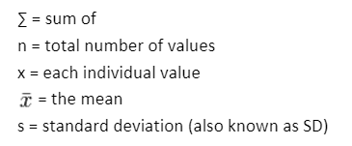
Standard deviation recap
Σ(x – x)²
SD =
√
n – 1
Data set 4,7,3,5,7
Find the SD for this data set
Find the mean x 26/5 = 5.2
Find the Subtract the mean value from each measurement and square each value (x – x)²
(4-5.2)²=1.44 (7-5.2)²=3.24 (3-5.2)²=4.84 (5-5.2)²=0 (7-5.2)²=3.24
3) Fin the Σ = 12.76
4)
12.76
SD =
√
= 2.96
5 – 1

Slide 3
What can the t-test tell you?
  If there is a statistically significant difference between two means, when:
  The sample size approximately 25 or over.
  The data is normally distributed
  The dependent variable is continuous
  There is crossover between the two data sets
Notes:
3

Slide 4
Two types of t test
Paired t-test: Used to compare the means of two samples when each individual in one sample also appears in the other sample - For example: is heartbeat statistically different before and after exercise?
Unpaired t-test: Used to compare the means of two samples when each individual in one sample is independent of every individual in the other sample. For example: Does pH affect coleoptile growth?

Slide 5
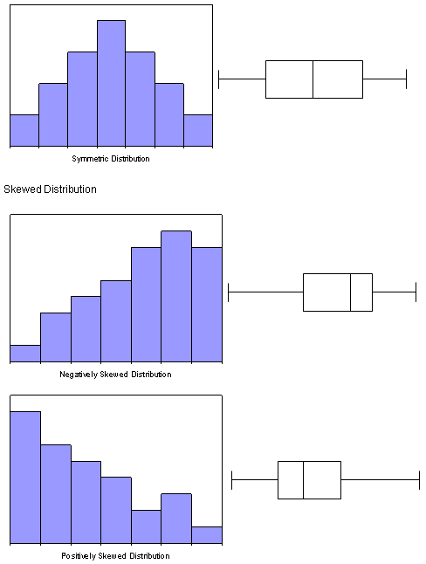
In order to compare and see whether the data is significantly different from one another, you need to first assess its distribution.
If the set of data is distributed symmetrically about a mean in other words “of normal distribution” we can do a t-test. But data is often clumped to one extreme we say the data is skewed, in this situation we can’t do a t-test.

Slide 6
Obviously you can ‘compare’ the means of two sets of data by subtracting one mean from the other to work out the difference.
The t-test does that but it also takes into account the degree of overlap between the two sets of data and lets you say how certain you are in saying that the means are, or are not, significantly different from each another.

Slide 7
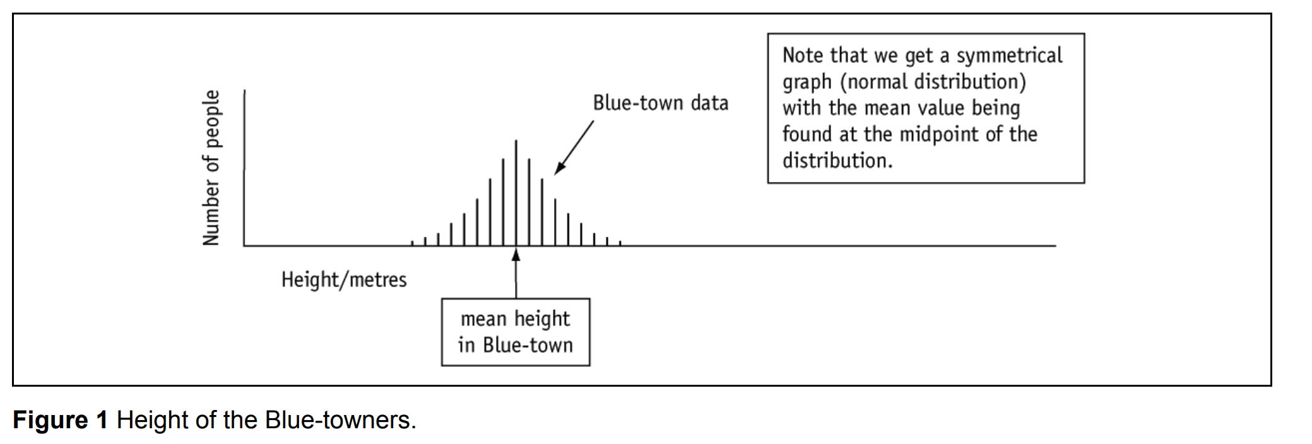
Let us suppose that you live in Blue-town.
Somewhat bizarrely you are extremely proud of the fact that you and your fellow townspeople are generally very tall (much taller than those vertically challenged people down the road in Red-town).
You decide to celebrate the glorious height of the Blue-towners by measuring lots of them and plotting the graph you see in Figure 1.

Slide 8
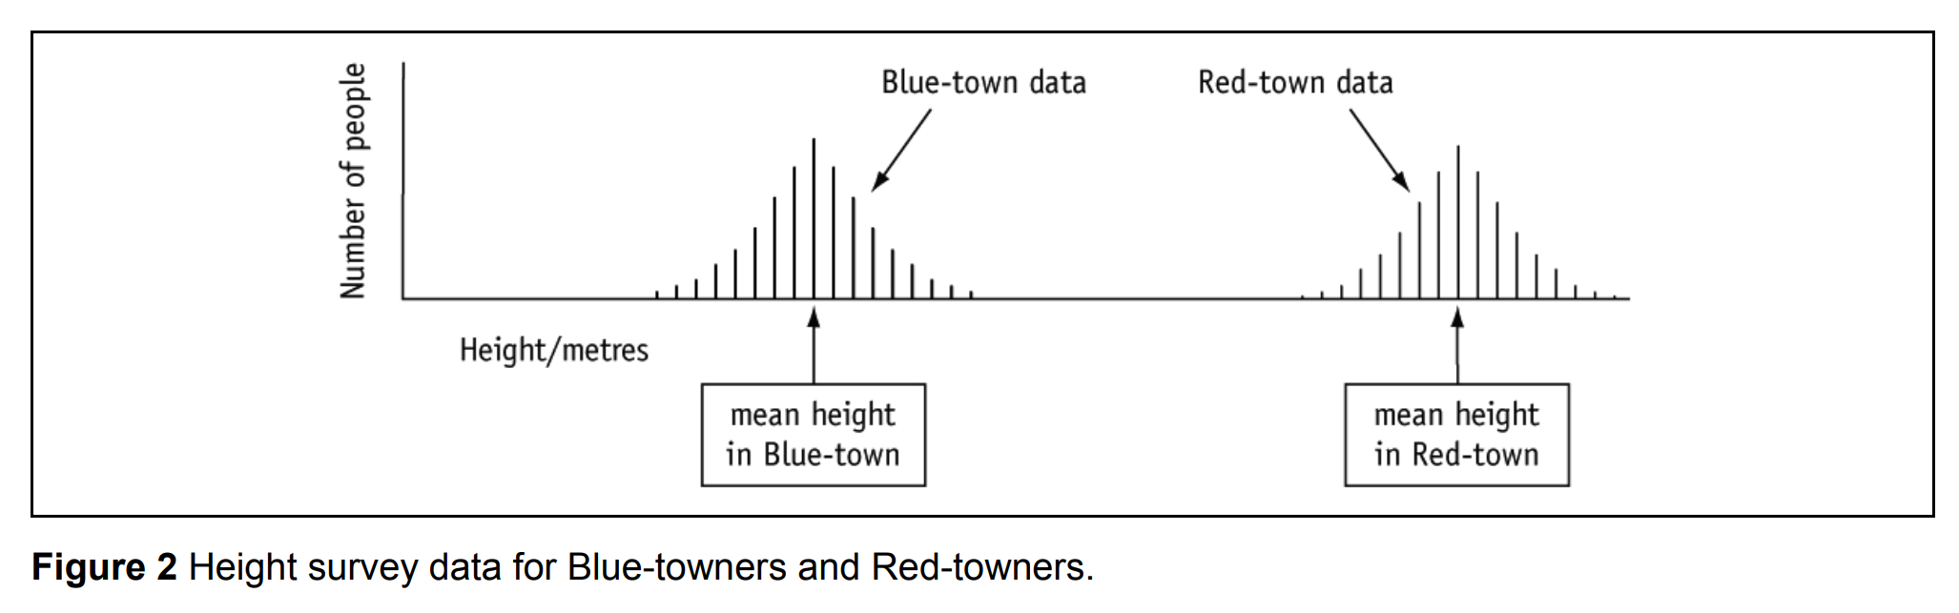
After spending a while gloating about Blue-town’s enormous mean height, you decide to rub it in by visiting Red-town and measuring some of the shorties who live there. Once you have demonstrated their shortness your joy will be complete.
You visit Red-town and measure as many people as you can get to agree to be measured and obtain the data displayed in Figure 2.
BUT HANG ON A SECOND!

Slide 9
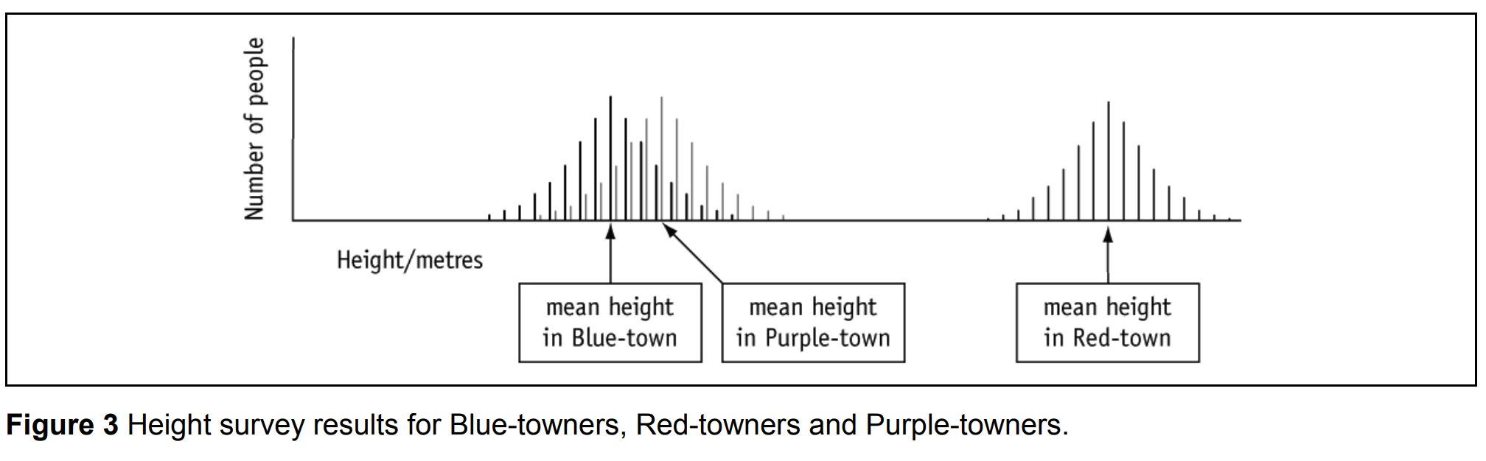
SHOCK!
Even the tallest person in Blue-town is shorter than the shortest person in Redtown. Your dubious heightist agenda has been shown up for the moronic conceit that it is.
If anyone were to ask themselves the question: ‘Is the mean height in Blue-town significantly different from the mean height in Red-town?’, the answer would not be in doubt: Yes, the mean in Red-town is much bigger and there is not even any overlap between the two datasets.
In an attempt to find somewhere where mean height is less than Blue-town you visit Purple-town and get the results displayed in Figure 3

Slide 10
Now the answer to the question ‘Is the mean height in Blue-town significantly different from the mean height in Purple-town?’ is not nearly so obvious. Not only are the two means quite close together but there is also a considerable amount of overlap between the two distributions (lots of readings in common).
The t-test allows you to answer the question ‘are the means significantly different?’. It takes into account the degree of overlap in the two sets of data and allows you to say how certain you are in either accepting that there is no significant difference, or stating that there is a significant difference.

Slide 11
HOW DO YOU DO IT?

Slide 12
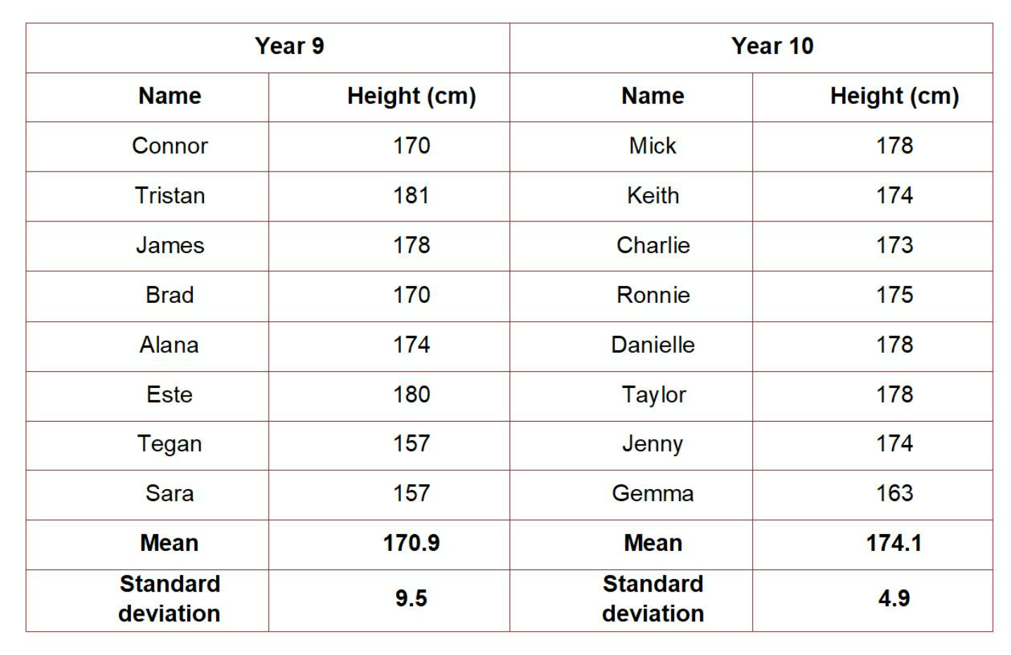
Student’s t-test / unpaired t-test
This is the best test for looking at average differences between independent groups.
So this is the test we would use to compare, for example, the average height of children in Year 9 and the average height of children in Year 10.

Slide 13
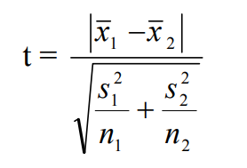
t-test for two sets of unrelated data (unpaired)
Used to compare the means from two unrelated groups
x₁ = mean of first sample
x₂ = mean of second sample
s₁ = standard deviation of first sample
s₂ = standard deviation of second sample
n₁ = number of measurements in first sample
n₂ = number of measurements in second sample
Recap SD?
Notes:
13

Slide 14
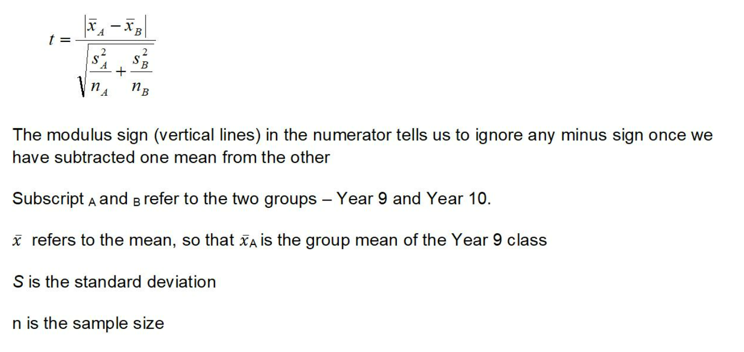
Our null hypothesis is that there is no significant difference between the heights of Year 9 and Year 10 children.

Slide 15
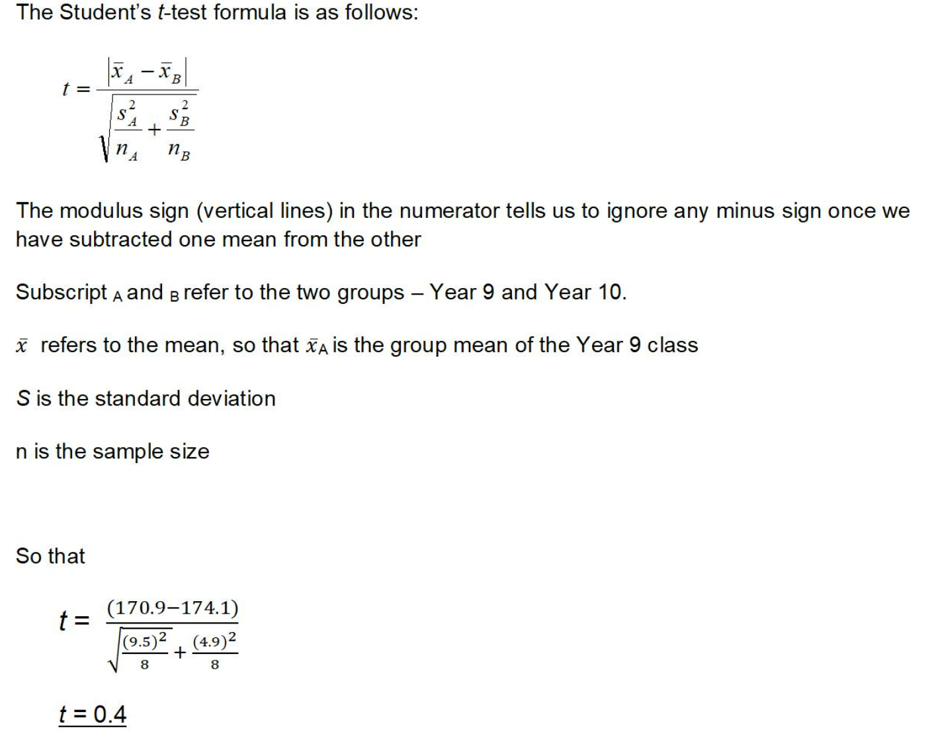

Slide 16
The calculated t value is compared with a critical value obtained from a table of critical values of t.
In order to use the correct row in the table you need to work out how many degrees of freedom your data had.
(df) = takes into account the number of measurements collecting using the following formula:
n1 + n2 – 2
For the data the degrees of freedom are 8 + 8 – 2 = 14 degrees of freedom

Slide 17
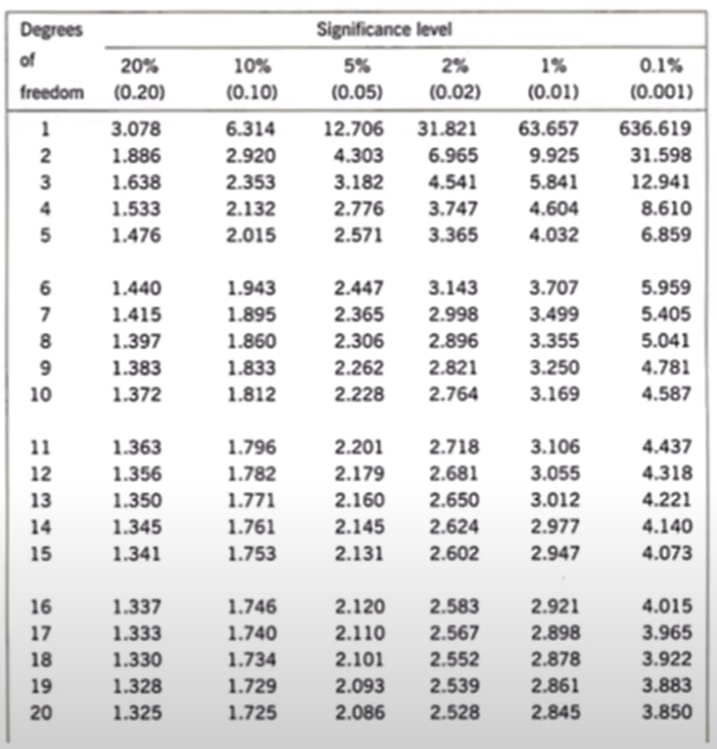
t = 0.4 (ignore any – sign)
Critical value is 5% / 0.05
df =14
Significance = 2.145

Slide 18

0.4 ← 2.145
Conclusion:
The t value (0.4) is smaller than the critical value of (2.145)
We ACCEPT the null hypothesis
There IS NOT a significant difference between the mean heart rate during moderate and intense exercise

Slide 20
Now you try
On OneNote page

Slide 21

Question 1
Does the pH of soil affect seed germination of a specific plant species?
Group 1: eight pots with soil at pH 5.5
Group 2: eight pots with soil at pH 7.0
50 seeds planted in each pot and the number that germinated in each pot was recorded.

Slide 22
What is the null hypothesis (H₀)?
H₀ = there is no statistically significant difference between the germination success of seeds in two soils of different pH
H_{A} = there is a significant difference between the germination of seeds in two soils of different pH
If the value for t exceeds the critical value (P = 0.05), then you can reject the null hypothesis.
Notes:
22

Slide 23
Pot | Group 1 (pH5.5) | (x – x)² | Group 2 (pH7.0) | (x – x)²
1 | 38 | ………. | 39 | ……….
2 | 41 | ………. | 45 | ……….
3 | 43 | ………. | 41 | ……….
4 | 39 | ………. | 46 | ……….
5 | 37 | ………. | 48 | ……….
6 | 38 | ………. | 39 | ……….
7 | 41 | ………. | 46 | ……….
8 | 36 | ………. | 44 | ……….
Mean | ………. |  | ………..
Σ |  | ………. |  | ……….
Complete the table
Notes:
23

Slide 24
Pot | Group 1 (pH5.5) | (x – x)² | Group 2 (pH7.0) | (x – x)²
1 | 38 | 1.21 | 39 | 20.25
2 | 41 | 3.61 | 45 | 2.25
3 | 43 | 15.21 | 41 | 6.25
4 | 39 | 0.01 | 46 | 6.25
5 | 37 | 4.41 | 48 | 20.25
6 | 38 | 1.21 | 39 | 20.25
7 | 41 | 3.61 | 46 | 6.25
8 | 36 | 9.61 | 44 | 0.25
Mean | 39.1 |  | 43.5
Σ |  | 38.88 |  | 82.0
Notes:
24

Slide 25
t-test for two sets of unrelated data
x₁ = mean of first sample 39.1
x₂ = mean of second sample 43.5
s₁ = standard deviation of first sample
s₂ = standard deviation of second sample
n₁ = number of measurements in first sample
n₂ = number of measurements in second sample
Notes:
25

Slide 26
Calculate standard deviation for both groups
Σ(x – x)²
SD =
√
n – 1
Group 1:
Σ(x – x)²
38.88
= 2.36
SD =
√
=
√
n – 1
8 – 1
Group 2:
Σ(x – x)²
82.0
SD =
√
=
√
= 3.42
n – 1
8 – 1

Slide 27
t-test for two sets of unrelated data
x₁ = mean of first sample 39.1
x₂ = mean of second sample 43.5
s₁ = standard deviation of first sample 2.36
s₂ = standard deviation of second sample 3.42
n₁ = number of measurements in first sample 8
n₂ = number of measurements in second sample 8
Notes:
27

Slide 28
Using your means and SDs, calculate value for t
x₁ – x₂
t =
√ (s₁²/n₁) + (s₂²/n₂)
39.1 – 43.5
-4.4
t =
=
√ (2.36²/8) + (3.42²/8)
√ 0.696 + 1.462
t = 2.99 (ignore negative sign)

Slide 29
The calculated t value (2.99) is compared with a critical value obtained from a table of critical values of t.
In order to use the correct row in the table you need to work out how many degrees of freedom your data had.
(df) = takes into account the number of measurements collecting using the following formula:
n1 + n2 – 2
For the data the degrees of freedom are 8 + 8 – 2 = 14 degrees of freedom

Slide 30
t = 2.99 (ignore any – sign)
Critical value is 5% / 0.05
df =14
Significance = 2.145

Slide 31
2.145 → 2.99
Conclusion:
The t value (2.99) is greater than the critical value of (2.145)
We reject the null hypothesis
There IS a significant difference between the mean heart rate during moderate and intense exercise

Slide 34
Another unpaired questions
 | Critical t values
Degrees of Freedom | P=0.10 | P=0.05 | P=0.02
12 | 1.782 | 2.179 | 2.681
13 | 1.771 | 2.160 | 2.650
14 | 1.761 | 2.145 | 2.624
15 | 1.753 | 2.131 | 2.602
16 | 1.746 | 2.121 | 2.583
17 | 1.740 | 2.110 | 2.567
A scientist investigated growth of lettuce seedlings in pH 4.3 and pH 5.2.
What is the null hypothesis?
The standard deviations for each group were:
4.3 = 2.36 (8 plants)
5.2 = 3.42 (8 plants)
Calculate t
3. What were the degrees of freedom of this experiment?
4. Using the table opposite, identify the critical value at the 95% confidence level
5. Write a conclusion

Slide 35
Question 2
A scientist investigated growth of lettuce seedlings in pH 4.3 and pH 5.2.
What is the null hypothesis?
  There is no statistically significant difference in growth height between the seedlings in pH 4.3 and pH 5.2
The standard deviations for each group were:
4.3 = 2.36 (8 plants)
5.2 = 3.42 (8 plants)
Calculate t
t = 2.99
3. What were the degrees of freedom of this experiment?
DF = (8-1)+(8-1)
DF = 14
Notes:
You can use the t test calculator to work through this example more fully.

Slide 36
Question 2
 | Critical t values
Degrees of Freedom | P=0.10 | P=0.05 | P=0.02
12 | 1.782 | 2.179 | 2.681
13 | 1.771 | 2.160 | 2.650
14 | 1.761 | 2.145 | 2.624
15 | 1.753 | 2.131 | 2.602
16 | 1.746 | 2.121 | 2.583
17 | 1.740 | 2.110 | 2.567
4. Using the table opposite, identify the critical value at the 95% confidence level

Slide 37
Compare our calculated value of r with the relevant critical value in the stats table of critical values
Our value of t = 2.99
Degrees of freedom = n₁ + n₂ – 2 = 14
Note: this is different for each test that you learn
D.F. | Critical Value (P = 0.05)
14 | 2.15
15 | 2.13
16 | 2.12
17 | 2.11
18 | 2.10
Our value for t exceeds the critical value, so we can reject the null hypothesis.
We can conclude that there is a significant difference between the two means, so pH does affect the germination rate for this plant.
Notes:
37

Slide 40
Another unpaired question below

Slide 41
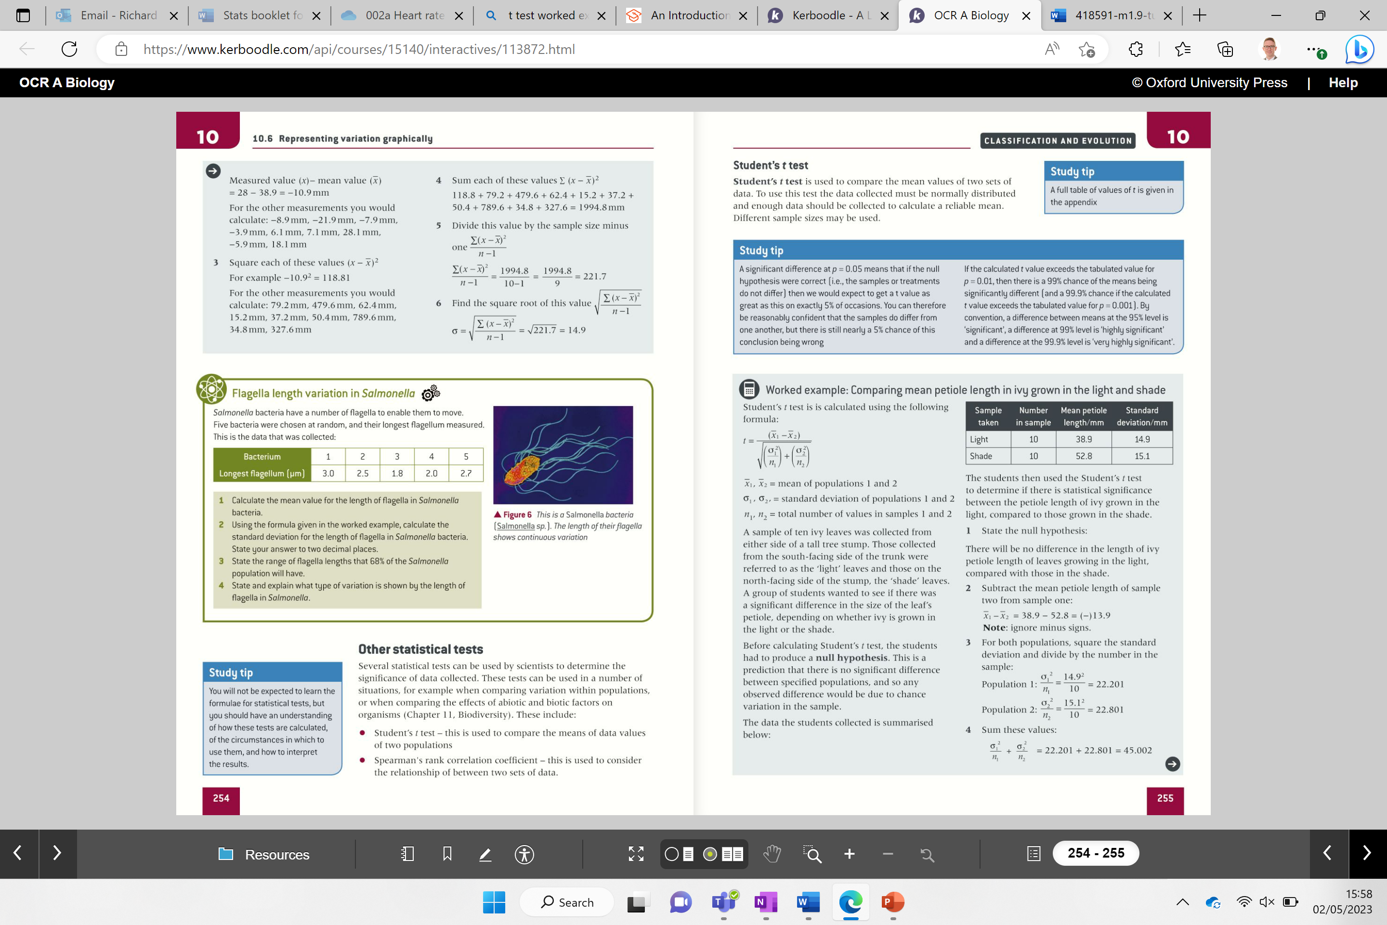

Slide 43
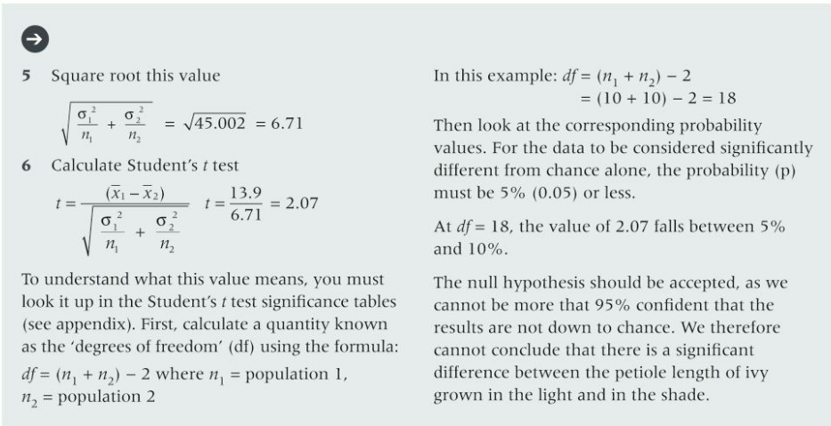

Slide 47
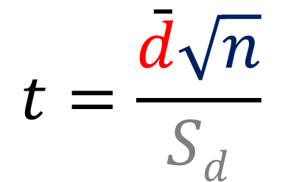
Paired t-test
Taken from the same test subject at different times!
Mean of differences
Square root of number of pairs
$$t=\frac{\bar{d}\sqrt{n}}{Sd}$$
Standard deviation of differences
Notes:
The equation is usually provided, depending on exam board
Ignore any negatives; it is the magnitude of the t value that is important, not if it is positive or negative
Again, using tables is the most effective way to calculate t

Slide 48
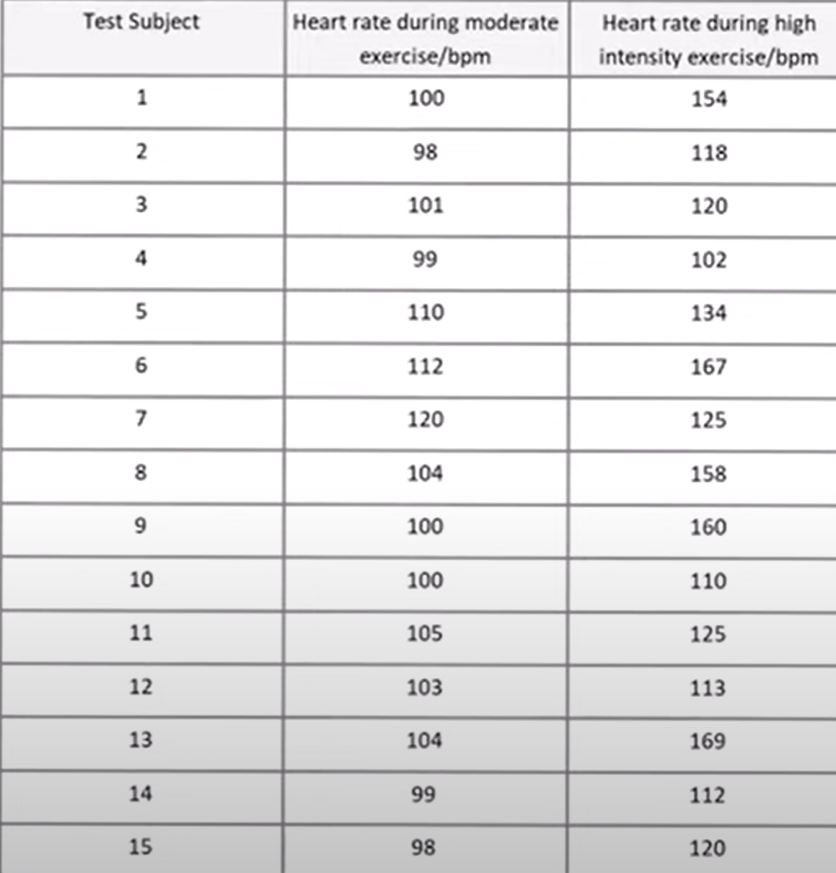
Comparing students mean heart rate during moderate exercise and during high exercise
Null hypothesis: No sig diff between the mean HR during moderate and high intensity exercise.
Calculate the differences in HR
Calculate the total of the difference in HR and find the mean
Calculate the standard deviation of difference
Put values into the PAIRED t test formula
Compare t to critical value to accept/reject null hypothesis

Slide 49
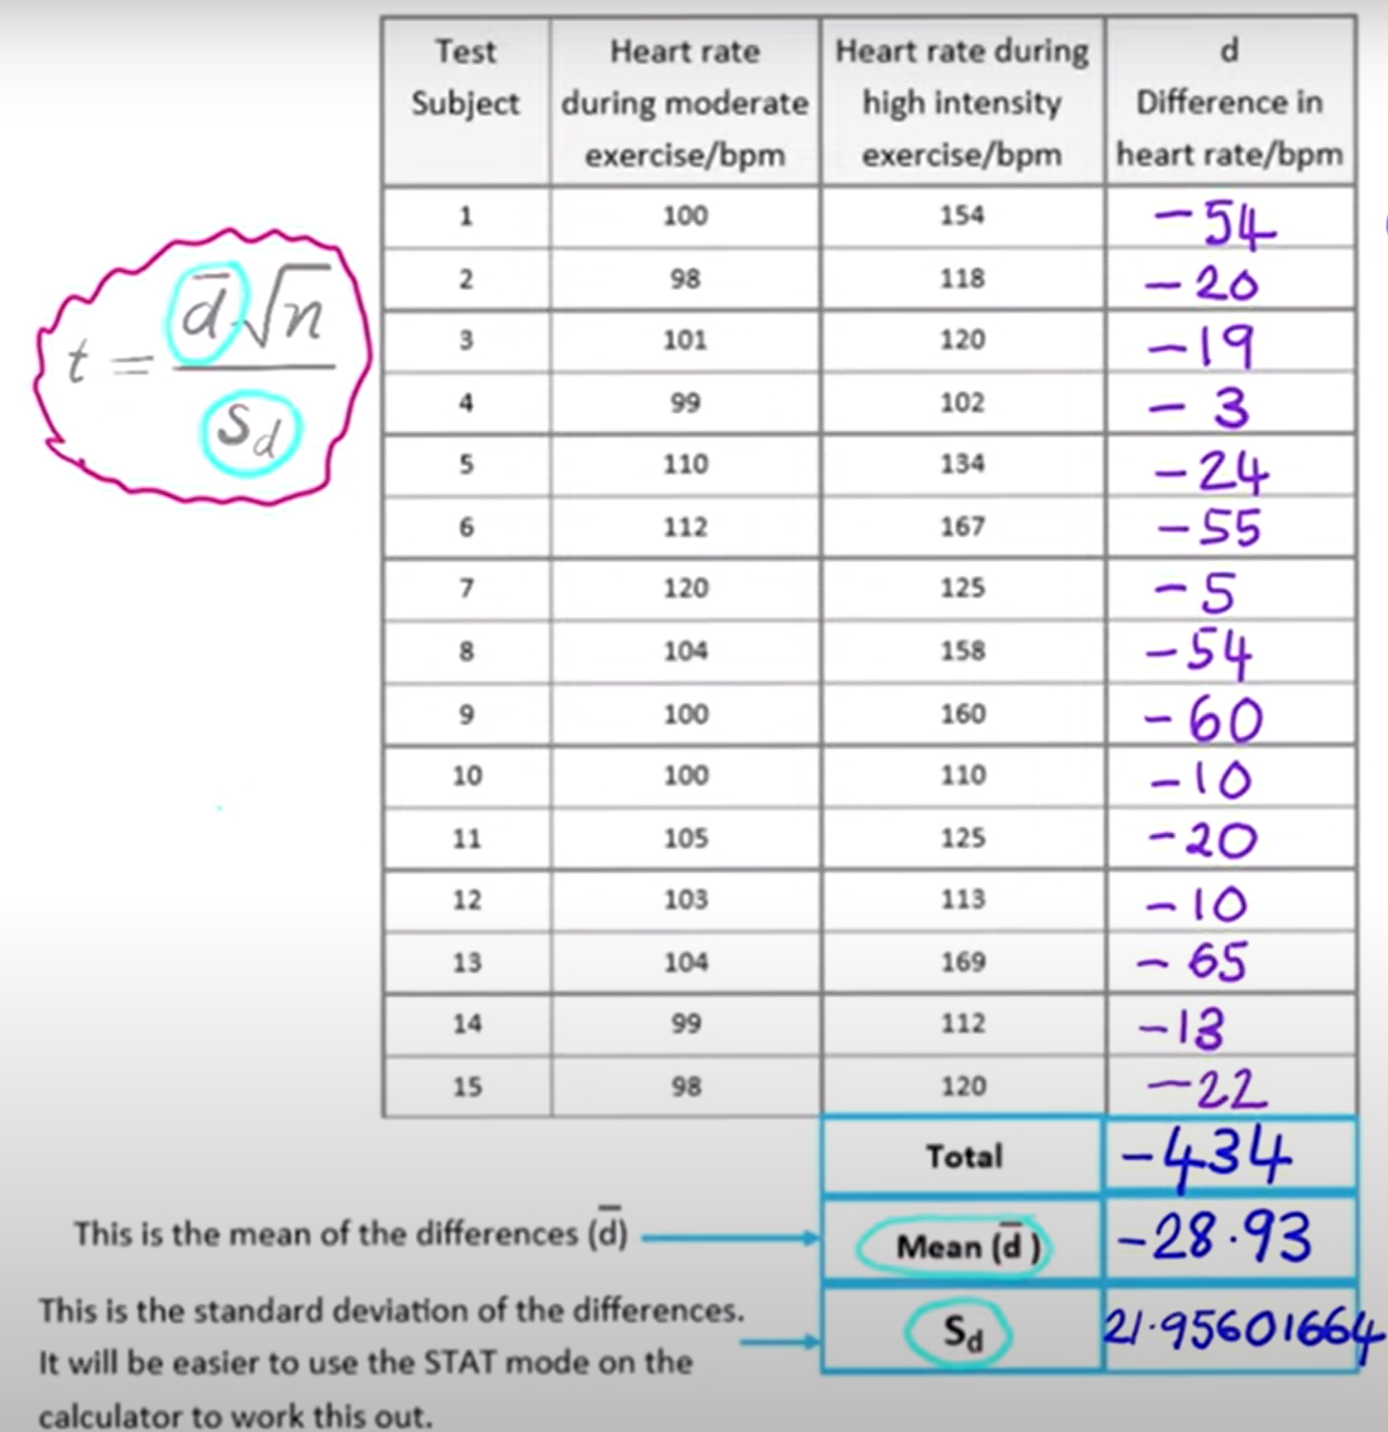
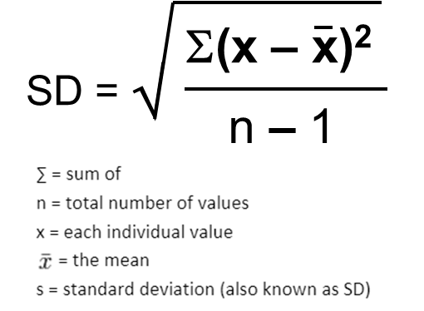
Calculating SD of the difference
(-54+28.93)² = 628.50
(-20+28.93)² = 79.74
(-19+28.93)² = 98.60
(-3+28.93)² = 672.36
(-24+28.93)² = 24.30
(-55+28.93)² = 679.64
(-5+28.93)² = 572.64
(-54+28.93)² = 628.50
(-60+28.93)² = 965.34
(-10+28.93)² = 358.34
(-20+28.93)² = 79.74
(-10+28.93)² = 358.34
(-65+28.93)² = 1301.04
(-13+28.93)² = 253.76
(-22+28.93)² = 48.02
Total: 6748.86
S_{d} =
√
^{6748.86}
= 21.956
14

Slide 50
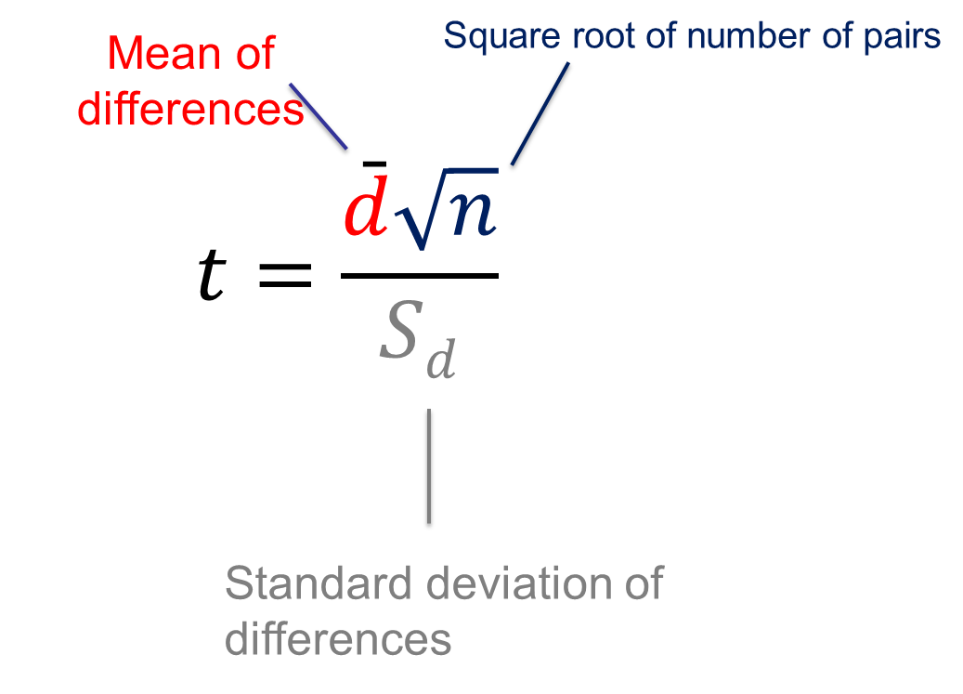
Answer
t = -28.93 x √15
21.956
t = -5.10 (ignore negatives)

Slide 51
t = 5.10 (ignore the – sign)
df for PAIRED t test is n-1
So df is 15-1=14
Critical value is 5% / 0.05
Significance = 2.145

Slide 52
2.145 → 5.10
Conclusion:
The t value (5.10) is greater than the critical value of (2.145)
We reject the null hypothesis
There IS a significant difference between the mean heart rate during moderate and intense exercise

Slide 54
Now you try
On OneNote page​

Slide 55
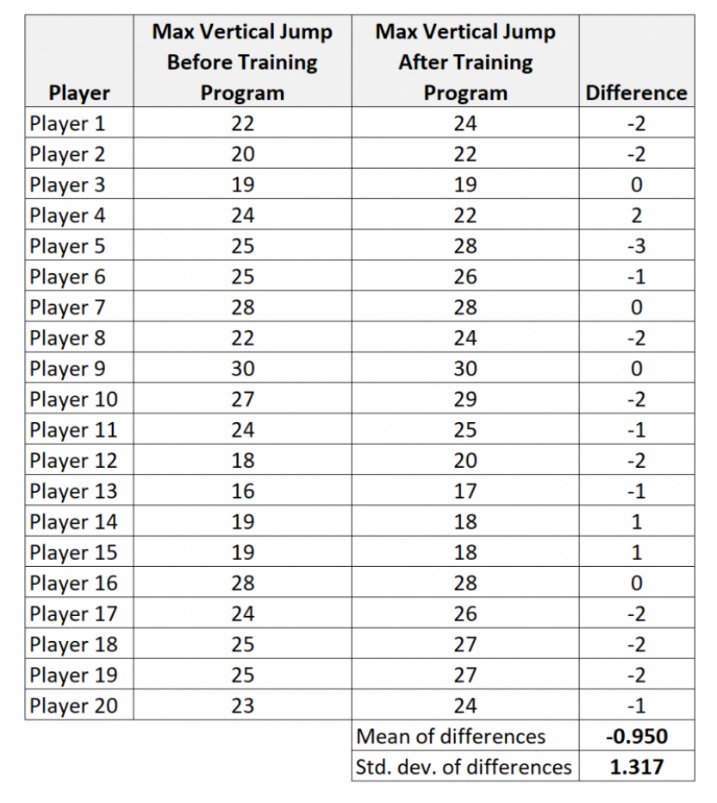
Q1. State the null hypothesis:
No sig diff between the mean HR during moderate and high intensity exercise.
Q2. Calculate t
Q3. Compare to critical value and write conclusion

Slide 56
Calculate t
t = -0.950 x √20
1.317
t = 3.23 (ignore negatives)

Slide 57
t = 3.23 (ignore the – sign)
df for PAIRED t test is n-1
So df is 20-1=19
Critical value is 5% / 0.05
Significance = 2.093

Slide 58
2.093 → 3.23
Conclusion:
The t value (3.23) is greater than the critical value of (2.093)
We reject the null hypothesis
There IS a significant difference between the mean heart rate during moderate and intense exercise

Slide 61
More standard deviation recap last two slide

Slide 62
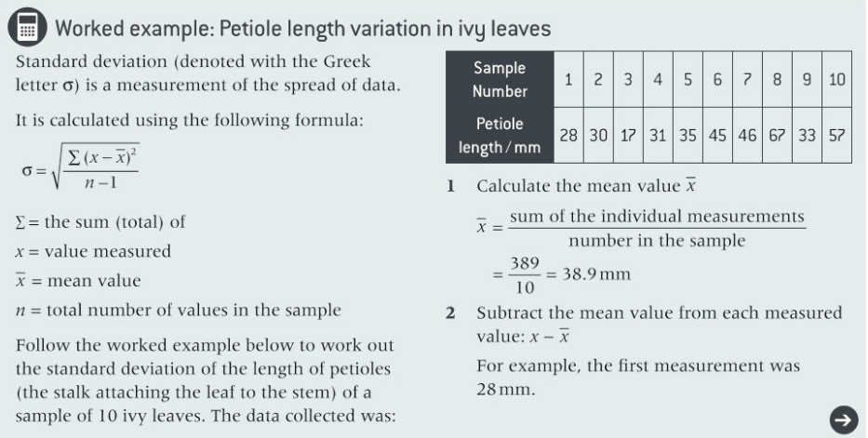
Recap standard deviation

Slide 63


