Slide 1
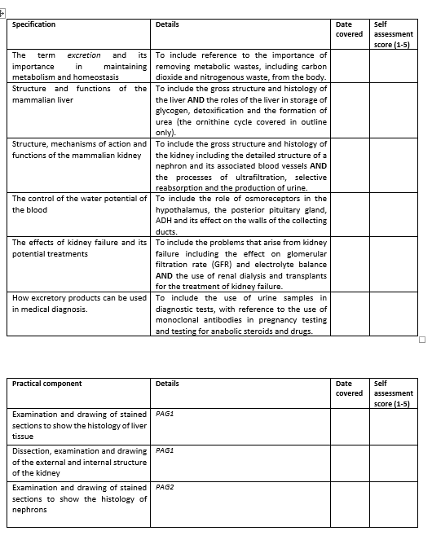
Learning Outcomes
The control of water potential of the blood.

Slide 2
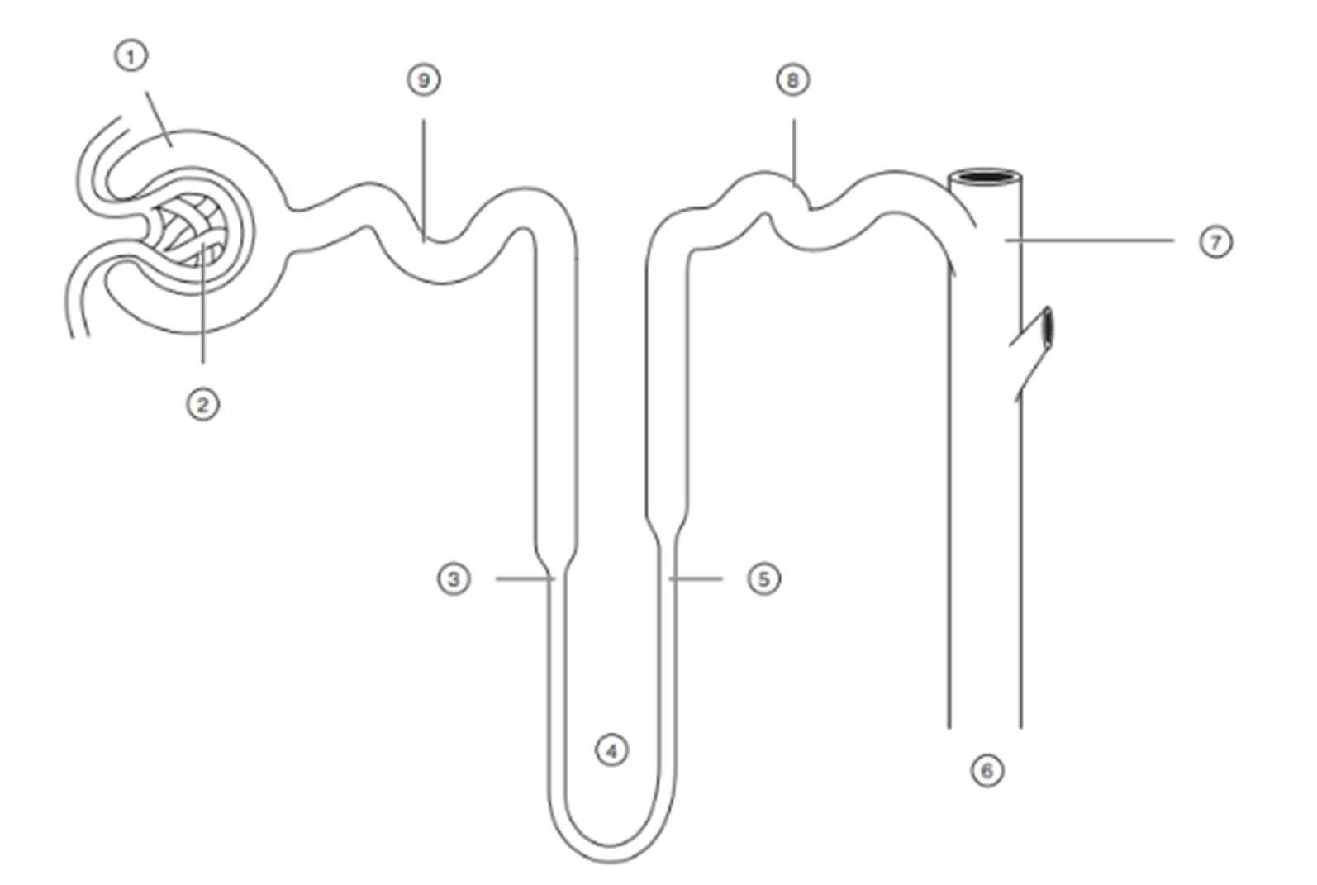
Include where:
Ultrafiltration occurs
Selective reabsorption occurs
Majority of water is absorbed
Where ions diffuse out of the tubule
Where ions are actively pumped from the tubules
Annotate your diagram with as much information from last lesson as you can remember

Slide 4
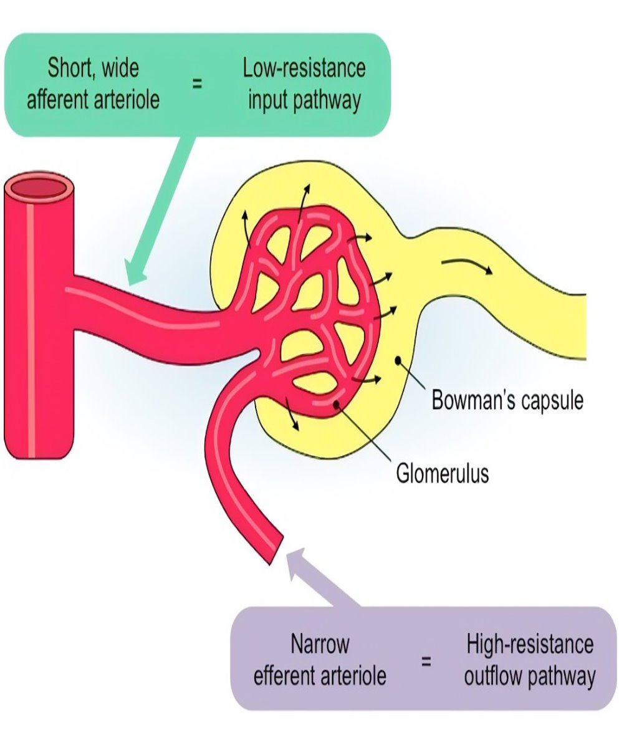
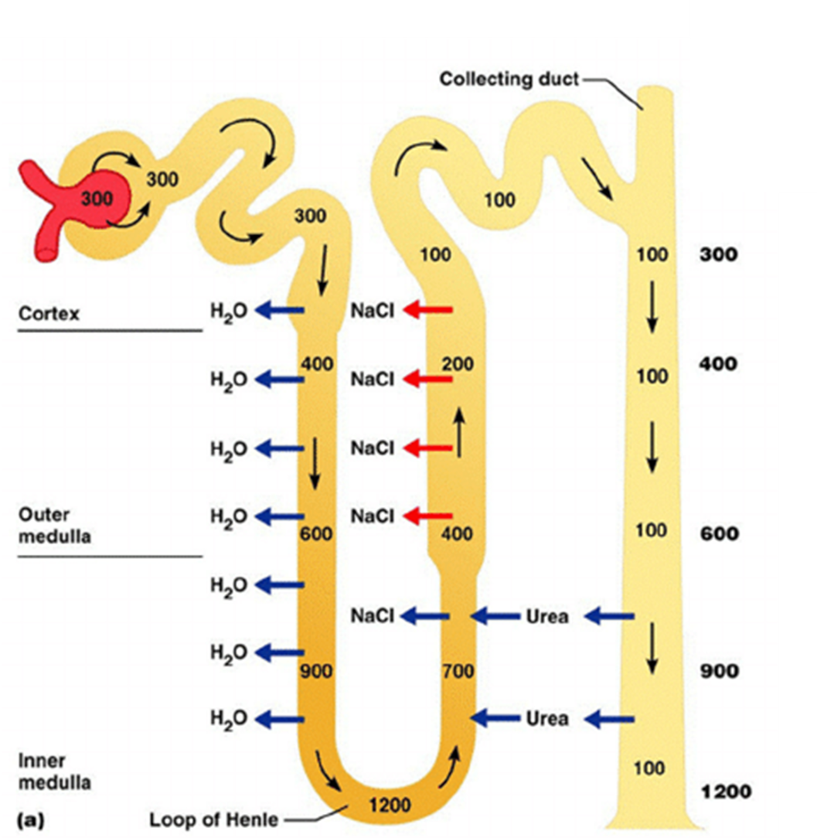

Slide 5
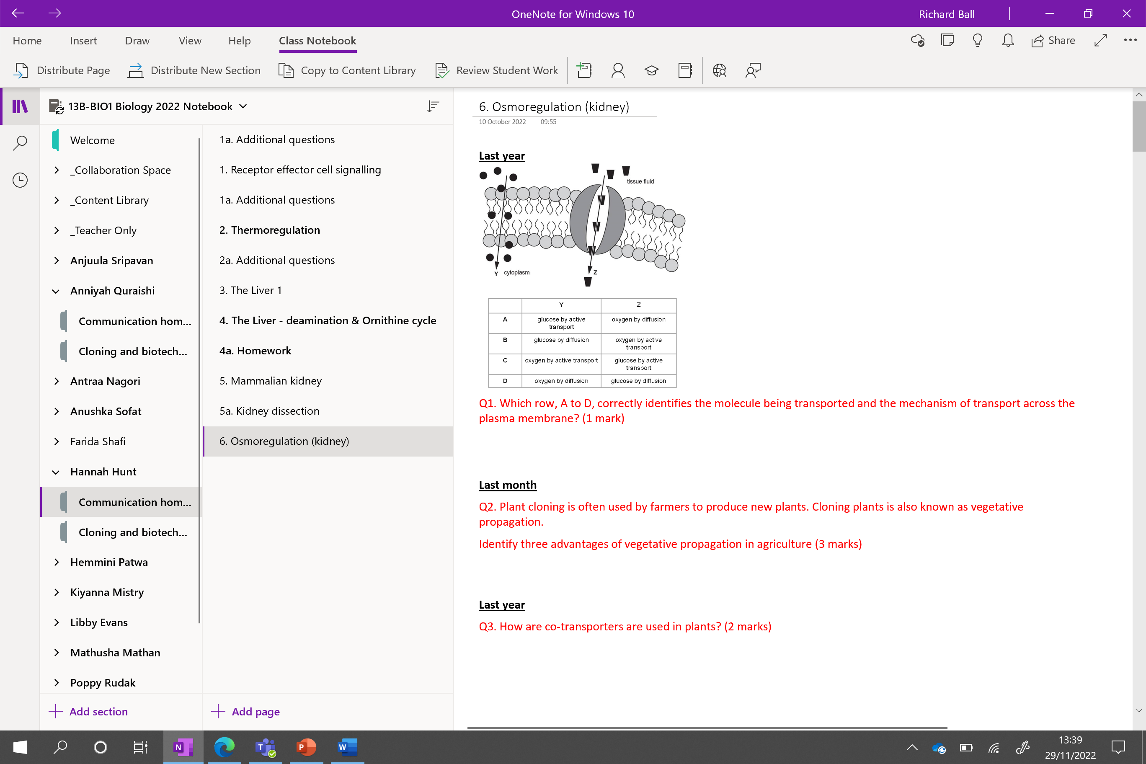

Slide 6
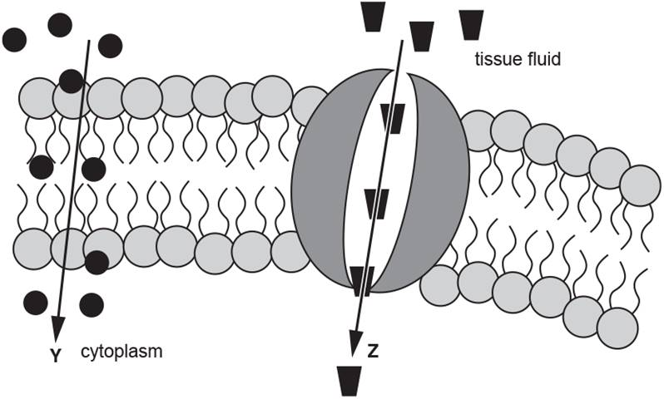
Knowledge retrieval questions
Last year
Q1. Which row, A to D, correctly identifies the molecule being transported and the mechanism of transport across the plasma membrane? (1 mark)
D
Last month
Q2. Plant cloning is often used by farmers to produce new plants. Cloning plants is also known as vegetative propagation.
Identify three advantages of vegetative propagation in agriculture (3 marks)
some crop plants cannot reproduce, sexually / from seed
quicker than, growing from seed / sexual reproduction
uniform / predictable, shape / size / quality / yield
(propagation) can be done, at any season / time of year
young seedlings, less likely to survive
Last year
Q3. How are co-transporters used in plants at the beginning of translocation?​ (2 marks)
Companion cells in plants, actively pumping of H⁺ out of cell
H+ ions then re-enters with sucrose​ using co-transporters
 | Y | Z
A | glucose by active transport | oxygen by diffusion
B | glucose by diffusion | oxygen by active transport
C | oxygen by active transport | glucose by active transport
D | oxygen by diffusion | glucose by diffusion

Slide 7
Counter current multiplier
Countercurrent Multiplication in the Loop of Henle - YouTube
Na transport pumps in ascending tube actively pumps Na ions into medulla
This draws water from descending tube into the medulla (osmotic pressure) At the same time this increases the concentration of ions in descending loop
While decreasing the ion concentration in the ascending limb
Highly concentrated solution is transported around from the descending to ascending limb to actively pump more Na into medulla
Multiplying its concentration further in medulla further = multiplication
Movement down and up = counter current
Until maximum saturation reached

Slide 8
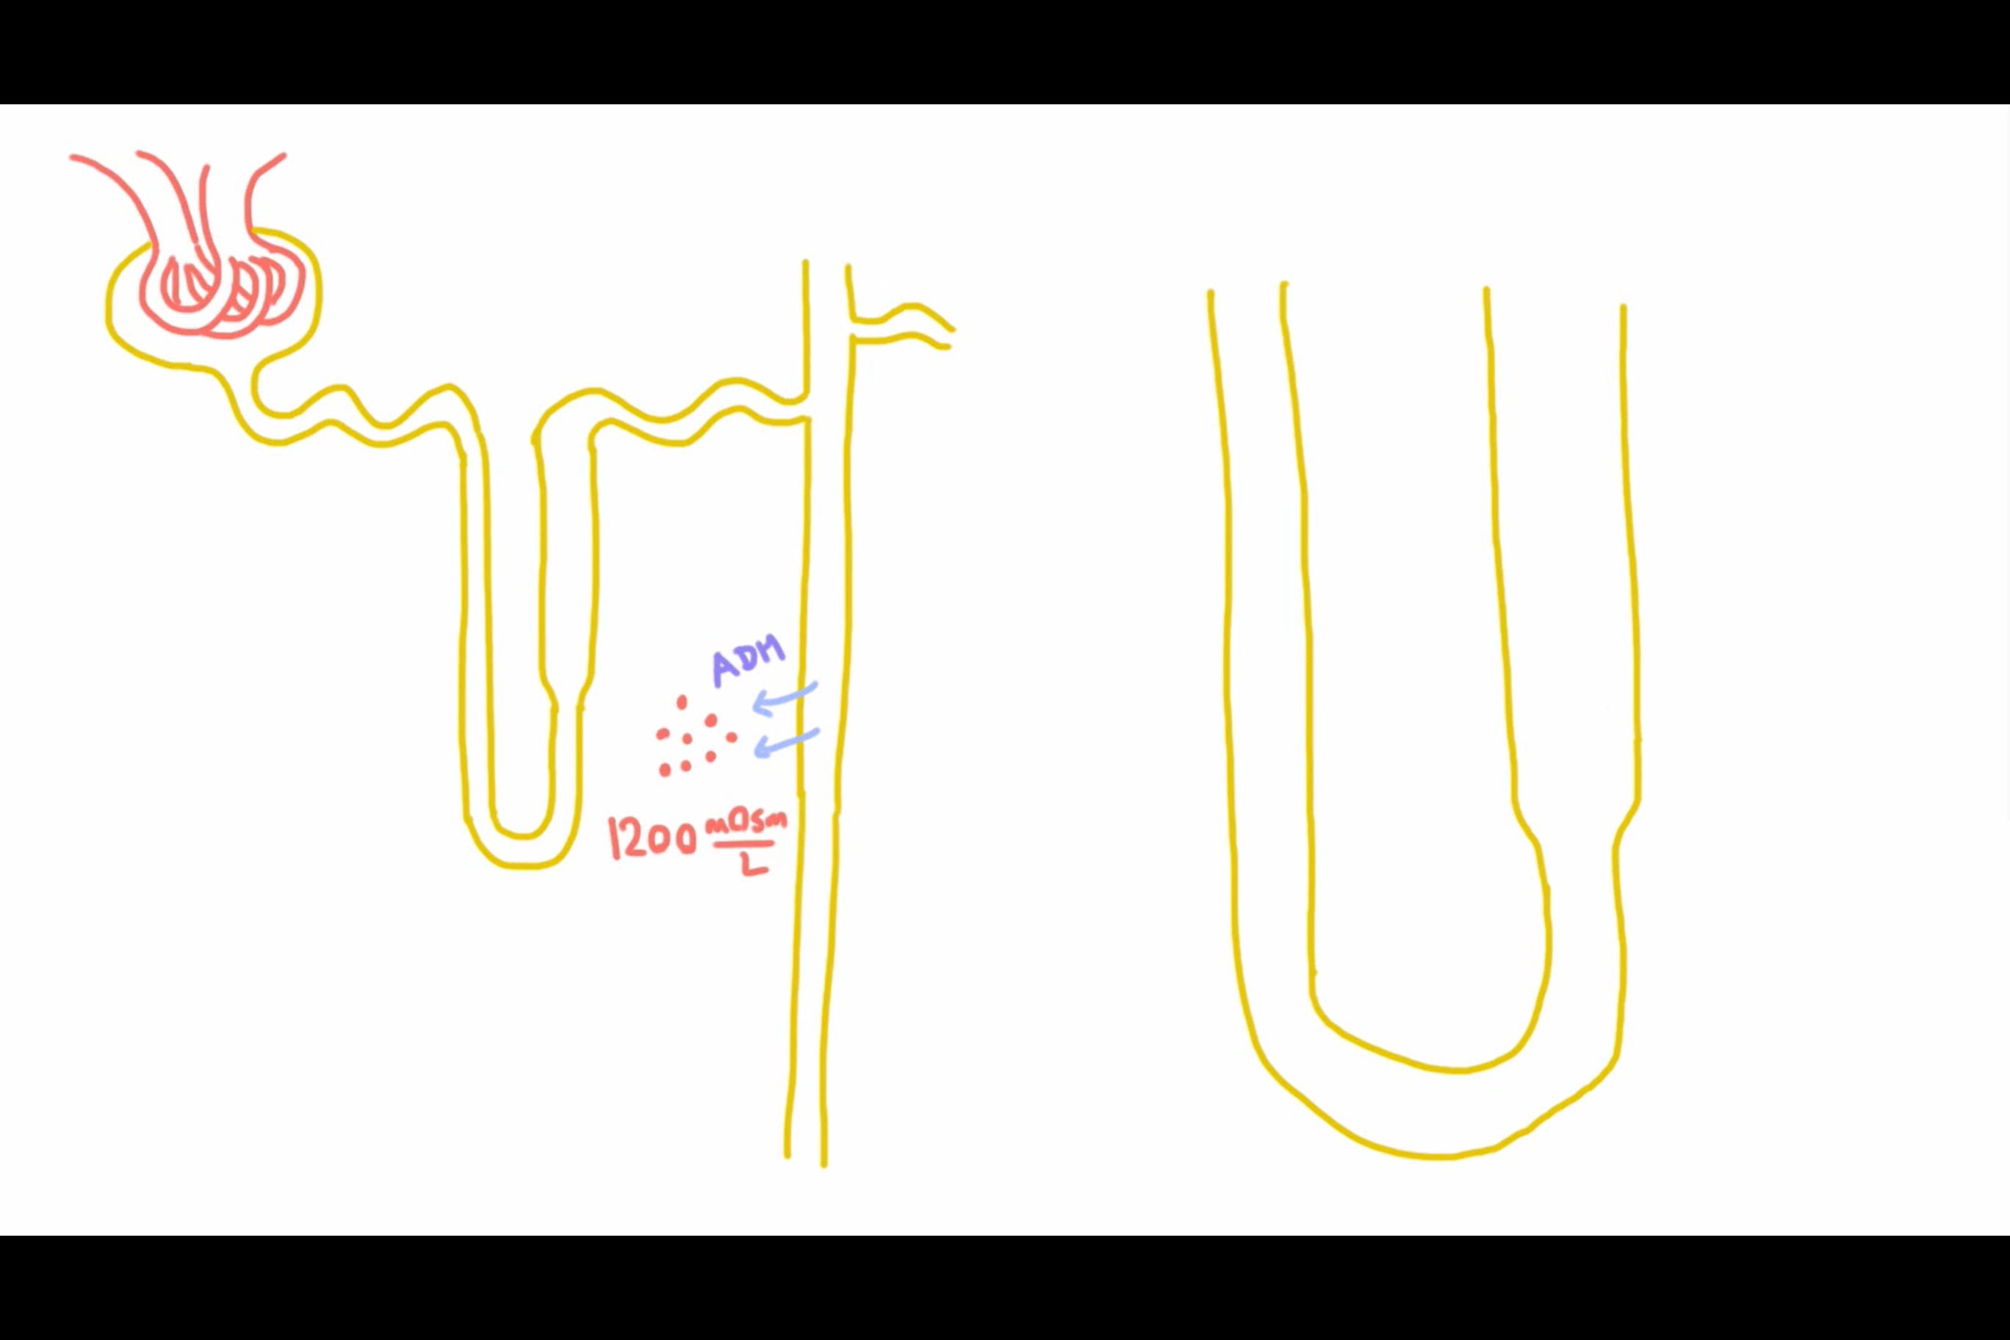
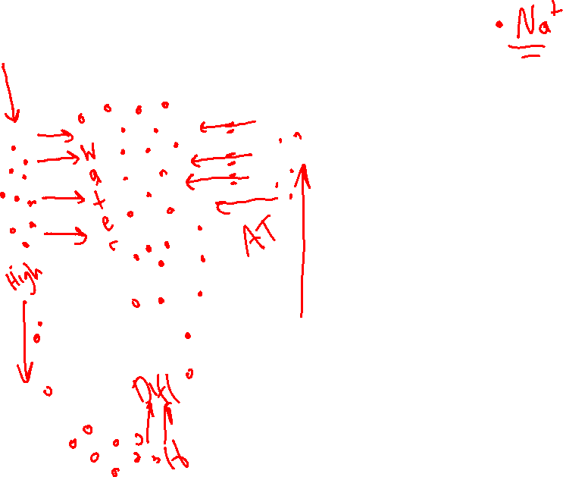
Counter current multiplier
Notes:
Countercurrent Multiplication in the Loop of Henle - YouTube

Slide 9
Osmoregulation

Slide 10
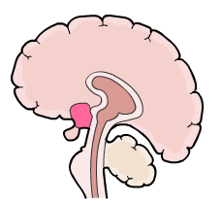



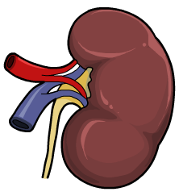


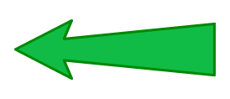
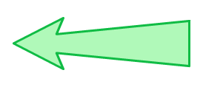
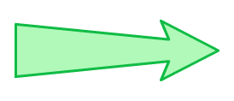

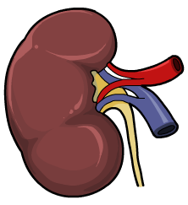



Osmoregulation negative feedback loop
change detected by osmoreceptors in the …………………
…………….. gland releases more …….
ADH increases ……………… of collecting ducts
must ……….. water
decrease in water potential
……………. urine
normal water potential of blood
……… urine
increase in water potential
must ……… excess water
……………… in permeability of ………….. ducts
change detected by …………………. in the hypothalamus
pituitary gland releases …… ADH
Notes:
Teacher notes
High concentrations of ADH in the blood also induce the feeling of thirst in the animal. This helps to increase the body’s water content.

Slide 11
change detected by osmoreceptors in the hypothalamus
pituitary gland releases more ADH
ADH increases permeability of collecting ducts
must conserve water
decrease in water potential
concentrated urine
normal water potential of blood
dilute urine
increase in water potential
must expel excess water
decrease in permeability of collecting ducts
change detected by osmoreceptors in the hypothalamus
pituitary gland releases less ADH
Notes:
Teacher notes
High concentrations of ADH in the blood also induce the feeling of thirst in the animal. This helps to increase the body’s water content.

Slide 12
The square is zoomed in to the right
ADH binds to receptors on collecting duct
Causes aquaporins to appear in membrane
Water molecules pass through from collecting duct
What is forcing water to move in this direction? High concentration of solutes in the medulla so osmotic force.
Its only when ADH is present that the aquaporins are present that allows you to make use of that difference in concentration

Slide 13
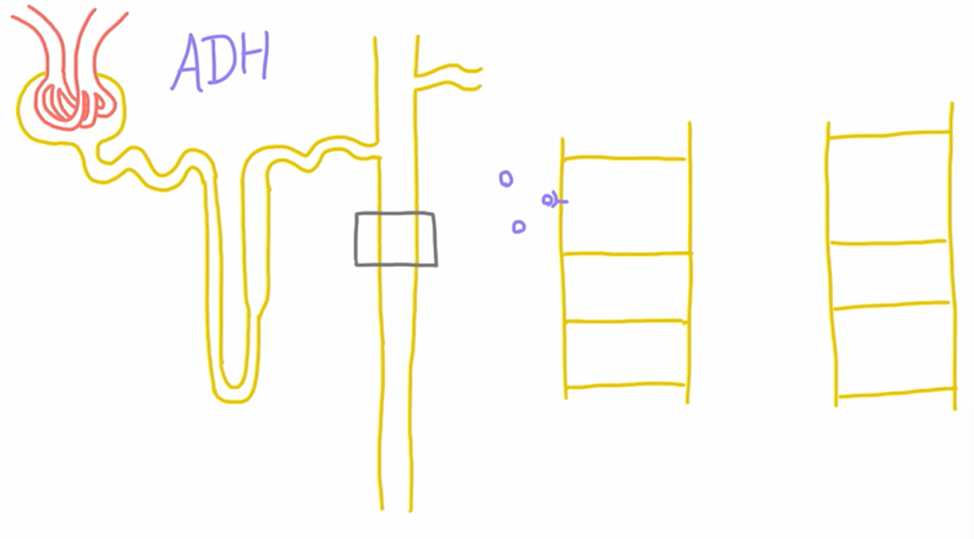
Action of ADH
ADH binds to receptors cells in the collecting duct
Diagram zoomed of collecting duct
ADH & collecting duct
Water movement in one direction only
Notes:
Interstitium – spaces between vessels, Organs etc
Basal membrane side always contains aquaporins
The number of aquaporins on the side parallel to the collecting duct can vary the number aquaporins
Medulla has a very high concentration of salts – created by the high permeability to salts in the ascending side of the LofH

Slide 14
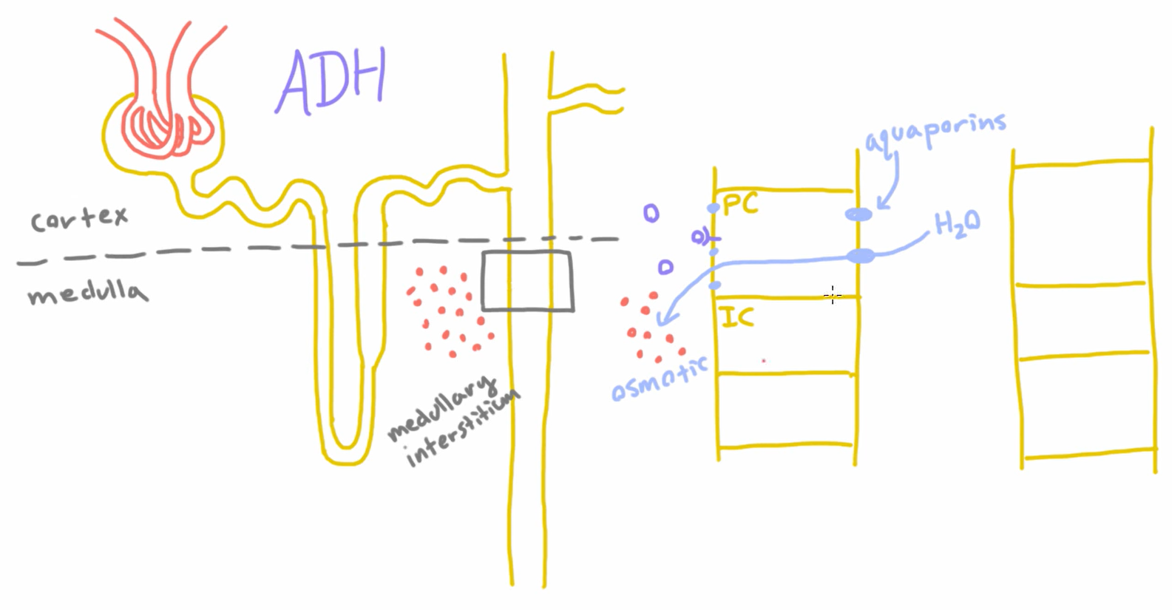

Slide 15
Osmoregulation
Outline the process of osmoregulation
Osmoreceptors in the hypothalamus are cells which respond to decreasing water potentials of blood
Low water potential causes water to leave osmoreceptor cells, making these cells shrink
This stimulates hypothalamus, sending signal to posterior pituitary gland, ADH released via exocytosis
ADH travels in blood to cells of the collecting duct
Binds to membrane bound receptors on collecting ducts
Vesicles containing aquaporins fuse with cell surface membrane.
Collecting duct walls become more permeable to water

Slide 16
Osmoregulation
Outline the process of osmoregulation
Osmoreceptors in the hypothalamus are cells which respond to decreasing water potentials of blood
Low water potential causes water to leave osmoreceptor cells, making these cells shrink
This stimulates hypothalamus, sending signal to posterior pituitary gland, ADH released via exocytosis
ADH travels in blood to cells of the collecting duct
Binds to membrane bound receptors on collecting ducts
Vesicles containing aquaporins fuse with cell surface membrane.
Collecting duct walls become more permeable to water

Slide 18
NL below

Slide 19
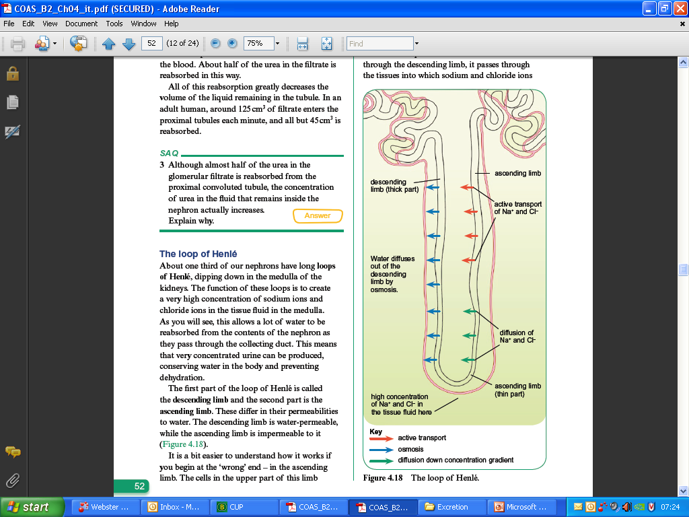
The loop of Henlé
Descending limb
  Water-permeable
Ascending limb
  more permeable to salts/less permeable to water.

Slide 20
Descending Limb
RECAP!
Ascending Limb
Lower part of ascending limb
Fluid is very .....................
Sodium and chloride ions ............... out into the surrounding tissues
Upper part of ascending limb
................. .................... of sodium and chloride ions out of the nephron into surrounding tissue
................... water potential of fluid inside nephron
As water moves down into the ................. the water potential gradient .................
Water moves down a water ................. gradient from nephron and into surrounding ...................
High salt concentration in the surrounding tissues moves water across by .....................

Slide 21
Descending Limb
Ascending Limb
Lower part of ascending limb
Fluid is very concentrated
Sodium and chloride ions diffuse out into the surrounding tissues
Upper part of ascending limb
Active transport of sodium and chloride ions out of the nephron into surrounding tissue
Increases water potential of fluid inside nephron tubules
As water moves down into the medulla the water potential gradient increases
Water moves down a water potential gradient from nephron tubules and into surrounding tissues
High salt concentration in the surrounding tissues moves water across by osmosis

Slide 22
How can we conserve more water?
Increase the length of the loop of Henlé - More water reabsorbed
Higher salt concentration in medulla - greater the water potential gradient

Slide 23
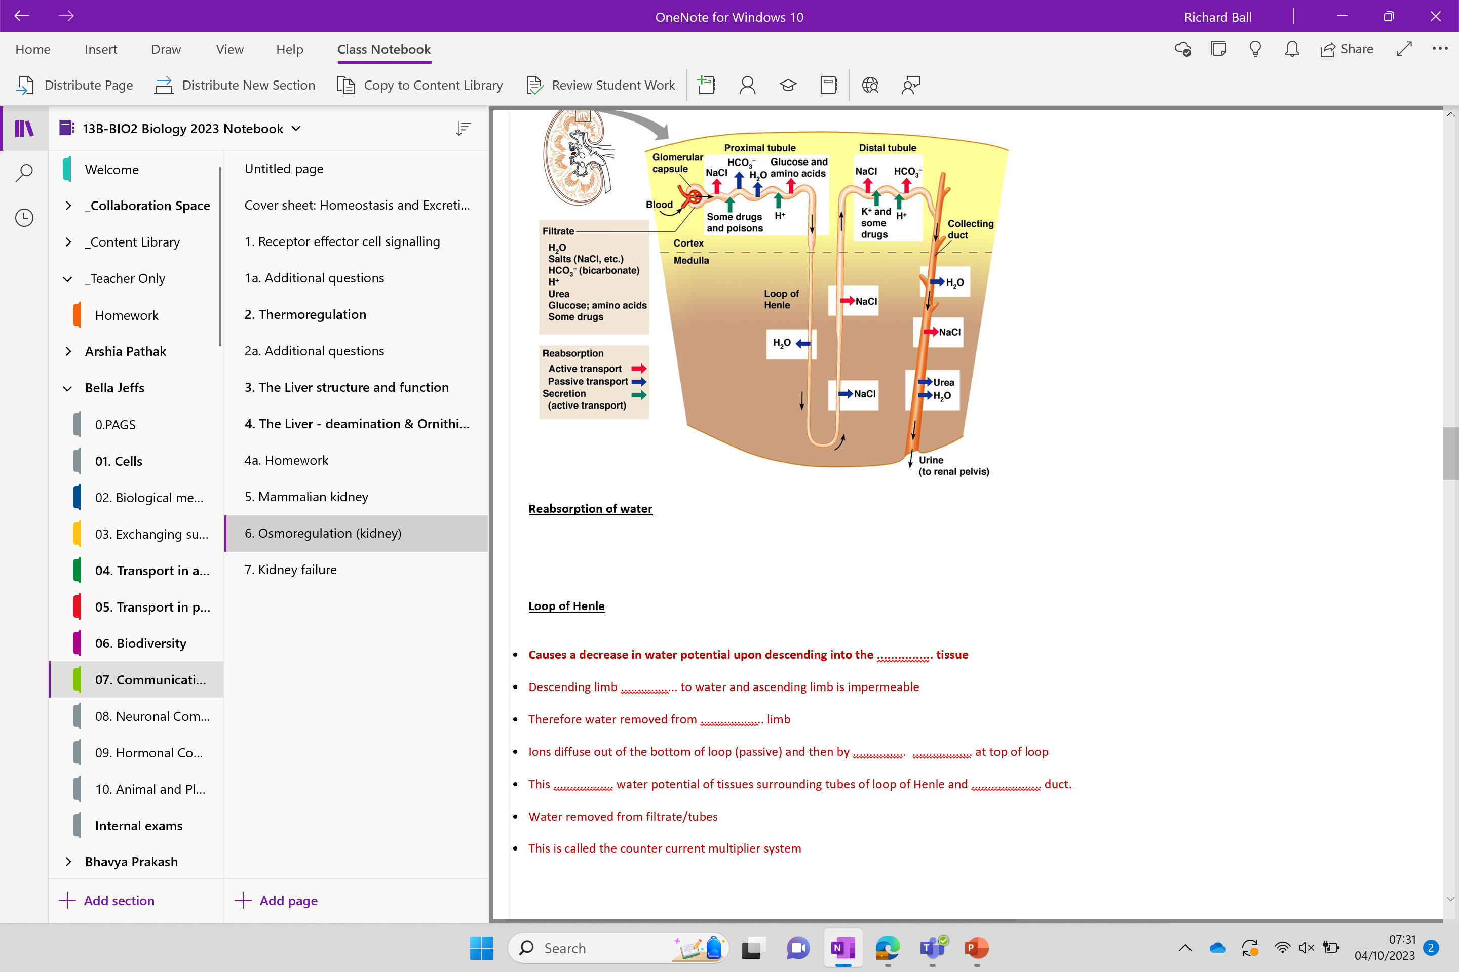

Slide 24
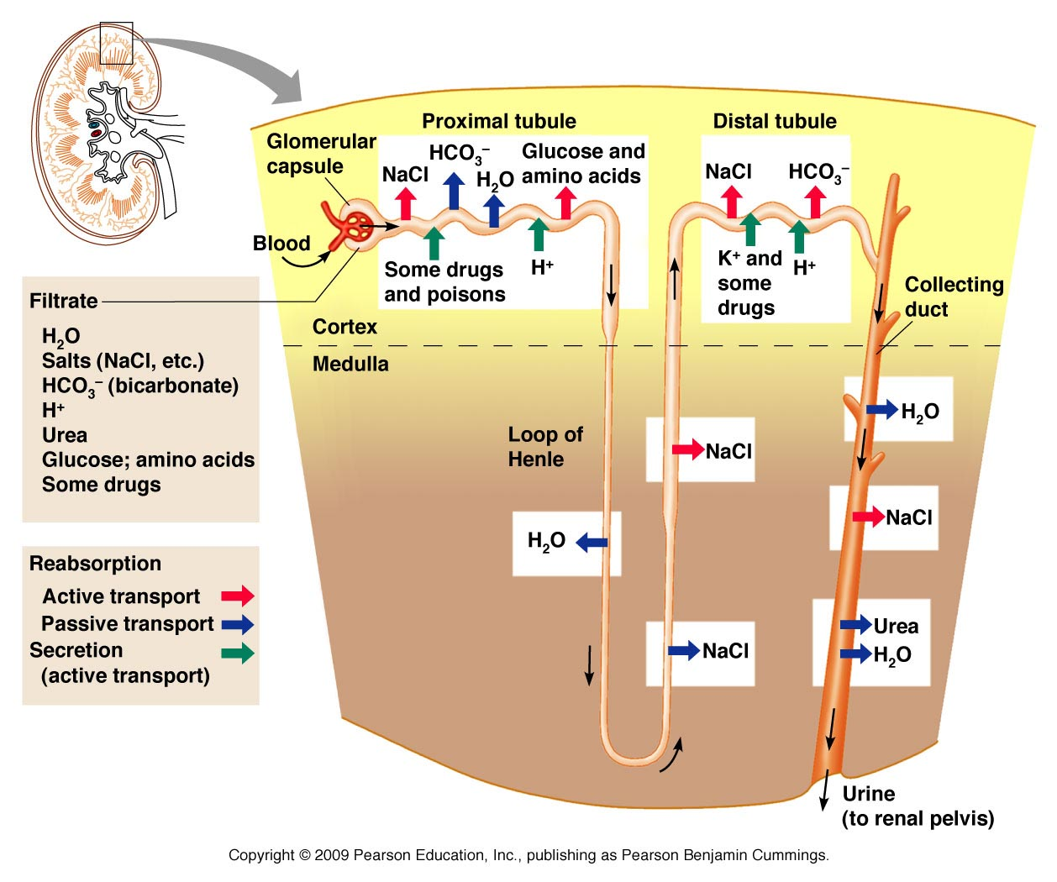
Starter
Reabsorption of water (name the three main locations in order)
……………….…….
………………………
……………………..
Loop of Henle
Causes a decrease in water potential upon descending into the ................ tissue
Descending limb ................. to water and ascending limb is impermeable
Therefore water removed from ................... limb
Ions diffuse out of the bottom of loop (passive) and then by ................ .................. at top of loop
This .................. water potential of tissues surrounding tubes of loop of Henle and ................. duct.
Water removed from filtrate/tubes
This is called the counter current multiplier system

Slide 25
https://www.youtube.com/watch?v=hjQd9nWAxQk
Reabsorption of water – three locations
In PCT
Then in descending limb of loop of Henle
Then in collecting duct
Loop of Henle
Causes a decrease in water potential upon descending the medulla tissue
Descending limb permeable to water and ascending limb is impermeable
Therefore water removed from descending limb
Ions diffuse out of the bottom of loop (passive) and then by active transport at top of loop
This decreases water potential of tissues surrounding tubes of loop of Henle and collecting duct.
Water removed from filtrate
This is called the counter current multiplier system

Slide 26
Final recap video!
LOOP OF HENLE explained!! - YouTube
Notes:
Start 0.6s

Slide 28
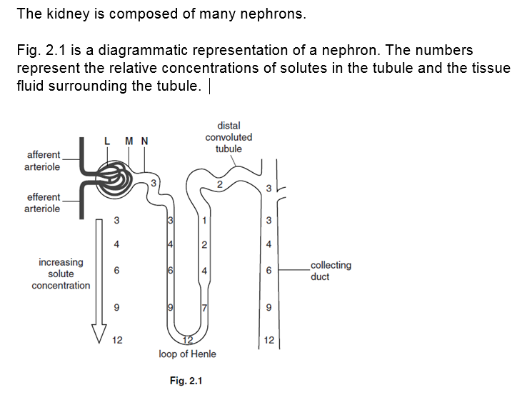
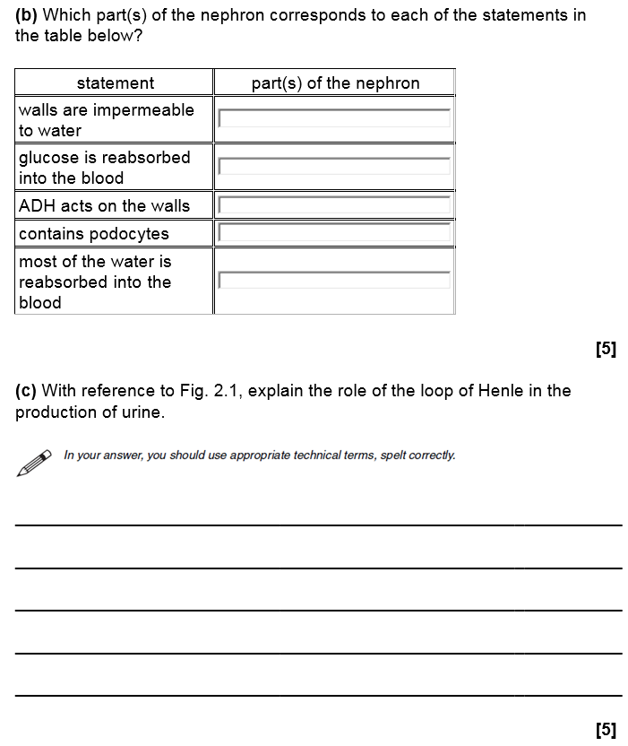
(a) Name the parts of the nephron labelled L, M and N

Slide 29
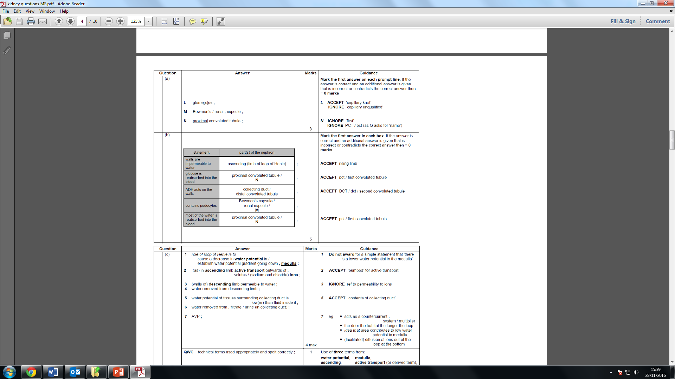
(a) Name the parts of the nephron labelled L, M and N
TRY ADDITIONAL QUESTIONS BELOW

Slide 31
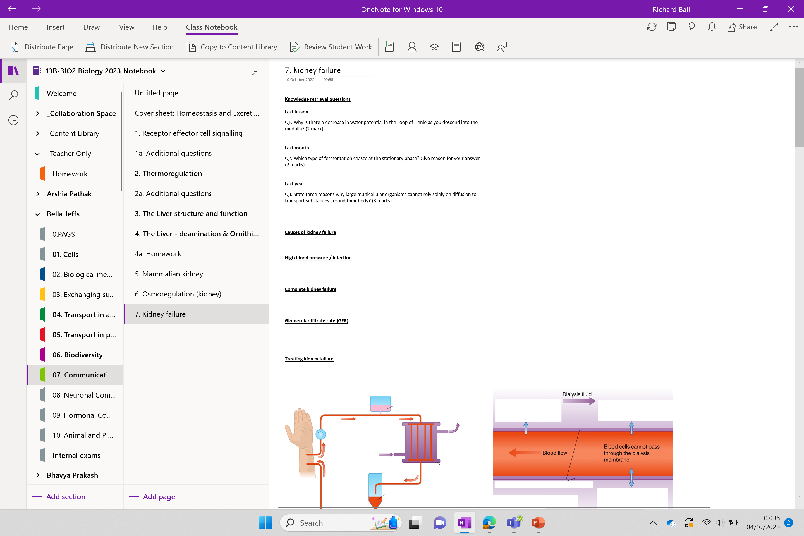

Slide 32
Additional questions below

Slide 33
Learning Outcomes
The control of water potential of the blood.

Slide 34
Tomorrow’s Lesson
Kidney Microscopy PAG!

Slide 35
Tb or post-it game

