Slide 1
In pairs, predict what the following code does
1 2 3 4 5 6 7 8 9 10 11 | class Animal(): def setFeeding(self,feeding): self.feeding=feeding def getFeeding(self): return self.feeding class Bird(Animal): def __init__(self,species): self.species=species eagle=Bird("Golden Eagle") eagle.setFeeding("carnivore") print(eagle.getFeeding())

Slide 2
Run the code
1 2 3 4 5 6 7 8 9 10 11 | class Animal(): def setFeeding(self,feeding): self.feeding=feeding def getFeeding(self): return self.feeding class Bird(Animal): def __init__(self,species): self.species=species eagle=Bird("Golden Eagle") eagle.setFeeding("carnivore") print(eagle.getFeeding())
Download the code here: inheritance.py
Run the code. Does it perform in the way you predicted?

Slide 3
Object oriented Programming (OOP)
Inheritance

Slide 4
Learning objectives
Understand how classes relate to one another using inheritance
Modify OOP code that uses inheritance

Slide 5
Class Relationships
Up to now we have worked only with a single class.
For multiple classes we may want to create relationships between those classes
Inheritance, aggregation association and composition association define how classes relate to one another.

Slide 6
Inheritance
Inheritance allows us to use methods and attributes in one class from another class.
The inherited class is called the parent or super class. At the top of the inheritance chain is the base class, so parents and super classes are not always a base class.
The subclass will have the methods and attributes from the superclass in addition to its own method and attributes
Many programming languages only allow single inheritance. In Python multiple inheritance is allowed, but we will consider only single inheritance.
Inheritance defines an IS-A relation between classes. For instance:
A house is a building
A car is a vehicle
An aardvark is a mammal
Animal
(Superclass)
Mammal
(Subclass)
Bird
(Subclass)
Animal is the super / base / parent class. The mammal and bird classes are the derived / child / sub classes

Slide 7
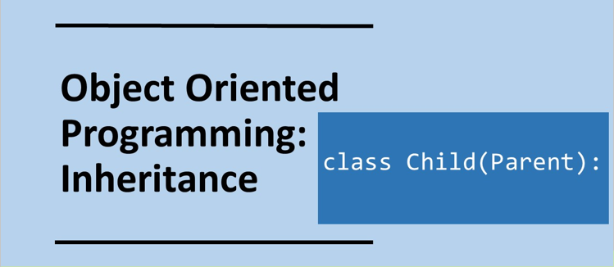

Slide 8
Inheritance
Animal
Mammal
A chain or hierarchy of classes can be established.
At the top of the chain of classes is the base class. In this example it is Animal.
As far as possible inheritance chains should be avoided.
Inheritance from a superclass class into a subclass can be invoked by:
class Subclass(Baseclass):
e.g.
class Bird(Animal)
Bear
Polar bear
1 2 3 4 5 6 7 | class Greeting(): def hello(self): print("Hi, How are you?") class Salutation(Greeting): pass hi=Salutation() hi.hello()

Slide 9
Task 1
A Zoo has wombats and koala bears.
Identify three suitable classes to model this
Draw the inheritance diagram
2) A bookshop sells three types of books
Non-fiction
Fiction children
Fiction adults
Identify five OOP classes to model this
Draw the inheritance diagram
Inheritance diagram for vehicles
Vehicles
Cars
Motorbikes

Slide 10
Task 1
Mammals
A Zoo has Koalas and Wombats. Both are mammals
Identify three suitable classes to model this
Draw the inheritance diagram
2) A bookshop sells three types of books
Non-fiction
Fiction children
Fiction adults
Identify five OOP classes to model this
Draw the inheritance diagram
Koalas
Wombats
Books
Fiction
Non-fiction
Children
Adults

Slide 11
Investigate the code
1 2 3 4 5 6 7 8 9 10 11 | class Animal(): def setFeeding(self,feeding): self.feeding=feeding def getFeeding(self): return self.feeding class Bird(Animal): def __init__(self,species): self.species=species eagle=Bird("Golden Eagle") eagle.setFeeding("carnivore") print(eagle.getFeeding())
Answer the questions by adding comments to the code
Identify the super class
Identify the child class
On what line does inheritance occur
On what line is the object instantiation occurring
Explain why eagle can use the setFeeding method on line 10
What would happen if we did not call the setFeeding method on line 10

Slide 12
Investigate the code; Comments
1 2 3 4 5 6 7 8 9 10 11 | class Animal(): # Super Class def setFeeding(self,feeding): self.feeding=feeding def getFeeding(self): return self.feeding class Bird(Animal): # Child class, inheritance def __init__(self,species): self.species=species eagle=Bird("Golden Eagle") # instantiation eagle.setFeeding("carnivore") print(eagle.getFeeding())
Answer the questions by adding comments to the code
Identify the super class Animal
Identify the child class Bird
On what line does inheritance occur 6
On what line is the object instantiation occurring 9
Explain why eagle can use the setFeeding method on line 10. The Bird class inherits the setFeeding method from Animal and eagle is a Bird object
What would happen if we did not call the setFeeding method on line 10? Carnivore feeding would not exist so program would return an error

Slide 14
Getter and setter methods
1 2 3 4 5 6 7 8 9 10 11 12 | class Animal(): def setFeeding(self,feeding): self.feeding=feeding def getFeeding(self): return self.feeding class Bird(Animal): def __init__(self,species): self.species=species eagle=Bird("Golden Eagle") #eagle.setFeeding("carnivore") eagle.feeding="carnivore" print(eagle.getFeeding())
Getter and setter methods help protect data in the object.
A get method returns the value of an attribute.
A set method allows the value of an attribute to be changed.
We could set feeding using eagle.feeding="carnivore"
instead of:
eagle.setFeeding("carnivore")
However, this could cause side effects. It is much better to make the changes through the set method.
def setAttribute(self,attribute):
self.attribute=attribute
def getAttribute(self):
return self.attribute

Slide 15
Modify the code
In class Animal, Add an equivalent get and set method for topSpeed of the animal.
In class Bird, add equivalent get and set method for migratory (this yes or no ie Boolean) and wingspan.
Create a new class called Fish, add appropriate get and set methods.
Create another Bird object for Robin
Create a Fish object.
Use the inherited set and get methods.
Example solution: inheritance_completed.py
1 2 3 4 5 6 7 8 9 10 11 | class Animal(): def setFeeding(self,feeding): self.feeding=feeding def getFeeding(self): return self.feeding class Bird(Animal): def __init__(self,species): self.species=species eagle=Bird("Golden Eagle") eagle.setFeeding("carnivore") print(eagle.getFeeding())

Slide 16
Reference: Super() function
Super() allows the method from the super class not to be overridden by a method of the same name in the child class: super_example.py
1 2 3 4 5 6 7 8 | class Parent(): def __init__(self, name): self.name = name class Child(Parent): def __init__(self, name): super().__init__(name) obj = Child("Homer") print(obj.name)

