Slide 1
In pairs, discuss the differences between these programs
1 2 3 4 5 6 7 8 | # inheritance class Greeting(): def hello(self): print("Hi, How are you?") class Salutation(Greeting): def __init__(self): pass hi=Salutation() hi.hello()
1 2 3 4 5 6 7 8 | #composition class Greeting(): def hello(self): print("Hi, How are you?") class Salutation(): def __init__(self): self.greet=Greeting() hi=Salutation() hi.greet.hello()
1 2 3 4 5 6 7 8 9 | # aggregation class Greeting(): def hello(self): print("Hi, How are you?") class Salutation(): def __init__(self,greet): self.greet=greet h=Greeting() hi=Salutation(h) hi.greet.hello()
Download the code here: inheritance_association.py
Run the code, do they all do the same thing?
In each case explain how the relationship between the two classes is formed

Slide 2
Object oriented Programming (OOP)
Association: Aggregation and Composition

Slide 3
Learning objectives
Understand how classes can relate to one another using aggregation association and Composition
Write code in OOP that uses aggregation and composition

Slide 4
Class Relationships
We have used inheritance as a means of relating two classes with one another.
Aggregation association and composition association also allows us to define how classes relate to one another.

Slide 5
Forms of association: Composition v aggregation
A class is used by creating an instance of it with another class.
Association links multiple classes and defines a HAS-A relation between classes as opposed to the IS-A relationship defined by inheritance
There are two forms of association:
Composition association: The child class cannot exist independently of the parent class
Aggregation association: The child class can exist independently of the parent class.

Slide 6
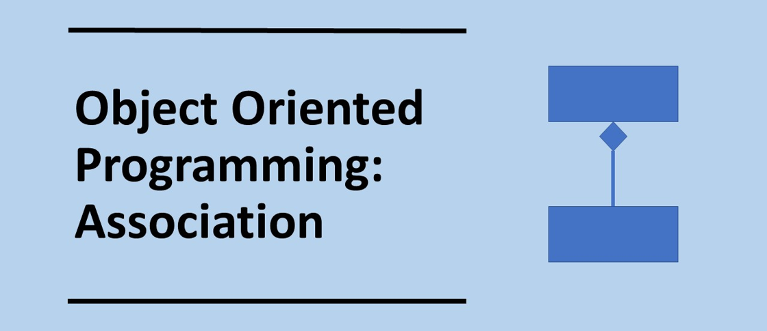

Slide 7
Composition
Composition uses an instance of a class.
One object is contained in another object.
A child object does not exist independently of its parent class. In other words, if a parent object does not exist, then the child object cannot exist.
Composition is said to have a strong HAS-A relation.
For instance a building can have rooms, but if the building does not exist then the rooms cannot exist.
Building
Room

Slide 8
Composition
Composition uses an instance of a class.
Subclass Salutation will not work without the superclass Greeting.
1 2 3 4 5 6 7 8 | class Greeting(): def hello(self): print("Hi, How are you?") class Salutation(): def __init__(self): self.greet=Greeting() hi=Salutation() hi.greet.hello()
Instance of class
Invoke method from class

Slide 9
Complete the code using composition
1 2 3 4 5 6 7 10 11 12 13 | #Complete this code class Home(): def setCategory(self, category): self.category=category def getCategory(self): return self.category class Room(): def __init__(self,room): def setArea(self, width, length): self.area=width*length def getArea(self): return self.roomArea
1 2 3 4 5 6 7 8 | class Greeting(): def hello(self): print("Hi, How are you?") class Salutation(): def __init__(self): self.greet=Greeting() hi=Salutation() hi.greet.hello()
Use the greeting code to help complete the home-room code using composition: compositionHome.py
In Room complete the code for the constructor
Create a Kitchen object
Set the category of the home to Detached House
Get the category of the home

Slide 10
Complete the code using composition
1 2 3 4 5 6 7 8 9 10 11 12 13 14 16 17 | #Complete this code class Home(object): def setCategory(self, category): self.category=category def getCategory(self): return self.category class Room(): def __init__(self,room): self.home=Home() # Composition self.room=room def setArea(self, width, length): self.area=width*length def getArea(self): return self.roomArea kitchen=Room("Kitchen") kitchen.home.setCategory("Detached House") print(kitchen.home.getCategory())
1 2 3 4 5 6 7 8 | class Greeting(): def hello(self): print("Hi, How are you?") class Salutation(): def __init__(self): self.greet=Greeting() hi=Salutation() hi.greet.hello()
compositionHomeCompleted.py

Slide 11
Aggregation
In aggregation one object is the owner of another object.
The classes can exist independently of one another.
Aggregation is said to have a weak HAS-A relation.
For instance, a student can have a teacher. But if teacher is removed, the student object will still exist.
Teacher
Student

Slide 12
Aggregation
Aggregation we pass an object h as a parameter into the class Salutation
1 2 3 4 5 6 7 8 9 | class Greeting(): def hello(self): print("Hi, How are you?") class Salutation(): def __init__(self,greet): self.greet=greet h=Greeting() hi=Salutation(h) hi.greet.hello()
Pass object as parameter

Slide 13
Complete the code using aggregation
1 2 3 4 5 6 7 8 9 | class Greeting(): def hello(self): print("Hi, How are you?") class Salutation(): def __init__(self,greet): self.greet=greet h=Greeting() hi=Salutation(h) hi.greet.hello()
1 2 3 4 5 6 7 8 9 10 11 | #Complete this code class Department(): def setDeptName(self,department): self.department=department def setLocation(self,location): self.location=location class Employee(): def __init__(self,department): def setName(self,name): self.name=name def getName(self): return self.name
Use the greeting code to help complete the department-Employee code using aggregation: aggregationEmployee.py
In Department, add the corresponding getter methods
In Room complete the code for the constructor
Create a finance object with location as Floor 13 and Department name as finance
Create an employee object called Mr Bean
Output the department name and location

Slide 14
Complete the code using aggregation
1 2 3 4 5 6 7 8 9 10 11 12 13 14 15 16 17 18 19 20 21 22 23 | class Department(): def setDeptName(self,department): self.department=department def getDeptName(self): return self.department def setLocation(self,location): self.location=location def getLocation(self): return self.location class Employee(): def __init__(self,department): self.department=department def setName(self,name): self.name=name def getName(self): return self.name finance=Department() finance.setDeptName("Finance") finance.setLocation("Floor 13") bean=Employee(finance) bean.setName("Mr Bean") print(bean.department.getDeptName()) print(bean.department.getLocation())
1 2 3 4 5 6 7 8 9 | class Greeting(): def hello(self): print("Hi, How are you?") class Salutation(): def __init__(self,greet): self.greet=greet h=Greeting() hi=Salutation(h) hi.greet.hello()
aggregationEmployeeCompleted.py

Slide 15
Object-oriented design principles
A key object-oriented design principle is to favour composition over inheritance
Each class can be tested more easily using composition. It is not possible to test a child class independently of a parent class using inheritance.
There can be side-effects for child classes if a method in the parent class is changed.
Composition is more flexible. A new class can replace another class easily if composition is used.
Inheritance can rely too much on long inheritance chains.
When developing code with inheritance there is a need for more classes compared with composition

Slide 16
Summary Class Relationships
Inheritance: IS-A relation between classes
Association
HAS-A relation between classes
Composition:
Strong HAS-A
Aggregation:
Weak HAS-A
Mammal
Building
Teacher
Bear
Room
Student

Slide 17
Plenary: Think, Pair, Share
Discuss the differences between inheritance, composition and aggregation
In what situations would you use each of these?

