Slide 1
OCR GCSE (9–1) in Computer Science (J277)
Programming Languages and Integrated Development Environments
This pack is intended for students to use once they have covered the GCSE content, either in preparation for their L1 & L2 exam, or more likely alongside year 2 of the course to improve fluency, recall and pace on GCSE topics. It could be used as lesson starters, or supplied to students for independent use.

Slide 2
Bell Work
Can you work out the sums below:
54 MOD 7 =
5 EXP 3 =
58 DIV 12 =

Slide 3
2.5 Learn about programming languages and translators
2.5 Learn about programming languages and translators
State the types of programming languages.
Explain what a translator is.
Compare the two types of translators.

Slide 4
2.5 Translators and Languages
Programming languages vary on a spectrum (in a range).
They can be high or low level languages, and machines only understand machine code.

Slide 5
2.5 Translators and Languages
High Level
Low Level

Slide 6
2.5 Translators and Languages
High Level
Python
Low Level

Slide 7
2.5 Translators and Languages
High Level
Python
Pascal
Low Level

Slide 8
2.5 Translators and Languages
High Level
Python
Pascal
Fortran
Low Level

Slide 9
2.5 Translators and Languages
High Level
Python
Pascal
Fortran
JAVA
Low Level

Slide 10
2.5 Translators and Languages
High Level
Python
Pascal
Fortran
JAVA
C++
C
Low Level

Slide 11
2.5 Translators and Languages
High Level
Python
Pascal
Fortran
JAVA
C++
C
Assembly
Low Level

Slide 12
2.5 Translators and Languages
High Level
Python
Pascal
Fortran
JAVA
C++
C
Assembly
1s and 0s
Low Level
Machine Code

Slide 13
2.5 Translators and Languages
High Level
Python
Pascal
High
Level Languages
Fortran
JAVA
C++
C
Assembly
1s and 0s
Low Level
Machine Code

Slide 14
2.5 Translators and Languages
High Level
Python
Pascal
High
Level Languages
Fortran
JAVA
C++
C
Assembly
1s and 0s
Low Level
Machine Code

Slide 15
2.5 Translators and Languages
High Level
Python
Pascal
Middle
Level Languages
Fortran
JAVA
C++
C
Assembly
1s and 0s
Low Level
Machine Code

Slide 16
2.5 Translators and Languages
High Level
Python
Pascal
Middle
Level
Languages
Fortran
JAVA
C++
C
Assembly
1s and 0s
Low Level
Machine Code

Slide 17
2.5 Translators and Languages
High Level
Python
Pascal
Low
Level
Languages
Fortran
JAVA
C++
C
Assembly
1s and 0s
Low Level
Machine Code

Slide 18
2.5 Translators and Languages
High Level
Python
Pascal
Low
Level
Languages
Fortran
JAVA
C++
C
Assembly
1s and 0s
Low Level
Machine Code

Slide 19
2.5 Translators and Languages
High level languages are languages that are written with complex words.
Like when we wrote our Python programs.
Print / Round / Input / If / Else

Slide 20
2.5 Translators and Languages
Middle level languages still use the same words as high level, but you need to code more of the program to make it work (i.e. defining variables rather than just typing it out).

Slide 21
2.5 Translators and Languages
Assembly languages use a range of short words to create code.
ADD / SUB / AX / MOV
Low level languages are machine code and assembly languages.

Slide 22
2.5 Translators and Languages
What is machine code?
How is data stored in a computer?

Slide 23
2.5 Translators and Languages
What is machine code?
Machine code is the language computers understand.
1s and 0s
How is data stored in a computer?

Slide 24
2.5 Translators and Languages
What is machine code?
Machine code is the language computers understand.
1s and 0s
How is data stored in a computer?
All data stored in a computer is stored as binary (1s and 0s). The machine understands nothing else other than 1s and 0s.

Slide 25
2.5 Translators and Languages
What is machine code?
Machine code is the language computers understand.
1s and 0s
How is data stored in a computer?
All data stored in a computer is stored as binary (1s and 0s). The machine understands nothing else other than 1s and 0s.
So when you coded in Python for your NEA, how did the machine understand your code?

Slide 26
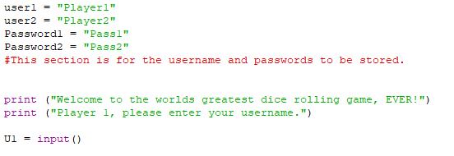
2.5 Translators and Languages
What is machine code?
Machine code is the language computers understand.
1s and 0s
How is data stored in a computer?
All data stored in a computer is stored as binary (1s and 0s). The machine understands nothing else other than 1s and 0s.
So when you coded in Python for your NEA, how did the machine understand your code?

Slide 27
2.5 Translators and Languages
What is machine code?
Machine code is the language computers understand.
1s and 0s
How is data stored in a computer?
All data stored in a computer is stored as binary (1s and 0s). The machine understands nothing else other than 1s and 0s.
Any programming you do must be converted into correct 1s or 0s.

Slide 28
2.5 Translators and Languages
What is machine code?
Machine code is the language computers understand.
1s and 0s
How is data stored in a computer?
All data stored in a computer is stored as binary (1s and 0s). The machine understands nothing else other than 1s and 0s.
Any programming you do must be converted into correct 1s or 0s.

Slide 29
2.5 Translators and Languages
If you go on holiday to another country, how do you convert your language (English) into a language that the people in that country understands?
If a person cannot speak in English in this country how do we understand what they are saying?

Slide 30
2.5 Translators and Languages
We translate our language.

Slide 31
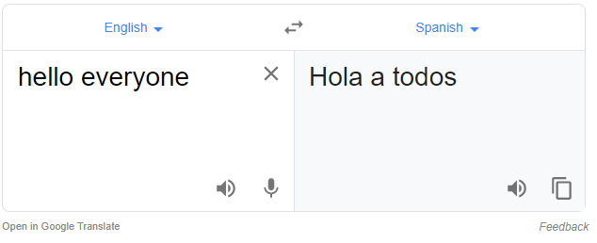
2.5 Translators and Languages
We translate our language.

Slide 32
2.5 Translators and Languages
Computers also need our programming languages to translate into the language a machine understands (machine code).

Slide 33
2.5 Translators and Languages
Computers also need our programming languages to translate into the language a machine understands (machine code).
We use a translator (two types):
Compiler
interpreter

Slide 34
2.5 Translators and Languages
A translator turns high level code into machine code.
This allows the machine to understand what we mean by print (“Hello World”).

Slide 35
2.5 Translators and Languages
One of them compiles a program into a separate document, then executes the program.
The other executes the program line-by-line.
Which one do you think is a description for a compiler?

Slide 36
2.5 Translators and Languages
One of them compiles a program into a separate document, then executes the program.
The other executes the program line-by-line.
Which one do you think is a description for a compiler?

Slide 37
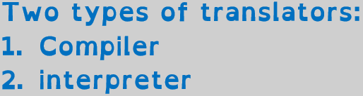
2.5 Translators and Languages
One of them compiles a program into a separate document, then executes the program.
The other executes the program line-by-line.
Which one do you think is a description for a compiler?

Slide 38
2.5 Translators and Languages
One of them compiles a program into a separate document, then executes the program.
The other executes the program line-by-line.
Which one do you think is a description for a compiler?
Compiler – executable file

Slide 39
2.5 Translators and Languages
One of them compiles a program into a separate document, then executes the program.
The other executes the program line-by-line.
Which one do you think is a description for a compiler?
Compiler – executable file
Interpreter – line-by-line

Slide 40
2.5 Translators and Languages
One of them compiles a program into a separate document, then executes the program.
The other executes the program line-by-line.
Which one do you think is a description for a compiler?

Slide 41
2.5 Translators and Languages
Compiler
  Takes the whole program and converts this into machine code.
  Creates a single file to be executed.

Slide 42
2.5 Translators and Languages
Compiler
  Takes the whole program and converts this into machine code.
  Creates a single file to be executed.
  What if you have an error though? Will it be easy to find?

Slide 43
2.5 Translators and Languages
Interpreter
  Runs the code line by line.
  Is an error easier to spot on this type of translator?
  Think about when you built your programs in Python, what happened if you made an error?

Slide 44
2.5 Translators and Languages
So why do we even have a compiler?
Why don’t we all just use interpreters? Surely they are the best?
You have just created a brilliant program. It is going to sell for billions of pounds.
So do you want anyone to see the source code?

Slide 45
2.5 Translators and Languages
So why do we even have a compiler?
Why don’t we all just use interpreters? Surely they are the best?
You have just created a brilliant program. It is going to sell for billions of pounds.
So do you want anyone to see the source code?
If you use an interpreter the source code has to be sent with the program… so?

Slide 46
2.5 Translators and Languages
Compilers allow a software engineer to create code, compile it into machine code (separate file), and keep the source code secret.
The machine code is saved as a single file separate from the source code.

Slide 47
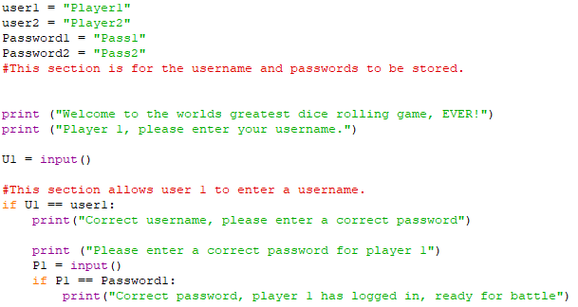
2.5 Translators and Languages

Slide 48
2.5 Translators and Languages
You create your billion £ program.

Slide 49
2.5 Translators and Languages
You use a compiler to translate the language into machine code.
You create your billion £ program.

Slide 50
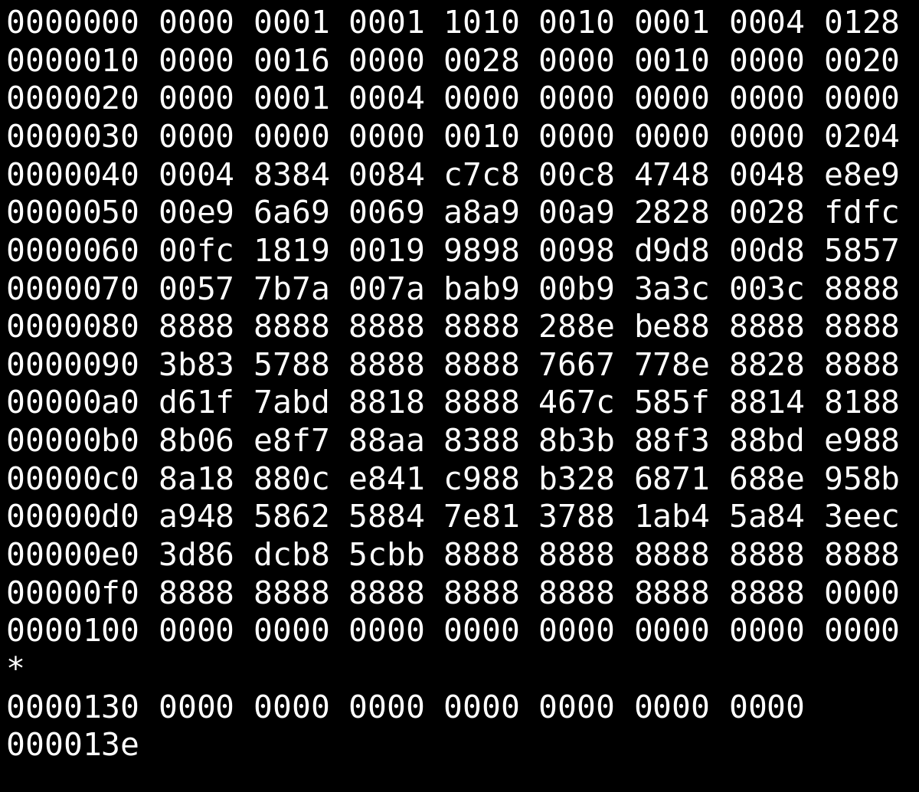
2.5 Translators and Languages
You use a compiler to translate the language into machine code.
You create your billion £ program.

Slide 51
2.5 Translators and Languages
Separate file is created.
You create your billion £ program.

Slide 52
2.5 Translators and Languages
Nobody has access to your amazing source code. Nobody can copy it and sell it cheaper!
Separate file is created.

Slide 53
2.5 Translators and Languages
Nobody has access to your amazing source code. Nobody can copy it and sell it cheaper!
People only see the binary file.

Slide 54
2.5 Translators and Languages
What will happen if you use an interpreter to translate your file?

Slide 55
2.5 Translators and Languages
You create your billion £ program.

Slide 56
2.5 Translators and Languages
When you use an interpreter to translate it, the source code is sent with the binary file, as one file.

Slide 57
2.5 Translators and Languages
If you sell this the person who buys it can view your source code.
They can use it to create a similar program and sell it cheaper.

Slide 58
2.5 Translators and Languages
Harry is planning to create a computer game using high-level programming language.
State why the computer needs to translate the code before it is executed. [1]

Slide 59
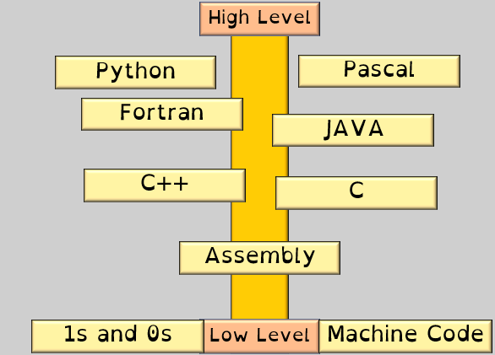
2.5 Translators and Languages
State the difference between machine code and high level programming languages. [2]

Slide 60
2.5 Translators and Languages
Machine code is 1s or 0s – binary.
1

Slide 61
2.5 Translators and Languages
Machine code is 1s or 0s – binary.
High level languages are written in English and use common words.
1
1

Slide 62
2.5 Translators and Languages
Harry can use either a compiler or an interpreter to translate the code.
Describe two differences between how a compiler and an interpreter would translate Harry’s computer game. [4]

Slide 63
2.5 Translators and Languages
1
Compiler translates all the code in one go…

Slide 64
2.5 Translators and Languages
1
Compiler translates all the code in one go…
…Whereas an interpreter translates one line at a time.
1

Slide 65
2.5 Translators and Languages
1
Compiler translates all the code in one go…
…Whereas an interpreter translates one line at a time.
Compiler creates an executable file…
1
1

Slide 66
2.5 Translators and Languages
1
Compiler translates all the code in one go…
…Whereas an interpreter translates one line at a time.
Compiler creates an executable file…
…Whereas an interpreter does not/executes one line at a time.
1
1
1

Slide 67
2.5 Translators and Languages
1
Compiler translates all the code in one go…
…Whereas an interpreter translates one line at a time.
Compiler creates an executable file…
…Whereas an interpreter does not/executes one line at a time.
Compiler reports all errors at the end…
1
1
1

Slide 68
2.5 Translators and Languages
1
Compiler translates all the code in one go…
…Whereas an interpreter translates one line at a time.
Compiler creates an executable file…
…Whereas an interpreter does not/executes one line at a time.
Compiler reports all errors at the end…
…Whereas an interpreter stops when it finds an error.
1
1
1
1
1

Slide 69
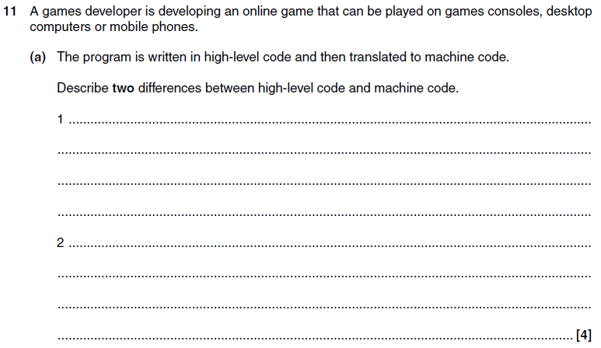
2.5 Translators and Languages
EQP June 2012

Slide 70
2.5 Translators and Languages
EQP June 2012

Slide 71
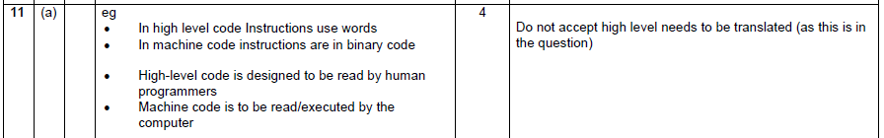
2.5 Translators and Languages
EQP June 2012

Slide 72
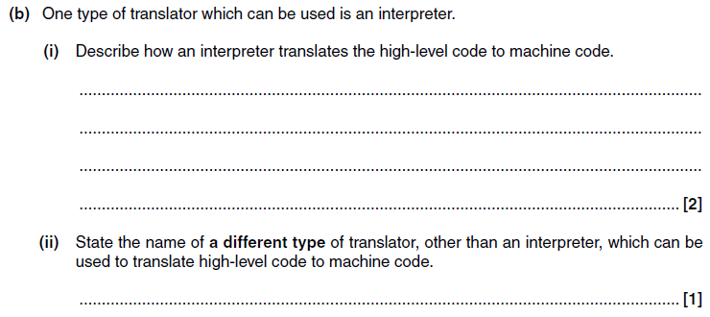
2.5 Translators and Languages
EQP June 2012

Slide 73
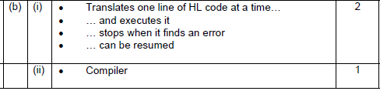
2.5 Translators and Languages
EQP June 2012

