Slide 1
OCR GCSE (9–1) in Computer Science (J277)
Boolean Logic
This pack is intended for students to use once they have covered the GCSE content, either in preparation for their L1 & L2 exam, or more likely alongside year 2 of the course to improve fluency, recall and pace on GCSE topics. It could be used as lesson starters, or supplied to students for independent use.

Slide 2
2.3 Bell Work
Complete the logic diagram below.
Q = A B

Slide 3
2.4 Learn about MOD, DIV and EXP in programming.
2.4 Learn about MOD, DIV and EXP in programming.
State what MOD, DIV and EXP mean.
Explain how MOD, DIV and EXP work in programs.
Complete exam questions on MOD, DIV and EXP.

Slide 4
2.4 Computational Logic
Define the following terms:
Modulus –
Exponential –

Slide 5
2.4 Computational Logic
Define the following terms:
Modulus – gives the remainder when two numbers are divided.
Exponential –

Slide 6
2.4 Computational Logic
Define the following terms:
Modulus – gives the remainder when two numbers are divided.
Exponential – multiples the value by itself the given number of times.

Slide 7
2.4 Computational Logic
MOD = divide the value by a number and output the remainder.
EXP = multiply the number by itself, the amount of times specified.
DIV =

Slide 8
2.4 Computational Logic
MOD = divide the value by a number and output the remainder.
EXP = multiply the number by itself, the amount of times specified.
DIV = if MOD is divide by 2 and leave the remainder, DIV is almost the opposite…

Slide 9
2.4 Computational Logic
MOD = divide the value by a number and output the remainder.
EXP = multiply the number by itself, the amount of times specified.
DIV = divide the value by a number and output just the whole number.

Slide 10
2.4 Computational Logic
10 MOD 3 = 1
MOD = divide the value by a number and output the remainder.
EXP = multiply the number by itself, the amount of times specified.
DIV = divide the value by a number and output just the whole number.

Slide 11
2.4 Computational Logic
10 MOD 3 = 1
MOD = divide the value by a number and output the remainder.
EXP = multiply the number by itself, the amount of times specified.
DIV = divide the value by a number and output just the whole number.
5 EXP 3 = 125

Slide 12
2.4 Computational Logic
10 MOD 3 = 1
MOD = divide the value by a number and output the remainder.
EXP = multiply the number by itself, the amount of times specified.
DIV = divide the value by a number and output just the whole number.
5 EXP 3 = 125
21 DIV 4 = 5

Slide 13
2.4 Computational Logic
Can you work out the sums below:
74 MOD 9 =
3 EXP 3 =
100 DIV 30 =

Slide 14
2.4 Computational Logic
Can you work out the sums below:
74 MOD 9 = 2
3 EXP 3 =
100 DIV 30 =

Slide 15
2.4 Computational Logic
Can you work out the sums below:
74 MOD 9 = 2
3 EXP 3 = 27
100 DIV 30 =

Slide 16
2.4 Computational Logic
Can you work out the sums below:
74 MOD 9 = 2
3 EXP 3 = 27
100 DIV 30 = 3

Slide 17
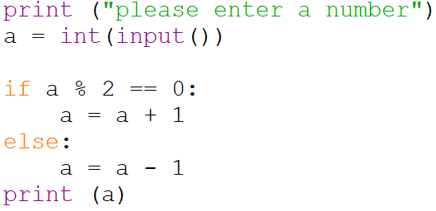
2.4 Computational Logic
What does the code below do.

Slide 18
2.4 Computational Logic
What does the code below do.
Inputs a value.

Slide 19
2.4 Computational Logic
What does the code below do.
What type of data type?

Slide 20
2.4 Computational Logic
What does the code below do.
INT = integer

Slide 21
2.4 Computational Logic
What does the code below do.
Divides the integer by 2.

Slide 22
2.4 Computational Logic
What does the code below do.
If the integer divided by 2 is 0 then the variable (a) has 1 added to it.

Slide 23
2.4 Computational Logic
What does the code below do.
Otherwise we subtract 1 from the variable (a)

Slide 24
2.4 Computational Logic
Draw the logic diagram for the expression below.
X AND Y = Q
X AND (NOT Y) = Q
(X AND Y) AND (NOT Z) = Q

Slide 25
2.4 Computational Logic
Draw the logic diagram for the expression below.
X Y = Q
X AND Y = Q
X AND (NOT Y) = Q
(X AND Y) AND (NOT Z) = Q

Slide 26
2.4 Computational Logic
Draw the logic diagram for the expression below.
X Y = Q
X AND Y = Q
X Y = Q
X AND (NOT Y) = Q
(X AND Y) AND (NOT Z) = Q

Slide 27
2.4 Computational Logic
Draw the logic diagram for the expression below.
X Y = Q
X AND Y = Q
X Y = Q
X AND (NOT Y) = Q
(X Y) ( Y) = Q
(X AND Y) AND (NOT Z) = Q

Slide 28
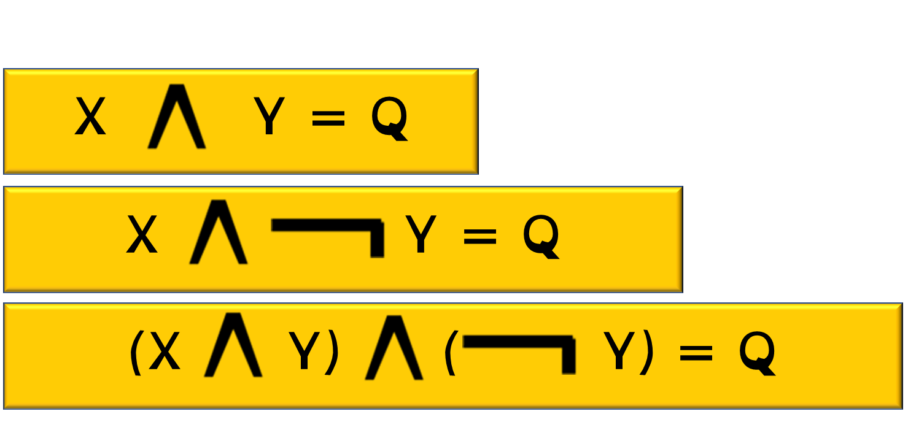
2.4 Computational Logic
Draw the logic diagram for the expression below.
X AND Y = Q
X AND (NOT Y) = Q
(X AND Y) AND (NOT Z) = Q

Slide 29
2.4 Computational Logic
Draw the logic diagram for the expression below.
X OR Y = Q
(NOT X) OR (NOT Y) = Q
(X AND Y) OR (NOT Z) = Q

Slide 30
2.4 Computational Logic
An online retailer wants to offer a discount to customers that haven’t bought with them before, but only if they enter a discount code emailed to them. Construct a Boolean expression to show this.
Let A = Returning Customer, B = Discount code entered.
Display the combinations in truth table.

Slide 31
2.4 Computational Logic
An online retailer wants to offer a discount to customers that haven’t bought with them before, but only if they enter a discount code emailed to them. Construct a Boolean expression to show this.
Let A = Returning Customer, B = Discount code entered.
Display the combinations in truth table.

Slide 32
2.4 Computational Logic
A gym wants to offer new customers a discount on protein shakes. They can only get this discount if they are a brand new customer and are over the age of 21. Construct a Boolean expression to show this.
Let A = Previous Customer, B = Age over 21
Display the combinations in a truth table.

Slide 33
2.4 Computational Logic
A gym wants to offer new customers a discount on protein shakes. They can only get this discount if they are a brand new customer and are over the age of 21. Construct a Boolean expression to show this.
Let A = Previous Customer, B = Age over 21
Display the combinations in a truth table.

