Slide 1
OCR GCSE (9–1) in Computer Science (J277)
Boolean Logic
This pack is intended for students to use once they have covered the GCSE content, either in preparation for their L1 & L2 exam, or more likely alongside year 2 of the course to improve fluency, recall and pace on GCSE topics. It could be used as lesson starters, or supplied to students for independent use.

Slide 2
2.3 Bell Work
Complete the truth table below for an OR logic gate.
Draw out the AND and OR logic gates.
A | B | Q
0 | 0
 | 1
1 | 0
1 |  | 1

Slide 3
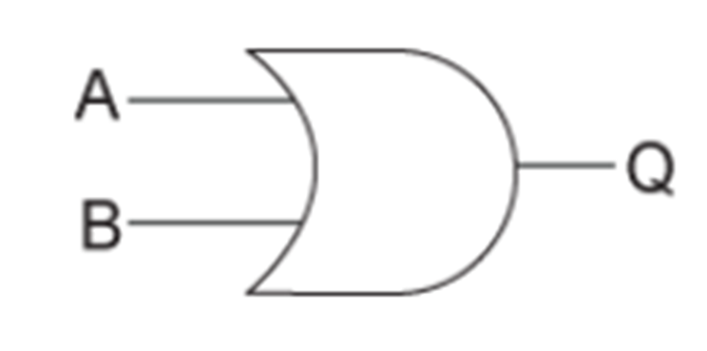
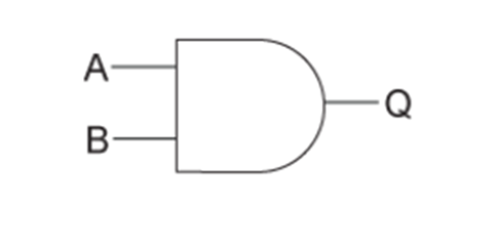
2.3 Bell Work
Complete the truth table below for an OR logic gate.
A | B | Q
0 | 0 | 0
0 | 1 | 1
1 | 0 | 0
1 | 1 | 1

Slide 4
2.4 Learn about two-tier logic gates and truth tables.
2.4 Learn about two-tier logic gates and truth tables.
State the different types of logic gates.
Explain how the different types of logic gates work.
Complete exam questions based on logic gates.

Slide 5
2.4 Computational Logic
Recap
1 and 0
1 = TRUE or on
0 = FALSE or off

Slide 6
2.4 Computational Logic
Recap
3 different logic gates:
AND
OR
NOT

Slide 7
2.4 Computational Logic
Recap
3 different logic gates:
AND
OR
NOT

Slide 8
2.4 Computational Logic
Recap
3 different logic gates:
AND
OR
NOT

Slide 9
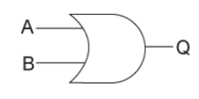
2.4 Computational Logic
Recap
3 different logic gates:
AND
OR
NOT

Slide 10
2.4 Computational Logic
Recap
3 different logic gates:
AND
OR
NOT

Slide 11
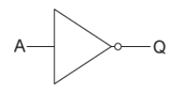
2.4 Computational Logic
Recap
3 different logic gates:
AND
OR
NOT

Slide 12
2.4 Computational Logic
Recap
3 different logic gates:
AND
OR
NOT

Slide 13
2.4 Computational Logic
Recap
AND – both input must be TRUE (1) for the output to be TRUE (1).
OR – one input must be TRUE for the output to be TRUE.
NOT – if the input is TRUE, the output must be FALSE.

Slide 14
2.4 Computational Logic
Recap
AND – both inputs must be TRUE (1) for the output to be TRUE (1).
OR – one input must be TRUE for the output to be TRUE.
NOT – if the input is TRUE, the output must be FALSE.

Slide 15
2.4 Computational Logic
Recap
AND – both inputs must be TRUE (1) for the output to be TRUE (1).
OR – one input must be TRUE for the output to be TRUE.
NOT – if the input is TRUE, the output must be FALSE.

Slide 16
2.4 Computational Logic
Recap
AND – both inputs must be TRUE (1) for the output to be TRUE (1).
OR – one input must be TRUE for the output to be TRUE.
NOT – if the input is TRUE, the output must be FALSE.

Slide 17
2.4 Computational Logic
Recap
AND – both inputs must be TRUE (1) for the output to be TRUE (1).
OR – one input must be TRUE for the output to be TRUE.
NOT – if the input is TRUE, the output must be FALSE. It inverts the value inputted.

Slide 18
2.4 Computational Logic
Recap
AND – both inputs must be TRUE (1) for the output to be TRUE (1).
OR – one input must be TRUE for the output to be TRUE.
NOT – if the input is TRUE, the output must be FALSE. It inverts the value inputted.
* Inverts = reverses *

Slide 19
2.4 Computational Logic
Recap
NOT gates invert the value that goes in.
Invert means reverses!
1
0
0
1

Slide 20
2.4 Computational Logic
Recap
A table can be used to list down all the possible inputs and outputs of a logic gate.
Complete the table below for the AND gate.
A | B | Q
0 | 0 | 0
0 | 1 | 0
1 | 0 | 0
1 | 1 | 1

Slide 21
2.4 Computational Logic
Recap
A table can be used to list down all the possible inputs and outputs of a logic gate.
Complete the table below for the OR gate.
A | B | Q
0 | 0 | 0
0 | 1 | 1
1 | 0 | 1
1 | 1 | 1

Slide 22
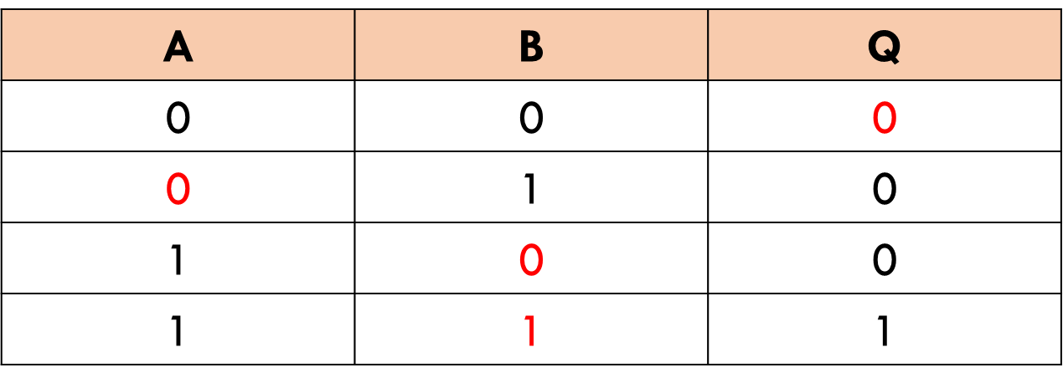
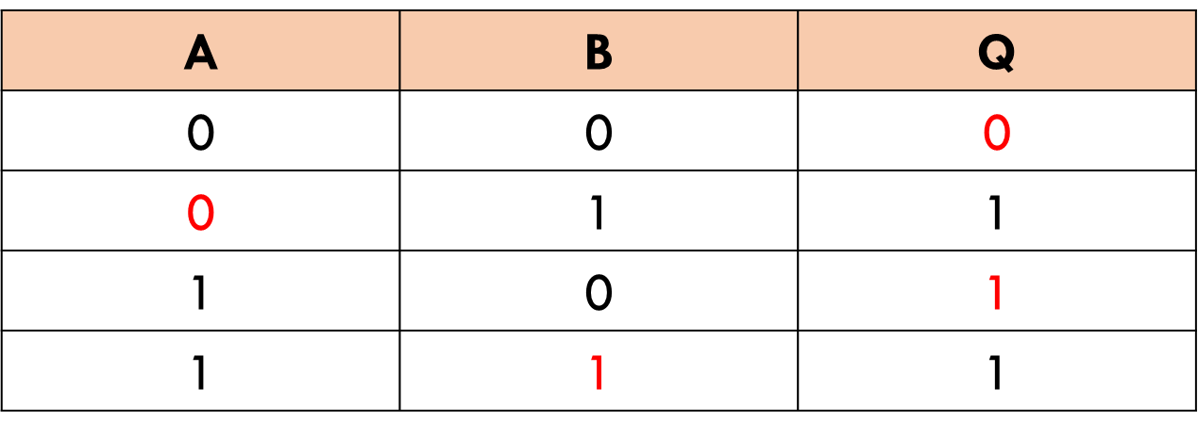
2.4 Computational Logic
Recap
How does the AND and OR gate truth table differ to the NOT gate?

Slide 23
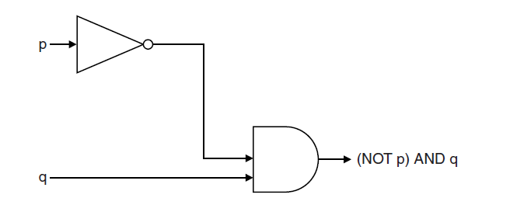
2.4 Computational Logic
Recap
0 and 1 going into an AND gate gives a 0.
1
0
0
1

Slide 24
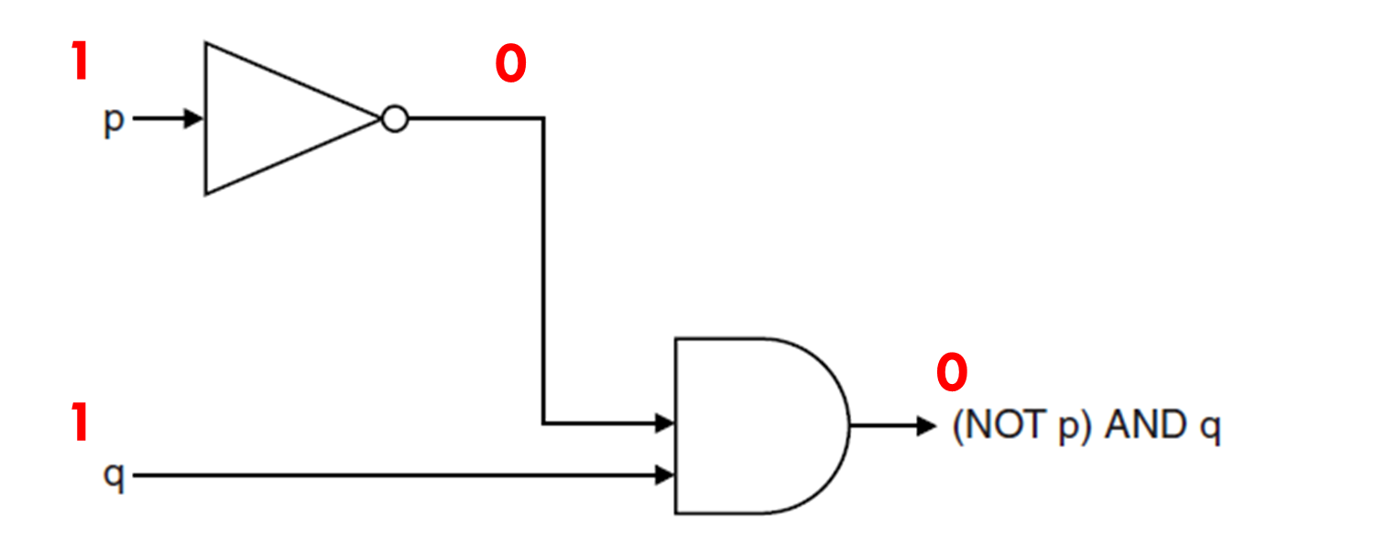
2.4 Computational Logic
We can create a truth table for the logic diagram below. But this will have a different result to our previous ones.
P and Q never change. It is just counting in binary.
P | Q | Q
0 | 0 | 0
0 | 1 | 1
1 | 0 | 1
1 | 1 | 1

Slide 25
2.4 Computational Logic
We can create a truth table for the logic diagram below. But this will have a different result to our previous ones.
P | Q | (NOT P) AND Q
0 | 0
0 | 1
1 | 0
1 | 1
You now need to invert P to get the right output.

Slide 26
2.4 Computational Logic
We can create a truth table for the logic diagram below. But this will have a different result to our previous ones.
P | Q | (NOT P) AND Q
0 | 0
0 | 1
1 | 0
1 | 1
1

Slide 27
2.4 Computational Logic
We can create a truth table for the logic diagram below. But this will have a different result to our previous ones.
P | Q | (NOT P) AND Q
0 | 0
0 | 1
1 | 0
1 | 1
1
1

Slide 28
2.4 Computational Logic
We can create a truth table for the logic diagram below. But this will have a different result to our previous ones.
P | Q | (NOT P) AND Q
0 | 0
0 | 1
1 | 0
1 | 1
1
1
0

Slide 29
2.4 Computational Logic
The output is now based on the red number in P and Q.
P | Q | (NOT P) AND Q
0 | 0
0 | 1
1 | 0
1 | 1
1
1
0
0

Slide 30
2.4 Computational Logic
The output is now based on the red number in P and Q.
P | Q | (NOT P) AND Q
0 | 0 | 0
0 | 1
1 | 0
1 | 1
1
1
0
0

Slide 31
2.4 Computational Logic
The output is now based on the red number in P and Q.
P | Q | (NOT P) AND Q
0 | 0 | 0
0 | 1 | 1
1 | 0
1 | 1
1
1
0
0

Slide 32
2.4 Computational Logic
The output is now based on the red number in P and Q.
P | Q | (NOT P) AND Q
0 | 0 | 0
0 | 1 | 1
1 | 0 | 0
1 | 1
1
1
0
0

Slide 33
2.4 Computational Logic
The output is now based on the red number in P and Q.
P | Q | (NOT P) AND Q
0 | 0 | 0
0 | 1 | 1
1 | 0 | 0
1 | 1 | 0
1
1
0
0

Slide 34
2.4 Computational Logic
What would the gate below look like?
How would you start to draw it?
(X AND Y) OR (NOT Z) = Q

Slide 35
2.4 Computational Logic
First draw the first bracket.
(X AND Y) OR (NOT Z) = Q

Slide 36
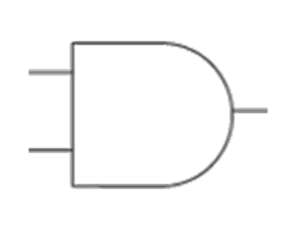
2.4 Computational Logic
First draw the first bracket.
X
Y

Slide 37
2.4 Computational Logic
Then draw the 2nd bracket.
(X AND Y) OR (NOT Z) = Q

Slide 38
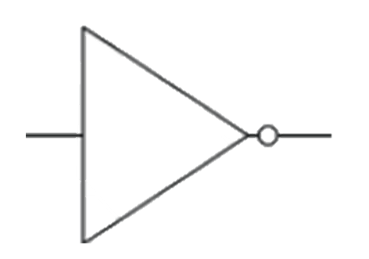
2.4 Computational Logic
Put the output of the whole question (Q here).
X
Y
Z

Slide 39
2.4 Computational Logic
Connect them together via the gate in the middle.
(X AND Y) OR (NOT Z) = Q

Slide 40
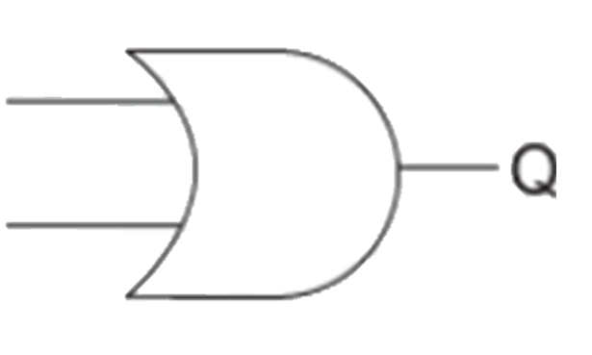
2.4 Computational Logic
Put the output of the whole question (Q here).
X
Y
Z

Slide 41
2.4 Computational Logic
Put the output of the whole question (Q here).
(X AND Y) OR (NOT Z) = Q

Slide 42
2.4 Computational Logic
Put the output of the whole question (Q here).
X
Y
Z

Slide 43
2.4 Computational Logic
State the value of Q if the values were as follows
1
X
0
Y
0
Z

Slide 44
2.4 Computational Logic
State the value of Q if the values were as follows
1
X
1
0
Y
0
Z

Slide 45
2.4 Computational Logic
State the value of Q if the values were as follows
1
X
0
0
Y
0
Z

Slide 46
2.4 Computational Logic
State the value of Q if the values were as follows
1
X
0
0
Y
0
Z
1

Slide 47
2.4 Computational Logic
State the value of Q if the values were as follows
1
X
0
0
Y
0
0
Z
1

Slide 48
2.4 Computational Logic
State the value of Q if the values were as follows
1
X
0
0
Y
1
0
Z
1

Slide 49
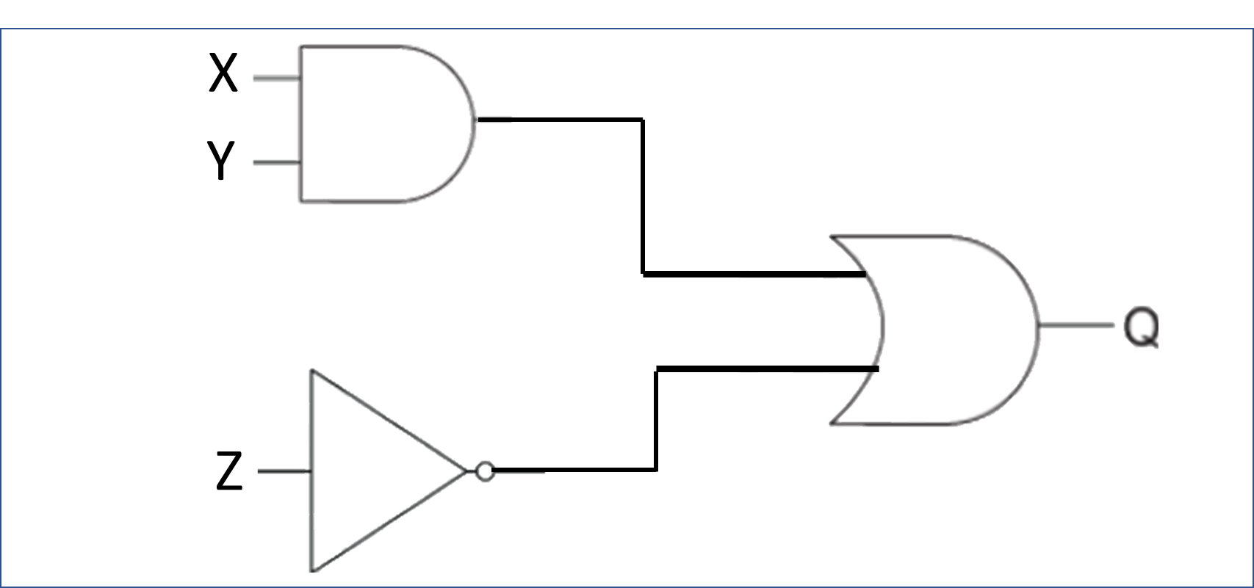
2.4 Computational Logic
How would you begin to fill this in?
Can you still count up in binary?
X | Y | Z | X AND Y | NOT Z | Q

Slide 50
2.4 Computational Logic
Count up the first 8 digits in binary.
X | Y | Z | X AND Y | NOT Z | Q

Slide 51
2.4 Computational Logic
Count up the first 8 digits in binary.
0 to 7 = 8 digits.
X | Y | Z | X AND Y | NOT Z | Q

Slide 52
2.4 Computational Logic
Count up the first 8 digits in binary.
0 to 7 = 8 digits.
X | Y | Z | X AND Y | NOT Z | Q
0 | 0 | 0
0 | 0 | 1

Slide 53
2.4 Computational Logic
Count up the first 8 digits in binary.
0 to 7 = 8 digits.
X | Y | Z | X AND Y | NOT Z | Q
0 | 0 | 0
0 | 0 | 1
0 | 1 | 0
0 | 1 | 1
1 | 0 | 0
1 | 0 | 1
1 | 1 | 0
1 | 1 | 1

Slide 54
2.4 Computational Logic
Focus on 1 column at a time.
This is just the column for an AND gate.
X | Y | Z | X AND Y | NOT Z | Q
0 | 0 | 0
0 | 0 | 1
0 | 1 | 0
0 | 1 | 1
1 | 0 | 0
1 | 0 | 1
1 | 1 | 0
1 | 1 | 1

Slide 55
2.4 Computational Logic
Focus on 1 column at a time.
This is just the column for an AND gate.
X | Y | Z | X AND Y | NOT Z | Q
0 | 0 | 0
0 | 0 | 1
0 | 1 | 0
0 | 1 | 1
1 | 0 | 0
1 | 0 | 1
1 | 1 | 0
1 | 1 | 1

Slide 56
2.4 Computational Logic
Focus on 1 column at a time.
This is just the column for a NOT gate.
X | Y | Z | X AND Y | NOT Z | Q
0 | 0 | 0
0 | 0 | 1
0 | 1 | 0
0 | 1 | 1
1 | 0 | 0
1 | 0 | 1
1 | 1 | 0
1 | 1 | 1

Slide 57
2.4 Computational Logic
Focus on 1 column at a time.
Put an OR gate on the last 2 columns.
X | Y | Z | X AND Y | NOT Z | Q
0 | 0 | 0 | 0 | 1
0 | 0 | 1 | 0 | 0
0 | 1 | 0 | 0 | 1
0 | 1 | 1 | 0 | 0
1 | 0 | 0 | 0 | 1
1 | 0 | 1 | 0 | 0
1 | 1 | 0 | 1 | 1
1 | 1 | 1 | 1 | 0

Slide 58
2.4 Computational Logic
Focus on 1 column at a time.
Put an OR gate on the last 2 columns.
X | Y | Z | X AND Y | NOT Z | Q
0 | 0 | 0 | 0 | 1 | 1
0 | 0 | 1 | 0 | 0 | 0
0 | 1 | 0 | 0 | 1 | 1
0 | 1 | 1 | 0 | 0 | 0
1 | 0 | 0 | 0 | 1 | 1
1 | 0 | 1 | 0 | 0 | 0
1 | 1 | 0 | 1 | 1 | 1
1 | 1 | 1 | 1 | 0 | 1

Slide 59
2.4 Computational Logic
Draw the logic gate diagram for the expression below.
(X OR Y) AND (NOT Z) = Q

Slide 60
2.4 Computational Logic
Draw the logic gate diagram for the expression below.
Remember the key rules – break up the diagram and do the brackets first!
(X OR Y) AND (NOT Z) = Q

Slide 61
2.4 Computational Logic
Draw the logic gate diagram for the expression below.
Remember the key rules – break up the diagram and do the brackets first!
(X OR Y) AND (NOT Z) = Q

Slide 62
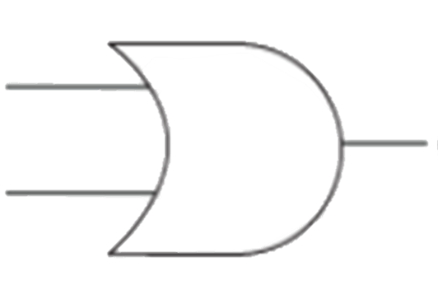
2.4 Computational Logic
(X OR Y) AND (NOT Z) = Q
X
Y

Slide 63
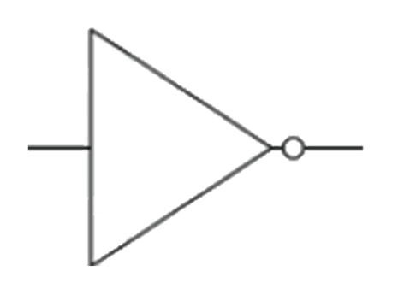
2.4 Computational Logic
(X OR Y) AND (NOT Z) = Q
X
Y
Z

Slide 64
2.4 Computational Logic
(X OR Y) AND (NOT Z) = Q
X
Y
Q
Z

Slide 65
2.4 Computational Logic
(X OR Y) AND (NOT Z) = Q
X
Y
Q
Z

Slide 66
2.4 Computational Logic
(X OR Y) AND (NOT Z) = Q
X
Y
Q
Z

Slide 67
2.4 Computational Logic
(X OR Y) AND (NOT Z) = Q
X
Y
Q
Z

Slide 68
2.4 Computational Logic
(X OR Y) AND (NOT Z) = Q
1
X
Y
0
Q
0
Z

Slide 69
2.4 Computational Logic
(X OR Y) AND (NOT Z) = Q
1
X
1
Y
0
Q
0
Z
1

Slide 70
2.4 Computational Logic
(X OR Y) AND (NOT Z) = Q
1
X
1
Y
0
Q
1
0
Z
1

Slide 71
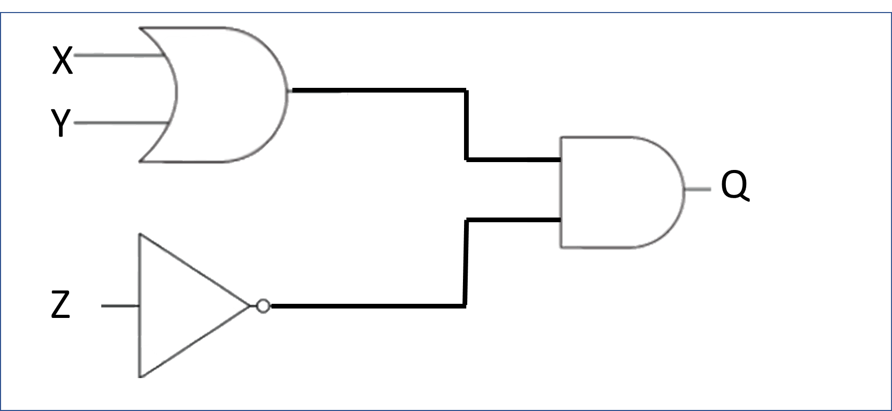
2.4 Computational Logic
(X OR Y) AND (NOT Z) = Q
Complete the truth table for the logic diagram below.
X | Y | Z | X OR Y | NOT Z | Q

Slide 72
2.4 Computational Logic
(X OR Y) AND (NOT Z) = Q
Just count up in binary. 0 to 7 = 8 digits.
X | Y | Z | X OR Y | NOT Z | Q
0 | 0 | 0
0 | 0 | 1
0 | 1 | 0
0 | 1 | 1
1 | 0 | 0
1 | 0 | 1
1 | 1 | 0
1 | 1 | 1

Slide 73
2.4 Computational Logic
(X OR Y) AND (NOT Z) = Q
X OR Y needs to be 1 for this column to be 1.
X | Y | Z | X OR Y | NOT Z | Q
0 | 0 | 0
0 | 0 | 1
0 | 1 | 0
0 | 1 | 1
1 | 0 | 0
1 | 0 | 1
1 | 1 | 0
1 | 1 | 1

Slide 74
2.4 Computational Logic
(X OR Y) AND (NOT Z) = Q
Invert the value at Z.
X | Y | Z | X OR Y | NOT Z | Q
0 | 0 | 0
0 | 0 | 1
0 | 1 | 0
0 | 1 | 1
1 | 0 | 0
1 | 0 | 1
1 | 1 | 0
1 | 1 | 1

Slide 75
2.4 Computational Logic
(X OR Y) AND (NOT Z) = Q
AND gate for the two yellow columns.
X | Y | Z | X OR Y | NOT Z | Q
0 | 0 | 0 | 0 | 1
0 | 0 | 1 | 0 | 0
0 | 1 | 0 | 1 | 1
0 | 1 | 1 | 1 | 0
1 | 0 | 0 | 1 | 1
1 | 0 | 1 | 1 | 0
1 | 1 | 0 | 1 | 1
1 | 1 | 1 | 1 | 0

Slide 76
2.4 Computational Logic
(X OR Y) AND (NOT Z) = Q
AND gate for the two yellow columns.
X | Y | Z | X OR Y | NOT Z | Q
0 | 0 | 0 | 0 | 1 | 0
0 | 0 | 1 | 0 | 0 | 0
0 | 1 | 0 | 1 | 1 | 1
0 | 1 | 1 | 1 | 0 | 0
1 | 0 | 0 | 1 | 1 | 0
1 | 0 | 1 | 1 | 0 | 0
1 | 1 | 0 | 1 | 1 | 1
1 | 1 | 1 | 1 | 0 | 0

Slide 77
2.4 Computational Logic
(X OR Y) AND (NOT Z) = Q
AND gate for the two yellow columns.
X | Y | Z | X OR Y | NOT Z | Q
0 | 0 | 0 | 0 | 1 | 0
0 | 0 | 1 | 0 | 0 | 0
0 | 1 | 0 | 1 | 1 | 1
0 | 1 | 1 | 1 | 0 | 0
1 | 0 | 0 | 1 | 1 | 0
1 | 0 | 1 | 1 | 0 | 0
1 | 1 | 0 | 1 | 1 | 1
1 | 1 | 1 | 1 | 0 | 0

Slide 78
2.4 Computational Logic
(X OR Y) AND (NOT Z) = Q
AND gate for the two yellow columns.
X | Y | Z | X OR Y | NOT Z | Q
0 | 0 | 0 | 0 | 1 | 0
0 | 0 | 1 | 0 | 0 | 0
0 | 1 | 0 | 1 | 1 | 1
0 | 1 | 1 | 1 | 0 | 0
1 | 0 | 0 | 1 | 1 | 1
1 | 0 | 1 | 1 | 0 | 0
1 | 1 | 0 | 1 | 1 | 1
1 | 1 | 1 | 1 | 0 | 0

Slide 79
2.4 Computational Logic
What do the 3 symbols mean?
AND
OR
NOT

Slide 80
2.4 Computational Logic
What do the 3 symbols mean?
AND
OR
NOT

Slide 81
2.4 Computational Logic
What do the 3 symbols mean?
AND
OR
NOT

Slide 82
2.4 Computational Logic
What do the 3 symbols mean?
AND
OR
NOT

Slide 83
2.4 Computational Logic
What do the 3 symbols mean?
AND
OR
NOT

Slide 84
2.4 Computational Logic
What do the 3 symbols mean?
AND
OR
NOT

Slide 85
2.4 Computational Logic
How would you draw the logic diagram for the expression below.
Q = A B

Slide 86
2.4 Computational Logic
How would you draw the logic diagram for the expression below.
Q = A B
NOT

Slide 87
2.4 Computational Logic
How would you draw the logic diagram for the expression below.
Q = A B
NOT
AND

Slide 88
2.4 Computational Logic
How would you draw the logic diagram for the expression below.
Q = A B

Slide 89
2.4 Computational Logic
How would you draw the logic diagram for the expression below.
Q = A B
OR

