Slide 1
OCR GCSE (9–1) in Computer Science (J277)
Boolean Logic
This pack is intended for students to use once they have covered the GCSE content, either in preparation for their L1 & L2 exam, or more likely alongside year 2 of the course to improve fluency, recall and pace on GCSE topics. It could be used as lesson starters, or supplied to students for independent use.

Slide 2
2.3 Bell Work
8 | 4 | 2 | 1 | Denary
 |  |  |  | 3
8 | 4 | 2 | 1 | Denary
1 | 1 | 1 | 0
128 | 64 | 32 | 16 | 8 | 4 | 2 | 1 | Denary
0 | 0 | 1 | 1 | 1 | 1 | 0 | 0
 |  |  |  |  |  |  |  | 129

Slide 3
2.4 Learn about Logic Gates.
2.4 Learn about Logic Gates.
State the different types of logic gates.
Explain how the different types of logic gates work.
Complete exam questions based on logic gates.

Slide 4
2.4 Computational Logic
1 and 0
1 = TRUE or on
0 = FALSE or off

Slide 5
2.4 Computational Logic
3 different logic gates:
AND
OR
NOT

Slide 6
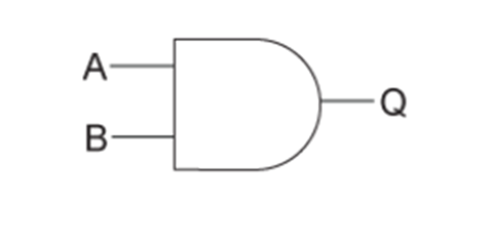

2.4 Computational Logic
3 different logic gates:
AND
OR
NOT
A . B or A B

Slide 7
2.4 Computational Logic
3 different logic gates:
AND
OR
NOT
A . B or A B

Slide 8
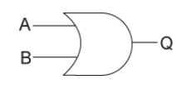
2.4 Computational Logic
3 different logic gates:
AND
OR
NOT
A + B or A B

Slide 9
2.4 Computational Logic
3 different logic gates:
AND
OR
NOT
A + B or A B

Slide 10
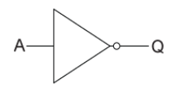
2.4 Computational Logic
3 different logic gates:
AND
OR
NOT
A OR A

Slide 11
2.4 Computational Logic
3 different logic gates:
AND
OR
NOT
A OR A

Slide 12
2.4 Computational Logic
AND – both input must be TRUE (1) for the output to be TRUE (1).
OR – one input must be TRUE for the output to be TRUE.
NOT – if the input is TRUE, the output must be FALSE.

Slide 13
2.4 Computational Logic
AND – both inputs must be TRUE (1) for the output to be TRUE (1).
OR – one input must be TRUE for the output to be TRUE.
NOT – if the input is TRUE, the output must be FALSE.

Slide 14
2.4 Computational Logic
AND – both inputs must be TRUE (1) for the output to be TRUE (1).
OR – one input must be TRUE for the output to be TRUE.
NOT – if the input is TRUE, the output must be FALSE.

Slide 15
2.4 Computational Logic
AND – both inputs must be TRUE (1) for the output to be TRUE (1).
OR – one input must be TRUE for the output to be TRUE.
NOT – if the input is TRUE, the output must be FALSE.

Slide 16
2.4 Computational Logic
AND – both inputs must be TRUE (1) for the output to be TRUE (1).
OR – one input must be TRUE for the output to be TRUE.
NOT – if the input is TRUE, the output must be FALSE. It inverts the value inputted.

Slide 17
2.4 Computational Logic
AND – both inputs must be TRUE (1) for the output to be TRUE (1).
OR – one input must be TRUE for the output to be TRUE.
NOT – if the input is TRUE, the output must be FALSE. It inverts the value inputted.
* Inverts = reverses *

Slide 18
2.4 Computational Logic
What type of gate?
A

Slide 19

2.4 Computational Logic
What type of gate?
A

Slide 20
2.4 Computational Logic
What type of gate?
1
A

Slide 21
2.4 Computational Logic
What type of gate?
1
0
A

Slide 22
2.4 Computational Logic
What type of gate?
1
0
0
A

Slide 23
2.4 Computational Logic
What type of gate?
1
0
0
1
A

Slide 24

2.4 Computational Logic
What type of gate?

Slide 25
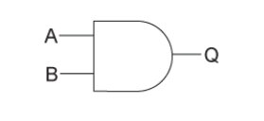
2.4 Computational Logic
What type of gate?

Slide 26
2.4 Computational Logic
What type of gate?
1
0

Slide 27
2.4 Computational Logic
What type of gate?
1
0
0

Slide 28

2.4 Computational Logic
Complete the logic gates below.
1
_
_
1
_
_
A V B

Slide 29
2.4 Computational Logic
A table can be used to list down all the possible inputs and outputs of a logic gate.
For the AND gate there are 4 possible scenarios.

Slide 30
2.4 Computational Logic
A table can be used to list down all the possible inputs and outputs of a logic gate.
Complete the table below for the AND gate.
A | B | Q
0 | 0
 | 1 | 0
1 |  | 0
1 |  | 1

Slide 31
2.4 Computational Logic
A table can be used to list down all the possible inputs and outputs of a logic gate.
Complete the table below for the AND gate.
A | B | Q
0 | 0 | 0
0 | 1 | 0
1 | 0 | 0
1 | 1 | 1

Slide 32
2.4 Computational Logic
A table can be used to list down all the possible inputs and outputs of a logic gate.
Complete the table below for the OR gate.
A | B | Q
0 | 0
 | 1 | 1
1 | 0
1 |  | 1

Slide 33
2.4 Computational Logic
A table can be used to list down all the possible inputs and outputs of a logic gate.
Complete the table below for the OR gate.
A | B | Q
0 | 0 | 0
0 | 1 | 1
1 | 0 | 1
1 | 1 | 1

Slide 34
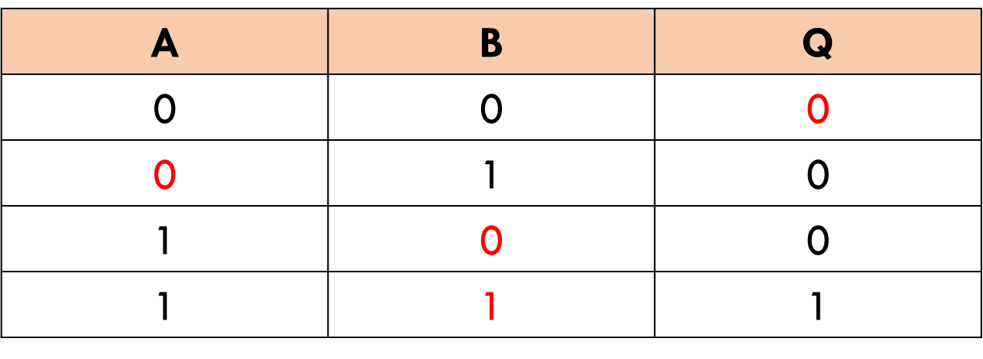
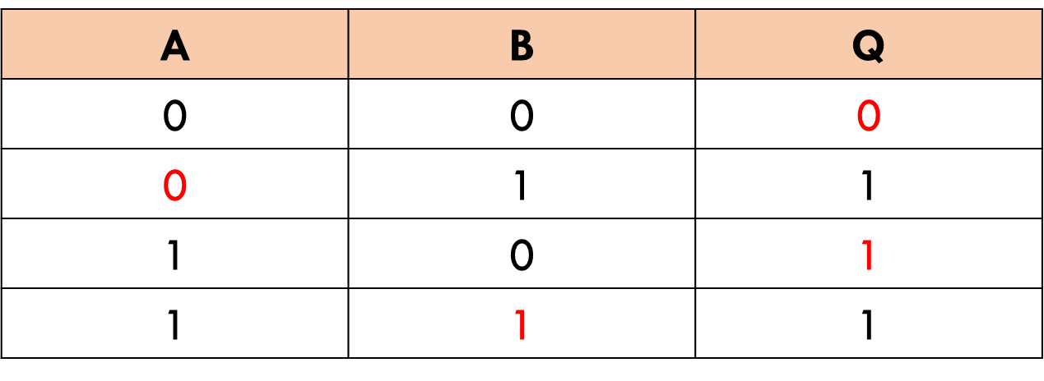
2.4 Computational Logic
How does the AND and OR gate truth table differ to the NOT gate?

Slide 35
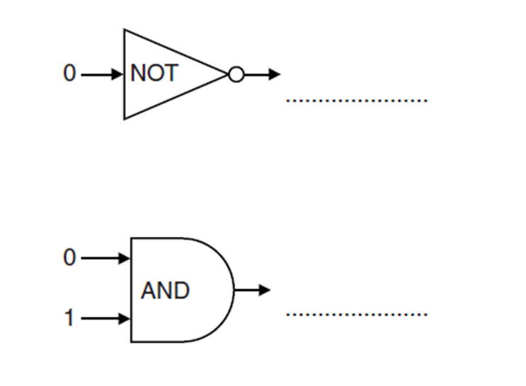
2.4 Computational Logic
EQP

Slide 36
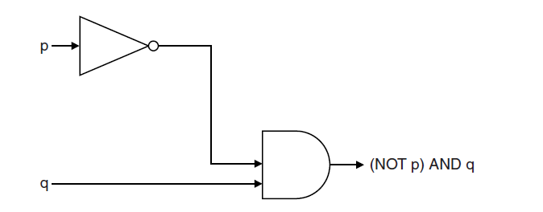
2.4 Computational Logic
How would you answer this?

Slide 37
2.4 Computational Logic
What are the two gates here?
1
1

Slide 38
2.4 Computational Logic
Invert the 1 going into the NOT gate.
1
0
1

Slide 39
2.4 Computational Logic
0 and 1 going into an AND gate gives a 0.
1
0
0
1

Slide 40
2.4 Computational Logic
Brackets evaluated first! Order of precedence (priority) is NOT first, then AND, then OR.
1
0
0
1

Slide 41
2.4 Computational Logic
Brackets evaluated first! Order of precedence (priority) is NOT first, then AND, then OR.
1
0
0
1

Slide 42
2.4 Computational Logic
State Q if the value of:
A = 1
B = 0

Slide 43
2.4 Computational Logic
State A and B if the value of Q is 1.

Slide 44
2.4 Computational Logic
State the value of Q if:
A = 0
B = 0

Slide 45
2.4 Computational Logic
State the value of Q if:
A = 0
B = 1

Slide 46
2.4 Computational Logic
State the value of Q if A = 1

