Slide 1
OCR GCSE (9–1) in Computer Science (J277)
Producing Robust Programs
This pack is intended for students to use once they have covered the GCSE content, either in preparation for their L1 & L2 exam, or more likely alongside year 2 of the course to improve fluency, recall and pace on GCSE topics. It could be used as lesson starters, or supplied to students for independent use.

Slide 2
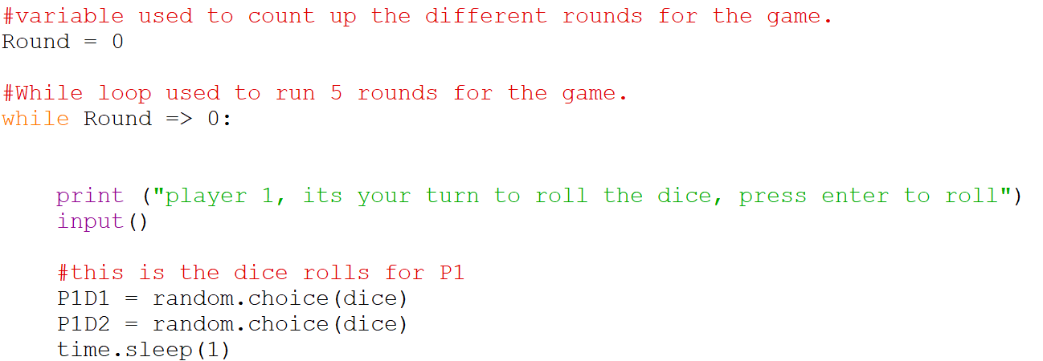
Bell Work
Syntax
Logical
Runtime
Can you spot the error?
What error type is it?
What are the 3 types of errors?

Slide 3
Bell Work
Syntax
Logical
Runtime
Round is equal to or greater than 0.
What error type is it?
What are the 3 types of errors?

Slide 4
Bell Work
Syntax
Logical
Runtime
Round is 0 and the program +1 to it.
What error type is it?
What are the 3 types of errors?

Slide 5
Bell Work
Syntax
Logical
Runtime
Round is 0 and the program +1 to it.
Logical error – will this run?
What are the 3 types of errors?

Slide 6
Bell Work
Syntax
Logical
Runtime
Round is 0 and the program +1 to it.
Logical error – Never stops running.
What are the 3 types of errors?

Slide 7
Bell Work
Syntax
Logical
Runtime
Round is 0 and the program +1 to it.
Runtime error? – Never stops running.
What are the 3 types of errors?

Slide 8
Bell Work
Syntax
Logical
Runtime
Syntax
Logical
Runtime

Slide 9
2.3 – Learn about defensive design and maintainability in programming.
2.3 – Learn about defensive design and maintainability in programming.
State the features of defensive design.
Explain how to maintain programs.
Complete exam questions based on defensive design and maintainability.

Slide 10
2.3 Robust Programs
Define the two terms below:
Robust
Maintainability
How could this be applied to programming?

Slide 11
2.3 Robust Programs
Define the two terms below:
Robust – strong and healthy.
Maintainability
How could this be applied to programming?

Slide 12
2.3 Robust Programs
Define the two terms below:
Robust – strong and healthy.
Maintainability – cause or enable (a condition or situation) to continue.
How could this be applied to programming?

Slide 13
2.3 Robust Programs
So what is a robust program?

Slide 14
2.3 Robust Programs
So what is a robust program?
A robust program is a program that has been designed to withstand misuse and variations of data being entered by users.
The programs are prepared to deal with multiple different eventualities.

Slide 15
2.3 Robust Programs
So what is a robust program?
A robust program is a program that has been designed to withstand misuse and variations of data being entered by users.
The programs are prepared to deal with multiple different eventualities.

Slide 16
2.3 Robust Programs
So what is a robust program?
A robust program is a program that has been designed to withstand misuse and variations of data being entered by users.
The programs are prepared to deal with multiple different eventualities.

Slide 17
2.3 Robust Programs
How can we maintain our programs?
Maintainability means ensuring our program can be managed, updated, and repaired as and when it is needed.

Slide 18
2.3 Robust Programs
What did you do in Python that helped maintain your program lesson-by-lesson?
Comments – These help us maintain our program because they tell us what is happening in the different parts of our program. This means any programmer can pick up the program and maintain it.

Slide 19
2.3 Robust Programs
What did you do in Python that helped maintain your program lesson-by-lesson?
Comments – These help us maintain our program because they tell us what is happening in the different parts of our program. This means any programmer can pick up the program and maintain it.
Indentation – This helps us maintain our program because it structures our program helping to keep it organised, neat, and easy to understand.

Slide 20
2.3 Robust Programs
What did you do in Python that helped maintain your program lesson-by-lesson?
Comments – These help us maintain our program because they tell us what is happening in the different parts of our program. This means any programmer can pick up the program and maintain it.
Indentation – This helps us maintain our program because it structures our program helping to keep it organised, neat, and easy to understand.

Slide 21
2.3 Robust Programs
What did you do in Python that helped maintain your program lesson-by-lesson?
Comments – These help us maintain our program because they tell us what is happening in the different parts of our program. This means any programmer can pick up the program and maintain it.
Indentation – This helps us maintain our program because it structures our program helping to keep it organised, neat, and easy to understand.

Slide 22
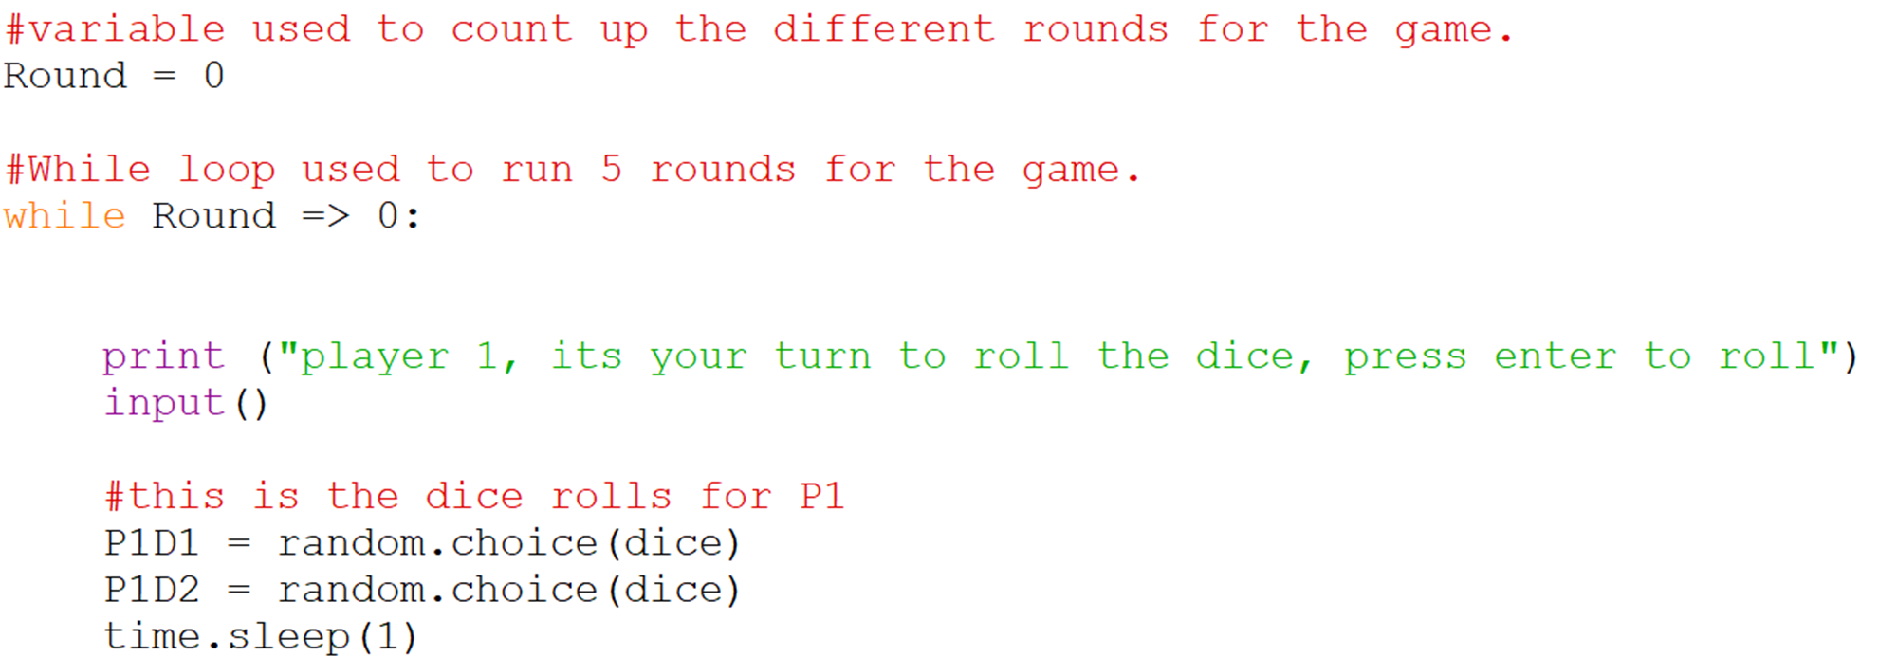
2.3 Robust Programs
How has this programmer aided maintainability in the future?

Slide 23
2.3 Robust Programs
How has this programmer aided maintainability in the future?

Slide 24
2.3 Robust Programs
How has this programmer aided maintainability in the future?

Slide 25
2.3 Robust Programs
How has this programmer aided maintainability in the future?

Slide 26
2.3 Robust Programs
How has this programmer aided maintainability in the future?

Slide 27
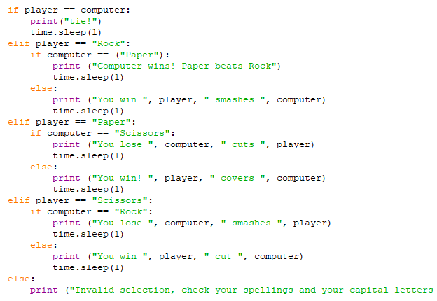
2.3 Robust Programs

Slide 28
2.3 Robust Programs

Slide 29
2.3 Robust Programs
Explain how comments aid maintainability for a programmer.

Slide 30
2.3 Robust Programs
Explain how comments aid maintainability for a programmer.
Comments aid maintainability because…
They allow other…

Slide 31
2.3 Robust Programs
Explain how comments aid maintainability for a programmer.
Comments aid maintainability because the programmer can log down what they have done to the program.
They allow other programmers…

Slide 32
2.3 Robust Programs
Explain how comments aid maintainability for a programmer.
Comments aid maintainability because the programmer can log down what they have done to the program.
They allow other programmers to update or edit the program, and track what has been done before them.

Slide 33
2.3 Robust Programs
State how indentation aids programmers.

Slide 34
2.3 Robust Programs
State how indentation aids programmers.
Indentation keeps the program…

Slide 35
2.3 Robust Programs
State how indentation aids programmers.
Indentation keeps the program organised, it is easy to see what groups of codes belong together.

Slide 36
2.3 Defensive Design
How can we create a program that is robust and reliable?

Slide 37
2.3 Defensive Design
These are the methods of defensive design that we can take to create a good program:
Input Sanitisation
Validation
Planning for Contingencies
Anticipating Misuse
Authentication

Slide 38
2.3 Defensive Design
These are the methods of defensive design that we can take to create a good program:
Input Sanitisation
Validation
Planning for Contingencies
Anticipating Misuse
Authentication

Slide 39
2.3 Defensive Design
What is Sanitisation?
Sanitisation is when you clean something and rid it of anything unwanted or unnecessary.

Slide 40
2.3 Defensive Design
What is Sanitisation?
Sanitisation is when you clean something and rid it of anything unwanted or unnecessary.

Slide 41
2.3 Defensive Design
What is Input Sanitisation?
Input Sanitisation is when we take the users input and ‘clean it’ or ‘tidy it up’ before it is processed.
For example, we might change the case to UPPER, or remove any excess and unnecessary white space.

Slide 42
2.3 Defensive Design
What is Input Sanitisation?
Input Sanitisation is when we take the users input and ‘clean it’ or ‘tidy it up’ before it is processed.
For example, we might change the case to UPPER, or remove any excess and unnecessary white space.

Slide 43
2.3 Defensive Design
What is Input Sanitisation?
Input Sanitisation is when we take the users input and ‘clean it’ or ‘tidy it up’ before it is processed.
For example, we might change the case to UPPER, or remove any excess and unnecessary white space.

Slide 44
2.3 Defensive Design
What is happening the code below?

Slide 45
2.3 Defensive Design
What is happening the code below?

Slide 46
2.3 Defensive Design
What is happening the code below?
In this example we are sanitising the users input as we are changing the input to uppercase ready for processing in the condition

Slide 47
2.3 Defensive Design
What is happening the code below?
In this example we are sanitising the users input as we are changing the input to uppercase ready for processing in the condition

Slide 48
2.3 Defensive Design
What is happening the code below?

Slide 49
2.3 Defensive Design
What is happening the code below?

Slide 50
2.3 Defensive Design
What is happening the code below?
In this example we are sanitising the users input as we are removing any white space in the users username

Slide 51
2.3 Defensive Design
What is happening the code below?
In this example we are sanitising the users input as we are removing any white space in the users username

Slide 52
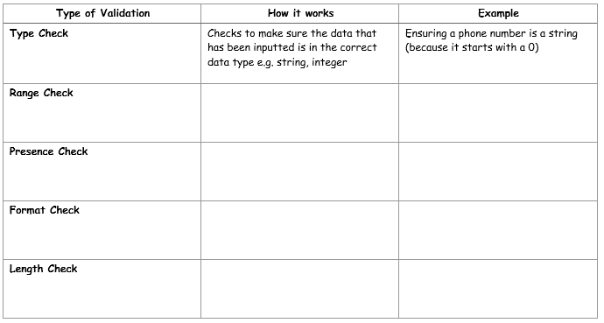
2.3 Defensive Design
The process of ensuring data that has been inputted
is sensible and reasonable, NOT that it is correct
Type Check
Range Check
Value falls within the correct range
A test score percentage (0 – 100)
Presence Check
Checks data has been entered (not null)
Email address when ordering online
Format Check
Data is in the correct format
Entering a date (dd/mm/yyyy)
Length Check
Checks data is not too short or long
Creating a password

Slide 53
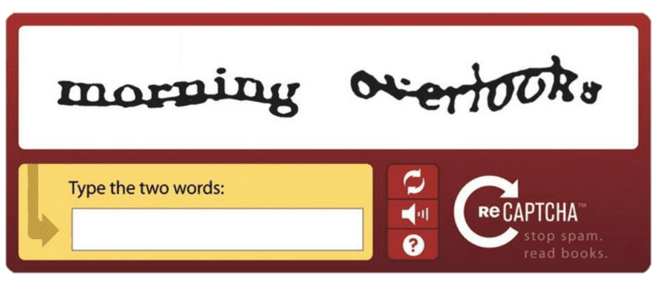
2.3 Defensive Design
What is the image below showing?

Slide 54
2.3 Defensive Design
What is the image below showing?
This is authentication – checking that you are not a bot!

Slide 55
2.3 Defensive Design
What is the image below showing?
Authentication is when the program requires a user to input some data in order to proceed with the program

Slide 56
2.3 Testing
What is testing?
Testing is checking to see if something works. We can do this by using it.
Why would we test our programs?

Slide 57
2.3 Testing
What is testing?
Testing is checking to see if something works. We can do this by using it.
Why would we test our programs?
We tested our programs to see if the program works as it should do.

Slide 58
2.3 Testing
When we created our program, how did we test it?

Slide 59
2.3 Testing
When we created our program, how did we test it?
While creating the program
At the end when it was complete

Slide 60
2.3 Testing
When we created our program, how did we test it?
While creating the program
At the end when it was complete
Final Testing
Iterative Testing

Slide 61
2.3 Testing
When we created our program, how did we test it?
While creating the program
At the end when it was complete
Iterative Testing
Final Testing

Slide 62
2.3 Testing
Using examples, define the two types of testing.
Final Testing
Iterative Testing

Slide 63
2.3 Testing
Testing the program once it is complete at the end.
What type of testing?
Final Testing
Iterative Testing

Slide 64
2.3 Testing
Testing the program once it is complete at the end.
What type of testing?
Final Testing
Iterative Testing

Slide 65
2.3 Testing
Testing while you are creating the program, testing a line or section at a time.
What type of testing?
Final Testing
Iterative Testing

Slide 66
2.3 Testing
Testing while you are creating the program, testing a line or section at a time.
What type of testing?
Final Testing
Iterative Testing

Slide 67
2.3 Testing
How do you test that a program works then?
How can I test that my quiz works?

Slide 68
2.3 Testing
How do you test that a program works then?
You can test it using data.
How can I test that my quiz works?

Slide 69
2.3 Testing
How do you test that a program works then?
You can test it using data.
How can I test that my quiz works?
Enter a variety of different answers and see if it works.

Slide 70
2.3 Testing
Normal
Boundary
Erroneous
What do each of them mean?
How does this relate to testing data?

Slide 71
2.3 Testing
Normal
Boundary
Erroneous
Enter data that you would usually expect to work.

Slide 72
2.3 Testing
Normal
Boundary
Erroneous
Enter data that you would usually expect to work.

Slide 73
2.3 Testing
Normal
Boundary
Erroneous
Enter data that is the complete wrong type of data.

Slide 74
2.3 Testing
Normal
Boundary
Erroneous
Enter data that is the complete wrong type of data.

Slide 75
2.3 Testing
Normal
Boundary
Erroneous
Enter data that is at the limit of just being accepted or refused.

Slide 76
2.3 Testing
Normal
Boundary
Erroneous
Enter data that is at the limit of just being accepted or refused.

Slide 77
2.3 Testing
What test could be performed on the code below to check that it works?

Slide 78
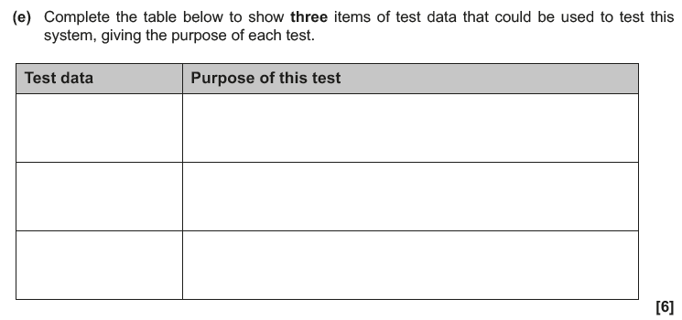
2.3 Testing

Slide 79
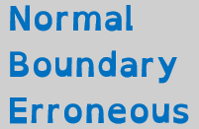
2.3 Testing

Slide 80
2.3 Testing

Slide 81
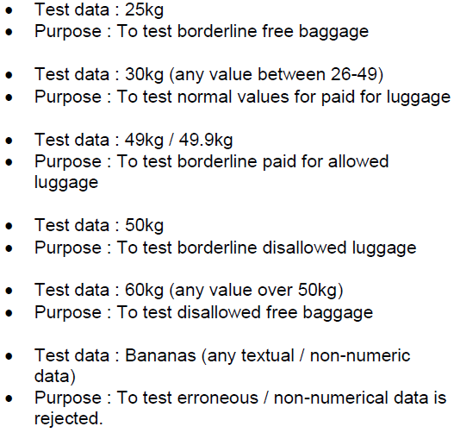
2.3 Testing

