Slide 1
OCR GCSE (9–1) in Computer Science (J277)
Producing Robust Programs
This pack is intended for students to use once they have covered the GCSE content, either in preparation for their L1 & L2 exam, or more likely alongside year 2 of the course to improve fluency, recall and pace on GCSE topics. It could be used as lesson starters, or supplied to students for independent use.

Slide 2
Bell Work
Complete the code below to open the Time.txt file to read and write to the file.
input date()
input time()
data_from_file = ____________________
if time > 11.59
print “good afternoon”
else
print “good morning”

Slide 3
Bell Work
Complete the code below to open the Time.txt file to read and write to the file.
input date()
input time()
data_from_file = ____________________
if time > 11.59
print “good afternoon”
else
print “good morning”
Open (“Time.txt”, “”)

Slide 4
Bell Work
Complete the code below to open the Time.txt file to read and write to the file.
input date()
input time()
data_from_file = ____________________
if time > 11.59
print “good afternoon”
else
print “good morning”
Open (“Time.txt”, “r+”)

Slide 5
2.3 - Learn about error types and testing in programs.
Learn about error types and testing in programs.
State how to call a file in a program.
Explain the key terms used to edit a file.
Complete exam questions based on calling files.

Slide 6
2.3 Testing
What is testing?
Why would we test our programs?

Slide 7
2.3 Testing
What is testing?
Testing is checking to see if something works. We can do this by using it.
Why would we test our programs?

Slide 8
2.3 Testing
What is testing?
Testing is checking to see if something works. We can do this by using it.
Why would we test our programs?
We tested our programs to see if the program works as it should do.

Slide 9
2.3 Testing
When we created our program, how did we test it?

Slide 10
2.3 Testing
When we created our program, how did we test it?
While creating the program
At the end when it was complete

Slide 11
2.3 Testing
When we created our program, how did we test it?
While creating the program
At the end when it was complete
Final Testing
Iterative Testing

Slide 12
2.3 Testing
When we created our program, how did we test it?
While creating the program
At the end when it was complete
Iterative Testing
Final Testing

Slide 13
2.3 Testing
Using examples, define the two types of testing.
Final Testing
Iterative Testing

Slide 14
2.3 Testing
Testing the program once it is complete at the end.
What type of testing?
Final Testing
Iterative Testing

Slide 15
2.3 Testing
Testing the program once it is complete at the end.
What type of testing?
Final Testing
Iterative Testing

Slide 16
2.3 Testing
Testing while you are creating the program, testing a line or section at a time.
What type of testing?
Final Testing
Iterative Testing

Slide 17
2.3 Testing
Testing while you are creating the program, testing a line or section at a time.
What type of testing?
Final Testing
Iterative Testing

Slide 18
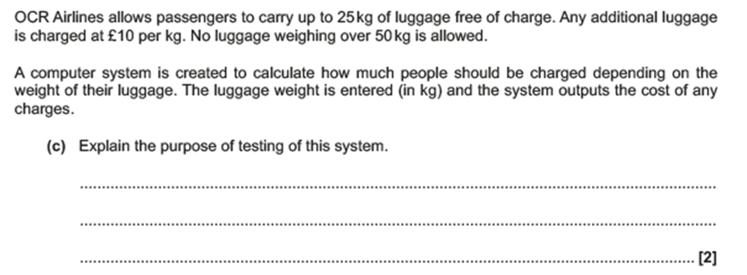
2.3 Testing

Slide 19
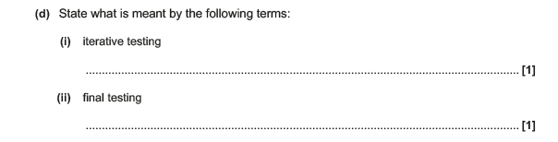
2.3 Testing

Slide 20
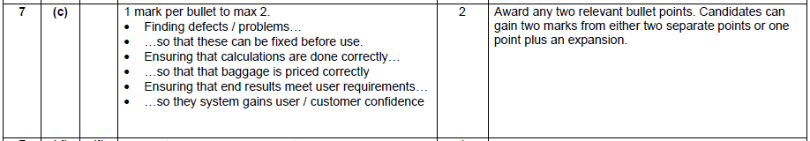
2.3 Testing

Slide 21

2.3 Testing

Slide 22
2.3 Testing

Slide 23
2.3 Testing

Slide 24
2.3 Testing

Slide 25
2.3 Error Types
When we create code we can have a range of different errors.
Do you remember any?

Slide 26
2.3 Error Types
Logical
Syntax
Runtime

Slide 27
2.3 Error Types
What is syntax?
What is meant by a syntax error?

Slide 28
2.3 Error Types
What is syntax?
Syntax are the codes that you need to use to follow the rules of the language.
What is meant by a syntax error?

Slide 29
2.3 Error Types
What is syntax?
Syntax are the codes that you need to use to follow the rules of the language.
What is meant by a syntax error?
A syntax error is when you break these rules.

Slide 30
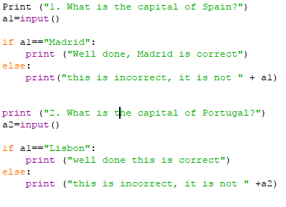
2.3 Error Types
Syntax
Logical
Runtime

Slide 31
2.3 Error Types
Syntax
Logical
Runtime

Slide 32

2.3 Error Types
Syntax
Logical
Runtime

Slide 33
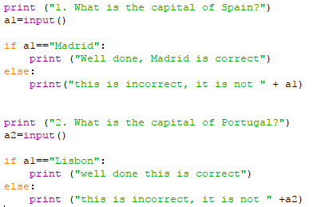
2.3 Error Types
Syntax
Logical
Runtime

Slide 34
2.3 Error Types
Syntax
Logical
Runtime

Slide 35

2.3 Error Types
Syntax
Logical
Runtime

Slide 36
2.3 Error Types
Logical error – not an error with the code, so the program will run.
The hardest to detect.
An error with how the programmer has written the code.
Programmer error

Slide 37
2.3 Error Types
Logical error – not an error with the code, so the program will run.
The hardest to detect.
An error with how the programmer has written the code.
Programmer error.

Slide 38
2.3 Error Types
Vehicles = [car, bus, bike]
Print vehicle([2])
We want to print out Bus.
What is the error here?

Slide 39
2.3 Error Types
Vehicles = [car, bus, bike]
Print vehicle([2])
This prints out “bike”.

Slide 40
2.3 Error Types
Vehicles = [car, bus, bike]
Print vehicle([2])
This prints out “bike”.

Slide 41
2.3 Error Types
Vehicles = [car, bus, bike]
Print vehicle([1])
This prints out “bike”.

Slide 42
2.3 Error Types
State a key difference between a logical and a syntax error.

Slide 43
2.3 Error Types
State a key difference between a logical and a syntax error.
Programmer / Identified

Slide 44
2.3 Error Types
Syntax
Logical
Runtime
A run time error occurs only once the program is complete and executed on the computer.
Why might this happen?

Slide 45
2.3 Error Types
Syntax
Logical
Runtime
Because…
Not enough hardware (e.g. not enough memory to run the program)
Computer trying to complete code it cannot complete (infinite loop)

Slide 46
2.3 Error Types
Syntax
Logical
Runtime
Because…
Not enough hardware (e.g. not enough memory to run the program)
Computer trying to complete code it cannot complete (infinite loop)

Slide 47
2.3 Error Types
Syntax
Logical
Runtime
Because…
Not enough hardware (e.g. not enough memory to run the program)
Computer trying to complete code it cannot complete (infinite loop)

Slide 48
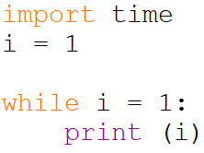
2.3 Error Types
Syntax
Logical
Runtime

Slide 49
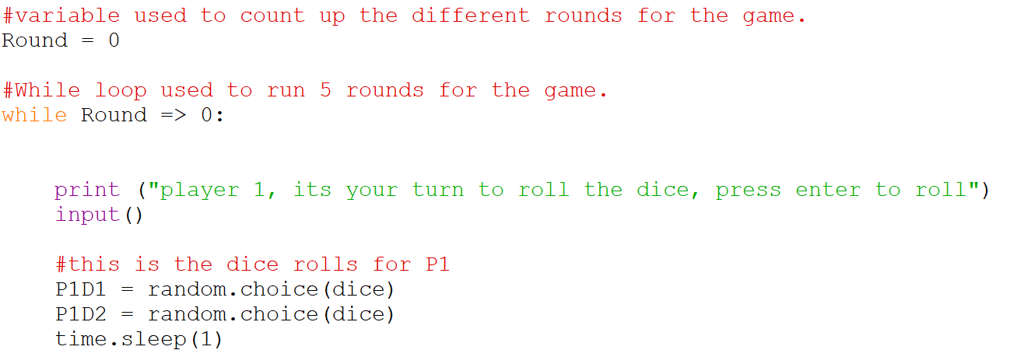
2.3 Error Types
Syntax
Logical
Runtime

Slide 50
2.3 Error Types
Syntax
Logical
Runtime

Slide 51
2.3 Error Types
Syntax
Logical
Runtime

Slide 52
2.3 Error Types
Joan has ran her program and it has informed her that she has a syntax error. Explain what a syntax error is. [2]

Slide 53
2.3 Error Types
Explain the difference between a logical error and a runtime error. [2]

