Slide 1
OCR GCSE (9–1) in Computer Science (J277)
Programming Fundamentals
This pack is intended for students to use once they have covered the GCSE content, either in preparation for their L1 & L2 exam, or more likely alongside year 2 of the course to improve fluency, recall and pace on GCSE topics. It could be used as lesson starters, or supplied to students for independent use.

Slide 2
Bell Work
What are the two types of sub-program? Complete the mind map below.
Can be user defined or p__-e_______.
Sub-programs
P________
F_______
D___ n__ output a value.
A_____ outputs a value.

Slide 3
Bell Work
What are the two types of sub-program? Complete the mind map below.
Can be user defined or pre-existing.
Sub-programs
Procedure
Function
Does not output a value.
Always outputs a value.

Slide 4
Learn about handling files in a program.
Learn about calling files in a program.
State how to call a file in a program.
Explain the key terms used to edit a file.
Complete exam questions based on calling files.

Slide 5
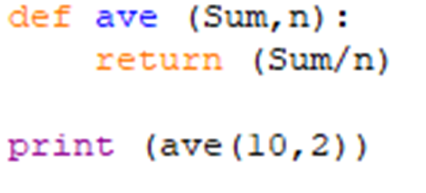
2.2 Sub-Programs
Parameters
Arguments

Slide 6
2.2 Sub-Programs
Parameters – these are the names of the variable in the program. (Sum,n)
Arguments

Slide 7
2.2 Sub-Programs
Parameters – these are the names of the variable in the program. (Sum,n)
Arguments

Slide 8
2.2 Sub-Programs
Parameters – these are the names of the variable in the program. (Sum,n)
Arguments – these are the actual data values that are “passed in” to the sub-program. (10,2)

Slide 9
2.2 Sub-Programs
Parameters – these are the names of the variable in the program. (Sum,n)
Arguments – these are the actual data values that are “passed in” to the sub-program. (10,2)

Slide 10
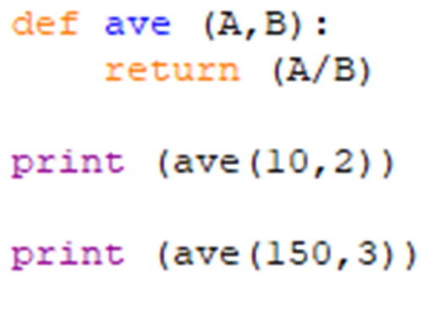
2.2 Sub-Programs
Is the program below a function or a procedure?
What will the sub-program do once the code is run?
10 / 2 =
150 / 3 =

Slide 11
2.2 Sub-Programs
Is the program below a function or a procedure?
What will the sub-program do once the code is run?
10 / 2 = 5
150 / 3 = 5

Slide 12
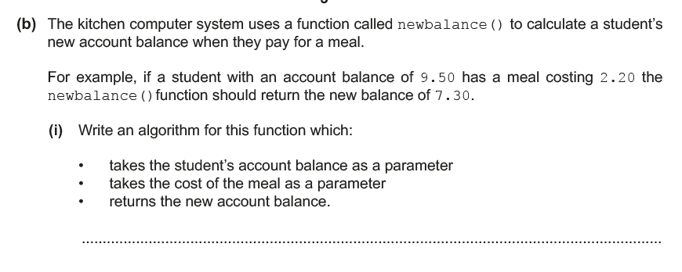
2.2 Sub-programs

Slide 13
2.2 Sub-programs
First step – identify if this is a function or not. You won’t be asked to write a procedure in the exam!

Slide 14
2.2 Sub-programs

Slide 15
2.2 Sub-programs
Second step – identify the name of the function. Copying this will form the basis of the first 2 marks!

Slide 16
2.2 Sub-programs

Slide 17
2.2 Sub-programs
Third step – work out the process. How does the example arrive at the answer £7.30?

Slide 18
2.2 Sub-programs
Third step – work out the process. How does the example arrive at the answer £7.30?

Slide 19
2.2 Sub-programs
9.50 – 2.20 = 7.30
We need to replace these values with parameter names.

Slide 20
2.2 Sub-programs
Function newbalance (balance, cost)
newcost = balance - cost
print newcost
End Function
1
2
3
4
5
6
What is the function called?

Slide 21
2.2 Sub-programs

Slide 22
2.2 Sub-programs
Function newbalance (balance, cost)
newcost = balance - cost
print newcost
End Function
2
3
4
5
6
Now give the parameters appropriate names.

Slide 23
2.2 Sub-programs

Slide 24
2.2 Sub-programs

Slide 25
2.2 Sub-programs
Function newbalance (balance, cost)
newcost = balance - cost
print newcost
End Function
4
5
6
Now work out the process part.

Slide 26
2.2 Sub-programs
Function newbalance (balance, cost)
newcost = balance - cost
print newcost
End Function
4
5
6
Now work out the process part.

Slide 27
2.2 Sub-programs
Function newbalance (balance, cost)
newcost = balance - cost
print newcost
End Function
6
Now output the result of the process.

Slide 28
2.2 Sub-programs
Function newbalance (balance, cost)
newcost = balance - cost
print newcost
End Function
Now output the result of the process.

Slide 29
2.2 Sub-programs
Function newbalance (balance, cost)
newcost = balance - cost
print newcost
End Function
Input / Process / Output

Slide 30
2.2 Sub-programs
Function newbalance (balance, cost)
newcost = balance - cost
print newcost
End Function
Input / Process / Output

Slide 31
2.2 Sub-programs
Function newbalance (balance, cost)
newcost = balance - cost
print newcost
End Function
Input / Process / Output

Slide 32
2.2 Sub-programs
Function newbalance (balance, cost)
newcost = balance - cost
print newcost
End Function
Input / Process / Output

Slide 33
2.2 Sub-programs

Slide 34
2.2 Sub-programs
Alan wants to create a sub-program that will work out the average of any 3 test scores that will be inputted.
For example, if the test scores are 3, 7 and 5, the sub-program will return 5.
The system uses a function called TestAverage.
Write an algorithm that:
- takes the 3 scores as a parameter
- performs a calculation to work out the average
- outputs the average

Slide 35
2.2 Sub-programs
1
2
Function TestAverage (A1, A2, A3)
Average = (A1 + A2 + A3) / 3
return Average
End Function
3
4

Slide 36
2.2 Sub-programs
1
2
Function TestAverage (A1, A2, A3)
Average = (A1 + A2 + A3) / 3
return Average
End Function
3
4
1st mark for naming the function.
2nd mark for creating parameters to input.
3rd mark for creating the process.
4th mark for outputting the result.

Slide 37
2.2 Sub-programs
Alan wants to create a sub-program that will work out the average of any 3 test scores that will be inputted.
For example, if the test scores are 3, 7 and 5, the sub-program will return 5.
The system uses a function called TestAverage.
Write an algorithm that:
- takes the 3 scores as a parameter
- performs a calculation to work out the average
- outputs the average

Slide 38
2.2 Sub-programs
Alan wants to create a sub-program that will work out the average of any 3 test scores that will be inputted.
For example, if the test scores are 3, 7 and 5, the sub-program will return 5.
The system uses a function called TestAverage.
Write an algorithm that:
- takes the 3 scores as a parameter
- performs a calculation to work out the average
- outputs the average

Slide 39
2.2 Sub-programs
2
Function TestAverage (A1, A2, A3)
Average = (A1 + A2 + A3) / 3
return Average
End Function
3
4
1st mark – TestAverage
2nd mark for creating parameters to input.
3rd mark for creating the process.
4th mark for outputting the result.

Slide 40
2.2 Sub-programs
Alan wants to create a sub-program that will work out the average of any 3 test scores that will be inputted.
For example, if the test scores are 3, 7 and 5, the sub-program will return 5.
The system uses a function called TestAverage.
Write an algorithm that:
- takes the 3 scores as a parameter
- performs a calculation to work out the average
- outputs the average

Slide 41
2.2 Sub-programs
Alan wants to create a sub-program that will work out the average of any 3 test scores that will be inputted.
For example, if the test scores are 3, 7 and 5, the sub-program will return 5.
The system uses a function called TestAverage.
Write an algorithm that:
- takes the 3 scores as a parameter
- performs a calculation to work out the average
- outputs the average

Slide 42
2.2 Sub-programs
Function TestAverage (A1, A2, A3)
Average = (A1 + A2 + A3) / 3
return Average
End Function
3
4
1st mark – TestAverage
2nd mark – A1, A2, A3
3rd mark for creating the process.
4th mark for outputting the result.

Slide 43
2.2 Sub-programs
Alan wants to create a sub-program that will work out the average of any 3 test scores that will be inputted.
For example, if the test scores are 3, 7 and 5, the sub-program will return 5.
The system uses a function called TestAverage.
Write an algorithm that:
- takes the 3 scores as a parameter
- performs a calculation to work out the average
- outputs the average

Slide 44
2.2 Sub-programs
Alan wants to create a sub-program that will work out the average of any 3 test scores that will be inputted.
For example, if the test scores are 3, 7 and 5, the sub-program will return 5.
The system uses a function called TestAverage.
Write an algorithm that:
- takes the 3 scores as a parameter
- performs a calculation to work out the average
- outputs the average

Slide 45
2.2 Sub-programs
Function TestAverage (A1, A2, A3)
Average = (A1 + A2 + A3) / 3
return Average
End Function
4
1st mark – TestAverage
2nd mark – A1, A2, A3
3rd mark – (A1 + A2 + A3) / 3
4th mark for outputting the result.

Slide 46
2.2 Sub-programs
Alan wants to create a sub-program that will work out the average of any 3 test scores that will be inputted.
For example, if the test scores are 3, 7 and 5, the sub-program will return 5.
The system uses a function called TestAverage.
Write an algorithm that:
- takes the 3 scores as a parameter
- performs a calculation to work out the average
- outputs the average

Slide 47
2.2 Sub-programs
Alan wants to create a sub-program that will work out the average of any 3 test scores that will be inputted.
For example, if the test scores are 3, 7 and 5, the sub-program will return 5.
The system uses a function called TestAverage.
Write an algorithm that:
- takes the 3 scores as a parameter
- performs a calculation to work out the average
- outputs the average

Slide 48
2.2 Sub-programs
Function TestAverage (A1, A2, A3)
Average = (A1 + A2 + A3) / 3
return Average
End Function
1st mark – TestAverage
2nd mark – A1, A2, A3
3rd mark – (A1 + A2 + A3) / 3
4th mark – Output Average

Slide 49
2.2 Sub-programs
Function TestAverage (A1, A2, A3)
Average = (A1 + A2 + A3) / 3
return Average
End Function
What are the parameters in this code called?
Why is this not a procedure?

Slide 50
2.2 Sub-programs
Alana uses the edges of triangles to work out the perimeter. She does this by adding up the length of each of the sides.
For example, a triangle that has sides of 11cm, 12cm and 5cm has a perimeter of 28cm.
Write a sub-program called Triangle that:
Takes each side of the triangle as a parameter.
Calculates the perimeter.
Works out the perimeter.

Slide 51
2.2 Sub-programs
1
Function Triangle (S1, S2, S3)
Perimeter = S1 + S2 + S3
return Perimeter
End Function
2
3
4
1st mark for naming the function.
2nd mark for creating parameters to input.
3rd mark for creating the process.
4th mark for outputting the result.

Slide 52
2.2 Sub-programs
2
Function Triangle (S1, S2, S3)
Perimeter = S1 + S2 + S3
return Perimeter
End Function
3
4
1st mark for Triangle
2nd mark for creating parameters to input.
3rd mark for creating the process.
4th mark for outputting the result.

Slide 53
2.2 Sub-programs
Function Triangle (S1, S2, S3)
Perimeter = A1 + A2 + A3
return Perimeter
End Function
3
4
1st mark for Triangle
2nd mark for (S1, S2, S3)
3rd mark for creating the process.
4th mark for outputting the result.

Slide 54
2.2 Sub-programs
Function Triangle (S1, S2, S3)
Perimeter = S1 + S2 + S3
return Perimeter
End Function
4
1st mark for Triangle
2nd mark for (S1, S2, S3)
3rd mark for S1 + S2 + S3 = Perimeter
4th mark for outputting the result.

Slide 55
2.2 Sub-programs
Function Triangle (S1, S2, S3)
Perimeter = S1 + S2 + S3
return Perimeter
End Function
1st mark for Triangle
2nd mark for (S1, S2, S3)
3rd mark for S1 + S2 + S3 = Perimeter
4th mark for outputting Perimeter

Slide 56
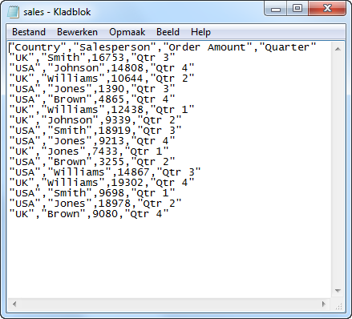
2.2 Programs

Slide 57
2.2 Programs
Open the text file
Close the text file
Read the text file – i.e. view it
Write to text file – i.e. edit it
Append the text file – i.e. add text at the end.

Slide 58
2.2 Programs
Open the text file
Close the text file
Read the text file – i.e. view it
Write to text file – i.e. edit it
Append the text file – i.e. add text at the end.

Slide 59
2.2 Programs
Open the text file
Close the text file
Read the text file – i.e. view it
Write to text file – i.e. edit it
Append the text file – i.e. add text at the end.

Slide 60
2.2 Programs
Open the text file
Close the text file
Read the text file – i.e. view it
Write to text file – i.e. edit it
Append the text file – i.e. add text at the end.

Slide 61
2.2 Programs
Open the text file
Close the text file
Read the text file – i.e. view it
Write to text file – i.e. edit it
Append the text file – i.e. add text at the end.

Slide 62
2.2 Programs
Open the text file
Close the text file
Read the text file – i.e. view it
Write to text file – i.e. edit it
Append the text file – i.e. add text at the end.

Slide 63
2.2 Programs
Open the text file
Close the text file
Read the text file – i.e. view it
Write to text file – i.e. edit it
Append the text file – i.e. add text at the end.

Slide 64
2.2 Programs
Open the text file
Close the text file
Read the text file – i.e. view it
Write to text file – i.e. edit it
Append the text file – i.e. add text at the end.

Slide 65
2.2 Programs
data_from_file
This line will be used to identify what you want to do with your file.

Slide 66
2.2 Programs
What do you think the link text below does?

Slide 67
2.2 Programs
The code will open the timetable file.

Slide 68
2.2 Programs
The code will open the timetable file.

Slide 69
2.2 Programs
The code will open the timetable file.

Slide 70
2.2 Programs
The code will open the timetable file.

Slide 71
2.2 Programs
What will this code do?

Slide 72
2.2 Programs
This code will close down any files that you have already opened.

Slide 73
2.2 Programs
This code will close down any files that you have already opened.

Slide 74
2.2 Programs
This code will close down any files that you have already opened.

Slide 75
2.2 Programs
This code will close down any files that you have already opened.

Slide 76
2.2 Programs
Once we have opened a program we must specify what we want to do to that program.
If you open up a PowerPoint what can you do to it?

Slide 77
2.2 Programs
Once we have opened a program we must specify what we want to do to that program.
If you open up a PowerPoint what can you do to it?
Read (view) it.
Write (edit) it.
Append (add to) it.
Read and write it.

Slide 78
2.2 Programs
What is the code below going to let us do?

Slide 79
2.2 Programs
This will allow us to open the timetable file and read the file. Read it just means to view it.

Slide 80
2.2 Programs
This will allow us to open the timetable file and read the file. Read it just means to view it. Can you edit this file?

Slide 81
2.2 Programs
Each time we open a text file we have to specify how we want to open it, with a mode:
r - Read mode, is used when the file is only being read
w - Write mode, is used to edit any existing information or write new information to the file
a - Append mode, is used to append (add) new information to the end of the text file
r+ - Read and Write mode, is used when both reading and writing are required

Slide 82
2.2 Programs
Each time we open a text file we have to specify how we want to open it, with a mode:
r - Read mode, is used when the file is only being read
w - Write mode, is used to edit any existing information or write new information to the file
a - Append mode, is used to append (add) new information to the end of the text file
r+ - Read and Write mode, is used when both reading and writing are required

Slide 83
2.2 Programs
Each time we open a text file we have to specify how we want to open it, with a mode:
r - Read mode, is used when the file is only being read
w - Write mode, is used to edit any existing information or write new information to the file
a - Append mode, is used to append (add) new information to the end of the text file
r+ - Read and Write mode, is used when both reading and writing are required

Slide 84
2.2 Programs
Each time we open a text file we have to specify how we want to open it, with a mode:
r - Read mode, is used when the file is only being read
w - Write mode, is used to edit any existing information or write new information to the file
a - Append mode, is used to append (add) new information to the end of the text file
r+ - Read and Write mode, is used when both reading and writing are required

Slide 85
2.2 Programs
Each time we open a text file we have to specify how we want to open it, with a mode:
r - Read mode, is used when the file is only being read
w - Write mode, is used to edit any existing information or write new information to the file
a - Append mode, is used to append (add) new information to the end of the text file
r+ - Read and Write mode, is used when both reading and writing are required

Slide 86
2.2 Programs
Each time we open a text file we have to specify how we want to open it, with a mode:
r - Read mode, is used when the file is only being read
w - Write mode, is used to edit any existing information or write new information to the file
a - Append mode, is used to append (add) new information to the end of the text file
r+ - Read and Write mode, is used when both reading and writing are required

Slide 87
2.2 Programs
Each time we open a text file we have to specify how we want to open it, with a mode:
r - Read mode, is used when the file is only being read
w - Write mode, is used to edit any existing information or write new information to the file
a - Append mode, is used to append (add) new information to the end of the text file
r+ - Read and Write mode, is used when both reading and writing are required
Create some pseudocode that opens the file Presentation.txt to append it.

Slide 88
2.2 Programs
Each time we open a text file we have to specify how we want to open it, with a mode:
r - Read mode, is used when the file is only being read
w - Write mode, is used to edit any existing information or write new information to the file
a - Append mode, is used to append (add) new information to the end of the text file
r+ - Read and Write mode, is used when both reading and writing are required
Create some pseudocode that opens the file Scores.txt to read/write it.

Slide 89
2.2 Programs
Complete the code below to open the Time.txt file to view it and then append it.
input time()
data_from_file = ____________________
data_from_file = ____________________
if time > 11.59
print “good afternoon”
else
print “good morning”

Slide 90
2.2 Programs
Complete the code below to open the Time.txt file to view it and then append it.
input time()
data_from_file = ____________________
data_from_file = ____________________
if time > 11.59
print “good afternoon”
else
print “good morning”
Open (“Time.txt”, “r”)

Slide 91
2.2 Programs
Complete the code below to open the Time.txt file to view it and then append it.
input time()
data_from_file = ____________________
data_from_file = ____________________
if time > 11.59
print “good afternoon”
else
print “good morning”
Open (“Time.txt”, “r”)
Open (“Time.txt”, “a”)

Slide 92
2.2 Programs
Explain what the following codes do when attached to data_from_file
= close()
= open (“timinigs.txt”, “r+”)
A)
B)

Slide 93
2.2 Programs
A)
Data_from_file = close()
This will allow the user to…
Data_from_file = open(“timings.txt”, “r+”)
This will allow the user to…
B)

Slide 94
2.2 Programs
Explain what the following codes do when attached to data_from_file
= close()
= open (“timings.txt”, “r+”)
A)
This will close the file that is open.
B)

Slide 95
2.2 Programs
Explain what the following codes do when attached to data_from_file
= close()
= open (“timings.txt”, “r+”)
A)
This will close the file that is open.
B)
This open the file timings.txt and will allow you to read it (view it) and write to it (edit it).

