Slide 1
OCR GCSE (9–1) in Computer Science (J277)
Programming Fundamentals
This pack is intended for students to use once they have covered the GCSE content, either in preparation for their L1 & L2 exam, or more likely alongside year 2 of the course to improve fluency, recall and pace on GCSE topics. It could be used as lesson starters, or supplied to students for independent use.

Slide 2
Bell Work
What is casting?
List down 3 different types of data used in a database.
What are the 3 key terms for writing SQL?

Slide 3
Learn about sub-programs in a program.
Learn about sub-programs in a program.
State what a sub-program is.
Explain sub-programs are used.
Write code for sub-programs.

Slide 4
2.2 Sub-Programs
What do you think is meant by the term sub-program?
Why do we have them?
How can they be used?

Slide 5
2.2 Sub-Programs
A sub-program (or sub-routine) is a program that is already written and can be used by the programmer to use in his program.

Slide 6
2.2 Sub-Programs
A sub-program is a piece of code that is created and then ‘called’ within a program. It allows us to use the piece of code multiple times, and makes our programs more structured and efficient.
A sub-program can also be called a sub-routine, a function, and a procedure.

Slide 7
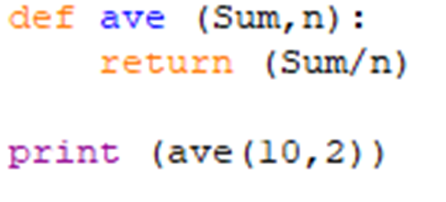
2.2 Sub-Programs
To write a program the programmer must define the program.
The name is given to the sub-program.

Slide 8
2.2 Sub-Programs
To write a program the programmer must define the program.
The name is given to the sub-program.

Slide 9
2.2 Sub-Programs
To write a program the programmer must define the program.
The name is given to the sub-program.

Slide 10
2.2 Sub-Programs
To write a program the programmer must define the program.
The name is given to the sub-program.

Slide 11
2.2 Sub-Programs
Variables are then used in the program to store data.
What are the variables of this program called?

Slide 12
2.2 Sub-Programs
Variables are then used in the program to store data.
What are the variables of this program called?
If they are variables, what are these?

Slide 13
2.2 Sub-Programs
In a sub-program we have the variable names and then the data that is actually “passed in” to the variables when the program is run.
This means we need two names for the data to be clear.

Slide 14
2.2 Sub-Programs
Parameters
Arguments

Slide 15
2.2 Sub-Programs
Parameters – these are the names of the variable in the program. (Sum,n)
Arguments

Slide 16
2.2 Sub-Programs
Parameters – these are the names of the variable in the program. (Sum,n)
Arguments

Slide 17
2.2 Sub-Programs
Parameters – these are the names of the variable in the program. (Sum,n)
Arguments – these are the actual data values that are “passed in” to the sub-program. (10,2)

Slide 18
2.2 Sub-Programs
Parameters – these are the names of the variable in the program. (Sum,n)
Arguments – these are the actual data values that are “passed in” to the sub-program. (10,2)

Slide 19
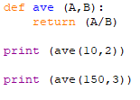
2.2 Sub-Programs
What are the parameters in this program called?
What are the arguments that are passed in?

Slide 20
2.2 Sub-Programs
Define the terms:
Sub-program
Arguments
Parameters

Slide 21
2.2 Sub-Programs
Sub-Programs
Procedures
Functions

Slide 22
2.2 Sub-Programs
Sub-Programs
Procedures
Functions
Doesn’t output a value.
Always outputs a value.

Slide 23
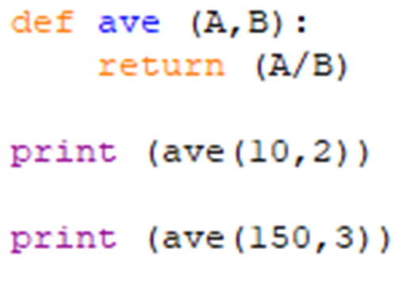
2.2 Sub-Programs
Is the program below a function or a procedure?
What will the sub-program do once the code is run?

Slide 24
2.2 Sub-Programs
Is the program below a function or a procedure?
What will the sub-program do once the code is run?
10 / 2 =
150 / 3 =

Slide 25
2.2 Sub-Programs
Is the program below a function or a procedure?
What will the sub-program do once the code is run?
10 / 2 = 5
150 / 3 = 50

Slide 26
2.2 Sub-Programs
Value is outputted. What is the sub-program that outputs a value?

Slide 27
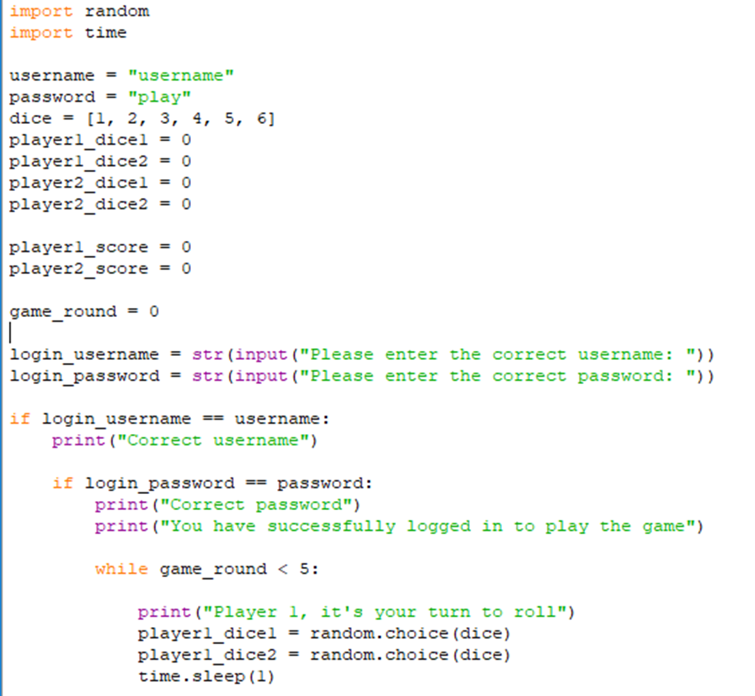
2.2 Sub-Programs
Sub-programs?

Slide 28
2.2 Sub-Programs
Sub-programs?

Slide 29
2.2 Sub-Programs
Sub-programs?
Do they output values?
What type of sub-programs are these?

Slide 30
2.2 Sub-Programs
Sub-programs?
No value outputted. These are procedures.
Did we make these?

Slide 31
2.2 Sub-Programs
Sub-programs?
No “Def” in the code so we did not make them.
These are pre-existing sub-programs.

Slide 32
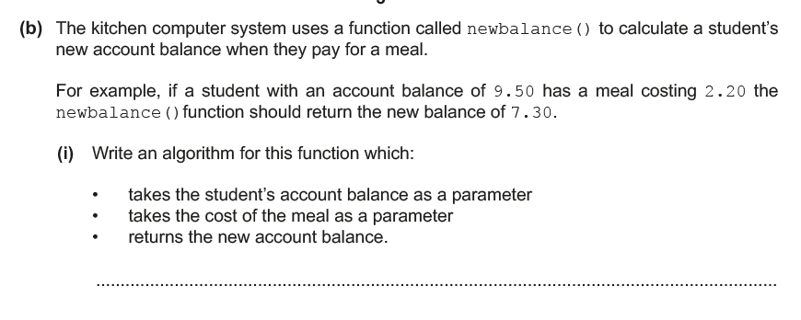
2.2 Sub-programs

Slide 33
2.2 Sub-programs
First step – identify if this is a function or not. You won’t be asked to write a procedure in the exam!

Slide 34
2.2 Sub-programs

Slide 35
2.2 Sub-programs
Second step – identify the name of the function. Copying this will form the basis of the first 2 marks!

Slide 36
2.2 Sub-programs

Slide 37
2.2 Sub-programs
Third step – work out the process. How does the example arrive at the answer £7.30?

Slide 38
2.2 Sub-programs
Third step – work out the process. How does the example arrive at the answer £7.30?

Slide 39
2.2 Sub-programs
9.50 – 2.20 = 7.30
We need to replace these values with parameter names.

Slide 40
2.2 Sub-programs
Function newbalance (balance, cost)
newcost = balance - cost
print newcost
End Function
1
2
3
4
5
6
What is the function called?

Slide 41
2.2 Sub-programs

Slide 42
2.2 Sub-programs
Function newbalance (balance, cost)
newcost = balance - cost
print newcost
End Function
2
3
4
5
6
Now give the parameters appropriate names.

Slide 43
2.2 Sub-programs

Slide 44
2.2 Sub-programs

Slide 45
2.2 Sub-programs
Function newbalance (balance, cost)
newcost = balance - cost
print newcost
End Function
4
5
6
Now work out the process part.

Slide 46
2.2 Sub-programs
Function newbalance (balance, cost)
newcost = balance - cost
print newcost
End Function
4
5
6
Now work out the process part.

Slide 47
2.2 Sub-programs
Function newbalance (balance, cost)
newcost = balance - cost
print newcost
End Function
6
Now output the result of the process.

Slide 48
2.2 Sub-programs
Function newbalance (balance, cost)
newcost = balance - cost
print newcost
End Function
Now output the result of the process.

Slide 49
2.2 Sub-programs
Function newbalance (balance, cost)
newcost = balance - cost
print newcost
End Function
Input / Process / Output

Slide 50
2.2 Sub-programs
Function newbalance (balance, cost)
newcost = balance - cost
print newcost
End Function
Input / Process / Output

Slide 51
2.2 Sub-programs
Function newbalance (balance, cost)
newcost = balance - cost
print newcost
End Function
Input / Process / Output

Slide 52
2.2 Sub-programs
Function newbalance (balance, cost)
newcost = balance - cost
print newcost
End Function
Input / Process / Output

Slide 53
2.2 Sub-programs

Slide 54
2.2 Sub-programs
Alan wants to create a sub-program that will work out the average of any 3 test scores that will be inputted.
For example, if the test scores are 3, 7 and 5, the sub-program will return 5.
The system uses a function called TestAverage.
Write an algorithm that:
- takes the 3 scores as a parameter
- performs a calculation to work out the average
- outputs the average

Slide 55
2.2 Sub-programs
1
2
Function TestAverage (A1, A2, A3)
Average = (A1 + A2 + A3) / 3
return Average
End Function
3
4

Slide 56
2.2 Sub-programs
1
2
Function TestAverage (A1, A2, A3)
Average = (A1 + A2 + A3) / 3
return Average
End Function
3
4
1st mark for naming the function.
2nd mark for creating parameters to input.
3rd mark for creating the process.
4th mark for outputting the result.

Slide 57
2.2 Sub-programs
Alan wants to create a sub-program that will work out the average of any 3 test scores that will be inputted.
For example, if the test scores are 3, 7 and 5, the sub-program will return 5.
The system uses a function called TestAverage.
Write an algorithm that:
- takes the 3 scores as a parameter
- performs a calculation to work out the average
- outputs the average

Slide 58
2.2 Sub-programs
Alan wants to create a sub-program that will work out the average of any 3 test scores that will be inputted.
For example, if the test scores are 3, 7 and 5, the sub-program will return 5.
The system uses a function called TestAverage.
Write an algorithm that:
- takes the 3 scores as a parameter
- performs a calculation to work out the average
- outputs the average

Slide 59
2.2 Sub-programs
2
Function TestAverage (A1, A2, A3)
Average = (A1 + A2 + A3) / 3
return Average
End Function
3
4
1st mark – TestAverage
2nd mark for creating parameters to input.
3rd mark for creating the process.
4th mark for outputting the result.

Slide 60
2.2 Sub-programs
Alan wants to create a sub-program that will work out the average of any 3 test scores that will be inputted.
For example, if the test scores are 3, 7 and 5, the sub-program will return 5.
The system uses a function called TestAverage.
Write an algorithm that:
- takes the 3 scores as a parameter
- performs a calculation to work out the average
- outputs the average

Slide 61
2.2 Sub-programs
Alan wants to create a sub-program that will work out the average of any 3 test scores that will be inputted.
For example, if the test scores are 3, 7 and 5, the sub-program will return 5.
The system uses a function called TestAverage.
Write an algorithm that:
- takes the 3 scores as a parameter
- performs a calculation to work out the average
- outputs the average

Slide 62
2.2 Sub-programs
Function TestAverage (A1, A2, A3)
Average = (A1 + A2 + A3) / 3
return Average
End Function
3
4
1st mark – TestAverage
2nd mark – A1, A2, A3
3rd mark for creating the process.
4th mark for outputting the result.

Slide 63
2.2 Sub-programs
Alan wants to create a sub-program that will work out the average of any 3 test scores that will be inputted.
For example, if the test scores are 3, 7 and 5, the sub-program will return 5.
The system uses a function called TestAverage.
Write an algorithm that:
- takes the 3 scores as a parameter
- performs a calculation to work out the average
- outputs the average

Slide 64
2.2 Sub-programs
Alan wants to create a sub-program that will work out the average of any 3 test scores that will be inputted.
For example, if the test scores are 3, 7 and 5, the sub-program will return 5.
The system uses a function called TestAverage.
Write an algorithm that:
- takes the 3 scores as a parameter
- performs a calculation to work out the average
- outputs the average

Slide 65
2.2 Sub-programs
Function TestAverage (A1, A2, A3)
Average = (A1 + A2 + A3) / 3
return Average
End Function
4
1st mark – TestAverage
2nd mark – A1, A2, A3
3rd mark – (A1 + A2 + A3) / 3
4th mark for outputting the result.

Slide 66
2.2 Sub-programs
Alan wants to create a sub-program that will work out the average of any 3 test scores that will be inputted.
For example, if the test scores are 3, 7 and 5, the sub-program will return 5.
The system uses a function called TestAverage.
Write an algorithm that:
- takes the 3 scores as a parameter
- performs a calculation to work out the average
- outputs the average

Slide 67
2.2 Sub-programs
Alan wants to create a sub-program that will work out the average of any 3 test scores that will be inputted.
For example, if the test scores are 3, 7 and 5, the sub-program will return 5.
The system uses a function called TestAverage.
Write an algorithm that:
- takes the 3 scores as a parameter
- performs a calculation to work out the average
- outputs the average

Slide 68
2.2 Sub-programs
Function TestAverage (A1, A2, A3)
Average = (A1 + A2 + A3) / 3
return Average
End Function
1st mark – TestAverage
2nd mark – A1, A2, A3
3rd mark – (A1 + A2 + A3) / 3
4th mark – Output Average

Slide 69
2.2 Sub-programs
Function TestAverage (A1, A2, A3)
Average = (A1 + A2 + A3) / 3
return Average
End Function
What are the parameters in this code called?
Why is this not a procedure?

Slide 70
2.2 Sub-programs
Statement | True | False
A parameter is a variable in a sub-program.
A sub-program is a program that can be defined or selected from a pre-existing list.
A function is a sub-program that passes out a value.

