Slide 1
OCR GCSE (9–1) in Computer Science (J277)
Programming Fundamentals
This pack is intended for students to use once they have covered the GCSE content, either in preparation for their L1 & L2 exam, or more likely alongside year 2 of the course to improve fluency, recall and pace on GCSE topics. It could be used as lesson starters, or supplied to students for independent use.

Slide 2
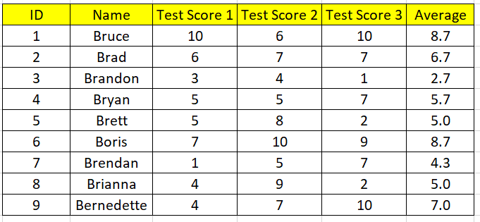
SQL
1
SELECT Name AND ID FROM Students WHERE Average > 8

Slide 3
SQL
2
SELECT ID FROM Students WHERE Test Score 1 < 3

Slide 4
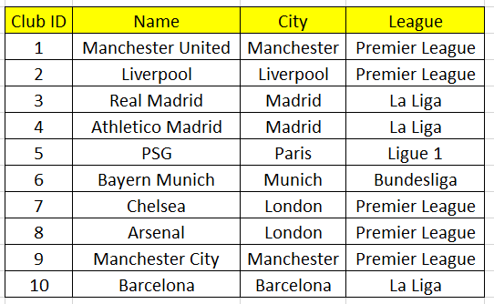
SQL
3
Create an SQL statement to select Bayern Munich.

Slide 5
SQL
4
Create an SQL statement to show only students who have scored more than 8 marks in Test 3.

Slide 8
Learn about SQL and databases.
Learn about SQL and databases.
State what a field and record is.
Explain the structure of SQL.
Complete exam questions on different SQL.

Slide 9
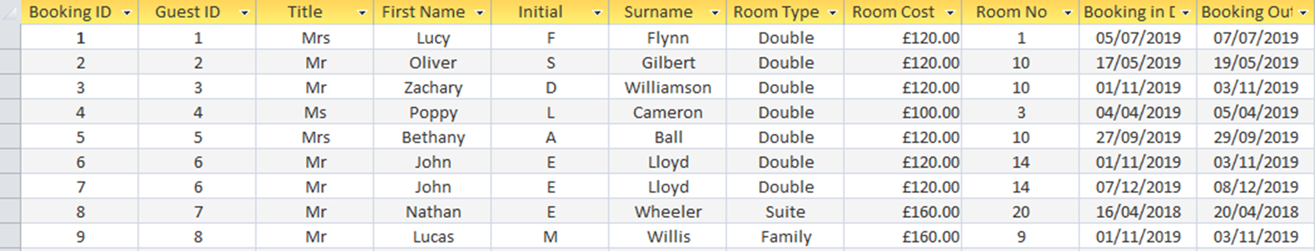
Databases

Slide 10
Databases
How many records does this table have? [1]

Slide 11
Databases
How many fields does the database below have? [1]

Slide 12
Databases
Explain the difference between records and fields. [2]

Slide 13
Databases
A record is…a set of data that is relevant to one data subject within a table.
A field is… the vertical category of data in a database.

Slide 14
SQL
Key terms include:
SELECT
FROM
WHERE
LIKE
AND / OR / NOT

Slide 15
SQL
Key terms include:
SELECT
FROM
WHERE
LIKE
AND / OR / NOT

Slide 16
SQL
Rooms Table
Write an SQL statement that shows all fields for bookings of the suite room.

Slide 17
SQL
Rooms Table
SELECT *

Slide 18
SQL
Rooms Table
SELECT * FROM Rooms

Slide 19
SQL
Rooms Table
SELECT * FROM Rooms WHERE Room Type = “Suite”

Slide 20
SQL
Rooms Table
SELECT * FROM Rooms WHERE Room Type = “Suite”

Slide 21
SQL
Rooms Table
Write an SQL statement that shows all fields for rooms that cost less than £120.

Slide 22
SQL
Rooms Table
SELECT *

Slide 23
SQL
Rooms Table
SELECT * FROM Rooms

Slide 24
SQL
Rooms Table
SELECT * FROM Rooms WHERE Room Cost < “£120”

Slide 25
SQL
Rooms Table
SELECT * FROM Rooms WHERE Room Cost < “£120”

Slide 26
SQL
Rooms Table
Create an SQL statement that shows on the Title, First Name of any person who has booked a room which costs more than £120.

Slide 27
SQL
Rooms Table
SELECT Title, First Name

Slide 28
SQL
Rooms Table
SELECT Title, First Name FROM Rooms

Slide 29
SQL
Rooms Table
SELECT Title, First Name FROM Rooms WHERE Room Cost > “£120”

Slide 30
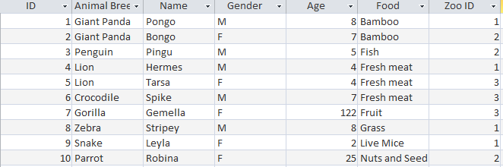
Animal Table
Create an SQL statement that selects the ID and Name of animals that eat Fresh meat.

Slide 31
Animal Table
SELECT ID, Name

Slide 32
Animal Table
SELECT ID, Name FROM Animal

Slide 33
Animal Table
SELECT ID, Name FROM Animal WHERE Food = “Fresh Meat”

Slide 34
Animal Table
SELECT ID, Animal Breed FROM Animal WHERE Age > “7”

Slide 35
Animal Table
1, Giant Panda and 8, Zebra

Slide 36
Animal Table
Create an SQL statement that selects all fields for animals who eat Fish OR Grass.

Slide 37
Animal Table
SELECT *

Slide 38
Animal Table
SELECT * FROM Animals

Slide 39
Animal Table
SELECT * FROM Animals WHERE Food = “Fish” OR “Grass”

Slide 40
Animal Table
Create an SQL statement that selects all fields for animals who are female AND are older than 6 years old.

Slide 41
Animal Table
SELECT *

Slide 42
Animal Table
SELECT * FROM Animal

Slide 43
Animal Table
SELECT * FROM Animal WHERE Gender = “F” AND Age > “6”

