Slide 1
OCR GCSE (9–1) in Computer Science (J277)
Programming Fundamentals
This pack is intended for students to use once they have covered the GCSE content, either in preparation for their L1 & L2 exam, or more likely alongside year 2 of the course to improve fluency, recall and pace on GCSE topics. It could be used as lesson starters, or supplied to students for independent use.

Slide 2
EQP
Loop | Will Loop Infinitely | Won’t Loop Infinitely
X = 5 While True print x Endwhile
Y = 0 While Y < 10 print y
X = 2 While x = 2 print x
Y = 1 While Y < 10 print Y Y = Y + 1

Slide 3
EQP
Loop | Will Loop Infinitely | Won’t Loop Infinitely
X = 5 While True print x Endwhile
Y = 0 While Y < 10 print y
X = 2 While x = 2 print x
Y = 1 While Y < 10 print Y Y = Y + 1

Slide 4
EQP
Loop | Will Loop Infinitely | Won’t Loop Infinitely
X = 5 While True print x Endwhile
Y = 0 While Y < 10 print y
X = 2 While x = 2 print x
Y = 1 While Y < 10 print Y Y = Y + 1

Slide 5
EQP
Loop | Will Loop Infinitely | Won’t Loop Infinitely
X = 5 While True print x Endwhile
Y = 0 While Y < 10 print y
X = 2 While x = 2 print x
Y = 1 While Y < 10 print Y Y = Y + 1

Slide 6
EQP
Loop | Will Loop Infinitely | Won’t Loop Infinitely
X = 5 While True print x Endwhile
Y = 0 While Y < 10 print y
X = 2 While x = 2 print x
Y = 1 While Y < 10 print Y Y = Y + 1

Slide 7
EQP
Loop | Will Loop Infinitely | Won’t Loop Infinitely
X = 5 While True print x Endwhile
Y = 0 While Y < 10 print y
X = 2 While x = 2 print x
Y = 1 While Y < 10 print Y Y = Y + 1

Slide 8
Learn about SQL and databases.
Learn about SQL and databases.
State what a field and record is.
Explain the structure of SQL.
Complete exam questions on different SQL.

Slide 9
Databases
Databases are simply organised tables of data.
They consist of fields and records.

Slide 10
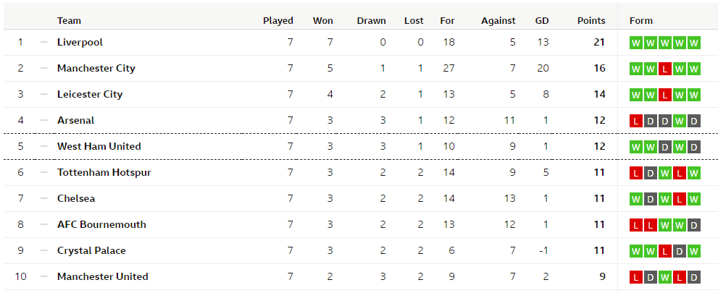
Databases

Slide 11
Databases

Slide 12
Databases
How many records does this table have? [1]

Slide 13
Databases
How many fields does the database below have? [1]

Slide 14
Databases
Explain the difference between records and fields. [2]

Slide 15
Databases
A record is…
A field is…

Slide 16
Databases
A record is…a set of data that is relevant to one data subject within a table.
A field is… the vertical category of data in a database.

Slide 17
SQL
Structured Query Language
Used to search for key of data in a database.

Slide 18
SQL
Key terms include:
SELECT
FROM
WHERE
LIKE
AND / OR / NOT

Slide 19
SQL
Key terms include:
SELECT
FROM
WHERE
LIKE
AND / OR / NOT

Slide 20
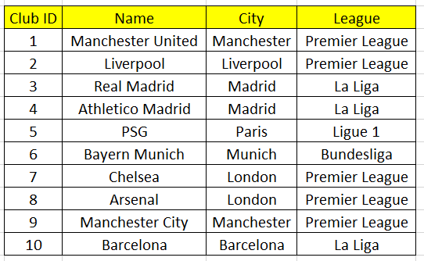
SQL
Table is called Teams

Slide 21
SQL
Table is called Teams
SELECT * FROM Teams WHERE City = “Manchester”

Slide 22
SQL
Table is called Teams
SELECT * FROM Teams WHERE City = “Manchester”

Slide 23
SQL
Table is called Teams
SELECT * FROM Teams WHERE City = “Manchester”
* = Wildcard – it will return all values.

Slide 24
SQL
Table is called Teams
SELECT * FROM Teams WHERE City = “Manchester”
* = Wildcard – it will return all values.

Slide 25
SQL
Table is called Teams
SELECT * FROM Teams WHERE League = “Premier League”
What does this search return?

Slide 26
SQL
Table is called Teams
SELECT * FROM Teams WHERE League = “Premier League”
What does this search return?

Slide 27
SQL
Table is called Teams
SELECT * FROM Teams WHERE League = “Premier League”
What does this search return?

Slide 28
SQL
Table is called Teams
What does this search return?
SELECT * FROM Teams WHERE League = “Premier League” OR City = “Madrid”

Slide 29
SQL
Table is called Teams
What does this search return?
SELECT club id, city FROM Teams WHERE League = “Premier League” OR City = “Madrid”

Slide 30
SQL
Table is called Teams
What does this search return?
SELECT club id, city FROM Teams WHERE city = “Liverpool”

Slide 31
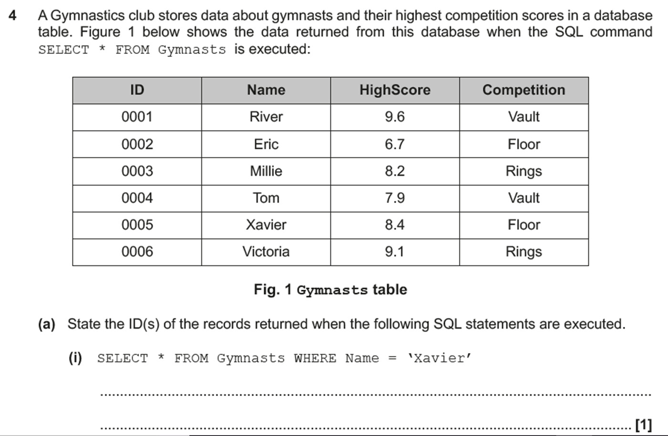
SQL

Slide 32
SQL

Slide 33
SQL

Slide 34
SQL
SELECT Name, Highscore FROM Gymnasts WHERE Competition = “Vault”

Slide 35
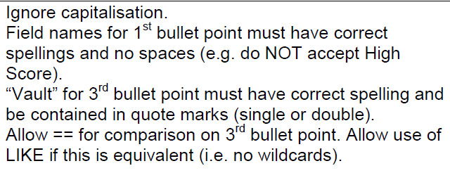
SQL

Slide 36
SQL

Slide 37
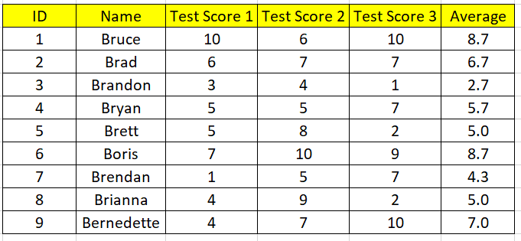
SQL
1
SELECT Name AND ID FROM Students WHERE Average > 8

Slide 38
SQL
2
SELECT ID FROM Students WHERE Test Score 1 < 3

Slide 39
SQL
3
Create an SQL statement to select Bayern Munich.

Slide 40
SQL
4
Create an SQL statement to show only students who have scored more than 8 marks in Test 3.

