Slide 1
OCR GCSE (9–1) in Computer Science (J277)
Programming Fundamentals
This pack is intended for students to use once they have covered the GCSE content, either in preparation for their L1 & L2 exam, or more likely alongside year 2 of the course to improve fluency, recall and pace on GCSE topics. It could be used as lesson starters, or supplied to students for independent use.

Slide 2
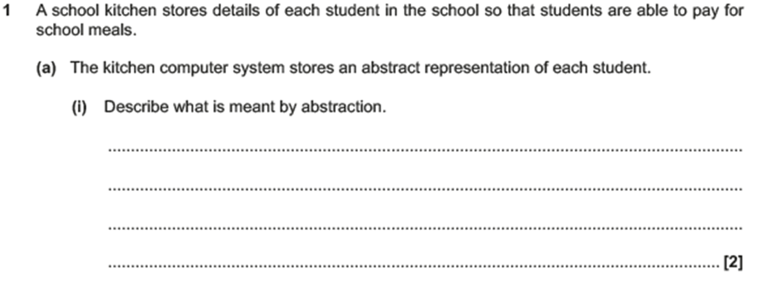
Bell Work

Slide 3
Abstraction

Slide 4
Abstraction

Slide 5
Abstraction

Slide 6
Learn about sequence and selection in algorithms.
Learn about sequence and selection in algorithms.
State what sequence and selection mean.
Explain how sequence and selection run in a program.
Complete exam questions on sequence and selection algorithms.

Slide 7
Algorithms
Can you define:
Sequence
Selection
Iteration
Use your dictionaries to help. Can you relate them to a Computing example?

Slide 8
Algorithms
Sequence is when all lines of code are run.
Selection is when a choice is made and only part of the code runs (IF statement).
Iteration is a loop, this is when the program will loop until a condition is met or the count stops.

Slide 9
Constructs
Constructs are used to construct a program.
What types of code did we use to create our NEA?

Slide 10
Constructs
Print
Inputs
Variables
IF statements
Loops
Constructs are use to create a program.

Slide 11
Constructs
Print
Inputs
Variables
IF statements
Loops
Sequence

Slide 12
Constructs
Print
Inputs
Variables
IF statements
Loops
Selection

Slide 13
Constructs
Print
Inputs
Variables
IF statements
Loops
Iteration

Slide 14
Constructs
Sequence code – how would you describe this?
Is all of this code executed?

Slide 15
Constructs
Sequence code is code that is executed.
Look at the following program.
Identify the sequence code in this program.

Slide 16
Constructs
Selection code – a decision is made on the code before the program executes some of the code.
IF statements – not all of the code is executed, why?

Slide 17
Constructs
Sequence or Selection?
1

Slide 18
Constructs
Sequence or Selection?
2

Slide 19
Constructs
Sequence or Selection?
3

Slide 20
Constructs
Sequence or Selection?
4

Slide 21
Constructs
Sequence or Selection?
5

Slide 22
Constructs
Sequence or Selection?
1

Slide 23
Constructs
Sequence or Selection?
1
Selection – there is an IF statement, this means only the code that meets the criteria will run.

Slide 24
Constructs
Sequence or Selection?
2

Slide 25
Constructs
Sequence or Selection?
2
Sequence – this code will run no matter what. There is no test here.

Slide 26
Constructs
Sequence or Selection?
3

Slide 27
Constructs
Sequence or Selection?
3
Sequence – this code will run no matter what. There is no test here.

Slide 28
Constructs
Sequence or Selection?
4

Slide 29
Constructs
Sequence or Selection?
4
Selection – ELIF provides a 3rd (or more) options for the IF statement (2 options).

Slide 30
Constructs
Sequence or Selection?
5

Slide 31
Constructs
Sequence or Selection?
5
Selection – there is an IF statement, this means only the code that meets the criteria will run.

Slide 32
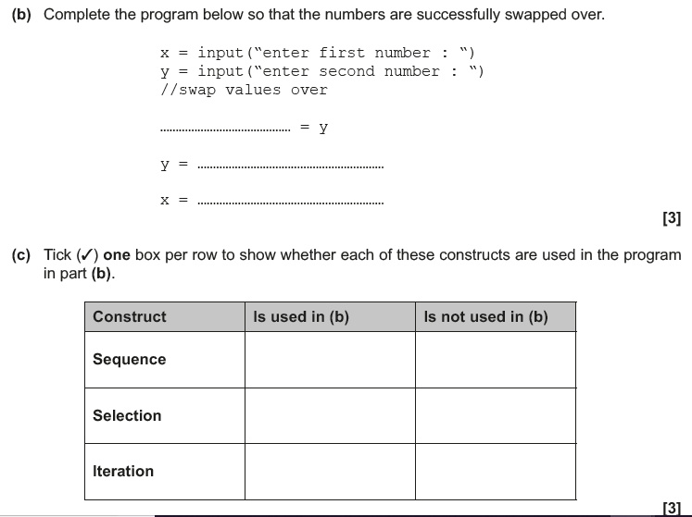
EQP

Slide 33
EQP

Slide 34
EQP

Slide 35
Constructs
Discuss the differences between sequence codes and selection codes in programming. [2]

