Slide 1
OCR GCSE (9–1) in Computer Science (J277)
Algorithms
This pack is intended for students to use once they have covered the GCSE content, either in preparation for their L1 & L2 exam, or more likely alongside year 2 of the course to improve fluency, recall and pace on GCSE topics. It could be used as lesson starters, or supplied to students for independent use.

Slide 2
Bell Work
Can you define:
Abstraction
Decomposition
Algorithmic Thinking

Slide 3
Learn about algorithms, abstraction and decomposition.
Learn about algorithms, abstraction and decomposition.
State what abstraction and decomposition is.
Explain how abstraction and decomposition apply to real life.
Complete exam questions on abstraction and decomposition.

Slide 4
Decomposition
What does the word decomposition mean?
Decompose
How can it be related to computer programming?

Slide 5
Decomposition
Each sub-problem needs to be able to be solved independently of others.
Where will this be used in the gaming industry?

Slide 6
Decomposition
Combine the sub-problems at the end of the task to solve the whole problem.
Where have we seen this before?

Slide 7
Decomposition

Slide 8
Decomposition
Define the term decomposition.

Slide 9
Abstraction
What do you think abstraction is?
What is abstract art?
How could abstraction be used in computer science?

Slide 10
Abstraction
Removing unnecessary detail from the problem.
Remove information you don’t need.
Simply the problem.

Slide 11
Abstraction
How is using Python an abstraction from machine code?
And the actual voltages that change?

Slide 12
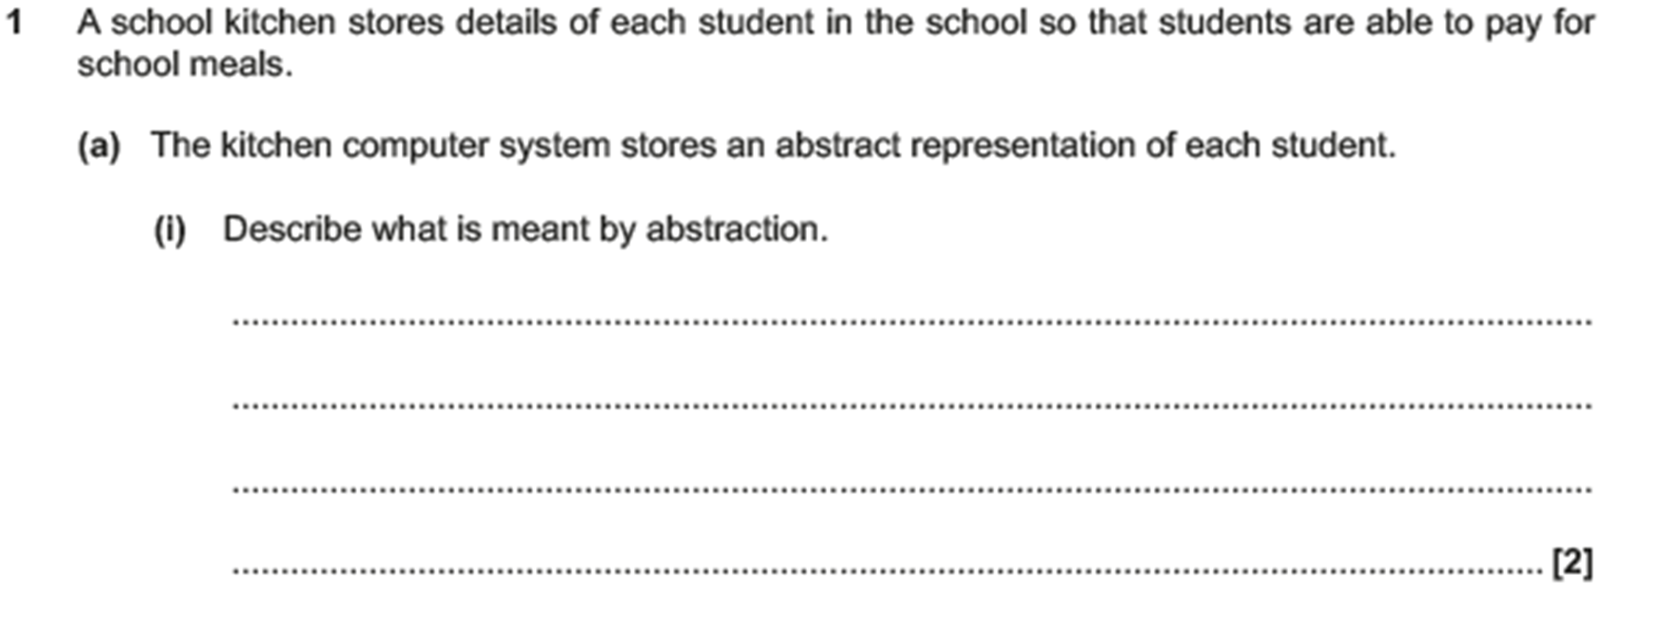
Abstraction

Slide 13
Abstraction

Slide 14
Abstraction

Slide 15
Abstraction

Slide 16
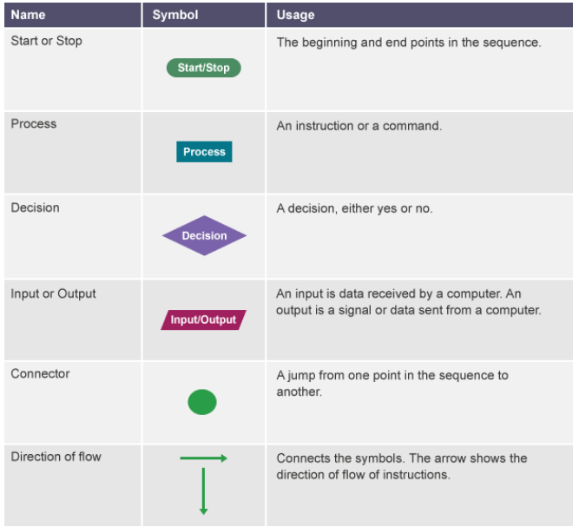
Flowcharts

Slide 17
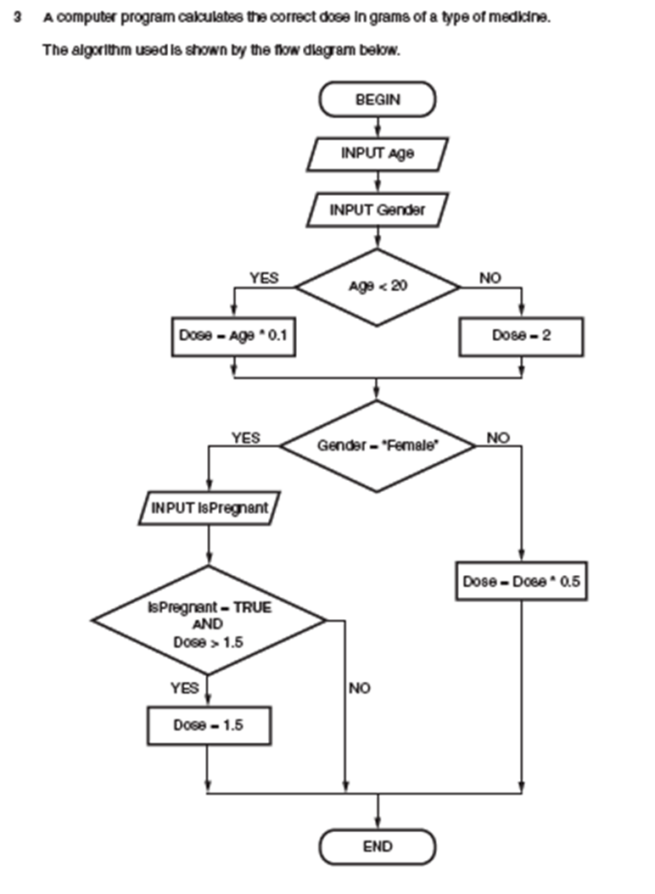
Flowcharts

Slide 18
Flowcharts

Slide 19
Flowcharts

Slide 20
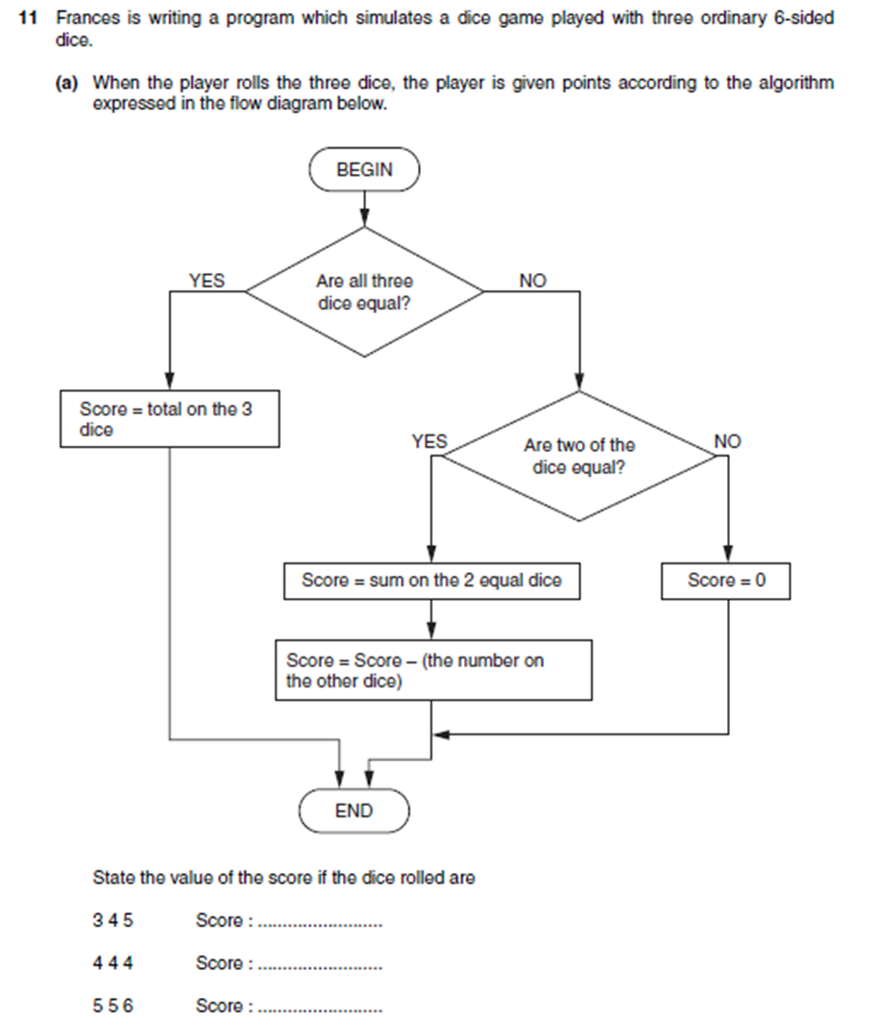
Flowcharts

Slide 21
Flowcharts

Slide 22
Flowcharts

