Slide 1
OCR GCSE (9–1) in Computer Science (J277)
Ethical, Legal, Cultural and Environmental Impacts of Digital Technology
This pack is intended for students to use once they have covered the GCSE content, either in preparation for their L1 & L2 exam, or more likely alongside year 2 of the course to improve fluency, recall and pace on GCSE topics. It could be used as lesson starters, or supplied to students for independent use.

Slide 2
Bell Work
What is the role of the operating system in a computer?
List down 1 advantage of using both a GUI and a command-line interface.

Slide 3
1.6 Develop my understanding of the different laws in Computing.
1.6 Develop my understanding of the different laws in Computing.
Understand what the different laws are in Computing.
State what the different laws cover in Computing.
Explain how the laws protect people.

Slide 4
1.5 Software
Identify two features the operating system may provide to help protect Alana’s computer. [2]
Allow different user accounts, giving access to own personal data that cannot be seen by another person.
It has anti-theft measures such as password protection
It can include encryption software that allows the user to protect their files.
It may include anti-virus software or a firewall to help protect against unauthorised users or software.

Slide 5
1.5 Software
Describe what is meant by device drivers. [2]
Devices drivers are pieces of software…
…that allow the OS and the hardware to communicate with each other.

Slide 6
1.5 Software
The OS will move the necessary programs/files to RAM when they are opened by the user.
The OS will remove the unwanted data on the RAM – positive or negative?
The OS divides memory into segments, so that when a program opens more instructions it has a set space that cannot be overwritten while the program is open.
The OS governs the movement of data from RAM and Virtual Memory.
The OS divides CPU time between the running programs/apps/processes.
The OS can prioritise CPU time for different programs in order for them to be processed efficiently.
Identify 3 ways an OS can aid multi-tasking. [3]

Slide 7
1.5 Software
Utility software is software that generally comes with a computer to aid the user.
They can be built into the OS.
Encryption software
Defragmentation software
Back up software
Compression software

Slide 8
1.5 Software
What is defragmentation software?
A defragmenter is a software utility that rearranges the fragments or discontinuous parts of each file stored on a computer hard disk so that the small, empty storage spaces adjacent to fragments can be used, effectively creating new storage space and possibly making file access faster.

Slide 9
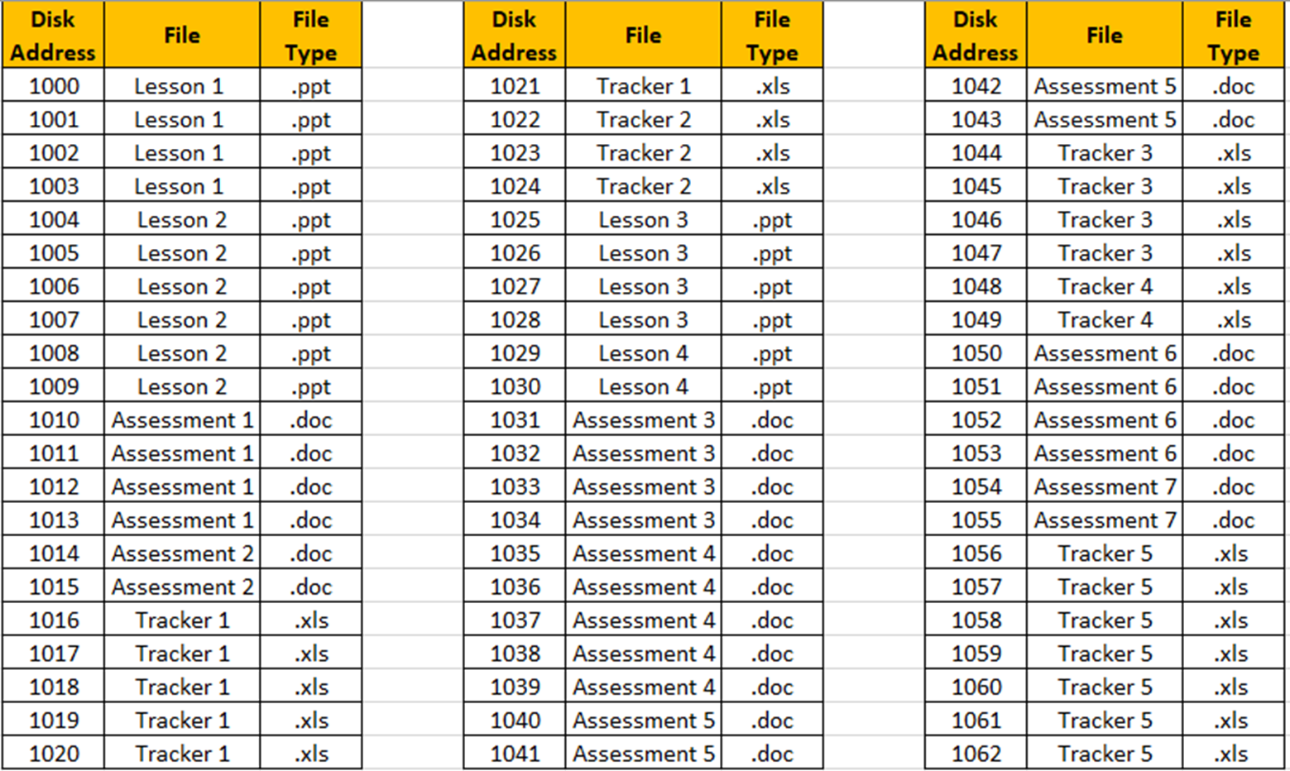
1.5 Software

Slide 10
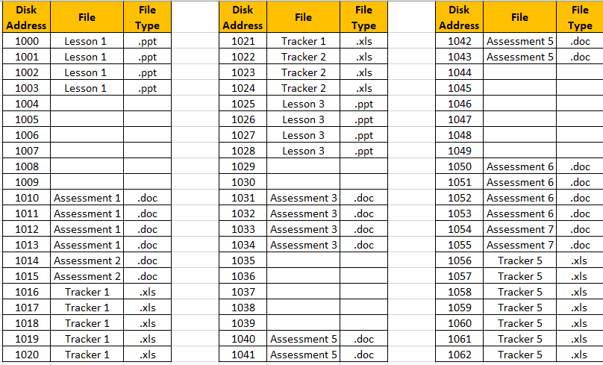
1.5 Software

Slide 11
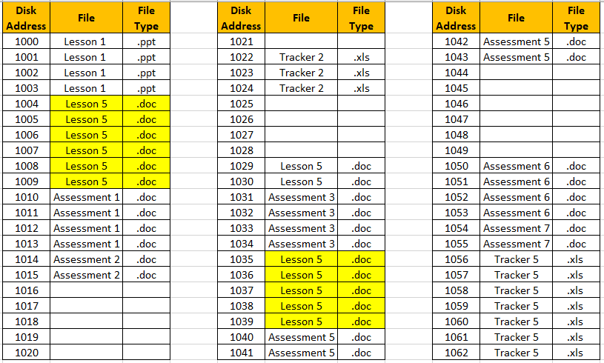
1.5 Software

Slide 12
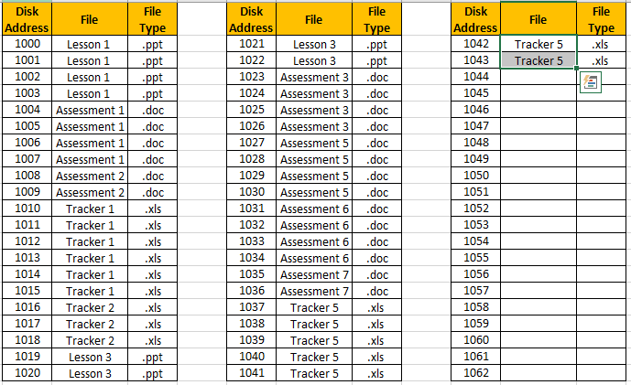
1.5 Software

Slide 13
1.5 Software
Original address location.
Address location after defragmentation.

Slide 14
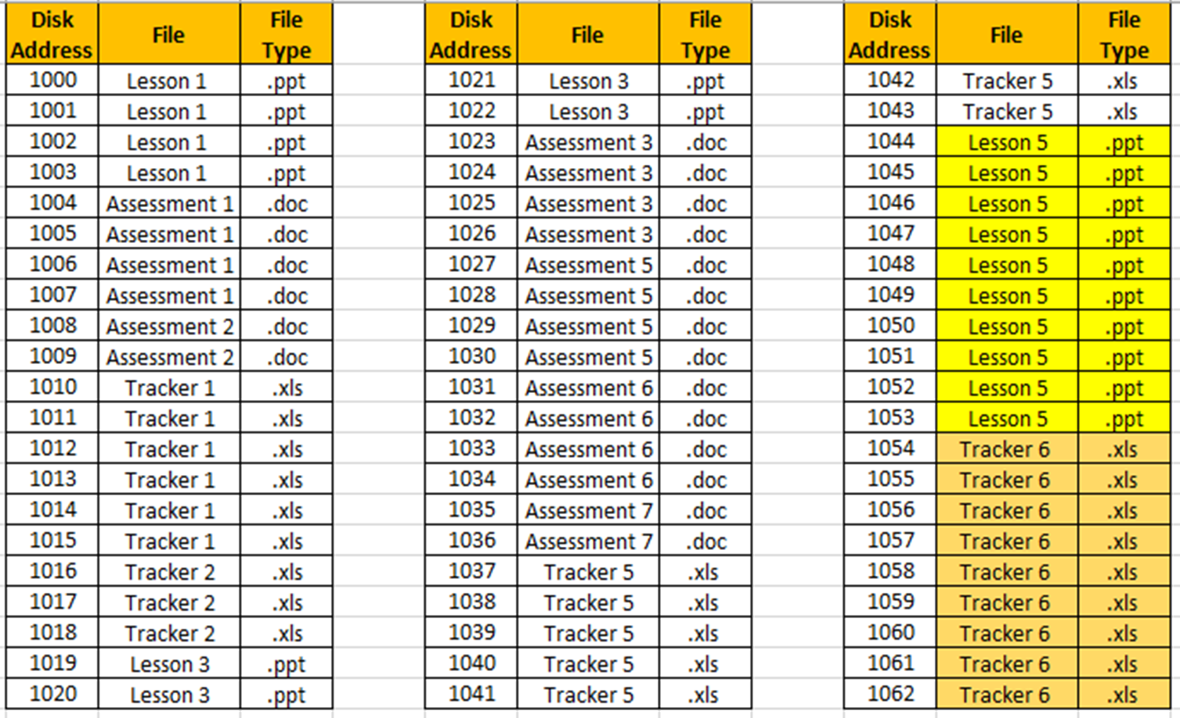
1.5 Software
New files that are saved can now be kept together.

Slide 15
1.5 Software
2 types of back up:
Full back up
Incremental back up

Slide 16
1.5 Software
State the differences between a full back up and an incremental back up.
I
Only backs up changed files. | Backs up all data and files.
Faster to restore the back up. | Takes less time to back up.
Must do this type of back up first. | Small number of files will have been changed.
Take less space to back up. | Safer as more past versions to revert to
F
F
I
F
I
I
F

Slide 17
1.5 Software
Encryption software – scrambles the data so that anyone who intercepts it cannot read it.
Defragmentation software – moves files to chronological addresses. Saves time finding files.
Compression software – reduces the size of files to make them take up less storage.
Back up software – backs up data in case it is lost or damaged.

Slide 18
1.6 ELCE
What crimes can be committed on a computer?
What do these crimes involve?

Slide 19
1.6 ELCE
Data Protection Act (1998)
Computer Misuse Act (1990)
Copyright Designs and Patents Act (1988)
Creative Commons Licence.

Slide 20
1.6 ELCE
How do you think the Data Protection Act helps citizens in computing?

Slide 21
1.6 ELCE
How do you think the Data Protection Act helps citizens in computing?
8 principles.

Slide 22
1.6 ELCE
How do you think the Data Protection Act helps citizens in computing?
8 principles.
They ensure that the holder of the data (e.g. a company) has to put in place measures to protect the persons data.

Slide 23
1.6 ELCE
How do you think the Data Protection Act helps citizens in computing?
8 principles.
They ensure that the holder of the data (e.g. a company) has to put in place measures to protect the persons data.
If these are broken the company can face large sanctions.

Slide 24
1.6 ELCE
How do you think the Data Protection Act helps citizens in computing?
8 principles.
They ensure that the holder of the data (e.g. a company) has to put in place measures to protect the persons data.
If these are broken the company can face large sanctions.

Slide 25
1.6 ELCE
How do you think the Data Protection Act helps citizens in computing?
8 principles.
They ensure that the holder of the data (e.g. a company) has to put in place measures to protect the persons data.
If these are broken the company can face large sanctions.

Slide 26
1.6 ELCE
Data must be kept secure;

Slide 27
1.6 ELCE
Data must be kept secure;
Data stored must be relevant;

Slide 28
1.6 ELCE
Data must be kept secure;
Data stored must be relevant;
Data stored must be kept no longer than necessary;

Slide 29
1.6 ELCE
Data must be kept secure;
Data stored must be relevant;
Data stored must be kept no longer than necessary;
Data stored must be kept accurate and up-to-date;

Slide 30
1.6 ELCE
Data must be kept secure;
Data stored must be relevant;
Data stored must be kept no longer than necessary;
Data stored must be kept accurate and up-to-date;

Slide 31
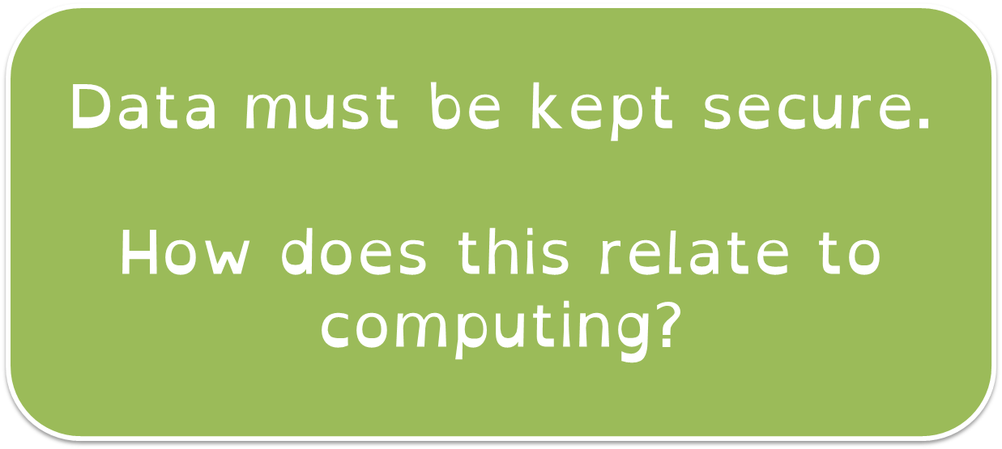
1.6 ELCE
Data must be kept secure;
Data stored must be relevant;
Data stored must be kept no longer than necessary;
Data stored must be kept accurate and up-to-date;

Slide 32
1.6 ELCE
Data must be kept secure;
Data stored must be relevant;
Data stored must be kept no longer than necessary;
Data stored must be kept accurate and up-to-date;
Data must not be transferred to countries without adequate data protection laws.

Slide 33
1.6 ELCE
Data must be kept secure;
Data stored must be relevant;
Data stored must be kept no longer than necessary;
Data stored must be kept accurate and up-to-date;
Data must not be transferred to countries without adequate data protection laws.

Slide 34
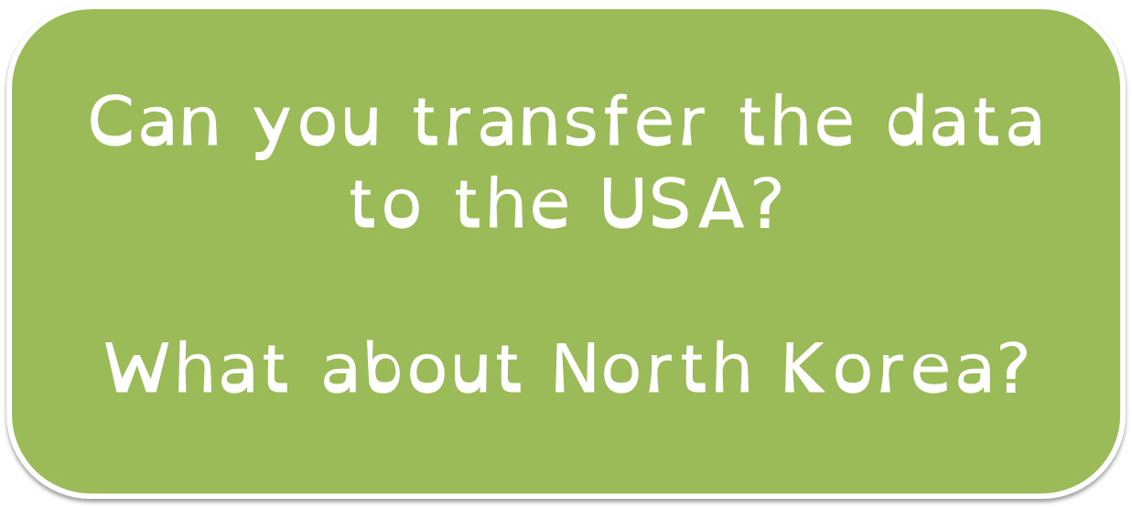
1.6 ELCE
Data must be kept secure;
Data stored must be relevant;
Data stored must be kept no longer than necessary;
Data stored must be kept accurate and up-to-date;
Data must not be transferred to countries without adequate data protection laws.

Slide 35
1.6 ELCE
https://www.bbc.co.uk/news/technology-44785151
£500k fine for Facebook.

Slide 36
1.6 ELCE
https://www.bbc.co.uk/news/technology-44785151
£500k fine for Facebook.

Slide 37
1.6 ELCE
Explain how the DPA protects people with regards to computer use.

Slide 38
1.6 ELCE
Explain how the DPA protects people with regards to computer use.
Secure / Transfer / Relevant

Slide 39
1.6 ELCE
Computer Misuse Act makes it illegal to view unauthorised access.
What is the common activity does this cover?

Slide 40
1.6 ELCE
Statement | Crime | Not a Crime
Editing software that is open-source (i.e. you have access to the source code).
Accessing data that you don’t have permission to, with the intent to commit a crime with that data.
Modifying a program where the source code is kept secret.
Accessing data that you do not have permission to access.

Slide 41
1.6 ELCE
Statement | Crime | Not a Crime
Editing software that is open-source (i.e. you have access to the source code).
Accessing data that you don’t have permission to, with the intent to commit a crime with that data.
Modifying a program where the source code is kept secret.
Accessing data that you do not have permission to access.

Slide 42
1.6 ELCE
Statement | Crime | Not a Crime
Editing software that is open-source (i.e. you have access to the source code).
Accessing data that you don’t have permission to, with the intent to commit a crime with that data.
Modifying a program where the source code is kept secret.
Accessing data that you do not have permission to access.

Slide 43
1.6 ELCE
Statement | Crime | Not a Crime
Editing software that is open-source (i.e. you have access to the source code).
Accessing data that you don’t have permission to, with the intent to commit a crime with that data.
Modifying a program where the source code is kept secret.
Accessing data that you do not have permission to access.

Slide 44
1.6 ELCE
Statement | Crime | Not a Crime
Editing software that is open-source (i.e. you have access to the source code).
Accessing data that you don’t have permission to, with the intent to commit a crime with that data.
Modifying a program where the source code is kept secret.
Accessing data that you do not have permission to access.

Slide 45
1.6 ELCE
What does the word unauthorised mean?
Can you think of situations where you might have unauthorised access in school?

Slide 46
1.6 ELCE
Unauthorised = not having official permission or approval.

Slide 47
1.6 ELCE
Unauthorised = not having official permission or approval.

Slide 48
1.6 ELCE
Unauthorised = not having official permission or approval.

Slide 49
1.6 ELCE
Alan has downloaded open office on his PC. The software is regarded as open-source software, meaning he can view and change the source code.
Alan is concerned that if he changes the source code then he will be committing a crime under the CMA (1990). Advice Alan regarding his position.

Slide 50
1.6 ELCE
Alan has downloaded open office on his PC. The software is regarded as open-source software, meaning he can view and change the source code.
Alan is concerned that if he changes the source code then he will be committing a crime under the CMA (1990). Advise Alan regarding his position.

Slide 51
1.6 ELCE
Alan has downloaded open office on his PC. The software is regarded as open-source software, meaning he can view and change the source code.
Alan is concerned that if he changes the source code then he will be committing a crime under the CMA (1990). Advise Alan regarding his position.
Not a crime under CMA – the software is open-source, so the owner allows people to change it.
Can you change MS Word source code?

Slide 52
1.6 ELCE
Alana enjoys white-hat hacking (this is where a competition is held, and the first person to view the secret code wins). Alana is worried that she will be breaking the law by competing in the hacking competition.
Advise Alana on her position as a white hat hacker (is she breaking the law – why?).

Slide 53
1.6 ELCE
Alana enjoys white-hat hacking (this is where a competition is held, and the first person to view the secret code wins). Alana is worried that she will be breaking the law by competing in the hacking competition.
Advise Alana on her position as a white hat hacker (is she breaking the law – why?).

Slide 54
1.6 ELCE
Alana enjoys white-hat hacking (this is where a competition is held, and the first person to view the secret code wins). Alana is worried that she will be breaking the law by competing in the hacking competition.
Advise Alana on her position as a white hat hacker (is she breaking the law – why?).
Not a crime under CMA – white hat hacking is legal as the person has permission to view the unauthorised material.

Slide 55
1.6 ELCE
What is copyright?
What does copyright stop?
China and Russia have no copyright laws – is this a positive or negative?

Slide 56
1.6 ELCE
Stops others from taking the property of your mind.
You wouldn’t steal someone else’s physical property, so why should you be allowed to steal their intellectual property?

Slide 57
1.6 ELCE
Creative Commons Licence.
A licence that allows you to distribute your work to others under copyright, allowing others to use your work free.
They cannot change or edit the work, or sell it on for money.

Slide 58
1.6 ELCE
https://www.youtube.com/watch?v=4ZvJGV6YF6Y
CCL

Slide 59
1.6 ELCE
Write a short summary on Copyright.

Slide 60
1.6 ELCE
Write a short summary on Copyright.
Restrictions / Uses / CCL

Slide 61
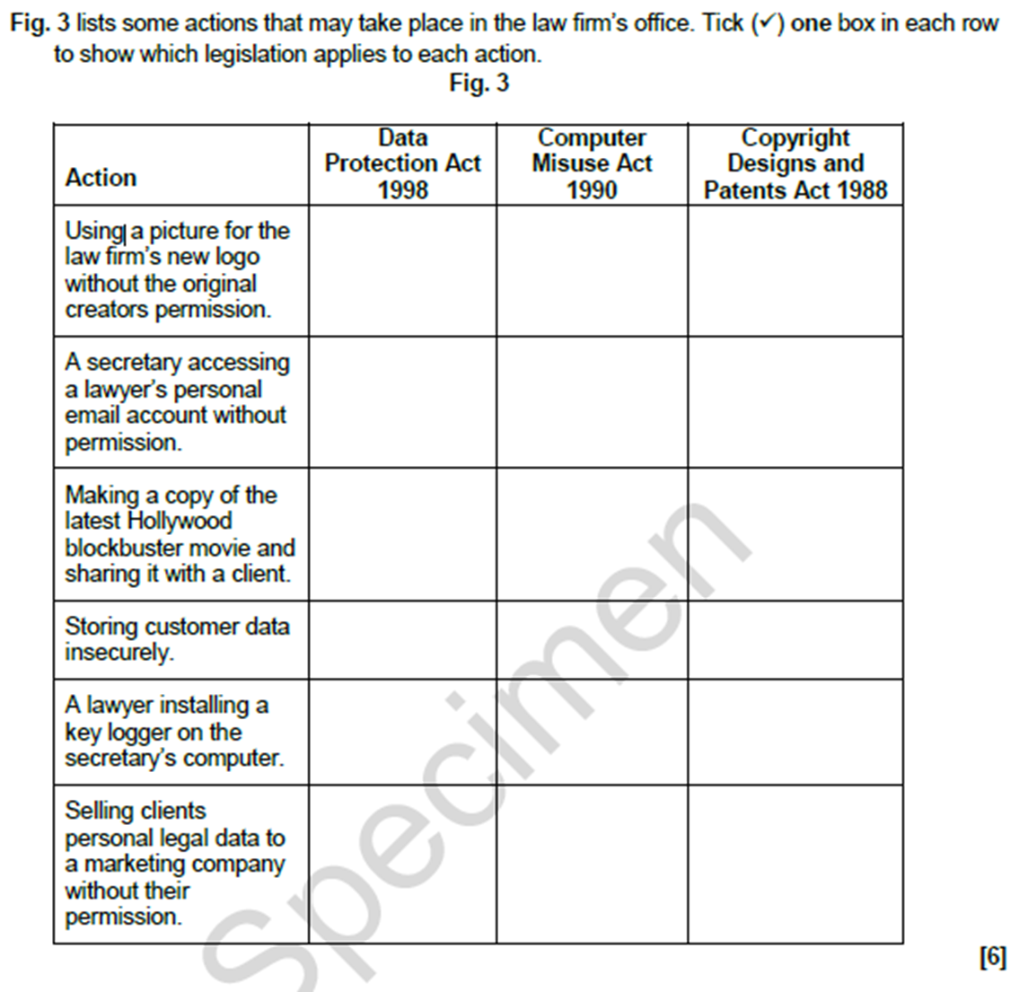
1.6 ELCE

