Slide 1
OCR GCSE (9–1) in Computer Science (J277)
Systems Software
This pack is intended for students to use once they have covered the GCSE content, either in preparation for their L1 & L2 exam, or more likely alongside year 2 of the course to improve fluency, recall and pace on GCSE topics. It could be used as lesson starters, or supplied to students for independent use.

Slide 2
Bell Work
What is the role of the operating system in a computer?
List down 1 advantage of using both a GUI and a command-line interface.

Slide 3
1.5 Learn about utility software in a computer system.
1.5 Learn about utility software in a computer system.
Understand what utility software is.
State the different types of utility software.
Explain the features of different utility software.

Slide 4
1.5 Software
You phone provides a user account for you to use.
So do the computers in school.
To gain access to it you must know the password.

Slide 5
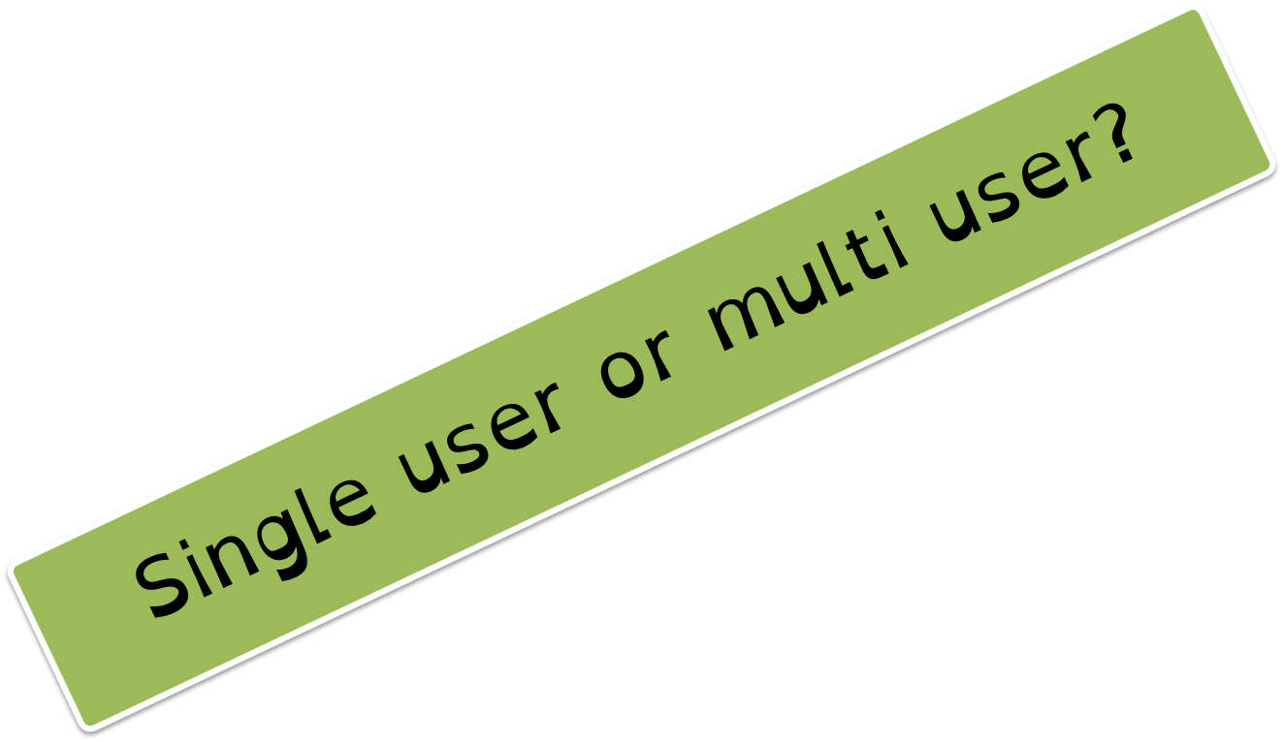
1.5 Software
You phone provides a user account for you to use.
So do the computers in school.
To gain access to it you must know the password.

Slide 6
1.5 Software
Encryption
Viruses
Firewall
How might the OS help?

Slide 7
1.5 Software
Allow the OS to communicate with hardware parts like memory (RAM) and the processor (CPU).
Software

Slide 8
1.5 Software
The OS works with RAM and CPU to ensure that programs/files that are open are able to work on the computer.

Slide 9
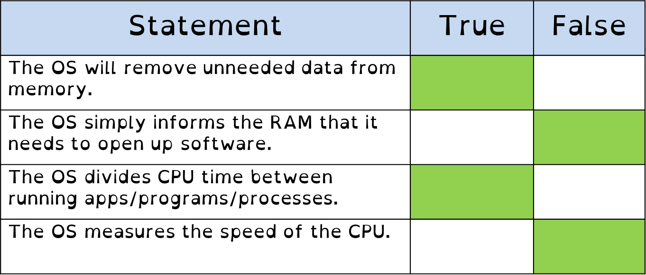
1.5 Software

Slide 10
1.5 Software
The OS will move the necessary programs/files to RAM when they are opened by the user.

Slide 11
CPU
RAM
SSD

Slide 12
CPU
RAM
SSD
The user clicks on the icon for Google Chrome to access the internet.

Slide 13
CPU
RAM
SSD
The OS now moves the data to the RAM so the data can be accessed by the CPU.

Slide 14
CPU
RAM
SSD
The OS now moves the data to the RAM so the data can be accessed by the CPU.

Slide 15
CPU
RAM
SSD
The OS now moves the data to the RAM so the data can be accessed by the CPU.

Slide 16
CPU
RAM
SSD
The OS now moves the data to the RAM so the data can be accessed by the CPU.

Slide 17
1.5 Software
The OS will move the necessary programs/files to RAM when they are opened by the user.
The OS will remove the unwanted data on the RAM – positive or negative?

Slide 18
CPU
RAM
SSD
Google Chrome is not working properly, so the user closes it down and selects internet explorer.

Slide 19
CPU
RAM
SSD
The OS moves Google Chrome from the RAM and places Internet Explorer there.

Slide 20
CPU
RAM
SSD
The OS moves Google Chrome from the RAM and places Internet Explorer there.

Slide 21
CPU
RAM
SSD
The OS moves Google Chrome from the RAM and places Internet Explorer there.

Slide 22
CPU
RAM
SSD
The OS moves Google Chrome from the RAM and places Internet Explorer there.

Slide 23
CPU
RAM
SSD
The OS moves Google Chrome from the RAM and places Internet Explorer there.

Slide 24
1.5 Software
The OS will move the necessary programs/files to RAM when they are opened by the user.
The OS will remove the unwanted data on the RAM – positive or negative?
The OS divides memory into segments, so that when a program opens more instructions it has a set space that cannot be overwritten while the program is open.

Slide 25
CPU
RAM
SSD
While IE is open, it’s section on the RAM cannot be overwritten. The OS makes sure of this.

Slide 26
RAM
SSD
While IE is open, it’s section on the RAM cannot be overwritten. The OS makes sure of this.

Slide 27
1.5 Software
The OS will move the necessary programs/files to RAM when they are opened by the user.
The OS will remove the unwanted data on the RAM – positive or negative?
The OS divides memory into segments, so that when a program opens more instructions it has a set space that cannot be overwritten while the program is open.
The OS governs the movement of data from RAM and Virtual Memory.

Slide 28
CPU
RAM
SSD
If the RAM is not big enough to run all the instructions being requested, the OS will create virtual memory on the storage drive.

Slide 29
CPU
RAM
SSD
If the RAM is not big enough to run all the instructions being requested, the OS will create virtual memory on the storage drive.

Slide 30
CPU
RAM
SSD
If the RAM is not big enough to run all the instructions being requested, the OS will create virtual memory on the storage drive.

Slide 31
CPU
RAM
SSD
If the RAM is not big enough to run all the instructions being requested, the OS will create virtual memory on the storage drive.

Slide 32
CPU
RAM
SSD
If the RAM is not big enough to run all the instructions being requested, the OS will create virtual memory on the storage drive.

Slide 33
CPU
RAM
SSD
If the RAM is not big enough to run all the instructions being requested, the OS will create virtual memory on the storage drive.

Slide 34
CPU
RAM
SSD
The SSD will be partitioned to act as RAM.

Slide 35
CPU
RAM
SSD
The SSD will be partitioned to act as RAM.

Slide 36
CPU
RAM
SSD
The SSD can now hold some of the instructions for RAM, and acts as RAM.

Slide 37
CPU
RAM
SSD
The SSD can now hold some of the instructions for RAM, and acts as RAM.

Slide 38
CPU
RAM
SSD
The SSD can now hold some of the instructions for RAM, and acts as RAM.

Slide 39
1.5 Software
The OS will move the necessary programs/files to RAM when they are opened by the user.
The OS will remove the unwanted data on the RAM – positive or negative?
The OS divides memory into segments, so that when a program opens more instructions it has a set space that cannot be overwritten while the program is open.
The OS governs the movement of data from RAM and Virtual Memory.
The OS divides CPU time between the running programs/apps/processes.

Slide 40
1.5 Software
The OS will move the necessary programs/files to RAM when they are opened by the user.
The OS will remove the unwanted data on the RAM – positive or negative?
The OS divides memory into segments, so that when a program opens more instructions it has a set space that cannot be overwritten while the program is open.
The OS governs the movement of data from RAM and Virtual Memory.
The OS divides CPU time between the running programs/apps/processes.
The OS can prioritise CPU time for different programs in order for them to be processed efficiently.

Slide 41
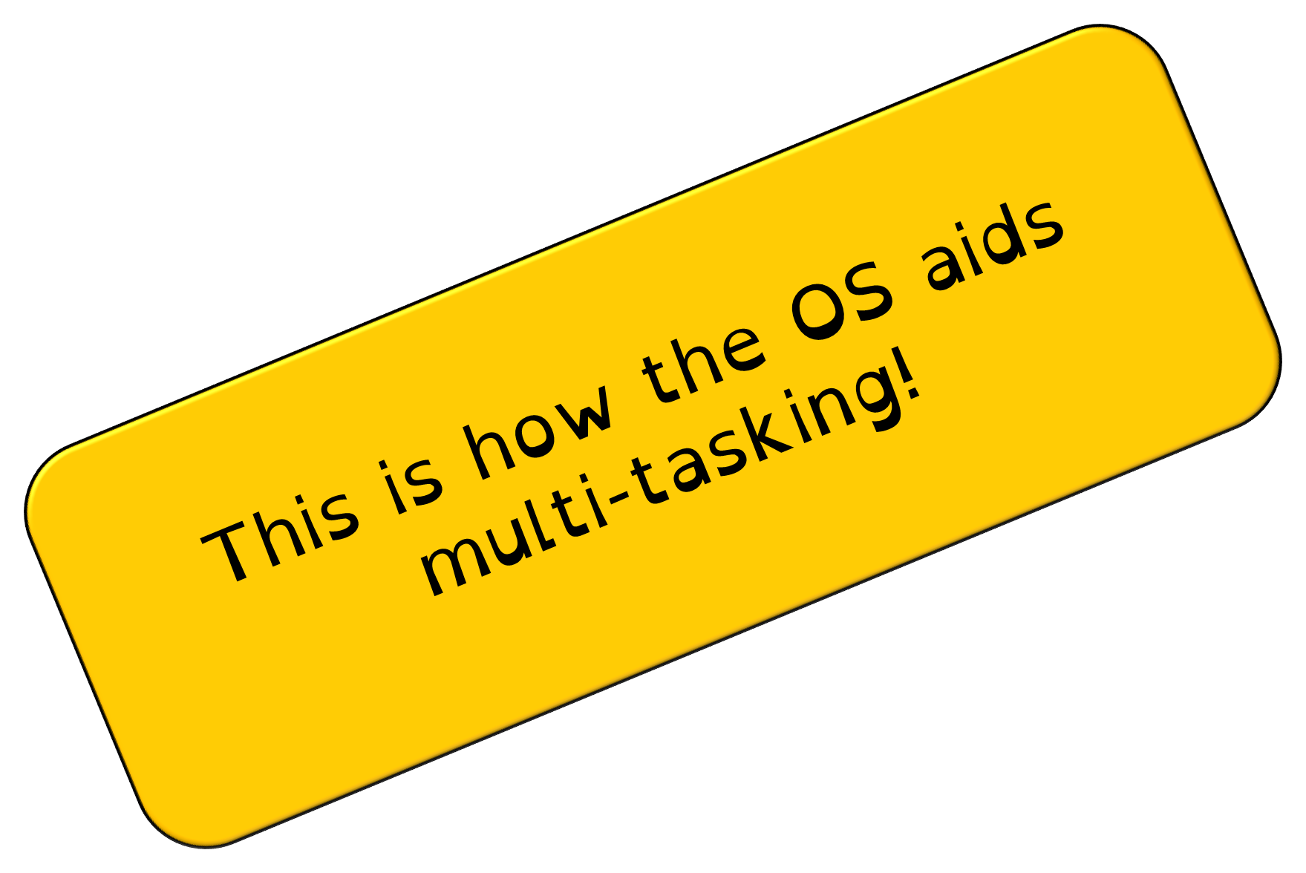
1.5 Software
The OS will move the necessary programs/files to RAM when they are opened by the user.
The OS will remove the unwanted data on the RAM – positive or negative?
The OS divides memory into segments, so that when a program opens more instructions it has a set space that cannot be overwritten while the program is open.
The OS governs the movement of data from RAM and Virtual Memory.
The OS divides CPU time between the running programs/apps/processes.
The OS can prioritise CPU time for different programs in order for them to be processed efficiently.

Slide 42
1.5 Software
Identify two features the operating system may provide to help protect Alana’s computer. [2]

Slide 43
1.5 Software
Identify two features the operating system may provide to help protect Alana’s computer. [2]
Allow different user accounts, giving access to own personal data that cannot be seen by another person.

Slide 44
1.5 Software
Identify two features the operating system may provide to help protect Alana’s computer. [2]
Allow different user accounts, giving access to own personal data that cannot be seen by another person.
It has anti-theft measures such as password protection

Slide 45
1.5 Software
Identify two features the operating system may provide to help protect Alana’s computer. [2]
Allow different user accounts, giving access to own personal data that cannot be seen by another person.
It has anti-theft measures such as password protection
It can include encryption software that allows the user to protect their files.

Slide 46
1.5 Software
Identify two features the operating system may provide to help protect Alana’s computer. [2]
Allow different user accounts, giving access to own personal data that cannot be seen by another person.
It has anti-theft measures such as password protection
It can include encryption software that allows the user to protect their files.
It may include anti-virus software or a firewall to help protect against unauthorised users or software.

Slide 47
1.5 Software
Describe what is meant by device drivers. [2]

Slide 48
1.5 Software
Describe what is meant by device drivers. [2]
Devices drivers are pieces of software…

Slide 49
1.5 Software
Describe what is meant by device drivers. [2]
Devices drivers are pieces of software…
…that allow the OS and the hardware to communicate with each other.

Slide 50
1.5 Software
Identify 3 ways an OS can aid multi-tasking. [3]

Slide 51
1.5 Software
The OS will move the necessary programs/files to RAM when they are opened by the user.
Identify 3 ways an OS can aid multi-tasking. [3]

Slide 52
1.5 Software
The OS will move the necessary programs/files to RAM when they are opened by the user.
The OS will remove the unwanted data on the RAM – positive or negative?
Identify 3 ways an OS can aid multi-tasking. [3]

Slide 53
1.5 Software
The OS will move the necessary programs/files to RAM when they are opened by the user.
The OS will remove the unwanted data on the RAM – positive or negative?
The OS divides memory into segments, so that when a program opens more instructions it has a set space that cannot be overwritten while the program is open.
Identify 3 ways an OS can aid multi-tasking. [3]

Slide 54
1.5 Software
The OS will move the necessary programs/files to RAM when they are opened by the user.
The OS will remove the unwanted data on the RAM – positive or negative?
The OS divides memory into segments, so that when a program opens more instructions it has a set space that cannot be overwritten while the program is open.
The OS governs the movement of data from RAM and Virtual Memory.
Identify 3 ways an OS can aid multi-tasking. [3]

Slide 55
1.5 Software
The OS will move the necessary programs/files to RAM when they are opened by the user.
The OS will remove the unwanted data on the RAM – positive or negative?
The OS divides memory into segments, so that when a program opens more instructions it has a set space that cannot be overwritten while the program is open.
The OS governs the movement of data from RAM and Virtual Memory.
The OS divides CPU time between the running programs/apps/processes.
Identify 3 ways an OS can aid multi-tasking. [3]

Slide 56
1.5 Software
The OS will move the necessary programs/files to RAM when they are opened by the user.
The OS will remove the unwanted data on the RAM – positive or negative?
The OS divides memory into segments, so that when a program opens more instructions it has a set space that cannot be overwritten while the program is open.
The OS governs the movement of data from RAM and Virtual Memory.
The OS divides CPU time between the running programs/apps/processes.
The OS can prioritise CPU time for different programs in order for them to be processed efficiently.
Identify 3 ways an OS can aid multi-tasking. [3]

Slide 57
1.5 Software
Utility software is software that generally comes with a computer to aid the user.
They can be built into the OS.
Does anyone know any common utility programs?

Slide 58
1.5 Software
Utility software is software that generally comes with a computer to aid the user.
They can be built into the OS.
Encryption software
Defragmentation software
Back up software
Compression software

Slide 59
1.5 Software
Utility software is software that generally comes with a computer to aid the user.
They can be built into the OS.
Encryption software
Defragmentation software
Back up software
Compression software

Slide 60
1.5 Software
What is defragmentation software?
What does fragment mean?
What does defragmentation do?

Slide 61
1.5 Software
What is defragmentation software?
A defragmenter is a software utility that rearranges the fragments or discontinuous parts of each file stored on a computer hard disk so that the small, empty storage spaces adjacent to fragments can be used, effectively creating new storage space and possibly making file access faster

Slide 62
1.5 Software
What is defragmentation software?
A defragmenter is a software utility that rearranges the fragments or discontinuous parts of each file stored on a computer hard disk so that the small, empty storage spaces adjacent to fragments can be used, effectively creating new storage space and possibly making file access faster.

Slide 63
1.5 Software
When saving documents to a hard disk drive the file is given an address.
The address is a number.

Slide 64
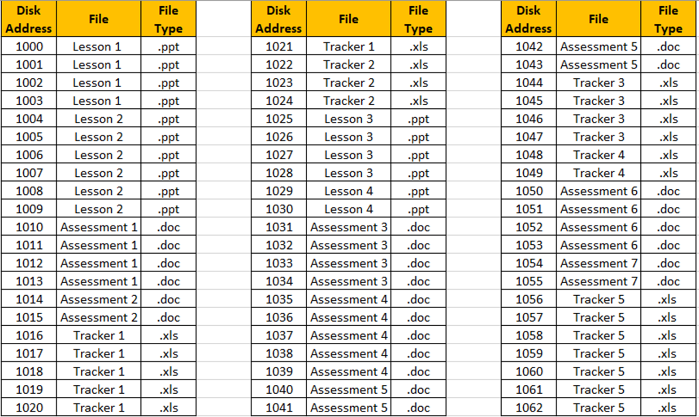
1.5 Software

Slide 65
1.5 Software

Slide 66
1.5 Software

Slide 67
1.5 Software

Slide 68
1.5 Software

Slide 69
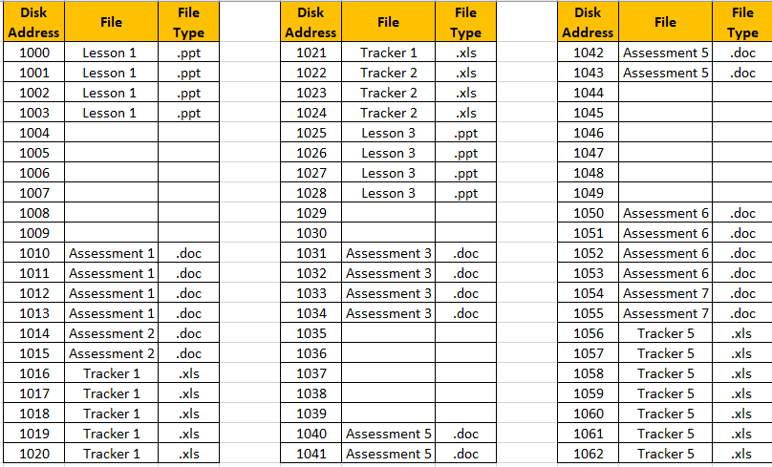
1.5 Software
I have now decided that some of the lessons and tasks I had planned were rubbish, and need to delete them to create better ones.

Slide 70
1.5 Software

Slide 71
1.5 Software

Slide 72
1.5 Software
I then create a new lesson and save this to my disk – this is with no defragmentation software.

Slide 73
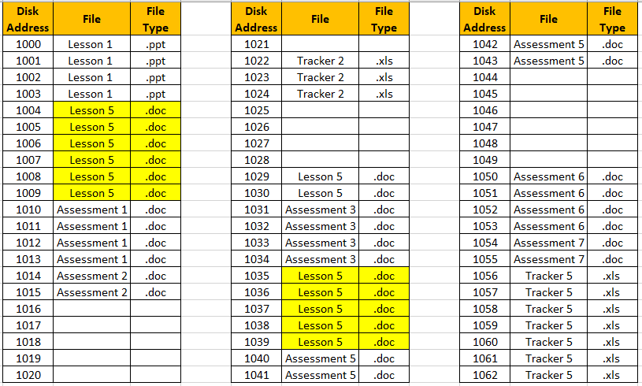
1.5 Software

Slide 74
1.5 Software
Lesson 5 is now saved over 2 different sections of location addresses.

Slide 75
1.5 Software
This will take the machine longer to find the file when it is required.

Slide 76
1.5 Software
How could defragmentation software help the computer be quicker?

Slide 77
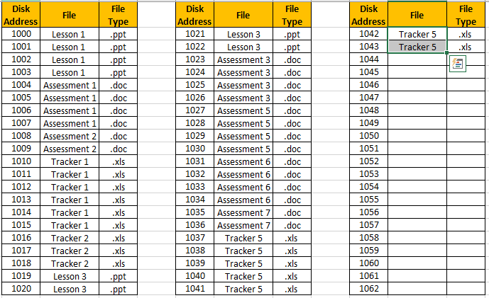
1.5 Software

Slide 78
1.5 Software
What has happened to the data here?

Slide 79
1.5 Software
Once old files are deleted, the defragmentation software has moved the saved files up in addresses.

Slide 80
1.5 Software
Original address location.
Address location after defragmentation.

Slide 81
1.5 Software
Original address location.
Address location after defragmentation.

Slide 82
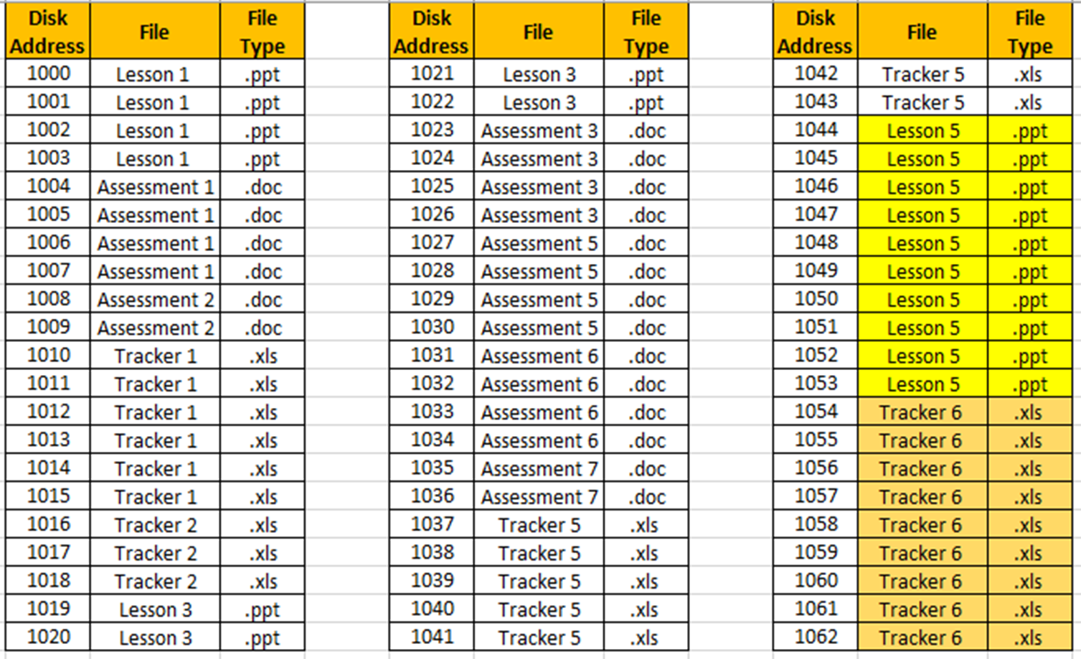
1.5 Software
New files that are saved can now be kept together.

Slide 83
1.5 Software
New files that are saved can now be kept together.

Slide 84
1.5 Software
Spaces
Documents saved at different addresses.

Slide 85
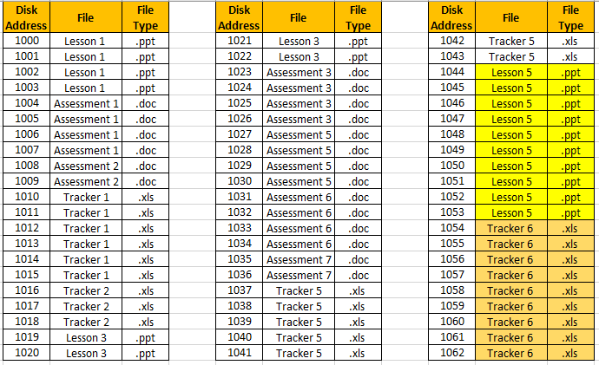
1.5 Software
All in order. No spaces between documents.
New lessons are added at the last available address.

Slide 86
1.5 Software
Describe the process of defragmentation.
How does it work?
What are the benefits? What if there was no defragmentation software?

Slide 87
1.5 Software
Back up software is utility software that allows the user to…

Slide 88
1.5 Software
Back up software is utility software that allows the user to back up their data in case the data is removed or deleted.
The data can then be…

Slide 89
1.5 Software
Back up software is utility software that allows the user to back up their data in case the data is removed or deleted.
The data can then be retrieved if it is lost.

Slide 90
1.5 Software
2 types of back up:
Full back up
Incremental back up

Slide 91
1.5 Software
2 types of back up:
Full back up
Incremental back up
What do you think a full back up does to the data on a computer system?

Slide 92
1.5 Software
A full back up backs up all of the data on the system.
So what does an incremental back up do?
What does incremental mean?

Slide 93
1.5 Software
A full back up backs up all of the data on the system.
An incremental back up backs up any data that has been saved since the last back up.

Slide 94
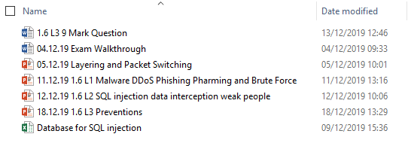
1.5 Software

Slide 95
1.5 Software

Slide 96
1.5 Software
My back up is set to back data up weekly.
The last back up was on the 12.12.2019.
What will be backed up this time?

Slide 97
1.5 Software
12.12.2019.

Slide 98
1.5 Software
12.12.2019.

Slide 99
1.5 Software
What if this was a full back up?

Slide 100
1.5 Software
What if this was a full back up?

Slide 101
1.5 Software
Which type of back up do you think is quicker at backing up data regularly?

Slide 102
1.5 Software
State the differences between a full back up and an incremental back up.

Slide 103
1.5 Software
State the differences between a full back up and an incremental back up.
Only backs up changed files. | Backs up all data and files.
Faster to restore the back up. | Takes less time to back up.
Must do this type of back up first. | Small number of files will have been changed.
Take less space to back up. | Safer as more past versions to revert to

Slide 104
1.5 Software
State the differences between a full back up and an incremental back up.
I
Only backs up changed files. | Backs up all data and files.
Faster to restore the back up. | Takes less time to back up.
Must do this type of back up first. | Small number of files will have been changed.
Take less space to back up. | Safer as more past versions to revert to
F

Slide 105
1.5 Software
State the differences between a full back up and an incremental back up.
I
Only backs up changed files. | Backs up all data and files.
Faster to restore the back up. | Takes less time to back up.
Must do this type of back up first. | Small number of files will have been changed.
Take less space to back up. | Safer as more past versions to revert to
F
F
I

Slide 106
1.5 Software
State the differences between a full back up and an incremental back up.
I
Only backs up changed files. | Backs up all data and files.
Faster to restore the back up. | Takes less time to back up.
Must do this type of back up first. | Small number of files will have been changed.
Take less space to back up. | Safer as more past versions to revert to
F
F
I
F
I

Slide 107
1.5 Software
State the differences between a full back up and an incremental back up.
I
Only backs up changed files. | Backs up all data and files.
Faster to restore the back up. | Takes less time to back up.
Must do this type of back up first. | Small number of files will have been changed.
Take less space to back up. | Safer as more past versions to revert to
F
F
I
F
I
I
F

Slide 108
1.5 Software
Encryption software –
Defragmentation software –
Compression software –
Back up software –

Slide 109
1.5 Software
Encryption software – scrambles the data so that anyone who intercepts it cannot read it.
Defragmentation software –
Compression software –
Back up software –

Slide 110
1.5 Software
Encryption software – scrambles the data so that anyone who intercepts it cannot read it.
Defragmentation software – moves files to chronological addresses. Saves time finding files.
Compression software –
Back up software –

Slide 111
1.5 Software
Encryption software – scrambles the data so that anyone who intercepts it cannot read it.
Defragmentation software – moves files to chronological addresses. Saves time finding files.
Compression software – reduces the size of files to make them take up less storage.
Back up software –

Slide 112
1.5 Software
Encryption software – scrambles the data so that anyone who intercepts it cannot read it.
Defragmentation software – moves files to chronological addresses. Saves time finding files.
Compression software – reduces the size of files to make them take up less storage.
Back up software – backs up data in case it is lost or damaged.

