Slide 1
OCR GCSE (9–1) in Computer Science (J277)
Systems Software
This pack is intended for students to use once they have covered the GCSE content, either in preparation for their L1 & L2 exam, or more likely alongside year 2 of the course to improve fluency, recall and pace on GCSE topics. It could be used as lesson starters, or supplied to students for independent use.

Slide 2
Bell Work
What is an operating system?
What operating systems have you used before.

Slide 3
1.5 Learn about the operating system.
1.5 Learn about the operating system.
Understand the role of an OS.
State what an OS does for a computer.
Explain the benefits of an OS.

Slide 4
1.5 Software
Link between the hardware, software and the user.
Allows us to access applications and allows the CPU to communicate with peripheral devices.

Slide 5
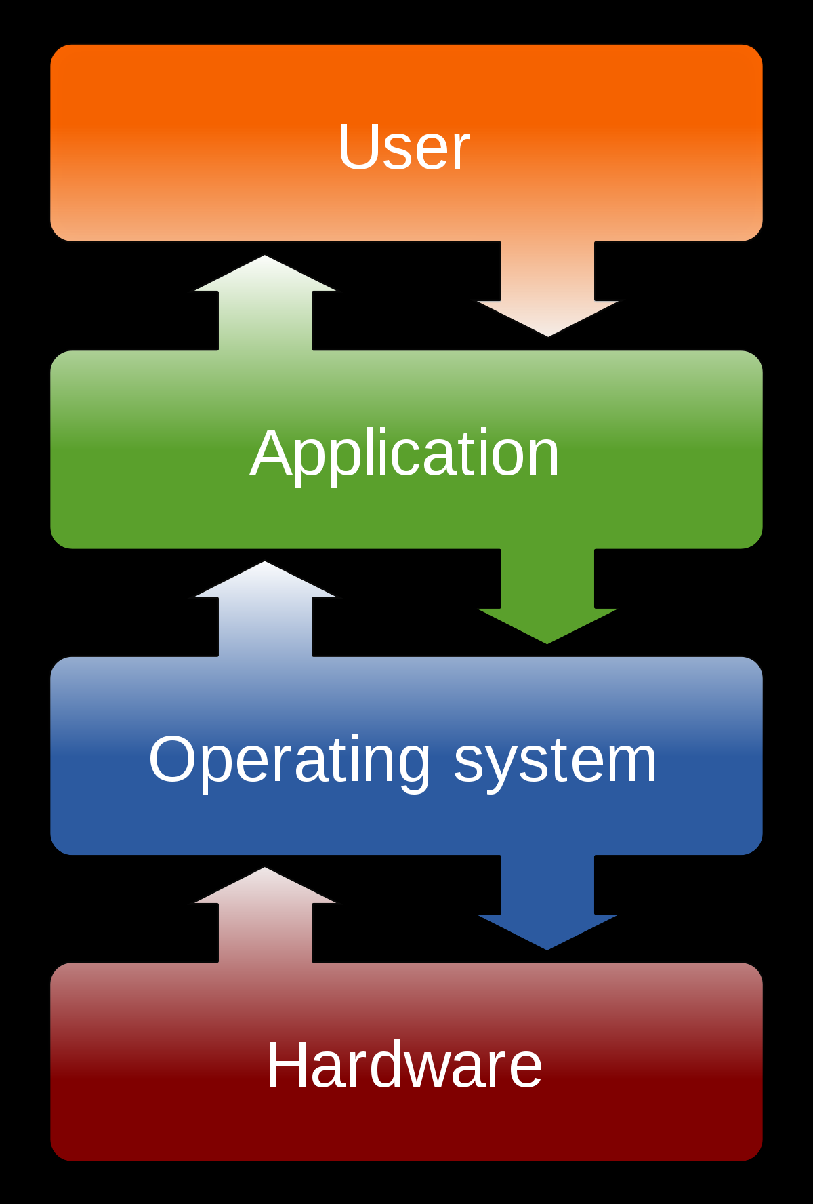
1.5 Software
Windows
iOS
KitKat
Ubuntu
Linux

Slide 6
1.5 Software
What is a user interface?
Command-line user interface
Graphical user interface

Slide 7
1.5 Software
What is a user interface?
Command-line user interface
Graphical user interface

Slide 8
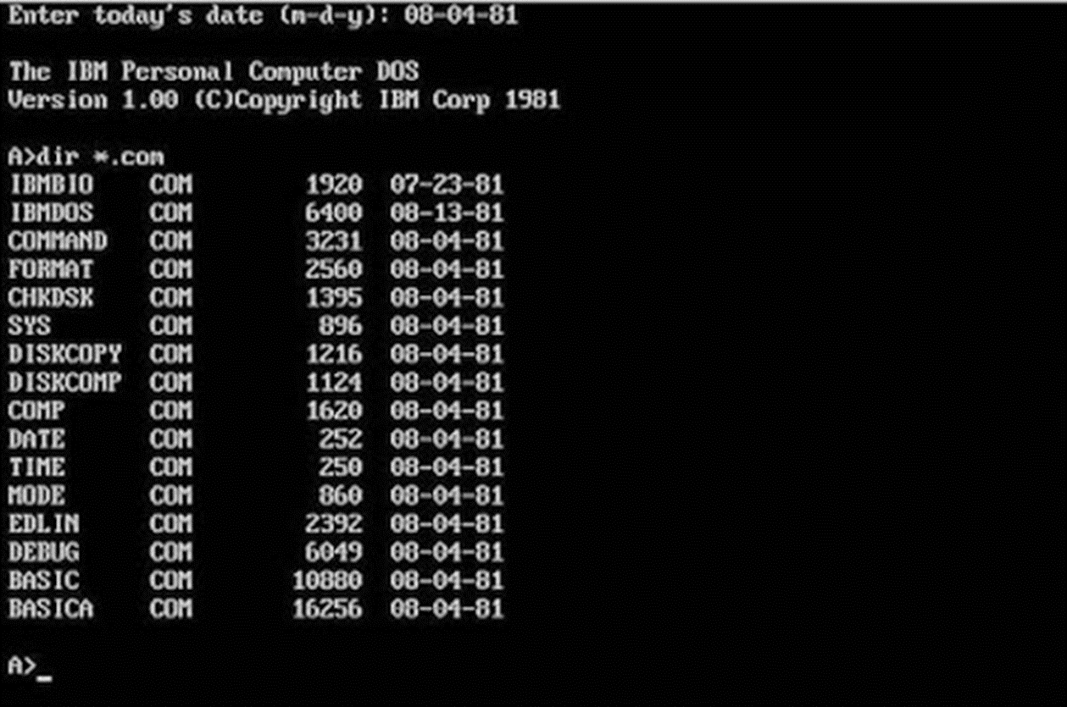
1.5 Software
What is a user interface?
Command-line user interface
Graphical user interface

Slide 9
1.5 Software
What is a user interface?
Command-line user interface
Graphical user interface

Slide 10
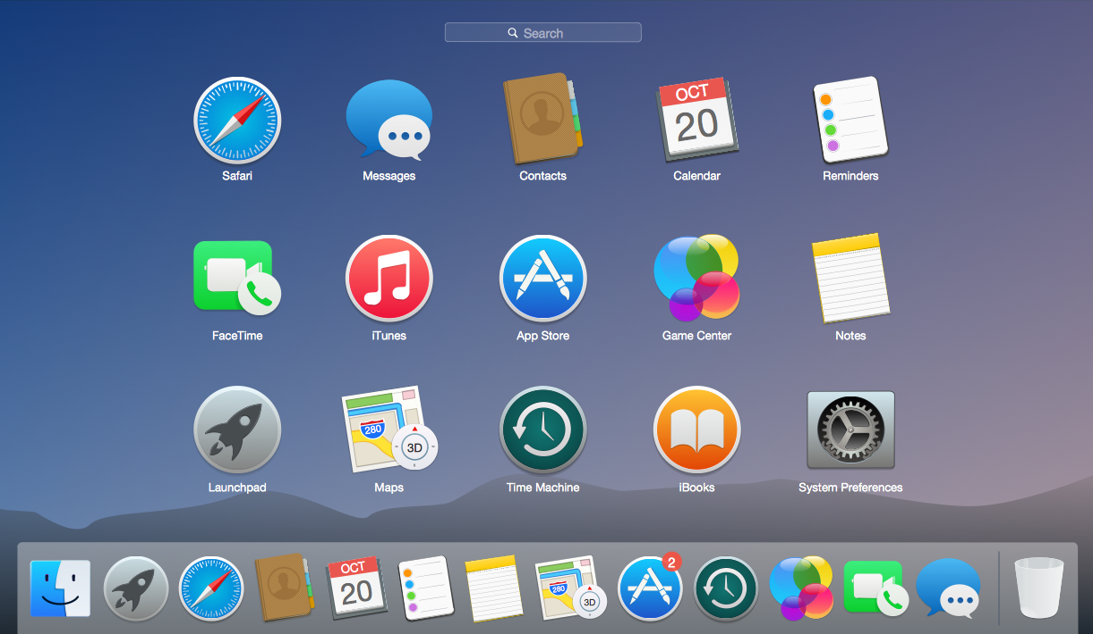
1.5 Software
What is a user interface?
Command-line user interface
Graphical user interface

Slide 11
1.5 Software
Greater control
More options
Easier to use
Less resources / data

Slide 12
1.5 Software
Greater control
More options
Easier to use
Less resources / data

Slide 13
1.5 Software
So what are the differences between GUI and command-line?
Graphic / Images / Pointers / Windows
Commands / Typing / List

Slide 14
1.5 Software
State 2 functions of an operating system. [2]

Slide 15
1.5 Software
Describe the purpose of a GUI. [2]

Slide 16
1.5 Software
Identify 2 benefits of using a command line interface over a GUI. [2]

Slide 17
1.5 Software
The OS of a computer can help protect a persons data.
Think about your phone, how does the OS help you protect what is on there?

Slide 18
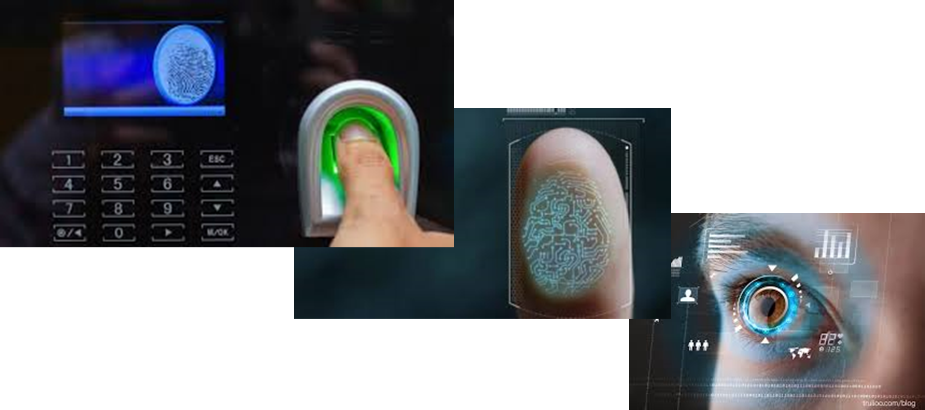
1.5 Software
The OS of a computer can help protect a persons data.
Think about your phone, how does the OS help you protect what is on there?

Slide 19
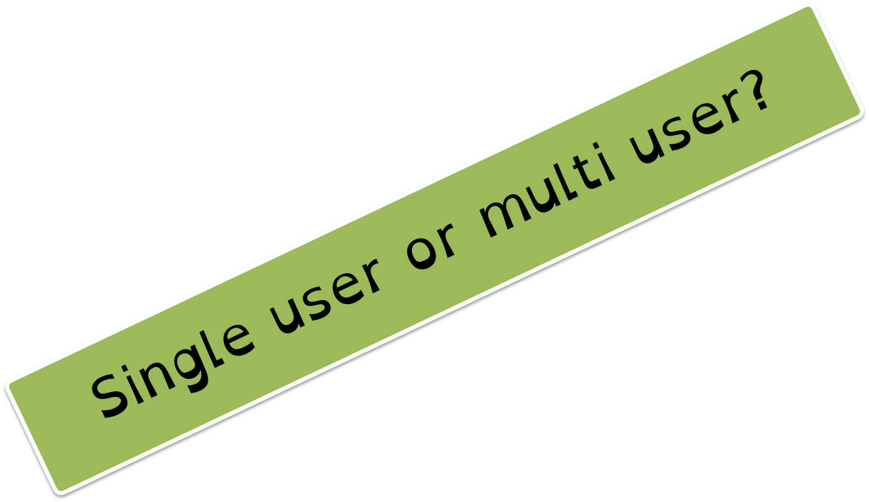
1.5 Software
You phone provides a user account for you to use.
So do the computers in school.
To gain access to it you must know the password.

Slide 20
1.5 Software
What would happen if we could not create separate accounts?
What if when you logged on a computer somebody’s data was already on there?

Slide 21
1.5 Software
How else can we protect our data?
Think about what we covered in 1.6 (system threats).

Slide 22
1.5 Software
Encryption
Viruses
Firewall
How might the OS help?

Slide 23
1.5 Software
What do you think device drivers are?
Hardware or Software?

Slide 24
1.5 Software
Allow the OS to communicate with hardware parts like memory (RAM) and the processor (CPU).
Software

Slide 25
1.5 Software
The OS works with RAM and CPU to ensure that programs/files that are open are able to work on the computer.

Slide 26
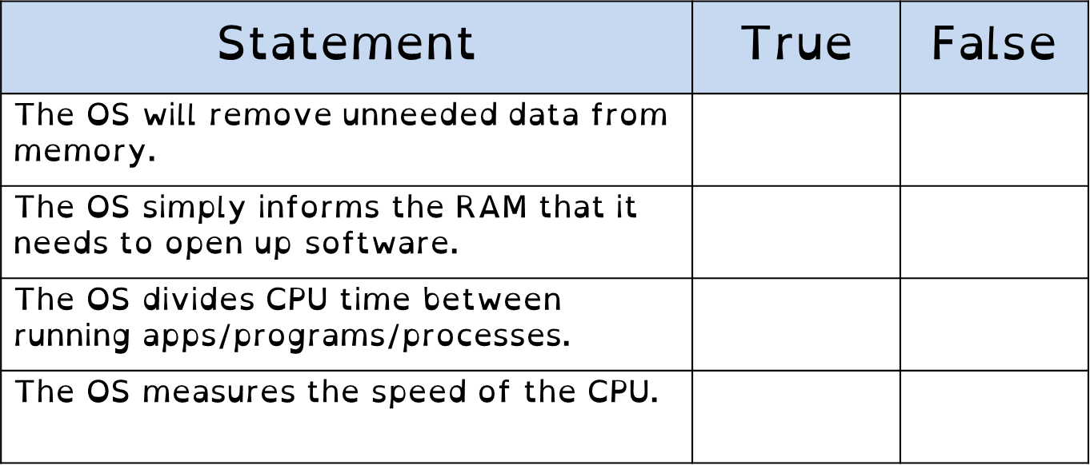
1.5 Software

Slide 27
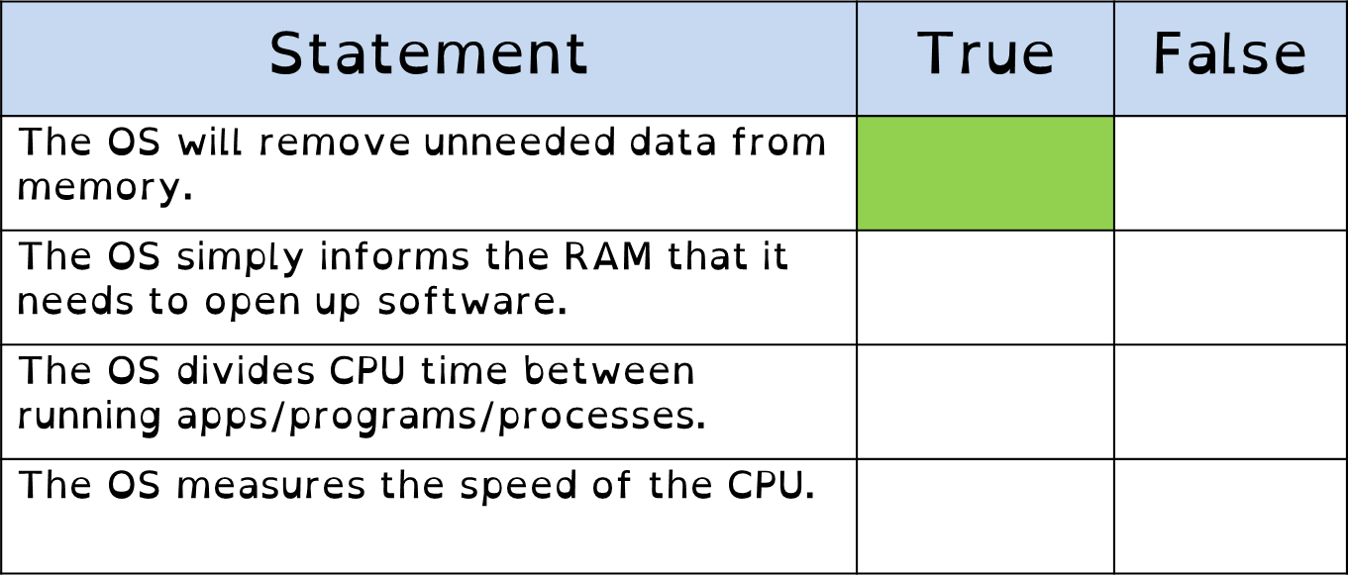
1.5 Software

Slide 28
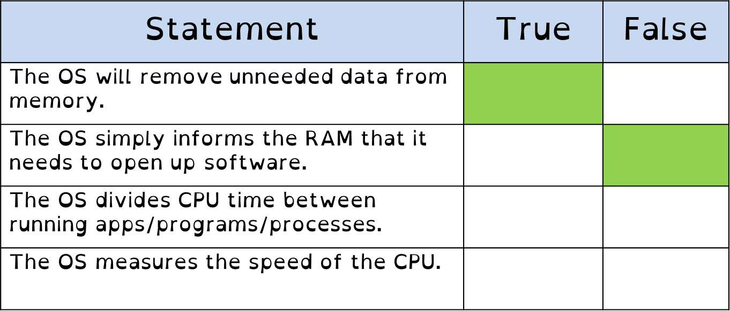
1.5 Software

Slide 29
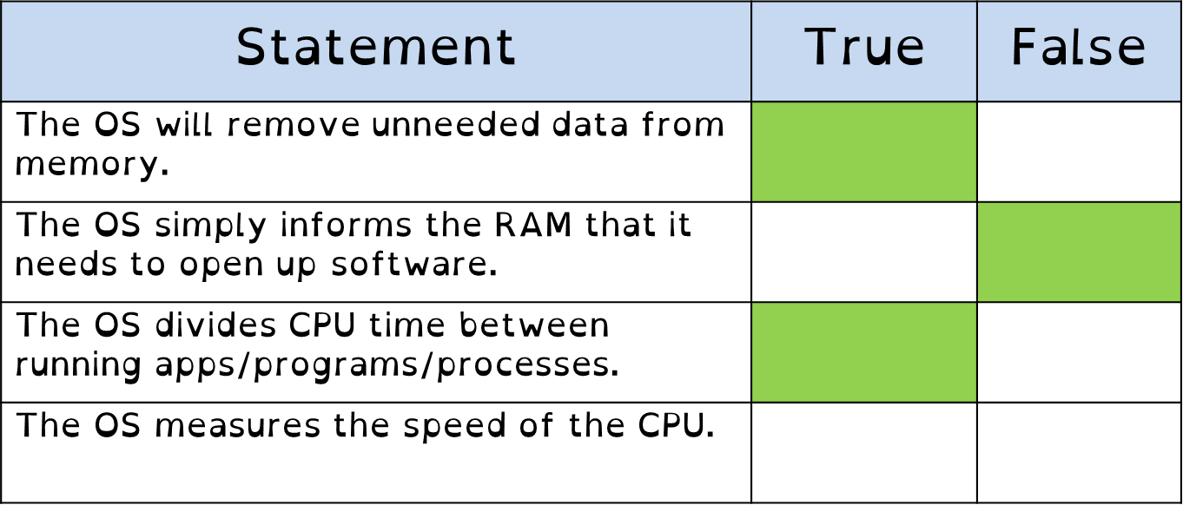
1.5 Software

Slide 30
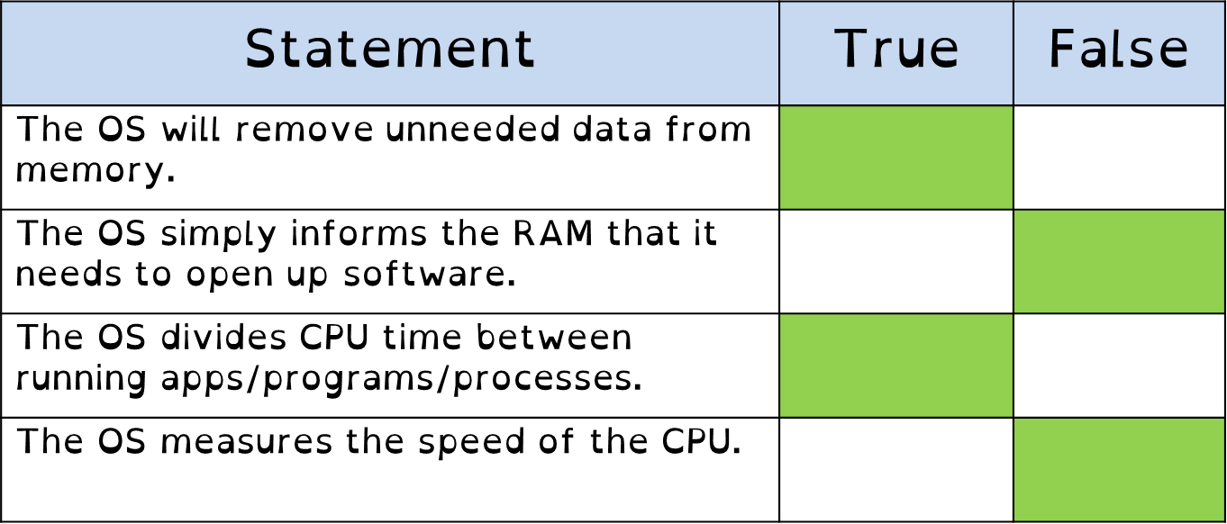
1.5 Software

Slide 31
1.5 Software
The OS is responsible for managing the memory in the computer.
What is memory?

Slide 32
1.5 Software
The OS is responsible for managing the memory in the computer.
What is memory?
Is memory storage – SSD/HDD?

Slide 33
1.5 Software
The OS will move the necessary programs/files to RAM when they are opened by the user.

Slide 34
CPU
RAM
SSD

Slide 35
CPU
RAM
SSD
The user clicks on the icon for Google Chrome to access the internet.

Slide 36
CPU
RAM
SSD
The OS now moves the data to the RAM so the data can be accessed by the CPU.

Slide 37
CPU
RAM
SSD
The OS now moves the data to the RAM so the data can be accessed by the CPU.

Slide 38
CPU
RAM
SSD
The OS now moves the data to the RAM so the data can be accessed by the CPU.

Slide 39
CPU
RAM
SSD
The OS now moves the data to the RAM so the data can be accessed by the CPU.

Slide 40
1.5 Software
The OS will move the necessary programs/files to RAM when they are opened by the user.
The OS will remove the unwanted data on the RAM – positive or negative?

Slide 41
CPU
RAM
SSD
Google Chrome is not working properly, so the user closes it down and selects internet explorer.

Slide 42
CPU
RAM
SSD
The OS moves Google Chrome from the RAM and places Internet Explorer there.

Slide 43
CPU
RAM
SSD
The OS moves Google Chrome from the RAM and places Internet Explorer there.

Slide 44
CPU
RAM
SSD
The OS moves Google Chrome from the RAM and places Internet Explorer there.

Slide 45
CPU
RAM
SSD
The OS moves Google Chrome from the RAM and places Internet Explorer there.

Slide 46
CPU
RAM
SSD
The OS moves Google Chrome from the RAM and places Internet Explorer there.

Slide 47
1.5 Software
The OS will move the necessary programs/files to RAM when they are opened by the user.
The OS will remove the unwanted data on the RAM – positive or negative?
The OS divides memory into segments, so that when a program opens more instructions it has a set space that cannot be overwritten while the program is open.

Slide 48
CPU
RAM
SSD
While IE is open, it’s section on the RAM cannot be overwritten. The OS makes sure of this.

Slide 49
RAM
SSD
While IE is open, it’s section on the RAM cannot be overwritten. The OS makes sure of this.

Slide 50
1.5 Software
The OS will move the necessary programs/files to RAM when they are opened by the user.
The OS will remove the unwanted data on the RAM – positive or negative?
The OS divides memory into segments, so that when a program opens more instructions it has a set space that cannot be overwritten while the program is open.
The OS governs the movement of data from RAM and Virtual Memory.

Slide 51
CPU
RAM
SSD
If the RAM is not big enough to run all the instructions being requested, the OS will create virtual memory on the storage drive.

Slide 52
CPU
RAM
SSD
If the RAM is not big enough to run all the instructions being requested, the OS will create virtual memory on the storage drive.

Slide 53
CPU
RAM
SSD
If the RAM is not big enough to run all the instructions being requested, the OS will create virtual memory on the storage drive.

Slide 54
CPU
RAM
SSD
If the RAM is not big enough to run all the instructions being requested, the OS will create virtual memory on the storage drive.

Slide 55
CPU
RAM
SSD
If the RAM is not big enough to run all the instructions being requested, the OS will create virtual memory on the storage drive.

Slide 56
CPU
RAM
SSD
If the RAM is not big enough to run all the instructions being requested, the OS will create virtual memory on the storage drive.

Slide 57
CPU
RAM
SSD
The SSD will be partitioned to act as RAM.

Slide 58
CPU
RAM
SSD
The SSD will be partitioned to act as RAM.

Slide 59
CPU
RAM
SSD
The SSD can now hold some of the instructions for RAM, and acts as RAM.

Slide 60
CPU
RAM
SSD
The SSD can now hold some of the instructions for RAM, and acts as RAM.

Slide 61
CPU
RAM
SSD
The SSD can now hold some of the instructions for RAM, and acts as RAM.

Slide 62
1.5 Software
The OS will move the necessary programs/files to RAM when they are opened by the user.
The OS will remove the unwanted data on the RAM – positive or negative?
The OS divides memory into segments, so that when a program opens more instructions it has a set space that cannot be overwritten while the program is open.
The OS governs the movement of data from RAM and Virtual Memory.
The OS divides CPU time between the running programs/apps/processes.

Slide 63
1.5 Software
The OS will move the necessary programs/files to RAM when they are opened by the user.
The OS will remove the unwanted data on the RAM – positive or negative?
The OS divides memory into segments, so that when a program opens more instructions it has a set space that cannot be overwritten while the program is open.
The OS governs the movement of data from RAM and Virtual Memory.
The OS divides CPU time between the running programs/apps/processes.
The OS can prioritise CPU time for different programs in order for them to be processed efficiently.

Slide 64
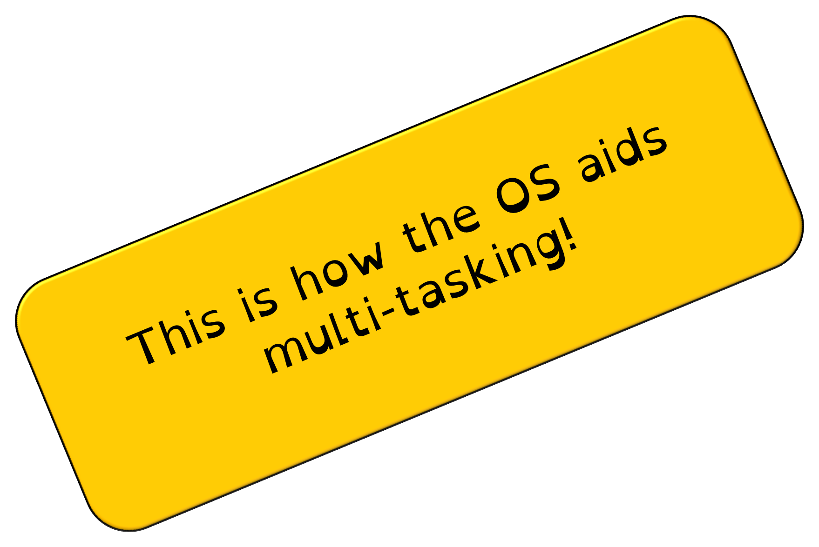
1.5 Software
The OS will move the necessary programs/files to RAM when they are opened by the user.
The OS will remove the unwanted data on the RAM – positive or negative?
The OS divides memory into segments, so that when a program opens more instructions it has a set space that cannot be overwritten while the program is open.
The OS governs the movement of data from RAM and Virtual Memory.
The OS divides CPU time between the running programs/apps/processes.
The OS can prioritise CPU time for different programs in order for them to be processed efficiently.

Slide 65
1.5 Software
Identify two features the operating system may provide to help protect Alana’s computer. [2]

Slide 66
1.5 Software
Identify two features the operating system may provide to help protect Alana’s computer. [2]
Allow different user accounts, giving access to own personal data that cannot be seen by another person.

Slide 67
1.5 Software
Identify two features the operating system may provide to help protect Alana’s computer. [2]
Allow different user accounts, giving access to own personal data that cannot be seen by another person.
It has anti-theft measures such as password protection

Slide 68
1.5 Software
Identify two features the operating system may provide to help protect Alana’s computer. [2]
Allow different user accounts, giving access to own personal data that cannot be seen by another person.
It has anti-theft measures such as password protection
It can include encryption software that allows the user to protect their files.

Slide 69
1.5 Software
Identify two features the operating system may provide to help protect Alana’s computer. [2]
Allow different user accounts, giving access to own personal data that cannot be seen by another person.
It has anti-theft measures such as password protection
It can include encryption software that allows the user to protect their files.
It may include anti-virus software or a firewall to help protect against unauthorised users or software.

Slide 70
1.5 Software
Describe what is meant by device drivers. [2]

Slide 71
1.5 Software
Describe what is meant by device drivers. [2]
Devices drivers are pieces of software…

Slide 72
1.5 Software
Describe what is meant by device drivers. [2]
Devices drivers are pieces of software…
…that allow the OS and the hardware to communicate with each other.

Slide 73
1.5 Software
Identify 3 ways an OS can aid multi-tasking. [3]

Slide 74
1.5 Software
Identify 3 ways an OS can aid multi-tasking. [3]

Slide 75
1.5 Software
The OS will move the necessary programs/files to RAM when they are opened by the user.
Identify 3 ways an OS can aid multi-tasking. [3]

Slide 76
1.5 Software
The OS will move the necessary programs/files to RAM when they are opened by the user.
The OS will remove the unwanted data on the RAM – positive or negative?
Identify 3 ways an OS can aid multi-tasking. [3]

Slide 77
1.5 Software
The OS will move the necessary programs/files to RAM when they are opened by the user.
The OS will remove the unwanted data on the RAM – positive or negative?
The OS divides memory into segments, so that when a program opens more instructions it has a set space that cannot be overwritten while the program is open.
Identify 3 ways an OS can aid multi-tasking. [3]

Slide 78
1.5 Software
The OS will move the necessary programs/files to RAM when they are opened by the user.
The OS will remove the unwanted data on the RAM – positive or negative?
The OS divides memory into segments, so that when a program opens more instructions it has a set space that cannot be overwritten while the program is open.
The OS governs the movement of data from RAM and Virtual Memory.
Identify 3 ways an OS can aid multi-tasking. [3]

Slide 79
1.5 Software
The OS will move the necessary programs/files to RAM when they are opened by the user.
The OS will remove the unwanted data on the RAM – positive or negative?
The OS divides memory into segments, so that when a program opens more instructions it has a set space that cannot be overwritten while the program is open.
The OS governs the movement of data from RAM and Virtual Memory.
The OS divides CPU time between the running programs/apps/processes.
Identify 3 ways an OS can aid multi-tasking. [3]

Slide 80
1.5 Software
The OS will move the necessary programs/files to RAM when they are opened by the user.
The OS will remove the unwanted data on the RAM – positive or negative?
The OS divides memory into segments, so that when a program opens more instructions it has a set space that cannot be overwritten while the program is open.
The OS governs the movement of data from RAM and Virtual Memory.
The OS divides CPU time between the running programs/apps/processes.
The OS can prioritise CPU time for different programs in order for them to be processed efficiently.
Identify 3 ways an OS can aid multi-tasking. [3]

