Slide 1
OCR GCSE (9–1) in Computer Science (J277)
Systems Software
This pack is intended for students to use once they have covered the GCSE content, either in preparation for their L1 & L2 exam, or more likely alongside year 2 of the course to improve fluency, recall and pace on GCSE topics. It could be used as lesson starters, or supplied to students for independent use.

Slide 2
Bell Work
What is an operating system?
What operating systems have you used before.

Slide 3
1.5 Learn about the operating system.
1.5 Learn about the operating system.
Understand the role of an OS.
State what an OS does for a computer.
Explain the benefits of an OS.

Slide 4
1.4 Security
There are different threats to a network including:
Malware
Phishing
Brute force attacks
DoS Attacks
People – weak point
Data interception and theft
SQL injection
Poor network policy

Slide 5
1.4 Security
Malware is malicious software.
There are different types of malware that can have devastating effects on your computer.

Slide 6
1.4 Security
Types of Malware:
Viruses
Worms
Trojan Horses
Ransomware
Spyware
Rootkits
Back doors

Slide 7
1.4 Security
Phishing – an email link that takes the user to fake website that looks like a real website. The user is prompted to enter personal details.
Pharming – a piece of software that redirects the user to a fake website. The user is prompted to enter fake details.

Slide 8
1.4 Security
DDoS is an attempt by hackers to deny the service of a website.
It loads software onto a person’s computer, and that software loads up a webpage without the users knowledge.

Slide 9
1.4 Security
An attack that just uses lots of attempts to gain access to your system.
It will keep trying different password combinations until the attempt is correct.

Slide 10
1.4 Security
Humans can be lazy, and don’t always follow the rules strictly.
Leave computers logged on
Writing down passwords
Sharing passwords
Not updating software
Opening unchecked/unsafe email attachments

Slide 11
1.4 Security
Data interception/theft is when data is intercepted from the network.
It can occur directly from the network or during transmission.

Slide 12
1.4 Security
SQL injection is when a hacker will use code to download all of the data behind a login screen.
It only works on web pages that have data bases attached to them.

Slide 13
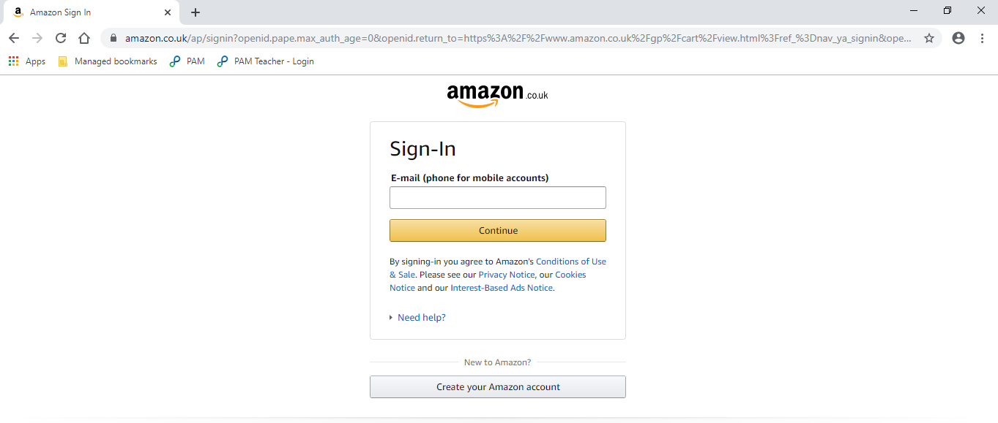
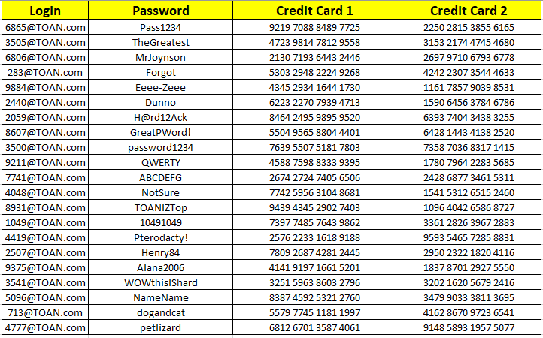
1.4 Security
MrJoynson@TOAN.com

Slide 14
1.4 Security
State what SQL injection is.
Explain how SQL injection is used to gain information.
SQL injection is using basic code to gain access to information from the database.
SQL injection is used to gain information from websites by inserting basic language into the login page of a website. If the website is not protected, the code will allow hackers to gain all of the data from the database attached to the login page.

Slide 15
1.4 Security
What is data interception?
State two reasons why humans may be the weak point in a network.
Data interception is when a hacker intercepts or steals data from a network.
Humans might be the weak link in a network as they can share passwords with other people and they don’t always update software when they should.

Slide 16
1.4 Security
Prevention measures:
Anti-virus/malware software
Firewalls
Penetration testing
User Access Levels
Strong passwords
Encryption
Network forensics
Network policies

Slide 17
1.4 Security
Anti-virus/malware software scans your computer.
It then removes any malware types that it recognises.
Scans can be set to happen regularly.

Slide 18
1.4 Security
Firewalls are a piece of software that block some packets of data from being received from the network or the internet.
They are the main defence against DoS attacks.
Packet-filter firewalls inspect each packet of data, and stop packets that do not meet the criteria set by the firewall.

Slide 19
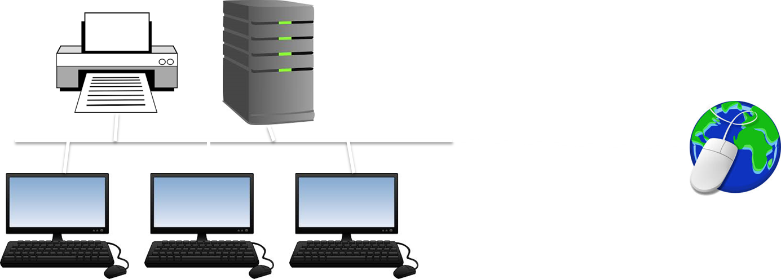
1.4 Security

Slide 20
1.4 Security

Slide 21
1.4 Security

Slide 22
1.4 Security

Slide 23
1.4 Security

Slide 24
1.4 Security

Slide 25
1.4 Security

Slide 26
1.4 Security

Slide 27
1.4 Security

Slide 28
1.4 Security

Slide 29
1.4 Security

Slide 30
1.4 Security

Slide 31
1.4 Security

Slide 32
1.4 Security

Slide 33
1.4 Security

Slide 34
1.4 Security

Slide 35
1.4 Security

Slide 36
1.4 Security

Slide 37
1.4 Security

Slide 38
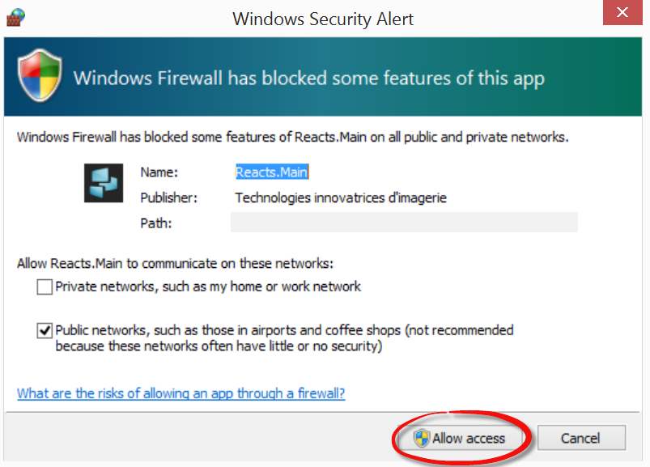
1.4 Security

Slide 39
1.4 Security

Slide 40
1.4 Security

Slide 41
1.4 Security

Slide 42
1.4 Security
This is where the company pays another person to purposely try to break into the network.
If they are successful they report back on how they did it.
Penetration Testing

Slide 43
1.4 Security
This allows the company to fix any bugs or loopholes in their system, safely.
They will pay the company depending on how many security flaws they have found.

Slide 44
1.4 Security
Entire network
A drive
B drive
C drive
IT tech team
Login accounts
Teaching staff
N drive
CBT resources
Students
SIMS - register

Slide 45
1.4 Security
Entire network
A drive
B drive
C drive
IT tech team
Login accounts
Teaching staff
N drive
CBT resources
Students
SIMS - register

Slide 46
1.4 Security
Entire network
A drive
B drive
C drive
IT tech team
Login accounts
Teaching staff
N drive
CBT resources
Students
SIMS - register

Slide 47
1.4 Security
Entire network
A drive
B drive
C drive
IT tech team
Login accounts
Teaching staff
N drive
CBT resources
Students
SIMS - register

Slide 48
1.4 Security
Entire network
A drive
B drive
C drive
IT tech team
Login accounts
Teaching staff
N drive
CBT resources
Students
SIMS - register

Slide 49
1.4 Security
Entire network
A drive
B drive
C drive
IT tech team
Login accounts
Teaching staff
N drive
CBT resources
Students
SIMS - register

Slide 50
1.4 Security
Entire network
A drive
B drive
C drive
IT tech team
Login accounts
Teaching staff
N drive
CBT resources
Students
SIMS - register

Slide 51
1.4 Security
To keep a network safe people must ensure they protect themselves with a strong password.
As we have already seen humans can be the weak part of the network.

Slide 52
1.4 Security
8 characters or more
Mix of upper and lower case letters
Mix of numbers, letters and special characters
Not something that is easy to guess (i.e. pets name)
Changed often
Different passwords for different accounts.

Slide 53
1.4 Security
Encryption:
Scrambles data.
Makes it unreadable.
If data is hacked/intercepted the hacker cannot read the data.
Protects sensitive information.

Slide 54
1.4 Security
Network Forensics is the monitoring of the network to allow managers to see if misuse is happening.
This can be done using a spyware – this is legal as consent is usually gained.
This can help managers identify who might have been responsible for a network breach.

Slide 55
1.5 Software
What is an operating system?
Can you name different operating systems?

Slide 56
1.5 Software
Link between the hardware, software and the user.
Allows us to access applications and allows the CPU to communicate with peripheral devices.

Slide 57
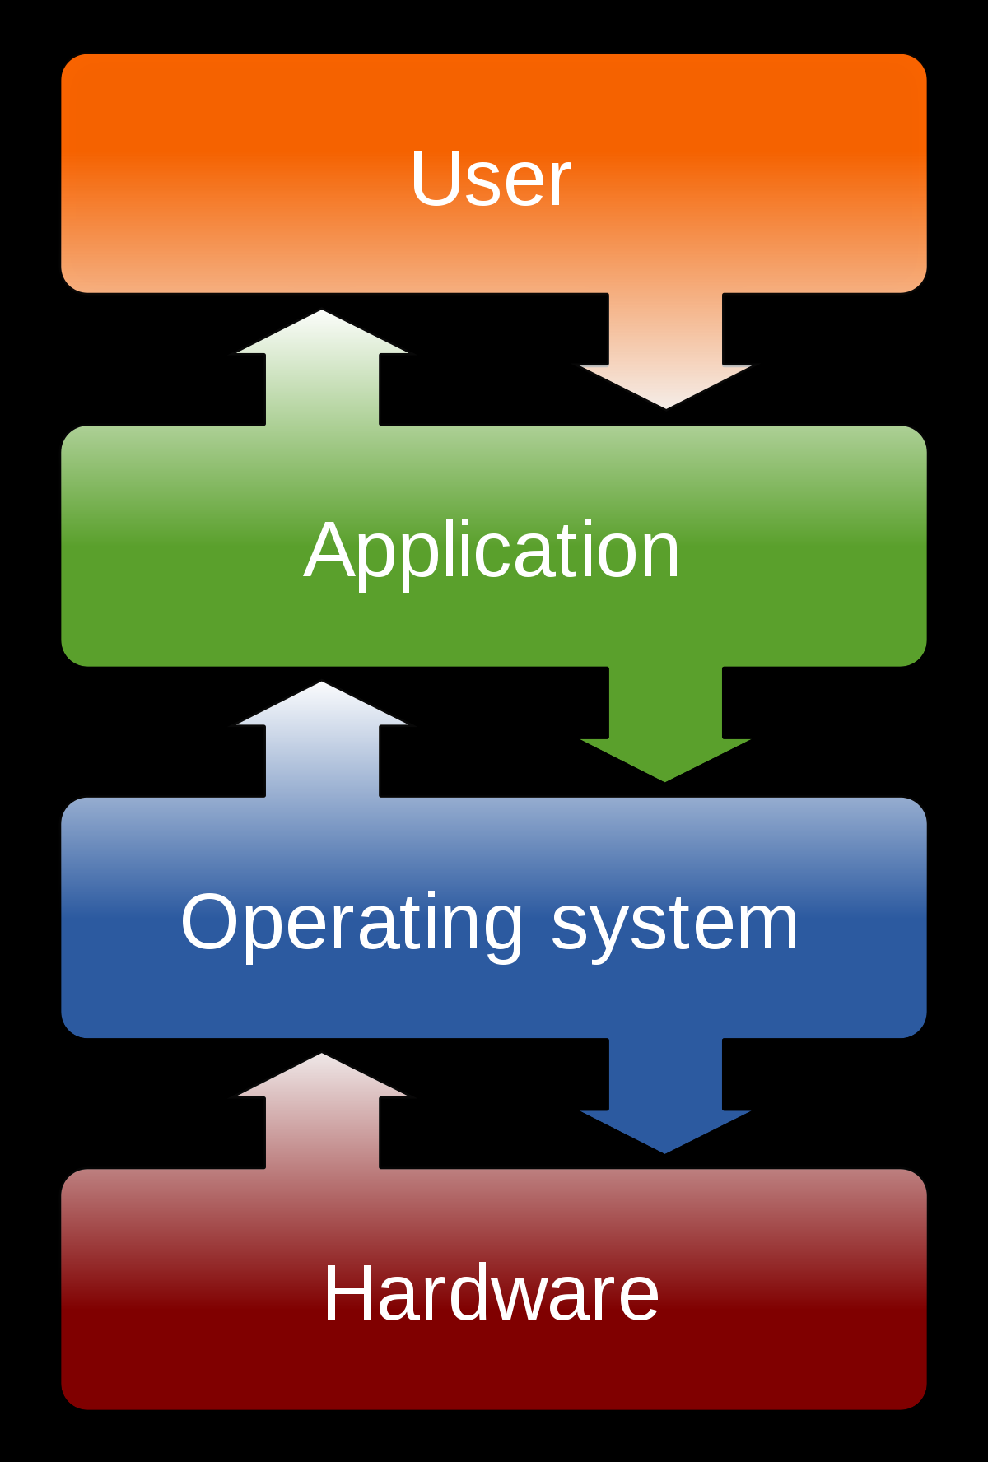
1.5 Software
Windows
iOS
KitKat
Ubuntu
Linux

Slide 58
1.5 Software
What is a user interface?
Command-line user interface
Graphical user interface

Slide 59
1.5 Software
What is a user interface?
Command-line user interface
Graphical user interface

Slide 60
1.5 Software
What is a user interface?
Command-line user interface
Graphical user interface

Slide 61
1.5 Software
What is a user interface?
Command-line user interface
Graphical user interface

Slide 62
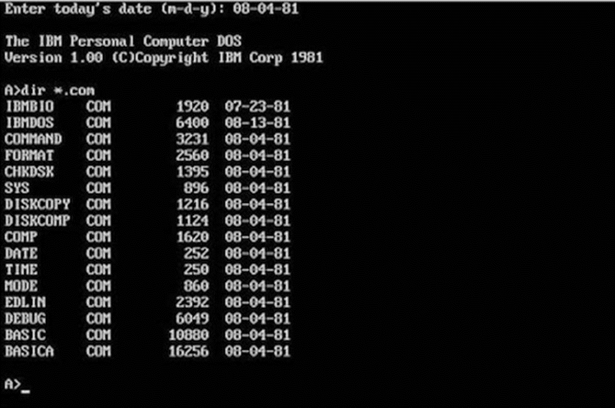
1.5 Software
What is a user interface?
Command-line user interface
Graphical user interface

Slide 63
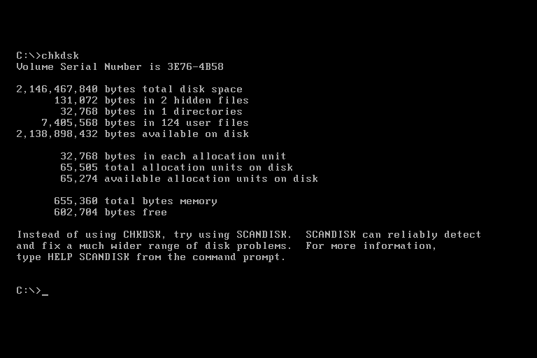
1.5 Software
What is a user interface?
Command-line user interface
Graphical user interface

Slide 64
1.5 Software
What is a user interface?
Command-line user interface
Graphical user interface

Slide 65
1.5 Software
What is a user interface?
Command-line user interface
Graphical user interface

Slide 66
1.5 Software
What is a user interface?
Command-line user interface
Graphical user interface

Slide 67
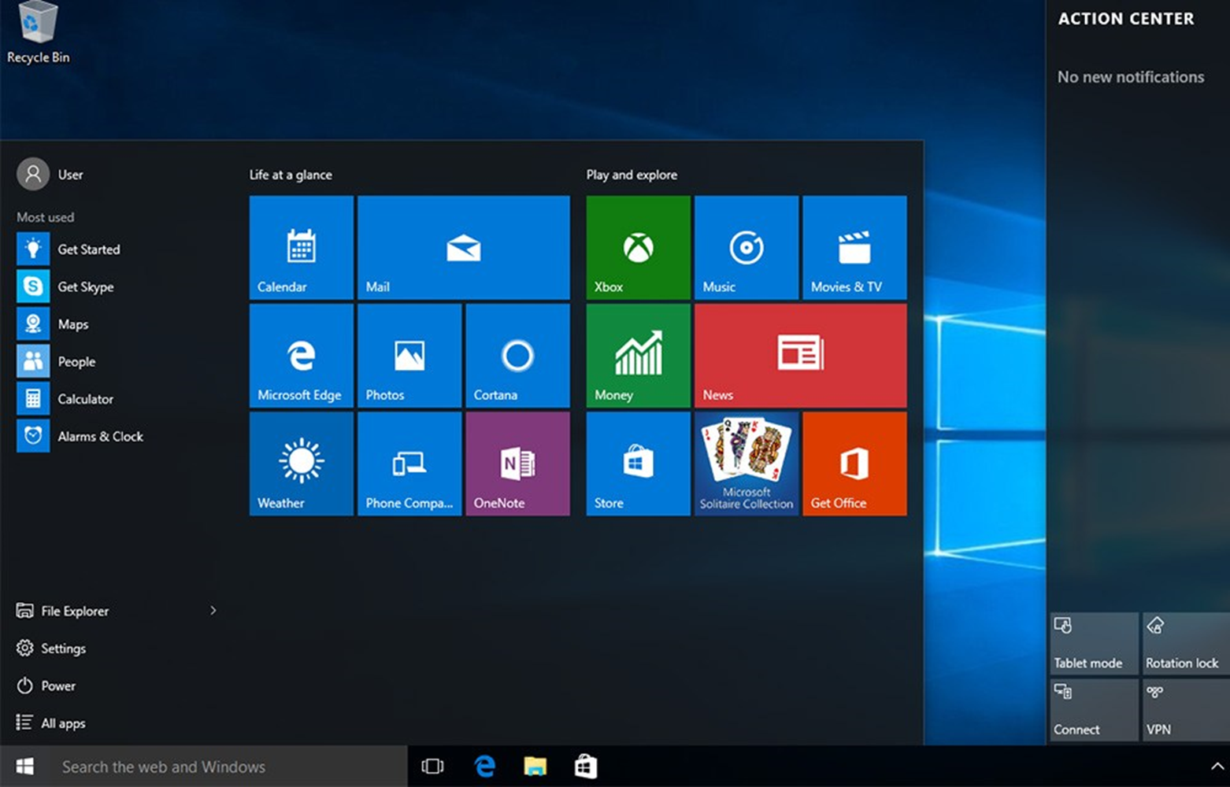
1.5 Software
What is a user interface?
Command-line user interface
Graphical user interface

Slide 68
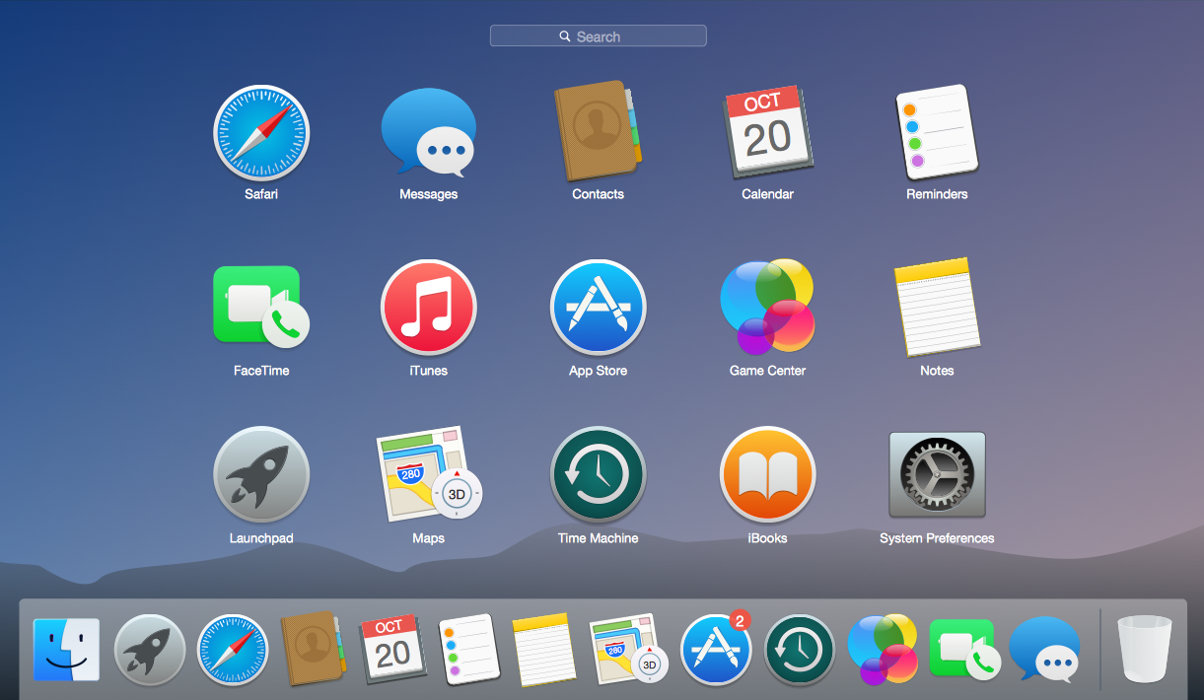
1.5 Software
What is a user interface?
Command-line user interface
Graphical user interface

Slide 69
1.5 Software
Which one is better, graphical or command-line?
Why?

Slide 70
1.5 Software
Greater control
More options
Easier to use
Less resources / data

Slide 71
1.5 Software
Greater control
More options
Easier to use
Less resources / data

Slide 72
1.5 Software
So what are the differences between GUI and command-line?
Graphic / Images / Pointers / Windows

Slide 73
1.5 Software
So what are the differences between GUI and command-line?
Graphic / Images / Pointers / Windows
Commands / Typing / List

Slide 74
1.5 Software
State 2 functions of an operating system. [2]

Slide 75
1.5 Software
State 2 functions of an operating system. [2]

Slide 76
1.5 Software
State 2 functions of an operating system. [2]

Slide 77
1.5 Software
Describe the purpose of a GUI. [2]

Slide 78
1.5 Software
Describe the purpose of a GUI. [2]

Slide 79
1.5 Software
Describe the purpose of a GUI. [2]

Slide 80
1.5 Software
Identify 2 benefits of using a command line interface over a GUI. [2]

Slide 81
1.5 Software
Identify 2 benefits of using a command line interface over a GUI. [2]

Slide 82
1.5 Software
The OS of a computer can help protect a persons data.
Think about your phone, how does the OS help you protect what is on there?

Slide 83
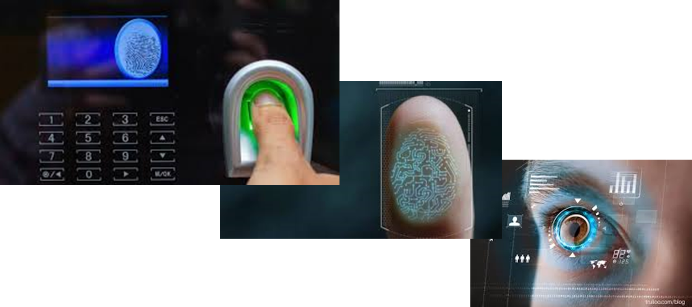
1.5 Software
The OS of a computer can help protect a persons data.
Think about your phone, how does the OS help you protect what is on there?

Slide 84
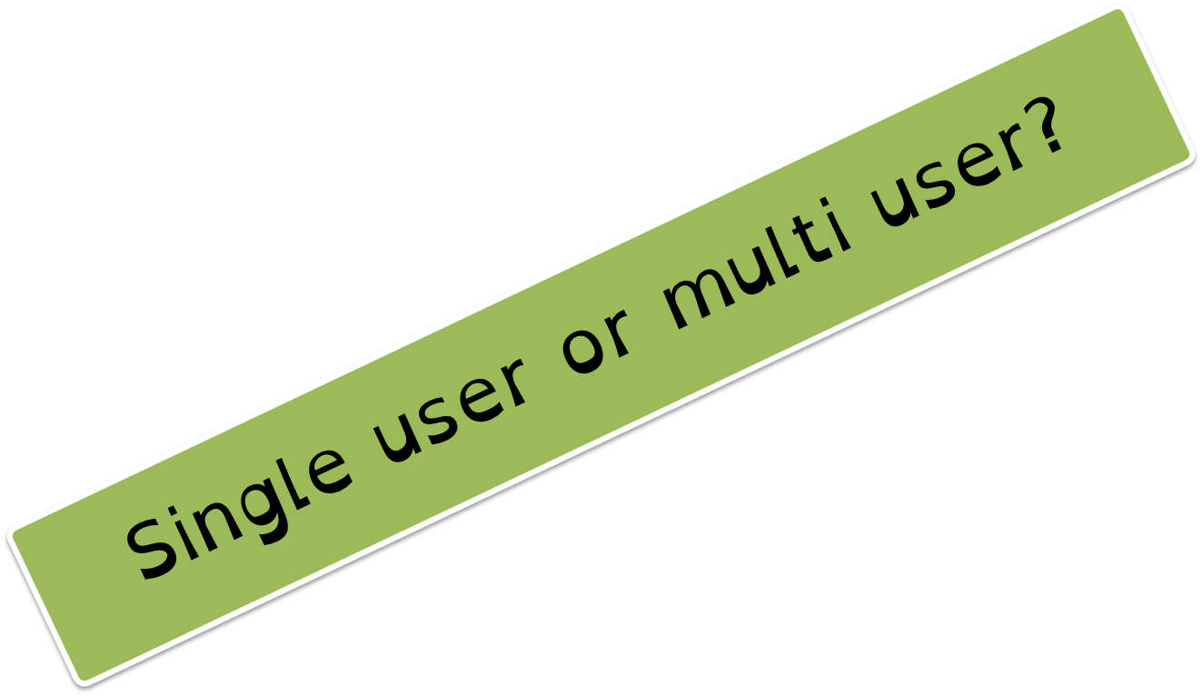
1.5 Software
You phone provides a user account for you to use.
So do the computers in school.
To gain access to it you must know the password.

Slide 85
1.5 Software
What would happen if we could not create separate accounts?
What if when you logged on a computer somebody’s data was already on there?

Slide 86
1.5 Software
How else can we protect our data?
Think about what we covered in 1.6 (system threats).

Slide 87
1.5 Software
Encryption
Viruses
Firewall
How might the OS help?

Slide 88
1.5 Software
What do you think device drivers are?
Hardware or Software?

Slide 89
1.5 Software
Allow the OS to communicate with hardware parts like memory (RAM) and the processor (CPU).
Software

Slide 90
1.5 Software
The OS works with RAM and CPU to ensure that programs/files that are open are able to work on the computer.

Slide 91
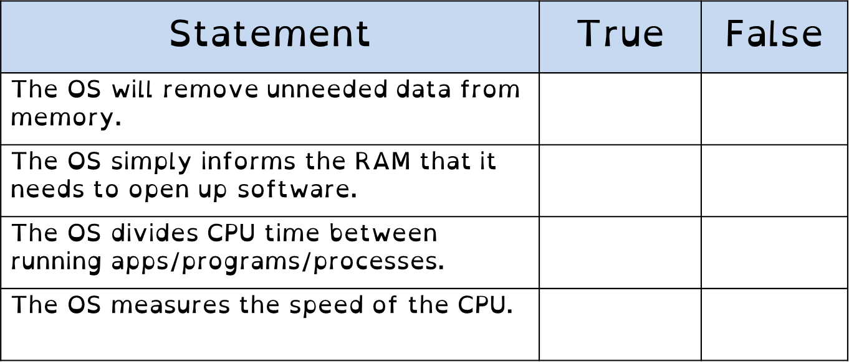
1.5 Software

Slide 92
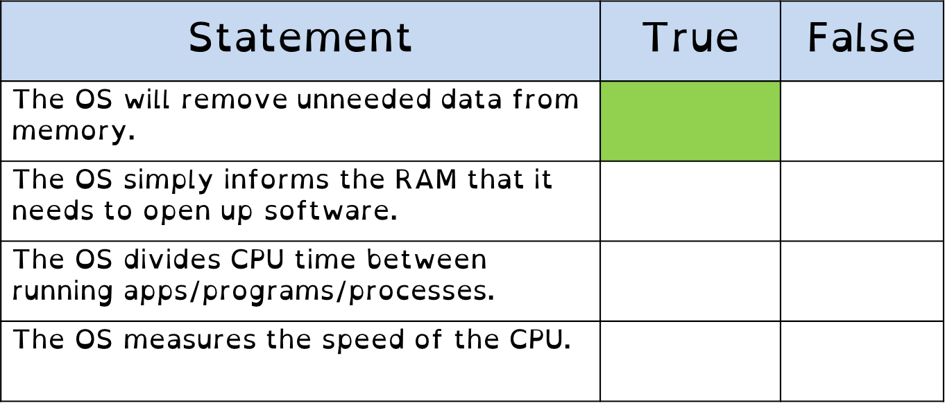
1.5 Software

Slide 93
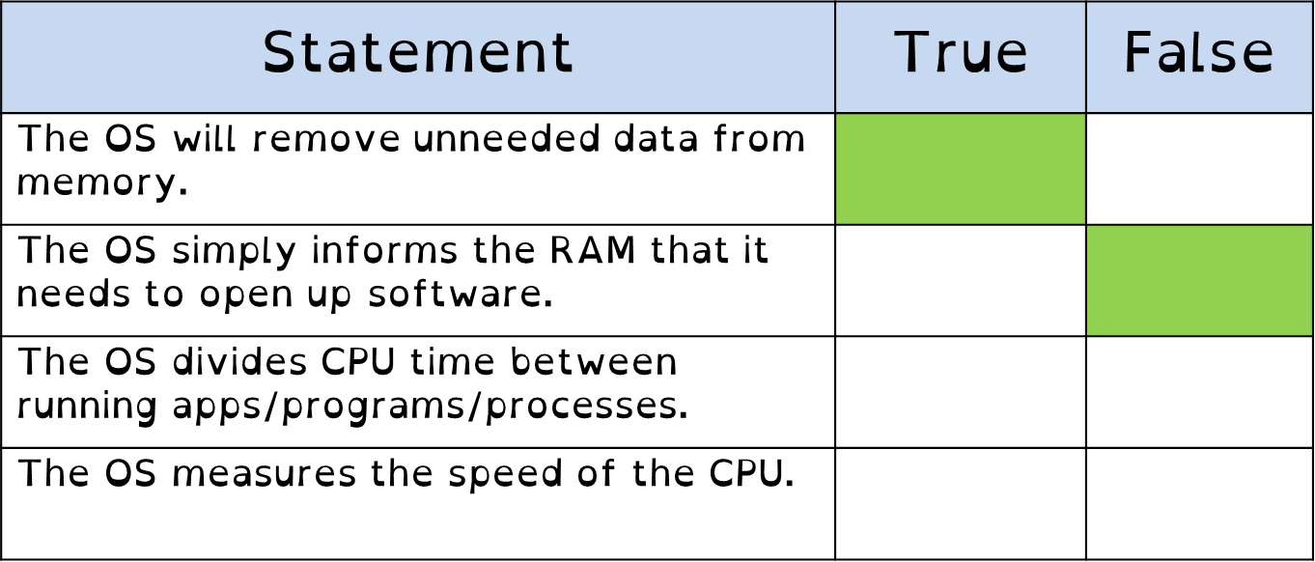
1.5 Software

Slide 94
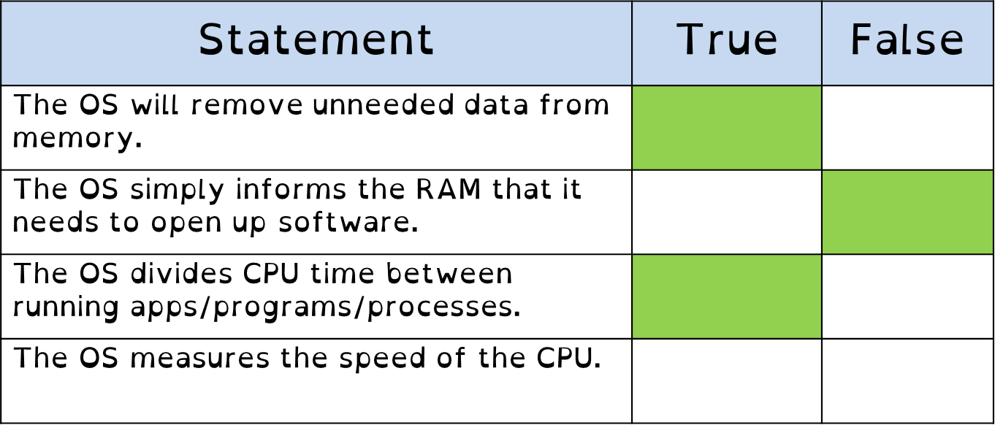
1.5 Software

Slide 95
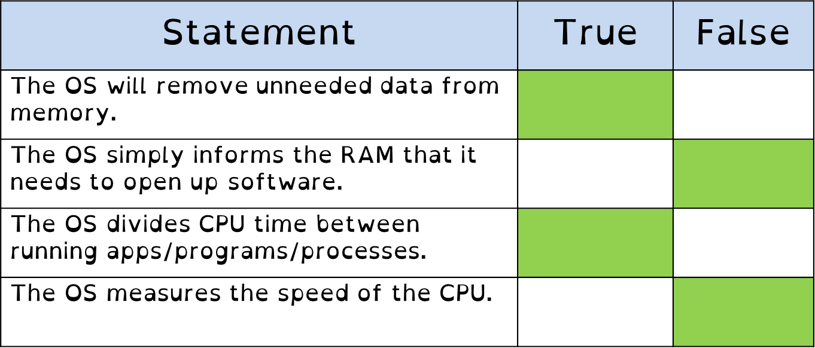
1.5 Software

