Slide 1
OCR GCSE (9–1) in Computer Science (J277)
Computer Networks, Connections and Protocols
This pack is intended for students to use once they have covered the GCSE content, either in preparation for their L1 & L2 exam, or more likely alongside year 2 of the course to improve fluency, recall and pace on GCSE topics. It could be used as lesson starters, or supplied to students for independent use.

Slide 2
Bell Work
State what encryption is.
Explain the difference between a star and mesh network topology.

Slide 3

Bell Work

Slide 4
Bell Work

Slide 5
1.3 Learn IP and MAC addresses.
1.3 Learn IP and MAC addresses.
State what a MAC address is.
Discuss what an IP address is.
Explain how MAC and IP addresses are different.

Slide 6


1.3 Networks
What is WIFI?
WIFI is the rules that we use to connect to a wireless network.
We have all used WIFI before but what does it actually do?

Slide 7
1.3 Networks
It allows your device to connect to the router without a cable.
Convenient!
However, it is much more complicated than just entering a password and off you go.

Slide 8
1.3 Networks
WIFI uses frequencies to send data.
What do frequencies do in Science?
How are waves used in Physics?

Slide 9
1.3 Networks
Frequencies are used to communicate with your device.
The device and the router must be on the same frequency.

Slide 10
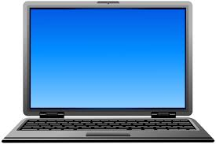
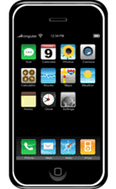
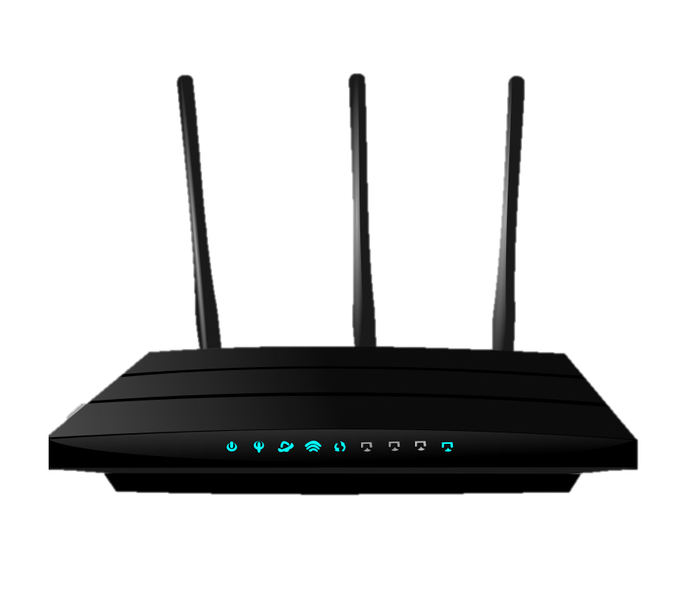

1.3 Networks

Slide 11
1.3 Networks
Router is set to frequency 3.5721

Slide 12
1.3 Networks
Rather than remembering the exact frequency we just give it a channel name.
Router is set to frequency 3.5721

Slide 13
1.3 Networks
Router is set to channel 1

Slide 14
1.3 Networks
Both devices are set to channel 1.

Slide 15
1.3 Networks
Perfect connection is established.

Slide 16
1.3 Networks
What if my phone is set to channel 2?

Slide 17
1.3 Networks
No connection is made. Why not?

Slide 18
1.3 Networks
The devices are on different channels.

Slide 19
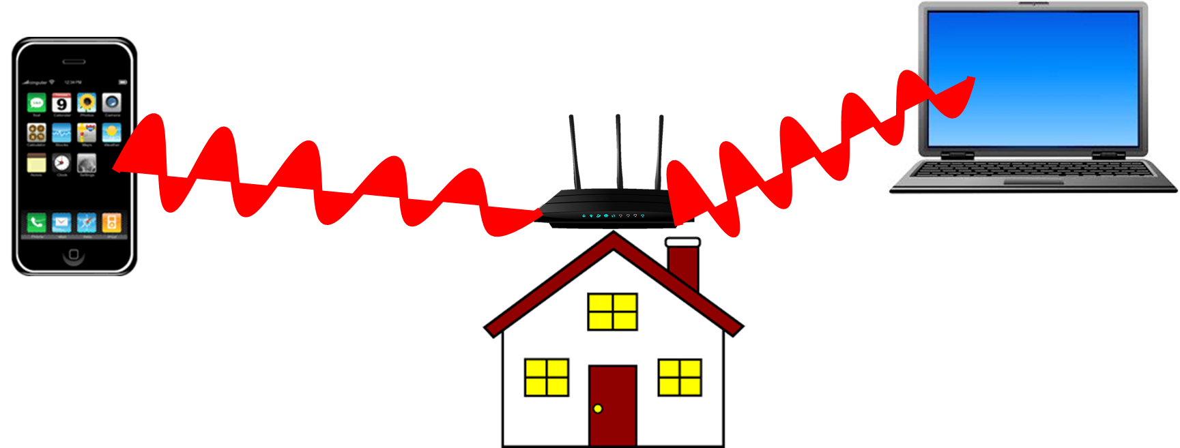

1.3 Networks

Slide 20
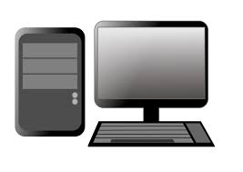
1.3 Networks
What will happen if both routers are set to the same channel?
e.g. channel 5?

Slide 21
1.3 Networks
Interference!
This will slow down your WIFI

Slide 22
1.3 Networks
Scrambling of data, to make it harder to read your data if it is intercepted.
You can only read the data if you have the master key to unscramble it.

Slide 23

1.3 Networks
Caesar Cipher is a basic form of encryption.
It uses a key to change the message.

Slide 24
1.3 Networks
A | B | C | D | E | F | G | H | I | J | K | L | M | N | O | P | Q | R | S | T | U | V | W | X | Y | Z
E | F | G | H | I | J | K | L | M | N | O | P | Q | R | S | T | U | V | W | X | Y | Z | A | B | C | D
The key is 4.
COMPUTING becomes GSQTYXMRK

Slide 25
1.3 Networks
A | B | C | D | E | F | G | H | I | J | K | L | M | N | O | P | Q | R | S | T | U | V | W | X | Y | Z
E | F | G | H | I | J | K | L | M | N | O | P | Q | R | S | T | U | V | W | X | Y | Z | A | B | C | D
QV NSCRWSR MW
XLI KVIEXIWX

Slide 26
1.3 Networks
A | B | C | D | E | F | G | H | I | J | K | L | M | N | O | P | Q | R | S | T | U | V | W | X | Y | Z
E | F | G | H | I | J | K | L | M | N | O | P | Q | R | S | T | U | V | W | X | Y | Z | A | B | C | D
QV NSCRWSR MW
XLI KVIEXIWX
MR JOYNSON IS
THE GREATEST

Slide 27
1.3 Networks
Ethernet is the standard rules used to send data over a wired connection.
It is the wired version of WIFI.
In UTP cables, one of the wires is used to send data while the other receives data.

Slide 28
1.3 Networks
Data is sent via Ethernet in frames.
Each of these frames carries up to 1500 bytes of information.
It is like a box that contains part of the information.

Slide 29
1.3 Networks
What is a MAC address?
- each device has 1!
What is an IP address?
- each device must have one to get on internet.

Slide 30
1.3 Networks
What is a MAC address?
- each device has 1!
What is an IP address?
- each device must have one to get on internet.
A MAC (Media Access Control) Address is specific to any piece of hardware on a network e.g. hub, router, laptop etc. E.g. F0:98:9D:45:CB:BA

Slide 31
1.3 Networks
What is a MAC address?
- each device has 1!
What is an IP address?
- each device must have one to get on internet.
A MAC (Media Access Control) Address is specific to any piece of hardware on a network e.g. hub, router, laptop etc. E.g. F0:98:9D:45:CB:BA

Slide 32
1.3 Networks
What is a MAC address?
- each device has 1!
What is an IP address?
- each device must have one to get on internet.
A MAC (Media Access Control) Address is specific to any piece of hardware on a network e.g. hub, router, laptop etc. E.g. F0:98:9D:45:CB:BA
An IP Address is a location that is unique to each device connected to the internet. They are used to direct data around the internet from senders to receivers e.g. 192.168.0.31

Slide 33
1.3 Networks
What is a MAC address?
- each device has 1!
What is an IP address?
- each device must have one to get on internet.
A MAC (Media Access Control) Address is specific to any piece of hardware on a network e.g. hub, router, laptop etc. E.g. F0:98:9D:45:CB:BA
An IP Address is a location that is unique to each device connected to the internet. They are used to direct data around the internet from senders to receivers e.g. 192.168.0.31

Slide 34
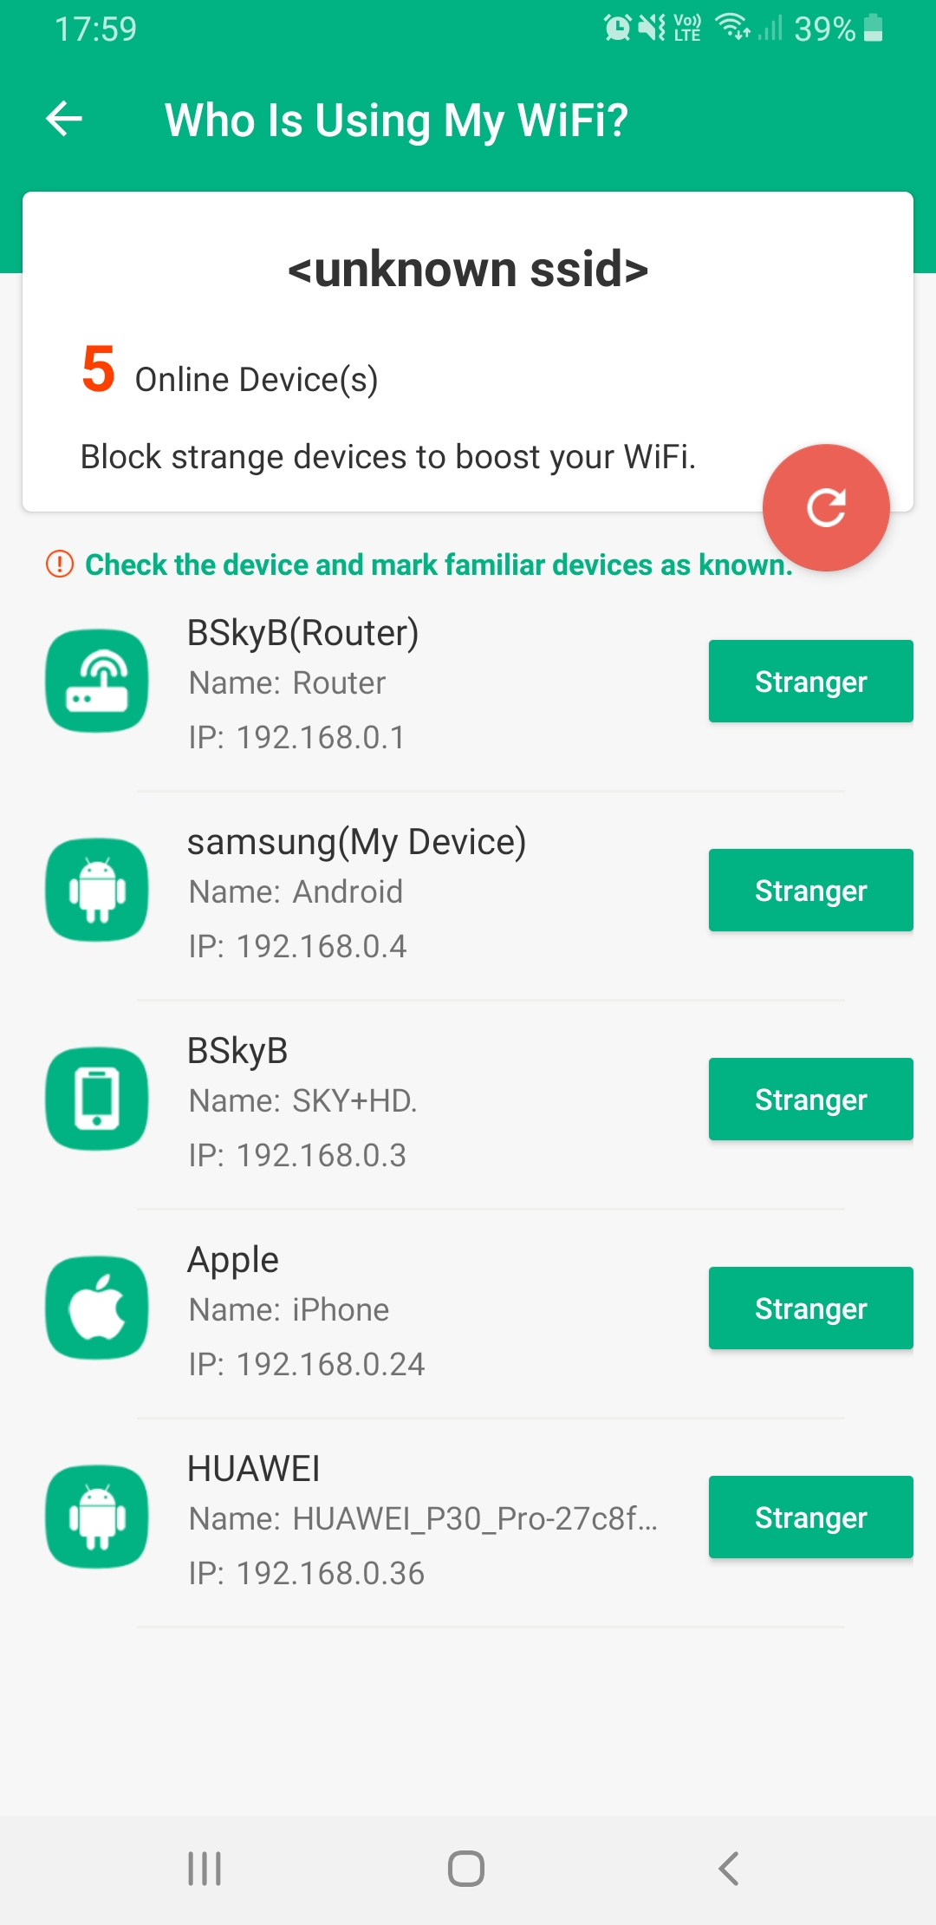
1.3 Networks

Slide 35
1.3 Networks

Slide 36
1.3 Networks

Slide 37
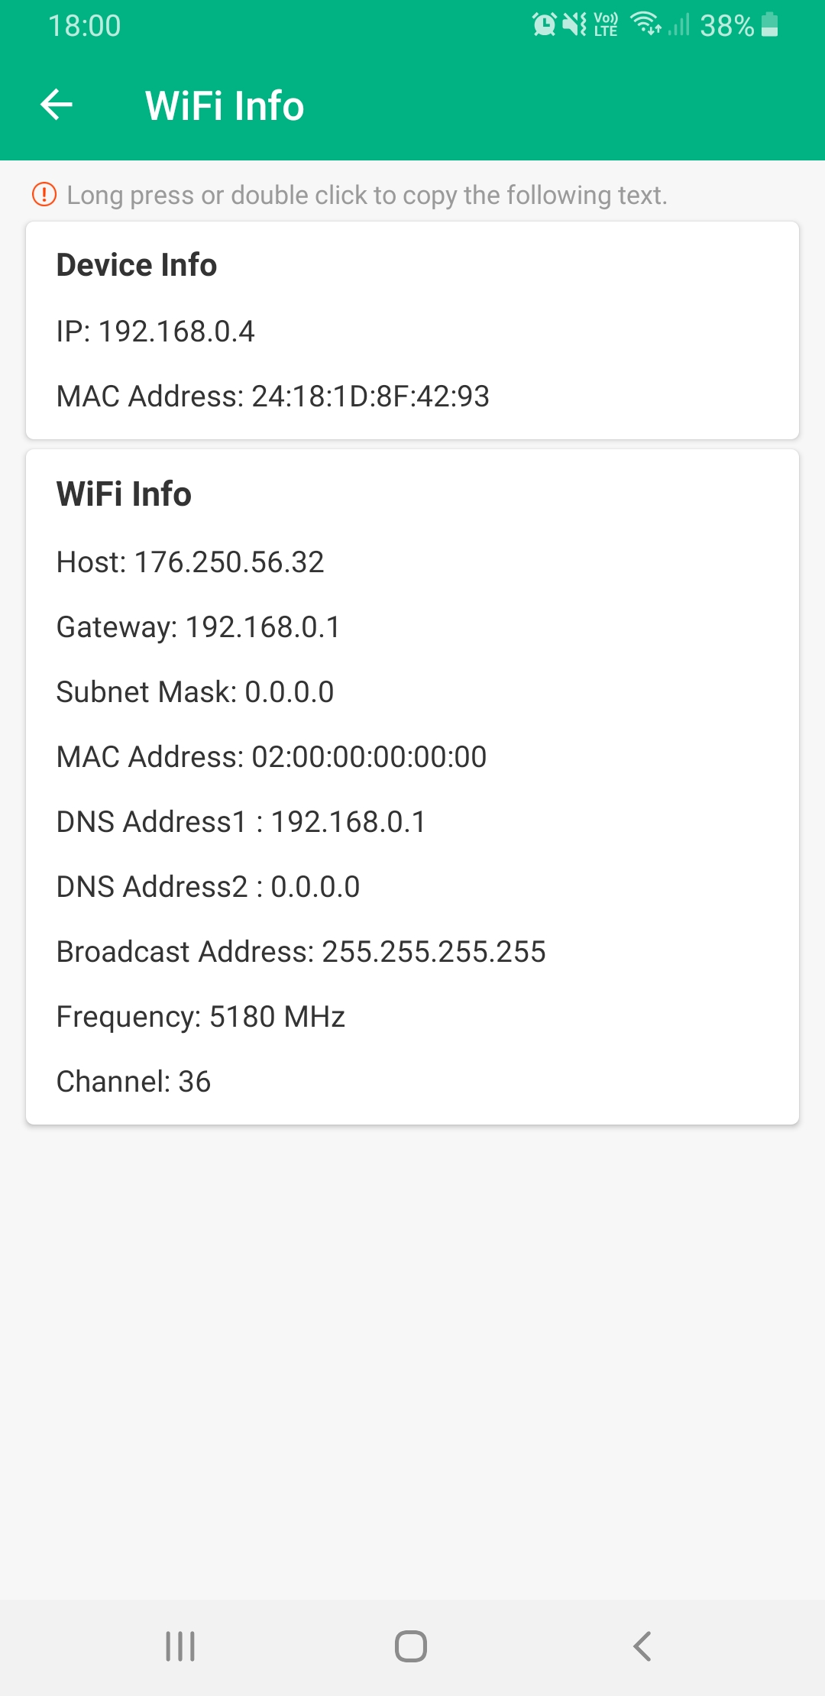
1.3 Networks

Slide 38
1.3 Networks

Slide 39
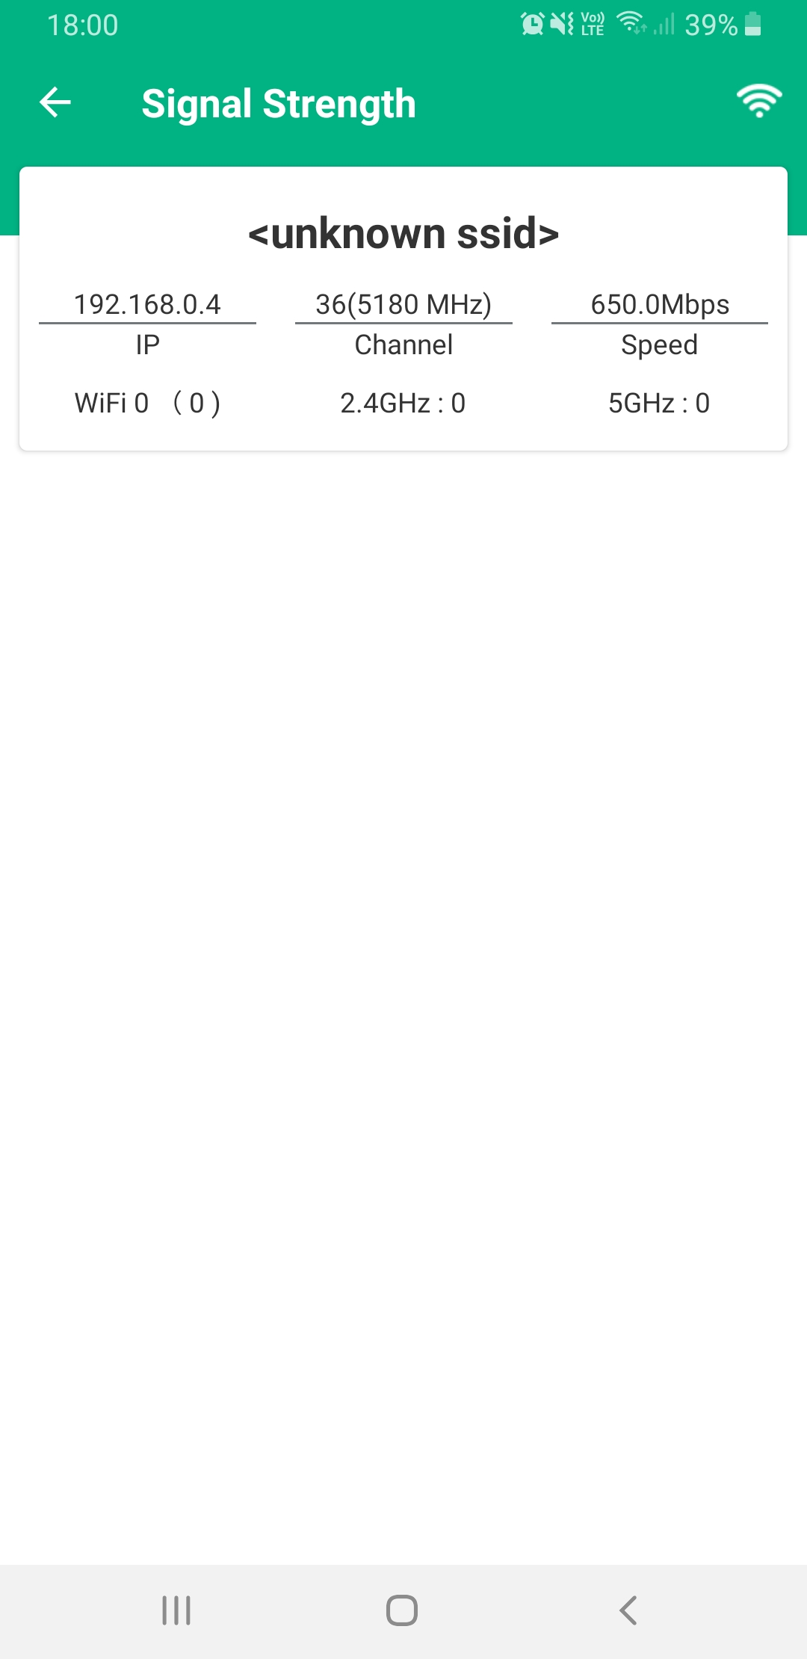
1.3 Networks

Slide 40
1.3 Networks
Why do IP addresses need to be unique?
Can they change?
Does your mobile phone change IP every time you log on your internet at home?

Slide 41
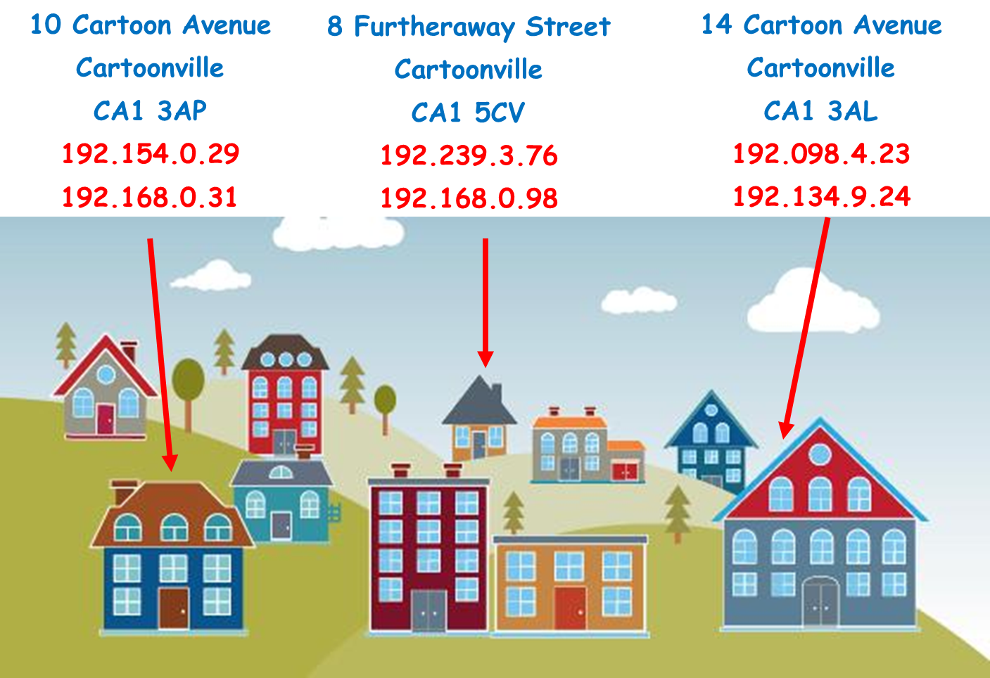
1.3 Networks

Slide 42
1.3 Networks
So if the IP address is unique, what is the point in having a unique MAC address?
Why do we even have MAC addresses?

Slide 43
1.3 Networks
MAC Addresses are assigned when hardware is born (created). Imagine this is your name (assume nobody else in the world has the same name as you)
IP Addresses are assigned depending on where you are and where you connect to the internet → Imagine this is your house address

Slide 44
1.3 Networks
MAC Addresses are assigned when hardware is born (created). Imagine this is your name (assume nobody else in the world has the same name as you).
IP Addresses are assigned depending on where you are and where you connect to the internet → Imagine this is your house address.

Slide 45
1.3 Networks
MAC Addresses are assigned when hardware is born (created) → Imagine this is your name (assume nobody else in the world has the same name as you).
IP Addresses are assigned depending on where you are and where you connect to the internet. Imagine this is your house address.

Slide 46
1.3 Networks
It is easier and quicker to send post to you knowing exactly where you live rather than by using your name
Routing data over the internet is easier when using an IP Address rather than a MAC Address

Slide 47
1.3 Networks
It is easier and quicker to send post to you knowing exactly where you live rather than by using your name
Routing data over the internet is easier when using an IP Address rather than a MAC Address

Slide 48
1.3 Networks
It is easier and quicker to send post to you knowing exactly where you live rather than by using your name
Routing data over the internet is easier when using an IP Address rather than a MAC Address

Slide 49
1.3 Networks
What is a protocol?
Where have you heard of the term protocol before?

Slide 50
1.3 Networks
A protocol is a set of rules that need to be followed.
There are lots of rules to follow when connecting to a network.

Slide 51
1.3 Networks
TCP/IP
HTTP
HTTPS
FTP
POP
IMAP
SMTP

Slide 52
1.3 Networks
TCP/IP
HTTP
HTTPS
FTP
POP
IMAP
SMTP

