Slide 1
OCR GCSE (9–1) in Computer Science (J277)
Computer Networks, Connections and Protocols
This pack is intended for students to use once they have covered the GCSE content, either in preparation for their L1 & L2 exam, or more likely alongside year 2 of the course to improve fluency, recall and pace on GCSE topics. It could be used as lesson starters, or supplied to students for independent use.

Slide 2
Bell Work
State the benefits of cloud computing.
Explain the role of the DNS.

Slide 3
1.3 Learn about WIFI and Ethernet.
1.3 Learn about WIFI and Ethernet.
State what a WIFI is.
Discuss the features of WIFI and Ethernet.
Explain how WIFI and Ethernet work.

Slide 4
1.3 Networks
A network topology is the arrangements of nodes of a network.
What is a node?

Slide 5
1.3 Networks

Slide 6
1.3 Networks
Switch / Hub

Slide 7
1.3 Networks
Hubs and switches connect devices together.
Are they nodes?
Switch / Hub

Slide 8
1.3 Networks
In a Mesh topology, each device (node) is connected to as many other devices (nodes) as possible.

Slide 9
1.3 Networks
Compare the positives and negatives of the star and mesh network topologies.
Cost
Data traffic
Node failure
Hub/switch failure

Slide 10
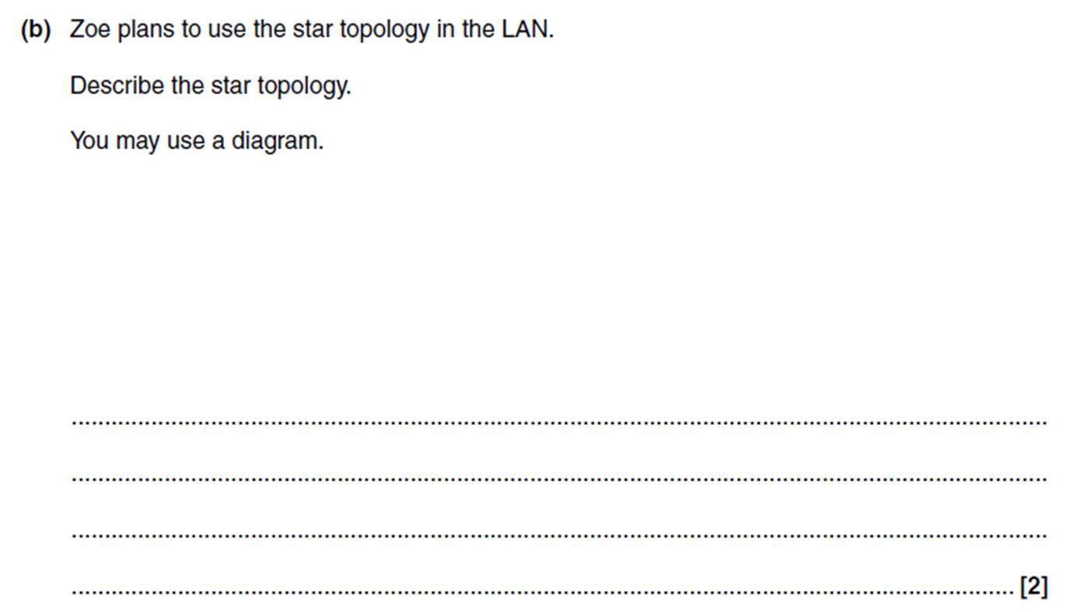
1.3 Networks

Slide 11
1.3 Networks
What is WIFI?
We have all used WIFI before but what does it actually do?

Slide 12
1.3 Networks
What is WIFI?
WIFI is the rules that we use to connect to a wireless network.
We have all used WIFI before but what does it actually do?

Slide 13
1.3 Networks
It allows your device to connect to the router without a cable.
Convenient!
However, it is much more complicated than just entering a password and off you go.

Slide 14
1.3 Networks
WIFI uses frequencies to send data.
What do frequencies do in Science?
How are waves used in Physics?

Slide 15
1.3 Networks
Frequencies are used to communicate with your device.
The device and the router must be on the same frequency.

Slide 16
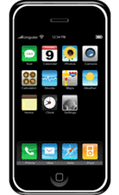
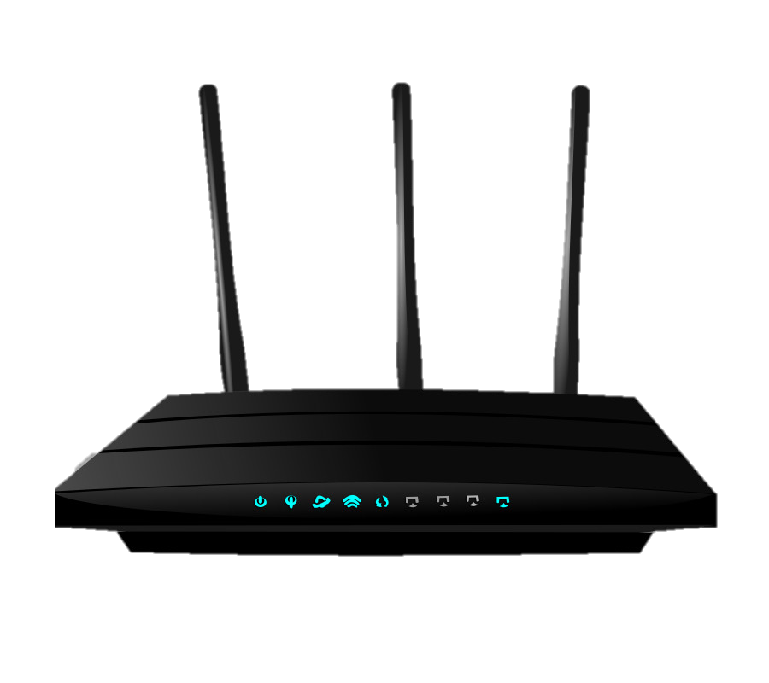
1.3 Networks

Slide 17
1.3 Networks
Router is set to frequency 3.5721

Slide 18
1.3 Networks
Rather than remembering the exact frequency we just give it a channel name.
Router is set to frequency 3.5721

Slide 19
1.3 Networks
Router is set to channel 1

Slide 20
1.3 Networks
Both devices are set to channel 1.

Slide 21
1.3 Networks
Perfect connection is established.

Slide 22
1.3 Networks
What if my phone is set to channel 2?

Slide 23
1.3 Networks
No connection is made. Why not?

Slide 24
1.3 Networks
The devices are on different channels.

Slide 25
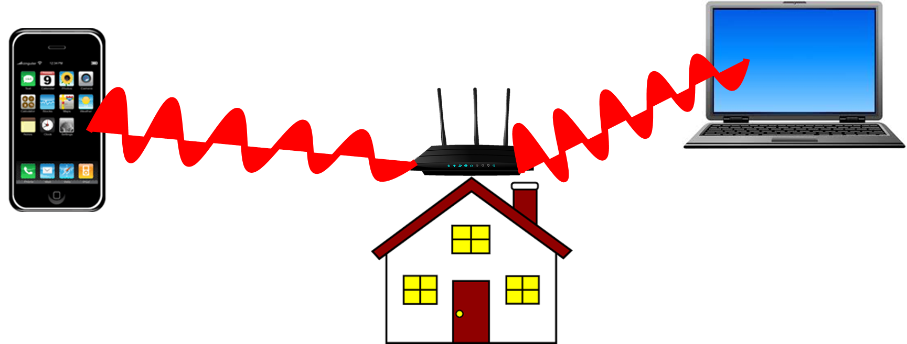
1.3 Networks

Slide 26
1.3 Networks
What will happen if both routers are set to the same channel?
e.g. channel 5?

Slide 27
1.3 Networks
Interference!
This will slow down your WIFI

Slide 28
1.3 Networks
So WIFI frequencies (channels) must be set to…

Slide 29
1.3 Networks
So WIFI frequencies (channels) must be set to…
Device
Interference

Slide 30
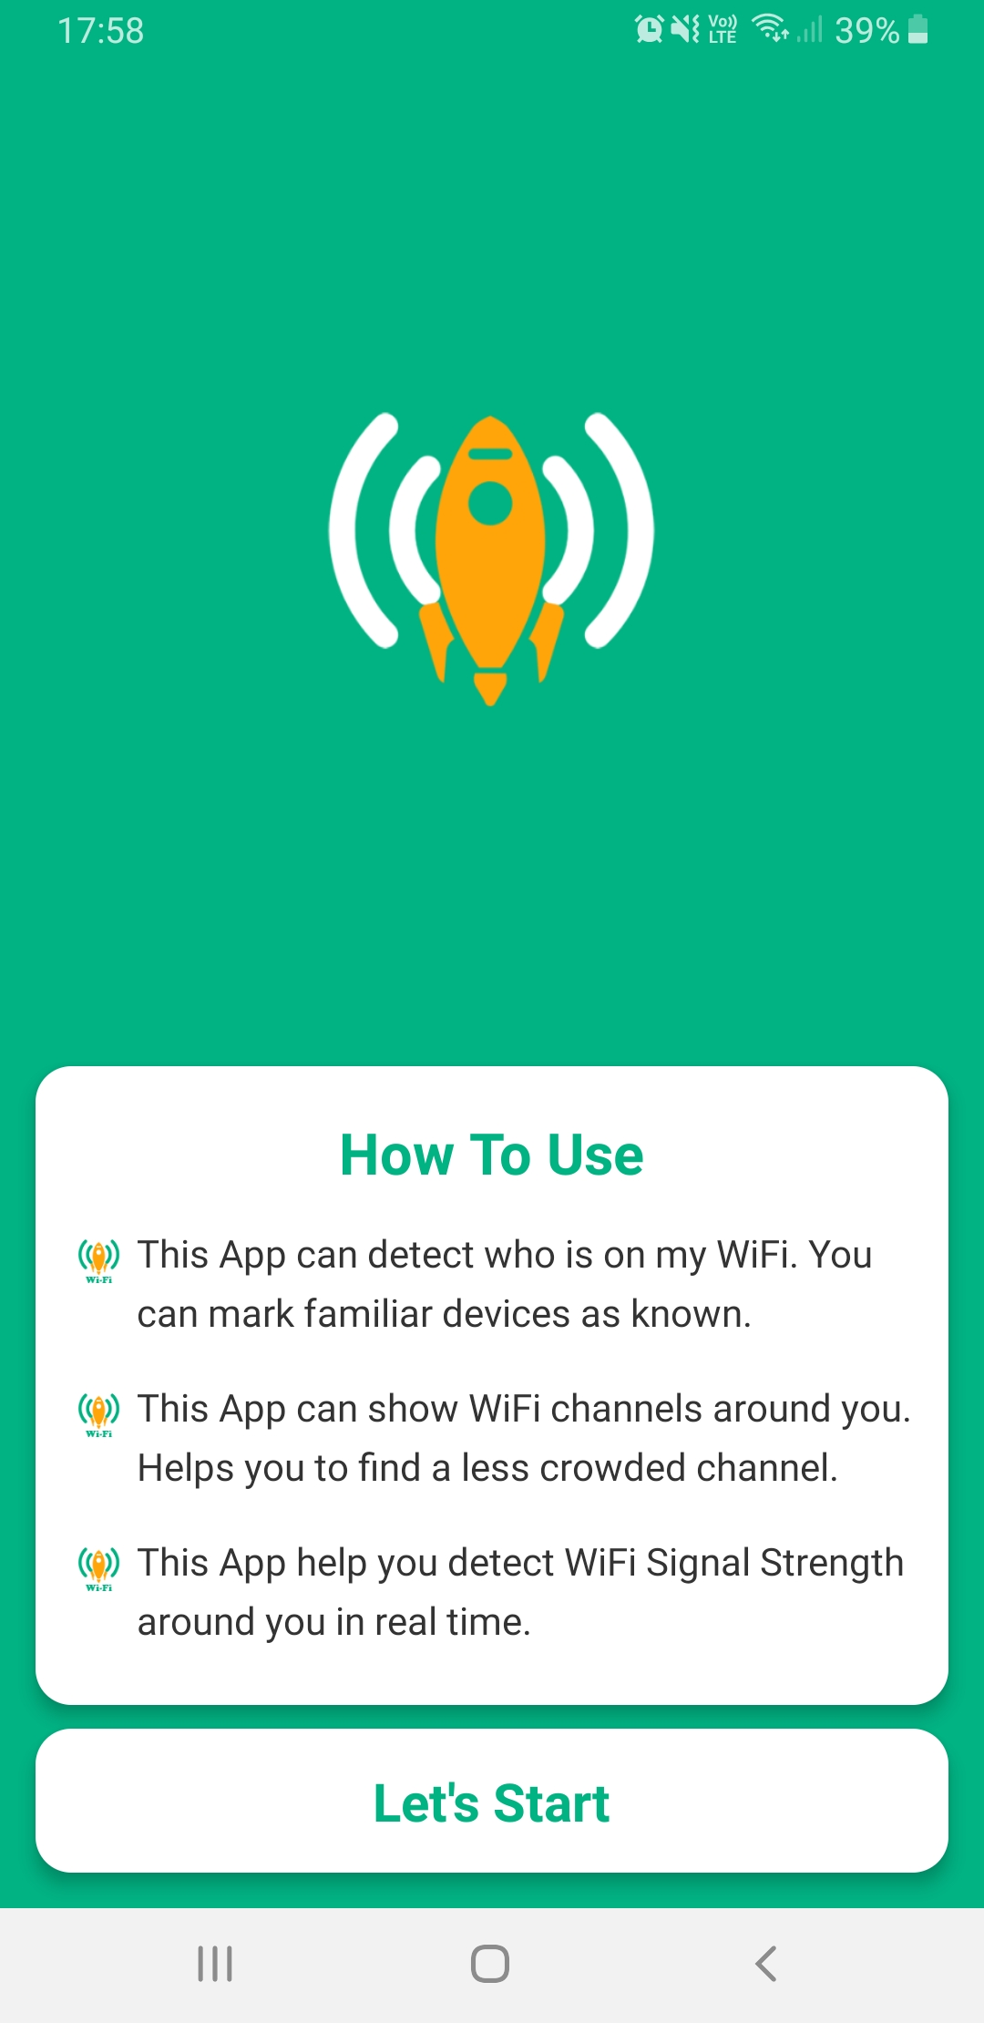
1.3 Networks

Slide 31
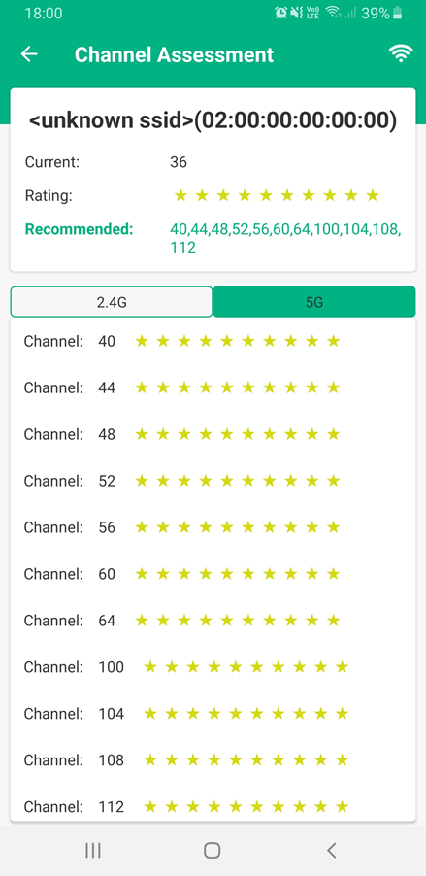
1.3 Networks

Slide 32
1.3 Networks

Slide 33
1.3 Networks

Slide 34
1.3 Networks
The problem with wireless networks is that they are relatively easy to break into.
They allow other people to get access to your network. What can we do to stop them seeing our data?

Slide 35
1.3 Networks
Encryption.
What is encryption?
Why would we have it?

Slide 36
1.3 Networks
Scrambling of data, to make it harder to read your data if it is intercepted.
You can only read the data if you have the master key to unscramble it.

Slide 37
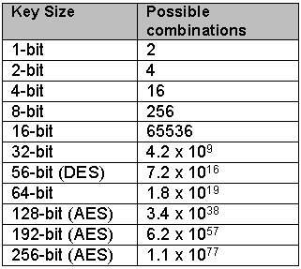
1.3 Networks
Scrambling of data, makes it harder to read your data if it is intercepted.

Slide 38
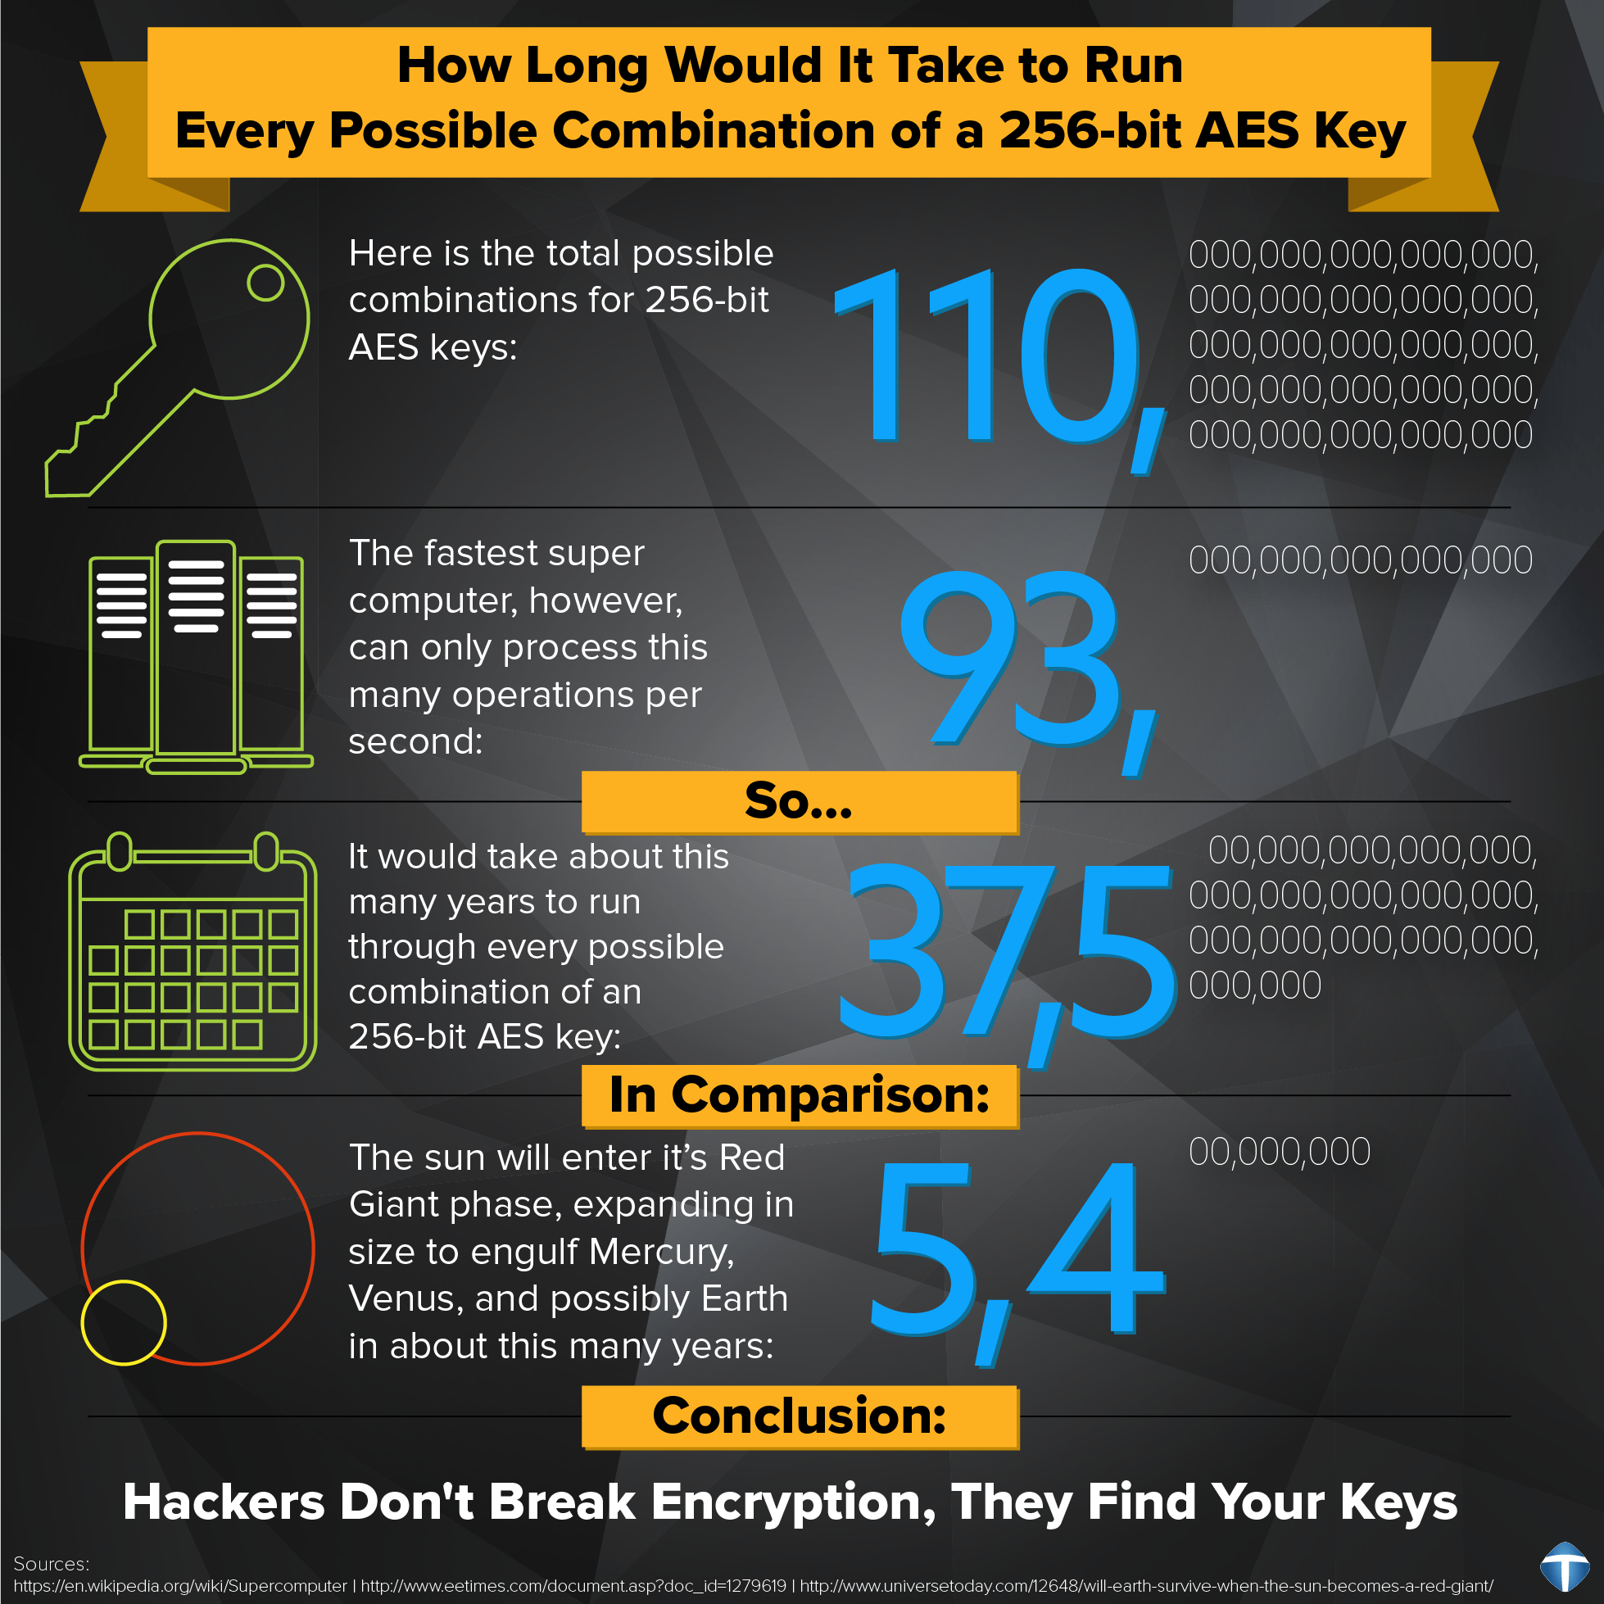
1.3 Networks

Slide 39
1.3 Networks
Caesar Cipher is a basic form of encryption.
It uses a key to change the message.

Slide 40
1.3 Networks
A | B | C | D | E | F | G | H | I | J | K | L | M | N | O | P | Q | R | S | T | U | V | W | X | Y | Z
E | F | G | H | I | J | K | L | M | N | O | P | Q | R | S | T | U | V | W | X | Y | Z | A | B | C | D
This is Caesar Cipher encryption. Is uses a key to change letters.
What is the key?

Slide 41
1.3 Networks
A | B | C | D | E | F | G | H | I | J | K | L | M | N | O | P | Q | R | S | T | U | V | W | X | Y | Z
E | F | G | H | I | J | K | L | M | N | O | P | Q | R | S | T | U | V | W | X | Y | Z | A | B | C | D
The key is 4.
COMPUTING becomes GSQTYXMRK

Slide 42
1.3 Networks
A | B | C | D | E | F | G | H | I | J | K | L | M | N | O | P | Q | R | S | T | U | V | W | X | Y | Z
E | F | G | H | I | J | K | L | M | N | O | P | Q | R | S | T | U | V | W | X | Y | Z | A | B | C | D
QV NSCRWSR MW
XLI KVIEXIWX

Slide 43
1.3 Networks
A | B | C | D | E | F | G | H | I | J | K | L | M | N | O | P | Q | R | S | T | U | V | W | X | Y | Z
E | F | G | H | I | J | K | L | M | N | O | P | Q | R | S | T | U | V | W | X | Y | Z | A | B | C | D
QV NSCRWSR MW
XLI KVIEXIWX
MR JOYNSON IS

Slide 44
1.3 Networks
A | B | C | D | E | F | G | H | I | J | K | L | M | N | O | P | Q | R | S | T | U | V | W | X | Y | Z
E | F | G | H | I | J | K | L | M | N | O | P | Q | R | S | T | U | V | W | X | Y | Z | A | B | C | D
QV NSCRWSR MW
XLI KVIEXIWX
MR JOYNSON IS
THE GREATEST

Slide 45
1.3 Networks
Shaun has not encrypted his data before sending it via email.
Explain to Shaun what is meant by the term encryption. [2]

Slide 46
1.3 Networks
Explain how encryption works to protect data. [2]

Slide 47
1.3 Networks
What is an Ethernet cable?
Is Ethernet the same as the internet?

Slide 48
1.3 Networks
Ethernet is the standard rules used to send data over a wired connection.
It is the wired version of WIFI.
In UTP cables, one of the wires is used to send data while the other receives data.

Slide 49
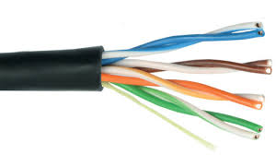
1.3 Networks

Slide 50
1.3 Networks
Data is sent via Ethernet in frames.
Each of these frames carries up to 1500 bytes of information.
It is like a box that contains part of the information.

Slide 51
1.3 Networks
Each frame contains a wealth of information that is useful to the computer.
Mac Addresses of sender and receiver
CRC checking for errors
The data being sent/received

Slide 52
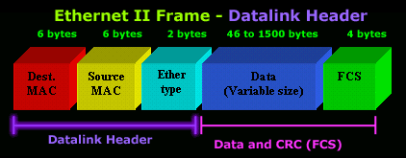
1.3 Networks

