Slide 1
OCR GCSE (9–1) in Computer Science (J277)
Computer Networks, Connections and Protocols
This pack is intended for students to use once they have covered the GCSE content, either in preparation for their L1 & L2 exam, or more likely alongside year 2 of the course to improve fluency, recall and pace on GCSE topics. It could be used as lesson starters, or supplied to students for independent use.

Slide 2
Bell Work
State the difference between the internet and the WWW.
Explain what a VPN is.
Why is a VPN preferable to businesses with not a lot of money.

Slide 3
1.3 Learn about DNS, Hosting, Cloud Computing, Wired and Wireless Networks
1.3 Learn about DNS, Hosting, Cloud Computing, Wired and Wireless Networks
State what the internet and WWW are.
Explain what a VPN is.
Compare the internet, WWW and VPNs.

Slide 4
1.3 Networks
What is a network?
A computer network is two or more devices connected together so they can communicate

Slide 5
1.3 Networks
What is the internet?
The internet is a collection of LANs all connected together. The worlds biggest network.
Is the WWW different from the internet?
The WWW is the service that runs on the network. Kind of like a bus on a road
How would you explain the two?

Slide 6
1.3 Networks
What is the internet?
The internet is a collection of LANs all connected together. The worlds biggest network.
Is the WWW different from the internet?
The WWW is the service that runs on the network. Kind of like a bus on a road
How would you explain the two?

Slide 7
1.3 Networks
What is the internet?
The internet is a collection of LANs all connected together. The worlds biggest network.
Is the WWW different from the internet?
The WWW is the service that runs on the network. Kind of like a bus on a road.
How would you explain the two?

Slide 8
1.3 Networks

Slide 9
1.3 Networks
The internet

Slide 10
1.3 Networks
The internet

Slide 11
1.3 Networks
The internet

Slide 12
1.3 Networks
The internet

Slide 13
1.3 Networks
The internet
The WWW

Slide 14
1.3 Networks
How do you access the internet?
You access the internet via a connection to your ISP.
Who provides it to you?
You ISP provides you with a connection. They maintain your connection to their network.

Slide 15
1.3 Networks
What does the word virtual mean?
Virtual means it does not exist physically but appears to exist.
What is virtual reality?
Virtual reality is a life within a game or computer.

Slide 16
1.3 Networks
Definition
A virtual private network extends a private network across a public network, and enables users to send and receive data across shared or public networks as if their computing devices were directly connected to the private network
Private / Data / Directly / Public

Slide 17
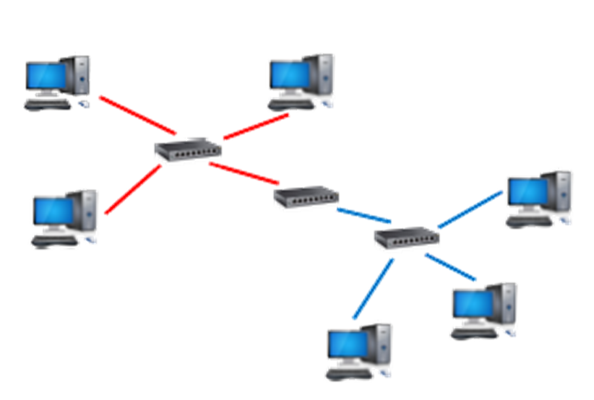
1.3 Networks

Slide 18
1.3 Networks

Slide 19
1.3 Networks

Slide 20
1.3 Networks

Slide 21
1.3 Networks

Slide 22
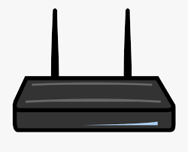
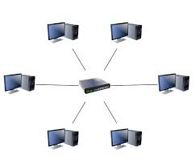
1.3 Networks
My house
TOAN
Now I can access their network as though I am actually in school.

Slide 23
1.3 Networks
So what’s the point of a VPN?
Scalability – Users can be connected to different switches but appear on the same network, meaning bandwidth is used more efficiently
Security – Users cannot access secure files even if they are connected to the same switch
Cost – As the business changes you don’t need to change the network infrastructure, you just add additional VLANs

Slide 24
1.3 Networks
What is a domain name on a website?
A domain name is the name of a website that the human remembers – like google.com or bbc.co.uk
What do you think a domain name server is?
A domain name server stores the names of the servers and the addresses that these websites “live” at.
A domain name is…
A domain name server…

Slide 25
1.3 Networks
What is a domain name on a website?
A domain name is the name of a website that the human remembers – like google.com or bbc.co.uk
What do you think a domain name server is?
A domain name server stores the names of the servers and the addresses that these websites “live” at.
A domain name server…

Slide 26
1.3 Networks
What is a domain name on a website?
A domain name is the name of a website that the human remembers – like google.com or bbc.co.uk
What do you think a domain name server is?
A domain name server stores the names of the servers and the addresses that these websites “live” at.

Slide 27
1.3 Networks

Slide 28
1.3 Networks

Slide 29
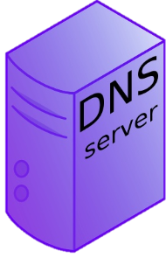
1.3 Networks

Slide 30
1.3 Networks

Slide 31
1.3 Networks

Slide 32
1.3 Networks

Slide 33
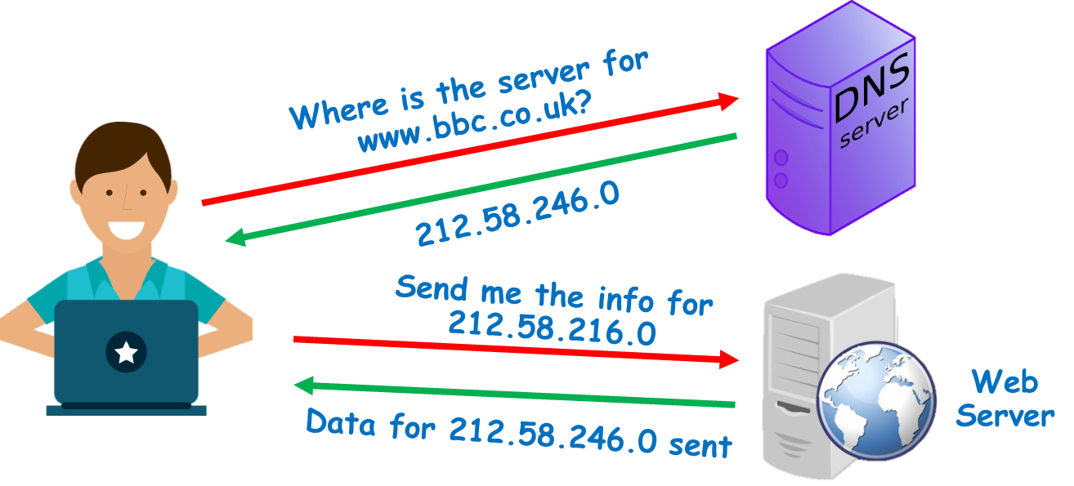
1.3 Networks

Slide 34
1.3 Networks
A DNS (Domain Name Server) is a special server on the internet.
Their job is to convert URL’s the user types in into IP Addresses, so the locations of web pages can be found

Slide 35
1.3 Networks
A DNS (Domain Name Server) is a special server on the internet.
Their job is to convert URL’s the user types in into IP Addresses, so the locations of web pages can be found

Slide 36
1.3 Networks
What would happen if we did not have a DNS?
Would the internet be easier or harder to use?
Without DNS, users would have to remember IP addresses rather than URLs.

Slide 37
1.3 Networks
Without DNS, users would have to remember IP addresses rather than URLs
Would the internet be easier or harder to use?
Without DNS, users would have to remember IP addresses rather than URLs.
Think about all the websites you can remember off the top of your head. Imagine having to remember IP Addresses like 212.58.246.0 for each one instead!

Slide 38
1.3 Networks
What is hosting?
What is meant by hosting a website?
When Facebook goes down what happens to their host?

Slide 39
1.3 Networks
Data / Accessible / Security / Server
In order for a website to be accessible over the internet, it must be hosted
This is when all the data for websites is stored on dedicated servers for users to access
Hosts offer 24/7 access to your website, security for your website, and access for multiple users without crashing.
However, if the hosts server goes down, so does your website!

Slide 40
1.3 Networks
Data / Accessible / Security / Server
In order for a website to be accessible over the internet, it must be hosted
This is when all the data for websites is stored on dedicated servers for users to access
Hosts offer 24/7 access to your website, security for your website, and access for multiple users without crashing.
However, if the hosts server goes down, so does your website!

Slide 41
1.3 Networks
Data / Accessible / Security / Server
In order for a website to be accessible over the internet, it must be hosted
This is when all the data for websites is stored on dedicated servers for users to access
Hosts offer 24/7 access to your website, security for your website, and access for multiple users without crashing.
However, if the hosts server goes down, so does your website!

Slide 42
1.3 Networks
Data / Accessible / Security / Server
In order for a website to be accessible over the internet, it must be hosted
This is when all the data for websites is stored on dedicated servers for users to access
Hosts offer 24/7 access to your website, security for your website, and access for multiple users without crashing.
However, if the hosts server goes down, so does your website!

Slide 43
1.3 Networks
Data / Accessible / Security / Server
In order for a website to be accessible over the internet, it must be hosted
This is when all the data for websites is stored on dedicated servers for users to access
Hosts offer 24/7 access to your website, security for your website, and access for multiple users without crashing.
However, if the hosts server goes down, so does your website!

Slide 44
1.3 Networks
State the role of a DNS.
State what hosting is.
Explain the benefits of having a DNS.

Slide 45
1.3 Networks
What is cloud computing?
Have you ever used cloud storage before?
Why would you use cloud computing?

Slide 46
1.3 Networks
What is cloud computing?
Have you ever used cloud storage before?
Why would you use cloud computing?

Slide 47
1.3 Networks
Cloud Computing is when your data and applications are stored on the internet, rather than locally (actually on your device).
People store large amounts of data on the cloud, such as photos, word documents and presentations.
Cloud storage is basically storing information on another companies computer and accessing your data over the internet.

Slide 48
1.3 Networks

Slide 49
1.3 Networks

Slide 50
1.3 Networks
So what are the positives of storing information and apps on the cloud?
Why are they in so much demand?

Slide 51
1.3 Networks
So what are the positives of storing information and apps on the cloud?
Why are they in so much demand?

Slide 52
1.3 Networks

Slide 53
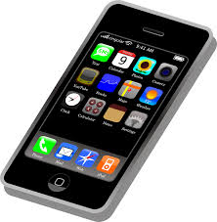
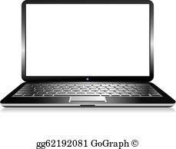
1.3 Networks

Slide 54
1.3 Networks

Slide 55
1.3 Networks

Slide 56
1.3 Networks

Slide 57
1.3 Networks

Slide 58
1.3 Networks

Slide 59
1.3 Networks

Slide 60
1.3 Networks

Slide 61
1.3 Networks
What is one HUGE negative with this?

Slide 62
1.3 Networks
No internet?

Slide 63
1.3 Networks

Slide 64
1.3 Networks

Slide 65
1.3 Networks
What about security?

Slide 66
1.3 Networks

Slide 67
1.3 Networks

Slide 68
1.3 Networks

Slide 69
1.3 Networks
Positives
Work on the go, wherever you go, as long as you have internet connection.
Data is backed up and can be recovered if device breaks.
Apps update automatically – you don’t need to update.
Apps are usually free.

Slide 70
1.3 Networks
Negatives
Small amount of storage is free, then need to pay.
Can lose copyrights over work.
Data can be hacked easily.
No internet = no access to files.

Slide 71
1.3 Networks
Wired v wireless – which is best?

Slide 72
1.3 Networks
Wired v wireless – which is best?
Range
Security
Cost

Slide 73
1.3 Networks
Wired v wireless – which is best?
Range – wireless – why?
Security
Cost

Slide 74
1.3 Networks
Wired v wireless – which is best?
Range – wireless – why?
Security – wired – why?
Cost

Slide 75
1.3 Networks
Wired v wireless – which is best?
Range – wireless – why?
Security – wired – why?
Cost – wireless – why?

Slide 76
1.3 Networks
Wired v wireless – which is best?
Range – wireless – why?
Security – wired – why?
Cost – wireless – why?

Slide 77
1.3 Networks
State the benefits of cloud computing.

Slide 78
1.3 Networks
Discuss the negatives of cloud computing.

Slide 79
1.3 Networks
Compare wired and wireless networks.

Slide 80
1.3 Networks
Compare wired and wireless networks.
Range
Security
Cost

