Slide 1
OCR GCSE (9–1) in Computer Science (J277)
Computer Networks, Connections and Protocols
This pack is intended for students to use once they have covered the GCSE content, either in preparation for their L1 & L2 exam, or more likely alongside year 2 of the course to improve fluency, recall and pace on GCSE topics. It could be used as lesson starters, or supplied to students for independent use.

Slide 2
Bell Work
State what a server is and what it’s role is in a client-server network.

Slide 3
1.3 Learn about the internet, the WWW and VPNs.
1.3 Learn about the internet, the WWW and VPNs.
State what the internet and WWW are.
Explain what a VPN is.
Compare the internet, WWW and VPNs.

Slide 4

1.3 Networks
What is a network?
A computer network is two or more devices connected together so they can communicate

Slide 5
1.3 Networks
What is a network?
A computer network is two or more devices connected together so they can communicate

Slide 6
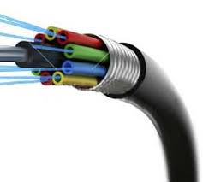
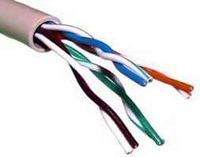
1.3 Networks

Slide 7
1.3 Networks
Bandwidth
The number of errors that occur when data is transferred. The higher this is, the more frequently data has to be resent before arriving safely
Number of Users
The amount of data that can be sent and received successfully in a given time. Measured in Mbps
Transmission Media
This is the delay between sending data and receiving data. This can be increased by not having sufficient hardware to direct traffic around the network correctly
Error Rate
This is the number of people using the network at one time. The higher this is, the more traffic on the network and the more bandwidth being used, the slower the network will be
Latency
This is the media/hardware you choose to use on your network. The better this is, the better your network will perform

Slide 8
1.3 Networks
Router
Switch
Hub
Used to send data around a network. It sends data to all devices on the network, not just to the correct recipient
Used to send data between multiple networks. You cannot access the internet without one of these. Uses IP Addresses to direct data
Used to send data around a network. It sends data to just the correct recipient, not all devices on the network

Slide 9
1.3 Networks
NIC
WAP
Cable
Connects a device to a wired or wireless network. It is built into the device. It uses protocols to ensure communication is consistent
Used to create a wired network. There are two main types: Copper Cables, and Fibre Optic
Used to connect a device to a network wirelessly, without any cables

Slide 10
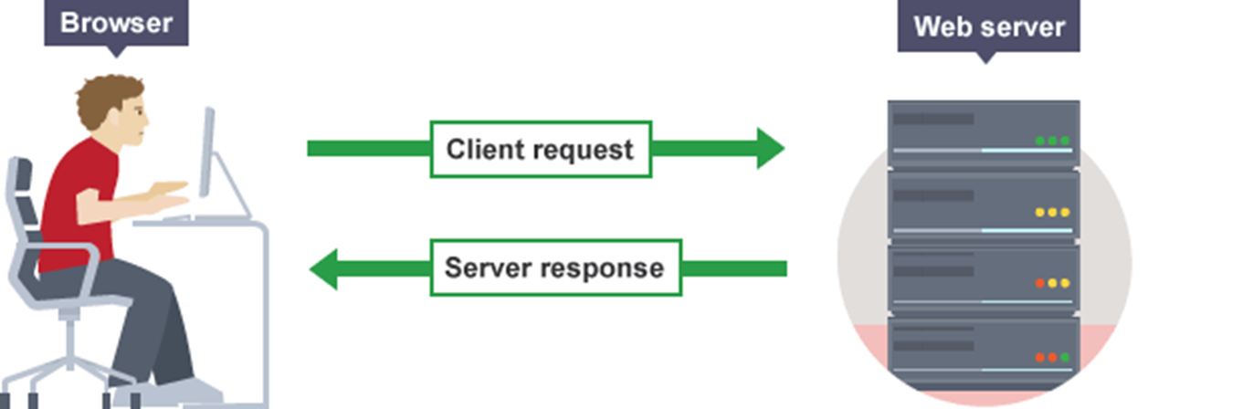
1.3 Networks

Slide 11
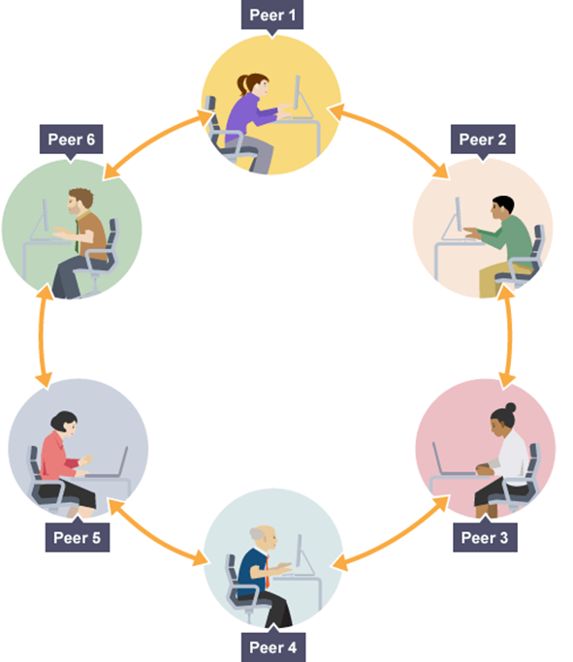
1.3 Networks

Slide 12
1.3 Networks
How the Client-Server model works:
1) The client makes a service request to the server (e.g. using a web browser for a website)
2) The server receives the request, processes it, and sends all the requested information back to the client

Slide 13
1.3 Networks
1) The client makes a service request (e.g. using a web browser for a website).
2) This will be passed to the first device, which will check its files and storage to see if it has the information. If it does, it will send it back. If it doesn’t, it will pass the request on to the next device, and so on.

Slide 14
1.3 Networks
What is the internet?
The internet is a collection of LANs all connected together. The worlds biggest network.
Is the WWW different from the internet?
The WWW is the service that runs on the network. Kind of like a bus on a road
How would you explain the two?

Slide 15
1.3 Networks
What is the internet?
The internet is a collection of LANs all connected together. The worlds biggest network.
Is the WWW different from the internet?
The WWW is the service that runs on the network. Kind of like a bus on a road
How would you explain the two?

Slide 16
1.3 Networks
What is the internet?
The internet is a collection of LANs all connected together. The worlds biggest network.
Is the WWW different from the internet?
The WWW is the service that runs on the network. Kind of like a bus on a road.
How would you explain the two?

Slide 17

1.3 Networks

Slide 18
1.3 Networks
The internet

Slide 19

1.3 Networks
The internet

Slide 20

1.3 Networks
The internet

Slide 21
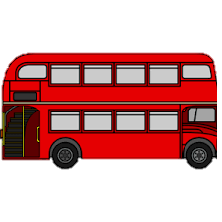
1.3 Networks
The internet

Slide 22
1.3 Networks
The internet
The WWW

Slide 23
1.3 Networks
How do you access the internet?
You access the internet via a connection to your ISP.
Who provides it to you?
You ISP provides you with a connection. They maintain your connection to their network.

Slide 24
1.3 Networks
How do you access the internet?
You access the internet via a connection to your ISP.
Who provides it to you?
You ISP provides you with a connection. They maintain your connection to their network.

Slide 25
1.3 Networks
How do you access the internet?
You access the internet via a connection to your ISP.
Who provides it to you?
You ISP provides you with a connection. They maintain your connection to their network.

Slide 26
1.3 Networks
State the difference between the internet and the WWW.
The internet is a collection of LANs connected together, the WWW is a service that runs on the internet.

Slide 27
1.3 Networks
State the difference between the internet and the WWW.
The internet is a collection of LANs connected together, the WWW is a service that runs on the internet.

Slide 28
1.3 Networks
What does the word virtual mean?
Virtual means it does not exist physically but appears to exist.
What is virtual reality?
Virtual reality is a life within a game or computer.

Slide 29
1.3 Networks
What does the word virtual mean?
Virtual means it does not exist physically but appears to exist.
What is virtual reality?
Virtual reality is a life within a game or computer.

Slide 30
1.3 Networks
What does the word virtual mean?
Virtual means it does not exist physically but appears to exist.
What is virtual reality?
Virtual reality is a life within a game or computer.

Slide 31
1.3 Networks
So what is a virtual network then?
A Virtual Network is when the logical structure is applied to a network independent of the physical structure. Sometimes these are called VPNs.
What does a virtual network look like?

Slide 32
1.3 Networks
So what is a virtual network then?
A Virtual Network is when the logical structure is applied to a network independent of the physical structure. Sometimes these are called VPNs.
What does a virtual network look like?

Slide 33
1.3 Networks
Definition
A virtual private network extends a private network across a public network, and enables users to send and receive data across shared or public networks as if their computing devices were directly connected to the private network

Slide 34
1.3 Networks
Definition
A virtual private network extends a private network across a public network, and enables users to send and receive data across shared or public networks as if their computing devices were directly connected to the private network
Private / Data / Directly / Public

Slide 35
1.3 Networks
Definition
A virtual private network extends a private network across a public network, and enables users to send and receive data across shared or public networks as if their computing devices were directly connected to the private network
Private / Data / Directly / Public

Slide 36
1.3 Networks
Definition
A virtual private network extends a private network across a public network, and enables users to send and receive data across shared or public networks as if their computing devices were directly connected to the private network
Private / Data / Directly / Public

Slide 37
1.3 Networks
Definition
A virtual private network extends a private network across a public network, and enables users to send and receive data across shared or public networks as if their computing devices were directly connected to the private network
Private / Data / Directly / Public

Slide 38
1.3 Networks
Definition
A virtual private network extends a private network across a public network, and enables users to send and receive data across shared or public networks as if their computing devices were directly connected to the private network
Private / Data / Directly / Public

Slide 39
1.3 Networks
Below we have an example of two separate LANs in a company connected together
The red lines show a LAN for a sales team
The blue lines show a LAN for a customer services team
Both LANs are then connected together so data and files can be shared
Both LANs are independent, but are connected together so they can communicate

Slide 40
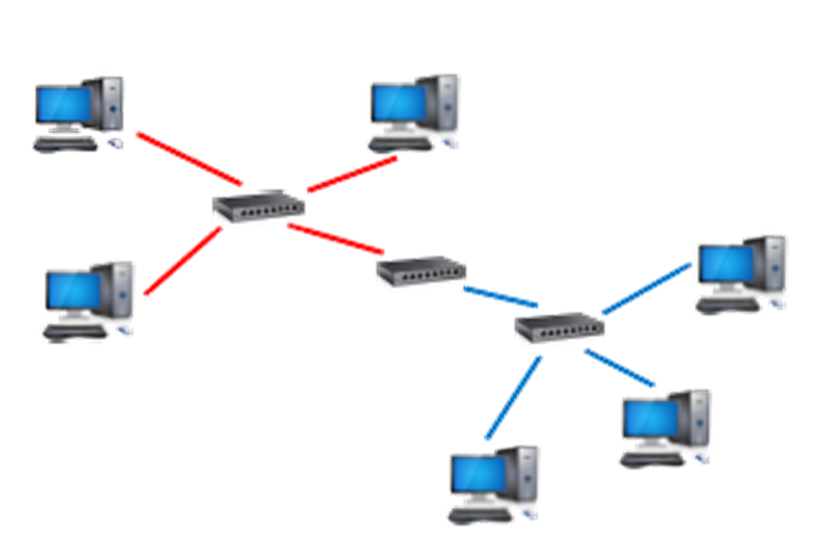
1.3 Networks

Slide 41
1.3 Networks

Slide 42
1.3 Networks

Slide 43
1.3 Networks

Slide 44
1.3 Networks

Slide 45
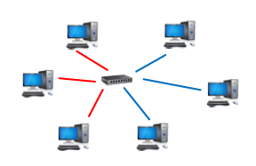
1.3 Networks
Below we have an example of a Virtual Network
The red lines show a LAN for a sales team
The blue lines show a LAN for a customer services team
However although it appears as it is one LAN using one switch, the logic of two networks is still maintained
For example, the sales team would not be able to access confidential files the customer services team can access despite being connected by the same switch

Slide 46
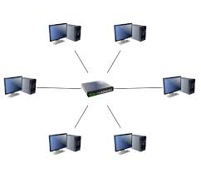

1.3 Networks

Slide 47
1.3 Networks
TOAN

Slide 48
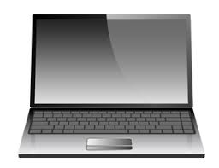

1.3 Networks
My house
TOAN

Slide 49
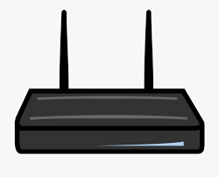
1.3 Networks
My house
TOAN

Slide 50
1.3 Networks
My house
TOAN
Currently I cannot access the files I have saved at school on their private network.

Slide 51
1.3 Networks
My house
TOAN
Make a connection to the private network.

Slide 52
1.3 Networks
My house
TOAN
Now I can access their network as though I am actually in school.

Slide 53
1.3 Networks
So what’s the point of a VPN?

Slide 54
1.3 Networks
So what’s the point of a VPN?
Scalability – Users can be connected to different switches but appear on the same network, meaning bandwidth is used more efficiently
Security – Users cannot access secure files even if they are connected to the same switch
Cost – As the business changes you don’t need to change the network infrastructure, you just add additional VLANs

Slide 55
1.3 Networks
So what’s the point of a VPN?
Scalability – Users can be connected to different switches but appear on the same network, meaning bandwidth is used more efficiently
Security – Users cannot access secure files even if they are connected to the same switch
Cost – As the business changes you don’t need to change the network infrastructure, you just add additional VLANs

Slide 56
1.3 Networks
So what’s the point of a VPN?
Scalability – Users can be connected to different switches but appear on the same network, meaning bandwidth is used more efficiently
Security – Users cannot access secure files even if they are connected to the same switch
Cost – As the business changes you don’t need to change the network infrastructure, you just add additional VLANs

Slide 57
1.3 Networks
So what’s the point of a VPN?
Scalability – Users can be connected to different switches but appear on the same network, meaning bandwidth is used more efficiently
Security – Users cannot access secure files even if they are connected to the same switch
Cost – As the business changes you don’t need to change the network infrastructure, you just add additional VLANs

Slide 58
1.3 Networks
TOAN uses a virtual network.
When staff go home and turn on their laptops, they can still connect to all the schools drives. It appears like they are in school, when actually they are not.
A virtual network has been created, independent of the physical structure (which in this case does not exist).

Slide 59
1.3 Networks
State what a VPN is.

