Slide 1
OCR GCSE (9–1) in Computer Science (J277)
Computer Networks, Connections and Protocols
This pack is intended for students to use once they have covered the GCSE content, either in preparation for their L1 & L2 exam, or more likely alongside year 2 of the course to improve fluency, recall and pace on GCSE topics. It could be used as lesson starters, or supplied to students for independent use.

Slide 2
Bell Work
John is unsure whether to buy a hub or a switch. Explain to John the positives and negatives of using a hub and switch. [4]

Slide 3
Bell Work
Comparatively Expensive
Less technical
Comparatively cheap
Comparatively Faster
More technical
Comparatively Slower

Slide 4
1.3 Learn about client-server and peer-to-peer networks.
1.3 Learn about client-server and peer-to-peer networks.
State what the set up of the 2 network types are.
Explain the benefits of the network types.
Compare negatives for the network types.

Slide 5
1.3 Networks
What is a network?
A computer network is two or more devices connected together so they can communicate

Slide 6
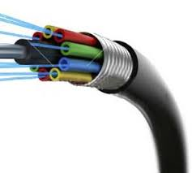
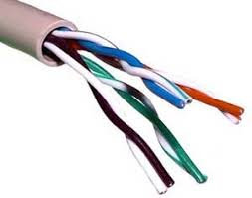
1.3 Networks

Slide 7
1.3 Networks
Bandwidth
The number of errors that occur when data is transferred. The higher this is, the more frequently data has to be resent before arriving safely
Number of Users
The amount of data that can be sent and received successfully in a given time. Measured in Mbps
Transmission Media
This is the delay between sending data and receiving data. This can be increased by not having sufficient hardware to direct traffic around the network correctly
Error Rate
This is the number of people using the network at one time. The higher this is, the more traffic on the network and the more bandwidth being used, the slower the network will be
Latency
This is the media/hardware you choose to use on your network. The better this is, the better your network will perform

Slide 8
1.3 Networks
Router
Switch
Hub
Used to send data around a network. It sends data to all devices on the network, not just to the correct recipient
Used to send data between multiple networks. You cannot access the internet without one of these. Uses IP Addresses to direct data
Used to send data around a network. It sends data to just the correct recipient, not all devices on the network

Slide 9
1.3 Networks
NIC
WAP
Cable
Connects a device to a wired or wireless network. It is built into the device. It uses protocols to ensure communication is consistent
Used to create a wired network. There are two main types: Copper Cables, and Fibre Optic
Used to connect a device to a network wirelessly, without any cables

Slide 10
1.3 Networks
There are two main types of networks that operate in industry.
Client-server networks.
Peer-to-peer networks.

Slide 11
1.3 Networks
There are two main types of networks that operate in industry.
Client-server networks.
Peer-to-peer networks.
This one is used mainly by businesses as it is more effective.

Slide 12
1.3 Networks
There are two main types of networks that operate in industry.
Client-server networks.
Peer-to-peer networks.
This one is used mainly by businesses as it is more effective.
This one is cheaper to set up.

Slide 13
1.3 Networks
Which one is which?
In this model there is a central, dedicated server for the network. The server (or multiple servers in a large business) manages the sending and receiving of requests from the client or clients.
In this model there is no central, dedicated server for the network.
Instead, every device on the network takes on the equal responsibility of being a server. This means they all process and handle service requests

Slide 14
1.3 Networks

Slide 15
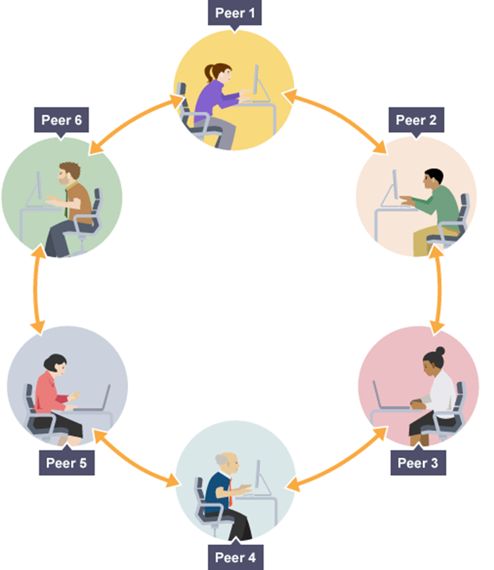
1.3 Networks

Slide 16
1.3 Networks
How the Client-Server model works:
1) The client makes a service request to the server (e.g. using a web browser for a website)
2) The server receives the request, processes it, and sends all the requested information back to the client

Slide 17
1.3 Networks
1) The client makes a service request (e.g. using a web browser for a website).
2) This will be passed to the first device, which will check its files and storage to see if it has the information. If it does, it will send it back. If it doesn’t, it will pass the request on to the next device, and so on.

Slide 18
1.3 Networks

Slide 19
1.3 Networks
Central server controls security. Security measures can be rolled out across all devices for consistency
All devices are responsible for the security of the network, and themselves. Security features may not be consistent

Slide 20
1.3 Networks
Central server controls security. Security measures can be rolled out across all devices for consistency
All devices are responsible for the security of the network, and themselves. Security features may not be consistent

Slide 21
1.3 Networks

Slide 22
1.3 Networks
Anyone can set the network up and manage it, and all devices are responsible for managing the network
Central server manages the network, but will need a team of network specialists to manage and maintain it also

Slide 23
1.3 Networks
Central server manages the network, but will need a team of network specialists to manage and maintain it also
Anyone can set the network up and manage it, and all devices are responsible for managing the network

Slide 24
1.3 Networks

Slide 25
1.3 Networks
Clients are not dependent on a single server, so if one server goes down, the network continues as normal
Clients are dependent (rely) on the server. If the server goes down, all clients are affected

Slide 26
1.3 Networks
Clients are dependent (rely) on the server. If the server goes down, all clients are affected
Clients are not dependent on a single server, so if one server goes down, the network continues as normal

Slide 27
1.3 Networks

Slide 28
1.3 Networks
Server can be upgraded easily to improve performance. However, this can be expensive
If devices on the network are slow, they slow the whole network down, and you would need to upgrade all devices to speed up the network. This can be cheaper than upgrading a server though

Slide 29
1.3 Networks
Server can be upgraded easily to improve performance. However, this can be expensive
If devices on the network are slow, they slow the whole network down, and you would need to upgrade all devices to speed up the network. This can be cheaper than upgrading a server though

Slide 30
1.3 Networks

Slide 31
1.3 Networks
Each device on the network has to be backed up individually. This could lead to data being lost or media containing the backups being lost
Data is backed up on the server, meaning it easy to access if it is lost or stolen from a device

Slide 32
1.3 Networks
Data is backed up on the server, meaning it easy to access if it is lost or stolen from a device
Each device on the network has to be backed up individually. This could lead to data being lost or media containing the backups being lost

Slide 33
1.3 Networks
State the features of a client-server network.

Slide 34
1.3 Networks
State the features of a client-server network.
How does it work?
What are the computers connected to?
How are processes carried out?

Slide 35
1.3 Networks
Compare the roles of client-server and peer-to-peer networks.

Slide 36
1.3 Networks
Compare the roles of client-server and peer-to-peer networks.
What are the key differences?
Are there any key advantages for either?
What are the negatives?

