Slide 1
OCR GCSE (9–1) in Computer Science (J277)
Computer Networks, Connections and Protocols
This pack is intended for students to use once they have covered the GCSE content, either in preparation for their L1 & L2 exam, or more likely alongside year 2 of the course to improve fluency, recall and pace on GCSE topics. It could be used as lesson starters, or supplied to students for independent use.

Slide 2
Bell Work
What is flash memory?
What is the benefit of flash memory?
What type of devices use flash memory?

Slide 3
1.3 Learn about LANs and WANs as networks.
1.3 Learn about LANs and WANs as networks.
Identify what a node is.
Explain what a network is.
Compare LANs and WANs.

Slide 4
1.3 Networks
What is a network?
What is a social network?

Slide 5
1.3 Networks
What is a network?
What is a social network?

Slide 6
1.3 Networks
What is a network?
What is a social network?
A computer network is two or more devices connected together so they can communicate

Slide 7
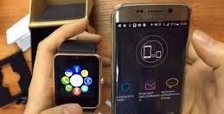
1.3 Networks
What is a network?
If I wear a smart watch and connect it to my phone is that a network?
A computer network is two or more devices connected together so they can communicate

Slide 8
1.3 Networks
What is a stand alone device?
Can a smart watch be a stand alone device?

Slide 9
1.3 Networks
What is a stand alone device?
Can a smart watch be a stand alone device?
A stand alone device is a device that is not connected to any other devices. It stands on its own.

Slide 10
1.3 Networks
There are now a huge variety of different networks that are governed by their size/area coverage.
These include:
LAN
WAN
PAN
SAN

Slide 11
1.3 Networks
There are now a huge variety of different networks that are governed by their size/area coverage.
These include:
LAN
WAN
PAN
SAN

Slide 12
1.3 Networks
There are now a huge variety of different networks that are governed by their size/area coverage.
These include:
LAN
WAN
PAN
SAN

Slide 13
1.3 Networks
LANs are Local Area Networks.
This means that they cover a small geographical area such as a house or single building.

Slide 14
1.3 Networks
LANs are Local Area Networks.
This means that they cover a small geographical area such as a house or single building.

Slide 15
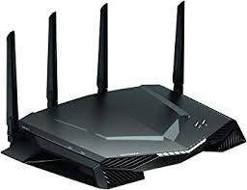
1.3 Networks
LANs are Local Area Networks.

Slide 16
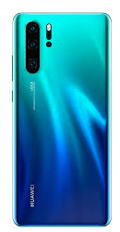
1.3 Networks
LANs are Local Area Networks.

Slide 17
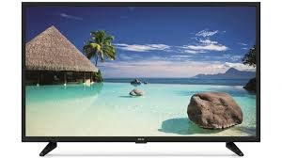
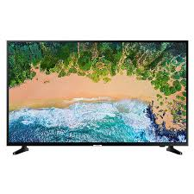
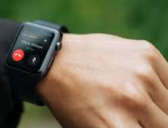
1.3 Networks
LANs are Local Area Networks.

Slide 18
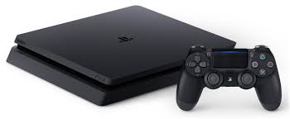
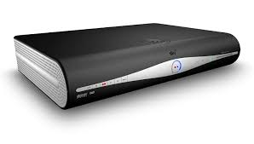
1.3 Networks
LANs are Local Area Networks.

Slide 19
1.3 Networks
LANs are Local Area Networks.

Slide 20
1.3 Networks
LANs are Local Area Networks.

Slide 21
1.3 Networks
LANs are Local Area Networks.

Slide 22
1.3 Networks
LANs are Local Area Networks.

Slide 23
1.3 Networks
So if a LAN is over a short geographical are what do you think WAN covers?
What does WAN stand for?

Slide 24
1.3 Networks
Wide Area Networks cover large geographical areas.
They will usually connect the smaller networks in buildings together. These buildings might belong to the same company.

Slide 25
1.3 Networks
Wide Area Networks cover large geographical areas.
They will usually connect the smaller networks (LANs) in buildings together. These buildings might belong to the same company.

Slide 26
1.3 Networks
Wide Area Networks cover large geographical areas.
They will usually connect the smaller networks (LANs) in buildings together. These buildings might belong to the same company.

Slide 27
1.4 Networks
The head office of the bank is in London.

Slide 28
1.4 Networks
The bank has other offices in Manchester.

Slide 29
1.4 Networks
And Glasgow.

Slide 30
1.4 Networks
And Belfast.

Slide 31
1.4 Networks
The head office needs to share crucial data with these offices.

Slide 32
1.4 Networks
Each office has a LAN.

Slide 33
1.4 Networks
The offices also connect to a much larger bank network.

Slide 34
1.4 Networks
The offices also connect to a much larger bank network.

Slide 35
1.4 Networks
The offices also connect to a much larger bank network.

Slide 36
1.4 Networks
These offices could even connect to each other to share data.

Slide 37
1.4 Networks
These offices could even connect to each other to share data.

Slide 38
1.3 Networks
Define the terms:
LAN
WAN
Provide an example with your definitions.

Slide 39
1.3 Networks
State why we would create networks in industry.

Slide 40
1.3 Networks
State why we would create networks in industry.
Share / Updates / Communication / Security / Data

Slide 41
1.3 Networks
Allow work to be shared between nodes.
Allow easy communication between users.
Allow files to be shared easily
Allow devices to be shared (i.e. printers)
Allows easy monitoring of nodes on the network
Allows easy control of access to the network and the nodes, and improves security
Updates can be centralised

Slide 42
1.3 Networks
Allow work to be shared between nodes.
Allow easy communication between users.
Allow files to be shared easily
Allow devices to be shared (i.e. printers)
Allows easy monitoring of nodes on the network
Allows easy control of access to the network and the nodes, and improves security
Updates can be centralised

Slide 43
1.3 Networks
Statement | True | False
A device in a network is called a node.
An advantage of a WAN is that they are expensive to set up.
Networks allow users to share data easily and quickly.
Creating networks allows a company to monitor use on devices more easily.

Slide 44
1.3 Networks
Statement | True | False
A device in a network is called a node.
An advantage of a WAN is that they are expensive to set up.
Networks allow users to share data easily and quickly.
Creating networks allows a company to monitor use on devices more easily.

Slide 45
1.3 Networks
Statement | True | False
A device in a network is called a node.
An advantage of a WAN is that they are expensive to set up.
Networks allow users to share data easily and quickly.
Creating networks allows a company to monitor use on devices more easily.

Slide 46
1.3 Networks
Statement | True | False
A device in a network is called a node.
An advantage of a WAN is that they are expensive to set up.
Networks allow users to share data easily and quickly.
Creating networks allows a company to monitor use on devices more easily.

Slide 47
1.3 Networks
Statement | True | False
A device in a network is called a node.
An advantage of a WAN is that they are expensive to set up.
Networks allow users to share data easily and quickly.
Creating networks allows a company to monitor use on devices more easily.

Slide 48
1.3 Networks
Statement | True | False
A device in a network is called a node.
An advantage of a WAN is that they are expensive to set up.
Networks allow users to share data easily and quickly.
Creating networks allows a company to monitor use on devices more easily.

