Slide 1
OCR GCSE (9–1) in Computer Science (J277)
Computer Networks, Connections and Protocols
This pack is intended for students to use once they have covered the GCSE content, either in preparation for their L1 & L2 exam, or more likely alongside year 2 of the course to improve fluency, recall and pace on GCSE topics. It could be used as lesson starters, or supplied to students for independent use.

Slide 2
Bell Work
What is the difference between WIFI and ethernet?
What does encryption do to data?

Slide 3
1.3 Learn about layering and packet switching in networks.
1.3 Learn about layering and packet switching in networks.
State the different layers in a network.
Discuss the benefits of packet switching.
Compare the benefits and drawbacks of packet switching.

Slide 4
1.3 Networks
TCP/IP
HTTP
HTTPS
FTP
POP
IMAP
SMTP

Slide 5
1.3 Networks
Summaries the role of SMTP as a protocol for sending emails.

Slide 6
1.3 Networks
Summaries the role of SMTP as a protocol for sending emails.
SMTP is the protocol for sending emails over the internet. It sends the email to the server.

Slide 7
1.3 Networks
State the role of the POP protocol in regards to receiving emails.

Slide 8
1.3 Networks
State the role of the POP protocol in regards to receiving emails.
POP downloads emails to the users device. The email is not kept on the email server and can only be accessed from the device it was first downloaded to.

Slide 9
1.3 Networks
Explain the differences between IMAP and POP.

Slide 10
1.3 Networks
Data is broke up and sent over the internet in chunks.
There are 2 different ways it can be sent.
Circuit Switching
Packet Switching

Slide 11
1.3 Networks
Data is broke up and sent over the internet in chunks.
There are 2 different ways it can be sent.
Circuit Switching
Packet Switching

Slide 12
1.3 Networks
https://www.youtube.com/watch?v=gB0DCb84T7c
Watch the video, think about the benefits of packet switching.

Slide 13
1.3 Networks

Slide 14
1.3 Networks

Slide 15
1.3 Networks

Slide 16
1.3 Networks

Slide 17
1.3 Networks

Slide 18
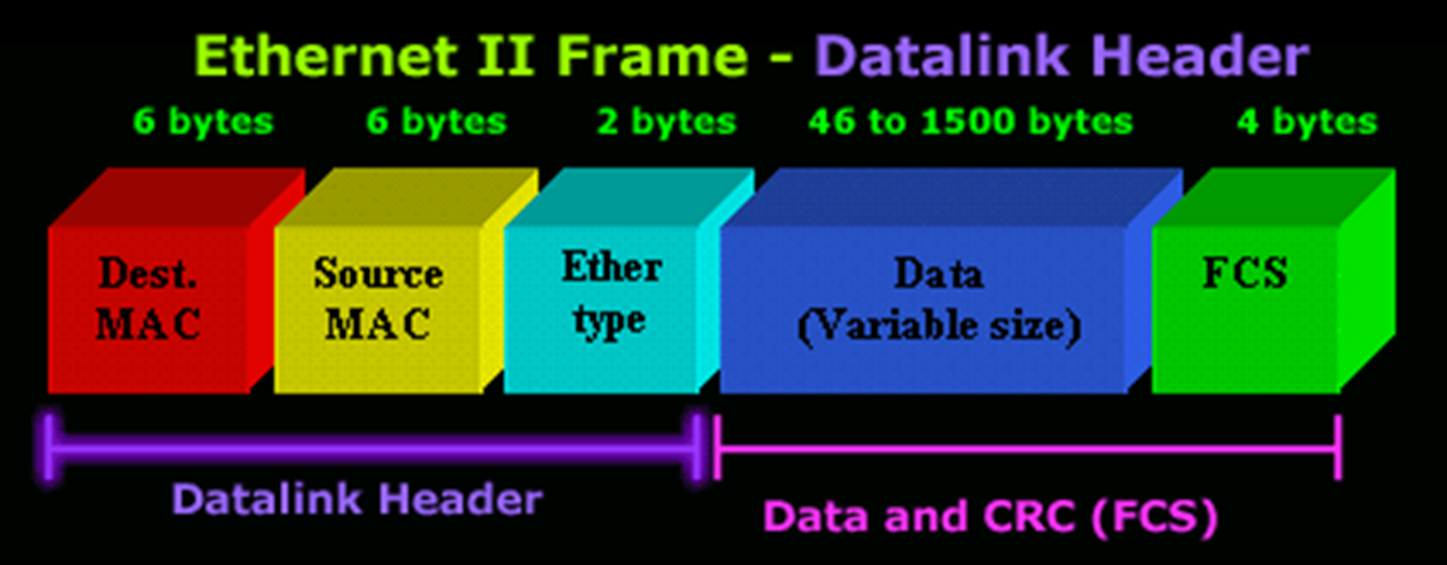
1.3 Networks

Slide 19
1.3 Networks
Data that is being sent is split up into packets.
The vast majority of this packet is the actual data that is being sent.
But it does contain some other information.

Slide 20
1.3 Networks
Destination MAC address (receiver)

Slide 21
1.3 Networks
Destination MAC address (receiver)
Source MAC address (Sender)

Slide 22
1.3 Networks
Destination MAC address (receiver)
Source MAC address (Sender)
Packet number – to reorder it at the other end.

Slide 23
1.3 Networks
Destination MAC address (receiver)
Source MAC address (Sender)
Packet number – to reorder it at the other end.
CRC – error checking data attached to it.

Slide 24
1.3 Networks
1 Packet of Data to be sent over the network.

Slide 25
1.3 Networks
1500 bytes in total size.
1 Packet of Data to be sent over the network.

Slide 26
1.3 Networks
1500 bytes in total size.
1 Packet of Data to be sent over the network.
Receiver MAC address – 6 bytes.

Slide 27
1.3 Networks
1500 bytes in total size.
1 Packet of Data to be sent over the network.
Receiver MAC address – 6 bytes.
Sender MAC address – 6 bytes.

Slide 28
1.3 Networks
1500 bytes in total size.
1 Packet of Data to be sent over the network.
Receiver MAC address – 6 bytes.
Sender MAC address – 6 bytes.
Protocol type – 2 bytes.

Slide 29
1.3 Networks
1500 bytes in total size.
1 Packet of Data to be sent over the network.
Receiver MAC address – 6 bytes.
Sender MAC address – 6 bytes.
Protocol type – 2 bytes.
CRC – error checking data – 4 bytes.

Slide 30
1.3 Networks
1500 bytes in total size.
1 Packet of Data to be sent over the network.
Receiver MAC address – 6 bytes.
Sender MAC address – 6 bytes.
Protocol type – 2 bytes.
CRC – error checking data – 4 bytes.
Data to be sent – up to 1486 bytes.

Slide 31
1.3 Networks

Slide 32
1.3 Networks

Slide 33
1.3 Networks

Slide 34
1.3 Networks

Slide 35
1.3 Networks

Slide 36
1.3 Networks

Slide 37
1.3 Networks

Slide 38
1.3 Networks

Slide 39
1.3 Networks

Slide 40
1.3 Networks

Slide 41
1.3 Networks
What if a hacker is watching the network?
Is this method a prevention measure or does it make it easy for the hackers to intercept our data?
How can we protect our data?

Slide 42
1.3 Networks

Slide 43
1.3 Networks

Slide 44
1.3 Networks

Slide 45
1.3 Networks

Slide 46
1.3 Networks

Slide 47
1.3 Networks

Slide 48
1.3 Networks

Slide 49
1.3 Networks

Slide 50
1.3 Networks

Slide 51
1.3 Networks

Slide 52
1.3 Networks

Slide 53
1.3 Networks

Slide 54
1.3 Networks

Slide 55
1.3 Networks
Packet Switching

Slide 56
1.3 Networks
Packet Switching
Breaks the data to be sent up. Why?

Slide 57
1.3 Networks
Packet Switching
Breaks the data to be sent up.
Data is sent in packets of up to 1500 bytes.

Slide 58
1.3 Networks
Packet Switching
Breaks the data to be sent up.
Data is sent in packets of up to 1500 bytes.
Packets are loaded with information. Why?

Slide 59
1.3 Networks
Packet Switching
Breaks the data to be sent up.
Data is sent in packets of up to 1500 bytes.
Packets are loaded with information.
Sent over different routes.

Slide 60
1.3 Networks
Packet Switching
Breaks the data to be sent up.
Data is sent in packets of up to 1500 bytes.
Packets are loaded with information.
Sent over different routes.
Harder for hackers – why?

Slide 61
1.3 Networks
Packet Switching
Breaks the data to be sent up.
Data is sent in packets of up to 1500 bytes.
Packets are loaded with information.
Sent over different routes.
Harder for hackers
More secure – why?

Slide 62
1.3 Networks
Watch the video on layering.
Think about how the protocols fit into the different layers.

Slide 63
1.3 Networks
TCP/IP has 4 main layers:
Application Layer
Transport Layer
Network Layer
Link Layer
Each layer is responsible for a different part of the sending/receiving of data.

Slide 64
1.3 Networks
Each layer has to be compatible with the layer above or below the layer.
Each layer does a specific job when sending data.

Slide 65
1.3 Networks
1992 – WWW was invented by Sir Tim Berners-Lee.
People started browsing the internet on a web browser. Looking at news etc.

Slide 66
1.3 Networks
1995 – Ebay was founded – people started to buy online.
HTTP was the current protocol used.
What is the problem that is going to arise in 1995?

Slide 67
1.3 Networks

Slide 68
1.3 Networks
We need a new protocol to protect us when entering data into our computers.

Slide 69
1.3 Networks
We need a new protocol to protect us when entering data into our computers.

Slide 70
1.3 Networks
We need a new protocol to protect us when entering data into our computers.

Slide 71
1.3 Networks
HTTPS had to work with existing layers below that were already being used.
It was designed to work with TCP as this protocol was already in use.

Slide 72
1.3 Networks
Application Layer
Transport Layer
Network Layer
Link Layer

Slide 73
1.3 Networks
Using apps/software
Application Layer
Transport Layer
Network Layer
Link Layer

Slide 74
1.3 Networks
Using apps/software
Application Layer
Transport Layer
Network Layer
Link Layer
Cables to send data.

Slide 75
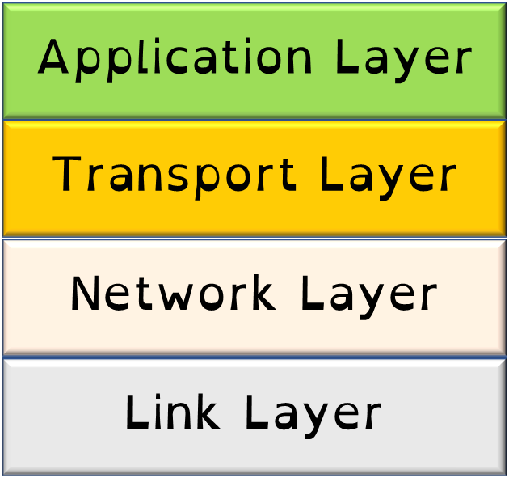
1.3 Networks
Application Layer – this is where the software is used to create the data being sent.
e.g. web browsers or email (Internet Explorer or Gmail).

Slide 76
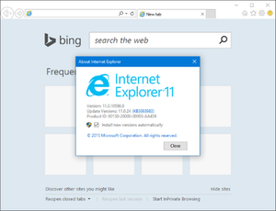
1.3 Networks
Application Layer

Slide 77
1.3 Networks
Application Layer

Slide 78
1.3 Networks
Application Layer

Slide 79
1.3 Networks
Transport layer – sets up the communication between the two nodes, agreeing on the rules to be used.
i.e. packet size.

Slide 80
1.3 Networks
Transport layer

Slide 81
1.3 Networks
Transport layer
Maximum 1000 bytes per packet

Slide 82
1.3 Networks
Transport layer
Maximum 1000 bytes per packet

Slide 83
1.3 Networks
Transport layer
Maximum 1000 bytes per packet

Slide 84
1.3 Networks
Transport layer
Maximum 1000 bytes per packet

Slide 85
1.3 Networks
Network layer – packets are addressed in this section and routes the data to the link layer.

Slide 86
1.3 Networks
Network layer

Slide 87
1.3 Networks
Network layer
Mac Address (Sender) – FF:01:A1:74:D2
Mac Address (Receiver) – D0:10:ED:45:7F

Slide 88
1.3 Networks
Network layer
MAS– FF:01:A1:74:D2
MAR– D0:10:ED:45:7F

Slide 89
1.3 Networks
Network layer
MAS– FF:01:A1:74:D2
MAR– D0:10:ED:45:7F
MAS– FF:01:A1:74:D2
MAR– D0:10:ED:45:7F

Slide 90
1.3 Networks
Network layer
MAS– FF:01:A1:74:D2
MAR– D0:10:ED:45:7F
MAS– FF:01:A1:74:D2
MAR– D0:10:ED:45:7F
MAS– FF:01:A1:74:D2
MAR– D0:10:ED:45:7F
MAS– FF:01:A1:74:D2
MAR– D0:10:ED:45:7F

Slide 91
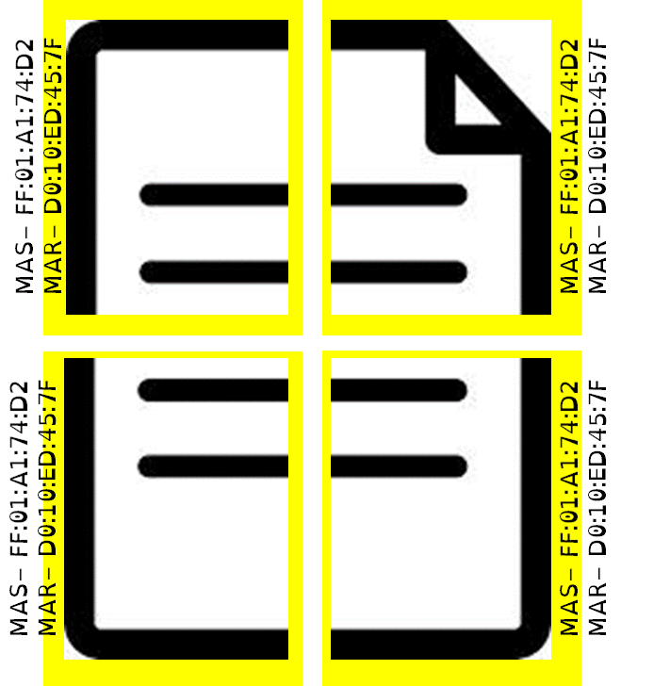
1.3 Networks
Network layer
Pushed on to the link layer.

Slide 92
1.3 Networks
Link layer – this is where the hardware used to send data operates.
i.e. Ethernet cables.

Slide 93
1.3 Networks
Link layer

Slide 94
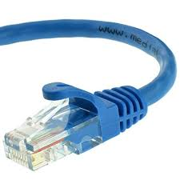
1.3 Networks
Link layer

Slide 95
1.3 Networks
Link layer

Slide 96
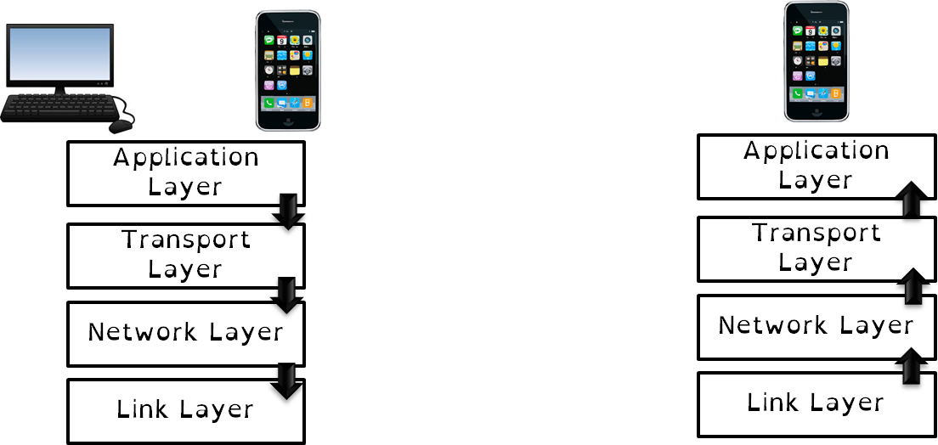
1.3 Networks

Slide 97
1.3 Networks

Slide 98
1.3 Networks

Slide 99
1.3 Networks
HTTP/S, FTP, POP, IMAP, SMTP

Slide 100
1.3 Networks
HTTP/S, FTP, POP, IMAP, SMTP
FTP

Slide 101
1.3 Networks
FTP

Slide 102
1.3 Networks
TCP or UDP
FTP

Slide 103
1.3 Networks
TCP or UDP
FTP
TCP

Slide 104
1.3 Networks
FTP
TCP

Slide 105
1.3 Networks
IP
FTP
TCP
IP

Slide 106
1.3 Networks
FTP
TCP
IP

Slide 107
1.3 Networks
Ethernet or WIFI
FTP
TCP
IP

Slide 108
1.3 Networks
Ethernet or WIFI
FTP
TCP
IP
WIFI

Slide 109
1.3 Networks
FTP
TCP
IP
WIFI

Slide 110
1.3 Networks
FTP
TCP
IP
WIFI

Slide 111
1.3 Networks
FTP
TCP
IP
WIFI

Slide 112
1.3 Networks
FTP
TCP
IP
WIFI

Slide 113
1.3 Networks
FTP
TCP
IP
WIFI

Slide 114
1.3 Networks
FTP
TCP
IP
WIFI

Slide 115
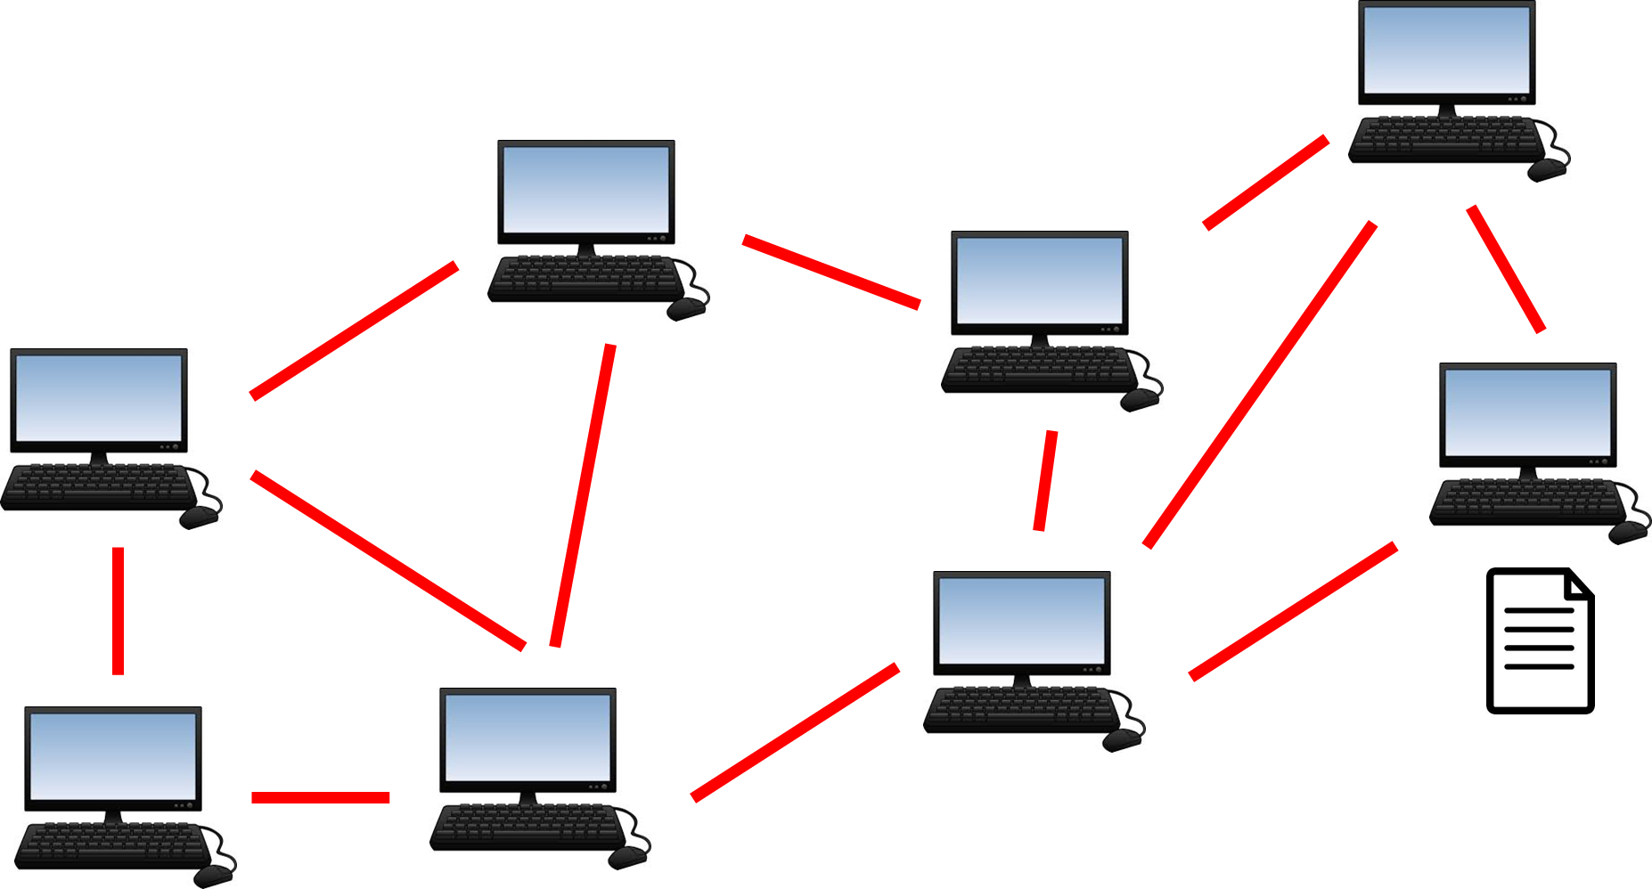
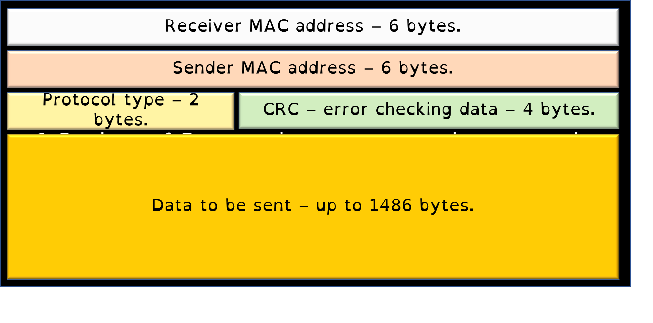
1.3 Networks
Explain how packet switching works in networking.
What are the benefits to this type of switching? Answer Support – use these sentence starters for guidance.
When sending data across a network, the data must be…
Inside the ______, certain pieces of information must be included. These are…
The r______ a___ss is needed because…
The s______ a___ss is needed because…
Similarly, the protocol type is needed…
Likewise, the CRC is needed…
Finally, …
These packets are sent using the p_____ s_____ method which means…
The benefits of using this method are…

Slide 116
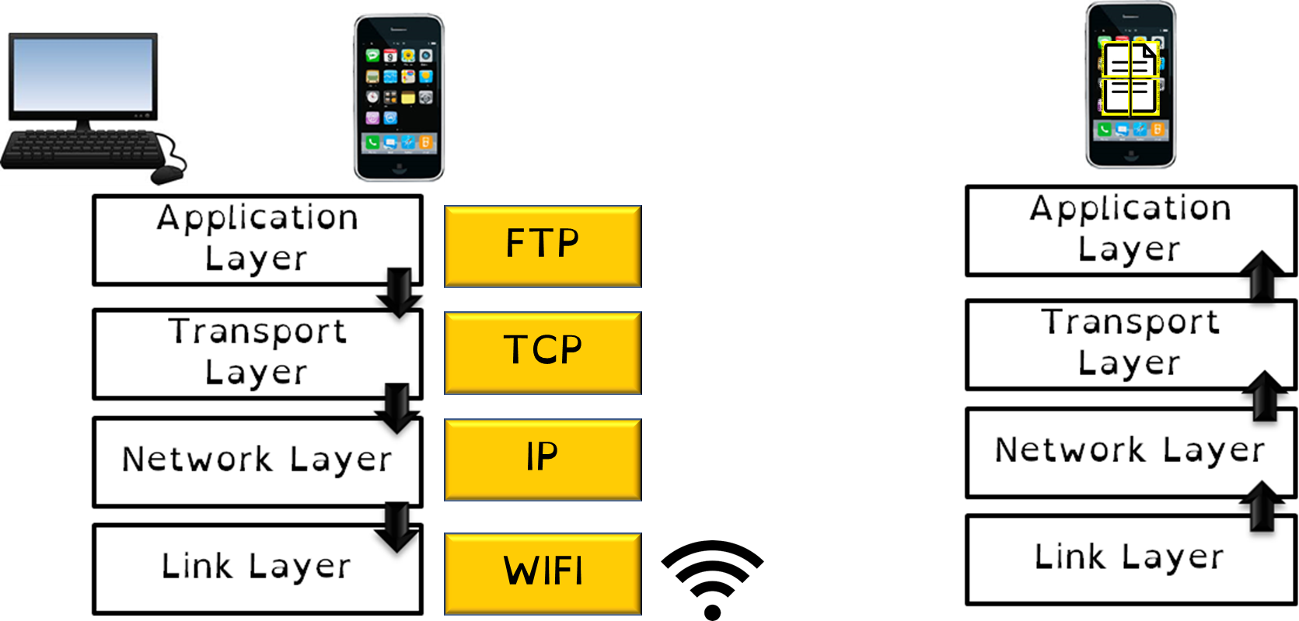
1.3 Networks
Summarise the term “layering” in Computer Science.
What role do each of the layers do in the transmission of data?

Slide 117
1.3 Networks
There are _ layers in networking.
The application layer is where…
The transport layer agrees…
The network layer breaks…
The link layer is the physical…

