Slide 1
OCR GCSE (9–1) in Computer Science (J277)
Computer Networks, Connections and Protocols
This pack is intended for students to use once they have covered the GCSE content, either in preparation for their L1 & L2 exam, or more likely alongside year 2 of the course to improve fluency, recall and pace on GCSE topics. It could be used as lesson starters, or supplied to students for independent use.

Slide 2
Bell Work
What is the difference between WIFI and ethernet?
What does encryption do to data?

Slide 3
1.3 Learn about the 7 types of protocols used in Computing.
1.3 Learn about the 7 types of protocols used in Computing.
State what a protocol is.
Discuss the features of some protocols.
Compare the roles of different protocols.

Slide 4

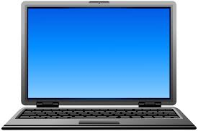
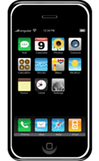
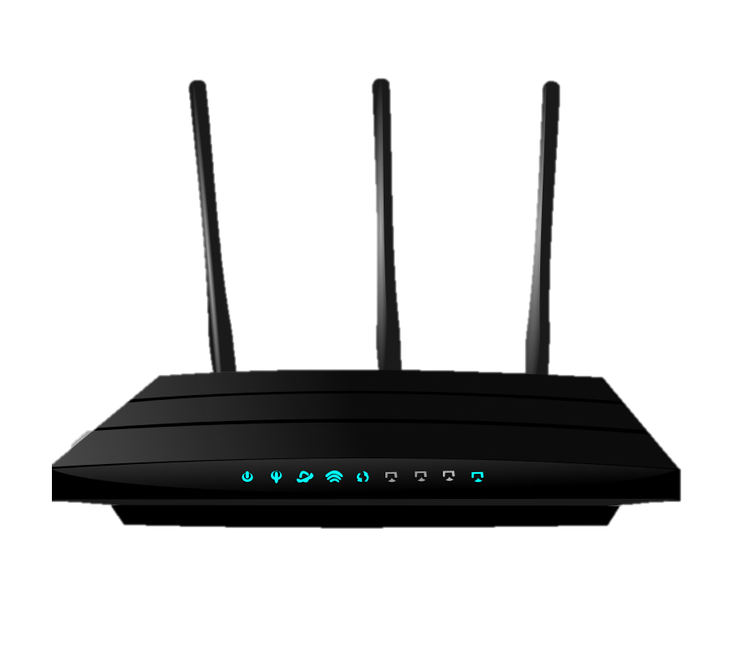

1.3 Networks
Router is set to frequency 3.5721

Slide 5
1.3 Networks
Both devices are set to channel 1.

Slide 6
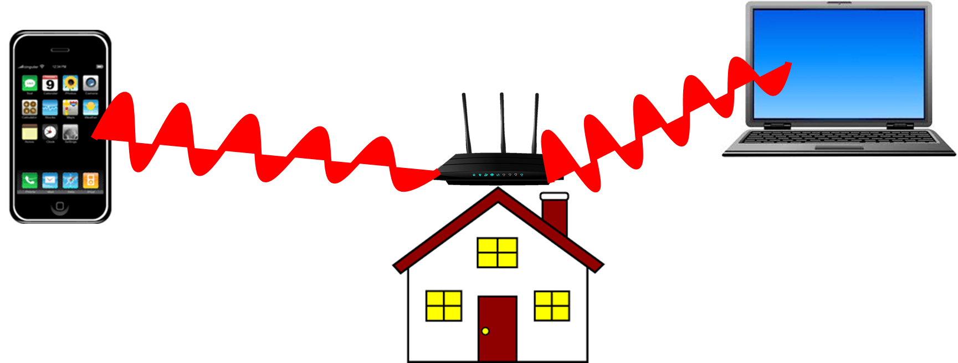

1.3 Networks

Slide 7
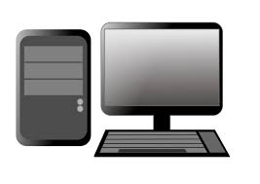
1.3 Networks

Slide 8
1.3 Networks

Slide 9
1.3 Networks
What is a MAC address?
- each device has 1!
What is an IP address?
- each device must have one to get on internet.
A MAC (Media Access Control) Address is specific to any piece of hardware on a network e.g. hub, router, laptop etc. E.g. F0:98:9D:45:CB:BA
An IP Address is a location that is unique to each device connected to the internet. They are used to direct data around the internet from senders to receivers e.g. 192.168.0.31

Slide 10
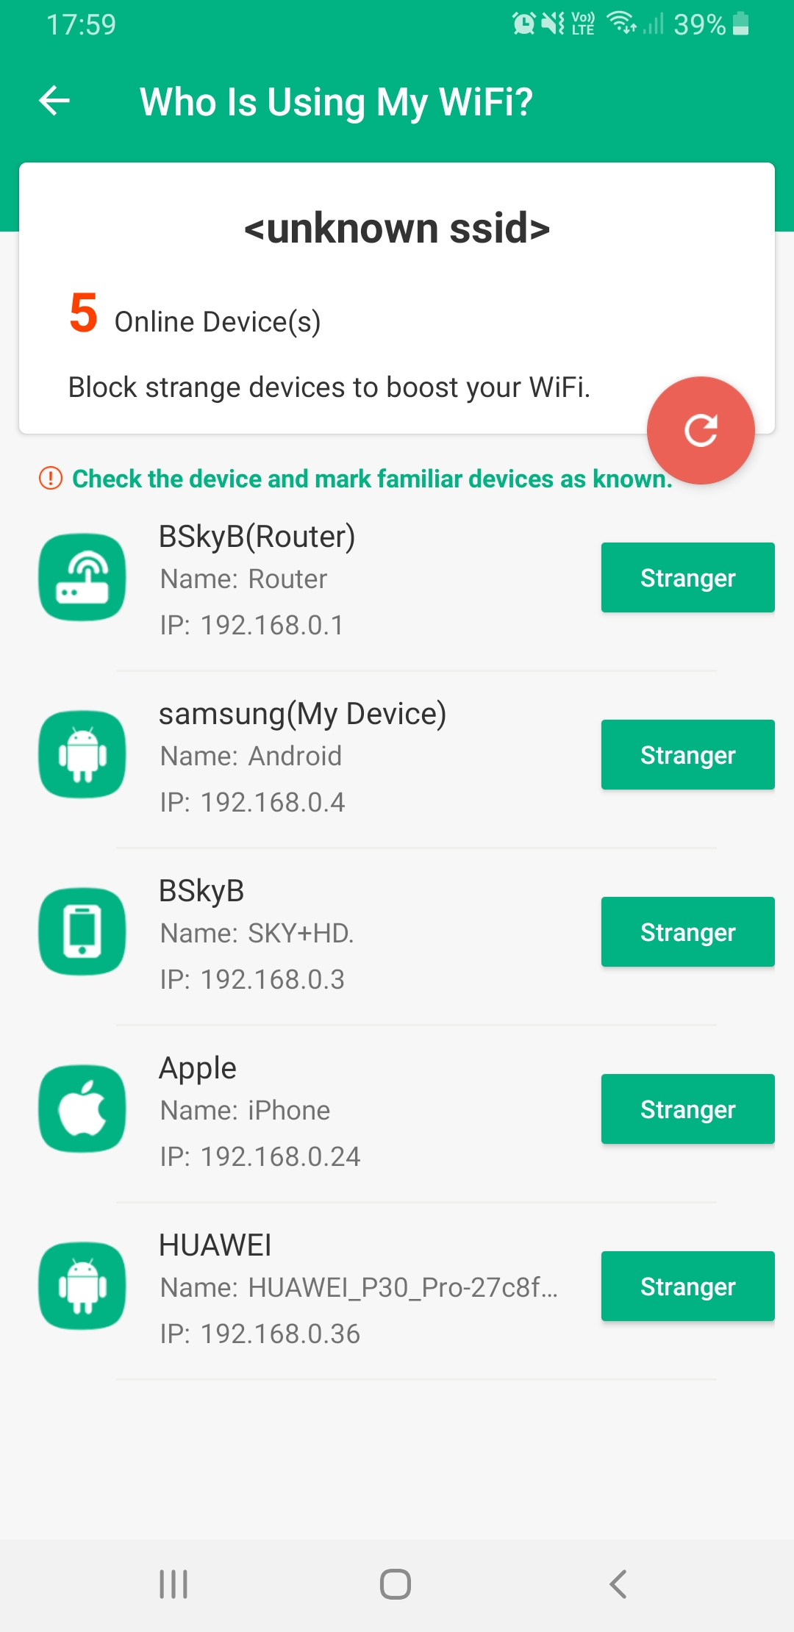
1.3 Networks

Slide 11
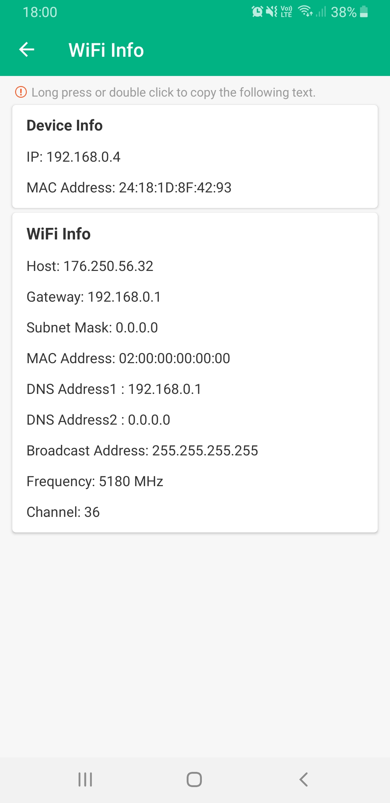
1.3 Networks

Slide 12
1.3 Networks
MAC Addresses are assigned when hardware is born (created) → Imagine this is your name (assume nobody else in the world has the same name as you).
IP Addresses are assigned depending on where you are and where you connect to the internet. Imagine this is your house address.

Slide 13
1.3 Networks
A protocol is a set of rules that need to be followed.
There are lots of rules to follow when connecting to a network.

Slide 14
1.3 Networks
TCP/IP
HTTP
HTTPS
FTP
POP
IMAP
SMTP

Slide 15
1.3 Networks
TCP/IP
HTTP
HTTPS
FTP
POP
IMAP
SMTP

Slide 16
1.3 Networks
TCP/IP
HTTP
HTTPS
FTP

Slide 17
1.3 Networks
Definitions
TCP/IP
HTTP
HTTPS
FTP
This protocol uses a client-server method of sending large files over a network.

Slide 18
1.3 Networks
Definitions
TCP/IP
HTTP
HTTPS
FTP
This protocol is used to transfer the data of web pages securely, from servers to clients.

Slide 19
1.3 Networks
Definitions
TCP/IP
HTTP
HTTPS
FTP
Sets out the rules that a device must follow when using a network. It sets the rules for packet switching and the routing of packets on a WAN.

Slide 20
1.3 Networks
Definitions
TCP/IP
HTTP
HTTPS
FTP
This protocol is used to transfer the data of web pages from servers to clients (after requested).

Slide 21
1.3 Networks
Self-assessment
TCP/IP
HTTP
HTTPS
FTP
This protocol uses a client-server method of sending large files over a network.

Slide 22
1.3 Networks
Self-assessment
TCP/IP
HTTP
HTTPS
FTP
This protocol uses a client-server method of sending large files over a network.

Slide 23
1.3 Networks
Self-assessment
TCP/IP
HTTP
HTTPS
FTP
This protocol is used to transfer the data of web pages securely, from servers to clients.

Slide 24
1.3 Networks
Self-assessment
TCP/IP
HTTP
HTTPS
FTP
This protocol is used to transfer the data of web pages securely, from servers to clients.

Slide 25
1.3 Networks
Self-assessment
TCP/IP
HTTP
HTTPS
FTP
Sets out the rules that a device must follow when using a network. It sets the rules for packet switching and the routing of packets on a WAN.

Slide 26
1.3 Networks
Self-assessment
TCP/IP
HTTP
HTTPS
FTP
Sets out the rules that a device must follow when using a network. It sets the rules for packet switching and the routing of packets on a WAN.

Slide 27
1.3 Networks
Self-assessment
TCP/IP
HTTP
HTTPS
FTP
This protocol is used to transfer the data of web pages from servers to clients (after requested).

Slide 28
1.3 Networks
Self-assessment
TCP/IP
HTTP
HTTPS
FTP
This protocol is used to transfer the data of web pages from servers to clients (after requested).

Slide 29
1.3 Networks
TCP/IP
HTTP
HTTPS
FTP
POP
IMAP
SMTP

Slide 30
1.3 Networks
TCP/IP
HTTP
HTTPS
FTP
POP
IMAP
SMTP

Slide 31
1.3 Networks
POP
IMAP
SMTP
These are protocols that are related to sending and receiving email.

Slide 32
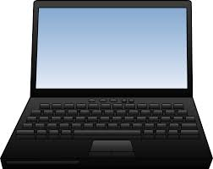
1.3 Networks

Slide 33

1.3 Networks

Slide 34

1.3 Networks

Slide 35


1.3 Networks

Slide 36
1.3 Networks

Slide 37
1.3 Networks

Slide 38

1.3 Networks

Slide 39

1.3 Networks

Slide 40
1.3 Networks

Slide 41
1.3 Networks

Slide 42
1.3 Networks

Slide 43
1.3 Networks

Slide 44
1.3 Networks
SMTP is the protocol for sending email to the web server.

Slide 45
1.3 Networks
SMTP is the protocol for sending email to the web server.

Slide 46
1.3 Networks
Summaries the role of SMTP as a protocol for sending emails.

Slide 47
1.3 Networks
Summaries the role of SMTP as a protocol for sending emails.
SMTP is the protocol for…

Slide 48
1.3 Networks
Summaries the role of SMTP as a protocol for sending emails.
SMTP is the protocol for sending emails over the internet. It sends the email to the server.

Slide 49
1.3 Networks
POP is 1 of the 2 protocols used to receive emails.

Slide 50
1.3 Networks
POP is 1 of the 2 protocols used to receive emails.

Slide 51
1.3 Networks
POP is 1 of the 2 protocols used to receive emails.

Slide 52
1.3 Networks
POP is 1 of the 2 protocols used to receive emails.

Slide 53
1.3 Networks
Once the email has been sent, it is deleted from the users device and the server.

Slide 54
1.3 Networks
What happens if I have a really important email I want to view on 2 different devices?

Slide 55
1.3 Networks

Slide 56
1.3 Networks

Slide 57
1.3 Networks

Slide 58
1.3 Networks

Slide 59
1.3 Networks
State the role of the POP protocol in regards to receiving emails.

Slide 60
1.3 Networks
State the role of the POP protocol in regards to receiving emails.
POP downloads emails…

Slide 61
1.3 Networks
State the role of the POP protocol in regards to receiving emails.
POP downloads emails to the users device. …

Slide 62
1.3 Networks
State the role of the POP protocol in regards to receiving emails.
POP downloads emails to the users device. The email is not kept on the email server and can only be accessed from the device it was first downloaded to.

Slide 63
1.3 Networks
IMAP stores the email on the web server until the user deletes it.

Slide 64
1.3 Networks
IMAP stores the email on the web server until the user deletes it.

Slide 65
1.3 Networks
IMAP stores the email on the web server until the user deletes it.

Slide 66
1.3 Networks
IMAP stores the email on the web server until the user deletes it.

Slide 67
1.3 Networks
IMAP stores the email on the web server until the user deletes it.

Slide 68
1.3 Networks
The user can access the email from different devices.

Slide 69
1.3 Networks
It is stored on the central server allowing the user to read and edit the email.

Slide 70
1.3 Networks
If the user deletes it they are deleting it off the server, not just their device.

Slide 71
1.3 Networks
If the user deletes it they are deleting it off the server, not just their device.

Slide 72
1.3 Networks
Explain the differences between IMAP and POP.

Slide 73
1.3 Networks
Explain the differences between IMAP and POP.
IMAP stores the email on…

Slide 74
1.3 Networks
Explain the differences between IMAP and POP.
IMAP stores the email on the email server, …

Slide 75
1.3 Networks
Explain the differences between IMAP and POP.
IMAP stores the email on the email server, allowing the user to view a copy of the email on multiple devices. The email needs to be deleted …

Slide 76
1.3 Networks
Explain the differences between IMAP and POP.
IMAP stores the email on the email server, allowing the user to view a copy of the email on multiple devices. The email needs to be deleted off the server to be deleted.

Slide 77
1.3 Networks
Explain the differences between IMAP and POP.
IMAP stores the email on the email server, allowing the user to view a copy of the email on multiple devices. The email needs to be deleted off the server to be deleted. Whereas POP downloads…

Slide 78
1.3 Networks
Explain the differences between IMAP and POP.
IMAP stores the email on the email server, allowing the user to view a copy of the email on multiple devices. The email needs to be deleted off the server to be deleted. Whereas POP downloads the email to the users device…

Slide 79
1.3 Networks
IMAP stores the email on the email server, allowing the user to view a copy of the email on multiple devices. The email needs to be deleted off the server to be deleted. Whereas POP downloads the email to the users device it is not stored centrally on the server. …

Slide 80
1.3 Networks
IMAP stores the email on the email server, allowing the user to view a copy of the email on multiple devices. The email needs to be deleted off the server to be deleted. Whereas POP downloads the email to the users device it is not stored centrally on the server. This means the email cannot be…

Slide 81
1.3 Networks
IMAP stores the email on the email server, allowing the user to view a copy of the email on multiple devices. The email needs to be deleted off the server to be deleted. Whereas POP downloads the email to the users device it is not stored centrally on the server. This means the email cannot be viewed on multiple devices.

