Slide 1
OCR GCSE (9–1) in Computer Science (J277)
Memory and storage
This pack is intended for students to use once they have covered the GCSE content, either in preparation for their L1 & L2 exam, or more likely alongside year 2 of the course to improve fluency, recall and pace on GCSE topics. It could be used as lesson starters, or supplied to students for independent use.

Slide 2
Bell Work
Discuss why programmers use hexadecimal.
State why computers use binary.

Slide 3
1.2 Recap binary / hex / denary.
1.2 Recap binary / hex / denary.
Understand the different values in binary, hex and denary.
Convert binary and denary numbers.
Convert hex, binary and denary numbers.

Slide 4
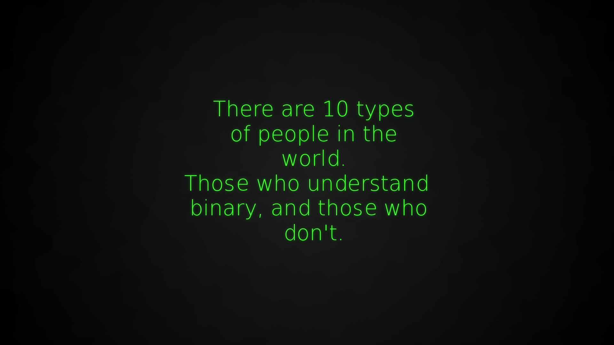
1.2 Memory and Storage

Slide 5
1.2 Memory and Storage
To work out 8-bits we just need to keep doubling our numbers from 8 until we can fit 8 binary digits in.
128 | 64 | 32 | 16 | 8 | 4 | 2 | 1 | Total
1 | 0 | 0 | 0 | 0 | 1 | 0 | 1 | =

Slide 6
1.2 Memory and Storage
To work out 8-bits we just need to keep doubling our numbers from 8 until we can fit 8 binary digits in.
128 | 64 | 32 | 16 | 8 | 4 | 2 | 1 | Total
1 | 0 | 0 | 0 | 0 | 1 | 0 | 1 | =

Slide 7
1.2 Memory and Storage
To work out 8-bits we just need to keep doubling our numbers from 8 until we can fit 8 binary digits in.
128 | 64 | 32 | 16 | 8 | 4 | 2 | 1 | Total
1 | 0 | 0 | 0 | 0 | 1 | 0 | 1 | 133

Slide 8
1.2 Memory and Storage
To work out 8-bits we just need to keep doubling our numbers from 8 until we can fit 8 binary digits in.
128 | 64 | 32 | 16 | 8 | 4 | 2 | 1 | Total
1 | 1 | 0 | 1 | 0 | 0 | 0 | 0 | =

Slide 9
1.2 Memory and Storage
To work out 8-bits we just need to keep doubling our numbers from 8 until we can fit 8 binary digits in.
128 | 64 | 32 | 16 | 8 | 4 | 2 | 1 | Total
1 | 1 | 0 | 1 | 0 | 0 | 0 | 0 | 208

Slide 10
1.2 Memory and Storage
To work out 8-bits we just need to keep doubling our numbers from 8 until we can fit 8 binary digits in.
128 | 64 | 32 | 16 | 8 | 4 | 2 | 1 | Total
 |  |  |  |  |  |  |  | 36

Slide 11
1.2 Memory and Storage
To work out 8-bits we just need to keep doubling our numbers from 8 until we can fit 8 binary digits in.
128 | 64 | 32 | 16 | 8 | 4 | 2 | 1 | Total
 |  |  |  |  |  |  |  | 144

Slide 12
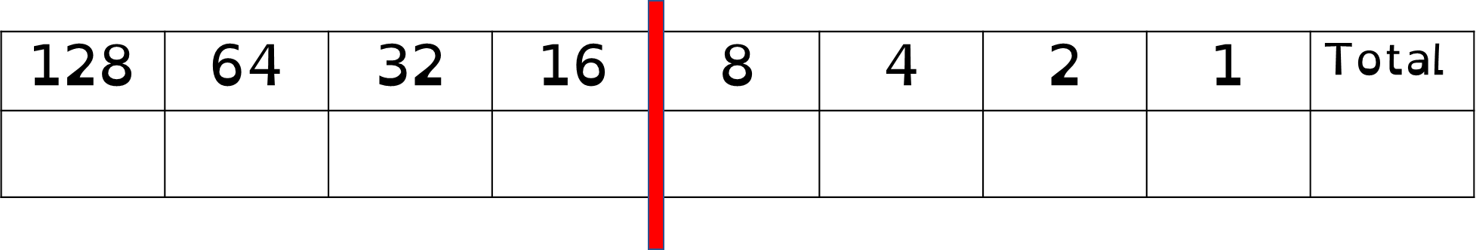
1.2 Memory and Storage
Work out the binary answer to the following:
240
92
196
127
54

Slide 13
1.2 Memory and Storage
Work out the denary answer to the following:
1100 0001
1010 1010
0101 0101
0011 1110
1001 0111

Slide 14
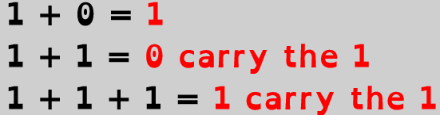
1.2 Memory and Storage
Add the binary numbers together below.
1010 0100
0011 0011
+

Slide 15
1.2 Memory and Storage
Add the binary numbers together below.
1010 0100
0011 0011
+
1101 0111

Slide 16
1.2 Memory and Storage
Add the binary numbers together below.
1
1100 0011
0011 1111
+
2
3
1100 0011
1111 1111
1110 0101
0111 0101
+
+

Slide 17
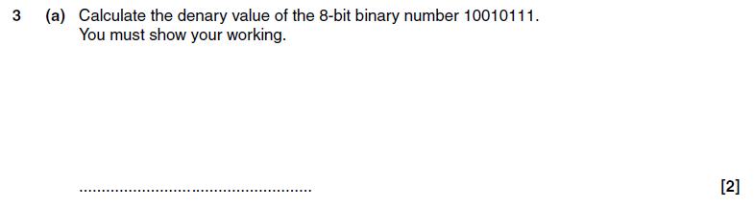
1.2 Memory and Storage
EQP Jan 2011

Slide 18
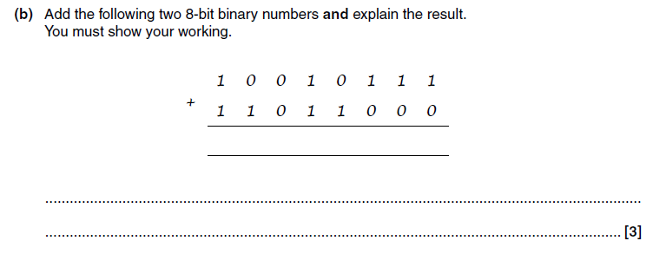
1.2 Memory and Storage
EQP Jan 2011

Slide 19
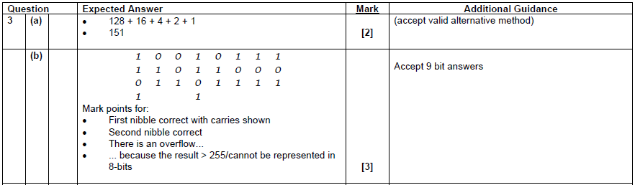
1.2 Memory and Storage
EQP Jan 2011

Slide 20
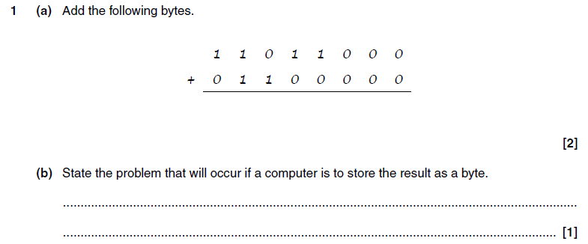
1.2 Memory and Storage
EQP Jan 2013

Slide 21
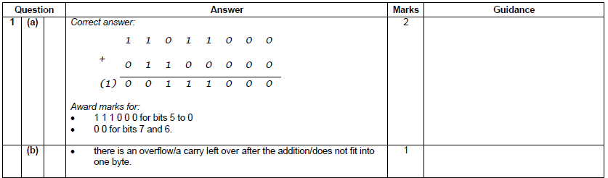
1.2 Memory and Storage
EQP Jan 2013

Slide 22
1.2 Memory and Storage
D | 0 | 1 | 2 | 3 | 4 | 5 | 6 | 7 | 8 | 9 | 10 | 11 | 12 | 13 | 14 | 15
H | 0 | 1 | 2 | 3 | 4 | 5 | 6 | 7 | 8 | 9 | A | B | C | D | E | F

Slide 23
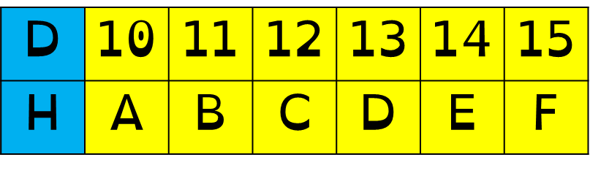
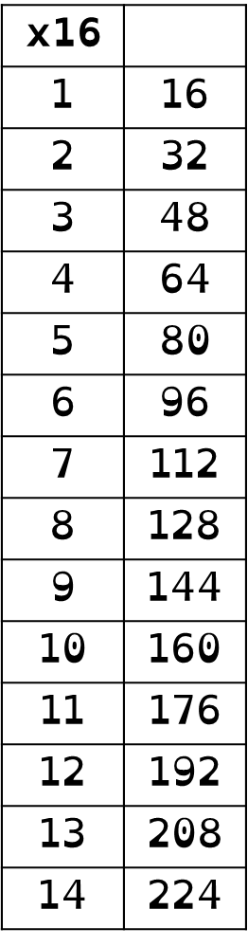
1.2 Memory and Storage
What is decimal number 178 converted into hex?

Slide 24
1.2 Memory and Storage
What is decimal number 178 converted into hex?
178 / 16 = 11 remainder 2
B2 = 178

Slide 25
1.2 Memory and Storage
Convert the following into hex
84
202
198
68
175

Slide 26
1.2 Memory and Storage
Convert the following into hex
192 / 16 =

Slide 27
1.2 Memory and Storage
Convert the following into hex
192 / 16 = 12 remainder

Slide 28
1.2 Memory and Storage
Convert the following into hex
192 / 16 = 12 remainder 0

Slide 29
1.2 Memory and Storage
Convert the following into hex
192 / 16 = 12 remainder 0
C

Slide 30
1.2 Memory and Storage
Convert the following into hex
192 / 16 = 12 remainder 0
C

Slide 31
1.2 Memory and Storage
Convert the following into hex
192 / 16 = 12 remainder 0
C
Is the answer just C?

Slide 32
1.2 Memory and Storage
Convert the following into hex
192 / 16 = 12 remainder 0
C
Is the answer just C?
No, you must place the 0 back in.

Slide 33
1.2 Memory and Storage
Convert the following into hex
192 / 16 = 12 remainder 0
C0
Is the answer just C?
No, you must place the 0 back in.

Slide 34
1.2 Memory and Storage
Convert the following into hex
192 / 16 = 12 remainder 0
C0
Is the answer just C?
No, you must place the 0 back in.

Slide 35
1.2 Memory and Storage
Hex value = A7

Slide 36
1.2 Memory and Storage
Hex value = A7
A 7

Slide 37
1.2 Memory and Storage
Hex value = A7
A 7

Slide 38
1.2 Memory and Storage
Hex value = A7
*16
A 7

Slide 39
1.2 Memory and Storage
Hex value = A7
*16
*1
A 7

Slide 40
1.2 Memory and Storage
Hex value = A7
*16
*1
A 7
16 * 10

Slide 41
1.2 Memory and Storage
Hex value = A7
*16
*1
A 7
16 * 10
1 * 7

Slide 42
1.2 Memory and Storage
Hex value = A7
*16
*1
A 7
16 * 10
160
1 * 7

Slide 43
1.2 Memory and Storage
Hex value = A7
*16
*1
A 7
16 * 10
160
1 * 7
7

Slide 44
1.2 Memory and Storage
Hex value = A7
*16
*1
A 7
16 * 10
160
1 * 7
7
167

Slide 45
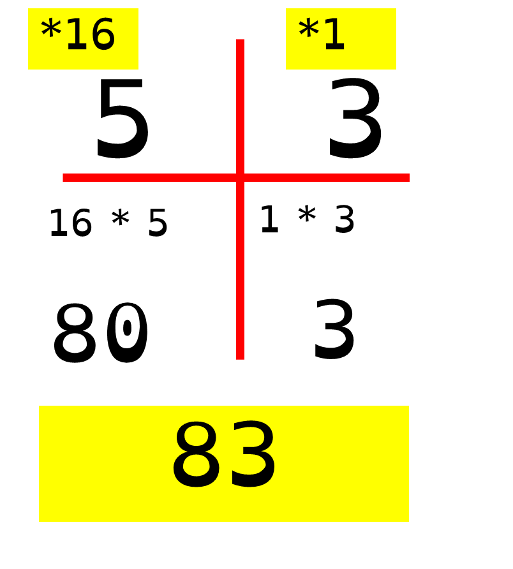
1.2 Memory and Storage
Convert the following
7A
DC
C5
2E
B0

Slide 46
1.2 Memory and Storage
What is 13 in hex?
1101 in hex is D.
8 | 4 | 2 | 1 | Total
1 | 1 | 0 | 1 | 13

Slide 47
1.2 Memory and Storage
Convert the following 4 bit numbers into hex:
0011
1010
1111
1001

Slide 48
1.2 Memory and Storage
Convert the following 4 bit numbers into hex:
0011
1010
1111
1001
3

Slide 49
1.2 Memory and Storage
Convert the following 4 bit numbers into hex:
0011
1010
1111
1001
3
10

Slide 50
1.2 Memory and Storage
Convert the following 4 bit numbers into hex:
0011
1010
1111
1001
3
A

Slide 51
1.2 Memory and Storage
Convert the following 4 bit numbers into hex:
0011
1010
1111
1001
3
A
15

Slide 52
1.2 Memory and Storage
Convert the following 4 bit numbers into hex:
0011
1010
1111
1001
3
A
F

Slide 53
1.2 Memory and Storage
Convert the following 4 bit numbers into hex:
0011
1010
1111
1001
3
A
F
9

Slide 54
1.2 Memory and Storage
Convert the following 4 bit numbers into hex:
0011
1010
1111
1001
Binary
3
A
F
9

Slide 55
1.2 Memory and Storage
Convert the following 4 bit numbers into hex:
0011
1010
1111
1001
Binary
Hex
3
A
F
9

Slide 56
1.2 Memory and Storage
Convert the following 4 bit numbers into hex:
0011
1010
1111
1001
Binary
Hex
Denary
3
A
F
9

Slide 57
1.2 Memory and Storage
Convert the following 4 bit numbers into hex:
0011
1010
1111
1001
Binary
Hex
Denary
3
3
A
F
9

Slide 58
1.2 Memory and Storage
Convert the following 4 bit numbers into hex:
0011
1010
1111
1001
Binary
Hex
Denary
3
3
A
10
F
9

Slide 59
1.2 Memory and Storage
Convert the following 4 bit numbers into hex:
0011
1010
1111
1001
Binary
Hex
Denary
3
3
A
10
F
15
9

Slide 60
1.2 Memory and Storage
Convert the following 4 bit numbers into hex:
0011
1010
1111
1001
Binary
Hex
Denary
3
3
A
10
F
15
9
9

Slide 61
1.2 Memory and Storage
Now lets look at an 8 bit number.
2 nibbles.

Slide 62
1.2 Memory and Storage
128 | 64 | 32 | 16 | 8 | 4 | 2 | 1 | Total
1 | 0 | 0 | 0 | 0 | 1 | 0 | 1 | =

Slide 63
1.2 Memory and Storage
128 | 64 | 32 | 16 | 8 | 4 | 2 | 1 | Total
1 | 0 | 0 | 0 | 0 | 1 | 0 | 1 | =

Slide 64
1.2 Memory and Storage
128 | 64 | 32 | 16 | 8 | 4 | 2 | 1 | Total
1 | 0 | 0 | 0 | 0 | 1 | 0 | 1 | 133

Slide 65
1.2 Memory and Storage
Break the byte into 2 nibbles.
You can then work out the hex.
128 | 64 | 32 | 16 | 8 | 4 | 2 | 1 | Total
1 | 0 | 0 | 0 | 0 | 1 | 0 | 1 | 133

Slide 66
1.2 Memory and Storage
Break the byte into 2 nibbles.
You can then work out the hex.
128 | 64 | 32 | 16
1 | 0 | 0 | 0
8 | 4 | 2 | 1
0 | 1 | 0 | 1

Slide 67
1.2 Memory and Storage
Break the byte into 2 nibbles.
You can then work out the hex.
128 | 64 | 32 | 16
1 | 0 | 0 | 0
8 | 4 | 2 | 1
0 | 1 | 0 | 1

Slide 68
1.2 Memory and Storage
Change the top numbers to 8, 4, 2, 1.
128 | 64 | 32 | 16
1 | 0 | 0 | 0
8 | 4 | 2 | 1
0 | 1 | 0 | 1

Slide 69
1.2 Memory and Storage
Change the top numbers to 8, 4, 2, 1.
8 | 64 | 32 | 16
1 | 0 | 0 | 0
8 | 4 | 2 | 1
0 | 1 | 0 | 1

Slide 70
1.2 Memory and Storage
Change the top numbers to 8, 4, 2, 1.
8 | 4 | 32 | 16
1 | 0 | 0 | 0
8 | 4 | 2 | 1
0 | 1 | 0 | 1

Slide 71
1.2 Memory and Storage
Change the top numbers to 8, 4, 2, 1.
8 | 4 | 2 | 16
1 | 0 | 0 | 0
8 | 4 | 2 | 1
0 | 1 | 0 | 1

Slide 72
1.2 Memory and Storage
Change the top numbers to 8, 4, 2, 1.
8 | 4 | 2 | 1
1 | 0 | 0 | 0
8 | 4 | 2 | 1
0 | 1 | 0 | 1

Slide 73
1.2 Memory and Storage
Now work out the hex value for each.
Put the values next to each other.
8 | 4 | 2 | 1
1 | 0 | 0 | 0
8 | 4 | 2 | 1
0 | 1 | 0 | 1

Slide 74
1.2 Memory and Storage
Now work out the hex value for each.
Put the values next to each other.
8 | 4 | 2 | 1
1 | 0 | 0 | 0
8 | 4 | 2 | 1
0 | 1 | 0 | 1
8
5

Slide 75
1.2 Memory and Storage
Now have a go at the list below:
1001 0011
1101 1010
1101 0011
0111 1110
0100 1111

