Slide 1
OCR GCSE (9–1) in Computer Science (J277)
Memory and storage
This pack is intended for students to use once they have covered the GCSE content, either in preparation for their L1 & L2 exam, or more likely alongside year 2 of the course to improve fluency, recall and pace on GCSE topics. It could be used as lesson starters, or supplied to students for independent use.

Slide 2
Bell Work
 | Length | Bit Rate | Sampling Frequency
Extract 1 | 1 minute | 64 kbit/s | 16 khz
Extract 2 | 1 minute | 128 kbit/s | 32 khz
Which sound is the better quality sound?
How do you know?
What do bit rate and sampling frequency mean?

Slide 3
1.2 Learn about compression in Computing.
1.2 Learn about compression in Computing.
State what compression is.
Discuss the two types of compression.
Explain the benefits of each type of compression.

Slide 4
1.2 Memory and Storage
Analogue sound wave taken.
Converted to digital by assigning a binary value at a set point in the sound.

Slide 5
1.2 Memory and Storage
Set point = sampling
A sample is taken at set intervals.

Slide 6
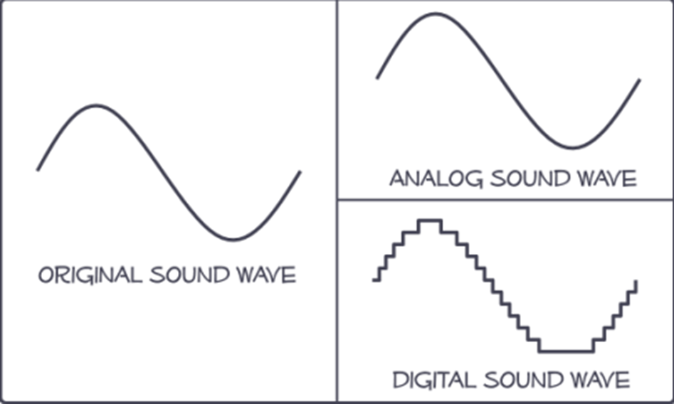
1.2 Memory and Storage

Slide 7
1.2 Memory and Storage
Sample rate is the amount of samples captured per second.
The higher the sampling rate the better the quality of the sound.

Slide 8
1.2 Memory and Storage
 | Length | Bit Rate | Sampling Frequency
Extract 1 | 1 minute | 64 kbit/s | 16 khz
Extract 2 | 1 minute | 128 kbit/s | 32 khz
Bit rate is the amount of bits that can be assigned to the wave length.

Slide 9
1.2 Memory and Storage
The computer will convert the analogue sound into a digital sound by using sampling.
This will assign a binary value to different parts of the song. Each binary value is a different sound.

Slide 10
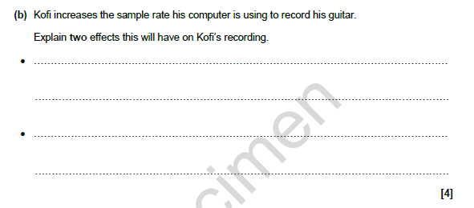
1.2 Memory and Storage
The recording will be a larger file as there will be more data saved from the recording due to more sampling.
The recording will be a higher quality sound and will sound more like the original sound due to the higher rates of samples.

Slide 11
1.2 Memory and Storage
Define the term bit depth in relation to digital sound. [2]
The amount of bits assigned to a sample point of the digital file.
The more binary digits the higher quality of sound.
The more binary digits the higher size of the file.

Slide 12
1.2 Memory and Storage
Compression – what does this word mean?
What does it mean in a computing context.

Slide 13
1.2 Memory and Storage
Reduction.
In computing, it is reducing the size of a file.
Example?

Slide 14
1.2 Memory and Storage
Original Image
Restored Image
Compressed
Which one is lossless and which one is lossy?
Why?
Original Image
Restored Image
Compressed

Slide 15
1.2 Memory and Storage
10MB
10MB
Original Image
1MB
Restored Image
Compressed
Original Image
Restored Image
Compressed

Slide 16
1.2 Memory and Storage
10MB
10MB
Original Image
1MB
Restored Image
Compressed
Lossless
Original Image
Restored Image
Compressed

Slide 17
1.2 Memory and Storage
Original Image
Restored Image
Compressed
10MB
Original Image
1MB
1MB
Restored Image
Compressed

Slide 18
1.2 Memory and Storage
Original Image
Restored Image
Compressed
10MB
Lossy
Original Image
1MB
1MB
Restored Image
Compressed

Slide 19
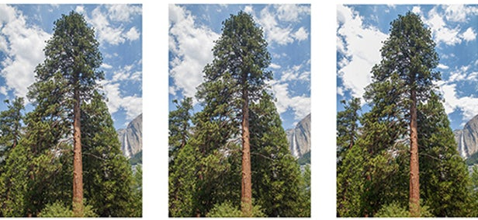
1.2 Memory and Storage
25.2MB
8.6MB
6.5MB
How many bytes does each image have?

Slide 20
1.2 Memory and Storage
25.2MB
8.6MB
6.5MB
Tip – mega = million.

Slide 21
1.2 Memory and Storage
25.2MB
8.6MB
6.5MB
What if it was KB?

Slide 22
1.2 Memory and Storage
25.2MB
8.6MB
6.5MB
Kilo = thousand.

Slide 23
1.2 Memory and Storage
25.2MB
8.6MB
6.5MB
Reducing the file size without taking out any quality that a human can see.

Slide 24
1.2 Memory and Storage
Original
Lossless
Lossy
25.2MB
8.6MB
6.5MB
Reducing the file size without taking out any quality that a human can see.

Slide 25
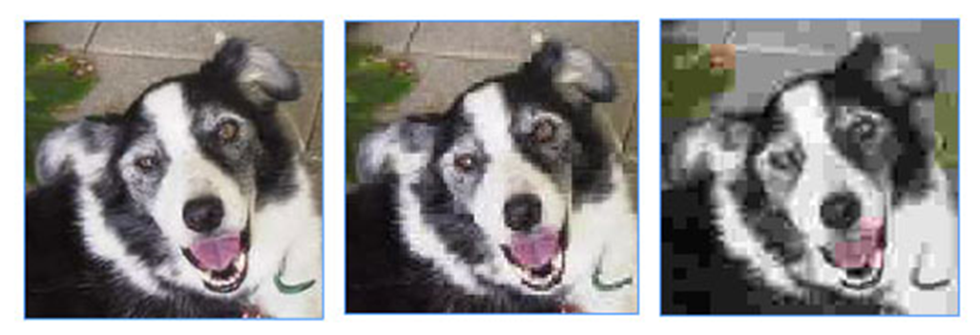
1.2 Memory and Storage

Slide 26
1.2 Memory and Storage
Feature of Lossy or Lossless compression?
Lose quality
Reduce quality
Can’t get the quality back.
Can get the quality back

Slide 27
1.2 Memory and Storage
Lossless compression uses a technique whereby none of the quality is lost during the compression.
This makes files smaller to store, but still retains the quality when they are opened.
Look at the paragraph on the next slide, we are going to compress it…

Slide 28
1.2 Memory and Storage
Lossless compression reduces the file size with no loss of quality. Unlike lossy, lossless compression on an image keeps the image looking fantastic, but doesn’t take up loads of storage. The storage of files takes up lots of room, meaning both lossy and lossless compression have a huge role to play in keeping files small.

Slide 29
1.2 Memory and Storage
Lossless compression reduces the file size with no loss of quality. Unlike lossy, lossless compression on an image keeps the image looking fantastic, but doesn’t take up loads of storage. The storage of files takes up lots of room, meaning both lossy and lossless compression have a huge role to play in keeping files small.

Slide 30
1.2 Memory and Storage
Lossless compression reduces the file size with no loss of quality. Unlike lossy, lossless compression on an image keeps the image looking fantastic, but doesn’t take up loads of storage. The storage of files takes up lots of room, meaning both lossy and lossless compression have a huge role to play in keeping files small.
Each letter for each word is 8 bits meaning this paragraph is 440 bits.

Slide 31
1.2 Memory and Storage
Lossless compression reduces the file size with no loss of quality. Unlike lossy, lossless compression on an image keeps the image looking fantastic, but doesn’t take up loads of storage. The storage of files takes up lots of room, meaning both lossy and lossless compression have a huge role to play in keeping files small.
We can reduce this by storing the word once and referring to it as a number in the paragraph.

Slide 32
1.2 Memory and Storage
Lossless compression reduces the file size with no loss of quality. Unlike lossy, lossless compression on an image keeps the image looking fantastic, but doesn’t take up loads of storage. The storage of files takes up lots of room, meaning both lossy and lossless compression have a huge role to play in keeping files small.
1 = Lossless 2 = Compression, 3 = Lossy

Slide 33
1.2 Memory and Storage
1 compression reduces the file size with no loss of quality. Unlike lossy, lossless compression on an image keeps the image looking fantastic, but doesn’t take up loads of storage. The storage of files takes up lots of room, meaning both lossy and lossless compression have a huge role to play in keeping files small.
1 = Lossless 2 = Compression, 3 = Lossy

Slide 34
1.2 Memory and Storage
1 2 reduces the file size with no loss of quality. Unlike lossy, lossless compression on an image keeps the image looking fantastic, but doesn’t take up loads of storage. The storage of files takes up lots of room, meaning both lossy and lossless compression have a huge role to play in keeping files small.
1 = Lossless 2 = Compression, 3 = Lossy

Slide 35
1.2 Memory and Storage
1 2 reduces the file size with no loss of quality. Unlike 3, 1 2on an image keeps the image looking fantastic, but doesn’t take up loads of storage. The storage of files takes up lots of room, meaning both lossy and lossless compression have a huge role to play in keeping files small.
1 = Lossless 2 = Compression, 3 = Lossy

Slide 36
1.2 Memory and Storage
1 2 reduces the file size with no loss of quality. Unlike 3, 1 2on an image keeps the image looking fantastic, but doesn’t take up loads of storage. The storage of files takes up lots of room, meaning both 3 and 1 2 have a huge role to play in keeping files small.
1 = Lossless 2 = Compression, 3 = Lossy

Slide 37
1.2 Memory and Storage
1 2 reduces the file size with no loss of quality. Unlike 3, 1 2on an image keeps the image looking fantastic, but doesn’t take up loads of storage. The storage of files takes up lots of room, meaning both 3 and 1 2 have a huge role to play in keeping files small.
When the file is saved, the numbers are saved in place of the word. This reduces the file size by huge amounts of bits!
1 = Lossless 2 = Compression, 3 = Lossy

Slide 38
1.2 Memory and Storage
1 2 reduces the file size with no loss of quality. Unlike 3, 1 2on an image keeps the image looking fantastic, but doesn’t take up loads of storage. The storage of files takes up lots of room, meaning both 3 and 1 2 have a huge role to play in keeping files small.
How does this reduce the file size?
Tip – 1 number = 8 bits.
1 = Lossless 2 = Compression, 3 = Lossy

Slide 39
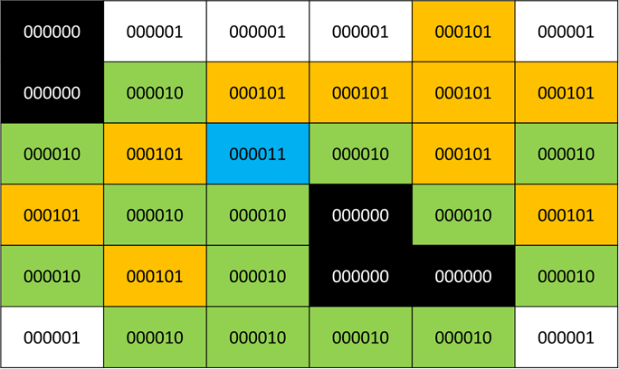
What is lossless compression?
How does lossless compression affect the image?
What does the computer do during lossless compression.

Slide 40
Lossless compression is compressing an image without reducing quality.
What is lossless compression?
How does lossless compression affect the image?
What does the computer do during lossless compression.

Slide 41
Lossless compression is compressing an image without reducing quality.
What is lossless compression?
How does lossless compression affect the image?
What does the computer do during lossless compression.
The file size will be smaller but the quality will be the same.

Slide 42
Lossless compression is compressing an image without reducing quality.
What is lossless compression?
How does lossless compression affect the image?
What does the computer do during lossless compression.
The file size will be smaller but the quality will be the same.
The computer will replace binary values with a character relating to the value. It uses an algorithm to reproduce the image.

Slide 43
Lossless compression uses an algorithm and changes the binary code.
000 | 001 | 001 | 001 | 101 | 001
000 | 010 | 101 | 101 | 101 | 101
010 | 101 | 011 | 010 | 101 | 010
101 | 010 | 010 | 000 | 010 | 101
010 | 101 | 010 | 000 | 000 | 010
001 | 010 | 010 | 010 | 010 | 001

Slide 44
Lossless compression uses an algorithm and changes the binary code.
When the image is restored it follows the algorithm to restore the image to its previous state.
000 | 001 | 001 | 001 | 101 | 001
000 | 010 | 101 | 101 | 101 | 101
010 | 101 | 011 | 010 | 101 | 010
101 | 010 | 010 | 000 | 010 | 101
010 | 101 | 010 | 000 | 000 | 010
001 | 010 | 010 | 010 | 010 | 001

Slide 45
Lossless compression uses an algorithm and changes the binary code.
When the image is restored it follows the algorithm to restore the image to its previous state.
This means no quality is lost during compression.
000 | 001 | 001 | 001 | 101 | 001
000 | 010 | 101 | 101 | 101 | 101
010 | 101 | 011 | 010 | 101 | 010
101 | 010 | 010 | 000 | 010 | 101
010 | 101 | 010 | 000 | 000 | 010
001 | 010 | 010 | 010 | 010 | 001

Slide 46
A = 000
B = 001
C = 101
D = 010
E = 011
000 | 001 | 001 | 001 | 101 | 001
000 | 010 | 101 | 101 | 101 | 101
010 | 101 | 011 | 010 | 101 | 010
101 | 010 | 010 | 000 | 010 | 101
010 | 101 | 010 | 000 | 000 | 010
001 | 010 | 010 | 010 | 010 | 001

Slide 47
A = 000
B = 001
C = 101
D = 010
E = 011
A | B | B | B | C | B
A | D | C | C | C | C
D | C | E | D | C | D
C | D | D | A | D | C
D | C | D | A | A | D
B | D | D | D | D | B

Slide 48
A = 000
B = 001
C = 101
D = 010
E = 011
A | B | B | B | C | B
A | D | C | C | C | C
D | C | E | D | C | D
C | D | D | A | D | C
D | C | D | A | A | D
B | D | D | D | D | B

Slide 49
A = 000
B = 001
C = 101
D = 010
E = 011
A | B | B | B | C | B
A | D | C | C | C | C
D | C | E | D | C | D
C | D | D | A | D | C
D | C | D | A | A | D
B | D | D | D | D | B

Slide 50
A = 000
B = 001
C = 101
D = 010
E = 011
A | B | B | B | C | B
A | D | C | C | C | C
D | C | E | D | C | D
C | D | D | A | D | C
D | C | D | A | A | D
B | D | D | D | D | B

Slide 51
1A 3B 1C 1B 1A 1D 4C 1D 1C 1E 1D 1C 1D 1C 2D 1A 1D 1C 1D 1C 1D 2A 1D 1B 4D 1B
A | B | B | B | C | B
A | D | C | C | C | C
D | C | E | D | C | D
C | D | D | A | D | C
D | C | D | A | A | D
B | D | D | D | D | B

Slide 52
A B B B C B A D C C C C D C E D C D C D D A D C D C D A A D B D D D D B
A | B | B | B | C | B
A | D | C | C | C | C
D | C | E | D | C | D
C | D | D | A | D | C
D | C | D | A | A | D
B | D | D | D | D | B

Slide 53
The same file, but compressed!
A3BCBAD4CDCEDCDC2DADCDCD2ADB4DB

Slide 54
The same file, but compressed!
A3BCBAD4CDCEDCDC2DADCDCD2ADB4DB
ABBBCBADCCCCDCEDCDCDDADCDCDAADBDDDDB

Slide 55
The same file, but compressed!
A3BCBAD4CDCEDCDC2DADCDCD2ADB4DB
ABBBCBADCCCCDCEDCDCDDADCDCDAADBDDDDB
000001001001101001000010101101101101010101011010101010101010010000010101010101010000000010001010010010010001

Slide 56
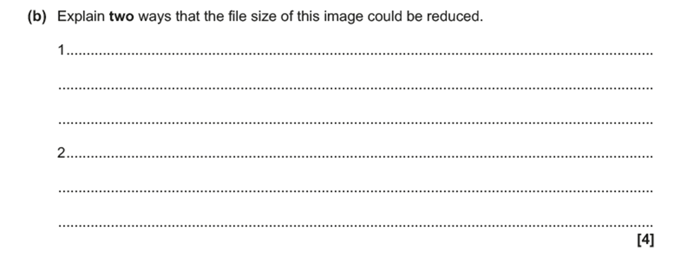
1.2 Memory and Storage

Slide 57
1.2 Memory and Storage
Lossy and Lossless compression = 2 ways.

Slide 58
1.2 Memory and Storage
To reduce the size of this file you could reduce the number of bits per pixel. Only 3 colours are used so you only need a pixel depth of 4 colours (or 2 binary numbers, not 4 as is currently).
You could also use lossy compression. This is where the image is compressed and some of the quality is lost.

Slide 59
1.2 Memory and Storage
You could use lossy compression. This is where the image is compressed and some of the quality is lost.
You could also use lossless compression…

Slide 60
1.2 Memory and Storage
You could use lossy compression. This is where the image is compressed and some of the quality is lost.
You could also use lossless compression…
… this is where the image is compressed and…

Slide 61
1.2 Memory and Storage
You could use lossy compression. This is where the image is compressed and some of the quality is lost.
You could also use lossless compression…
… this is where the image is compressed and…
… the quality is not lost.

Slide 62
1.2 Memory and Storage
You could use lossy compression. This is where the image is compressed and some of the quality is lost.
You could also use lossless compression…
… this is where the image is compressed and…
… the quality is not lost.

Slide 63
1.2 Memory and Storage
You could use lossy compression. This is where the image is compressed and some of the quality is lost.
You could also use lossless compression…
… this is where the image is compressed and…
… the quality is not lost.

Slide 64
1.2 Memory and Storage
You could use lossy compression. This is where the image is compressed and some of the quality is lost.
You could also use lossless compression…
… this is where the image is compressed and…
… the quality is not lost.

