Slide 1
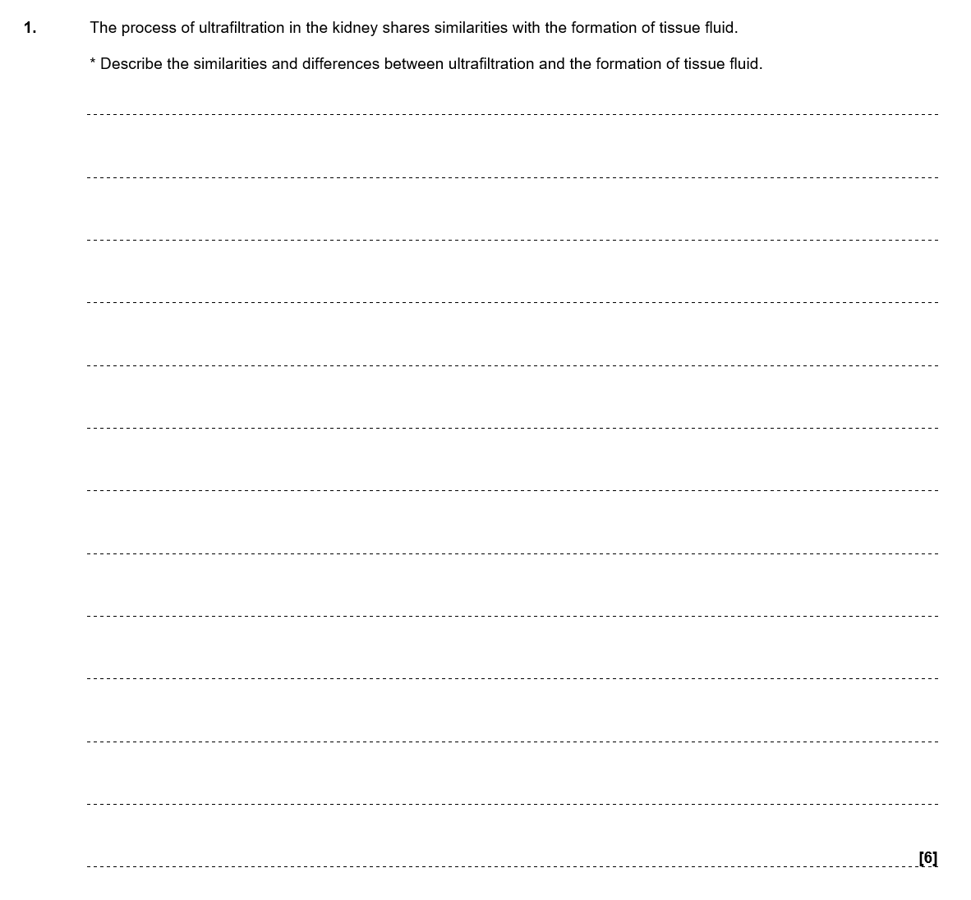
Independent exam question
You have 6 minutes
Start straight away
(6 marks)

Slide 2
Similarities:
• Small molecules are filtered from/diffuse out of the blood.
• Both processes occur in capillaries.
• Large molecules/proteins/ cells, remain in the blood.
• High (hydrostatic) pressure in both processes.
• Many molecules (e.g. water, sugars, ions) are reabsorbed back into capillaries.
• Blood vessels become narrower to maintain (hydrostatic) pressure
• Hydrostatic pressure greater than oncotic pressure in both
Differences:
• Filtrate enters the Bowman’s capsule and then the PCT in the kidney, but tissue fluid bathes cells/enters intercellular space.
• Molecules that are not reabsorbed by capillaries form urine go to the bladder / but molecules that are not reabsorbed from tissue fluid will form lymph.
• Blood filtered through 3 (named: basement membrane, podocytes and endothelial cells of capillaries) layers in ultrafiltration, but only 1 (endothelial cells of capillaries) layer in formation of tissue fluid
• knot of capillaries in ultrafiltration but a network of capillaries in formation of tissue fluid

Slide 3
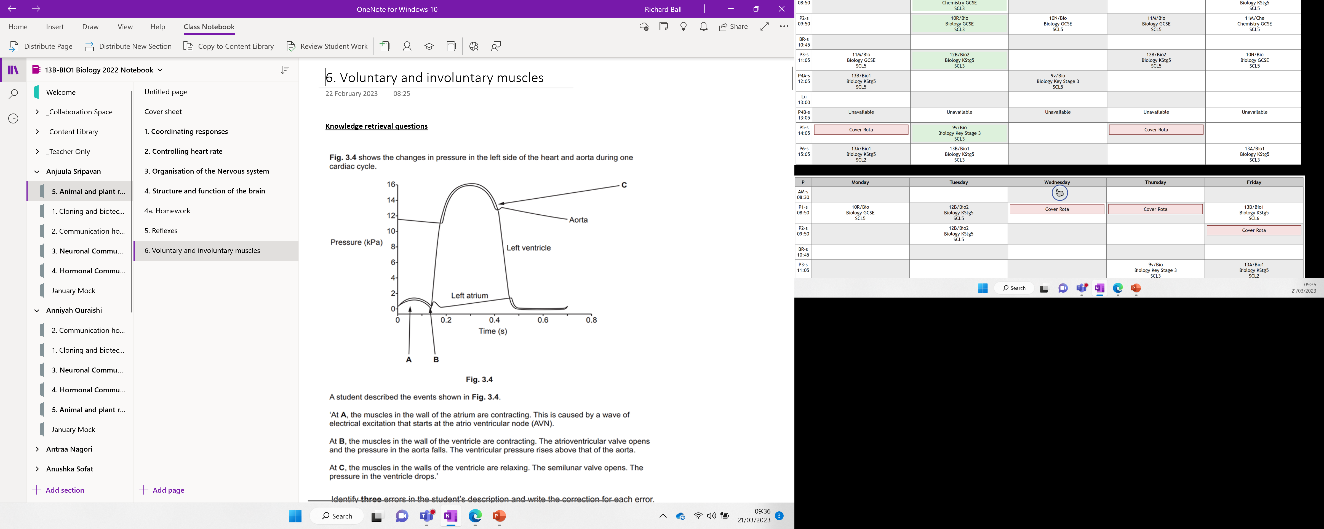

Slide 4
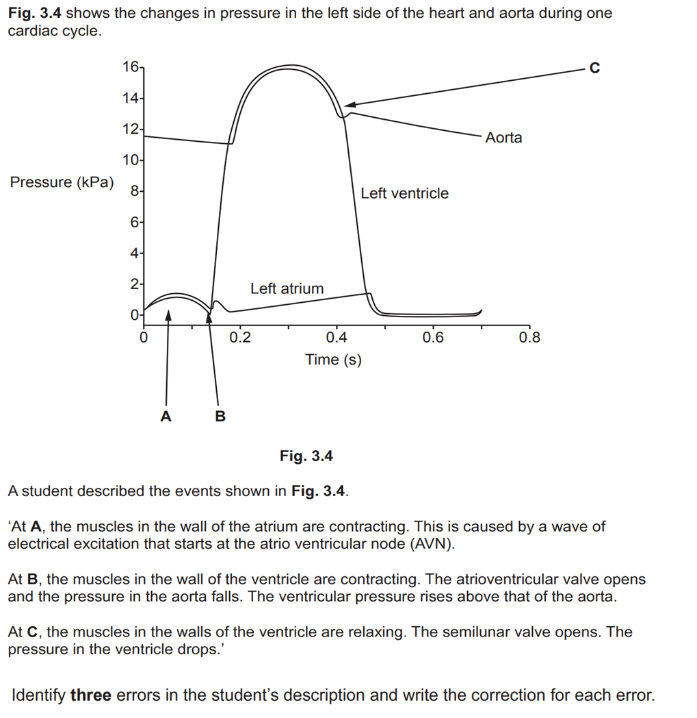
Knowledge retrieval question

Slide 5
Knowledge retrieval question
1 (A) it is not atrioventricular node (AVN), it is sino-atrial node (SAN) ✓
2 (B) atrioventricular valve doesn’t open, it closes. Semi-lunar valves open ✓
3 (B) the pressure in the aorta doesn’t fall, it rises ✓
4 (C) semilunar valve doesn’t open, it closes ✓

Slide 6
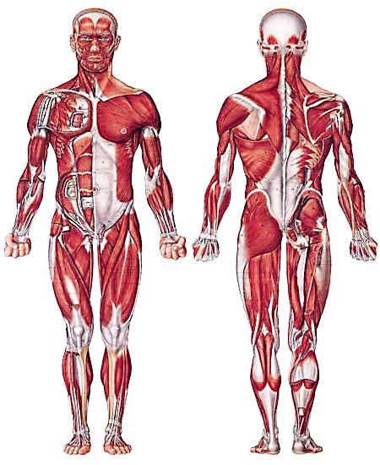
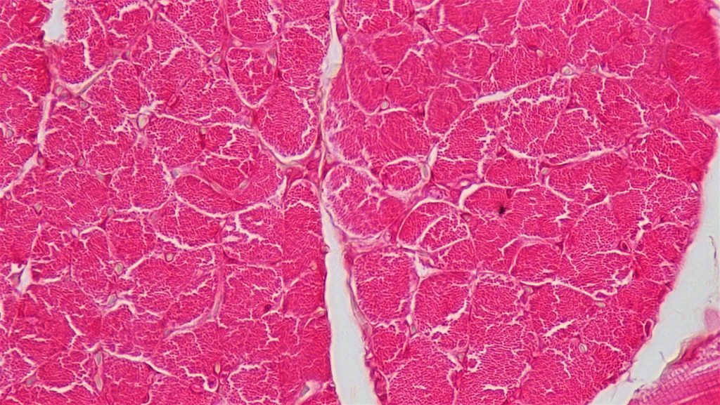
650 muscles in the body
Consisting of half your weight
Biggest:
Gluteus maximum
Smallest:
Stapedius muscle (1mm)
Notes:
Stapedius muscle – holds the smallest bone (stirrup in the middle ear)

Slide 7
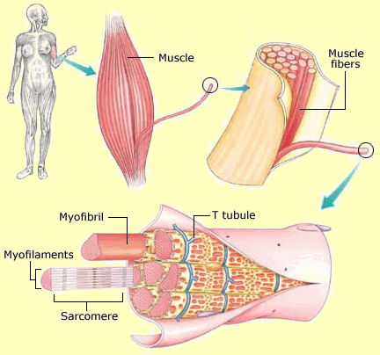
What do you already know?
What is a muscle?
A band or bundle of fibrous tissue that has the ability to contract, producing movement or maintaining the position of parts of the body
What are the different types of muscle?
Skeletal (striated), cardiac and smooth muscle
What happens to the length when a muscle cell contracts?
It decreases in length
How is contraction of muscles coordinated?
Autonomic nervous system – smooth and cardiac muscle
Somatic nervous system – skeletal muscle

Slide 8
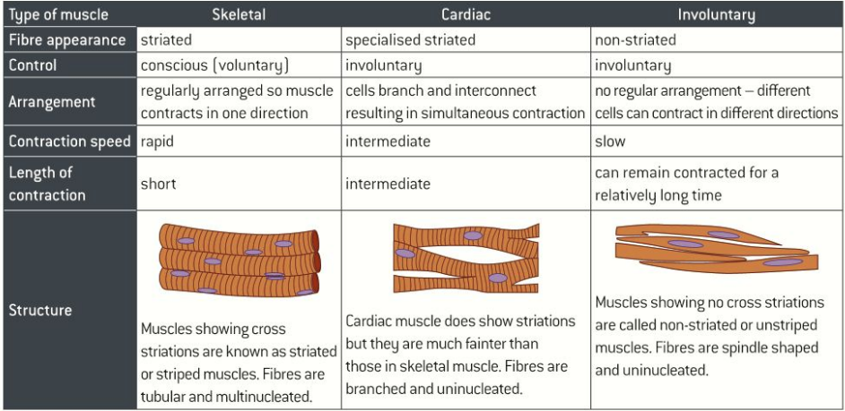

Slide 9
Single contraction characteristics of the three muscle types

Slide 10
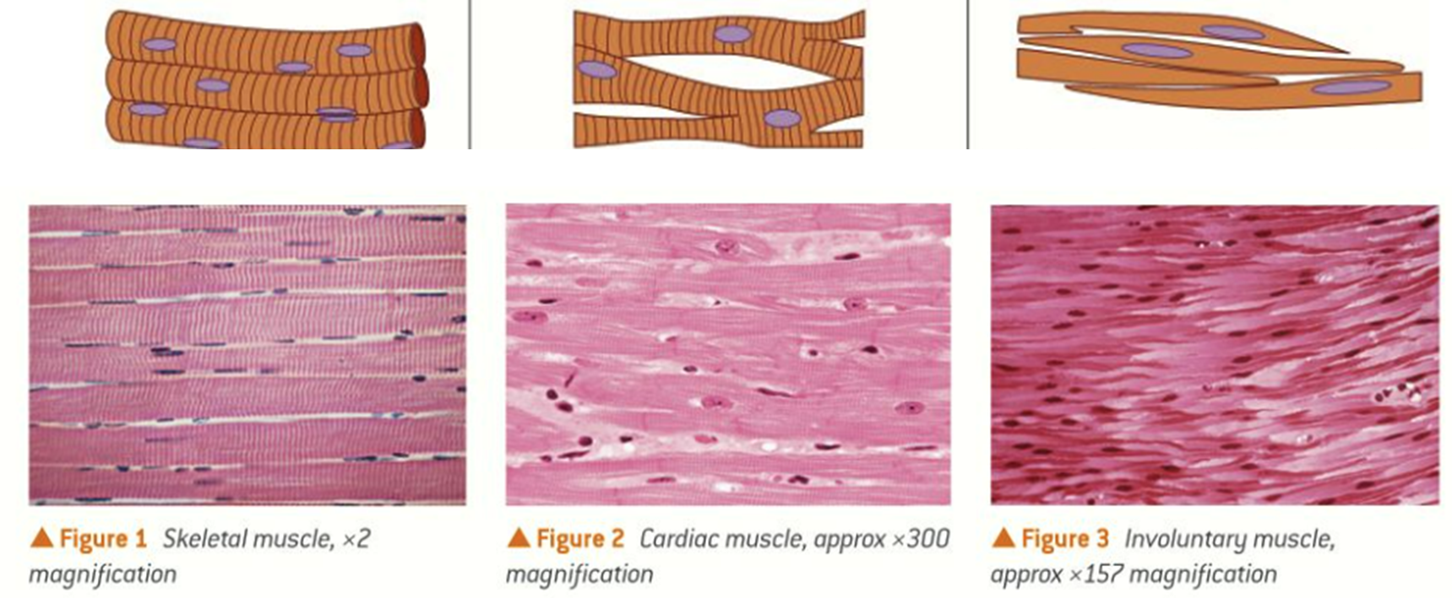
You need to known how skeletal muscle contracts

Slide 11
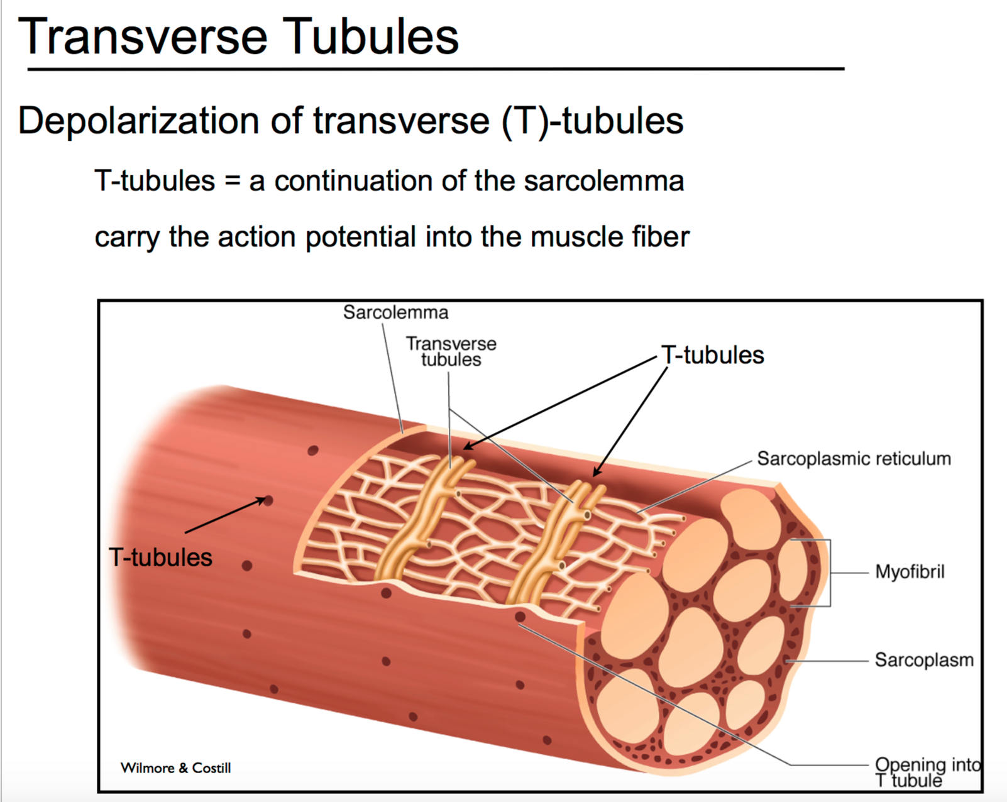
Skeletal muscle fibre
Notes:
Sarcolemma – membrane surrounding the muscle fibre
T-tubules – Inward folds of the sarcolemma to help spread the wave of excitation through the muscle
Sarcoplasm – cytoplasm found in the muscle fibre
Sarcoplasmic reticulum – a modified RER that contains Ca2+ for muscular contractions
Myofibril – contain actin and myosin required for contractions

Slide 12
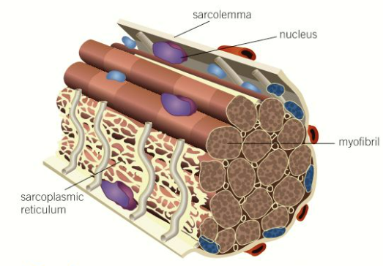
Structure of skeletal muscle
Made from bundles know as muscle fibres
Enclosed in a membrane known as a sarcolemma
Muscle cells fuse to form one long muscle fibre, so contain a number of nuclei. This makes them stronger as the junctions between adjacent cells would be a point of weakness.
The shared cytoplasm is known as the sarcoplasm.
Part of the sarcolemma folds inwards known as the T tubules (transverse tubules). They help spread electrical activity throughout the sarcoplasm at the same time.
Contain many mitochondria to provide ATP for muscle contractions
A modified RER call the sarcoplasmic reticulum, which spreads throughout the muscle fibre and contains Ca²⁺ ions required for muscle contraction.
Notes:
After you workout, your body repairs or replaces damaged muscle fibers through a cellular process where it fuses muscle fibers together to form new muscle protein strands or myofibrils. These repaired myofibrils increase in thickness and number to create muscle hypertrophy (growth).¹ Muscle growth occurs whenever the rate of muscle protein synthesis is greater than the rate of muscle protein breakdown. This adaption, however, does not happen while you actually lift the weights. Instead, it occurs while you rest.
So how do you actually add muscle to your muscle cells? This is where Satellite cells come in and act like stem cells for your muscles. When activated, they help to add more nuclei to the muscle cells and therefore contribute directly to the growth of myofibrils (muscle cells). Activating these satellite cells may be the difference between what allows certain “genetic freaks” to grow massive muscles and what makes other people “hard-gainers.²”
In one of the most interesting studies in the past 5 years, researchers showed that those who were “extreme responders” to muscle growth, with an incredible 58% myofiber hypertrophy from an exercise, had 23% activation of their satellite cells. Modest responders, who had a 28% growth, had 19% activation of their satellite cells. What is interesting to note, though, is that some people known as “non-responders” in the study had 0% growth and had a concurrent 0% activation of their satellite cells. Therefore, it seems the more you can activate these satellite cells, the more you’ll be able to grow. So then the question becomes, how do you activate these satellite cells to increase muscle growth?

Slide 13
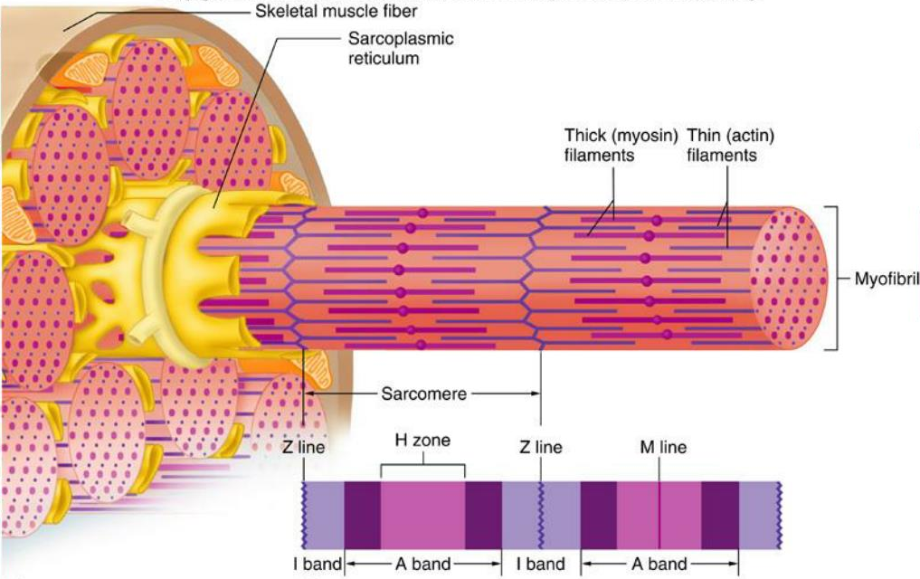
Myofibril and the sarcomere
Notes:
Individually provide almost no force, but collectively are very powerful!

Slide 14
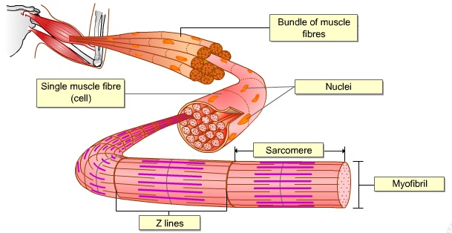
Myofibrils
Every muscle fibre contains myofibrils
These are long cylindrical organelles that are specialised for contractions.
Myofibrils are divided into functional units called sarcomeres
In each sarcomere there are two types of protein filaments:
Actin – the thinner filament. It consists of two strands twisted around each other.
Myosin – the thicker filament. It contains long rod-shaped fibres with myosin heads that project to one side.

Slide 15

Why are the bands different colours?

Slide 16
Light bands - No overlapping actin and myosin filaments (I-bands)
Dark bands - Overlapping actin and myosin filaments (A-bands)
Z-line - In the centre of each light band. The distance between each Z-line is called a sarcomere. This unit shortens during contraction. Actin attach to this line.
H-Zone – Lighter coloured region found in the centre of each band. Only myosin filaments are present.

Slide 17
NL below

Slide 18
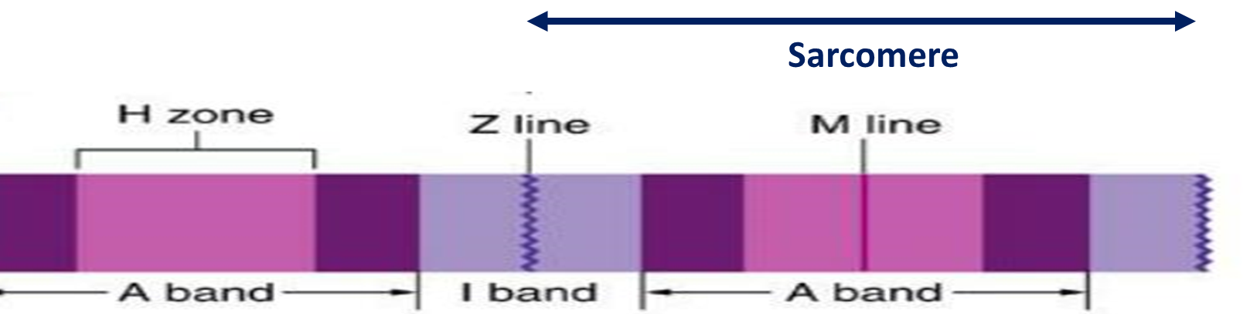
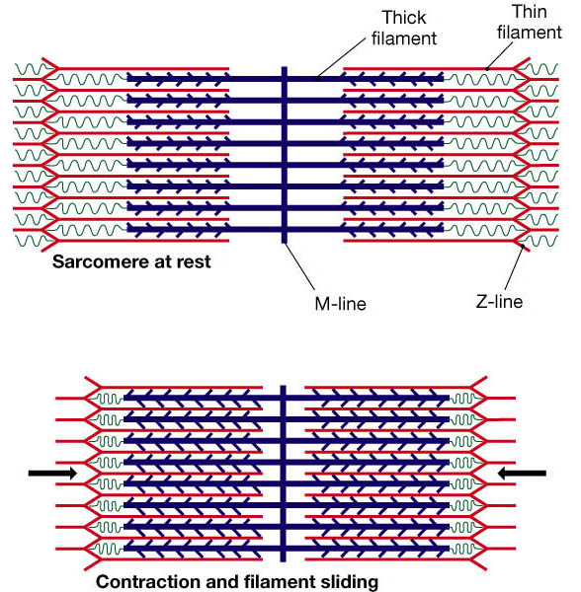
M-line - present in the centre of the A band, and thus, it lies in the exact centre region of the sarcomere.
Myosin filaments are attached to this line.
Sarcomere

Slide 19
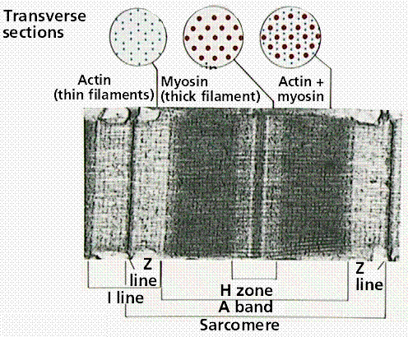

Slide 20
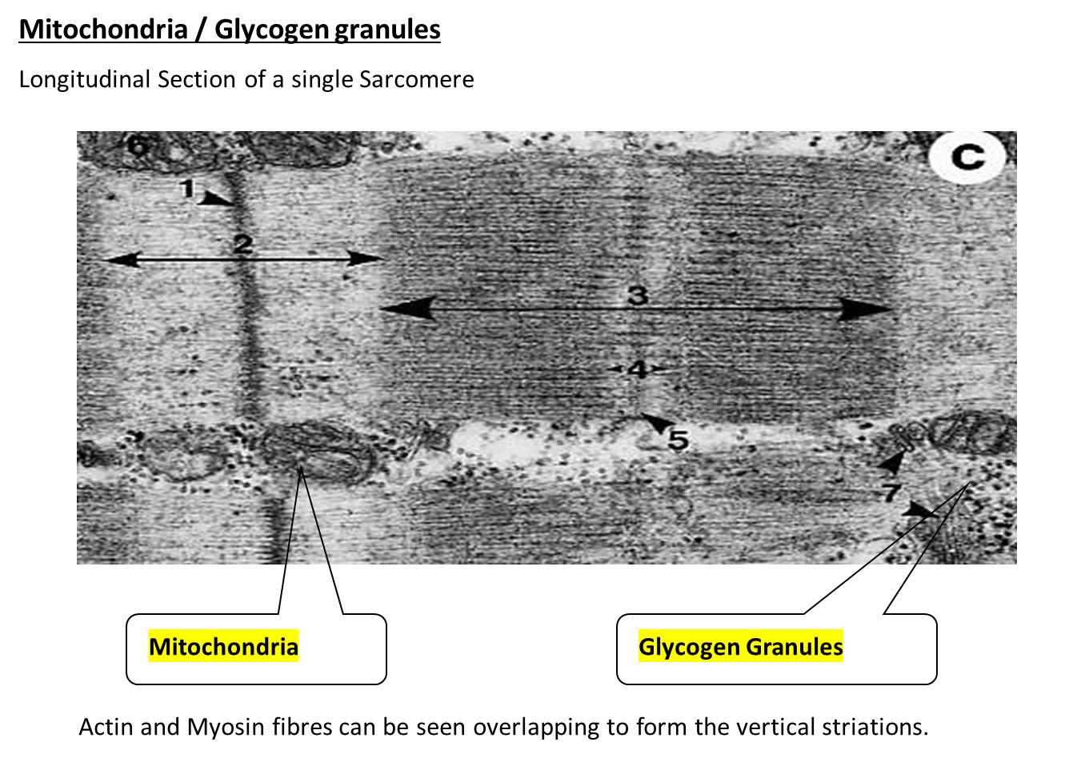

Slide 21
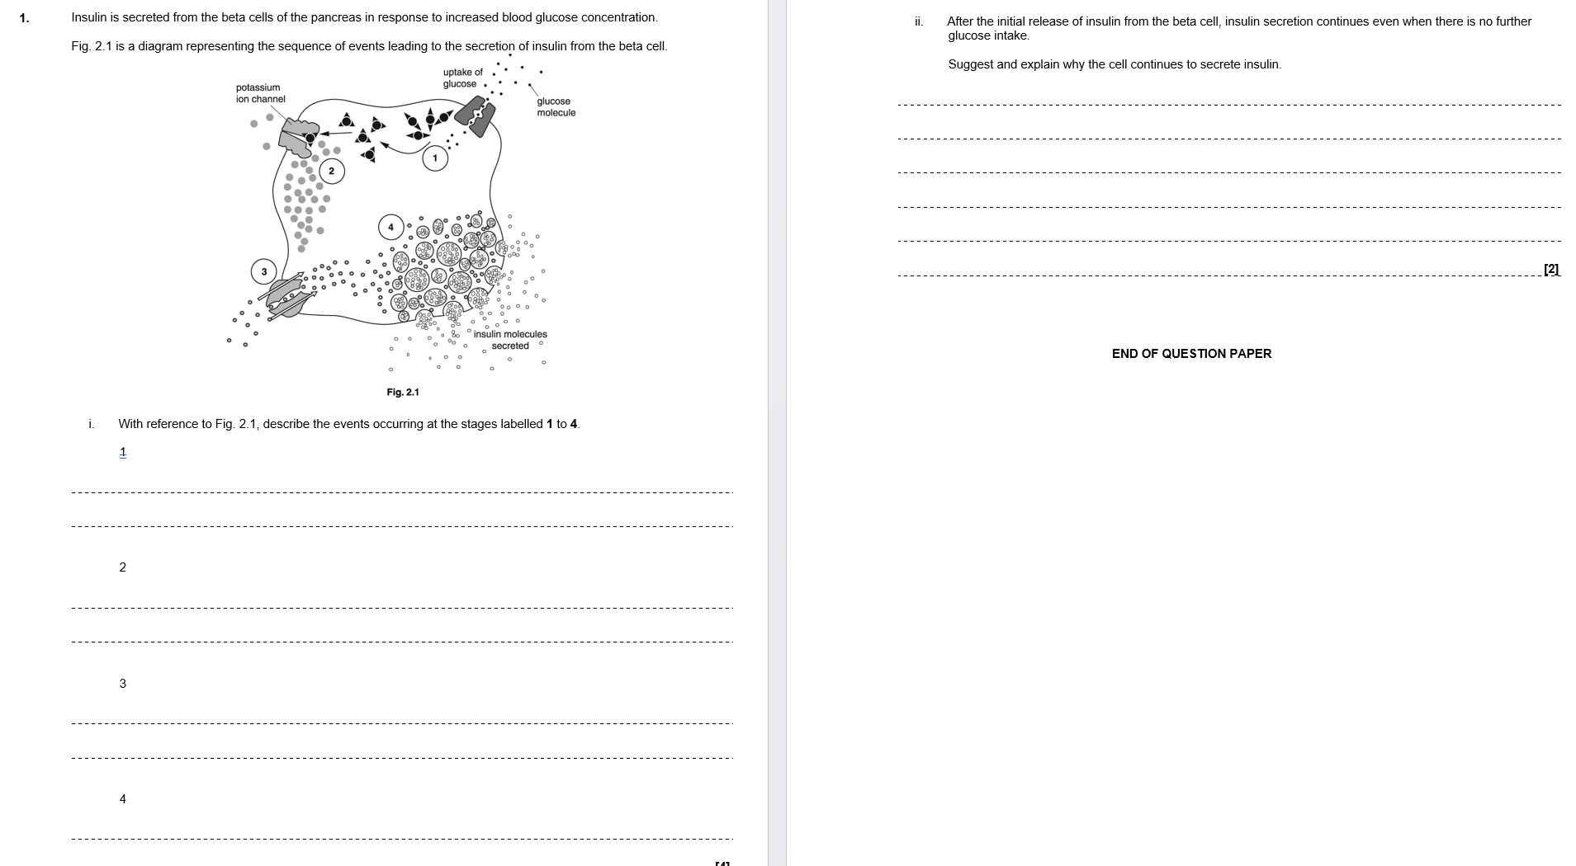
Independent exam question
You have 6 minutes
Start straight away

Slide 22
1. glucose, respired / phosphorylated / metabolised, to produce ATP;
2. ATP, blocks / closes, potassium ion channel(s) And potassium ions / K+, build up (inside cell) / cannot leave;
3. (voltage-gated) calcium ion / Ca2+, channels open And calcium ions / Ca2+, enter (cell by diffusion);
(more) calcium ions / Ca2+, resulting in, movement of vesicles to membrane / exocytosis / described;
ii)
1. (continues to be secreted) as long as blood / plasma, glucose (concentration), remains high / is higher than normal;
2. (sufficient) ATP is still present and so K+ channels remain closed;
3. (exocytosis) still being triggered by, calcium ions / Ca2+;

Slide 23
Why are the bands different colours?

Slide 24
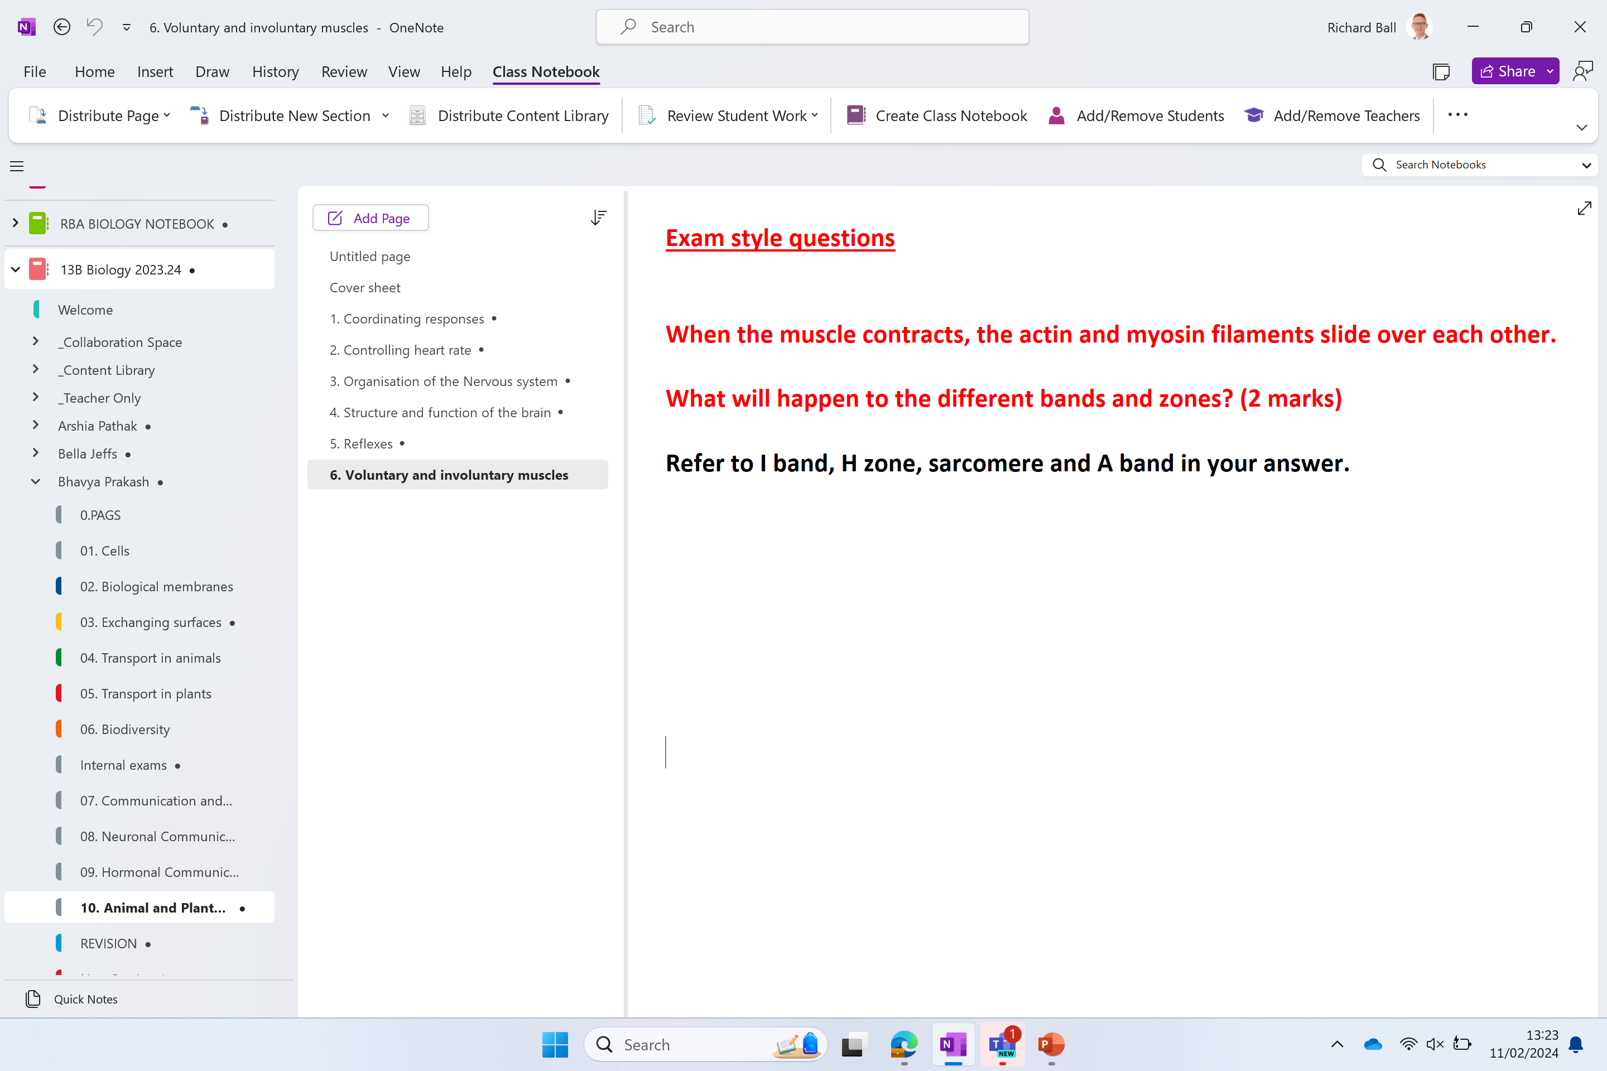

Slide 25
Exam style questions
When the muscle contracts, the actin and myosin filaments slide over each other.
What will happen to the different bands and zones?
You must refer to I band, H zone, sarcomere and A band in your answer.

Slide 26
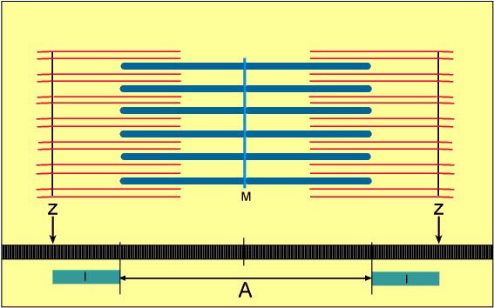
H-zone

Slide 27
H-zone
When the muscle contracts, the actin and myosin filaments slide over each other. What will happen to the different bands and zones? (2 marks)
Refer to I band, H zone, sarcomere and A band in your answer.
Length of I Band, H Zone, sarcomere, all decrease in length
A Band stays the same size

Slide 28
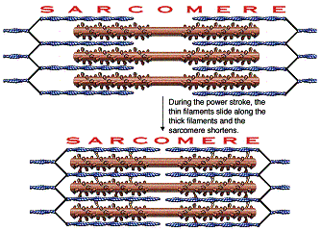
A Band (actin + myosin)
I Band (only actin)
H Zone
Sarcomere

Slide 29
Mechanism of muscle contraction
The above micrographs show that the sarcomere gets shorter when the muscle contracts
The light (I) bands become shorter
The dark bands (A) bands stay the same length

Slide 30
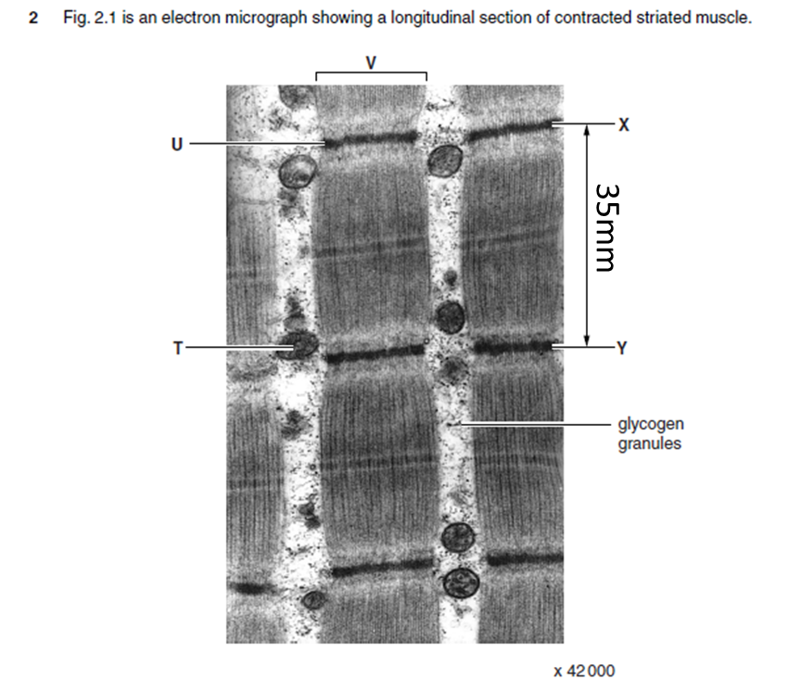
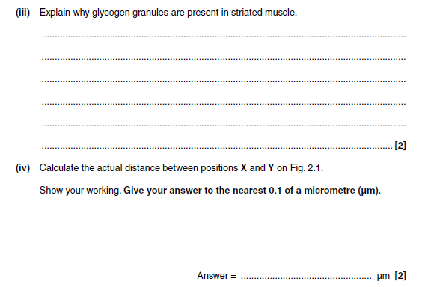
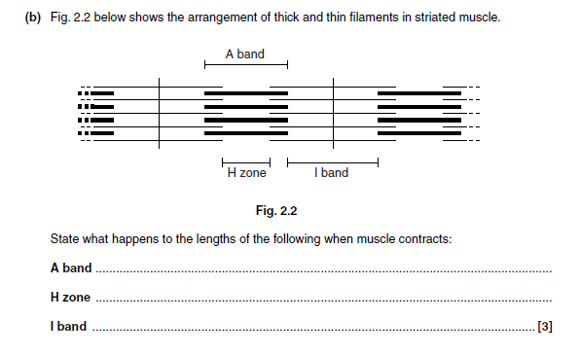
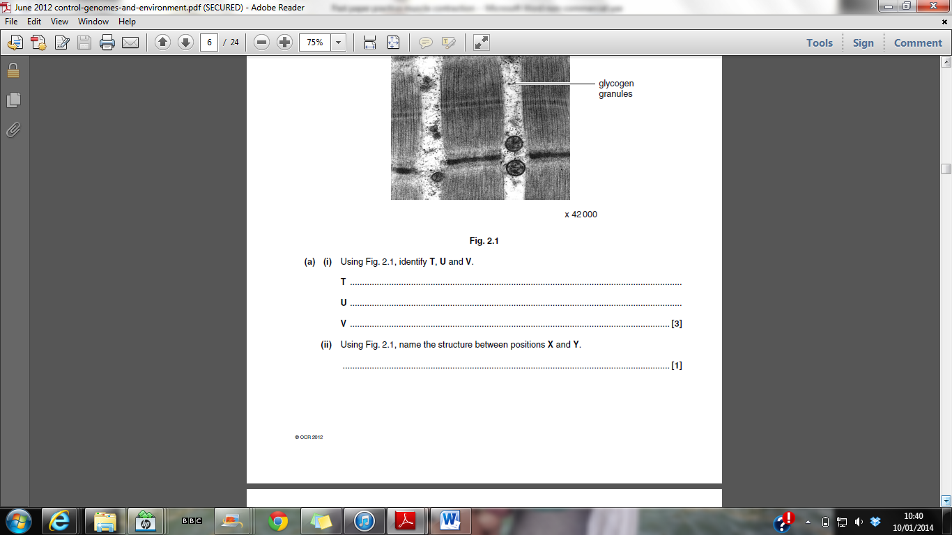
Glycogen can be broken down into glucose
Provide ATP for contraction of muscle fibres
35,000 / 42,000 = 0.8
Mitochondria
Z-line
Myofibril
Stays the same
Sarcomere
Shortens in length
Shortens in length

Slide 31
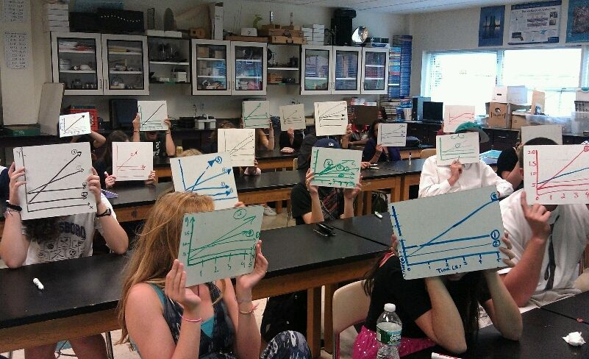
WHITE BOARDS AT THE READY!!

Slide 32
ROUND 1
Name the ECG trace!
First two to write the name and hold it up high win a point

Slide 33
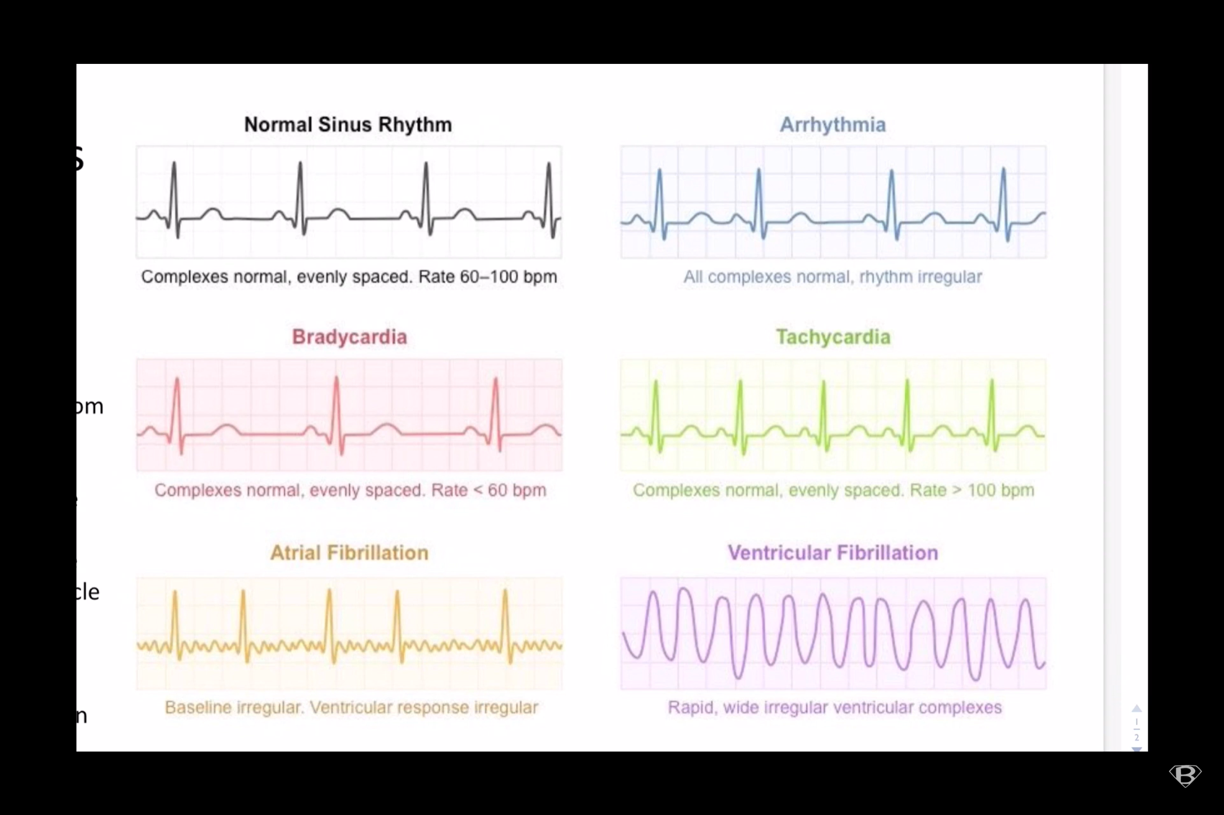

Slide 38
Ectopic heartbeat

Slide 39
ROUND 2
Draw the ECG trace!
First two to draw the ECG and hold it up high wins a point

Slide 41
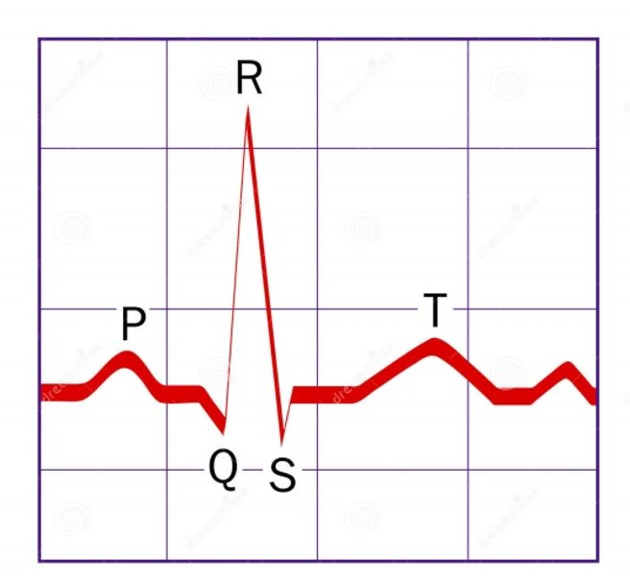
A normal ECG with an arrow pointing at the P wave

Slide 43
A normal ECG with an arrow pointing at the T wave

Slide 44
ROUND 3
What does the following show?

Slide 45
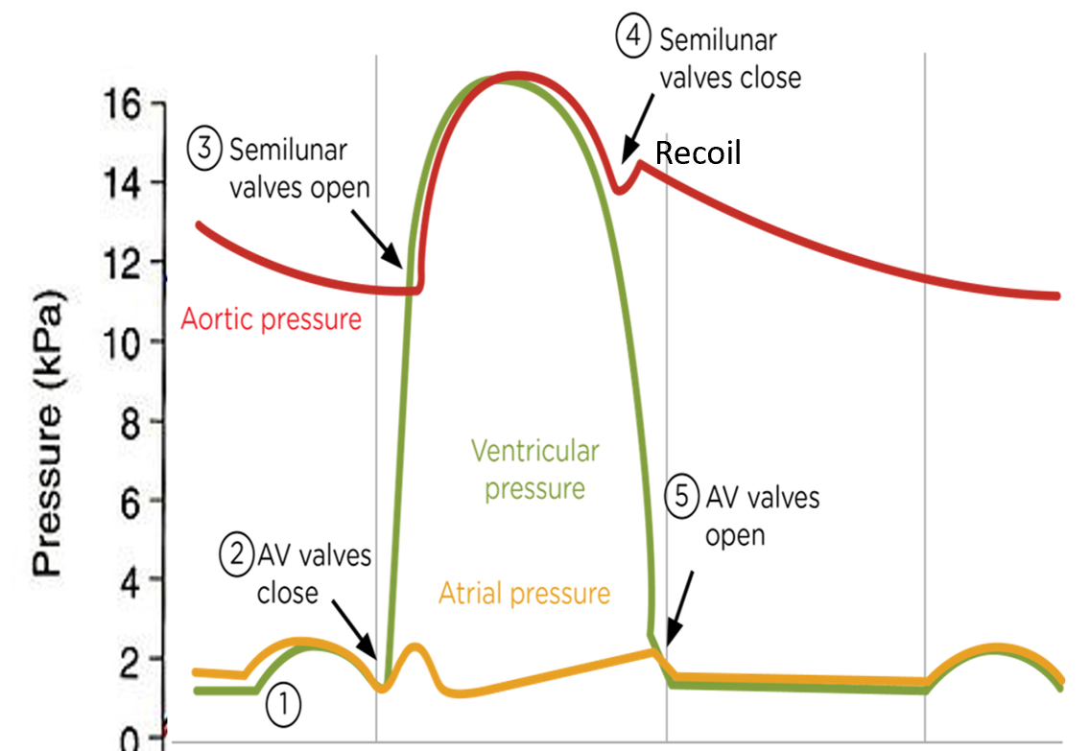
diastole

Slide 46
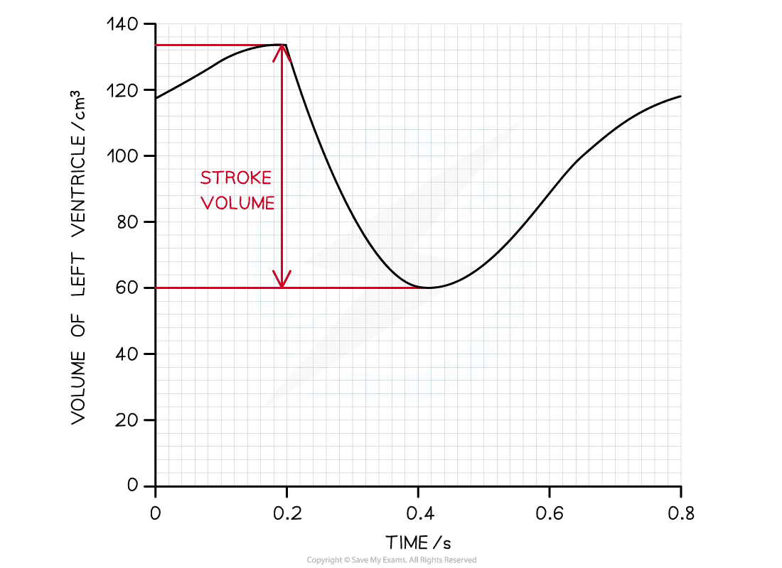
Stroke volume
?

Slide 47
Ventricular systole

Slide 48
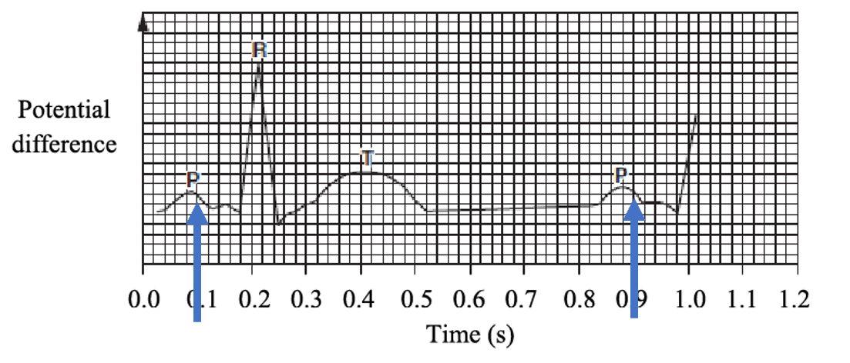
Length of one cardiac cycle

Slide 49
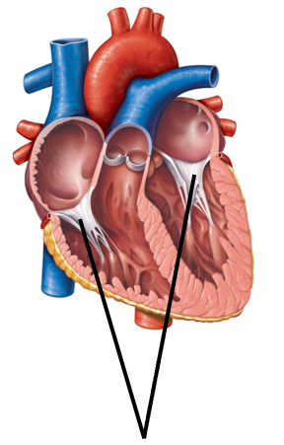
Tendinous cords
?

Slide 50
Atrial systole

Slide 51
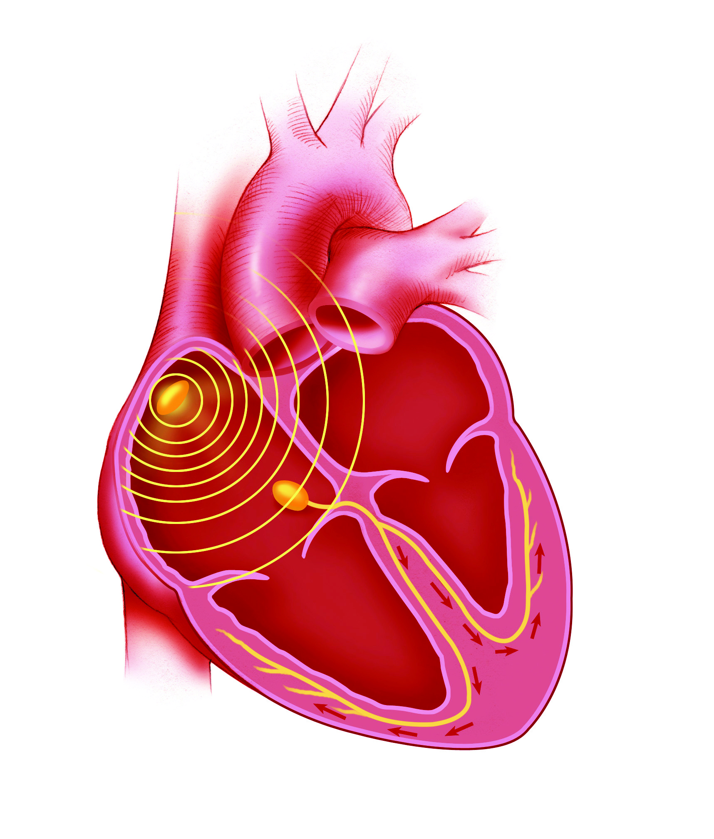
The location in the heart of the SA node

Slide 52
Final slide – triple points!
Draw the following…..

Slide 53
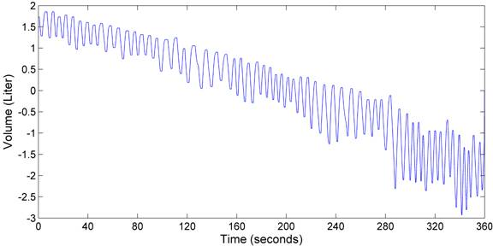
A spirometer trace showing a person who is starting to exercise

Slide 54
You need to known how skeletal muscle contracts

Slide 55
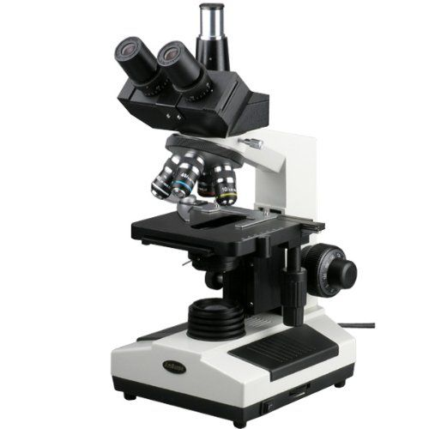
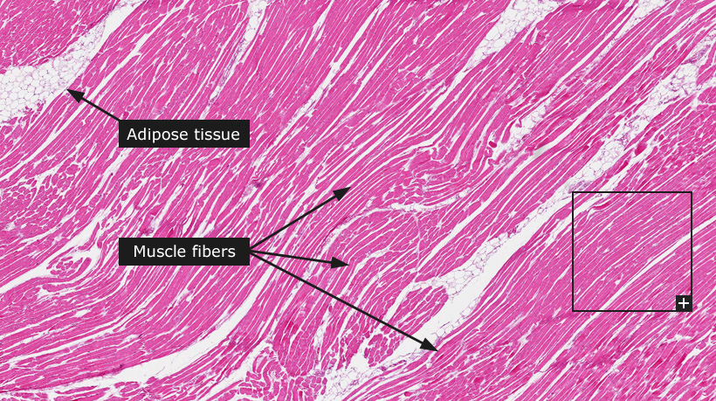
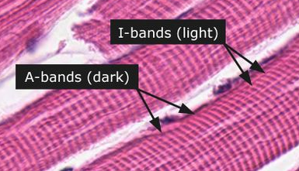
Go take a look!
TRY QUESTIONS WHEN DONE

Slide 56
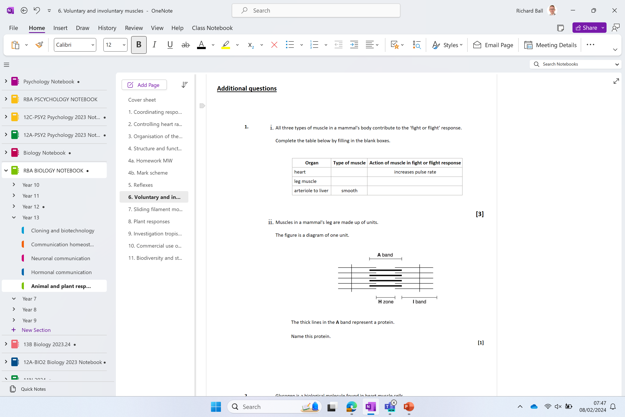
Additional questions

