Slide 1
Genetic diagrams
- Use genetic diagrams to solve problems involving co-dominance and sex linkage.
Task: Work out the genotype of Mrs Lupton's eye colour from the following information:
Mrs Lupton has brown eyes, her sister has blue eyes, her dad has brown eyes, and her mum brown eyes.
B = brown; b = blue
Key words:
Monohybrid inheritance
Phenotype ratios
Punnett squares

Slide 2
Genetic diagrams
Show the possible genotypes of offspring.
Used to predict the genotypes and phenotypes of the offspring if two parents bred (are crossed).
Monohybrid crosses
Punnett squares
Work through examples on your MWB

Slide 3
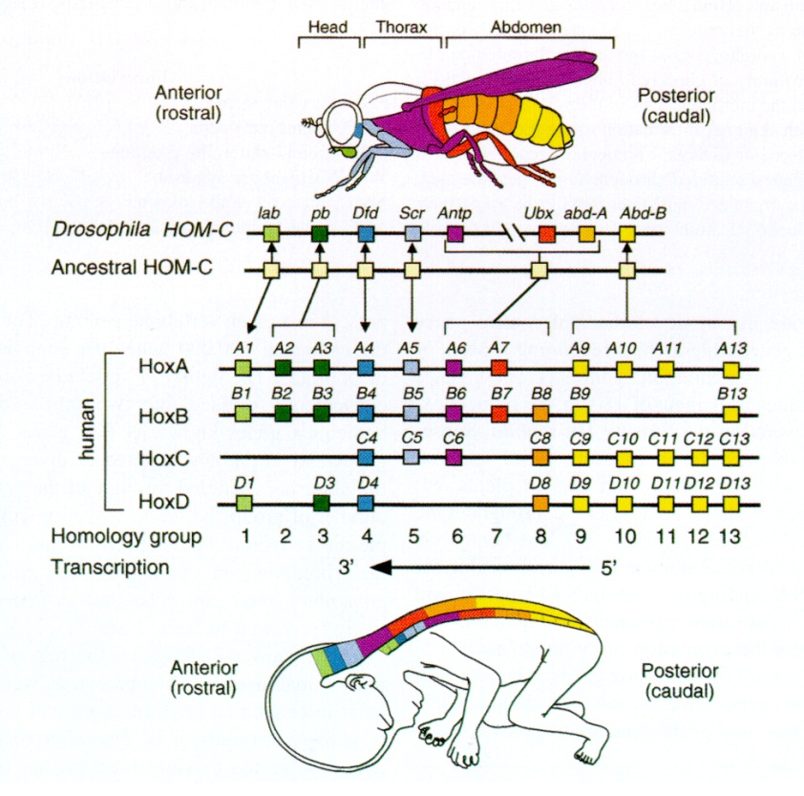
Monohybrid inheritance
The inheritance of a single characteristic (gene) controlled by different alleles.
Monohybrid crosses: Show the likelihood of alleles being inherited by offspring of particular parents.
Genotype
Fly 1
NN
nn
Genotype
Fly 2
Meiosis
Calculate the ratio of normal flies, flies who are carriers of the vestigial allele and flies that have vestigial wings in the next generation
N
N
n
n
Fertilisation
N = dominant allele for normal wings
n = recessive allele for small wings
Nn
Nn
Nn
Nn
All offspring are heterozygous, have normal wings but are carriers

Slide 4
Genotype
Fly 1
NN
nn
Genotype
Fly 2
Phenotypic ratio:
25 % normal
50% normal but carriers
25% vestigial wings
This is the ratio of different phenotypes in the offspring
Meiosis
N
N
n
n
Fertilisation
Nn
Nn
Nn
Nn
F1
Sometimes this ratio changes, due to crossing over (linkage) or epistasis
N
n
N
n
Epistasis – the expression of one gene is modified by the expression of another, e.g. hair colour and baldness
NN
Nn
Nn
nn
F2

Slide 5
Punnett squares
This is another way of showing a genetic diagram.
Possible genotypes of offspring, F1
Gametes alleles | N | N
n | Nn | Nn
n | Nn | Nn
All offspring have normal wings but are carriers.
100% normal
100% carriers
Nn
Nn
F1
Possible genotypes of offspring, F2
Gametes alleles | N | n
N | NN | Nn
n | Nn | nn
N
n
N
n
25% normal
50% normal but are carriers
25% vestigial wings
NN
Nn
Nn
nn
F2

Slide 6
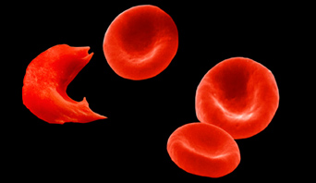
Inheritance of co-dominant alleles
Alleles can be co-dominant, that is, both are expressed in the phenotype, and neither one is recessive. e.g. sickle cell anaemia.
Sickle cell anaemia: the two alleles are co-dominant because they are both shown in the phenotype.
People who are homozygous with the normal alleles, H^{N}H^{N}, do not have the disease.
People who are homozygous with the sickle cell allele, H^{S}H^{S}, have sickle cell anaemia.
People who have the heterozygous genotype, H^{N}H^{S}, have an in between phenotype, where some haemoglobin are normal and some are sickle shaped.
Parents
genotypes
H^{N}H^{s}
H^{N}H^{s}
Gametes
alleles
H^{N}
H^{s}
H^{N}
H^{s}
Possible
genotypes
of offspring
H^{N}H^{N}
H^{N}H^{s}
H^{N}H^{s}
H^{s}H^{s}
Phenotypes of offspring: 25% have normal haemoglobin, 50% have the sickle cell trait, 25% have sickle cell anaemia, 1:2:1 ratio

Slide 7


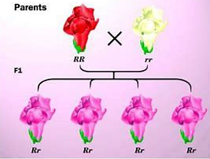
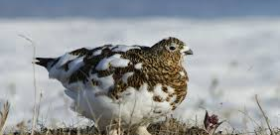
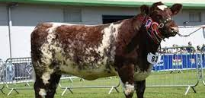
Suggest the difference between codominance and incomplete dominance
Incomplete dominance leads to a new phenotype, e.g. wavy hair. Neither allele is expressed and a new trait is observed.

Slide 8
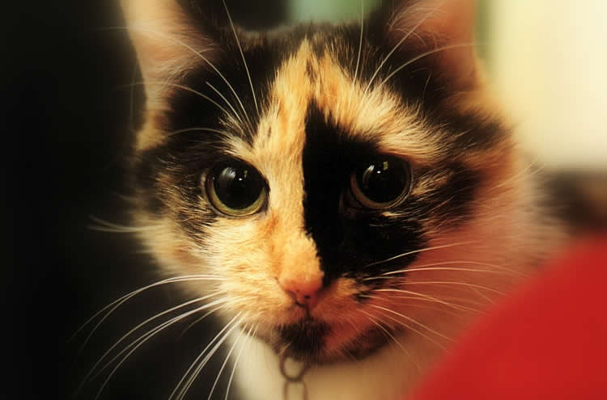
Tortoiseshell Cats
All tortoiseshell cats are female, this is because the allele for coat colour is carried on the X chromosome.
If a female cat inherits a black allele and a ginger allele, she will be tortoiseshell.
X^{B}X^{G}
A male cat can only inherit one of these alleles so he will be either black or ginger.
X^{B}Y or X^{G}Y
Extra: auto immune disease is more frequent in women as switching off X chromosomes occurs. More immune system proteins are found on X chromosomes. In autoimmune the switching off does not happen correctly.
Male tortoiseshell cats are rare but do occur. How can this be possible?
The male must inherit 2 X chromosomes, XXY

Slide 9
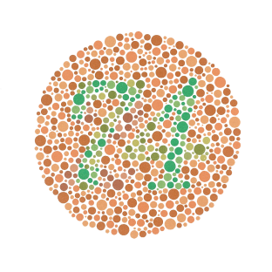

Inheritance of sex linked characteristics
Some characteristics are sex-linked, this means that the gene coding for them is located on a sex chromosome.
The Y chromosome is smaller than the X chromosome, therefore most genes are found on the X chromosome.
Men suffer from X chromosome related illnesses because they only have one X chromosome.
Men cannot be carriers of X-linked diseases because they only have one X chromosome.
Y blinded disorders do exist but are less common.
e.g. colour blindness and haemophilia.
Inheritance of sex linked characteristics
Some characteristics are sex-linked, this means that the gene coding for them is located on a sex chromosome.
Parents
genotypes
X^{N}X^{n}
X^{N}Y
Gametes
alleles
X^{N}
X^{n}
X^{N}
Y
Possible
genotypes
of offspring
X^{N}X^{N}
X^{N}Y
X^{n}X^{N}
X^{n}Y
Normal colour vision
Normal colour vision
Normal colour vision
but carrier of faulty gene
Colour blind

Slide 10
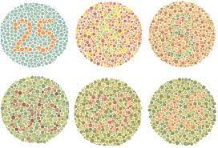

Slide 11

Practice application questions.

