Slide 1
Write each list on stick notes and place in a line on board.
Student races to draw out the word to group.
First team to complete the list wins

Slide 2
Pictionary
Relay Race

Slide 3
Relay Pictionary Race
Rough endoplasmic reticulum
Transmission electron microscope
Alveoli
Tidal volume
Elastin fibres
Mitral/bicuspid valve
Tachycardia
Chloride shift
Cytoskeleton
Electron microscope
Bronchus
Stroke volume
Smooth muscle
Tricuspid valve
Bradycardia
Bohr effect
Nucleus pore
Scanning electron microscope
Bronchioles
Total lung capacity
Collagen fibres
Atrio/ventricular valve
Arrhythmia / atrial fibrillation
Phloem loading

Slide 4
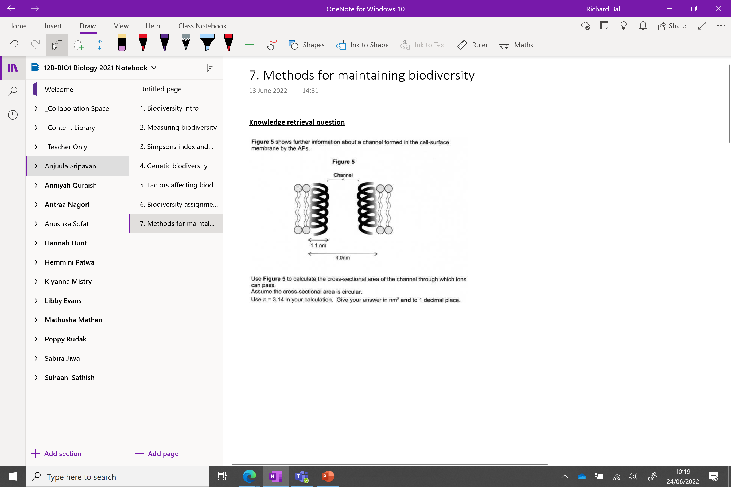

Slide 5
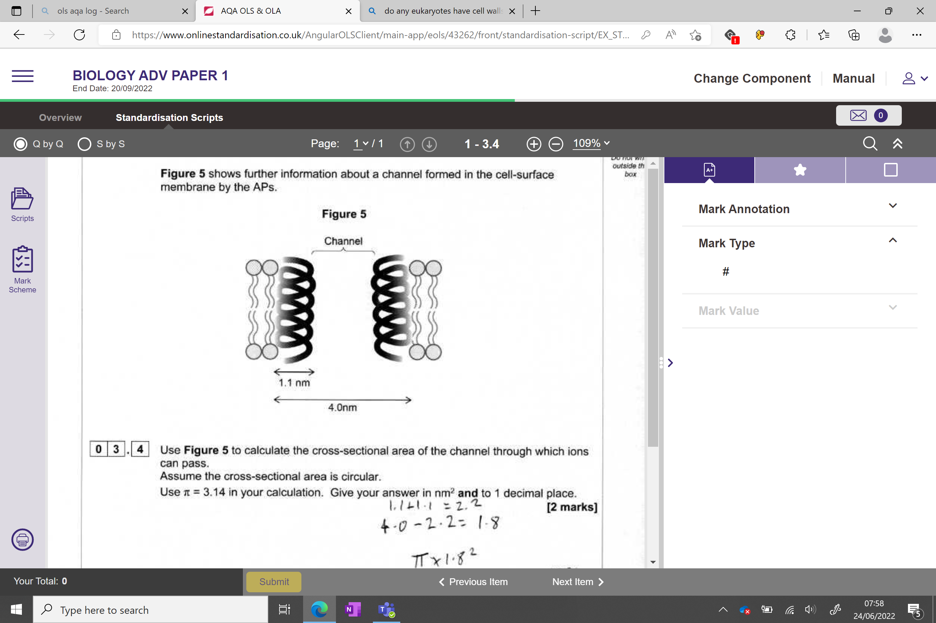
Knowledge retrieval question
4 – 2.2 = 1.8 diameter
1.8 / 2 = 0.9 radius
π x 0.9² = 2.5434 nm²
1dp = 2.5 nm²

Slide 6
Students to guess location and use of place on the next 3 slides

Slide 7
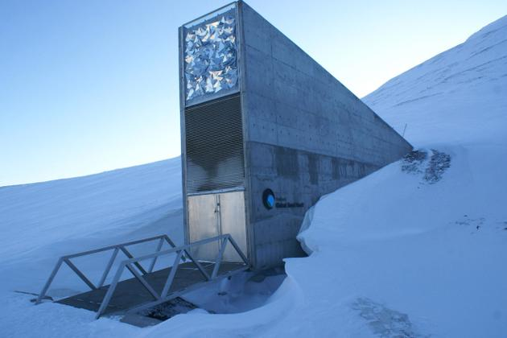

Slide 8
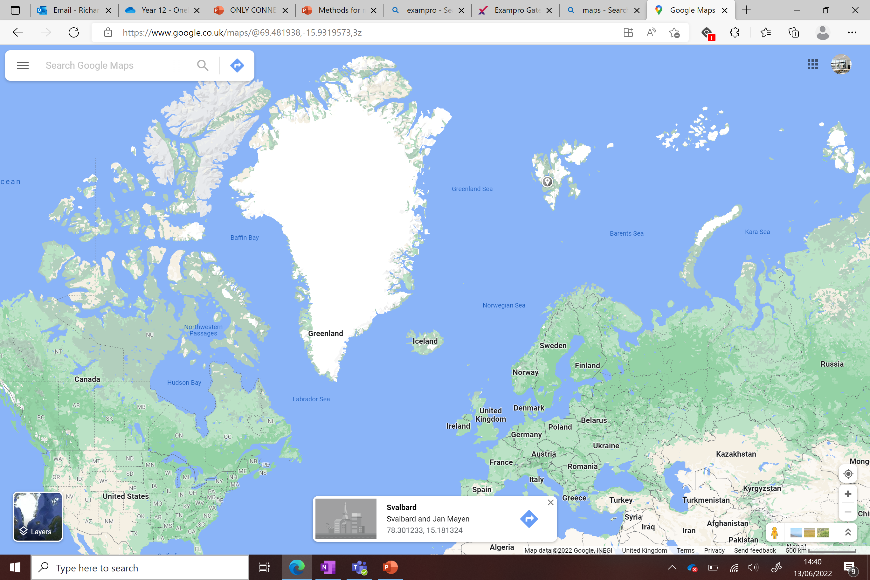

Slide 9
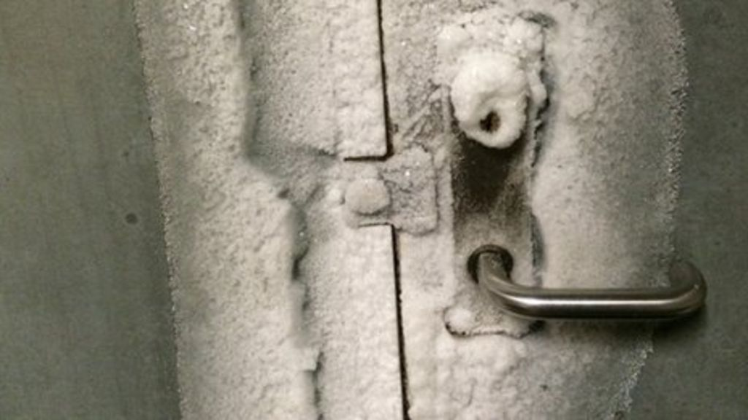
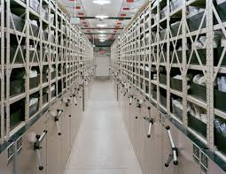
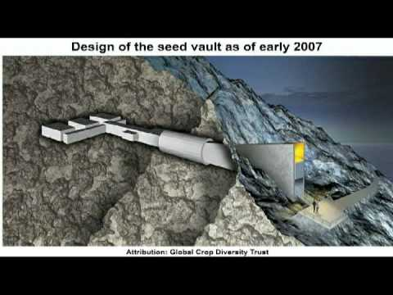
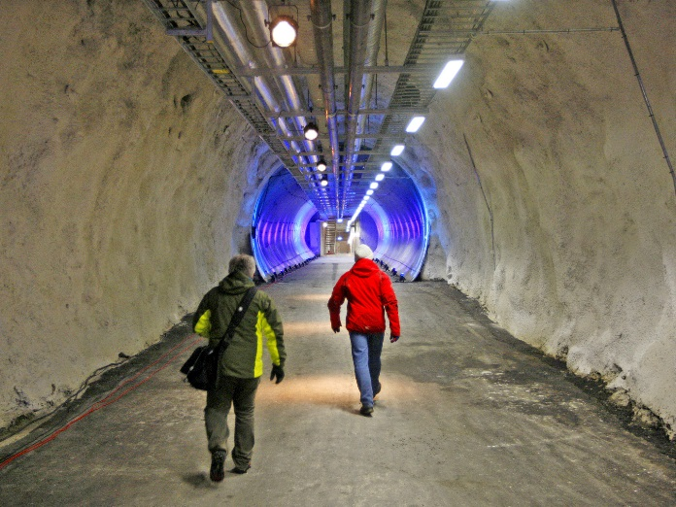
What’s so important about this place?
What could be stored here?

Slide 10
What conditions does it have that make it a perfect location?
Svalbard global seed vault. ‘The doomsday vault’
No tectonic activity
Permafrost – will remain at -18ºC for 3 weeks even if power fails
430 feet above sea level – will remain dry even if the ice cap melts
Unlikely to attract terrorist attack
Exploring the Arctic's Global Seed Vault - YouTube

Slide 11
Svalbard global seed vault is an example of ex situ conservation. But what does this mean?

Slide 12
Conserving biodiversity into two categories
• in situ conservation - within the natural environment
• ex situ conservation – out of the natural habitat

Slide 13
In situ conservation
Conserving species in their natural habitat by minimising human impact e.g. prevention of hunting, logging and land clearance.
Benefits:
  Maintains genetic diversity of species
  Maintains evolutionary adaptations
  Preserves interdependent relationships
Legislation is passed to protect these areas (next lesson)
Occurs in 2 main places, marine conservation zones and wildlife reserves.

Slide 14
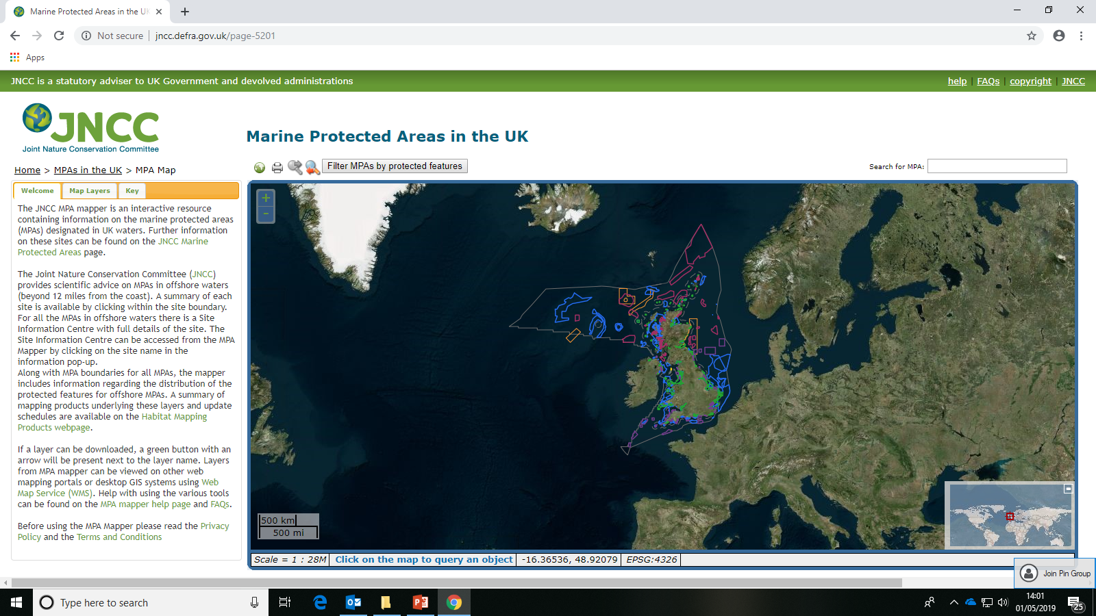

Slide 15
In situ: marine conservation zones
MCZ around the UK.
Conservation depends on habitat and type of organism being protected, e.g. sandbanks, wetland, deep water.
Why do you think many of these sites are not openly signposted?
To prevent people from visiting these areas which are often areas of natural beauty.

Slide 16
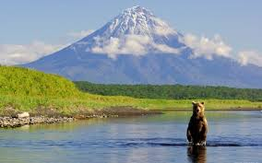
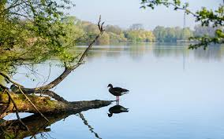
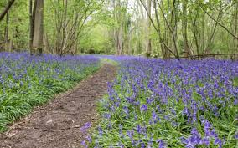
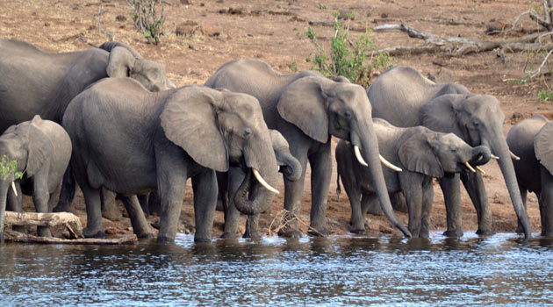
In situ: wildlife reserves
Conservation is an active process that involves management of habitats and species in them.
Preservation leaves ecosystems undisturbed
Preservation vs conservation – what is the difference?

Slide 17
Ex situ
What examples can you think of?
Seed banks
Zoo (captive breeding programmes)
Botanical gardens

Slide 18
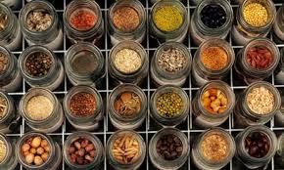
Ex situ 1: seed banks
Seeds are stored under tight conditions so that plants may be grown in the future ( Dry and -20°C)
This slows the rate that they lose their ability to germinate - keeps them ‘viable’
Provides a back up in case of extinction
https://www.kew.org/read-and-watch/saving-endangered-plants-in-the-Alps

Slide 19
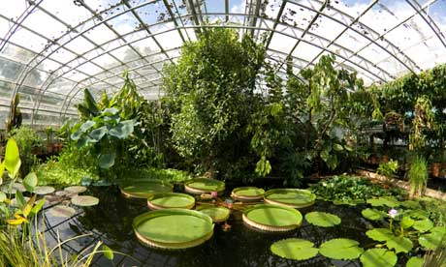
Ex situ 2: Botanic gardens
Storage and germination of seeds in protected surroundings
Allows sexual and asexual reproduction of plants
Tissue culture provides large numbers of plants for research or reintroduction

Slide 20
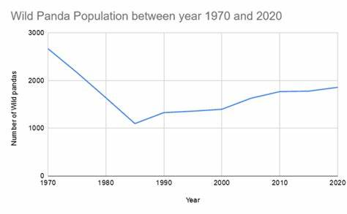
Ex situ 3: Captive Breeding Programmes
Vulnerable
Endangered
(96) Record: 42 Pandas Born in Breeding Program This Year | Nat Geo Wild - YouTube

Slide 21
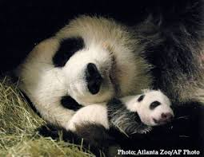
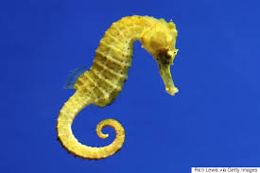
Ex situ 3: Captive Breeding Programmes
Offspring are produced in a human controlled environment
Often managed by zoos/ aquatic centres
Provide animals with shelter, food, no predators, vets and breeding partners

Slide 22
Problems with captive breeding
HINTS
Gene pool
Disease
Behaviour
Reintroduction issues

Slide 23
Problems with captive breeding
Make a list:
Maintaining genetic diversity – small numbers of breeding partners to choose from
Loss of resistance to disease/ new diseases in the wild
Behaviour – not knowing how to hunt
Genetic differences to wild population may mean they cannot interbreed and be reintroduced

Slide 24
Conservation agreements
Research the three conservation agreements
Make notes on your “Conservation agreements” page in notebook – these could be on your test next week
Try some of the exam style questions in the folders if you finish

Slide 25
IF TIME
(96) Chester Zoo - Conservation Breeding - YouTube

Slide 26
Exam question in folder

Slide 27
Only Connect

Slide 28
Ex situ: Zoos and wildlife parks
For and against zoos and wildlife parks
Evaluate zoos and wildlife parks and present in a table.
Advantages | Disadvantages

Slide 29
Ex situ: Zoos and wildlife parks
For and against zoos and wildlife parks
Evaluate zoos and wildlife parks and present in a table.
Advantages | Disadvantages
Breeding endangered species for research and reintroduction | Captive population has limited gene pool
Allows use of IVF | Exposure to wide range of pathogens
Selective breeding increases genetic diversity | Organisms living in unnatural habitat
Education | Behaviour patterns affected including reproduction
Raises income for further conservation | Expensive to maintain environmental conditions
Organisms protected from predators and disease | Reintroduction is slow and costly
Division of populations ensures survival of one if there is a disaster. | Reintroduced animals can be rejected

