Slide 1
Mini test on specialist structures in the lungs - KH

Slide 2

Please open your homework and respond to my marking in a different colour.

Slide 3


Slide 4
Knowledge retrieval question
Q1. Ventilation involves various parts of the mammalian respiratory system.
Which of the following statements, A to D, describes inhalation?
A ribcage moves upwards and outwards; external intercostal muscles relax; diaphragm relaxes
B ribcage moves downwards and inwards; external intercostal muscles relax; diaphragm relaxes
C ribcage moves upwards and outwards; external intercostal muscles contract; diaphragm contracts
D ribcage moves downwards and inwards; external intercostal muscles contract; diaphragm contracts
Q2. Kartagener syndrome is a genetic disorder that affects the respiratory system.
Children born with Kartagener syndrome commonly have the following symptoms:
mucus retention
recurrent infections of the respiratory system
respiratory distress.
Suggest one reason why children with Kartagener syndrome may have ‘mucus retention’ and one reason why they may have ‘recurrent infections of the respiratory system’.
reason for ‘mucus retention’ (1 mark)
Cilia not functioning correctly / damaged OR goblet cells producing too much mucus
reason for ‘recurrent infections of the respiratory system (1 mark)
Bacteria / virus / pathogens / microorganisms not removed

Slide 5
Measuring Lung Volume
Wednesday, 23 July 2025

Slide 6
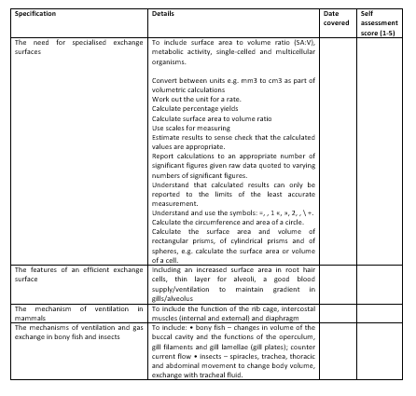
Learning Outcomes
Describe the relationships between vital capacity, tidal volume, breathing rate and oxygen uptake

Slide 7
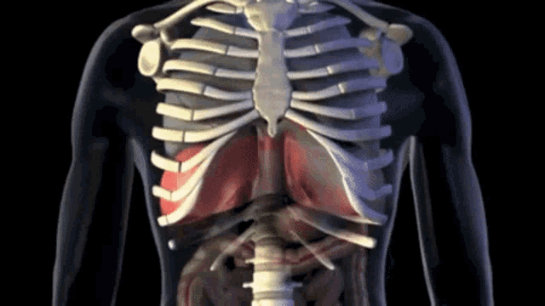

Slide 8
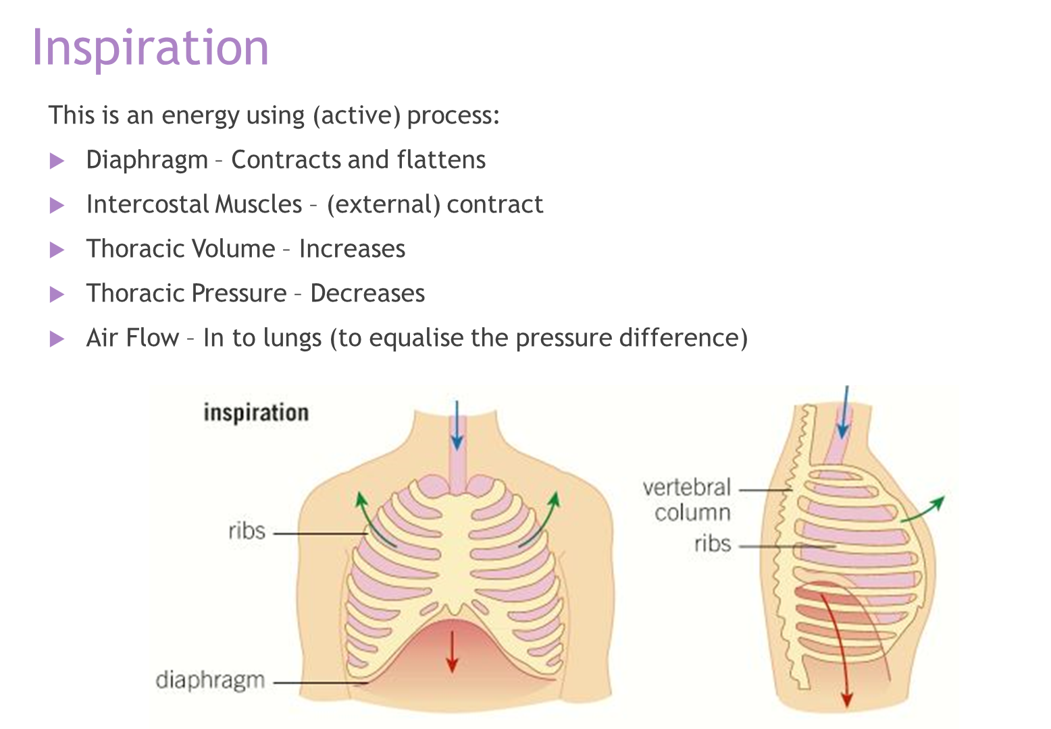
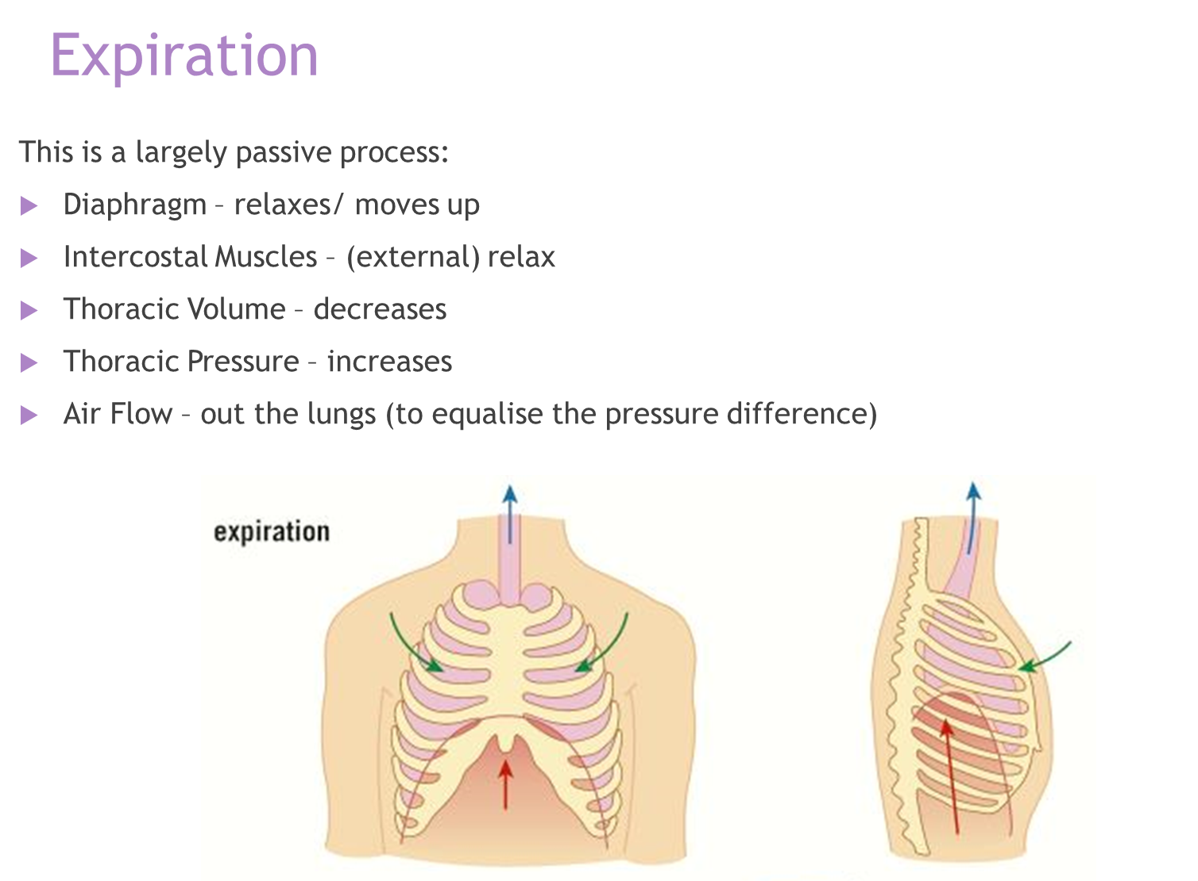

Slide 9
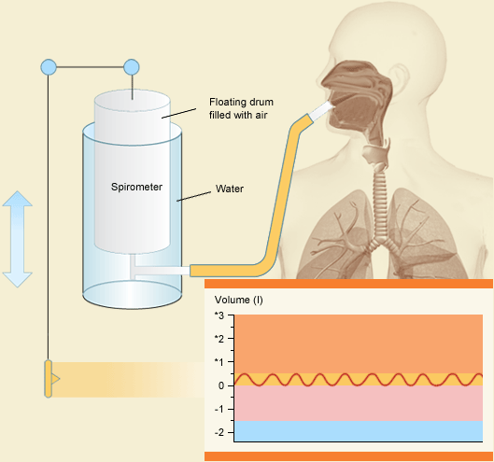

Slide 10
Measuring breathing
Spirometers are used to measure breathing.

Slide 11
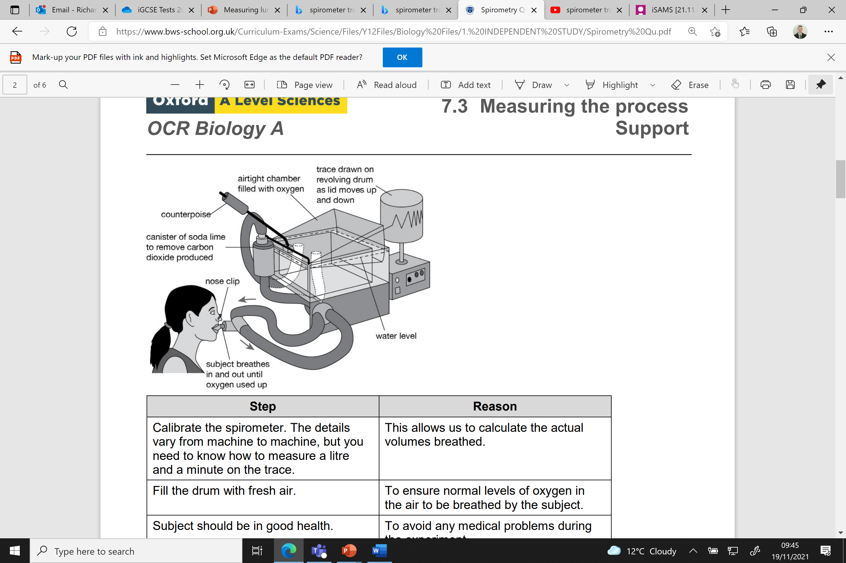
1. Patient breaths in and out of the disposable mouthpiece
2. Breathing out causes the chamber to rise / breathing in causes the chamber to fall
3. The chamber is attached to a datalogger, that produces a trace on the kymograph.
The trace is called a spirometer trace.
4. The soda lime absorbs the CO₂ ₋
Notes:
Why do we want to absorb co2?

Slide 12
Watch and answer follow up questions
https://www.youtube.com/watch?v=GDRfYJjICxI

Slide 13
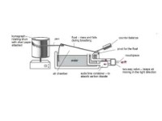
Watch and answer follow up questions

Slide 14
Follow up questions
Why does the patient wear a nose clip?
To ensure it is a closed system (no gas escapes) for an accurate spirometer trace
What is the counterweight used for?
To ensure there is no resistance from the weight of the lid
Why does the spirometer trace begin to decrease/slope downwards?
The oxygen is being used up by the subject.
Although the subject is breathing out carbon dioxide in replacement, it is being absorbed by the soda lime and does not play any part in the trace.
Why is it important to precisely measure the amount of oxygen in the chamber?
This oxygen is what the patient relies on to respire / insufficient oxygen could kill patient

Slide 15
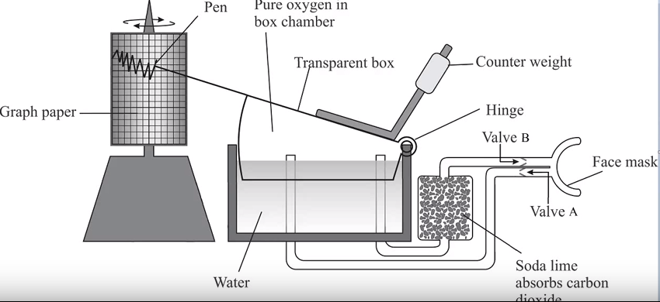
Spirometer trace – analysing results

Slide 16
Careful : When you breath in the spirometer line goes down………..(air in spirometer drops)
But what is happening to volume in your lungs?
Increasing
The spirometer trace conflicts with the volume in your lungs

Slide 17

Volume of air in spirometer
Volume of air in lungs
Notes:
Volume in of air in spirometer increase when you exhale BUT volume in your lungs decreases at same time – Y AXIS IS IMPORTANT

Slide 18
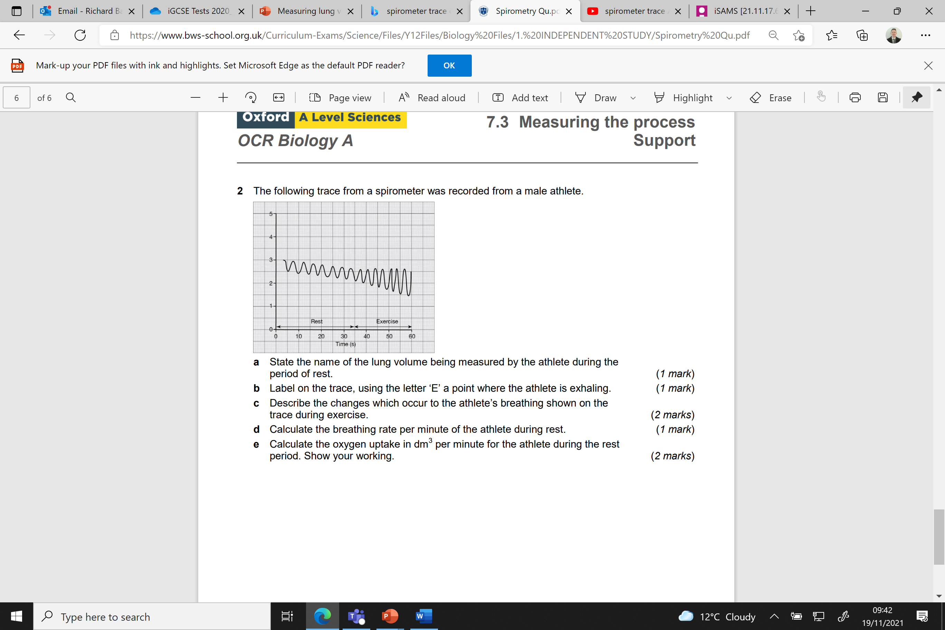
Label on both graphs, using the letter ‘X’ a point where the person has finished a normal resting exhalation (2 mark)
x
x
Volume of air in spirometer dm³
Volume of air in lungs dm³

Slide 19
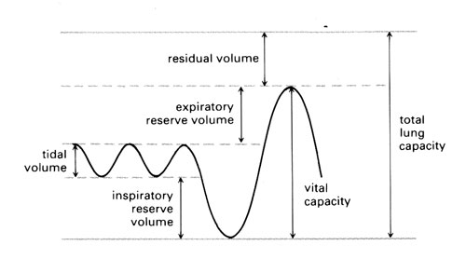
Spirometer trace
When you breath in the line on the spirometer trace goes down because the air in the spirometer decreases
When you breath out the line on the spirometer trace goes up because the air in the spirometer increases

Slide 20
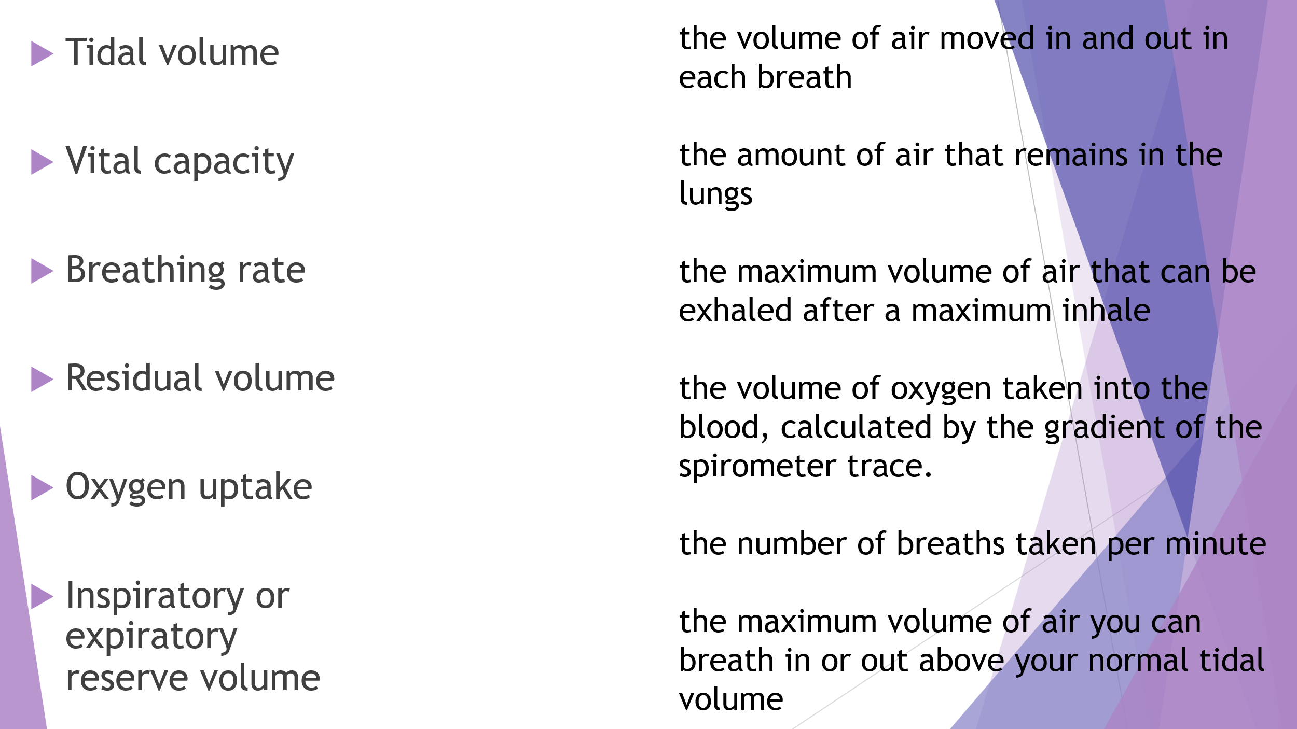

Slide 21
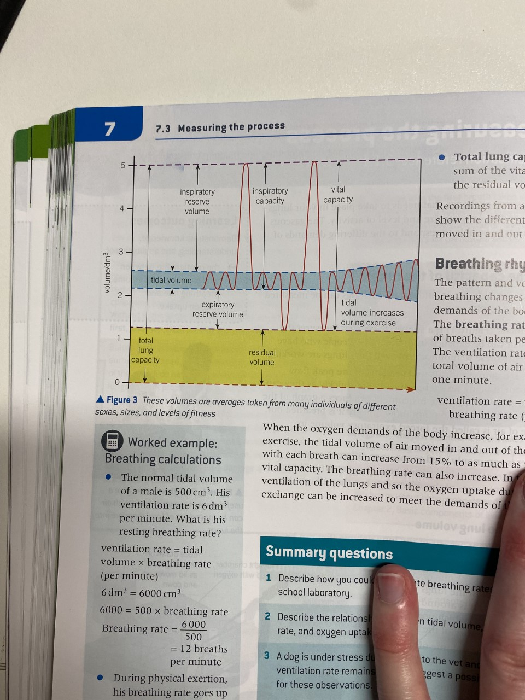
Lung volume graph
This air helps to keep the lungs partially inflated to protect the microscopic structures from being damaged.

Slide 22
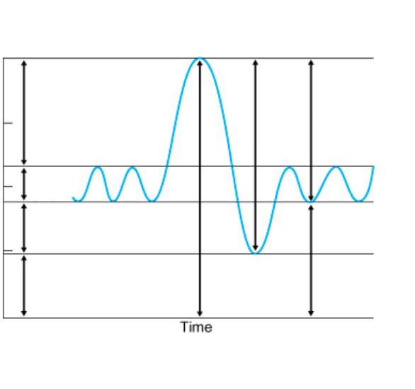
Label the trace with the following:
Vital capacity
Resting tidal volume
Inspiratory reserve volume
Maximum inspiration capacity
Total lung capacity
Expiration reserve volume
Residual volume
Functional residual capacity
B
F
E
E
A
B
D
F
A
Volume in the lungs (l)
D
C
C
H
G
G
H
*Functional residual capacity = is the volume of air that will remain in the lungs after a normal expiration
(expiratory reserve volume + residual volume)

Slide 23
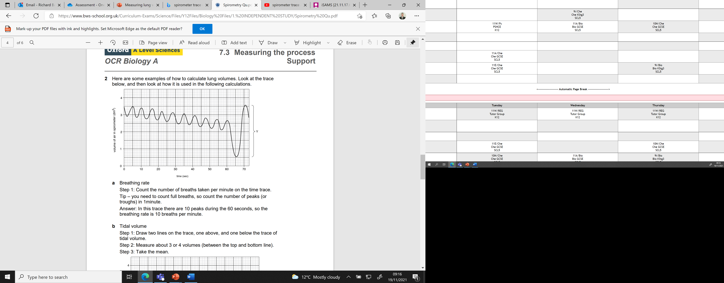
Notes:
How do you calculate breathing rate?

Slide 24
Calculating breathing rate
Count the number of breaths taken per minute on the time trace.
Tip – you need to count full breaths, so count the number of peaks (or troughs) in 1minute
Answer:
X10 peaks
10 breaths per minute

Slide 25
Calculating tidal volume
Step 1: Draw two lines on the trace, one above, and one below the trace of tidal volume.
Step 2: Measure about 3 or 4 volumes (between the top and bottom line).
Step 3: Take the mean.
Answer:
the volume of the first is 0.65 dm³
at the fourth peak the volume is 0.60 dm³
at the eighth peak the volume is 0.65 dm³
The mean volume is 0.63 dm³

Slide 26
Calculating vital capacity – deepest inhale / exhale
Use the scale on the Y axis.
Answer:
3 dm³ .
Sometimes a measurement and use of a scale bar is required if no scale is given on the Y axis

Slide 27
Calculating vital capacity
Required if given a scale bar
Step 1: Measure the height of the vital capacity indicated by the letter ‘Y’ on the trace.
Step 2: Convert this to a volume using the axis.
Answer:
The height of Y is 30 mm.
This is equivalent to 3 dm³ .
30mm
Scale: 10mm = 1dm³

Slide 28
Calculating oxygen uptake
Step 1: If we measure the drop of the slope in a period of time we get a value of the oxygen uptake.
Step 2: Draw a line across the top of the trace (use the drawing above).
Step 3: In one minute this line has fallen 8.5 squares on the axis.
Answer:
This is 0.85dm³. This is the volume of oxygen used in one minute.

Slide 29
Pulmonary ventilation
The total volume of air breathed per minute (not just oxygen used)
PV = Tidal volume x breathing rate
TV: 0.63dm³
Answer:
TV: 0.63dm³
BR: 10 breather per minute
0.63 x 10 = 6.3dm³ per minute

Slide 30
Test feedback
Make corrections in different colour
Upload photo of test to assignment
Complete the data analysis table assignment
Complete questions below test analysis table

Slide 31
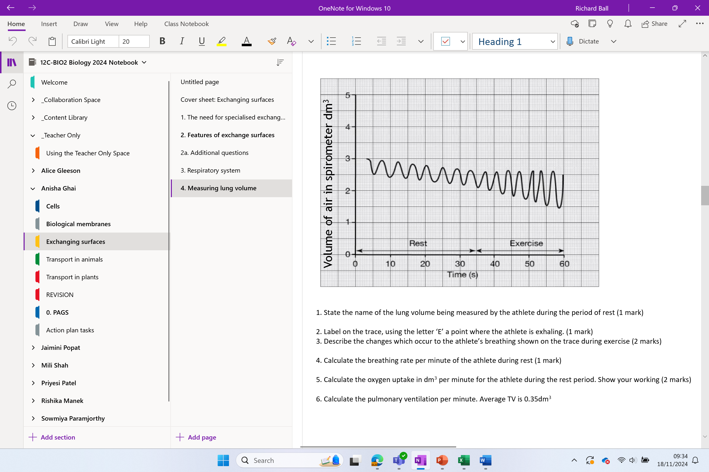

Slide 32
Try this
Each square is 0.05dm3
1. State the name of the lung volume being measured by the athlete during the period of rest. (1 mark)
Tidal volume
2. Label on the trace, using the letter ‘E’ a point where the athlete is exhaling. (1 mark)
3. Describe the changes which occur to the athlete’s breathing shown on the trace during exercise. (2 marks)
Breathing rate increases
Depth of breathing increases
4. Calculate the breathing rate per minute of the athlete during rest (1 mark)
6x2 = 12 breaths per minute
OR
7x2 = 14 breaths per minutes
5. Calculate the oxygen uptake in dm³ per minute for the athlete during the rest period. Show your working. (2 marks)
0.3 x 2 = 0.6dm³ per minute
E
Volume of air in spirometer dm³
6. Calculate the pulmonary ventilation per minute. Average TV is 0.35dm³
PV = TV x BR
PV = 0.35 x 12 = 4.2dm³ per minute
Or = 0.35 x 14 = 4.9dm³ per minute
Notes:
Average breaths per min at rest 12-20

Slide 33
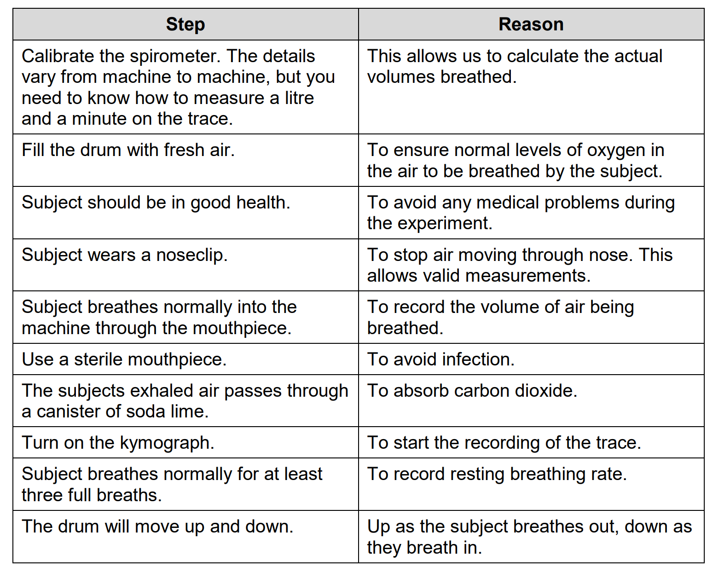
Recap

Slide 34
Recap

Slide 35
RECAP
Explain why the trace decrease diagonally?
CO_{2(g)} is absorbed by soda lime present in the spirometer.
Oxygen is being used up via aerobic respiration

Slide 36
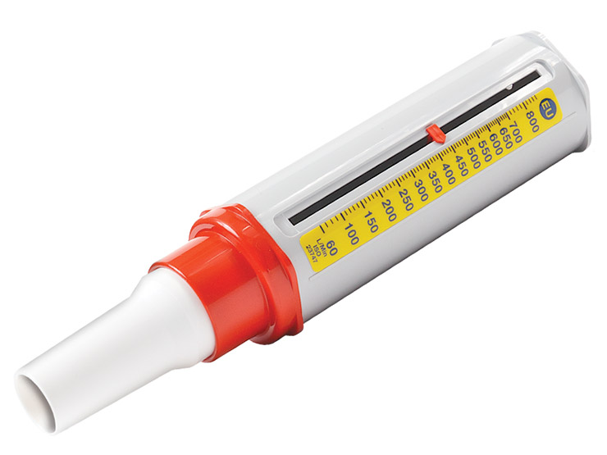
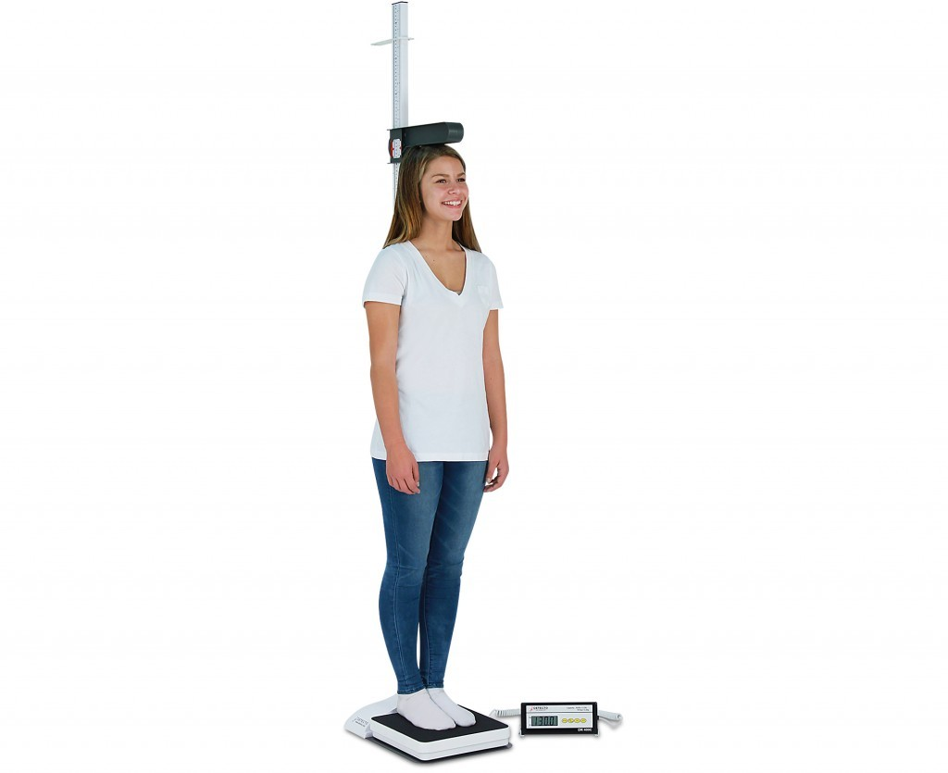
Peak flow meter
Used to give a quick indication of your airways condition
A low score could indicate signs of asthma or narrowing of the airways
People with asthma use these to monitor their condition

Slide 37
Peak flow meter
By measuring how fast you're able to breathe out, your peak flow score can indicate whether your airways are narrowed.
This could be a sign that you have asthma, although other tests such as spirometry will often be needed to confirm the diagnosis.
If you've already been diagnosed with asthma, measuring your peak flow regularly can be a useful way of monitoring your condition.
Your score can show whether or not your condition is getting worse. It can also check if your medication is working, and indicate whether you're having an asthma attack.

Slide 38
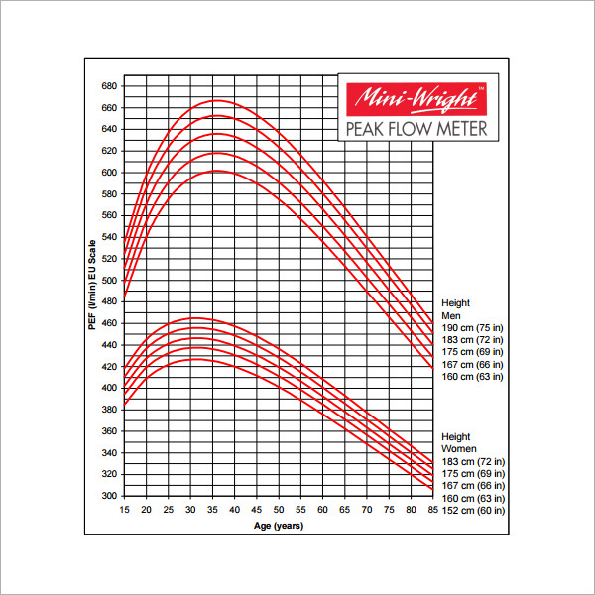
Lets try!

Slide 39
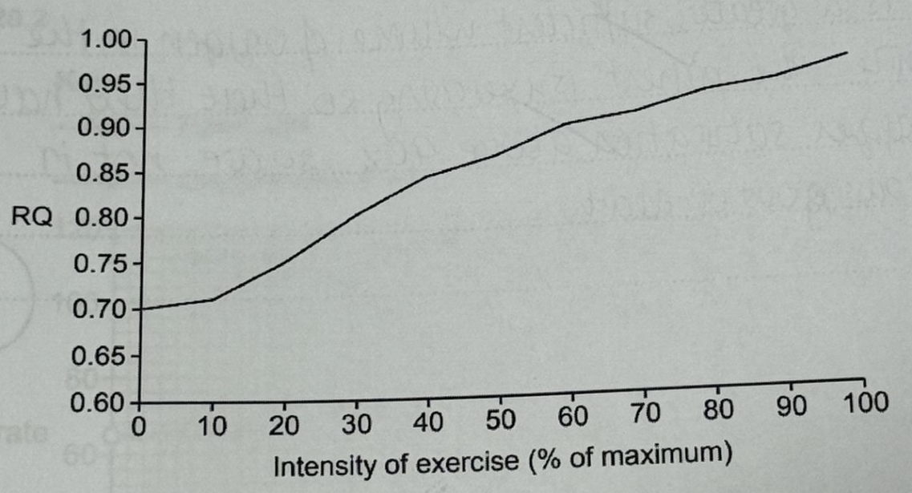

Slide 40
Respiratory quotient (RQ)
The respiratory quotient (RQ) is: the ratio of carbon dioxide molecules produced to oxygen molecules taken in during respiration.
Carbohydrates, lipids and proteins have different typical RQ values
At rest (0-10%) the body mostly burns fat. The RQ at rest is 0.7
So RQ of fat is 0.7
At higher intensity more carbohydrate (glucose) and fats are used as respiratory substrates.
The RQ of carbohydrate (glucose) is 1
Q. Explain what the graph shows about reparatory substrates used at different intensities

Slide 41
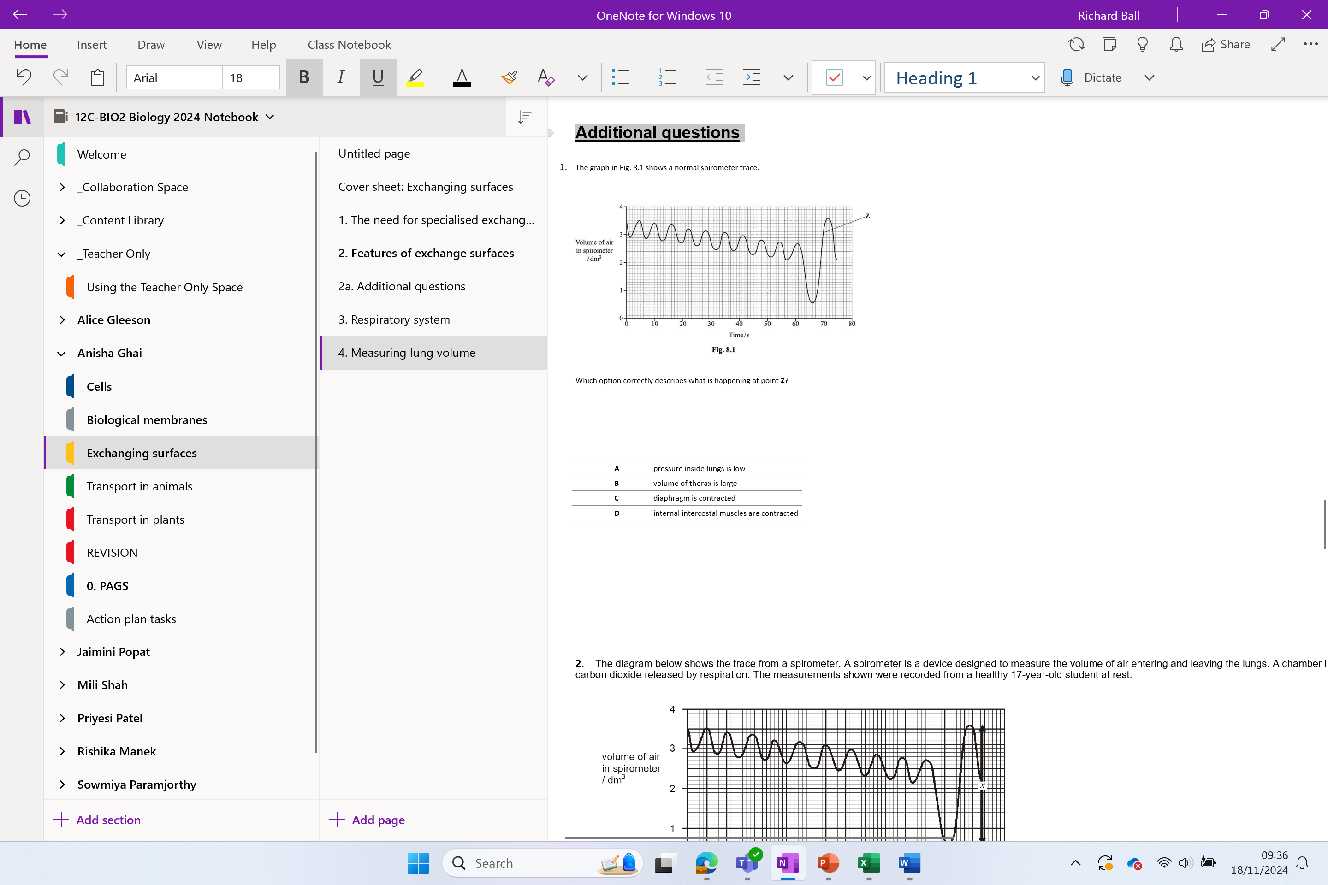
Additional questions

