Slide 1
Req kidney

Slide 2
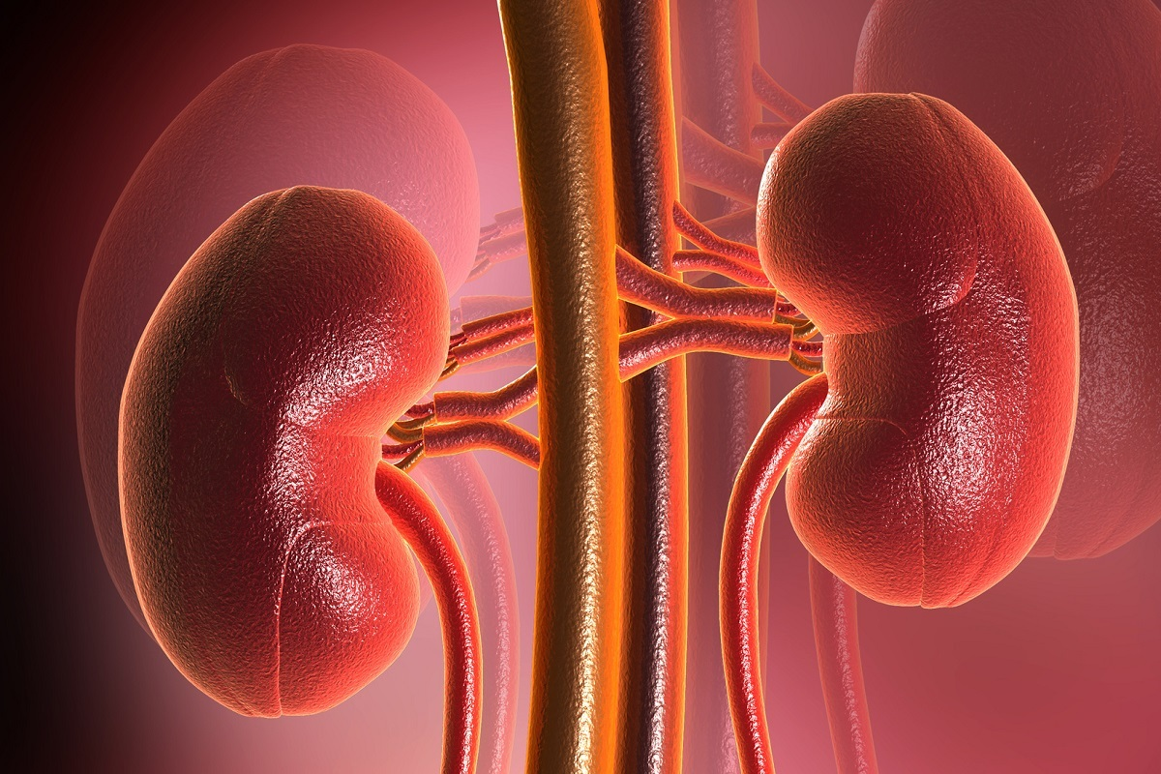
The mammalian kidney
Describe the structure, mechanisms of action and functions of the mammalian kidney, including the gross structure and histology of the kidney including the detailed structure of a nephron and its associated blood vessels AND the processes of ultrafiltration, selective reabsorption and the production of urine.
Describe the control of the water potential of the blood, including the role of osmoreceptors in the hypothalamus, the posterior pituitary gland, ADH and its effect on the walls of the collecting ducts.
http://classes.midlandstech.edu/carterp/Courses/bio211/chap25/chap25.htm

Slide 3
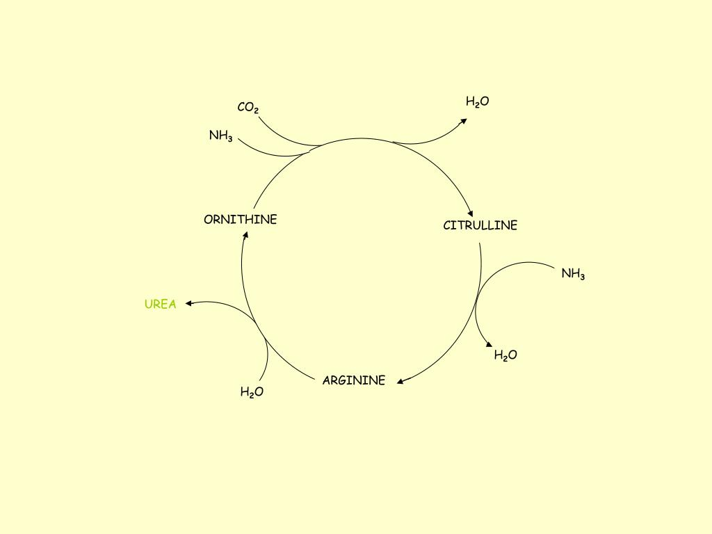
Complete the gaps and add additional information about each reaction
Ornithine cycle
Notes:
9 – hydrolysed
10- produces more ornithine which is fed back into the cycle

Slide 4
Complete the gaps and add additional information about each reaction
Ornithine cycle
Notes:
9 – hydrolysed
10- produces more ornithine which is fed back into the cycle

Slide 5
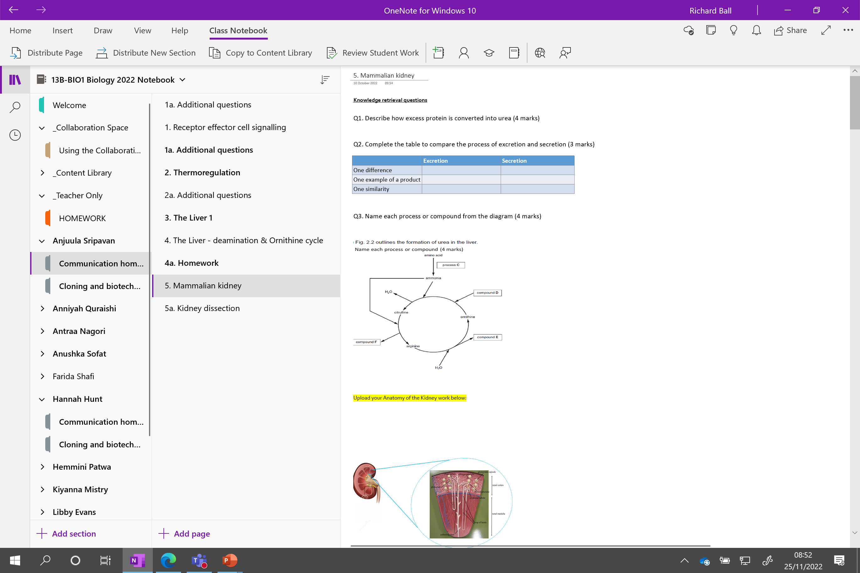

Slide 6
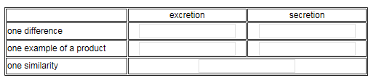
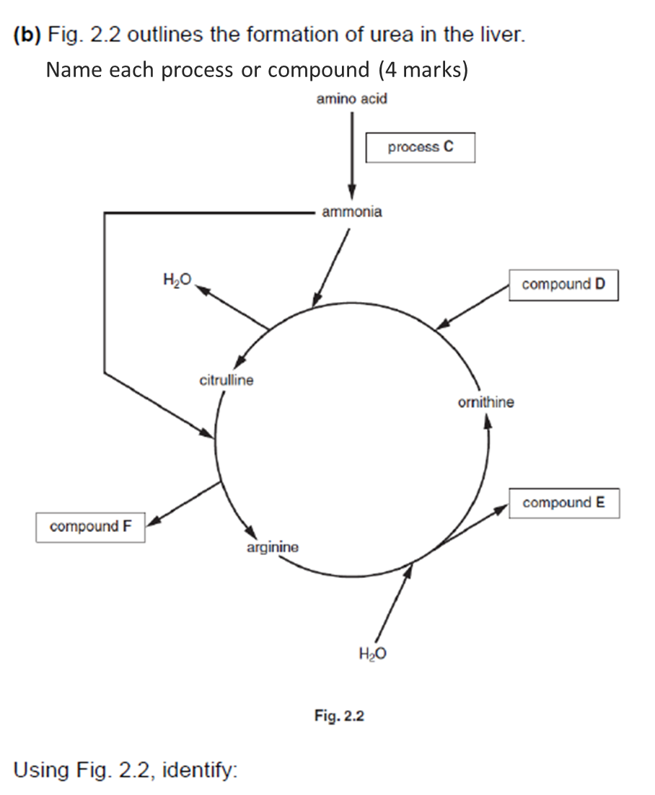
Knowledge retrieval questions
Q1. Describe how excess protein is converted into urea (4 marks)
Protein converted (broken down) into amino acids by protease
Excess amino acid undergo deamination / removal of amino group
Ammonia formed
Ammonia is combined with CO₂ and converted into urea in the ornithine cycle
Q2. Complete the table to compare the process of excretion and secretion (3 marks)
Q3. Name each process or compound from the diagram (4 marks)

Slide 7
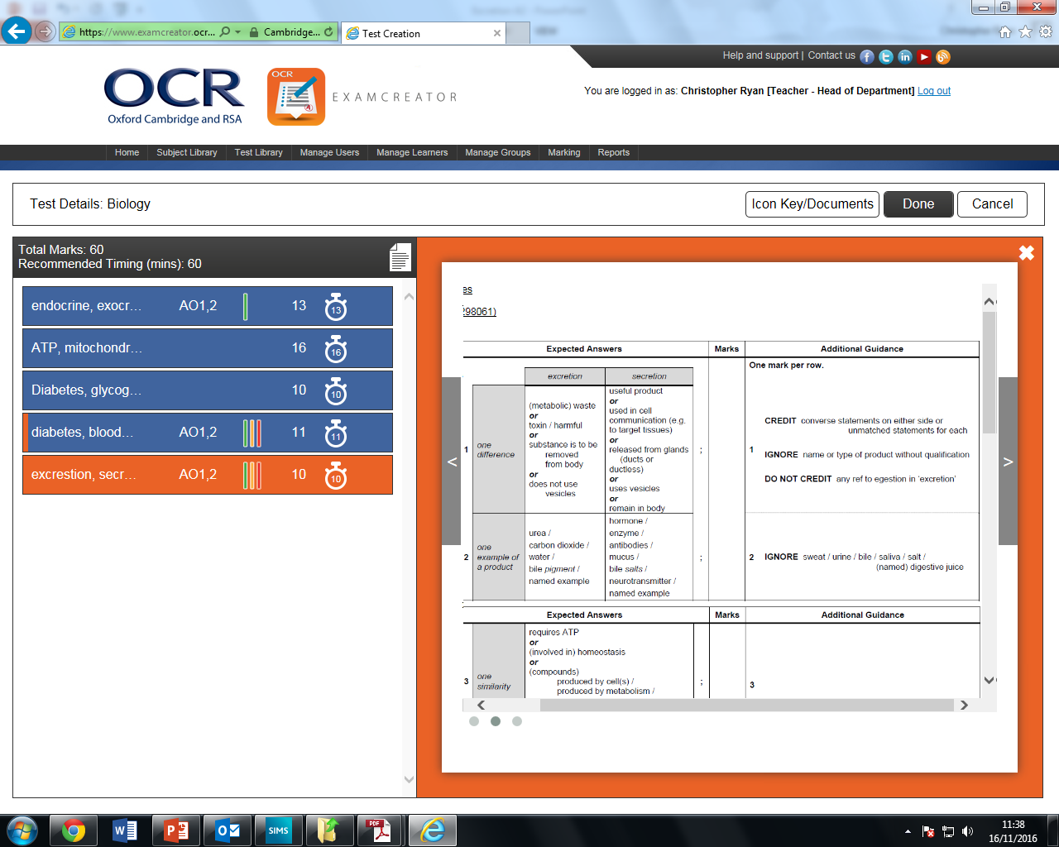
Deamination
CO₂
Urea
H₂O
Notes:
Arginine in the presence of water and under the action of arginase is split into ornithine (1 reaction) and urea (final product).

Slide 8

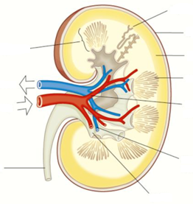
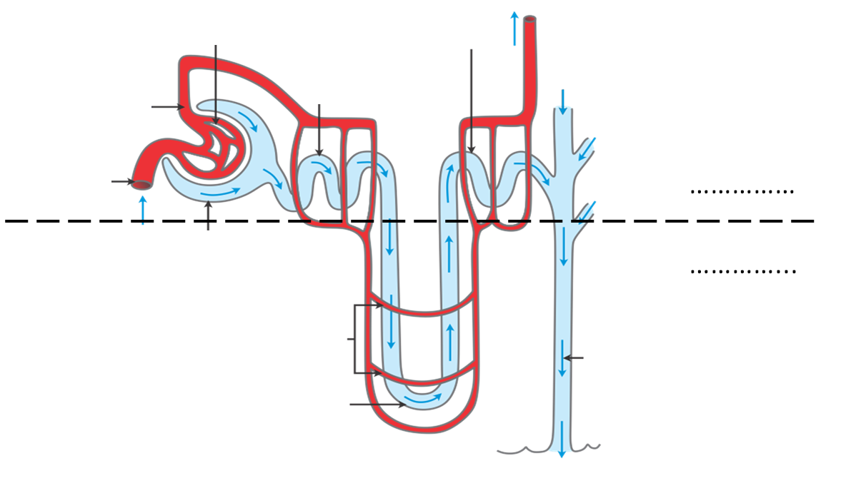
Anatomy of the kidney
Keep it neat you will be uploading this as your notes!

Slide 10
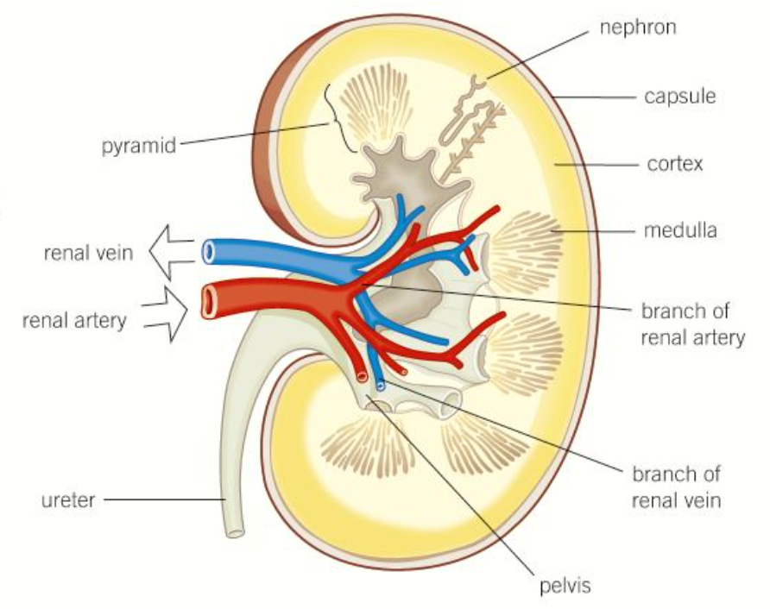
Please open to your h/w

Slide 11
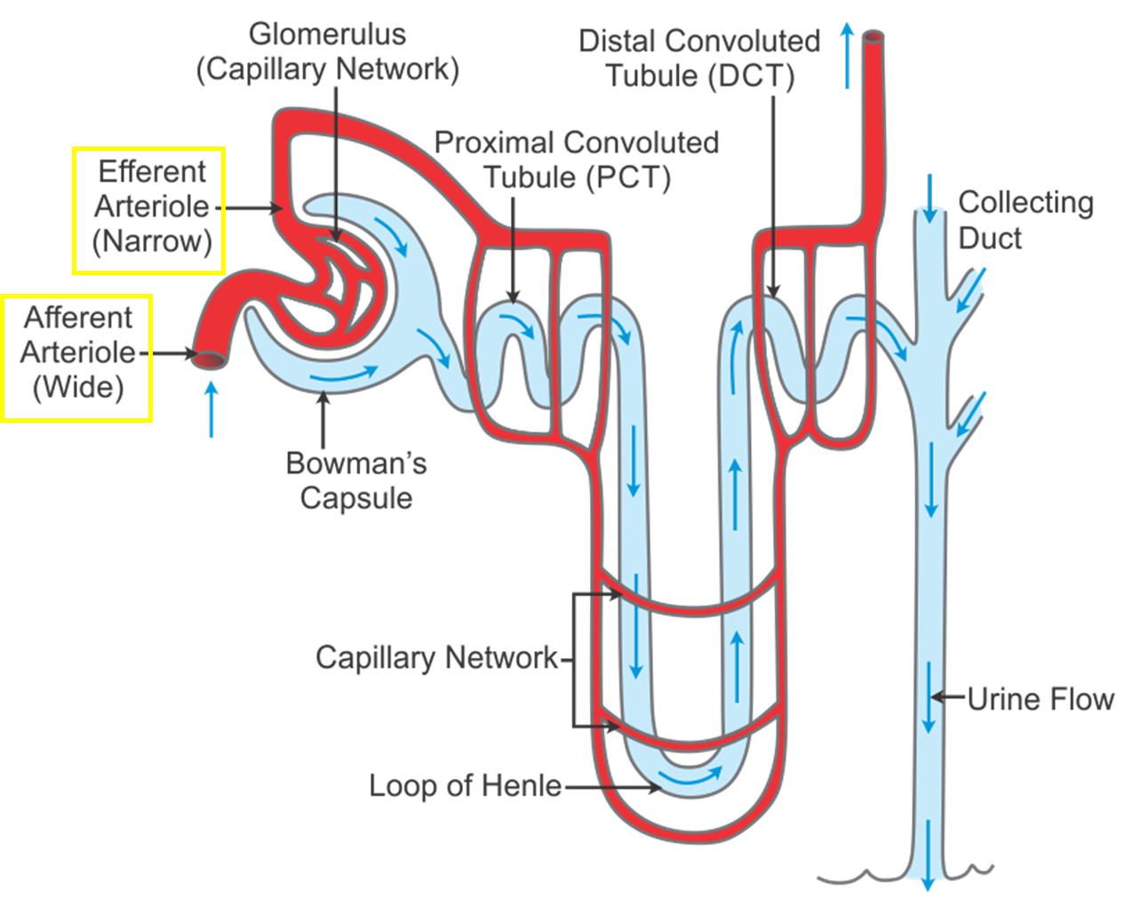
Cortex
Medulla
All situated inside a nephron!
Notes:
Efferent more narrow

Slide 12
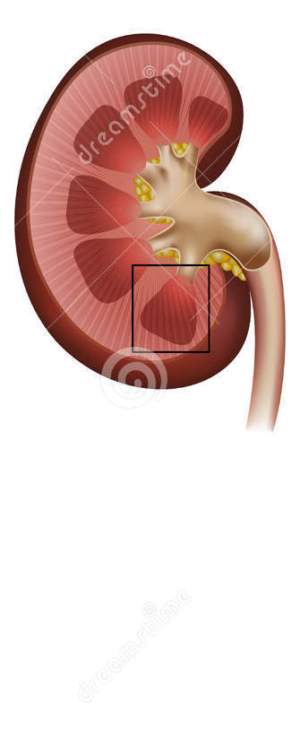
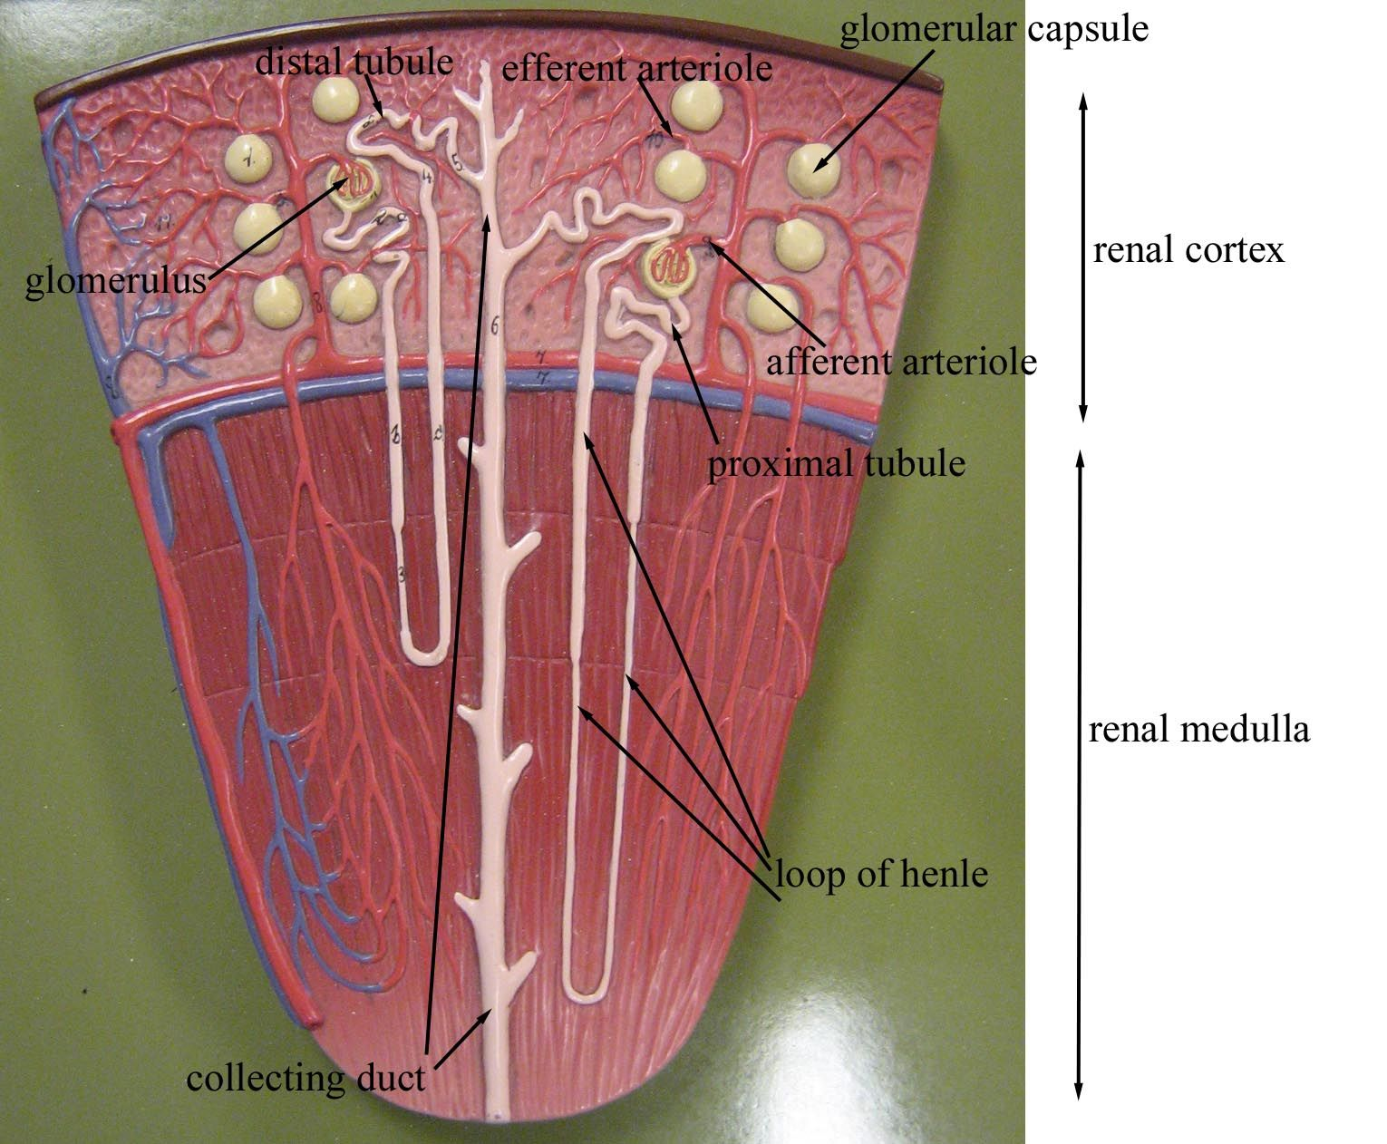

Slide 13
Kidney dissection
Kidney Dissection - GCSE, A Level, IB - YouTube

Slide 14
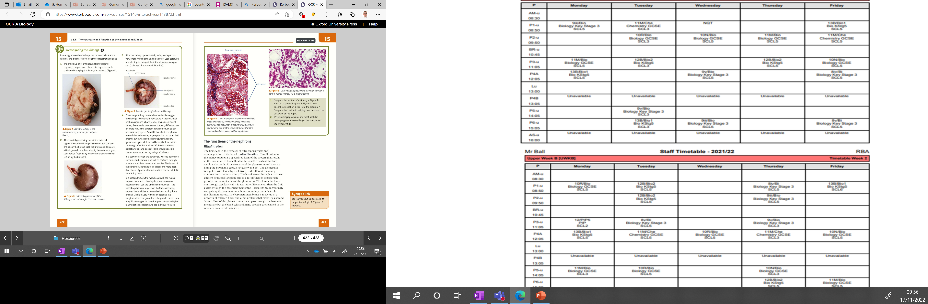
Kidney
dissection

Slide 15

Work down the list – no words – no numbers – pictures only!

Slide 16
Hepatocyte
Proximal convoluted tubule
Sinusoid
Citrulline
Collecting duct
Kupffer cells
Distal convoluted tubule
Canaliculus
Arginine
Hepatic artery
Central vein
Loop of Henle
Hepatic portal vein
Urea
Lobule

Slide 17

Ornithine cycle
One by one write the correct process / compound that comes next in the cycle
Remember to rub out your answer ready for the next time it comes around to you!

Slide 18
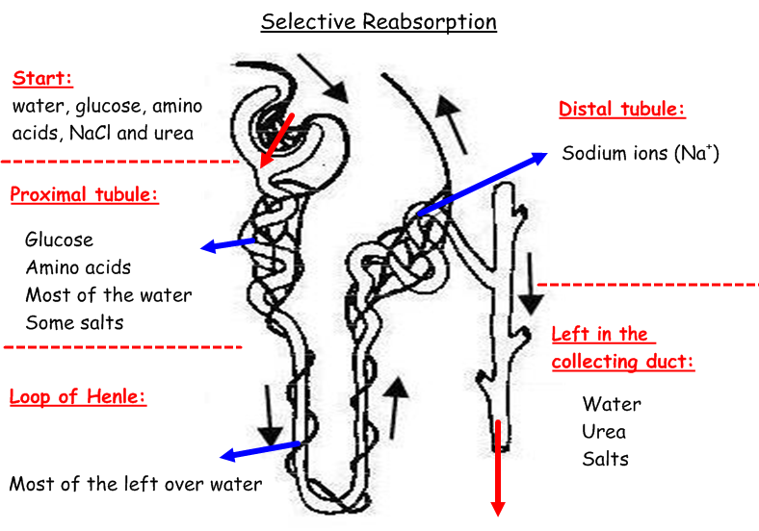
Complete the diagram
What gets filtered here?
What gets absorbed here ?
Some ions reabsorbed
What gets selectively reabsorbed here?
What gets transported to the pelvis before the ureter?
What gets absorbed here ?

Slide 19
Complete the diagram
Scroll down and move up
Glucose and amino acid are actively reabsorbed here

Slide 20
What is filtered and what stays in the blood?
Filtered:
water, amino acids, glucose, urea, inorganic mineral ions
Not filtered:
Large proteins and blood cells (too big)

Slide 21
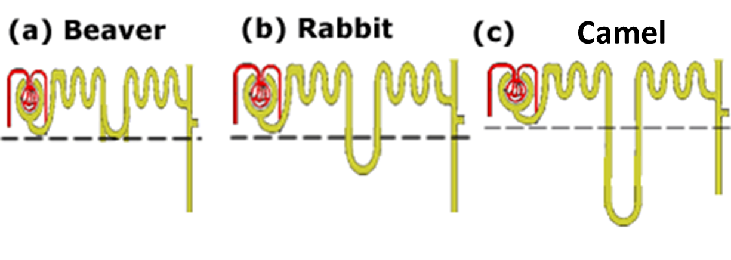
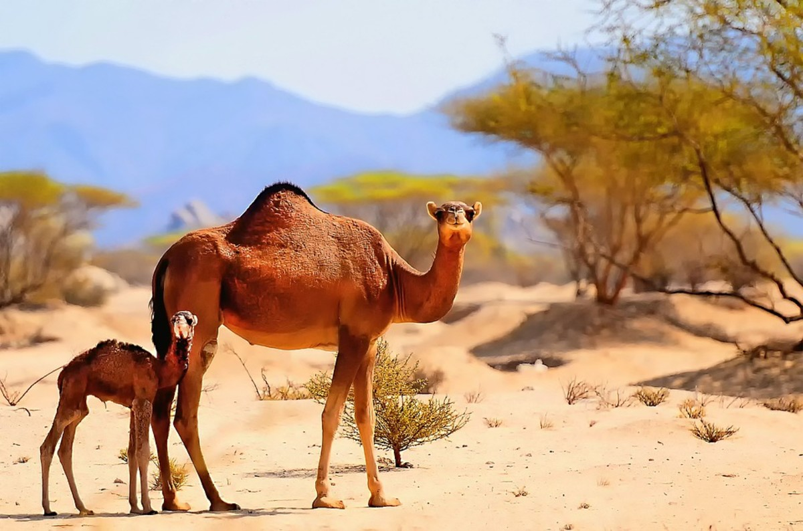
Xerophytic environment
Notes:
Longer descending loop for desert animals – maximum reabsorption of water

Slide 22
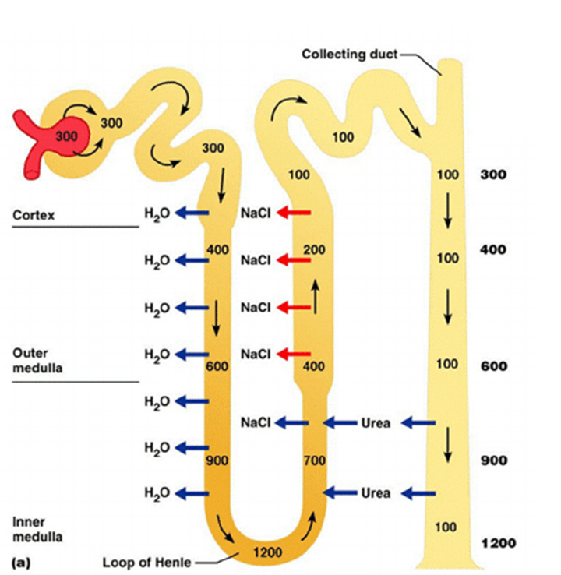
Why is water removed during the first half of the loop of Henle?
The descending limb is more permeable to water than the ascending limb.
The descending limb is also not permeable to Na⁺ and Cl⁻ ions
Notes:
The ascending limb actively pumps ions back into the tissue surrounding the nephron

Slide 23
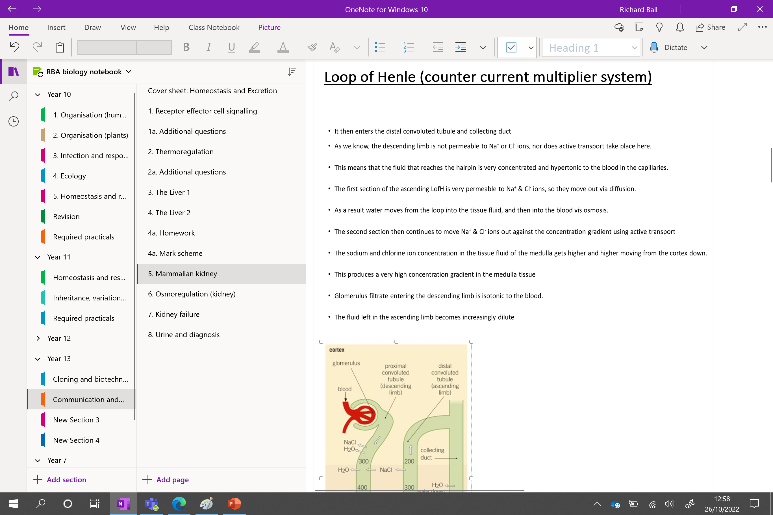
Loop of Henle (counter current multiplier system)
Use the diagram and your own knowledge to place the statements in the correct order:

Slide 24
Loop of Henle (counter current multiplier system)
Glomerulus filtrate entering the descending limb is isotonic to the blood.
The sodium and chlorine ion concentration in the tissue fluid of the medulla gets higher moving from the cortex down as ions are reabsorbed
As a result water moves from the loop into the tissue fluid, and then into the blood vis osmosis.
As we know, the descending limb is not permeable to Na⁺ or Cl⁻ ions, nor does active transport take place here.
This means that the fluid that reaches the hairpin is very concentrated and hypertonic to the blood in the capillaries.
The first section of the ascending L of H is very permeable to Na⁺ & Cl⁻ ions, so they move out via diffusion.
The second section then continues to move Na⁺ & Cl⁻ ions out against the concentration gradient using active transport
This produces a very high ion concentration gradient in the medulla tissue
The fluid left in the ascending limb becomes increasingly dilute
It then enters the distal convoluted tubule and collecting duct
Notes:
This function of the kidney permits reabsorption of urea. In this light, as the substance is being reabsorbed along the inner medullary collecting ducts of the nephrons, specific mechanisms occur such that water will also be absorbed. This intrinsic process is part of the regulatory mechanisms of the body to maintain and sustain the body’s vital functions. The reabsorption of urea is important as it prevents loss of water, maintains blood pressure at normal levels and ensures sustainable levels of sodium ions in the blood.
Complicated as it may seem but urea is one vital substance that is needed by the body.

Slide 25
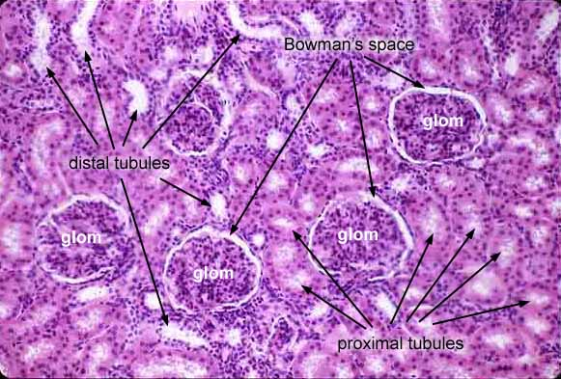
How can we tell the difference between PCT AND DCT?

Slide 26
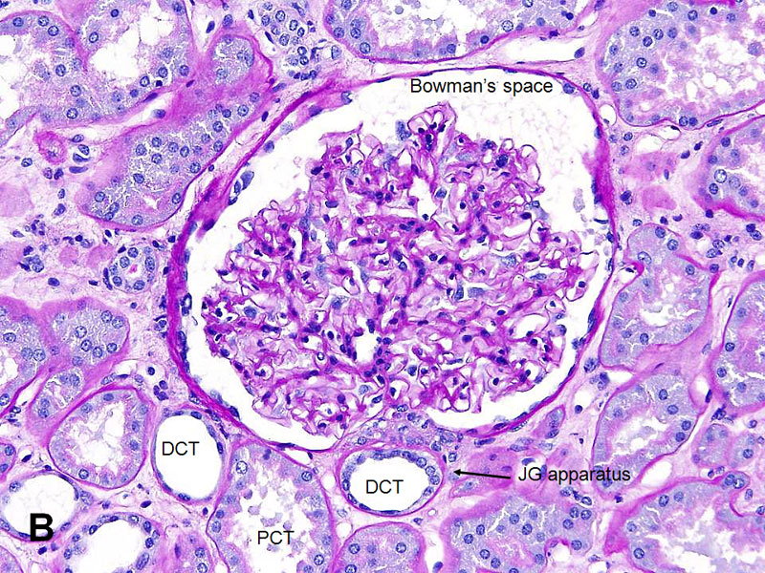
No brush border
(no microvilli)
WHY?
Brush border (microvilli) present
PCT = majority of selective reabsorption occurs here
Notes:
PCT = majority of selective reabsorption occurs here

Slide 27
Link both yellow boxes to the term ultrafiltration

Slide 28
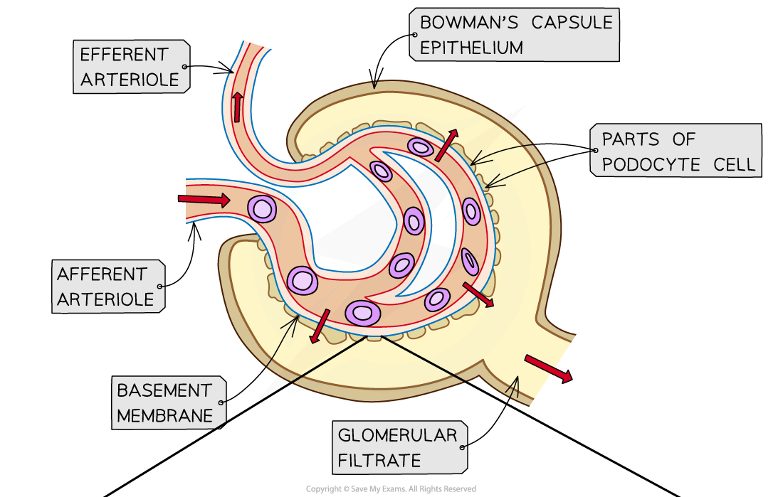

Slide 29
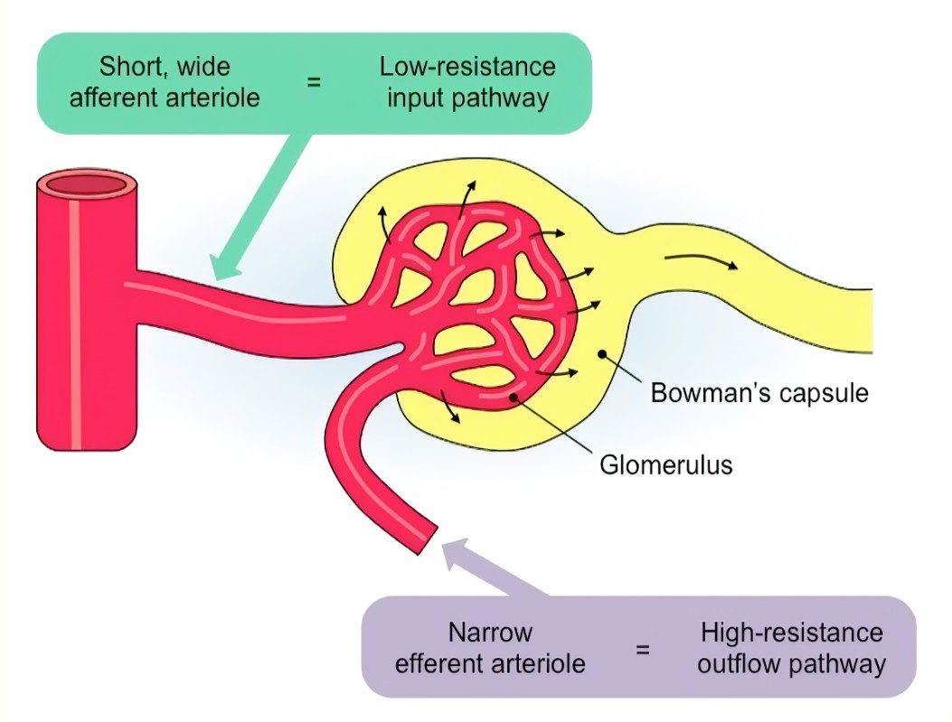
Ultrafiltration; filtration of blood at a molecular level under pressure to remove nitrogenous waste and regulate water.
Afferent arteriole is wider than efferent arteriole meaning…
………….…… hydrostatic pressure in glomerulus compared to the …………….. ……………… Causing fluid to be forced into the BC.
Endothelium has ……….. to allow passage of ………… substances and prevent the movement of ………… molecules (proteins) and cells
Basement membrane stops removal of …………. proteins and cells – located around the ………………..

Slide 30
Ultrafiltration; filtration of blood at a molecular level under pressure to remove nitrogenous waste and regulate water.
Afferent arteriole is wider than efferent arteriole meaning…
Higher hydrostatic pressure in glomerulus compared to the Bowmans capsule Causing fluid to be forced into the BC.
Endothelium has gaps to allow passage of small substances and prevent the movement of large molecules (proteins) and cells
Basement membrane stops removal of large proteins and cells – located around the glomerulus

Slide 31
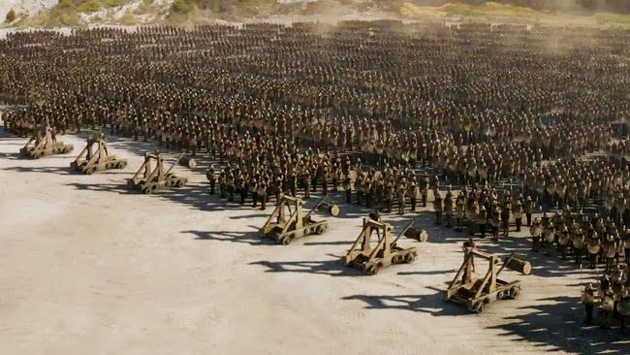
Podocytes
Second line of filtration

Slide 32
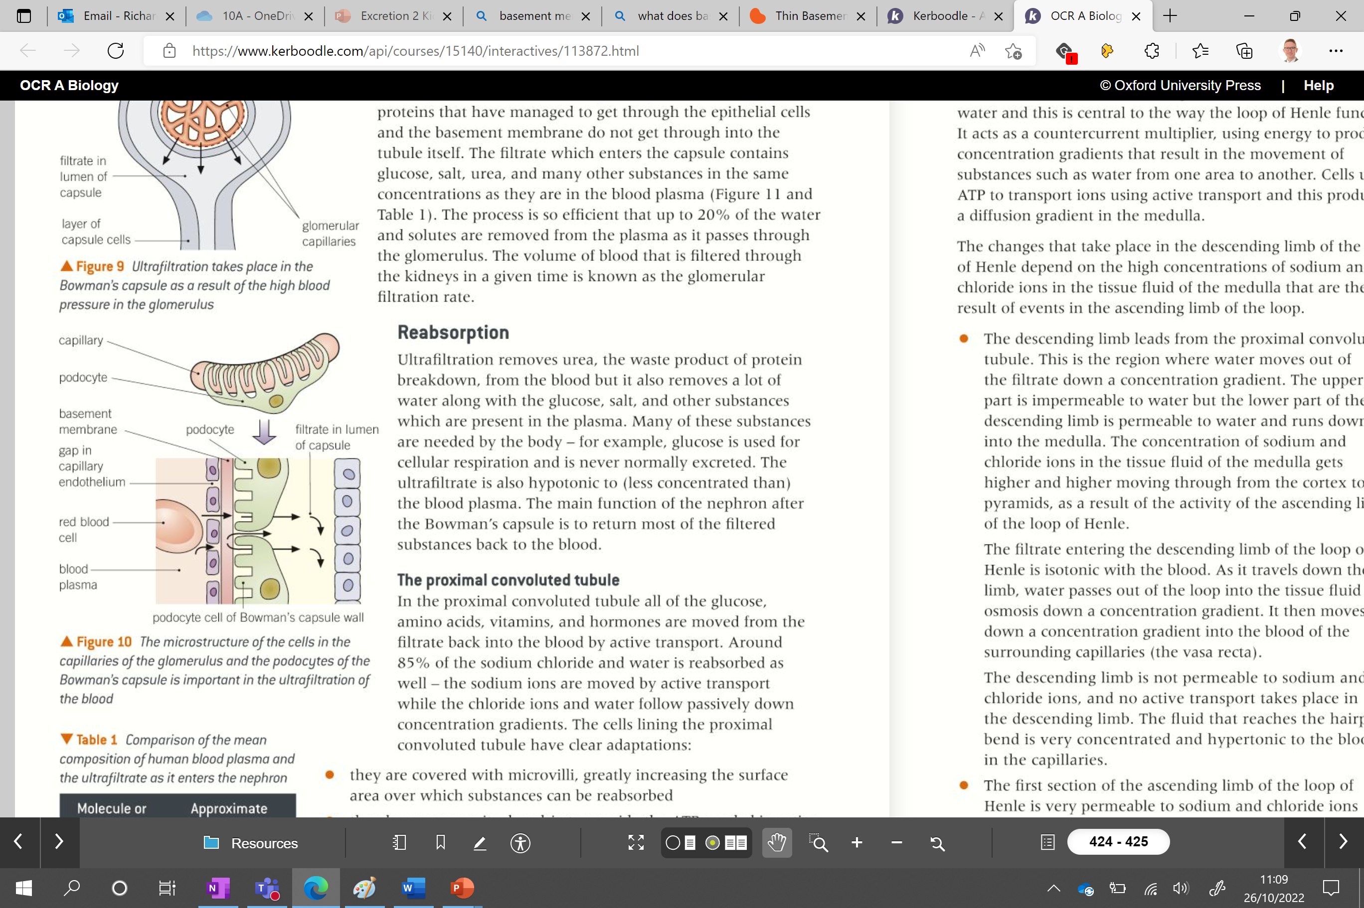

Slide 33
Podocytes
You have this slide
The Bowmans capsule is also surrounded by specialised cells called podocytes.
These act as additional filters.
They have extensions called pedicels that wrap around the capillary and ensure any large proteins or cells that have managed to get through epithelial cells and basement membrane do not enter the tubule

Slide 34
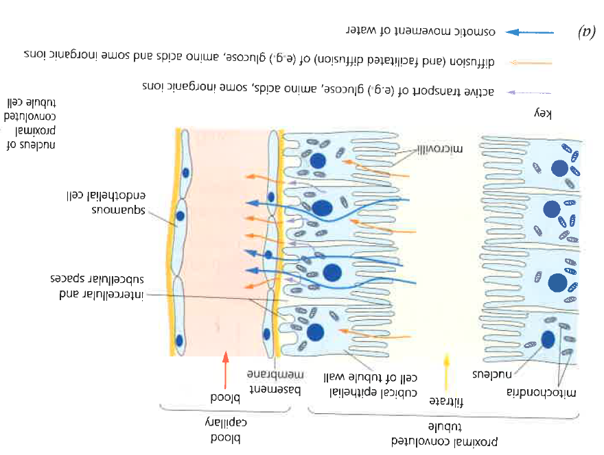
Selective reabsorption - PCT
Glucose, amino acids and any vitamins or hormones are all reabsorbed via active transport.
Na+ ions are transported back into cells via active transport
The concentration gradient allows water to be reabsorbed via osmosis
Adaptations of cells lining the PCT:
Microvilli increase surface area for uptake
Many mitochondria provide the ATP needed in active transport systems.
Many cotransporter proteins present
Recap: how co-transporters are used in plants?
Companion cells in plants, active pumping of H⁺ out of cell, they then re-enters with sucrose
Notes:
Chloride ions follow the Na down their electrochemical concentration gradients.... in the PCT

Slide 35
Ornithine cycle
One by one write the correct process / compound that comes next in the cycle
Remember to rub out your answer ready for the next time it comes around to you!

Slide 36
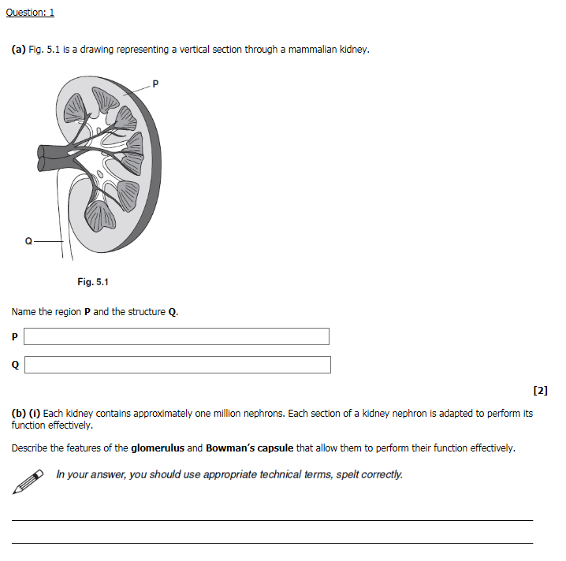
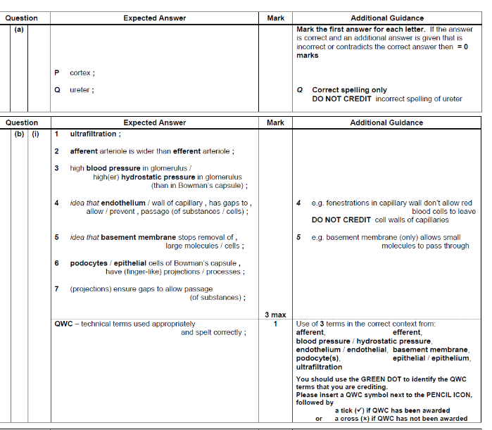

Slide 37
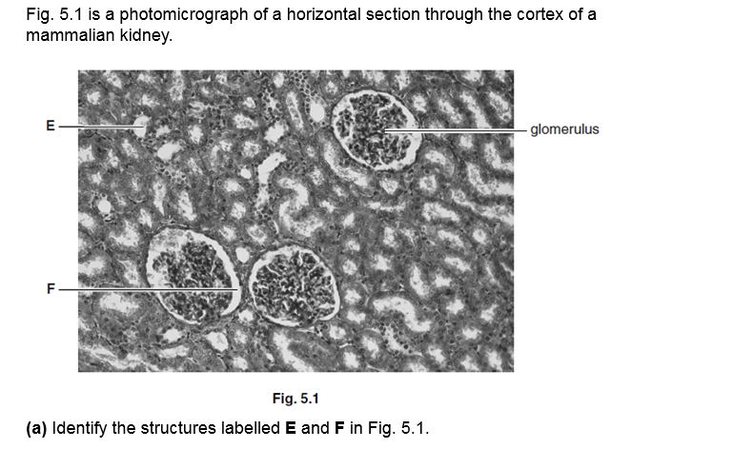
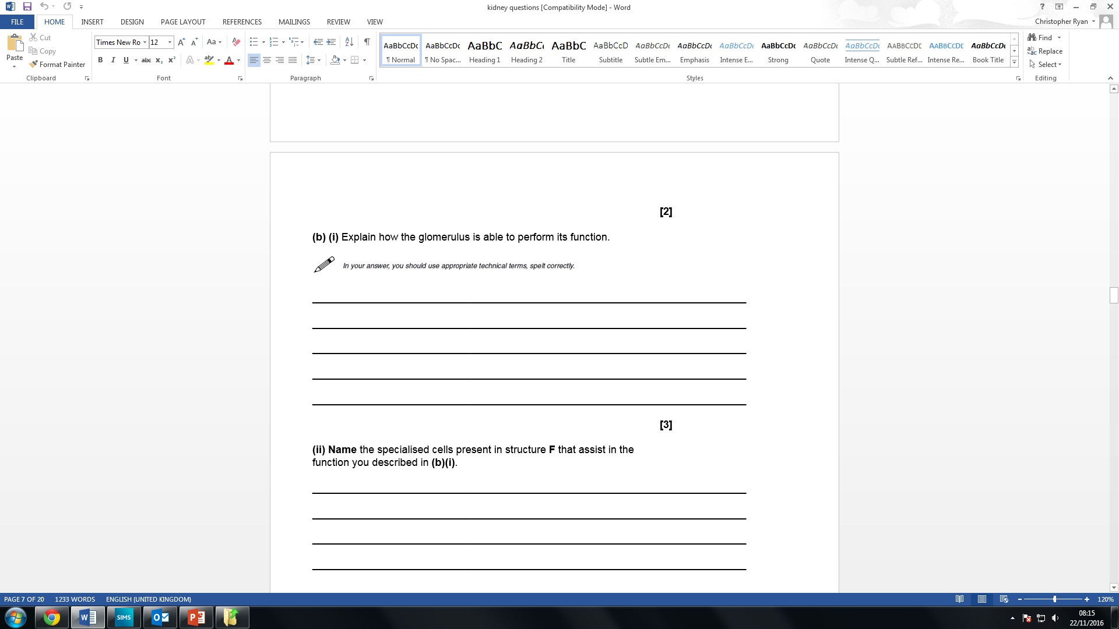
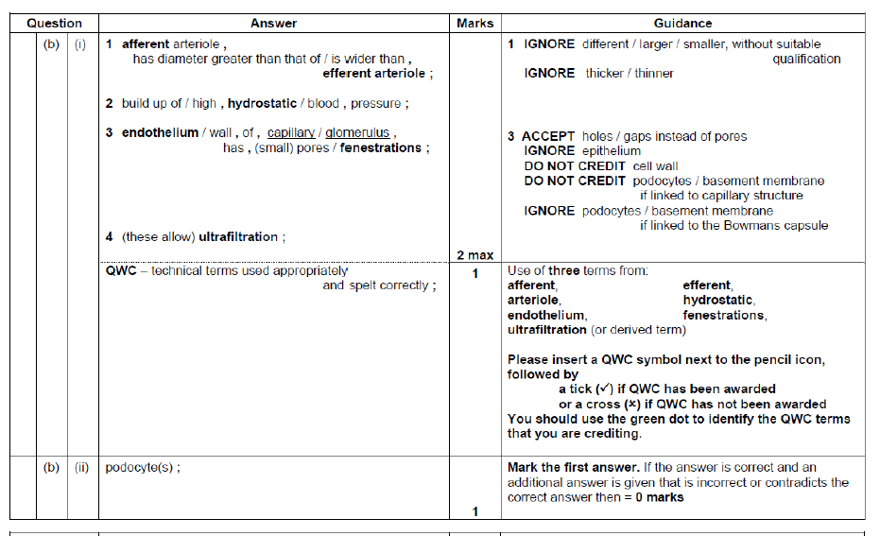
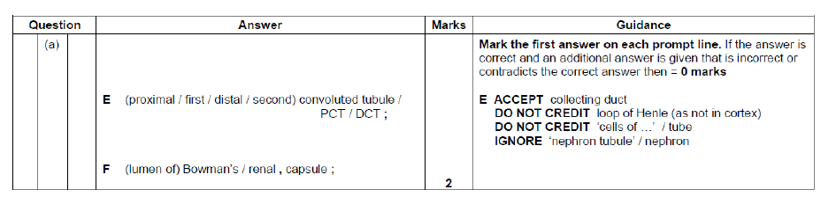

Slide 38
Taboo.

Slide 39
Kidney dissection

